Slide 1
Powered by Louisville: Inspiring Innovation and Engagement
Eugene Krentsel
Associate Vice President, Research & Innovation
May 6th, 2015

Slide 2
Innovation and Technology Commercialization at UofL
It’s NOT your father’s technology transfer!
Transformative partnerships (industry and community)
Ecosystem of invention and commercialization
Economic prosperity and innovation
Office of Technology Transfer (new director)
New Office of Industry Engagement
“New Ventures”
Partners (Nucleus, GLI, Mayor’s Office, KSTC, etc.)
Faculty and staff at UofL
Entrepreneurs

Slide 3
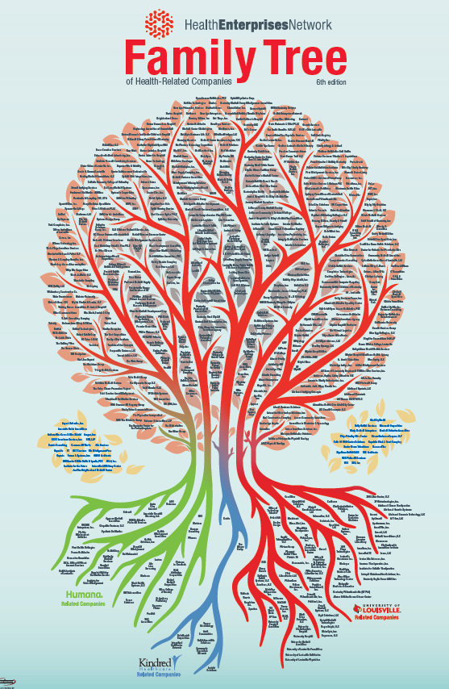
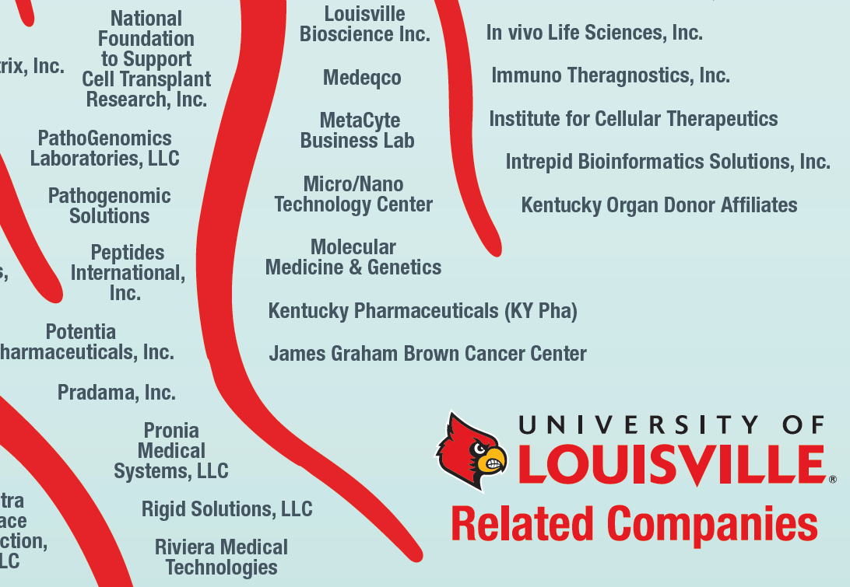

Slide 4
Key Principles
Creative and positive disruption
Meaningful impact
Culture of service excellence
Done is better than perfect
Revamping and modernizing policies and procedures
Choose definition of success and metrics that promote innovation and excellence
Proof-of-concept funding for cutting-edge research
Promoting success
Engaging deans and department chairs

Slide 5
Trifecta of the Most Prestigious Commercialization Programs
Coulter Translational Partnership
NIH REACH (Research Evaluation and Commercialization) ExCITE Hub – Expediting Commercialization, Innovation, Translation and Entrepreneurship
NSF I-Corps Site
Match from UofL
Unprecedented transformational opportunity
UofL is the ONLY university nationwide with all these programs !

Slide 6
Coulter Translational Partnership
The mission of the Coulter Translational Partnership (CTP) in Bioengineering at the University of Louisville is to promote translation of research through successful collaboration between engineers and clinicians, supporting promising technologies.
Member Institutions: University of Louisville, Boston University, Case Western Reserve University, Columbia University, Drexel University, Duke University, Georgia Tech/Emory University, Johns Hopkins University, Stanford University, University of Michigan, University of Missouri, University of Pittsburgh, University of Southern California, University of Virginia, University of Washington & University of Wisconsin.

Slide 7
NIH REACH ExCITE Hub

Slide 8
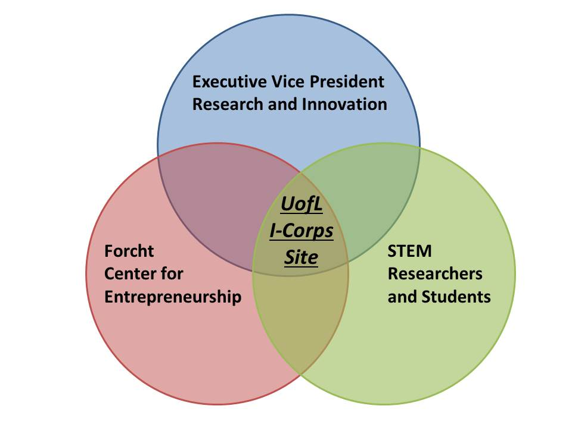
NSF I-Corps Site
Core components:
EVPRI: OTT & OIE
Nucleus
REACH
Coulter
Speed School
College of Business Forcht Center: Entrepreneurship MBA & PhD
Innovation Discovery Grants mechanism ($1,000 - $3,000) to support entrepreneurial teams.

Slide 9
Changes Made
From Industry Contracts to Industry Engagement
Innovative streamlined IP options/licenses
Focus on building relationships vs. concluding a transaction
Bringing companies to meet our researchers
Innovation Portal: louisville.edu/research/innovation
Internal and external constituents’ surveys
Gaps in talent being filled

Slide 10
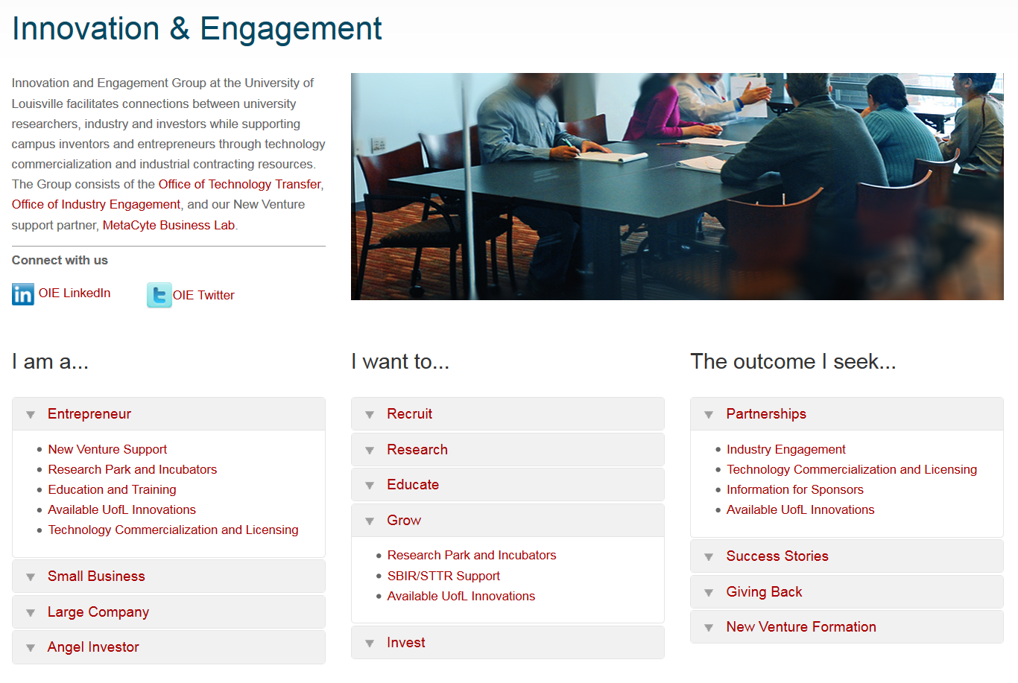
More information:
LOUISVILLE.EDU / RESEARCH / INNOVATION

Slide 11
Next Steps
Establish a highly effective Commercialization and Translation Advisory Council
Update relevant policies to be in line with high expectations of our faculty
Further streamline industry contracting process and technology licensing practices
Further develop mechanisms to support efforts to better expose our researchers to key commercialization partners
Continuously gauge our faculty’s satisfaction

Slide 12
The best is yet to come!

