Slide 1
Engaged Scholarship Project: 2014-15
Cate Fosl,
Special Assistant to the Provost for Engaged Scholarship;
Associate Professor of Women's and Gender Studies;
Director, Anne Braden Institute for Social Justice Research

Slide 2
Areas of Concentration
Engaged scholarship policy, internally
Engaged scholarship, policies and practices nationally
Faculty Development

Slide 3
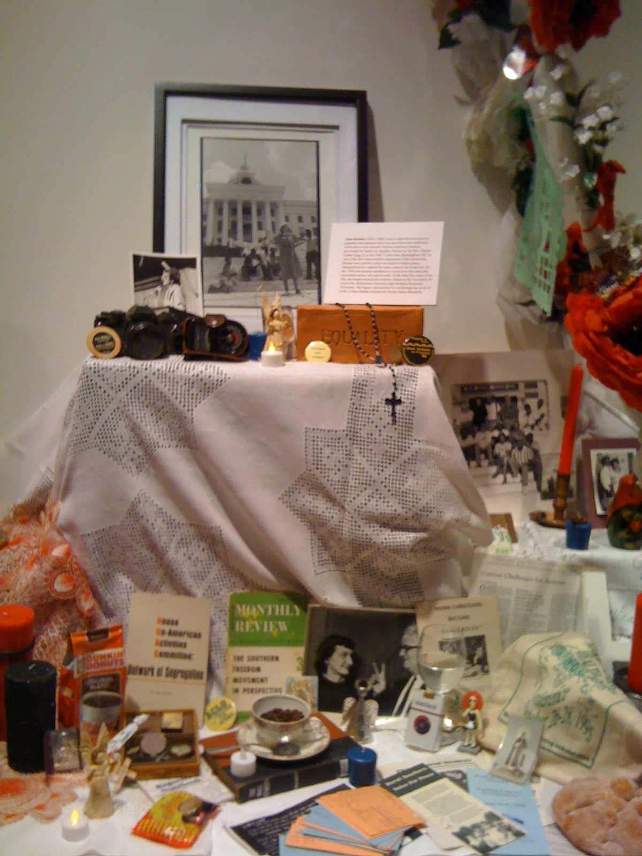
Status Quo at UofL
High community service traditions
Increasing Mutuality
Plenty of engagement activities, service and scholarly

Slide 4
Language of Engaged Scholarship
I. More likely to focus on or incorporate scholarly research into CE implementation
II. More likely to incorporate arts, humanities, softer social sciences into CE activities

Slide 5
Myths/ Misconceptions we have:
Every faculty member must "do" community engagement.
It will detract from our research excellence.
If I do it, I won't get tenure/ promotion! (Or how do I find the time?)

Slide 6
Best Practices across All 7
For Growing Engaged Scholarship:
1) Well-coordinated broad base of FACULTY LEADERSHIP for successful engaged scholarship
2) Top administrative advocacy and incentives
3) Advancing culture of interdisciplinarity, cross-unit collaboration and front door for community groups: see
oe.ncsu.edu
http://ccps.unc.edu/fes/
http://www.memphis.edu/esfc/aboutesfc.php
4) Coordinated sites and personnel for advancing curricular engagement and CE- research opportunities

Slide 7
Common Challenges across all 7:
Silos are prevalent and must be amended/windowed.
Restructuring is commonplace (centralized/decentralized and networks for wider communication)
P&T revisions must be part of conversation, but they are no magic fix. (Ex. on handout)

Slide 8
Questions? Comments?
Thank you.

