Slide 1
Problem-based Math
Elementary Math Lesson Plan Training for SPLASH

Slide 2
Overall Format
RTOP
Lesson Content
Book
RTOP: The Reformed Teacher Observation Protocol. The column shows you how each element of the lesson plan format aligns with the RTOP.
Book: This column guides you toward helpful explanations and examples from the book “Elementary and Middle School Mathematics: Teaching Developmentally ^{9th} ^{Edition}” written by Van de Walle, Karp, and Bay-Williams (2016).

Slide 3
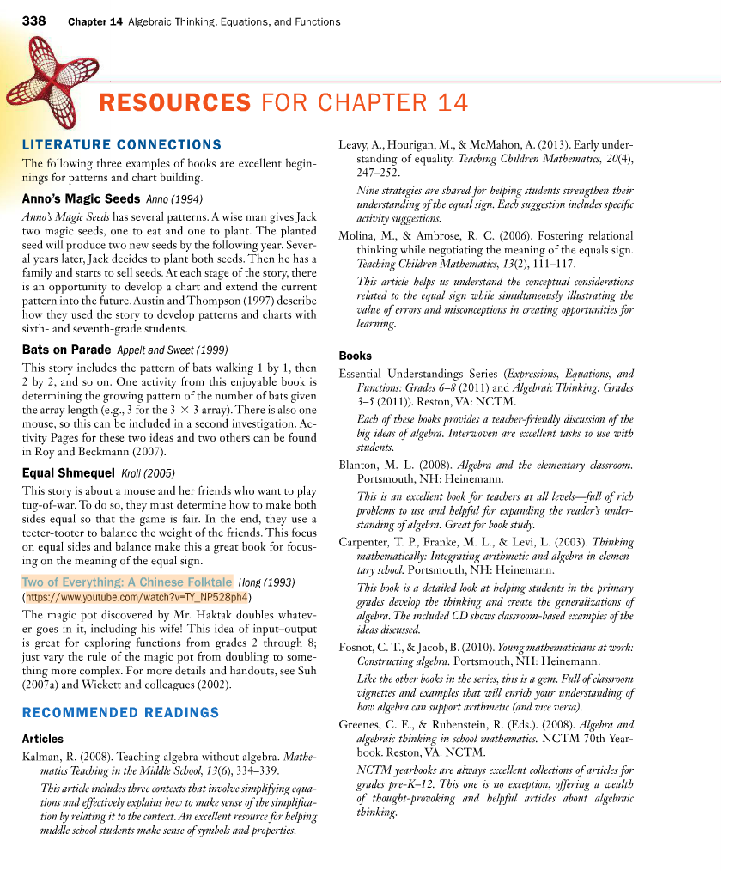
Math Standards and Cross Curricular Connections
Each chapter in the book has recommendations for CCSS connections and cross-curricular connections.
Be sure to look for this symbol.

Slide 4
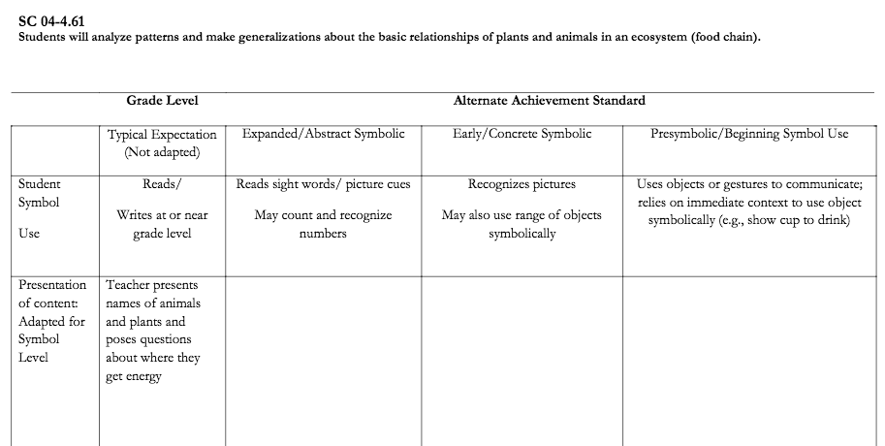
Lesson Objectives
For the Math Standards, don’t forget that you can use the Work-It-Across to help you differentiate the standard for all learners.
Decide which objectives are for all learners, and which are for small groups or individual learners. The student’s grade band and the work-it-across will help you to differentiate.
Link: https://www.dropbox.com/s/ecfdnmsjq26bzqu/Work%20it%20Across.docx?dl=0

Slide 5
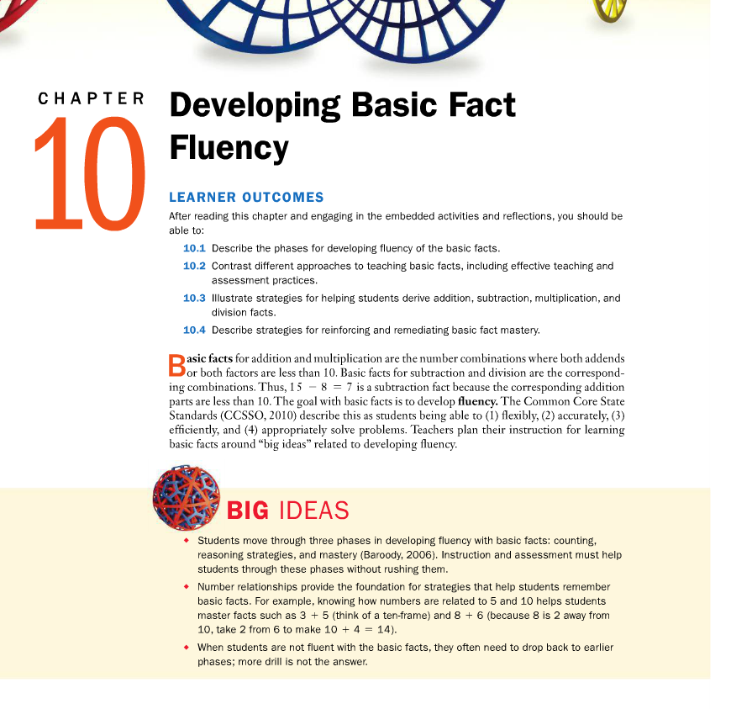
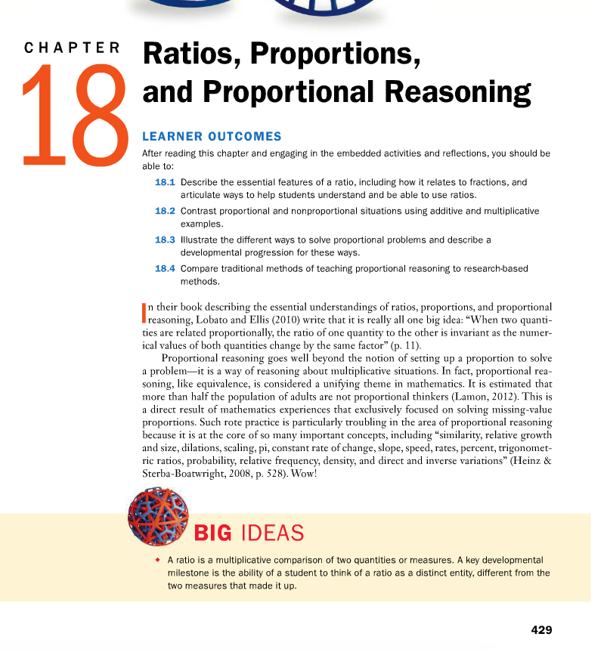
Math Concept
A math concept is the big idea, not the math fact. Each chapter of the book starts with a section that details the big ideas. Simplify the language and use it throughout the lesson as the Repeated Storyline. The Math Concept is the “main idea.”
E.g. Tools are used to measure objects.

Slide 6
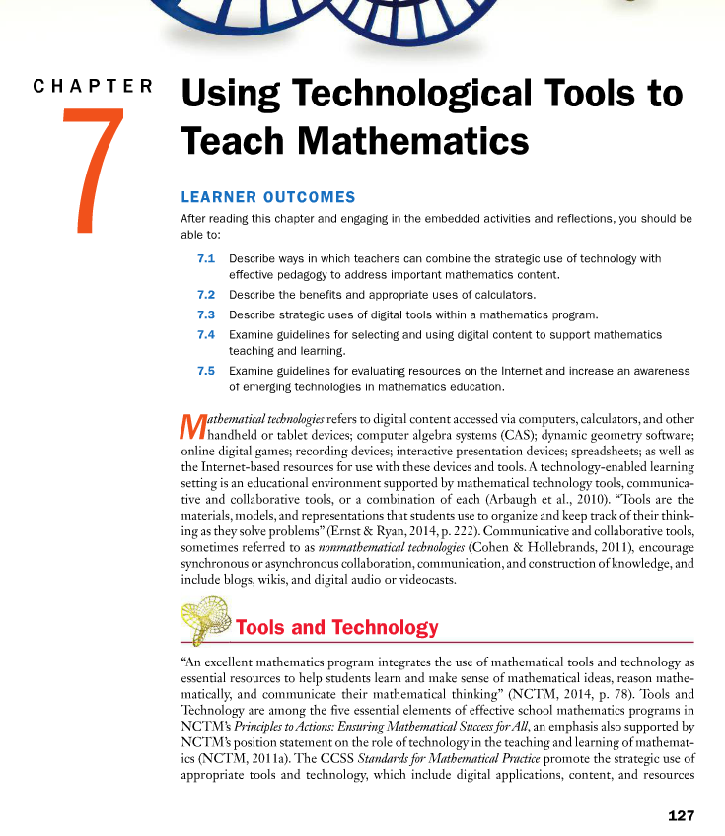
Technology
The AT will be driven by the IEP of each student, however, the book also provides some guidance. Chapter 7 provides technology supports for each section of the book.

Slide 7
Lesson Opener
Relate to an earlier simpler task.
Connect to real-life experiences
Estimate or predict.
Make sure the task (the problem) is understood (see: next slide)

Slide 8
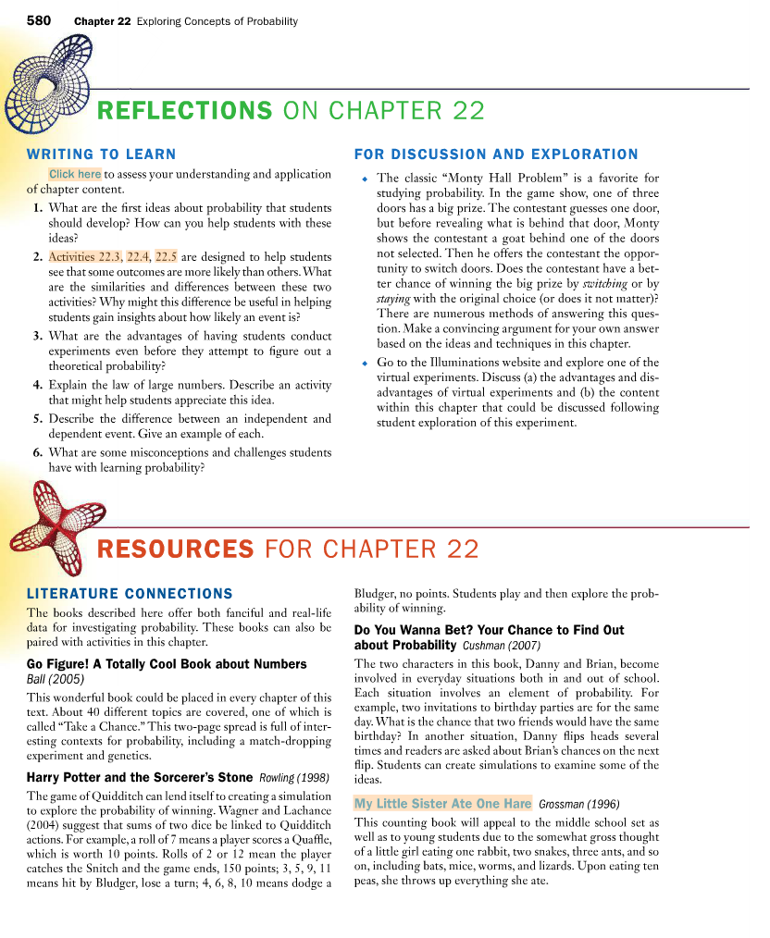
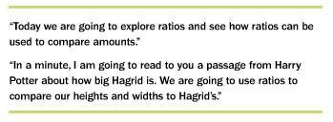
The Problem to be Solved
The story book you choose will help you to create both a problem to be solved, and context in which to place it.
Each chapter provides some possible books to use.

Slide 9
Vocabulary
Choose 3-5 words that help the student comprehend the math concepts and processes.
Be sure to pair these words with their math symbols – for all students.
Choose an instructional strategy. EBPs support CTD or SP.

Slide 10
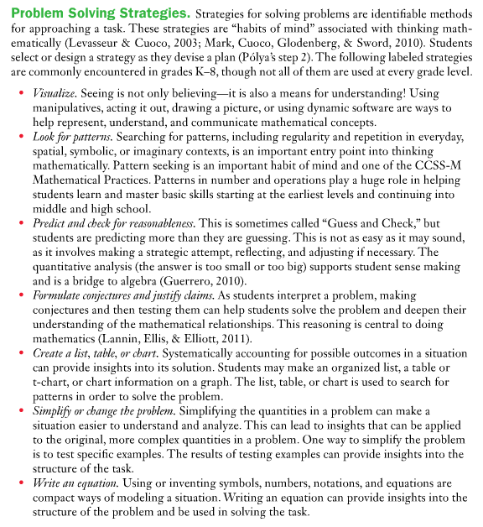
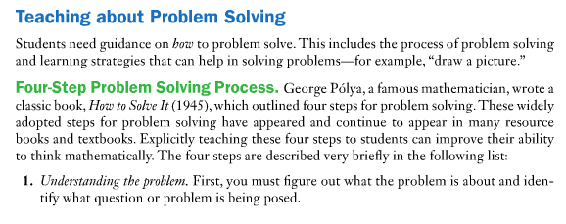
Staying Problem Focused

Slide 11
Teaching the Concepts
”Measuring Penny,” by Loreen Leedy, is about a young girl who decides to measure her dog for a class project. So, for our assignment, we could first ask the students what they want to measure, and provide multiple items from which to choose. Using the context of the book, the problem becomes, “How can we measure _________?” Multiple concepts come forth… measuring length in both standard and non-standard measures. Measuring weight. Measuring in metric vs. English units. Measuring time. Each concept can be taught as a way to solve the problem. Each concept can be taught using the CSA model.

Slide 12
Common Stumbling Blocks for Students with Disabilities

Slide 13
Graphic Organizers
Be sure to demonstrates the graphic organizer across the CSA model.
Graphic organizers are a great tool for helping students to transition from concrete to semi-concrete to abstract.

Slide 14
Peer Interaction
Embedding peer interaction involves planning for it by asking driving questions, and preparing for students to have a way to respond:
Examples:
Show/Tell your classmate which way you chose to measure Penny. (Provide picture prompts or VOD)
Which method did your classmate use to measure Penny? (Provide a field of 4 options with CTD or SP)
How are your methods the same? (Provide a set of options.)
How are your methods different? (Provide a set of options.)
Did you and _______ come up with the same or different answers?
Tell your peer how you solved the problem. (Provide a sequence of steps)

Slide 15
Self Assessment
Ask the students if they can state the problem:
What is the problem we’re solving?
What was the answer to the problem?
How did you show your thinking?
Showed a pattern or rule?
Made a diagram?
Made a chart or table?
Made a model to show someone else?

Slide 16
Lesson Closure
Review the vocabulary
Review the concept statement.

Slide 17
Student Progress Monitoring
Be clear about what you’re measuring.

Slide 18
Plan for Generalization
Across people (stimulus generalization)
Across settings (stimulus generalization)
Across tasks (response generalization)
Fade prompts
Alter the reinforcement schedule
Reinforce in natural settings

Slide 19
Questions?

