Slide 1
Virtual Praxis Review Workshop :
Core Mathematics Exam
Part II
Jonathan D. Watkins, Ph.D.
REACH Math Resources

Slide 2
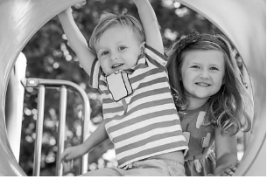
Agenda
Exam Overview
Algebra/Functions
Geometry
Formulas to Know
“Homework”
Closing Thoughts

Slide 3
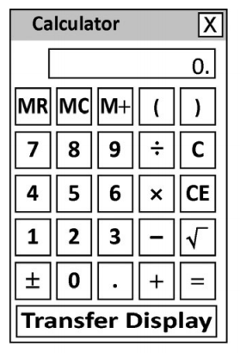
Exam Overview – “Old” (5732)
Core Academic Skills for Educators: Mathematics
85 minutes to complete 56 questions (about 1.5 minutes per question!)
Multiple-choice, selected-response
(with one or more answers), and
short-answer questions
On-screen calculator

Slide 4
Exam Overview – “Old” (5732)
CONTENT AREAS
Number & Quantity
(17 questions)
Algebra & Functions
(17 questions)
Geometry
(11 questions)
Statistics & Probability
(11 questions)

Slide 5
Exam Overview – “New” (5733)
Core Academic Skills for Educators: Mathematics
90 minutes to complete 56 questions (about 1.6 minutes per question!)
Multiple-choice, selected-response
(with one or more answers), and
short-answer questions
On-screen calculator

Slide 6
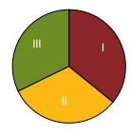
Exam Overview – “New” (5733)
CONTENT AREAS
I. Number & Quantity: +3
(20 questions)
II. Data, Statistics, & Probability: +7
(18 questions)
III. Algebra & Geometry: –10
(18 questions)

Slide 7
Exam Overview
LAST WEEK (Recording available)
Number & Quantity
Statistics & Probability (& Data)
THIS WEEK
Algebra & Functions
Geometry

Slide 8
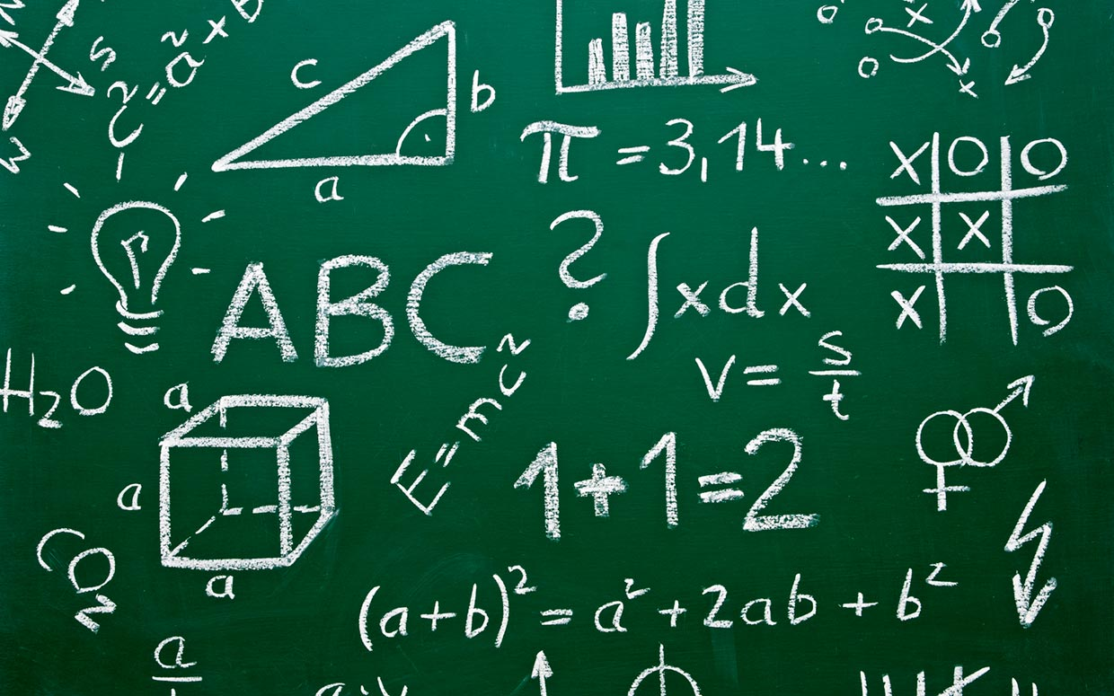
Exam Overview
Questions so far?
Now, let’s get started! =)

Slide 9
Algebra & Functions
Algebra & Functions Major Topics
(Not an Exhaustive List!)

Slide 10
Algebra & Functions
Simplifying expressions (using the distributive property)
Working with expressions/equations (e.g., evaluating and manipulating them)
Solving linear equations and inequalities
Working with functions (including tables of values)
Solving problems involving ratios/proportions
Understanding linear equations and their graphs
Interpreting graphs of equations/functions
Understanding and solving word problems

Slide 11
Algebra & Functions
Algebra & Functions Questions

Slide 12
Algebra & Functions
Solve the following linear equation: 3x – 9 = 12.
x = 1
x = 7
x = 9
x = 21
x = 63
Follow-Up Exercise:
Solve the following: $\frac{1}{5}x+4=−6$.
Tip: Work Backwards

Slide 13
Algebra & Functions
Marcus purchases a video game with a price tag of d dollars. If the sales tax on the item is 6%, which expression represents the final cost of the game?
0.06d
d + 0.06
d – 0.06
d + 0.06d
d – 0.06d
Test Tip 12:
If necessary, make an educated guess.

Slide 14
Algebra & Functions
Which of these functions will produce the table of values shown below.
f(x) = x
f(x) = x + 2
f(x) = x – 2
f(x) = 2x + 1
f(x) = 2x – 1
x | f(x)
1 | 1
2 | 3
3 | 5
4 | 7
5 | 9

Slide 15
Algebra & Functions
Which of the following expressions is equivalent to
–3(x – 5) – (2 – x)?
–4x – 17
–4x + 13
–2x – 17
–2x + 13
–3x² + 21x – 30

Slide 16
Algebra & Functions
If $\frac{2}{3}a−b=\frac{1}{4}c$, b = –1, and c = 20, find a.
a = 8/3
a = 4
a = 6
a = 9
a = 12
Test Tip 13:
Whenever possible, check your answers!

Slide 17
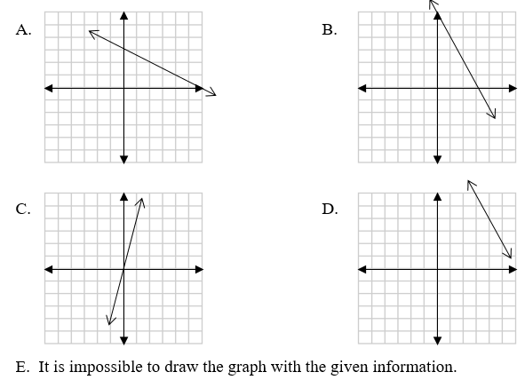
Algebra & Functions
Which of the following is the graph of the linear equation $y=−\frac{1}{2}x+3$ ?

Slide 18
Algebra & Functions
Translate the following phrase into an algebraic expression: Five less than twice a number.
5 – 2n
2n – 5
5 – (2 + n)
(2 + n) – 5
5 – $\frac{2}{n}$
Test Tip 14:
Be skeptical of answers that are “too good to be true.” Don’t fall into a trap!

Slide 19
Algebra & Functions
The relationship between x and y is given by the following equation: 3x + y = 7. If x increases by 2, then y…
Increases by 3.
Increases by 6.
Increases by 7.
Decreases by 3.
Decreases by 6.
Test Tip 15:
If a problem is too abstract, try plugging in some numbers to make it more concrete.

Slide 20
Algebra & Functions
There are 25 animals (chickens and goats) on a farm. If these farm animals have a total of 66 legs, how many goats are on the farm?
8 goats
9 goats
12 goats
16 goats
17 goats
Test Tip 16:
You probably want to skip the “textbook approach” on some problems. Ideally, you want to use the fastest approach that works!
Tip: Answer the Right Question

Slide 21
Algebra & Functions
Solve the following inequality: 2x + 1 > 4x – 5.
x < –3
x > –3
x < 3
x > 3
All real numbers
Tip: Check Your Answer

Slide 22
Algebra & Functions
The second angle of a triangle is twice as large as the first, and the third angle is 20$°$ less than the first angle. Given that the sum of the measures of the interior angles of a triangle is 180$°$, find the measure of the third angle.
30$°$
50$°$
60$°$
80$°$
100$°$
Tip: Answer the Right Question

Slide 23
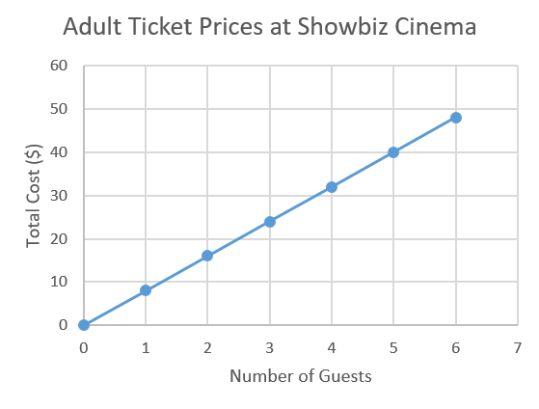
Algebra & Functions
The cost of movie tickets for adults at Showbiz Cinema is shown in the graph below. Based on this information, what is the cost of two movie tickets?
$8
$15
$16
$17
$18
Tip: Answer the Right Question

Slide 24
Geometry
Geometry Major Topics
(Not an Exhaustive List!)

Slide 25
Geometry
Perimeter, area, and volume of various shapes
Transformations in the xy-plane (e.g., translations, rotations, reflections)
Classifying triangles and quadrilaterals
Triangle Inequality Theorem
Pythagorean Theorem
Parallel lines cut by a transversal (angle relationships)
Circles (Circumference, arc length, area, and sector area)

Slide 26
Geometry
Geometry Questions

Slide 27
Geometry
The dimensions of five rectangles are given below. Which rectangle has an area of 12 in² and a perimeter of 16 in?
1” × 12”
2” × 6”
3” × 4”
4” × 8”
6” × 6”
Tip: Formulas

Slide 28
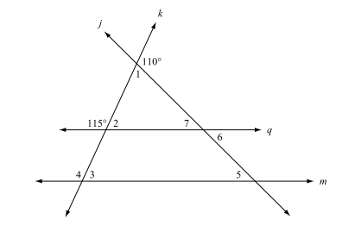
Geometry
Given that lines q and m are parallel, find the measure of ∠5.
35°
45°
65°
70°
110°

Slide 29
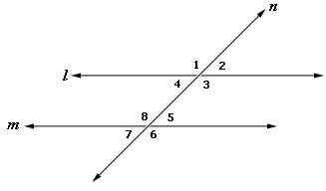
Geometry
Parallel Lines Cut by a Transversal

Slide 30
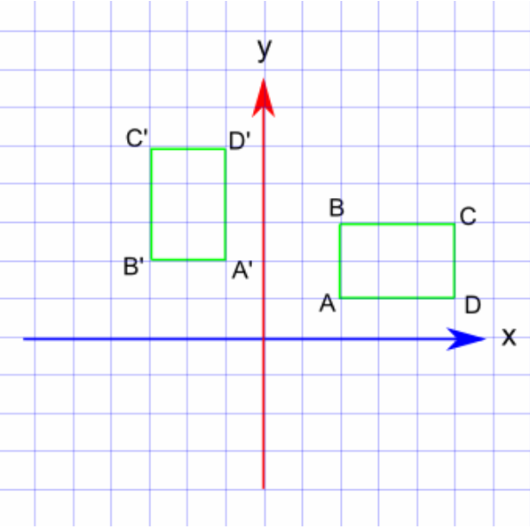
Geometry
Which geometric transformation is illustrated in the figure below?
Translation
Dilation
Rotation
Reflection
None of these
Tip: Terminology

Slide 31
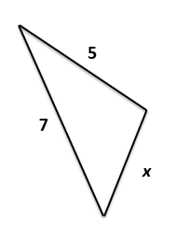
Geometry
Two sides of a triangle measure 5 cm and 7 cm. Which of the following side lengths are possible for the third side?
1 cm A. i, ii, and iii
3 cm B. ii, iii, and iv
7 cm C. iii, iv, and v
11 cm D. i, ii, iii and iv
13 cm E. All of them
Test Tip 17:
It never hurts to draw a picture!

Slide 32
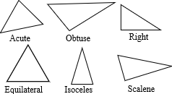
Geometry
Classifying Triangles

Slide 33
Geometry
The volume of a package (in the shape of a rectangular prism) is 4,692 in³. If the length of the package is 23 in and the width is 17 in, what is the height of the package?
12 in
17 in
23 in
4,301 in
4,652 in
Test Tip 18:
Algebra is a powerful tool. Use it!

Slide 34
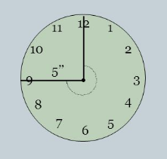
Geometry
The second hand of a clock is 5 inches long. Approximately how far does the tip of the hand travel in 45 seconds?
3.9 in
7.5 in
11.8 in
23.6 in
31.4 in
Test Tip 19:
Sometimes, you can use estimation to eliminate answer choices.

Slide 35
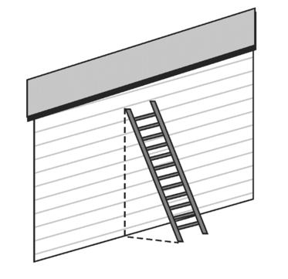
Geometry
A 26-foot ladder is leaned against a wall in such a way that the base of the ladder is 10 feet from the wall. At what height does the top of the latter touch the wall? (If necessary, round your answer to the nearest foot.)
16 ft
20 ft
24 ft
28 ft
36 ft

Slide 36
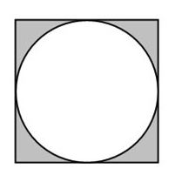
Geometry
A circle with a radius of 5 cm is inscribed in a square. What is the area of the shaded region (in cm)?
10π – 25
25 – 10π
25π – 25
100 – 25π
100 – 10π

Slide 37
Some Formulas to Know
Percent increase/decrease
Slope-intercept form of a linear equation
Pythagorean Theorem
Area of a triangle and rectangle
Circumference and area of a circle
Volume of a rectangular prism/cylinder
Distance-rate-time formula

Slide 38
Tips/Strategies from Week 1
Review important mathematical terminology.
Memorize key formulas. (See handout.)
Take time to understand the problem.
Read all of the questions very carefully, and be sure to answer the question that is being asked.
Read all of the choices before answering.
Pace yourself (≈ 1.5 minutes per question).
If you don’t know how to answer a question, skip it and return to it later.

Slide 39
Tips/Strategies from Week 1
If you get stuck, try to work backwards.
To find the probability of two or more events, use the multiplication rule:
P(A and B) = P(A)×P(B given A).
Review the most common representations of data, including dot plots, scatterplots, box plots, and histograms.
Sometimes, creating an organized list or table can help you solve a problem.

Slide 40
Tips/Strategies from Week 2
If necessary, make an educated guess.
Whenever possible, check your answers.
Be skeptical of answer choices that are “too good to be true.” Don’t fall into a trap!
If a problem is too abstract, try plugging in some numbers to make it more concrete.
Skip the “textbook approach” on some problems. Ideally, you want to use the fastest approach that works!

Slide 41
Tips/Strategies from Week 2
It never hurts to draw a picture.
Algebra is a powerful tool. Use it!
Sometimes, you can use estimation to eliminate answer choices.
Sometimes, you may want to convert your answer choices to decimal numbers. (See Additional Problem # 10.)

Slide 42
Homework
Check out the great resources available from ETS!
Google: “Praxis Core Math”
Direct link: https://www.ets.org/praxis/ prepare/materials/5732
Link to free Khan Academy prep course (NEW!)
Attempt the sample mathematics problems in the handout and from the Praxis Study Companion.

Slide 43
Homework
Solutions to last week’s additional exercises
(Part I)
C
C
C
E
A
E
B
E
A
E
D
E

Slide 44
Homework
Solutions to this week’s additional exercises
(Part II)
C
B
D
A
D
D
A
D
A
C
C
Answers will vary

Slide 45
Math Resource Center
UofL student? Need additional help?
Visit the REACH Math Resource Center!
https://reach.louisville.edu/tutoring/
Belknap Academic Building, Room 241

Slide 46
Closing Thoughts
You can pass the Praxis Core in Math! Stay positive.
Practice, practice, practice! (Rework all of the problems that we have discussed.)
Use the free resources that are available on the ETS website! (Google Praxis CASE Math.)
Find other good resources online.
Use the REACH Math Resource
Center. (We’re on MS Teams!)

Slide 47
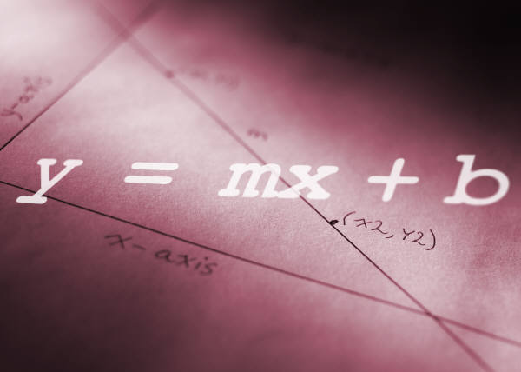
Additional Practice
Here are some additional practice problems related to Algebra & Functions and Geometry!

Slide 48
Algebra & Functions
Horizon Wireless charges a flat monthly fee of $20 per month and an additional 8 cents ($0.08) per minute to make cell-phone calls using its service. If m is the total number of minutes a customer used his/her phone during a particular monthly billing cycle, which of the following expressions represents the total cost of the customer’s bill?
(20 + 0.08)m
20m + 0.08
20 + 0.08m
20 + 0.08 + m
None of these

Slide 49
Algebra & Functions
Which of the following statements about the linear equation y = 4x – 1 is false?
The slope (m) of the line is 4.
The x-intercept of the line is –1.
The point (2, 7) is on the line.
The point (–1, 2) is above the line.
The point (3, 0) is below the line.
Tip: Terminology

Slide 50
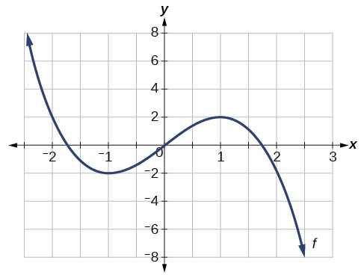
Algebra & Functions
The graph y = f(x) is given below. For which value(s) of x is/are f(x) = 2?
–2
1
2
–2 and 1
–2 and 2

Slide 51
Algebra & Functions
The perimeter (P) of a rectangle is given by the following formula: $P=2l+2w$. Which of the following gives the length (l) of a rectangle in terms in its perimeter and width (w)?
$\frac{P−2w}{2}$
$\frac{P+2w}{2}$
$P−w$
$P+w$
$2(P−2w)$

Slide 52
Geometry
Which of the following quadrilaterals has at least one pair of opposite sides that are parallel?
Rectangle A. i and iii
Rhombus B. ii and iv
Parallelogram C. ii, iii, and iv
Trapezoid D. i, ii, iii and iv
Kite E. i, ii, iii and v
Tip: Terminology

Slide 53
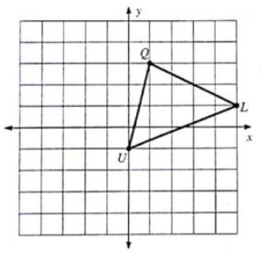
Geometry
The vertices of triangle LQU are as follows: L(5, 1), Q(1, 3), and U(0, –1). If triangle LQU is reflected about the x-axis, what is the image of the point Q?
Q’(1, 3)
Q’(–1, –3)
Q’(–1, 3)
Q’(1, –3)
None of these

Slide 54
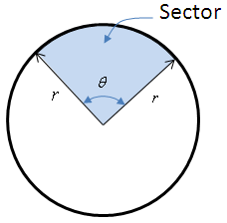
Geometry
Which of the following statements about circles is false?
The relationship between the diameter (d) and radius (r) of a circle is given by r = 2d.
The area of a circle is given by A = πr².
The circumference of a circle is given by C = 2πr.
The area of a sector is given by A = $\frac{Ɵ}{360}$πr², where
$Ɵ$ is the measure of the central angle in degrees.
Arc length is given by s = $\frac{Ɵ}{180}$πr, where $Ɵ$ is the measure of the central angle in degrees.

Slide 55
Geometry
The side view of a truss bridge is shown below. If the legs of the isosceles triangles in the design are 12 feet long, what is the area of this portion of the bridge? Note: The area of a trapezoid with bases b₁ and b₂ is given by $A=\frac{1}{2}\left(b_{1}+b_{2}\right)h$.
60 ft²
72 ft²
144 ft²
720 ft²
1,440 ft²
12 ft
Tip: Fastest method

Slide 56
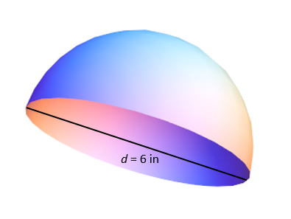
Geometry
The volume of a sphere is given by the formula $V=\frac{4}{3}πr^{2}$. What is the volume of a hemisphere with a diameter of 6 in?
6π in³
12π in³
24π in³
36π in³
48π in³
Tip: Answer the Right Question

Slide 57
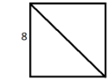
Geometry
What is the length of a diagonal of a square with a side length of 8 centimeters?
$4$ cm
$8$ cm
$8\sqrt{2}$ cm
$8\sqrt{3}$ cm
$64$ cm

Slide 58
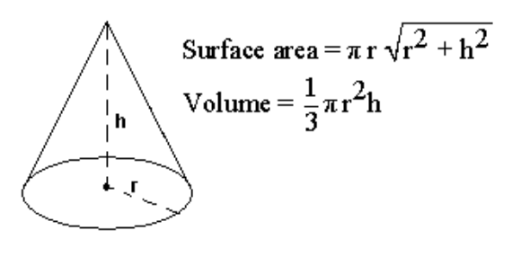
Geometry
A right circular cone has a height of 6 inches and a radius of 3 inches. If a second right circular cone has the same height but twice the volume of the first cone, what is the radius of the second cone?
$\sqrt{3}$ in
$3$ in
$3\sqrt{2}$ in
$6$ in
$9$ in

Slide 59
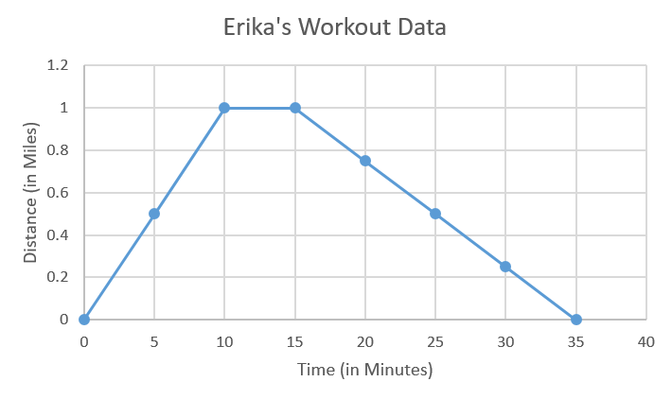
Bonus Problem!
BONUS: Data from Erika’s jogging workout are shown in the graph below. The y-axis gives Erika’s distance from the starting point in miles. What does this graph tell us?

