Slide 1
Virtual Praxis Review Workshop:
Core Mathematics Exam
Part I
Jonathan D. Watkins, Ph.D.
REACH Math Resources

Slide 2
Agenda
Introductions
Exam Overview
Number & Quantity
Data, Prob, & Stats
“Homework”
Looking Ahead

Slide 3
Introductions
Who am I?
Asst. Director for REACH Math Resources and Coordinator of the GEN 103/104 program at the University of Louisville
Mathematics/math education instructor
Former university supervisor for pre-service teachers
Former high school mathematics teacher
BA and MA in Mathematics
PhD in Mathematics Education

Slide 4
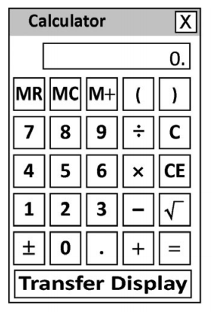
Exam Overview – “Old” (5732)
Core Academic Skills for Educators: Mathematics
85 minutes to complete 56 questions (about 1.5 minutes per question!)
Multiple-choice, selected-response
(with one or more answers), and
short-answer questions
On-screen calculator

Slide 5
Exam Overview – “Old” (5732)
CONTENT AREAS
Number & Quantity
(17 questions)
Algebra & Functions
(17 questions)
Geometry
(11 questions)
Statistics & Probability
(11 questions)

Slide 6
Exam Overview – “New” (5733)
Core Academic Skills for Educators: Mathematics
90 minutes to complete 56 questions (about 1.6 minutes per question!)
Multiple-choice, selected-response
(with one or more answers), and
short-answer questions
On-screen calculator

Slide 7
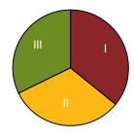
Exam Overview – “New” (5733)
CONTENT AREAS
I. Number & Quantity: +3
(20 questions)
II. Data, Statistics, & Probability: +7
(18 questions)
III. Algebra & Geometry: –10
(18 questions)

Slide 8
Exam Overview
THIS WEEK
Number & Quantity
Statistics & Probability (& Data)
NEXT WEEK
Algebra & Functions
Geometry

Slide 9
Exam Overview
Questions so far?
Now, let’s get started! =)

Slide 10
Number & Quantity
Number & Quantity Major Topics
(Not an Exhaustive List!)

Slide 11
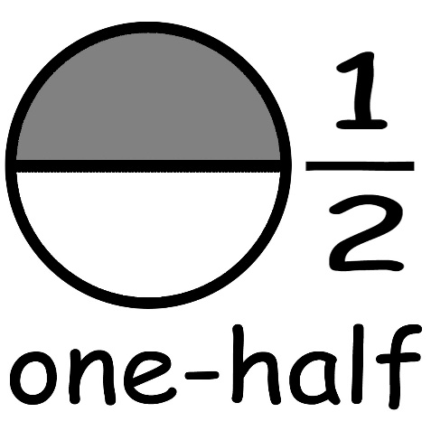
Number & Quantity
Order of operations
Fractions (e.g., ordering)
Operations involving integers
Operations involving fractions, decimals, and percents
Ratios/proportions
Percents (including percent inc/dec)
Basic number theory (e.g., factors)
Interpreting charts and graphs
Area models, etc.
Unit conversions
Scientific notation
Powers and roots (e.g., square roots)
Estimation
0.5

Slide 12
Number & Quantity
Number & Quantity Questions

Slide 13
Number & Quantity
What is the least common denominator of the following fractions: $\frac{2}{3}, \frac{3}{4}, \frac{5}{6}?$
6
12
24
30
62
Test Tip 1:
Be sure to know important mathematical terminology, such as LCD.
These terms are listed in the Praxis Study Companion for the CASE Math test!

Slide 14
Number & Quantity
Some kindergarten students were asked to give their favorite food. The results for 350 students are shown below. How many more students chose chicken nuggets than pizza?
14
25
49
56
140

Slide 15
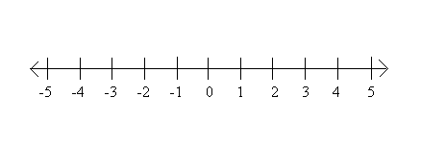
Number & Quantity
What is the distance between $−\frac{2}{3}$ and $\frac{3}{4}$ on the number line?
$−\frac{1}{2}$
$\frac{1}{12}$
$\frac{6}{7}$
$\frac{17}{12}$
$\frac{12}{7}$
Test Tip 2:
Take time to understand the problem!
Many problems on the Praxis Core test are worded differently than problems you have seen in the past.

Slide 16
Number & Quantity
Two buses arrive at Grand Central Station at 11:30 a.m. The first bus arrives at the station every 45 minutes, while the second bus arrives at the station every 20 minutes. When is the next time that both buses will arrive at this station at the same time?
1:00 p.m.
2:30 p.m.
3:30 p.m.
4:00 p.m.
5:30 p.m.
Test Tip 3:
Pace yourself! You can’t afford to spend too much time on any given problem.
Keep in mind that you only have about 1.5 minutes per question.

Slide 17
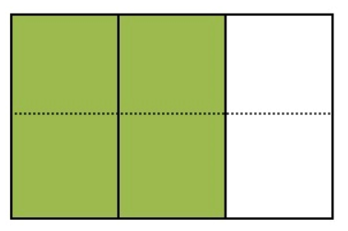
Number & Quantity
Which of the following problems can be solved using the area model below?
$\frac{2}{3}×\frac{1}{6}$
$\frac{2}{3}÷\frac{1}{6}$
$\frac{2}{3}×4$
$\frac{2}{3}÷6$
None of these
Test Tip 4:
If you don’t know how to answer a question, skip it and return to it later.
But be sure to answer all of the questions before your time is up!

Slide 18
Number & Quantity
Using the table, determine how many cups are in $3\frac{1}{2}$ gallons?
3.5 cups
14 cups
28 cups
42 cups
56 cups
1 cup = $\frac{1}{2}$ pint
2 pints = 1 quart
4 quarts = 1 gallon

Slide 19
Number & Quantity
One family’s water consumption (in thousands of gallons) over several months is shown in the bar graph below. What was the percent increase in water consumption from June to August?
2 %
20 %
40 %
66.7 %
100 %
Test Tip 5:
There are several formulas that you are expected to know for this test.
So be sure to review and practice using them before test day!

Slide 20
Number & Quantity
Which of the following numbers are greater than 3?
$\sqrt{2}$ A. i and ii
$\sqrt{3}$ B. i, ii, and iii
$\sqrt{9}$ C. iii, iv, and v
$\sqrt{10}$ D. iv and v
$π$ E. None of them
Test Tip 6:
Read all of the answer choices before selecting an answer.
This is especially important on questions that have more than one possible answer.

Slide 21
Number & Quantity
The ratio of female to male students in a class is 7:2. If there are 12 males in the class, what is the total enrollment?
17 students
29 students
42 students
54 students
84 students
Test Tip 7:
Read all questions very carefully!
Be sure that you answer the question that is being asked.

Slide 22
Statistics & Probability
Stats & Probability Major Topics
(Not an Exhaustive List!)

Slide 23
Statistics & Probability
Statistical questions
Random sampling
Measures of center (mean, median, mode)
Measures of spread (range)
Weighted average
Representing data and understanding data representations
Interpreting diagrams (e.g. scatterplot)
Probability of simple events
Independent and dependent events

Slide 24
Statistics & Probability
Statistics & Probability Questions

Slide 25
Statistics & Probability
A laundry basket contains some brown and black socks. In particular, there are 12 brown socks in the basket. If the probability of randomly drawing a black sock from the basket is 1/4, how many black socks are in the basket?
3
4
6
9
16
Test Tip 8:
If you get stuck, try to work backwards (i.e., start with the solutions).

Slide 26
Statistics & Probability
Which of the following is NOT a statistical question?
How many hours per week do college students do homework?
Do female students spend more time on homework than male students?
Do elementary-school teachers work more hours per year than high-school teachers?
On average, how many years do teachers remain in the profession?
How many teachers in Kentucky have tenure?

Slide 27
Statistics & Probability
The table below shows the number of children in 50 randomly selected families in the U.S. What is the average number of children per family in this random sample?
1.72
1.86
2.05
3
3.5
Number of Children | Number of Families
0 | 8
1 | 12
2 | 21
3 | 6
4 | 2
5 | 0
6 | 1

Slide 28
Statistics & Probability
If two cards are drawn from a standard deck, what is the probability that both cards will be spades? (Note that there are 52 cards in a standard deck, and one-fourth of them are spades.)
3/52
3/51 (= 1/17)
1/16
1/4
1/2
Test Tip 9:
To find the probability of two or more events, use the multiplication rule:
P(A and B) = P(A) × P(B given A).

Slide 29
Statistics & Probability
The dotplot below shows the number of hours of sleep reported by 14 people on a given night. What is the mean and median number of hours, respectively (rounded to the nearest tenth)?
7.4 hours; 7 hours D. 7 hours; 7.4 hours
7.4 hours; 7.5 hours E. 8 hours; 7.4 hours
7.4 hours; 8 hours
Test Tip 10:
Be sure to review the most common representations of data, including dot plots, scatterplots, box plots, and histograms.

Slide 30
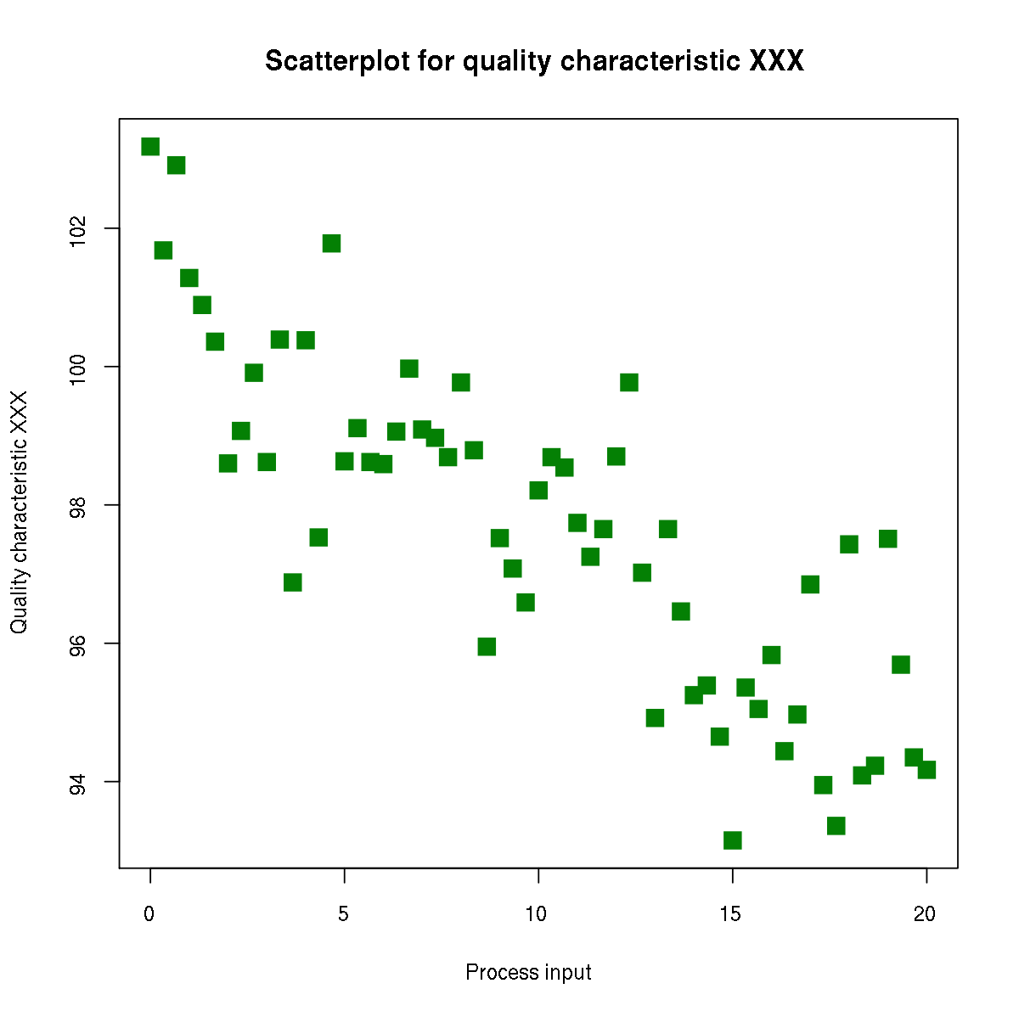
Statistics & Probability
Which of the following statements best describes the association of the variables in the scatterplot below?
Nonlinear association
Positive linear correlation
Negative linear correlation
Strong correlation
No correlation
Tip: Representations

Slide 31
Statistics & Probability

Slide 32
Statistics & Probability
In a certain game, players must roll two (2) six-sided dice at the beginning of each turn. At any given time, what is the probability that a player will roll a sum of 8?
1/36
1/11
1/9
5/36
1/6
Test Tip 11:
Sometimes, creating an organized list or table can help you solve a problem.

Slide 33
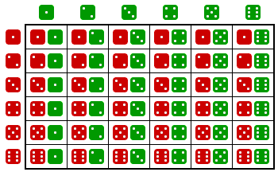
Statistics & Probability
In a certain game, players must roll two (2) six-sided dice at the beginning of their turn. At any given time, what is the probability that a player will roll a sum of 8?

Slide 34
Statistics & Probability
A certain company has both part-time and full-time employees; only full-time employees receive health benefits. The company CEO is interested in surveying a group of employees to determine their level of satisfaction with the current insurance carrier. Which method would most likely produce a sample that is representative of the population of interest and be practical to implement?
Supervisors select several employees in their area to be surveyed.
A random sample of all employees is selected.
All employees are surveyed.
Surveys are mailed to all full-time employees and returned surveys are used as the sample.
Every full-time employee is assigned a number and names are randomly drawn from a hat to select participants.

Slide 35
Homework
Check out the great resources available from ETS!
Google: “Praxis Core Math”
Direct link: https://www.ets.org/praxis/ prepare/materials/5732 (and 5733)
Attempt the sample mathematics problems in this handout and from the Praxis Study Companion.

Slide 36
Math Resource Center
UofL student? Need additional help?
Visit the REACH Math Resource Center!
https://reach.louisville.edu/tutoring/
Belknap Academic Building, Room 241

Slide 37
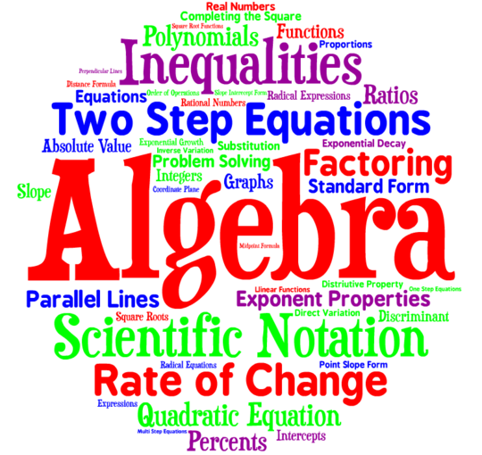
Looking Ahead
Next Friday
Algebra & Functions
Geometry
Questions?

Slide 38
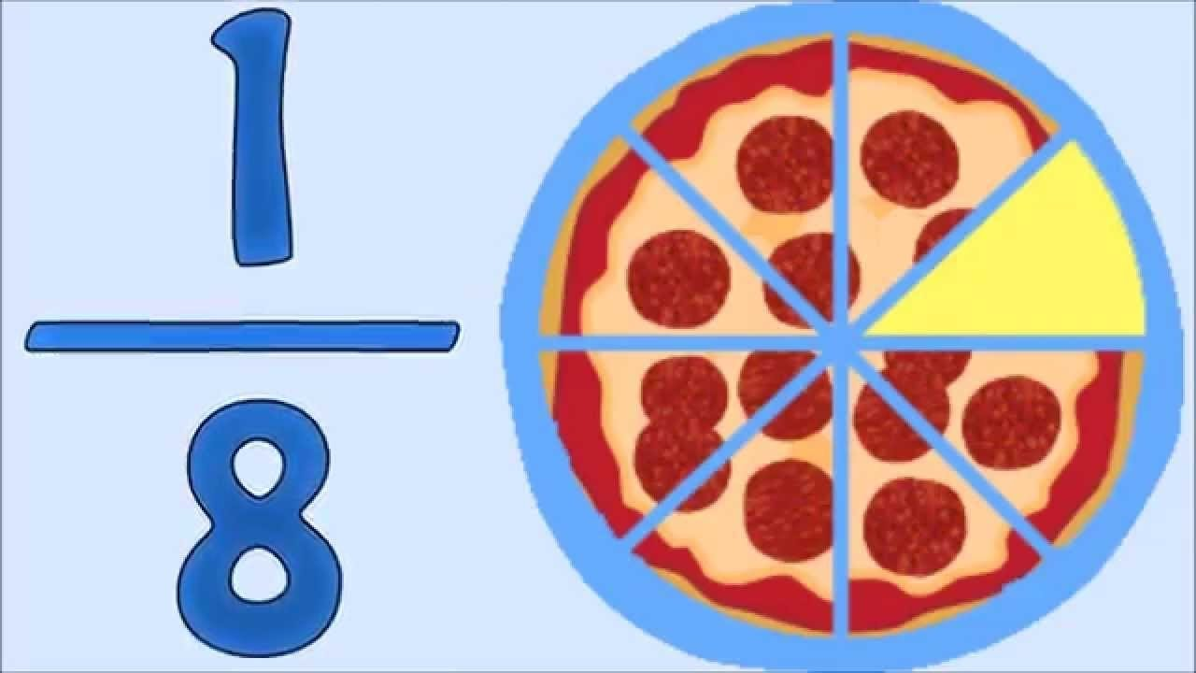
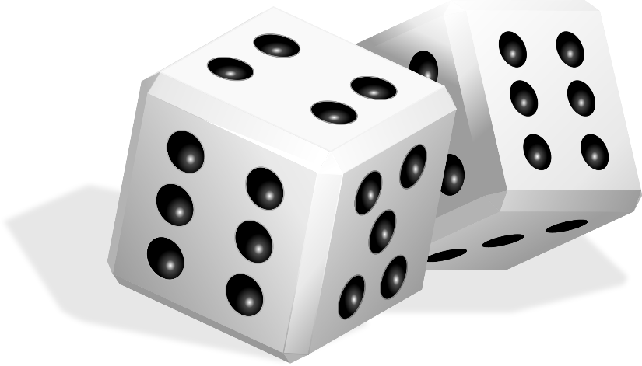
Additional Practice
Here are some additional practice problems related to Number & Quantity and Statistics & Probability!

Slide 39
Number & Quantity
On a certain map, the scale reads 2 inches = 3 miles. If two cities are 14 inches apart on the map, how far apart are the cities actually located from each other? (If necessary, round to the nearest mile.)
9 miles
15 miles
21 miles
42 miles
84 miles

Slide 40
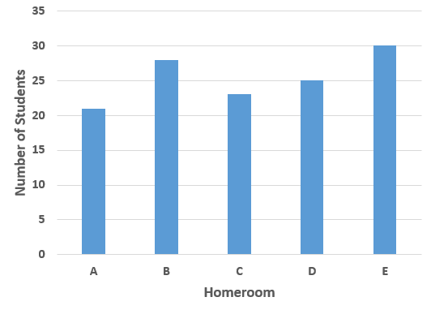
Number & Quantity
All 5th grade students at Anytown Elementary are going on a school trip. The bar graph below shows the number of students in each 5th grade homeroom. If the maximum capacity of Anytown’s school buses is 54, how many buses will be needed for the trip?
1
2
3
4
None of these

Slide 41
Number & Quantity
A recipe for Peanut Butter Blossoms calls for $1\frac{3}{4}$ cups of flour. How much flour would be needed to make half of this recipe?
$\frac{3}{8}$ cup
$\frac{5}{6}$ cup
$\frac{7}{8}$ cup
$\frac{7}{4}$ cups
$\frac{7}{2}$ cups

Slide 42
Number & Quantity
The average distance from the Earth to the Sun is about 9.3 × 10⁷ miles, or 1 Astronomical Unit (AU). The planet Neptune is about 30 AU from the sun. How far is this distance in miles?
9.3 × 10³⁷
9.3 × 10²¹⁰
2.79 × 10⁵
2.79 × 10⁷
2.79 × 10⁹

Slide 43
Number & Quantity
Which of the following mathematical expressions can be used to solve the problem below?
There are eight slices in each Mama Jane’s pizza. If I have $2\frac{1}{2}$ Mama Jane’s pizzas, how many total slices do I have?
$2\frac{1}{2}$ ÷ $\frac{1}{8}$ D. $2\frac{1}{2}$ ÷ 8
$2\frac{1}{2}$ × $\frac{1}{8}$ E. None of these
$2\frac{1}{2}$ – $\frac{1}{8}$

Slide 44
Number & Quantity
Place the following fractions in order from least to greatest: $−\frac{4}{7}, −\frac{1}{2}, −\frac{11}{7}, −\frac{11}{8}$.
$−\frac{4}{7}, −\frac{1}{2}, −\frac{11}{7}, −\frac{11}{8}$
$−\frac{1}{2}, −\frac{4}{7}, −\frac{11}{7}, −\frac{11}{8}$
$−\frac{1}{2}, −\frac{4}{7}, −\frac{11}{8}, −\frac{11}{7}$
$−\frac{11}{8}, −\frac{11}{7}, −\frac{4}{7}, −\frac{1}{2}$
$−\frac{11}{7}, −\frac{11}{8}, −\frac{4}{7}, −\frac{1}{2}$

Slide 45
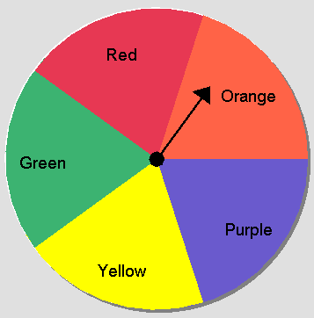
Statistics & Probability
If a person flips a coin and spins the spinner below, what is the probability that the coin will land on “heads” and the spinner will land in the orange region?
1/25
1/10
1/5
1/4
1/2

Slide 46
Statistics & Probability
In a certain class, students take five tests. Natalie earned the following scores on her first four tests: 81, 86, 95, and 91, respectively. How many points does Natalie need to earn on her fifth test to have an overall test average of 90%?
7
83
92
95
97

Slide 47
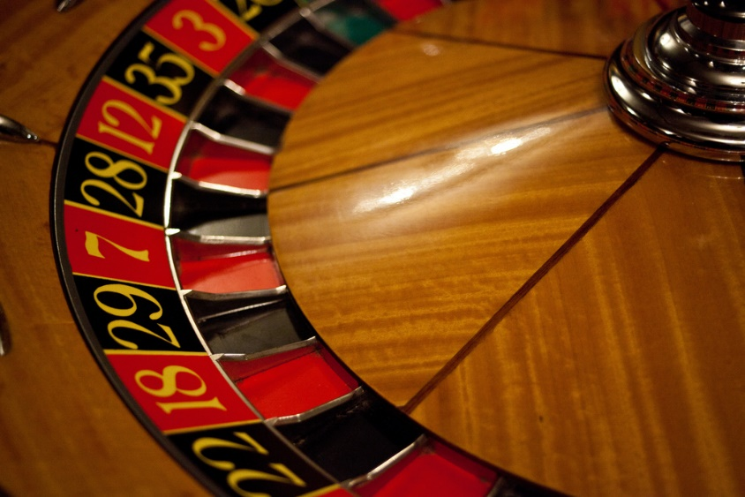
Statistics & Probability
An American roulette wheel contains 38 numbered pockets. Two are green, 18 are red, and 18 are black. The results of the first four spins of a roulette wheel are recorded: black, red, black, black. What is the probability that the ball will land in a black pocket on the next spin?
9/19
1/2
3/4
9/10
None of these

Slide 48
Statistics & Probability
Nine employees were asked to rate their job satisfaction on a scale from 0 (very low) to 10 (high very)? Their responses are displayed in the box plot below. Which of the following data sets could be represented by this box plot?
{1, 2, 3, 4, 5, 6, 7, 8, 9}
{2, 5, 5, 5, 7, 7, 8, 8, 9}
{1, 5, 5, 6, 7, 7, 8, 8, 8}
{1, 5, 5, 6, 6, 7, 8, 8, 9}
{1, 5, 5, 6, 7, 7, 8, 8, 9}

Slide 49
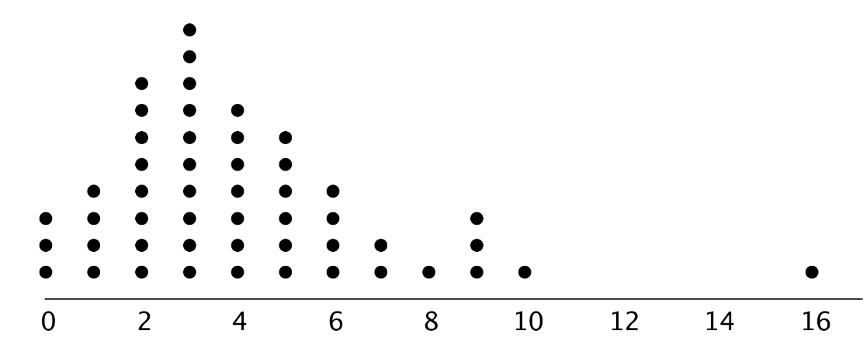
Statistics & Probability
Which of the following statements is true about the data shown in the dot plot below? (There are 50 data points.)
The median and mode of the data are the same.
The mode is greater than the median.
The mean and the mode are the same.
The mean is greater than the median.
The data are negatively skewed.

Slide 50
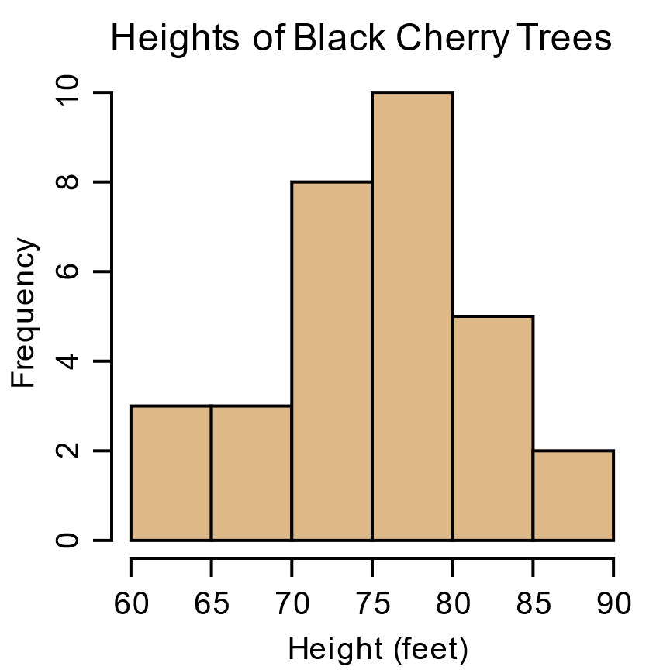
Statistics & Probability
Which of the following statements cannot be confirmed using only the information available in the histogram below?
The data are approximately
normally distributed.
There are 31 trees in the sample.
About 16.1% of the trees in the
sample are between 80-85 ft. tall.
The distribution is unimodal.
The median tree height is 77.5 ft.

