Slide 1
The Big Picture
The Big Picture
Notes:
Thank you for opportunity to share information with folks

Slide 2
KATC Overview
University of Louisville Autism Center
History of the KATC
From “SWAT Team” to Systemic Supports
Resources and Training
Partnership with KDE, NPDC on ASD & Special Ed Coops
Training for Early Childhood Professionals
Support for Families
Notes:
Broad range of diagnostic and treatment options available at UofL Autism Center
History of the KATC

Slide 3
History of the KATC
Initiated by families seeking training for educators, service providers and families
House Bill 159 passed 1996 General Assembly (State Autism Training Center KRS 164.981 to 164.9819 )
University of Louisville awarded administrative oversight – housed at the College of Education and Human Development
Notes:
Started by families seeking systemic training for educators and other service providers
In 1996, these families were successful in their question to create a autism center with the passage of HB 159. The function and scope of work of the KATC is broad. We constantly seek input from our advisory board that is comprised of 50% parents, 40% professionals and 10% lay person for input regarding the focus of our work.
University of Louisville awarded administrative oversight – housed at the College of Education and Human Development. Our offices my be in Louisville, but we take our state mission very seriously and make every effort to ensure that we are impacting as many individuals as possible
We are small staff, of 7.

Slide 4
University of Louisville Autism Center
Training
Research
Clinical Services
All Diagnostic Evaluations are conducted at WCEC or BCGC
Notes:
The Center's mission is to build a partnership by expanding state-of-the-art diagnostic programs in the School of Medicine's Departments of Pediatrics and Psychiatry, expanding treatment through Systematic Treatment of Autism & Related Disorders (STAR), training services provided by the College of Education and Human Development's Kentucky Autism Training Center and developing a supported research agenda. This mission will lead to creation of a premier autism program of treatment, evaluation, intervention, training and research that will serve residents of Kentucky and surrounding states, offering children, parents and primary care providers with a single source of treatment, referral and information.
Specific collaborative activities include:
clinical staff speaking at KATC training events (both live and web based)
Learn the Signs Act Early campaign
Early childhood training initiative
Internal cross training and sharing of expertise
With regards to the long wait for diagnostic services lack of behavioral pediatrics:
-- Receive 30 referrals a day – at maximum see 21 a day
– there are 4 in the state and all 4 work at WCEC
--Payment restrictions for all Medicaid and manage care this requires them to see a MD
Create in-take procedures to ensure that children are appropriately referred

Slide 5
Children with disabilities ages 3-5 and 6-21 are reported according to their: (a) disability category and discrete age year based upon the child's age as of the data collection date; (b) race/ethnicity and disability category; (c) discrete age year and educational environment; and (d) race/ethnicity and educational environment. Data are analyzed and a December 1 Child Count
Notes:
This chart graphs the number of students that meet the eligibility criteria for special education services under for autism.
Horizontal access is time and vertical is number of students identifies
Kentucky Department of Education reports to these annually to numbers to Office of Special Education Programs (OSEP)
So, in 1996 when the KATC was created, at the last count in Dec of 2012, 440 students meet the autism
The increased number of students forced the KATC to begin how we can provide support and training. It’s just no realistic to say 4 staff can provide supports to 500, 1000,200, almost 5000 students

Slide 6
Estimated Number of Individuals with ASD in Kentucky
…Birth to 3-yrs old | 2,563
…4 to 21 yrs old | 11,823
…18 yrs old + | 35,923
…Across the Life-Span | 49,311
About 1 in 88 children has been identified with an autism spectrum disorder (ASD) according to estimates from CDC's Autism and Developmental Disabilities Monitoring (ADDM) Network.
(2013)
Notes:
Folks often ask,” how many individuals are affected by autism?
There is not definitive database . . . But what we can do is apply the Centers of Disease Control to Prevention to census data

Slide 7
The KATC Evolution
Notes:
In 2007 the KATC embarked on strategic planning process to move beyond a SWAT team approach.
KATC staff and board members:
-talked to other training centers (IN, OH, WV, AZ, IL, TX, KS, NB) to learn about how they provided training
We worked with a strategic planner
-We also went to KDE, Larry Taylor was the state special ed director and explained that we wanted revision our relationship to improve outcomes for students, he agreed and provided resources, time and a staff person to support our re-visioning process

Slide 8
KATC: Resources, Training and Support
Information Dissemination
Training
Coaching and Support
Notes:
One of the concepts/ideas that borrowed from Positive Behavior Supports literature, implementation science and what we saw other centers doing … was this idea that we need to think about
How to reach the entire autism community through the internet and other products (information dissemination)
Increase opportunities for training
And then work to develop a skill core group across the state via more direct coaching

Slide 9
Kentucky’s Leading Resource on Autism Spectrum Disorders
The mission of the Kentucky Autism Training Center is to strengthen our state's systems of support for persons affected by autism by bridging research to practice and by providing training and resources to families and professionals.
KATC is committed to improving the quality of life for those affected by ASD.
Notes:
We are acutely aware that we are not in a position to serve all individuals (at least at our present staffing and funding levels)
However as a university based center, we take our charge of being clearing house for evidence based practice information very seriously. In addition to our staff with expertise backgrounds in evidence based interventions, we have access to faculty in special education and at the medical school

Slide 10
KATC Roles
Source of information on the systems of support for education, early childhood, mental health, and employment
Regional capacity-builder
Network facilitator

Slide 11
KATC Roles
Empower families to access the resources they need
Develop documents, videos, and other evidence-based information
Develop evidence-based models and practices
Collaborate with KDE to develop training and technical assistance for schools and school districts
Notes:
We further clarified our roles

Slide 12
Notes:
This is what we call “the one-page”
Lists all of our resources. We’ve brought copies with us.

Slide 13
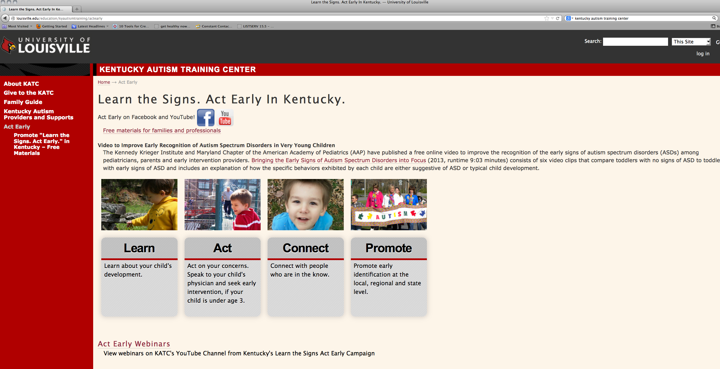
"Learn the Signs. Act Early."
Statewide Distribution of:
Public Service Announcements
Materials for:
Families
Healthcare Professionals
Early Childhood Processionals
Webinars
Presentations
Project website
Notes:
Learn the Signs. Act Early Campaign from the Center for Disease Control and Prevention
The Act Early Initiative promotes collaboration among early childhood programs so children with autism or other developmental disabilities can be identified early and get the services and support they and their families need.
Partners include, Cabinet for Families and Children, Education, Human Development Institute at UK and the UofL Autism Center

Slide 14
Autism Case Training: A Developmental-Behavioral Pediatrics Curriculum
Designed to educate future healthcare providers on fundamental components of identifying, diagnosing, and managing autism spectrum disorders through real life scenarios
Centers for Disease Control and Prevention, National Center on Birth Defects and Developmental Disabilities and the Health Resources and Services Administration’s Maternal and Child Health Bureau.

Slide 15
Early Childhood Training Initiative
Partnership with the University of Louisville Autism Center, First Steps, Kentucky Department of Education and Cabinet for Health and Family Services
Conduct screenings in multiple settings and refer families to appropriate services and resources
“Move beyond developmental disability label and towards specialized intervention”
Provide appropriate evidence-based interventions to children as young as possible
Create tools, practices and networks that improve a child’s transition from diverse service systems
Notes:
Several training over past 2 years
Folks from CDC came to talk about the campaign
Specialized training in screening instruments
Begun training in evidence based practices
If Tal Curry is there-defer to him

Slide 16
Each module guides you through case studies, instructional videos, pre- and post-assessments, a glossary, and much more.
AIM modules are available at no cost. If you would like to receive credit for your time on AIM, certificate and credit options are available for a fee.
AIM is designed to provide high-quality information and professional development for anyone who supports, instructs, works with, or lives with someone with autism.
43 Modules
2,242 AIM users from Kentucky
KATC Contributor to AIM
www.autisminternetmodules.org
Notes:
KATC has been sponsor of the AIMS module. Last check 2,242 AIM users from Kentucky.

Slide 17
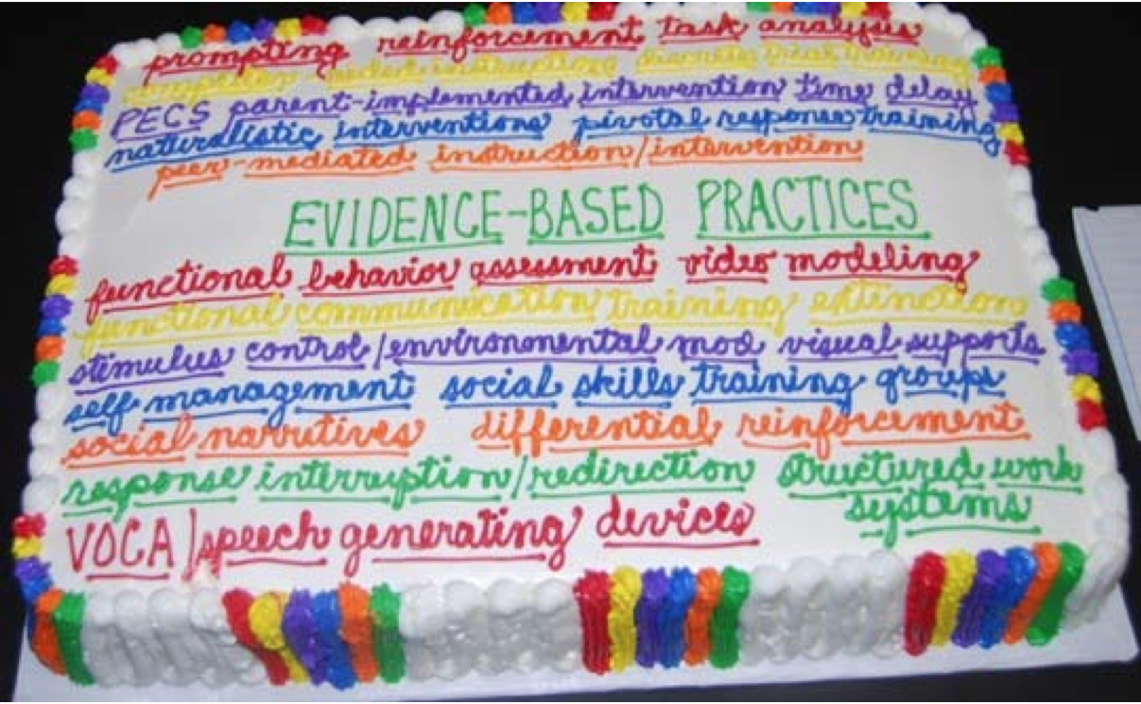

Slide 18
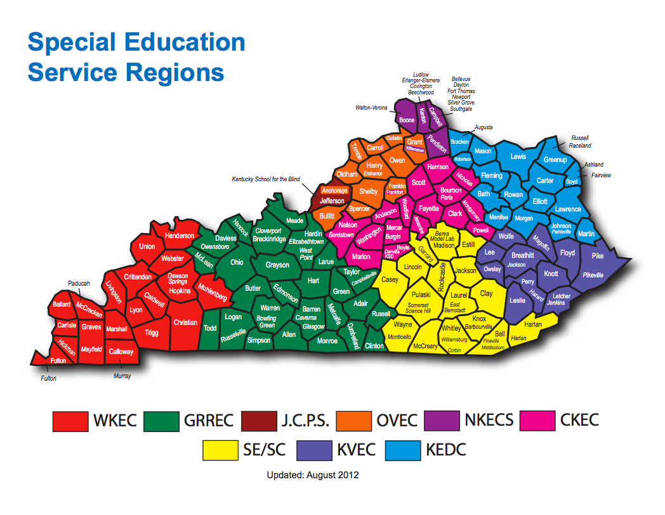

Slide 19
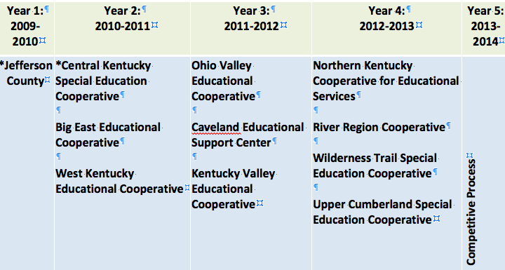
“Roll-out” of Training Sites *with support from NPDC on ASD
Notes:
Mention *
All other sites not part of the NPDCA partnership
Schools in each coop at the preschool, elementary, middle and high school
Ideally, each school has 3 to 4 target students

Slide 20
Notes:
What we just outlined was a defined coaching process that was aimed at building capacity at the state, regional, district and school level and ultimately improve outcomes for specific student.
Has this initiative been perfect. Of course not.
But what we had was a core group of folks across the state poised to assist in training a broader audience.

Slide 21
Autism Cadre in Kentucky Schools
720+ Members
Cooperative and district personnel are part of the autism initiative
90% +
School Districts Participate

Slide 22
Supporting Families
40 + Support Groups
Specialized training
Information Packets
Listserv
Special Events

Slide 23
KY TOTS Training of Trainers
Capacity Building
Regional
Networking
Core group prepared to provide basic training
East (2011-2012)
West (2012-2013)
Central (2013-2014)
Topics:
"What is autism?”
Identifying Sources of Stress and Teaching Coping Skills
It Takes a Village: Promoting Collaboration Among Families, Educators, and Related Providers
Transition to Adulthood

Slide 24
KATC Family Network: Families Supporting Families
Kentucky Autism Training Center (KATC) is developing the KATC Family Network: Families Supporting Families. Through a partnership with The Council on Developmental Disabilities (CDD).
The purpose of the KATC Family Network is to develop a network of family members affected by ASD who will reach, collaborate, empower, and develop relationships with others throughout Kentucky.

Slide 25
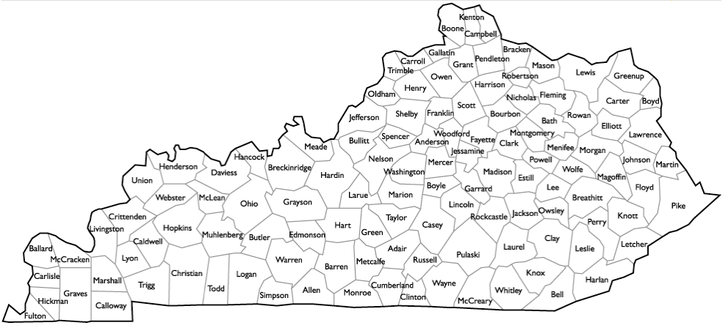
KATC Family Network: Families Supporting Families
May 2013 Cohort
16 participants from 10 counties

Slide 26
Estimated Number of Individuals with ASD in Kentucky
…Birth to 3-yrs old | 2,563
…4 to 21 yrs old | 11,823
…18 yrs old + | 35,923
…Across the Life-Span | 49,311
About 1 in 88 children has been identified with an autism spectrum disorder (ASD) according to estimates from CDC's Autism and Developmental Disabilities Monitoring (ADDM) Network.
(2013)

Slide 27
Kentucky Autism Training Center
Autism Spectrum Disorder in the DSM-5

Slide 28
Kentucky Autism Training Center
Five major changes
#1 New classification system eliminates the previously separate subcategories on the autism spectrum, including Asperger syndrome, PDD-NOS, childhood disintegrative disorder and autistic disorder. These subcategories will be folded into the broad term autism spectrum disorder (ASD).

Slide 29
Autism Speaks: Five major changes
#2
 | DSM-IV | DSM-V
Domains/Categories | Three domains: Social Impairment Language/Communication Impairment Repetitive/restricted/stereotyped behaviors | Two Categories: Social Communication Impairment Restricted interests/repetitive behaviors
Diagnosis Requirements | At least 6 out of 12 deficits in the three domain areas | 3 deficits in social communication At least 2 symptoms in Restricted Repetitive Patterns of Behavior/Interests New symptom: Hyper- or hypo-reactivity to sensory input or unusual interests in sensory aspects of the environment

Slide 30
Autism Speaks: Five major changes
#3 Symptoms can currently be present, or reported in past history.
#4 In addition to the diagnosis, each person evaluated will also be described in terms of:
Any known genetic cause (e.g., fragile X syndrome, Rett syndrome)
Level of language
Intellectual disability
Presence of medical conditions such as seizures, anxiety, depression, and/or gastrointestinal (GI) problems

Slide 31
Autism Speaks: Five major changes
#5 The work group added a new category called Social Communication Disorder (SCD). This will allow for a diagnosis of disabilities in social communication without the presence of repetitive behaviors.

Slide 32
Kentucky Autism Training Center
A. Persistent deficits in social communication and social interaction across multiple contexts, not accounted for by general developmental delays, and manifest by all 3 of the following:
Deficits in social-emotional reciprocity
Deficits in nonverbal communicative behaviors used for social interaction
Deficits in developing, maintaining, and understanding relationships

Slide 33
Kentucky Autism Training Center
B. Restricted, repetitive patterns of behavior, interests, or activities as manifested by at least 2 of the following:
Stereotyped or repetitive motor movements, use of objects, or speech
Insistence on sameness, inflexible adherence to routines, or ritualized patterns of verbal or nonverbal behavior
Highly restricted, fixated interests that are abnormal in intensity or focus
Hyper-or hypo-reactivity to sensory input or unusual interest in sensory aspects of the environment

Slide 34
Dimensional Ratings for DSM V ASD | Social Communication | Fixated Interests and Repetitive Behaviors
Requires very substantial support | Severe deficits in verbal and nonverbal. Very limited initiation of social interactions and minimal response to overtures. | Inflexibility of behavior, extreme difficulty coping with change, RRBs that markedly interfere in all spheres. Great Distress
Requires substantial support | Marked deficits with limited initiations and reduced or atypical responses. Impairment apparent even with supports in place. | Inflexible in behavior, difficulty coping with change, frequent RRBs and interfere in a variety of contexts. Some distress.
Requires support | With or without supports, noticeable impairments. Difficulty initiating social interactions and clear atypical responses. Maybe decrease social interest. | Behavioral inflexibility casues significant interference in one or more contexts. Trouble switching. Problems organizing and planning.

