Slide 1
A Collaborative Story: Imagining New Statewide Perceptions of Teacher Training
Thomas More University
Christy Petroze

Slide 2
Brief History
Thomas More Teacher Preparation
General Methods Course
Accreditation
Partnerships
Yealey Elementary
Cultural Shift
Student Centered
Professional Growth
Notes:
Christy

Slide 3
Let’s Try It!
Embed the General Methods course in Yealey
Elementary Placements for 60 hours at Yealey
60 hours middle and high elsewhere WITH intentional returns to Yealey
Pre-service teachers observe classrooms on Monday; Wednesday is follow up/lecture
GIVING UP CONTROL!

Slide 4
Intentional Planning
Use of administrators and teachers to co-teach the courses
Better use of formative assessment at university level to drive lecture
Better use of two hour/twice a week time
One hour blocks of lecture; one hour observation time
Still working this out!
Notes:
Yealey –
--Increased communication to share focus content and HPL practices for the week so students can observe and gain hands on experience in these specific areas.
-- How analysis process allowed LEA to see that the IHE was willing to hear feedback and address as needed
-- Analysis process opened conversation of how many teachers at Yealey felt that it would increase impact if candidate students had more time in classrooms.
--Plan for having time for classroom teachers to participate in college class time to share,

Slide 5
Intentional Planning
Intentional observations around HLPs with lecture first and observation second
Build stronger planning foundation
Longer time around deconstructing standards and lesson planning
Earlier introduction of formative assessment
Notes:
Jodi
Process allowed increased communication between stakeholders
Aligning syllabi with HLP
Awareness of all stakeholder of structure of classes
Teacher had a direct impact of revisions to IHE classes

Slide 6
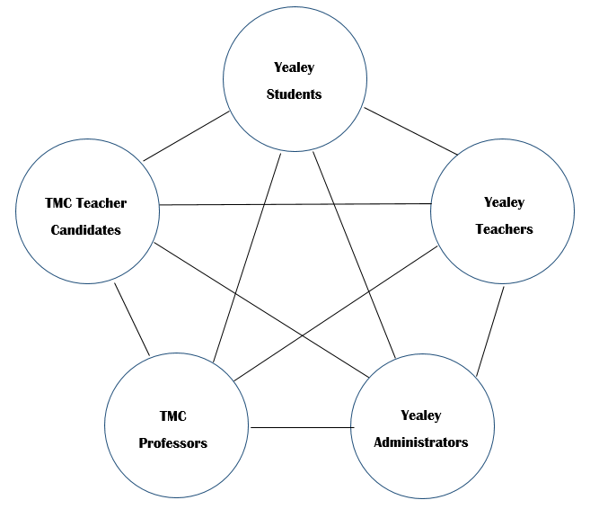
Yealey Goals/Data
Goals | Measures of Success | Timeline
Increase teacher candidate performance. | Professor evaluation of candidates. Teacher evaluation of candidates. | Final evaluations compared on a year to year basis.
Increase teacher capacity. | Principal evaluations of teachers that show an increase in accomplished and exemplary scores in domain 4. Leadership team observations of professionalism that show an increase in professional discourse. | Evaluations and observations compared on a year to year basis.
Increase student achievement. | Increase in proficiency on state and benchmark assessments | 2021 - 3 years’ worth of data
Anecdotal data from teachers indicate stronger interns/student teachers
Increase in the number of accomplished and exemplary teachers in domains 1, 2, and 4.
Increase of STAR proficient/distinguished from 43.2% in winter to 49% in spring 2018.

Slide 7
Thomas More College and Boone County Schools: Partners in Education Excellence
Analyze data from recent (1-3 years) IHE students and discuss strengths and weaknesses of classroom practices to determine HLP that need additional focus.
Stakeholders:
IHE: Thomas More Faculty
HLP and InTASC data (Content Knowledge, Application of Content, Planning for Instruction, and Instructional Strategies will be collected during student teaching and practicums.
Stakeholders:
LEA: Yealey Elementary School Faculty
IHE: Thomas More Faculty
PST: Thomas More Students
Ensure HLP are built into IHE class framework through syllabus review, analysis, and editing.
Stakeholders:
LEA: Yealey Elementary School Faculty
IHE: Thomas More Faculty
Continuous
Collaborative Improvement
Pre-service teachers gain hands on experience in HLP through practicums and student teaching.
Stakeholders:
LEA: Yealey Elementary School Faculty
PST: Thomas More Students
Work with IHE and LEA administrators to build common goals to ensure that pre-service teachers are gaining hands- on experience and observing HLP’s.
Stakeholders:
LEA: Yealey Elementary School Faculty
IHE: Thomas More Faculty
Provide professional development to LEA teachers as needed to ensure that HLP’s are embeded into classrooms allowing for more effective collaboration, assessment, social-emotional-behavorial pratices, and instruction.
Stakeholders:
LEA: Yealey Elementary School Faculty
IHE: Thomas More Faculty
HLP- High-Leverage Practices
IHE – Institution of Higher Education (Thomas More University)
LEA – Local Education Agency (Boone County Schools)
PST -- Pre-service teachers, Thomas More Students
Notes:
Jodi

Slide 8
Teacher Candidate Data Fall 2018
Cooperating Teacher Evaluations
 | KTPS 1 | KTPS 2 | KTPS 3 | KTPS 4 | KTPS 5 | KTPS 6 | KTPS 7 | KTPS 8
All Teacher Candidates (N=10) | 3.6 | 3.5 | 3.7 | 3.75 | 3.55 | 3.33 | 3.77 | 3.5
Elementary (N=7) | 3.7 | 3.5 | 3.7 | 3.8 | 3.55 | 3.33 | 3.77 | 3.6
Yealey Jrs. (N=5) | 3.8 | 3.5 | 3.7 | 3.75 | 3.55 | 3.33 | 3.77 | 3.5

Slide 9
Teacher Candidate Data Fall 2018
Faculty Supervisor Evaluations
 | KTPS 1 | KTPS 2 | KTPS 3 | KTPS 4 | KTPS 5 | KTPS 6 | KTPS 7 | KTPS 8
All Teacher Candidates (N=10) | 3.2 | 3.1 | 3.4 | 3.45 | 3.3 | 3.2 | 3.4 | 3.4
Elementary (N=7) | 3.3 | 3.2 | 3.4 | 3.5 | 3.3 | 3.25 | 3.5 | 3.44
Yealey Jrs. (N=5) | 3.4 | 3.2 | 3.45 | 3.55 | 3.4 | 3.15 | 3.53 | 3.5

Slide 10
Issues still at play
Yealey faculty focusing on HLP’s
Need to review Syllabi and program again with Yealey faculty
Data collection processes at Thomas More
Intentional change of observation tool
Focus on HLP’s in data and instruction (Yealey Teachers)
What does this mean moving forward?
Notes:
Dee
Professional Learning Night
How we can focus on PD based on Data gained trough cycle

Slide 11
Next Steps
Changing the structure of teacher preparation and continuing education of teachers

Slide 12
Questions?

