Slide 1
Speaking our Language: High-leverage Practices to Improve Clinical Collaboration
Christina Noel, Susan Keesey, Nancy Hulan,
and Pete Hoechner
May 16, 2019

Slide 2
Learner Outcomes
Learn how to use HLPs as the foundation for a shared vision and common language with clinical partners
Discuss how a clinical partnership grew from share training
Explore how our school partnerships can be expanded

Slide 3
KEEP Goals:
Develop a common knowledge base and coherent language of EBPs at the state, district, and university/college levels.
Construct partnerships with districts to ensure that pre-service educators are provided intentional, high-quality field/clinical experience in diverse settings.
Utilize the innovation configurations provided by CEEDAR to build consensus regarding EBPs and HLPs among faculty and integrate EBPs and HLPs into all coursework across programs.

Slide 4
Our Goals
Enhance clinical partnership through shared vision and common language
Host HLP training for preservice teachers and adjunct faculty (AFs)
Mentor AFs and document HLPs shared with preservice teachers
Hone AFs observation and feedback skills

Slide 5
Grant Implementation
Desired
Actual
Teachers partnered with preservice teachers
Four professional development workshops across a semester
Stipend for teacher participation
Teachers partnered with preservice teachers
Four professional development workshops in one day
Stipend to pay for substitutes and lunch

Slide 6
TopPrep
Five-year partnership
Grant to bridge the achievement gap
Three elementary partner schools
100% Free Lunch
Very Diverse – High proportion of English Learners

Slide 7
High-Leverage Practices (HLPs) Overview
What beginning (all) teachers should know and be able to do.
Twenty-two HLPs in four key areas:
Collaboration
Assessment
Social/Emotional/Behavioral
Instruction

Slide 8
Shared Vision – What We Know
Many critical aspects of teaching (classroom practice)--complex and non-natural work that must be taught systematically and thoroughly
Research on professional development shows it takes from 20-100 hours for practicing teachers to learn a skill to mastery
Skill must be practiced with support (coaching) in a natural, classroom setting

Slide 9
Shared Vision – What We Know
How should teacher education be improved to better prepare teachers?
Turn ‘upside down’ (NCATE, 2010) by embedding teacher education in clinical practice
Core curriculum should be focused on what teachers need to be able to do.
HLPs are what teachers need to be able to do.

Slide 10
Overarching Qualities
Notes:
www.senegambiademocracy.org

Slide 11
Duration

Slide 12
Cohesiveness
Notes:
http://colorful-illustration.com/04-bright/062-bright.html

Slide 13
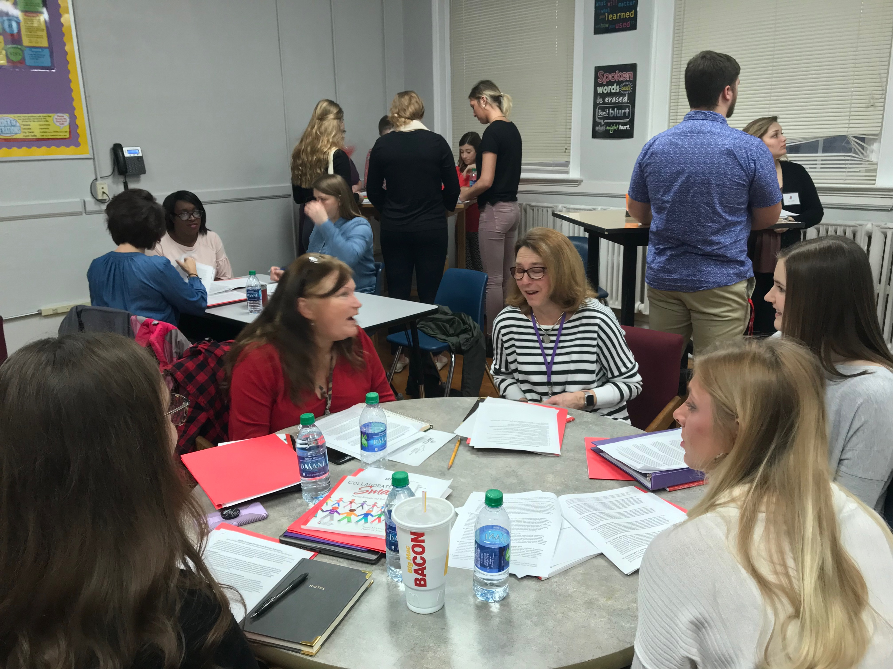
High-Leverage Practices (HLPs)
How are HLPs incorporated in your class?
Ideas for including our TCs to help promote HLPs?

Slide 14
Overview High Leverage Practices
 | Pre-Test (% correct) | Post-Test (% correct)
Teachers | 17.6 | 94.1
Students | 16.9 | 91.2

Slide 15
Literacy Overview

Slide 16
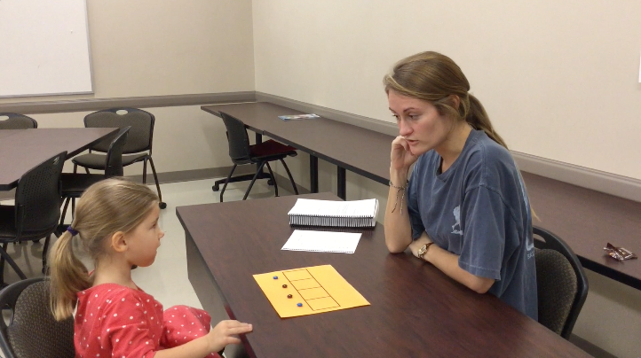
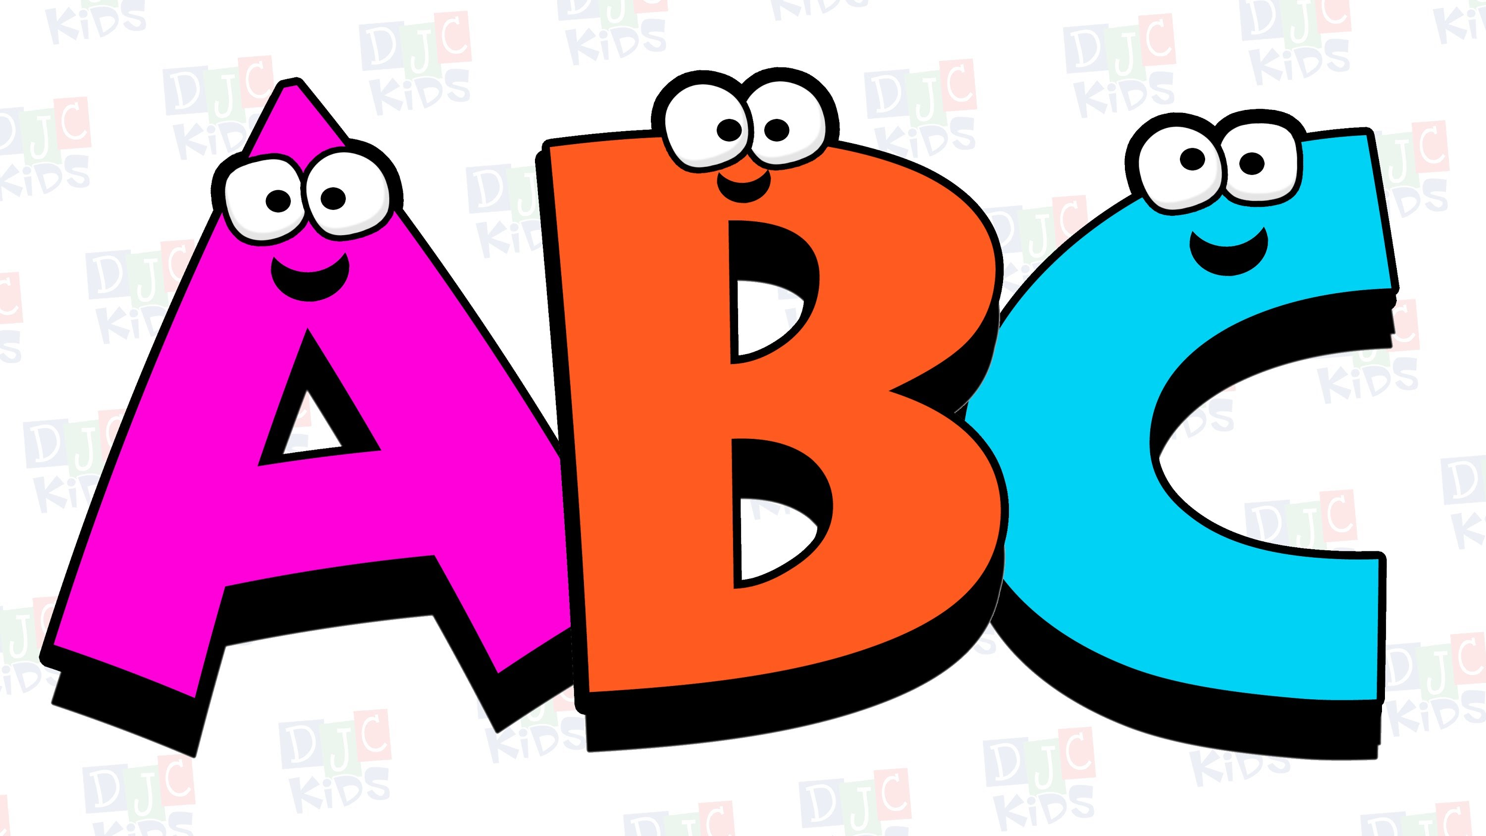
High Leverage Practice: HLP16
HLP16 | Use explicit instruction.
Teachers make content, skills, and concepts explicit by showing and telling students what to do or think while solving problems, enacting strategies, completing tasks, and classifying concepts. Teachers use explicit instruction when students are learning new material and complex concepts and skills. They strategically choose examples and non-examples and language to facilitate student understanding, anticipate common misconceptions, highlight essential content, and remove distracting information. They model and scaffold steps or processes needed to understand content and concepts, apply skills, and complete tasks successfully and independently.

Slide 17
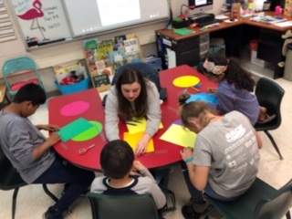
High Leverage Practice: HLP20
HLP20 | Provide intensive instruction.
Teachers match the intensity of instruction to the intensity of the student’s learning and behavioral challenges. Intensive instruction involves working with students with similar needs on a small number of high priority, clearly defined skills or concepts critical to academic success. Teachers group students based on common learning needs; clearly define learning goals; and use systematic, explicit, and well-paced instruction. They frequently monitor students’ progress and adjust their instruction accordingly. Within intensive instruction, students have many opportunities to respond and receive immediate, corrective feedback with teachers and peers to practice what they are learning.

Slide 18
High Leverage Practice: Social/Emotional Behavioral Practices

Slide 19
High Leverage Practice: HLP7
HLP7 | Establish a consistent, organized, and respectful learning environment.
To build and foster positive relationships, teachers should establish age- appropriate and culturally responsive expectations, routines, and procedures within their classrooms that are positively stated and explicitly taught and practiced across the school year. When students demonstrate mastery and follow established rules and routines, teachers should provide age-appropriate specific performance feedback in meaningful and caring ways. By establishing, following, and reinforcing expectations of all students within the classroom, teachers will reduce the potential for challenging behavior and increase student engagement. When establishing learning environments, teachers should build mutually respectful relationships with students and engage them in setting the classroom climate (e.g., rules and routines); be respectful; and value ethnic, cultural, contextual, and linguistic diversity to foster student engagement across learning environments.

Slide 20
High Leverage Practice: HLP8
HLP8 | Provide positive and constructive feedback to guide students’ learning and behavior.
The purpose of feedback is to guide student learning and behavior and increase student motivation, engagement, and independence, leading to improved student learning and behavior. Effective feedback must be strategically delivered and goal directed; feedback is most effective when the learner has a goal and the feedback informs the learner regarding areas needing improvement and ways to improve performance. Feedback may be verbal, nonverbal, or written, and should be timely, contingent, genuine, meaningful, age appropriate, and at rates commensurate with task and phase of learning (i.e., acquisition, fluency, maintenance). Teachers should provide ongoing feedback until learners reach their established learning goals.

Slide 21
What is Good Behavior Game?
Good Behavior Game (GBG) is a classroom management strategy that uses an interdependent group contingency to promote prosocial behavior (Barrish, Saunders, & Wolf, 1969).

Slide 22
Specific procedures
Choosing classroom behaviors
GBG Set-up
1:1 targeted training
Implementation
Choosing Student behaviors
Students who many need additional support
Identification of Problem Behaviors

Slide 23
Guiding questions for your classroom
When will you play the GBG?
What will be your GBG rules (3-5 rules)?
How will you divide the teams (who works well together? Who doesn’t?)?
How will you make it clear you are playing the game?
How long will you play the game?
What reinforcers do you plan to use?

Slide 24
Guiding questions for your classroom
When will you play the GBG?
What will be your GBG rules (3-5 rules)?
How will you divide the teams (who works well together? Who doesn’t?)?
How will you make it clear you are playing the game?
How long will you play the game?
What reinforcers do you plan to use?

Slide 25
Behavior High Leverage Practices
 | Pre-Test (% correct) | Post-Test (% correct)
Teachers | 64.25 | 71.4
Students | 65.4 | 81.45
10 teachers implementing Good Behavior Game

Slide 26
Feedback

Slide 27
Effective Feedback-What to Do
Provide clear specific corrective feedback that verifies and elaborates
The student misidentifies a shape in math, provide “No, that isn’t a circle because this shape has three sides and three vertices”.

Slide 28
Effective Feedback-What to Do
Provide immediate feedback, especially for struggling learners.
The student is reading sight words in a small group, the teacher should immediately correct any misread words rather than waiting until all the sight words have been read.

Slide 29
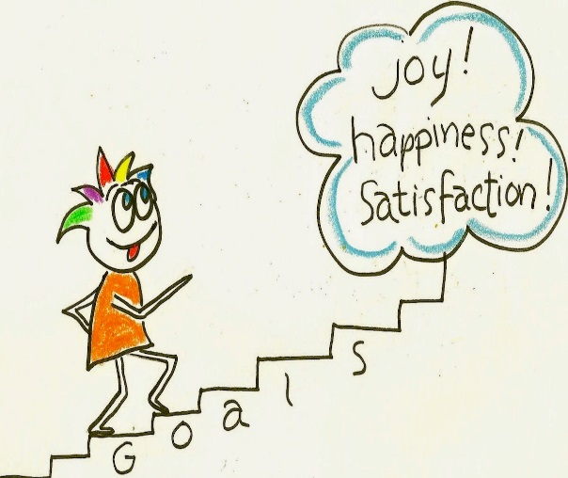
Effective Feedback-Other Considerations
Use goal-directed feedback
Help students close the gap between their current performance and an instructional goal.
Focus feedback on misunderstanding rather than a lack of information

Slide 30
Feedback High Leverage Practices
 | Pre-Test (% correct) | Post-Test (% correct)
Teachers | 55.5 | 87.5
Students | 54.8 | 80.6

Slide 31
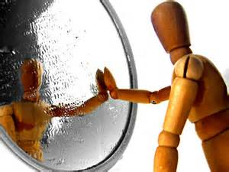
Analysis & reflection

Slide 32
Social Validity Feedback from Teachers
This was an accetable professional development for the elementary school | 6
Most teachers would find this professional development to be approriate | 5.6
This professional development was effective in meeting the purposes of training teachers and students on High Leverage Practices | 5.7
I would suggest this professional development to other teachers. | 5.6
The professional development was appropriate to meet the school's needs and mission. | 5.6
I will use High Leverage Practices in the school setting. | 5.9
This professional development will be appropriate for a variety of students. | 5.7
This professional development is consistent with those I have used in school settings. | 5.8
Overall, this professional development was beneficial for elementary school students. | 5.7

Slide 33
Social Validity Feedback: Preservice Teachers
This was an acceptable professional development for preservice teachers | 5.8
Most preservice teachers would find this professional development to be appropriate | 5.8
This professional development was effective in meeting the purposes of training preservice teachers on High Leverage Practices | 5.7
Attending this professional development with my cooperating teachers makes me feel more connected to the teacher. | 5.7
Attending this professional development with my cooperating teacher makes me feel more connected to my school | 5.4
After attending this professional development, I feel like I have a better line of communication with my teacher. | 5.6
This professional development was beneficial for preservice students. | 5.8
Overall, this professional development was beneficial for preservice students. | 5.8

Slide 34
Write-in Feedback
 | Frequency of Response
Getting to spend time with Cooperating Teachers | 19
Good Behavior Game | 11
Literacy | 9
High Leverage Practices | 3
Positive Feedback | 2

Slide 35
What was the most beneficial?
“I loved the phonics lesson, and ideas about the behavior game. Having time to plan with students was helpful also.”
“I love how the professors talked about real world classroom situations!!”
“The strategies and take away things that I can tweak to fit in my classroom.”

Slide 36
What was the least beneficial
“Nothing except all teachers should be present.”
“Maybe break it up by grade-level?”
“Having it on campus and inviting students from all of teacher education students.”

Slide 37
How do we collaborate to maximize student learning?

Slide 38
Resources
Download the High-Leverage Practices book
http://ceedar.education.ufl.edu/wp-content/uploads/2017/07/CEC-HLP-Web.pdf
HLP videos
https://highleveragepractices.org/701-2-2/
CEEDAR Center Website
http://ceedar.education.ufl.edu/high-leverage-practices/
NCATE Blue Ribbon Panel (2010). Transforming teacher education through clinical practice: A national strategy to prepare effective teachers. Washington, DC: National Council for Accreditation of Teacher Education (NCATE).

