Slide 1
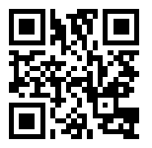
Evaluating Preservice Teachers’ Knowledge of the HLPs and Culturally Responsive Teaching

Slide 2
Diversity Experience

Slide 3
Higher Leverage Practices Reinforced
1.0 - Multicultural awareness
6.0 - Child-centered instruction
7.0 - Collaborative teaching
11.0 - Materials

Slide 4
Description
Murray State University is situated in western Kentucky, and our two county school districts have limited diversity. The demographics for our local districts are as follows:

Slide 5
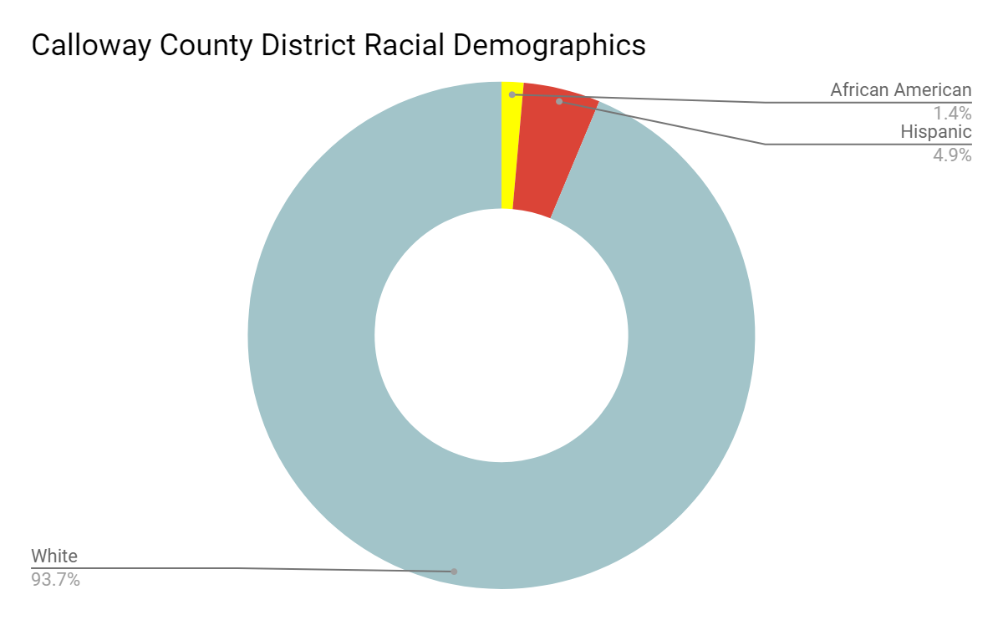
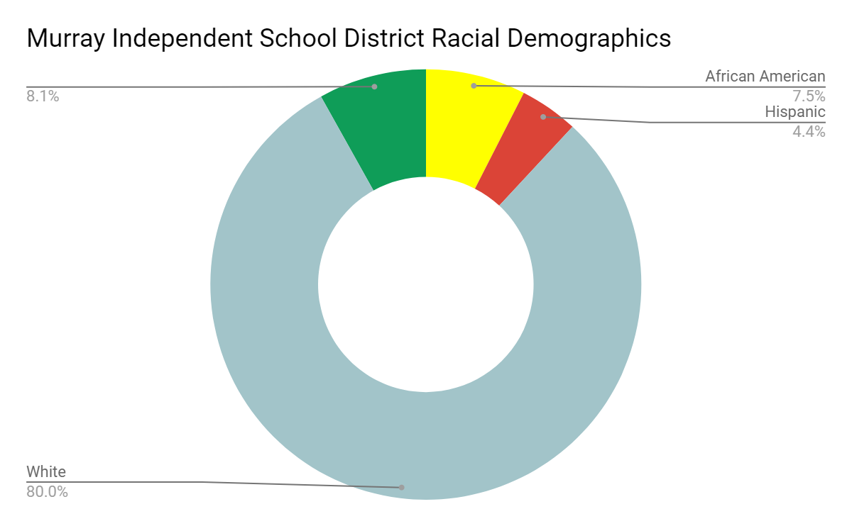
Diversity of current location

Slide 6
Description
Students in upper level elementary education courses complete all of their practicum hours in schools within these districts.
The demographics of our county do not reflect the current diversity seen within many school districts nationwide. A good teacher education program should prepare pre-service teachers for a variety of classroom settings, which includes diverse settings.

Slide 7
Description
Due to limited exposure to diverse settings, our students felt unprepared to teach in an environment that was culturally different from their own.
With funding from the KEEP grant, we were able to take students to Nashville, TN -an urban metropolitan district- where we partnered with a school in order to allow them to teach a culturally responsive lesson.

Slide 8
Purpose of the Experience
The goal of this trip was to
Expose students to an environment that is representative of a more demographically diverse area
Practice teaching a culturally responsive lesson
Collaborate with peers to create a student-centered lesson
Use materials that were culturally responsive
The demographics of the elementary school we visited are as follows:

Slide 9
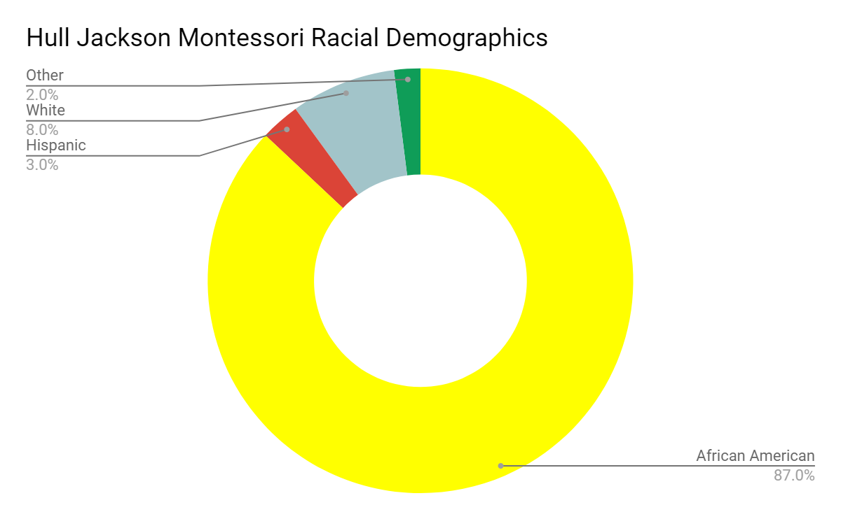
Diversity of the School We Visited

Slide 10
Purpose of the Experience
36 preservice teachers were placed in groups of 3, and assigned a cooperating teacher and classroom to prepare a culturally responsive lesson to teach during our visit.
Our preservice teachers had to work together to choose a subject, lesson, and materials that were culturally relevant. They then completed the lesson and activity with the students.

Slide 11
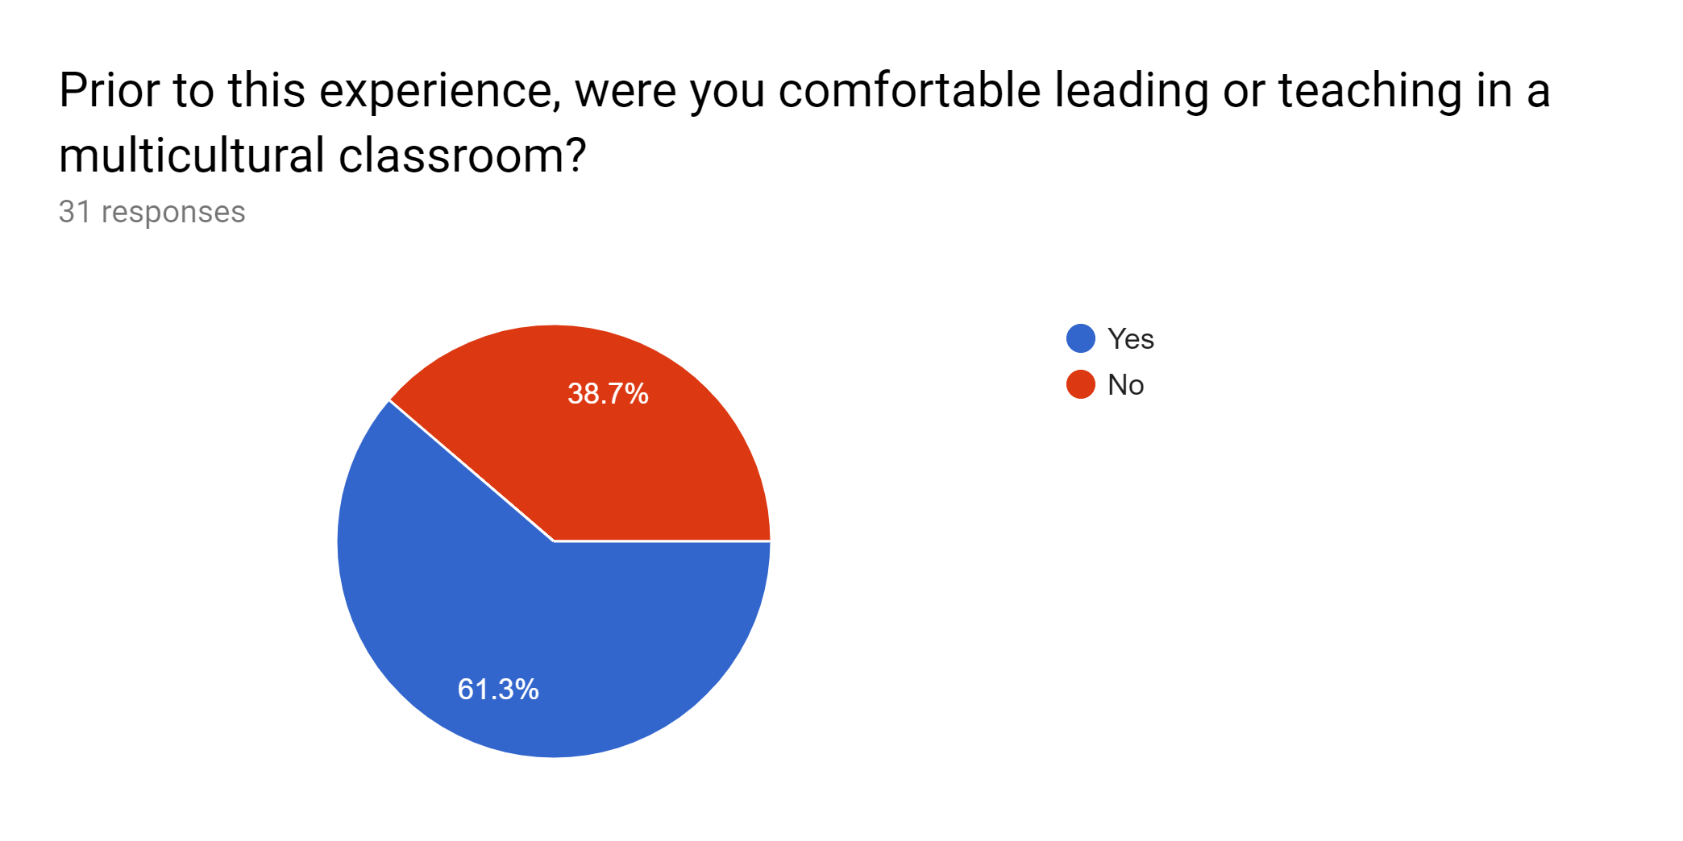
Results

Slide 12
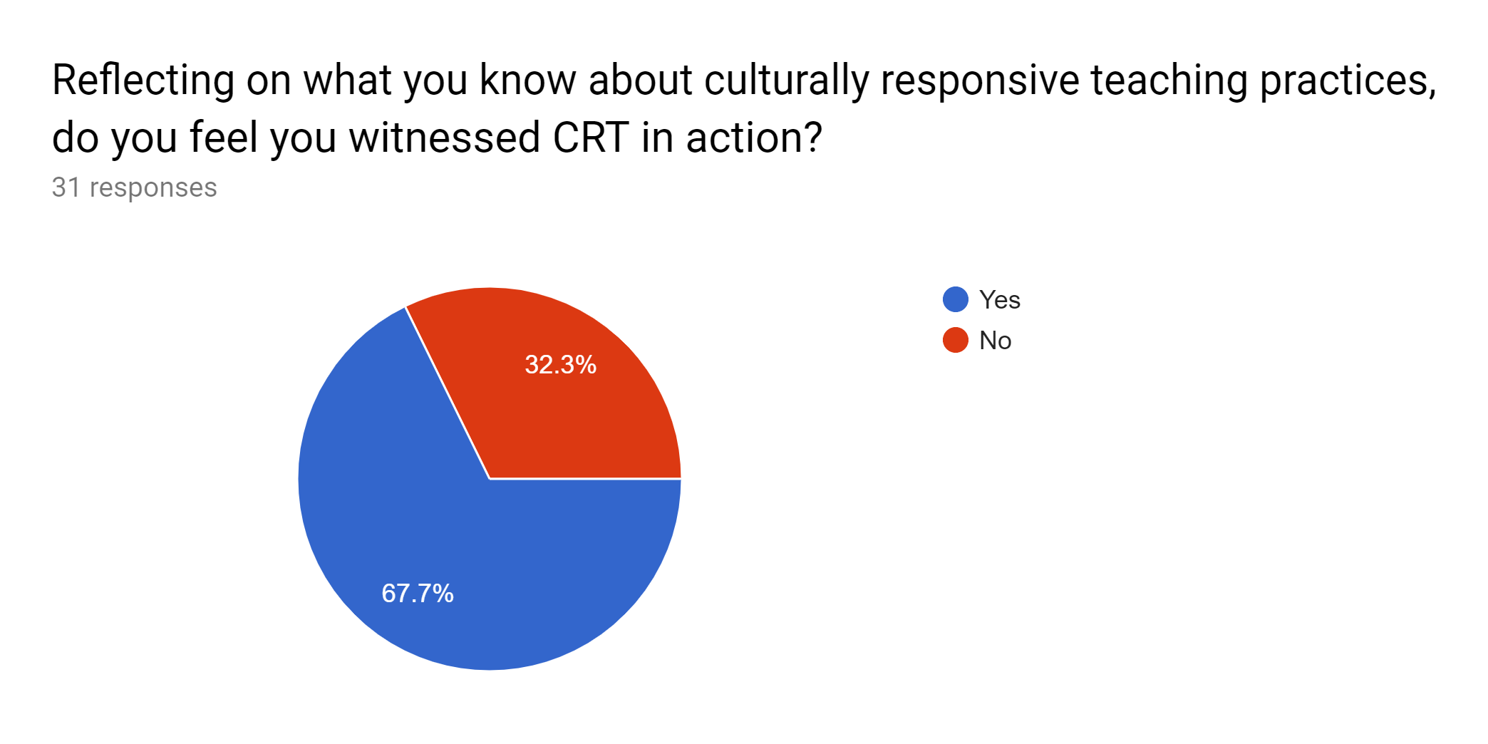
Results

Slide 13
Results

Slide 14
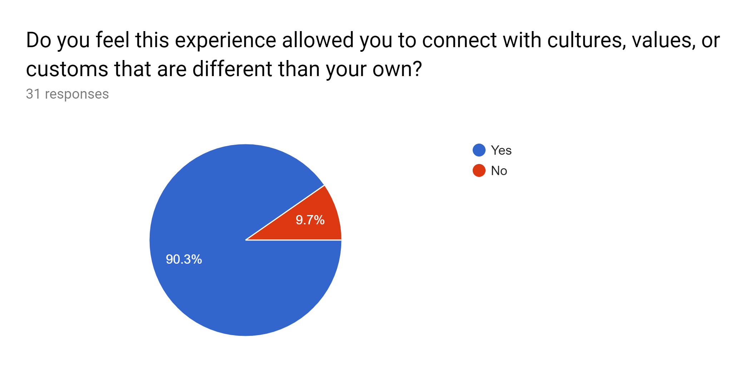
Results

Slide 15
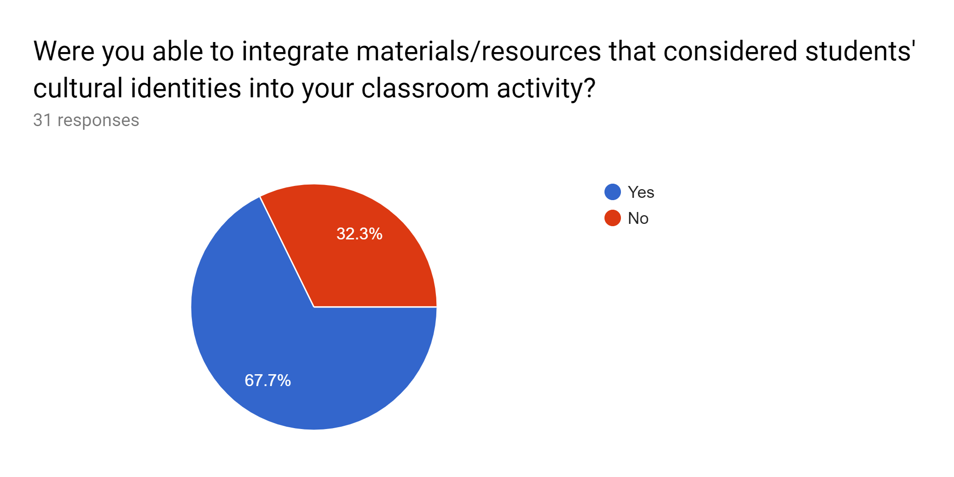
Results

Slide 16
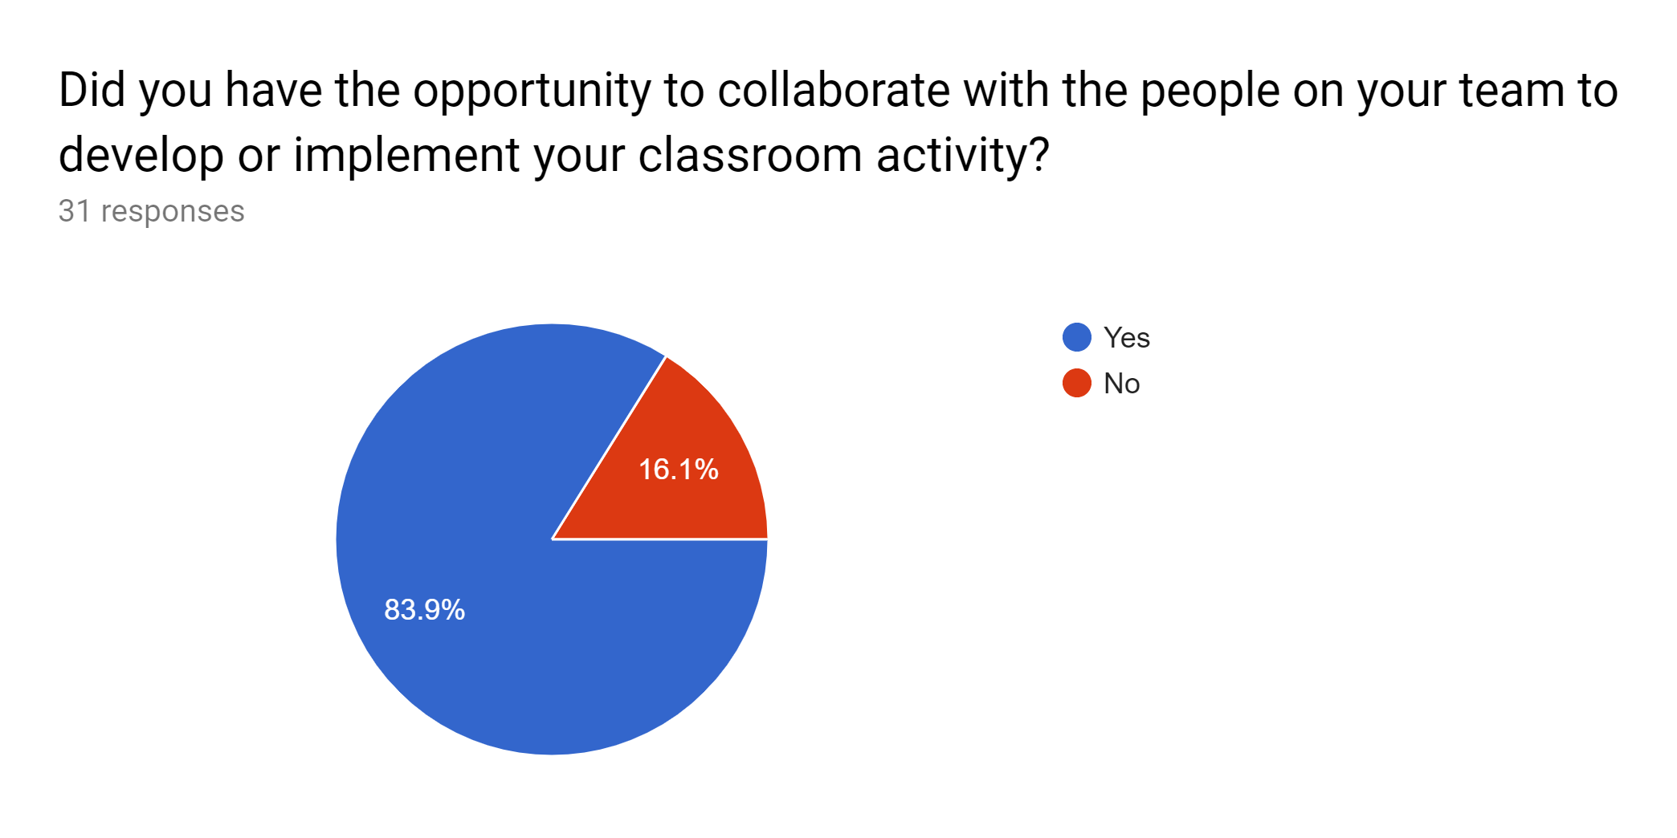
Results

Slide 17
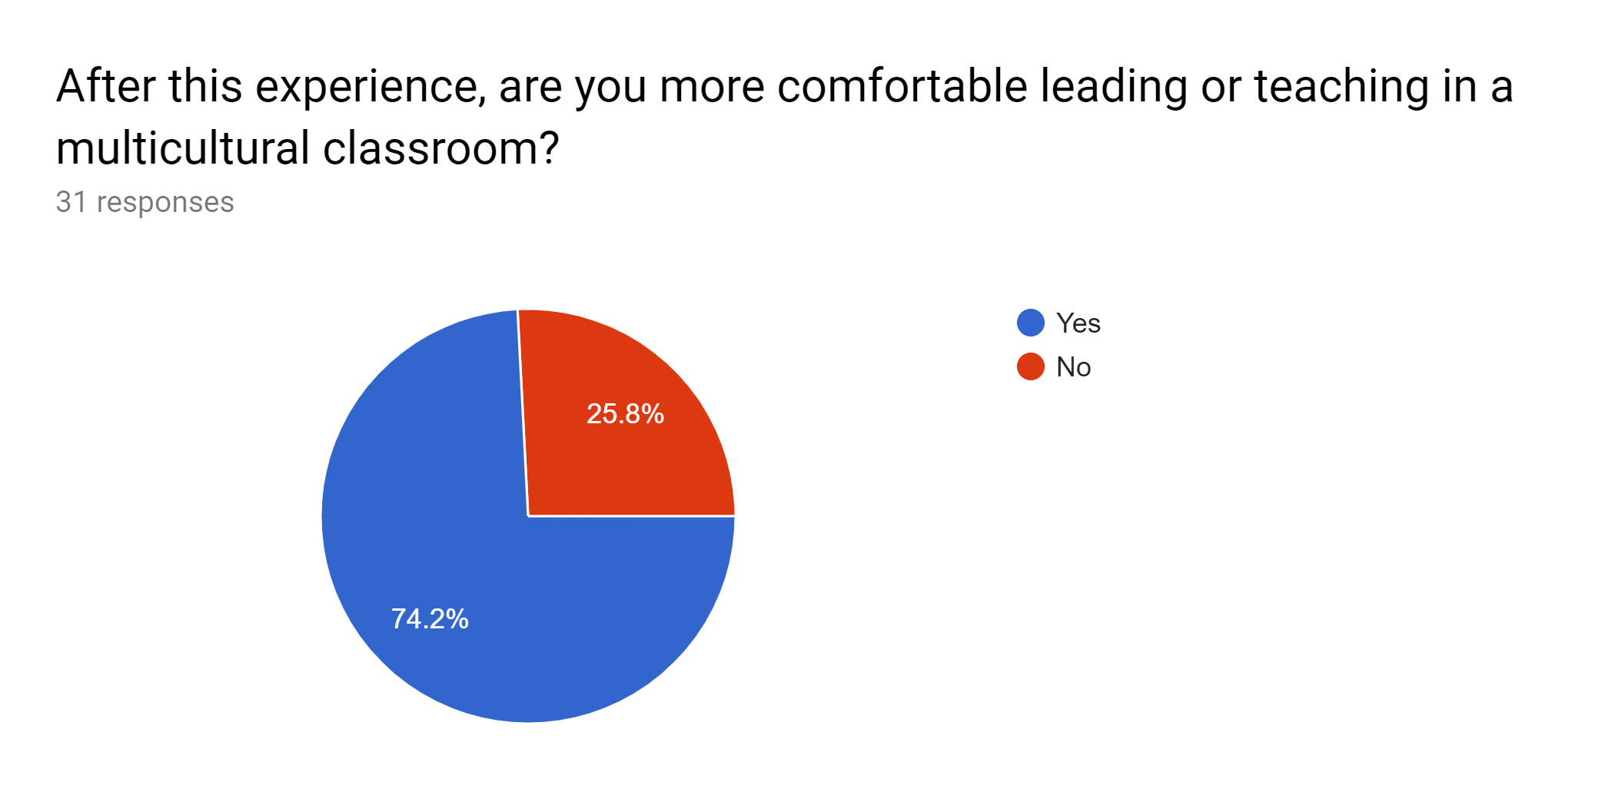
Results

Slide 18
Student Reflections
“I honestly had no idea what to expect, other than what I had seen about inner city schools in movies.”
“I learned the patience it takes to work with students and how to handle negative situations. The students at this school had the biggest hearts and were truly looking for someone to give them some love. It broke my heart to hear some of them talk about their home lives and made me realize the struggles some students have. Overall, I found this experience to be one that I will remember forever and I hope the education program continues this field experience in the future.”
“I knew going into it that it would not be like the schools I have been in. However, I think that it was not aligned with my preconceived notions.”

Slide 19
Student Reflections
“I definitely was reminded of my passion for education and children in general, as many of the kids were calling us their friends and begging us to stay.”
“It was definitely an experience being able to visit this school. I am glad that I had the opportunity to observe what it was like. I learned a lot about myself from being in this school. I learned that each student 'needs' something different from the other and it is important that you respond to each child the way that works for them to pay attention or listen.”
“I have to admit that this experience was unlike any other observation I have participated in. It was so much different than any of the schools in KY surrounding the Murray area, which was good to see.”

Slide 20
Considerations for the Future
Have our preservice teachers make multiple visits to allow the opportunity to connect more with the students in the classroom.
Complete more reading and preparation regarding teaching students in a high-needs, at-risk population
Articles
Book study: “Teaching with Poverty in Mind”

Slide 21
Assessing Student Knowledge of High Leverage Practices

Slide 22
Why Teach HLPs
Master, Loeb, & Wyckoff, (2014) provide evidence that the best way to improve outcomes for students with disabilities is to improve the effectiveness of their teachers.
Teachers make a greater contribution to student achievement than any other school influences including per-pupil spending by schools.
July 2016 - CEC Board approved a set of 22 practices that were identified as effective practices that have been shown to improve student learning or behavior.

Slide 23
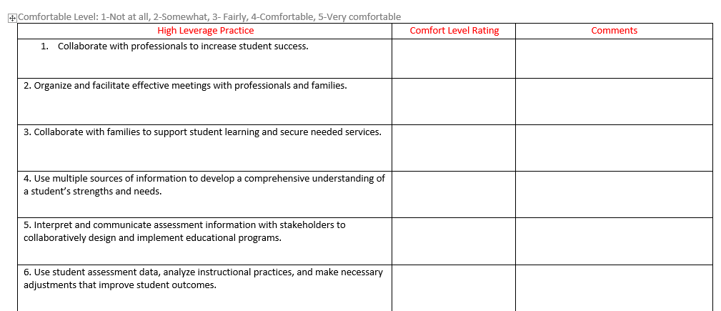
HLP Pretest

Slide 24
Sample
“I’m aware of how important feedback is from the teacher-I would like to learn how to give better and more meaningful feedback to students” “ I need more practice with FBAs-it has been so long”

Slide 25
Top 5
Based on pretest data, each instructor chose the lowest five HLPs to focus on in class.
Fall 2018-CC
HLP-2
HLP-6
HLP-14
HLP-15
HLP-16
Fall 2018-SM
HLP-2
HLP-5
HLP-9
HLP-14
HLP-16
Spring 2019-CC
HLP-2
HLP-6
HLP-12
HLP-20
HLP-Student Choice

Slide 26
Project Requirements
Students will complete a final project indicating their understanding of 5 high leverage practices for special educators. This project will show mastery of 5 practices.
Students will be provided with a chromebook and will use the Google Drawing program to document their work during their practicum to show mastery of these objectives.
This will then be shared with various stakeholders during the final week of class.

Slide 27
Example
https://docs.google.com/drawings/d/1Z8AxmvE6bdY6i_fWQsFgg20LoFBdeFEGyJ4BGJDxPQ8/edit?usp=sharing

Slide 28
Example
https://docs.google.com/drawings/d/1XmTG96viIdVTfx8ZRP_PQh8Kzwn7GiHmvYcS_tNvu94/edit?usp=sharing

Slide 29
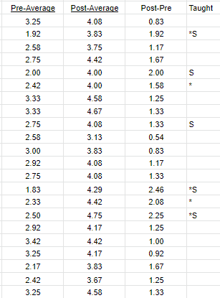
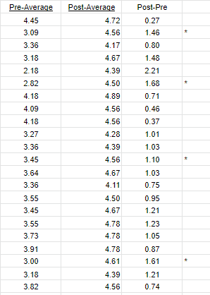
Results

Slide 30
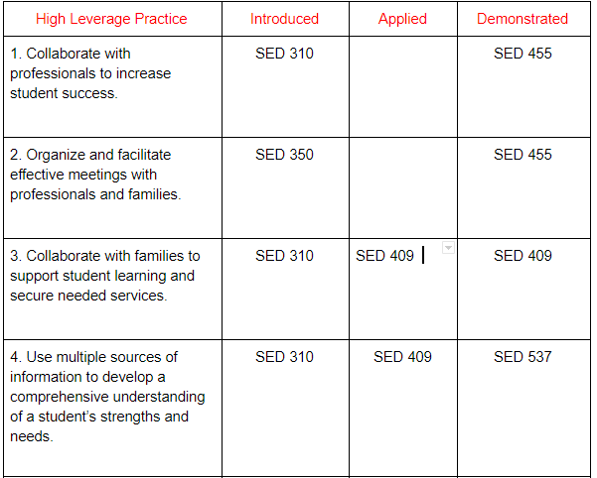
Implications
Evaluation of where we are providing instruction of the HLPs in our program and the intentionality

Slide 31
References
Council for Exceptional Children & CEEDAR Center, (2017). High Leverage Practices in Special Education. Arlington, VA 22202.
Master, Loeb, & Wyckoff, (2014). Learning that Lasts: Unpacking Variation in Teachers’ Effects on Students’ Long-Term Knowledge. CALDER - American Institutes for Research 1000 Thomas Jefferson Street N.W., Washington, D.C. 20007

