Slide 1
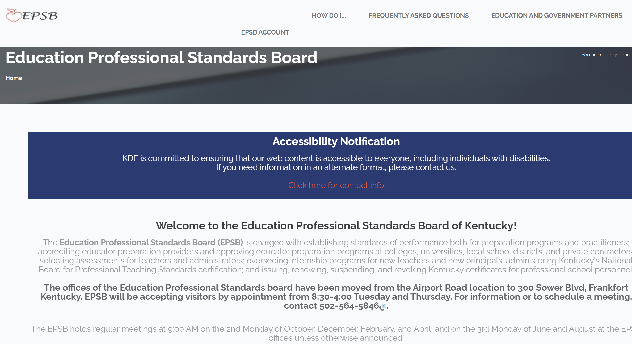
Creating a KFETS Account
The preferred browser for KFETS is IE 9 and above
Go to www.epsb.ky.gov
Click Here for log in

Slide 2
In May 2022, EBSP split their system into two parts in order to complete a systems upgrade. On the screen that pops up, you will first need to click “close” on the popup. Then, click the GREEN side of the screen.
Click Here
Click Here

Slide 3
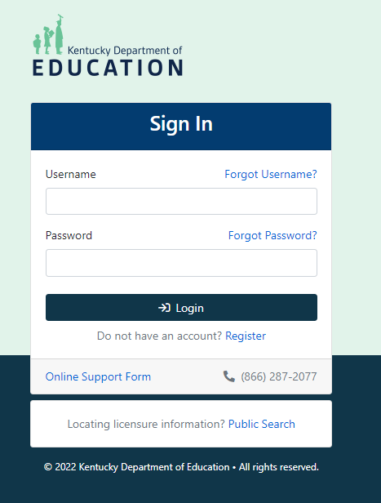
If you do not have a current account, click “Register” next to “Do not have an account?” when you get to the next screen. Please note that it may take up to 24 hours after account creation for you to be able to log in to the EPSB.
Click Here
Click Here

Slide 4
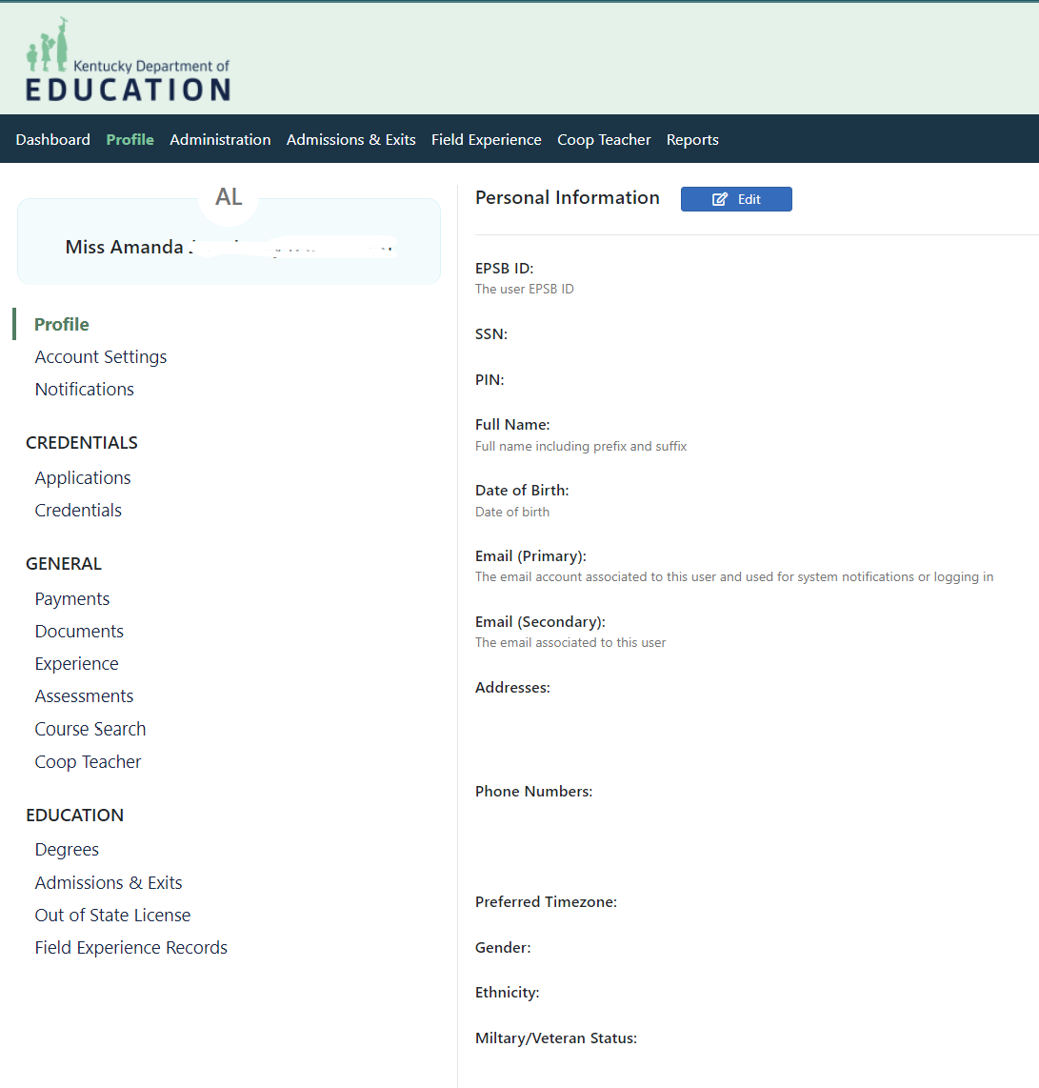
After logging in, you should be on your Profile page.
From the “Profile” page, select the “Field Experience Records” button.

Slide 5
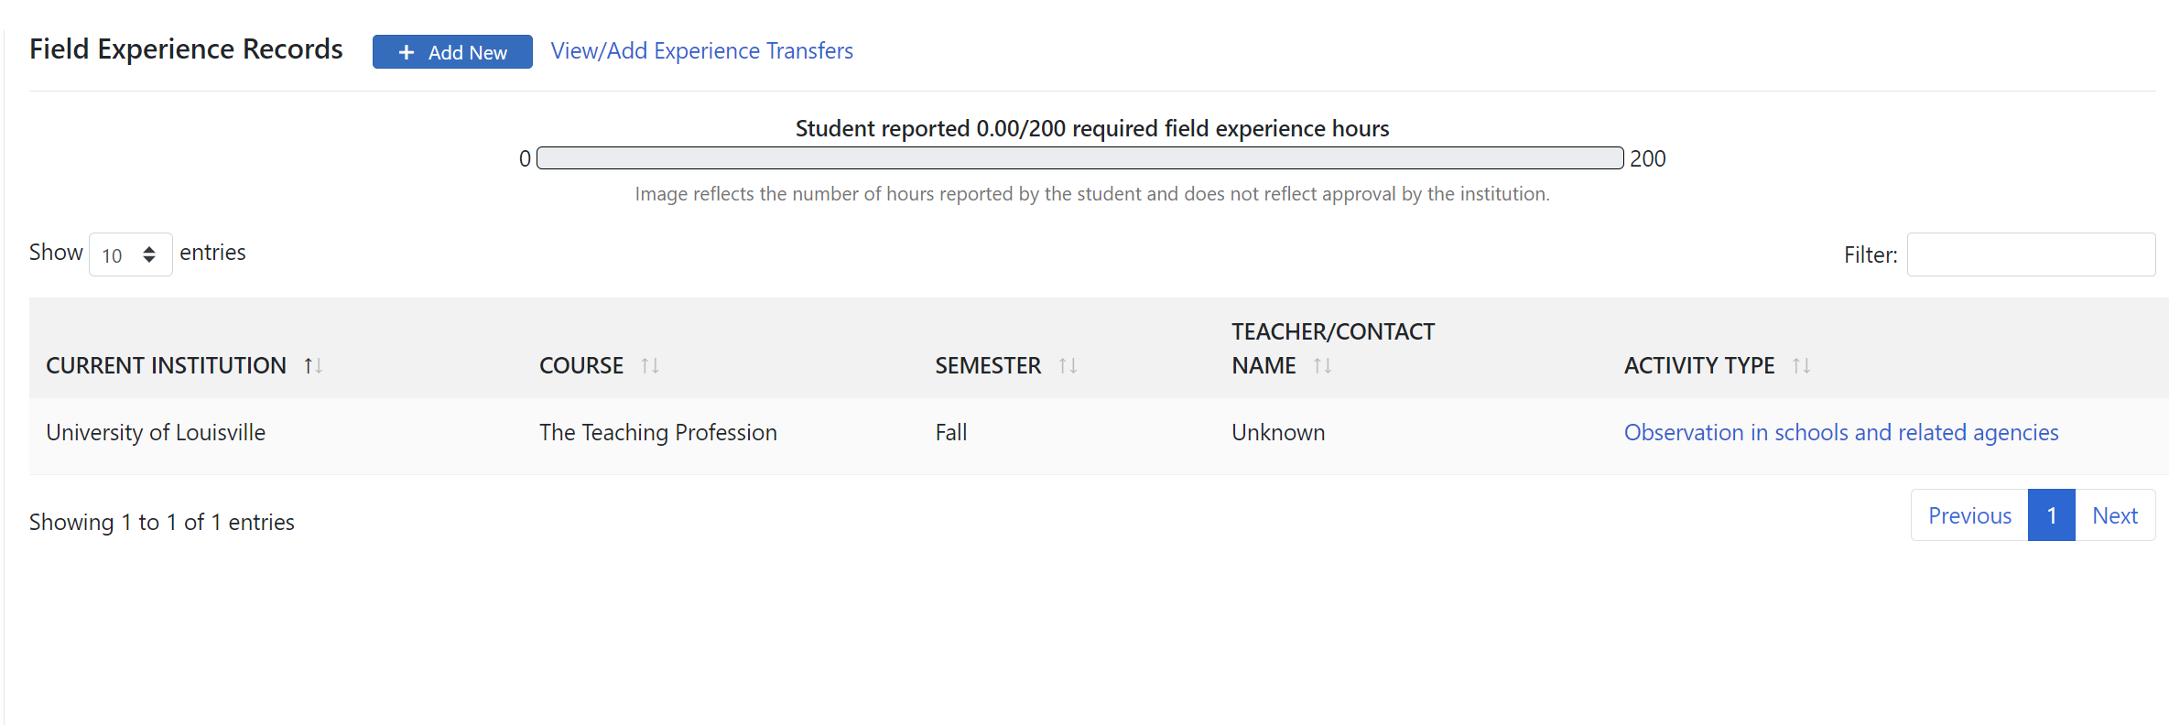
KFETS
Your total hours will be kept and shown here.
Click “Add New”
Notes:
You are directed to the EPSB portal, which containing links for teaching professionals across all career levels. Click the “KFETS” link indicated by the white arrow in this slide.

Slide 6
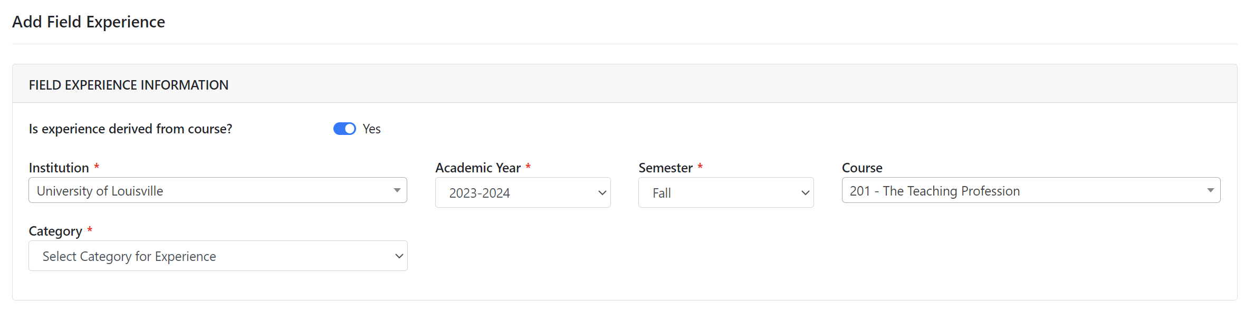
Enter in university, year, semester, course, and category type first.
Notes:
Click “Choose Course(s)” when you are ready to begin loading your field experience activities. Be sure to have your Field Documentation Logs at hand.

Slide 7
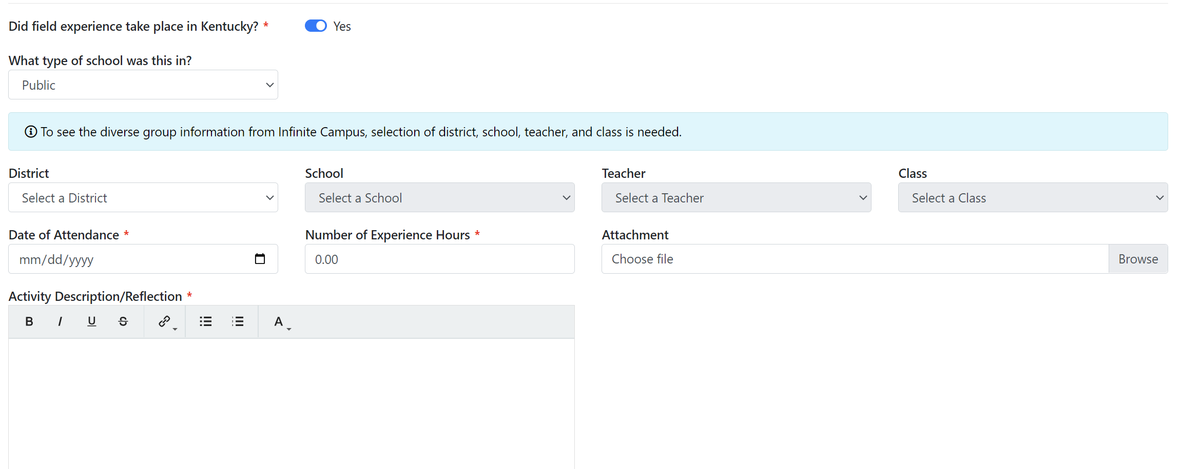
The bottom will then appear. Fill out school.
Notes:
Click “Choose Course(s)” when you are ready to begin loading your field experience activities. Be sure to have your Field Documentation Logs at hand.

Slide 8
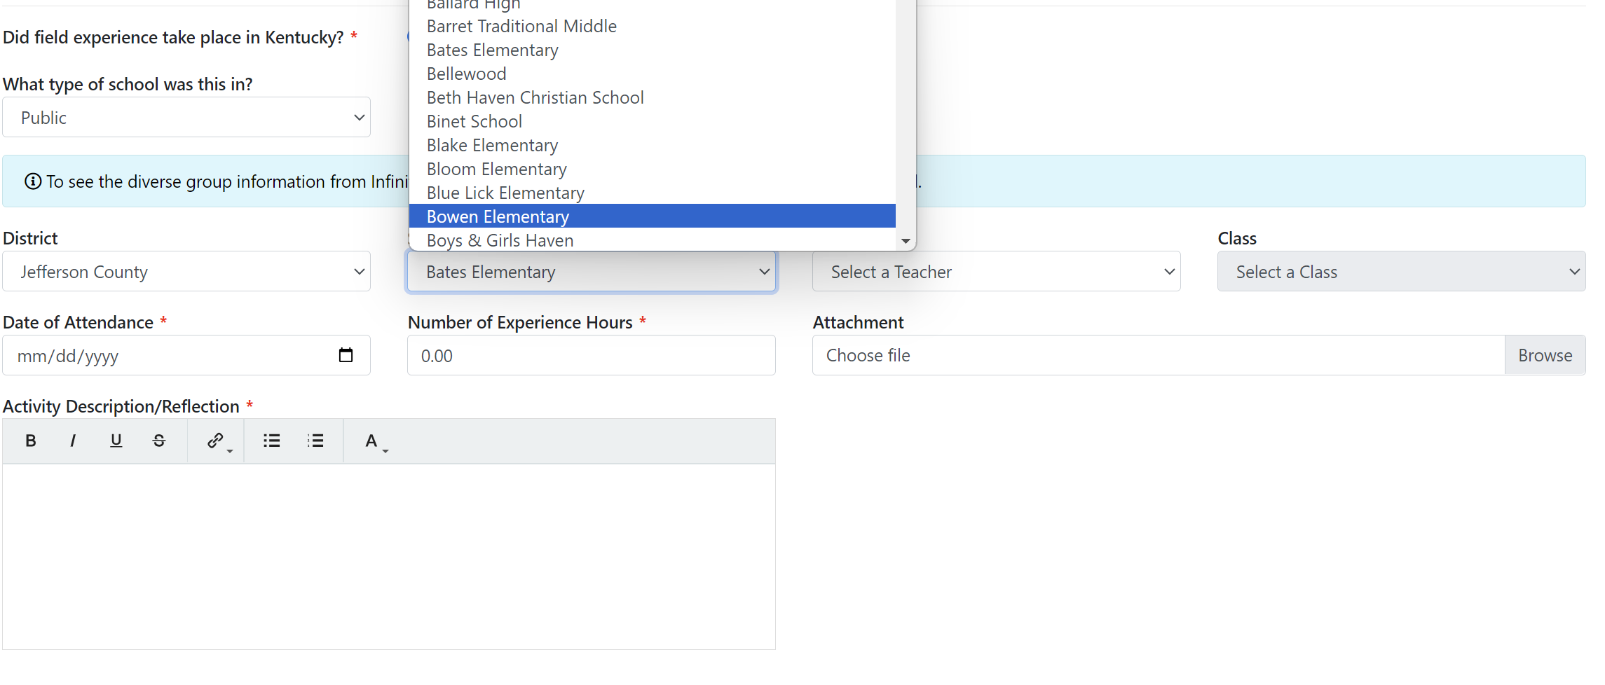
The bottom will then appear. Select district and school.
Notes:
Click “Choose Course(s)” when you are ready to begin loading your field experience activities. Be sure to have your Field Documentation Logs at hand.

Slide 9
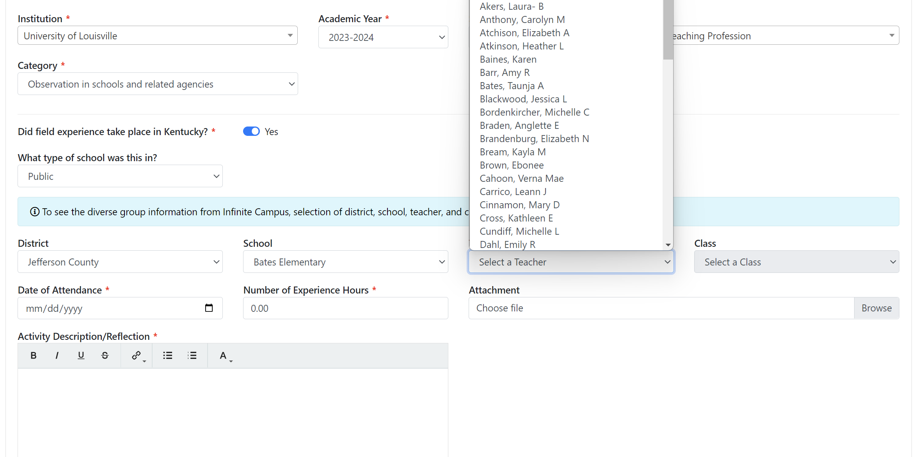
Select teacher. If teacher isn’t listed, skip that box. You can still submit the experience.
Notes:
Click “Choose Course(s)” when you are ready to begin loading your field experience activities. Be sure to have your Field Documentation Logs at hand.

Slide 10
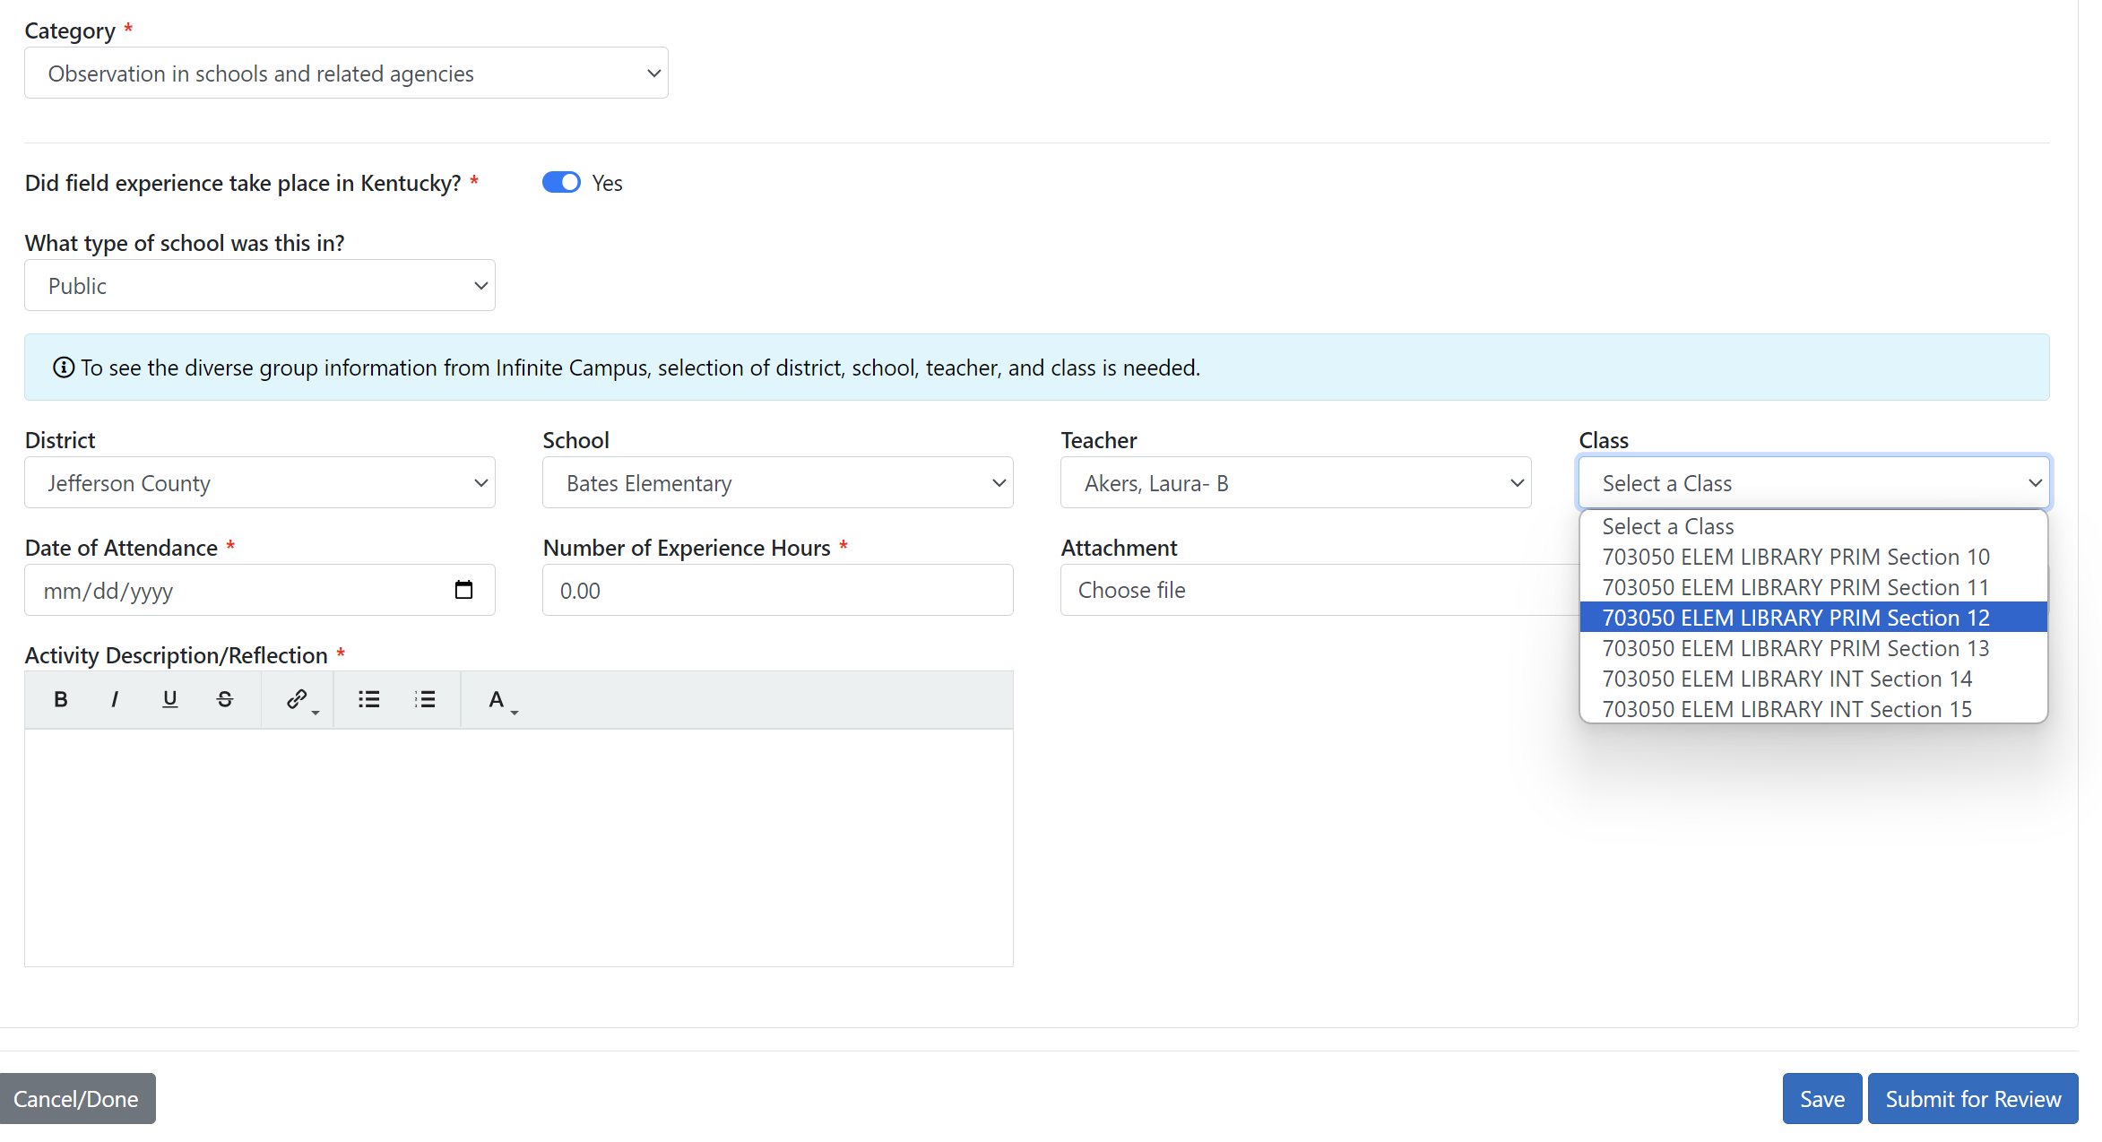
Select class/period. This auto-populates demographic information. Use best guess.
Notes:
Click “Choose Course(s)” when you are ready to begin loading your field experience activities. Be sure to have your Field Documentation Logs at hand.

Slide 11
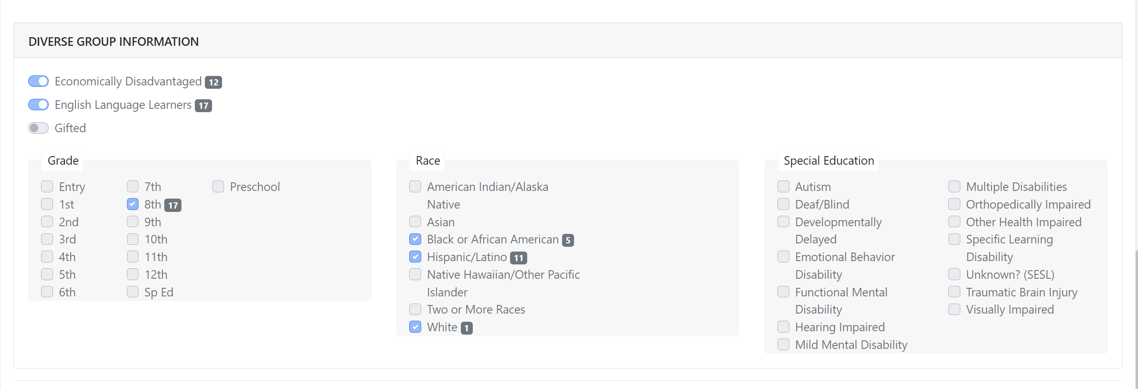
EXAMPLE OF DEMOGRAPHIC INFO
Notes:
Click “Choose Course(s)” when you are ready to begin loading your field experience activities. Be sure to have your Field Documentation Logs at hand.

Slide 12
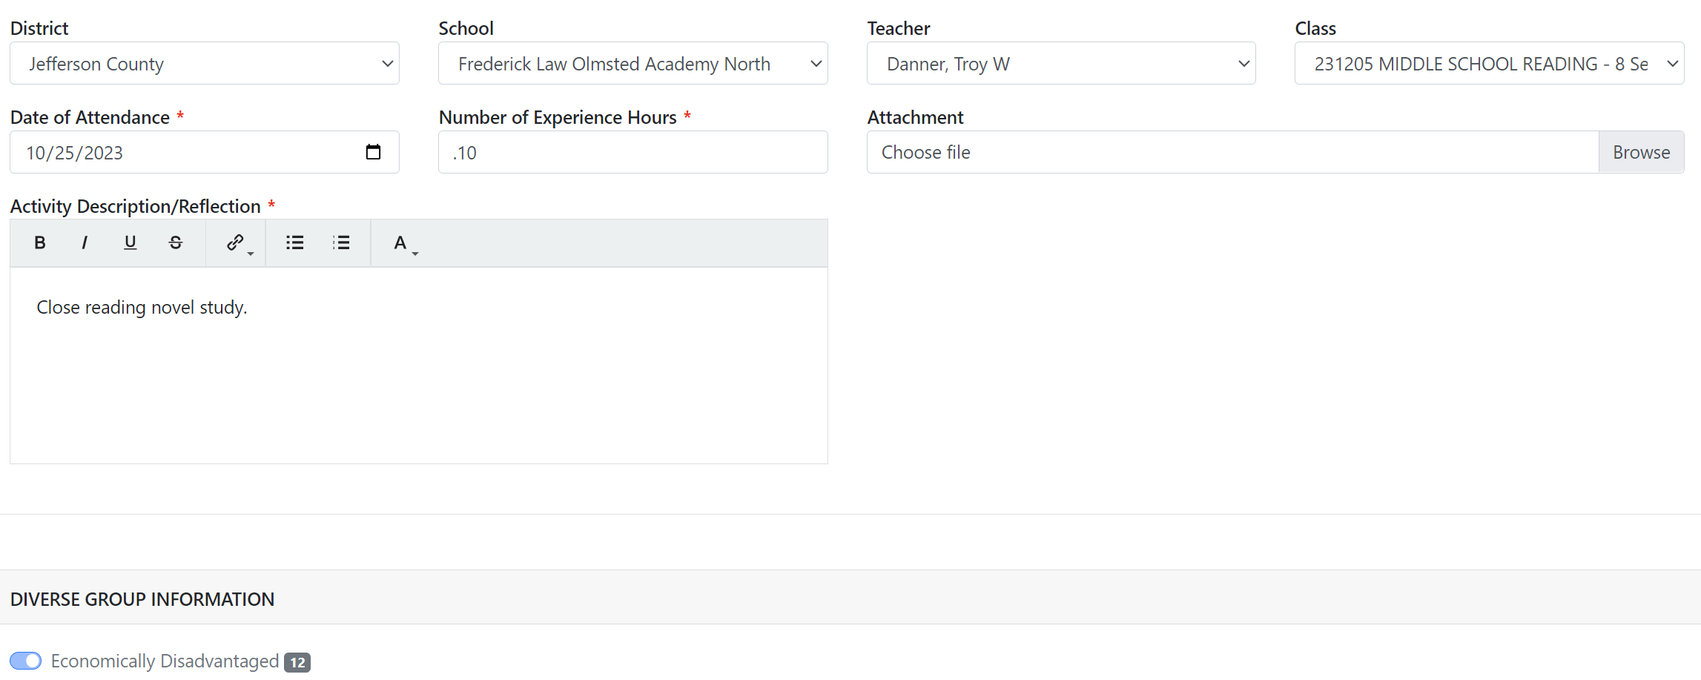
Add date and number of hours. Do NOT attach logs here. Enter in a short description in the “Activity/description box.”
Notes:
Click “Choose Course(s)” when you are ready to begin loading your field experience activities. Be sure to have your Field Documentation Logs at hand.

Slide 13
Enter ‘See logs’ in the Activity Description Box Activity descriptions should be on the field logs ONLY. Do NOT attach logs here either. Your field logs will be uploaded to Foliotek.
None required. Foliotek only.
“See Logs”
Notes:
Click “Choose Course(s)” when you are ready to begin loading your field experience activities. Be sure to have your Field Documentation Logs at hand.

Slide 14
Hit “Submit For Review.” You’re done!
Notes:
Click “Choose Course(s)” when you are ready to begin loading your field experience activities. Be sure to have your Field Documentation Logs at hand.

Slide 15
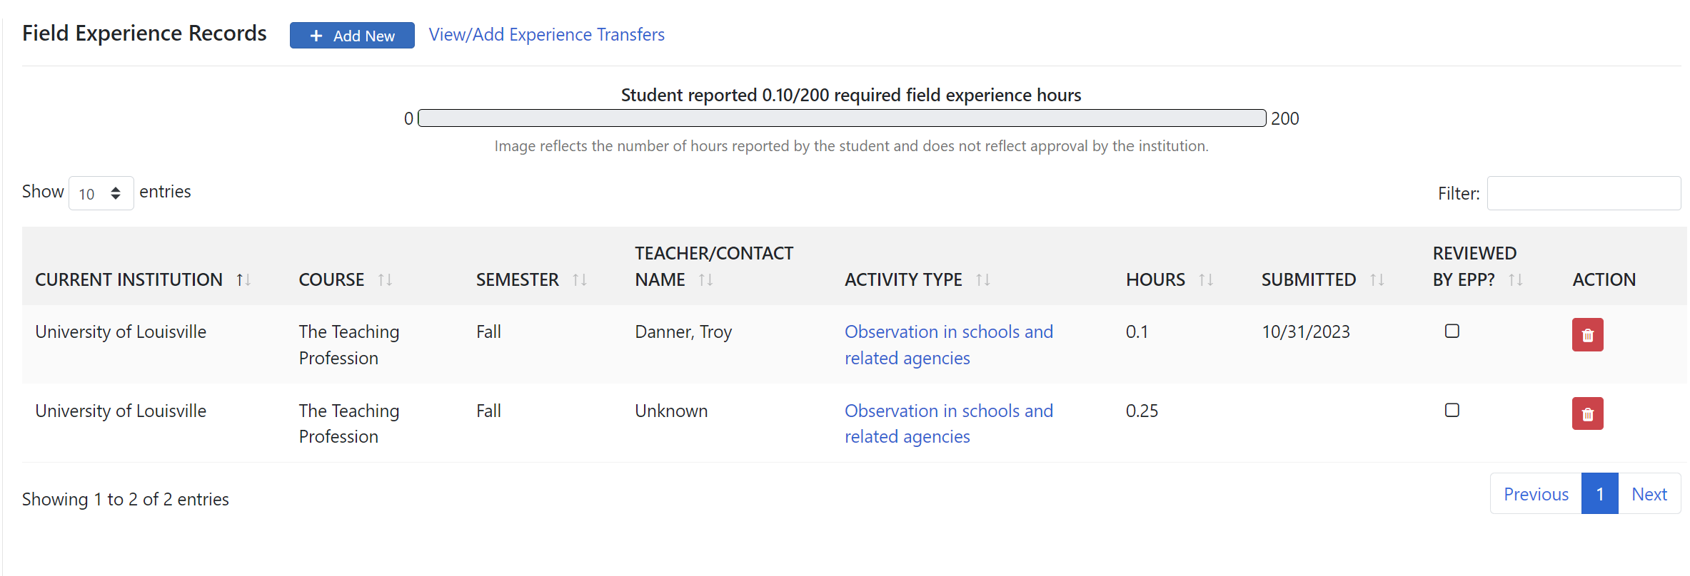
You will be taken back to the dashboard.
Notes:
Click “Choose Course(s)” when you are ready to begin loading your field experience activities. Be sure to have your Field Documentation Logs at hand.

Slide 16
NOTE: Click in any activity in the dashboard, scroll to “Rescind Submission”, and then modify the school (even if it’s the correct one – do it momentarily to “unfreeze” the form) to be able to modify the entire activity.
Notes:
Click “Choose Course(s)” when you are ready to begin loading your field experience activities. Be sure to have your Field Documentation Logs at hand.

Slide 17
1. There currently appears to be no minimum or max to the number of hours per activity per day, but they should make sense (you aren’t spending 8 hours observing in a single school day.) 2. You cannot double-dip, i.e. claim the same hours from the same day and timeframe for more than one activity. 3. Your “Description of Activity/Reflection” only needs to be a short description. Your field logs will be collected/looked at for this item. 4. Try to avoid categorizing activities under H – “Other”. 5. Teacher name/class automatically populates demographic information. You no longer need to collect infinite campus numbers. 6. This system is still new, and updates/bugs are common. Keep an eye out for updates/new information!
Good to Know:

Slide 18
Transferring field hours from another institution
Time spent in field experiences at another college or university may be transferred to UofL if appropriate.
A candidate must initiate the request from a KFETS administrator at the first institution. His/her hours be transferred from institution “A” to institution “B”.
This functionality may be part of the new KFETS system.
Notes:
If you plan on using field hours from other institutions, you must initiate a transfer with the KFETS point person in that institution before the field hours can be considered for transfer. The OEDCP may ask to review field logs or other evidence from previous non-UofL field experiences if the office has questions about those field experiences. Note that field hours are not credit hours.

Slide 19
OEDCP Contact Information
Cody Windhorst, Director of the OEDCP
cody.windhorst@Louisville.edu
Amanda Lacey, Placement Coordinator to the OEDCP (assistance with KFETS, Foliotek)
amanda.lacey@louisville.edu
OEDCP homepage:
http://louisville.edu/education/field-placement
OEDCP FAQs: https://docs.google.com/document/d/1s_0DUDP8WZnDSOWNviPQzCGhaAbLo5i8

