Slide 1
How do I complete a field experience?
Everything you Need to Know
Last Update: 08/05/2024

Slide 2
Preparing for Placement
1.Complete Background Checks and Portal Registration
2. Contact your mentor teacher quickly and professionally
3. Maintain a professional demeanor and appearance at your placement
4. Complete Field Experience Logs (to be completed after observations)

Slide 3
1. Complete Background Checks & JCPS Portal Account Registration
The COMPLETE How-to for completing this step of the process can be found here: https://www.youtube.com/watch?v=x8D9hFQI_Ds

Slide 4
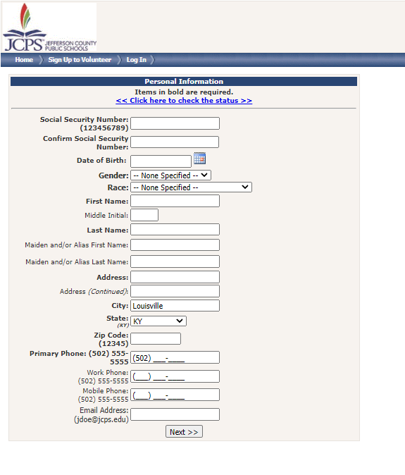
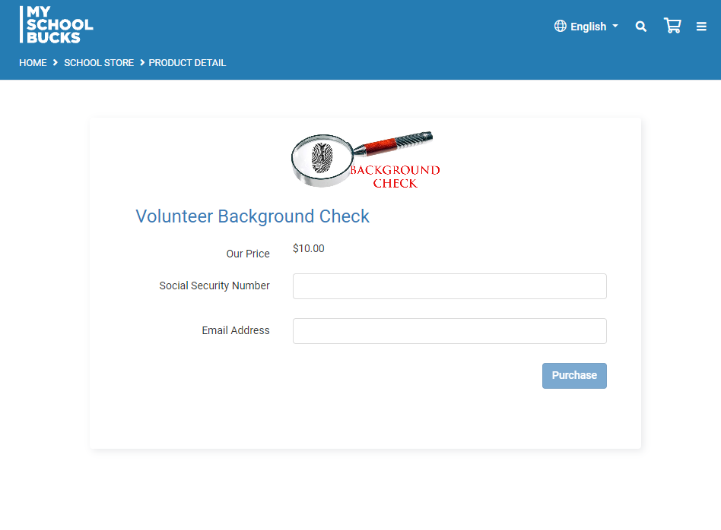
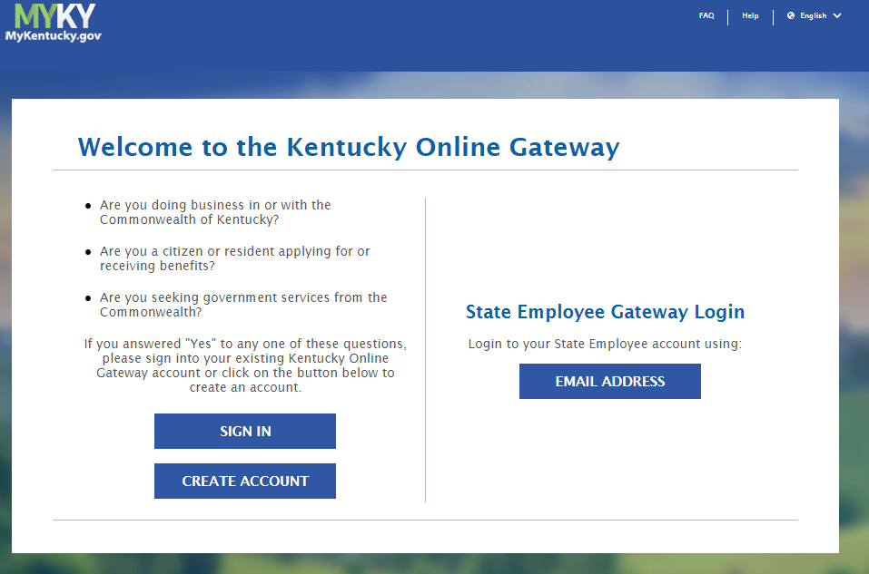
Three Different types of “Background” Checks
2. Volunteer JCPS Records Check
1. Paid JCPS Check
3. Child Abuse and Neglect (CAN) Check
$10; Renew every FIVE years
$10; Renew EVERY year
FREE. Renew every FIVE years.

Slide 5
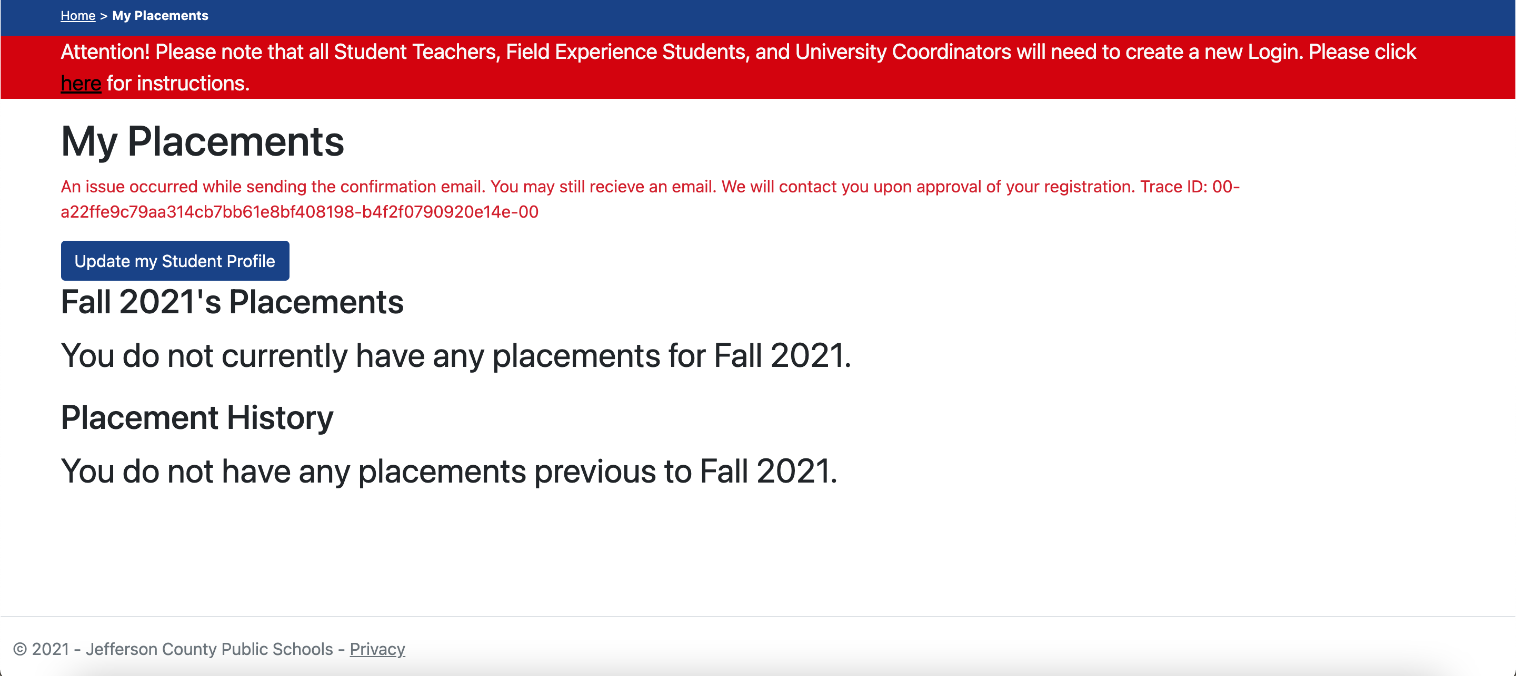
JCPS account Registration
This is a FREE account. JCPS will use this account to track your paperwork in their system as you complete field experiences.

Slide 6
Background Checks
Please note: having done any of these once does not necessarily mean you have done all of them.
You need to be on top of your own paperwork. There are hundreds of students and we will not repeatedly remind you of the next steps. Set renewal reminders if necessary!
Complete how-to for background checks can be found at: https://www.youtube.com/watch?v=x8D9hFQI_Ds

Slide 7
2. Contact your mentor teacher quickly and professionally

Slide 8
You will receive an emailed survey at the beginning of the semester that will help us place you in area schools for your course(s) for the semester. You CANNOT request a placement location.
EDTP 107:
Total field placement requirement 15 hours.
EDTP 201:
Total field placement requirement is 18 hours.
You will receive your placement once all background requirements have been completed. Then, its up to you to reach out to your mentor teacher!

Slide 9
Once you receive your field placement…
It is up to you to make first contact, via email, with your mentor teacher, before or near the start of the observation window. If you do not hear back from your mentor teacher within 3 days, check to ensure that you have typed the correct email address. Then call the school to make sure you have the correct email address. Some teacher email addresses can be found on the schools’ websites. If you are still unable to contact the teacher, via email, email the placement coordinator for further assistance. Do not wait more than a week to do this, as that gives you less time to complete your hours. Also, verify with the teachers that they have the correct contact information for you.
Placement locations and transportation:
Inform the placement coordinator ASAP about any transportation issues
When placing students, the placement coordinator assumes you are starting at U of L’s campus
PLEASE NOTE: You will NOT be given the name of your mentor teacher your background checks have all been completed

Slide 10
In your initial email, be sure to include:
Your availability!
Ask when your placement teacher has planning period and when the students are at lunch.
For high schools especially- ask where to park.
Know which entrance to use to check in at the main office.
Copy your 107/201 instructor on your email to the mentor teacher.
Reminder: This is a professional email.
*******ALL EMAILS MUST BE THROUGH YOUR UofL ACCOUNT.

Slide 11
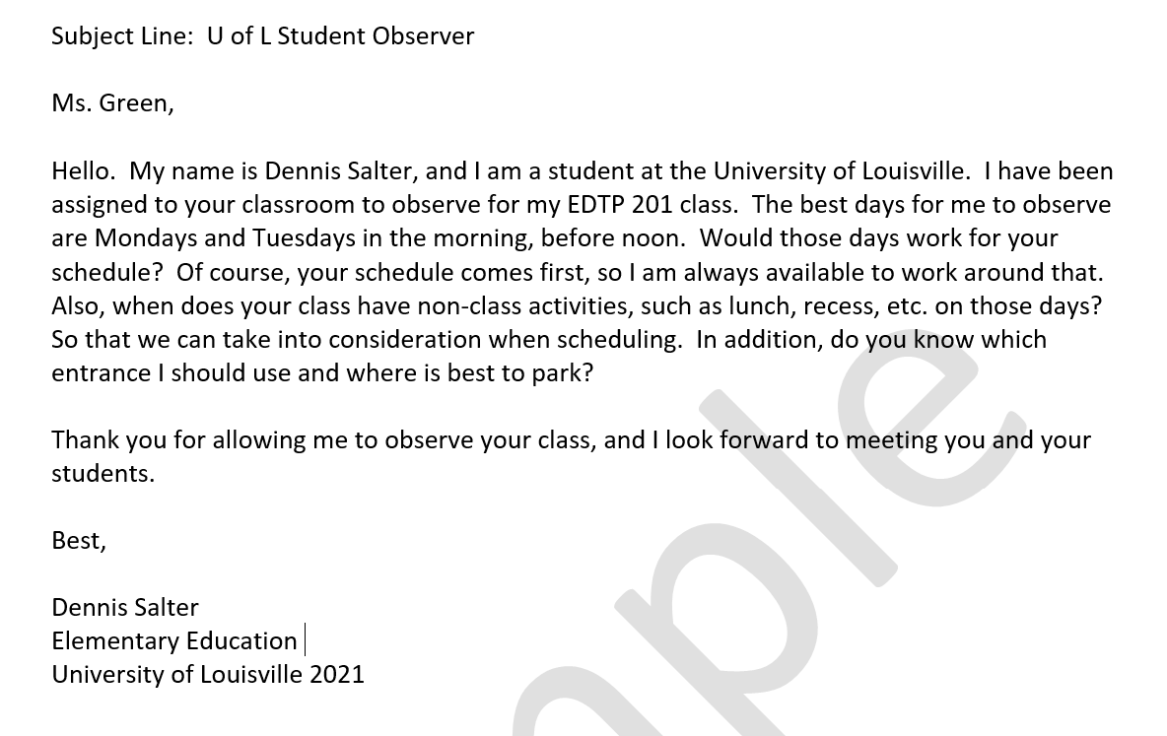
Sample Email

Slide 12
3. Maintain a professional appearance and demeanor at your placement

Slide 13
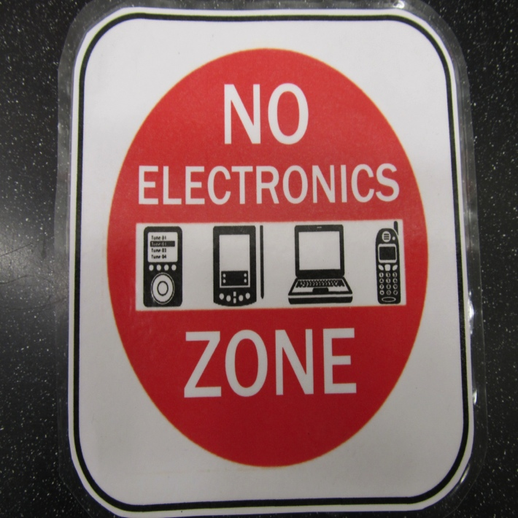
Professionalism and Expectations
Please show up on time and on the days you committed to; stay the entire scheduled time.
Ask questions about building procedures you don’t know
Remember: you are a role model to these students!
Check email regularly and respond promptly

Slide 14
Upon arriving:
Have your Driver’s License and your Student ID.
Introduce yourself to the receptionist, letting him or her know your name and the name of your placement teacher.
Sign in and receive a name badge, as required.
Arrive early to the classroom- DO NOT interrupt a class.

Slide 15
REMEMBER:
Please approach your placements as a job interview.
You never know who you will meet or who may be on a hiring committee later in your professional career.
Before your first day, meet/email with your placement teacher to discuss their expectations of you.

Slide 16
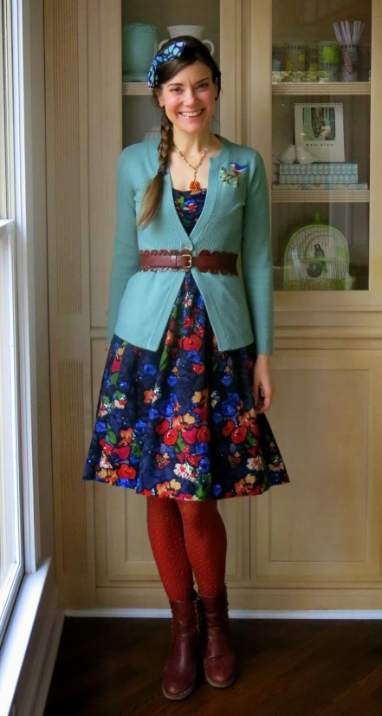
General Rule of Thumb is:
BUSINESS CASUAL

Slide 17
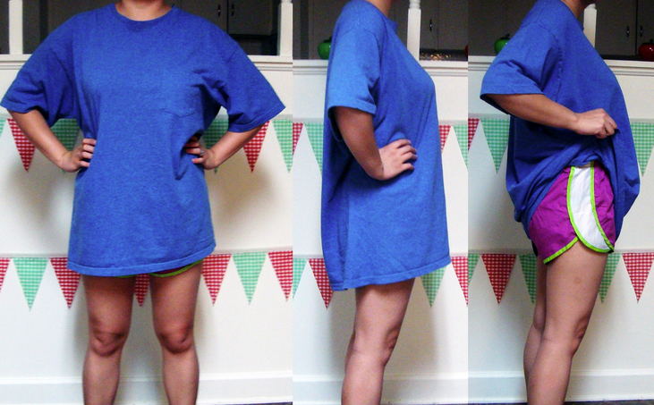
Avoid:
From JCPS:
Appropriate attire and a neat personal appearance are necessary to make a good impression on and to win the respect of the class and the school administration.
Individual schools have established dress standards; however, professional dress is always appropriate, regardless of what teachers may be wearing. In most schools, sweatshirts, jeans, T- shirts, and sandals are not appropriate.

Slide 18
4. Log every field experience on a field log

Slide 19
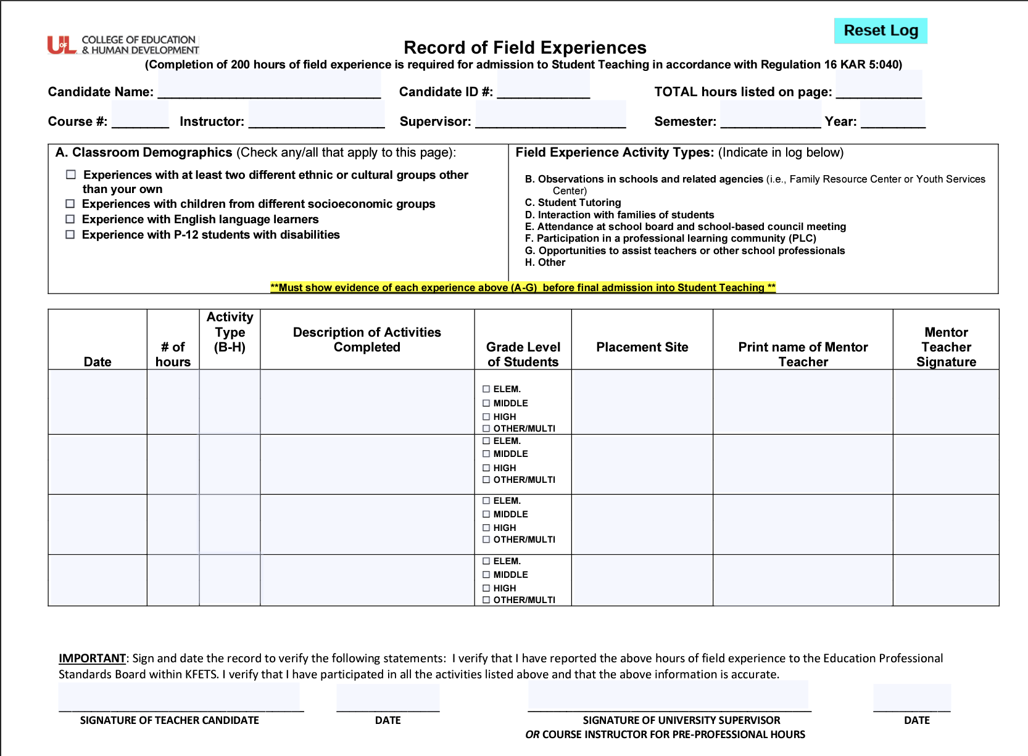
Field Log
Fill it out and have it signed for every experience.
Keep these safe until graduation! You will need them. If you do not have the information on these logs, the hours will need to be repeated before you apply for teacher candidate (student teaching) status.
Copies must be kept by you! We do not keep logs at the OEDCP, and your professor does not keep logs.
https://louisville.edu/education/field-placement/files/field-logv4.pdf
HOW TO: https://youtu.be/6mjeV9Ney1Y
Notes:
As reads in syllabus

Slide 20
Remember: obtain signatures and keep copies!!
Logs can be electronically signed using the signature feature in Adobe Acrobat DC
This signature must look like a signature, and cannot be just a typed name
Adobe Signature How To: https://youtu.be/J_fu2hKvV4o

Slide 21
Field Log Example
Notes:
As reads in syllabus

Slide 22
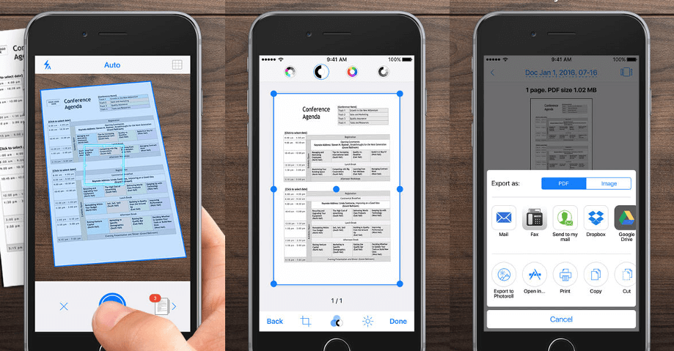
IMPORTANT: Scan or make copies of all logs – you will need them for KECS and your student teaching application.
Logs showing 200 completed field experience hours in all categories (B-G) and all school levels (middle, elementary, and high) are required for student teaching. If you lose any, you will have to repeat your hours!
Recommended apps:
CamScanner
Notes app (iPhone)
Just use camera
Scanner

Slide 23
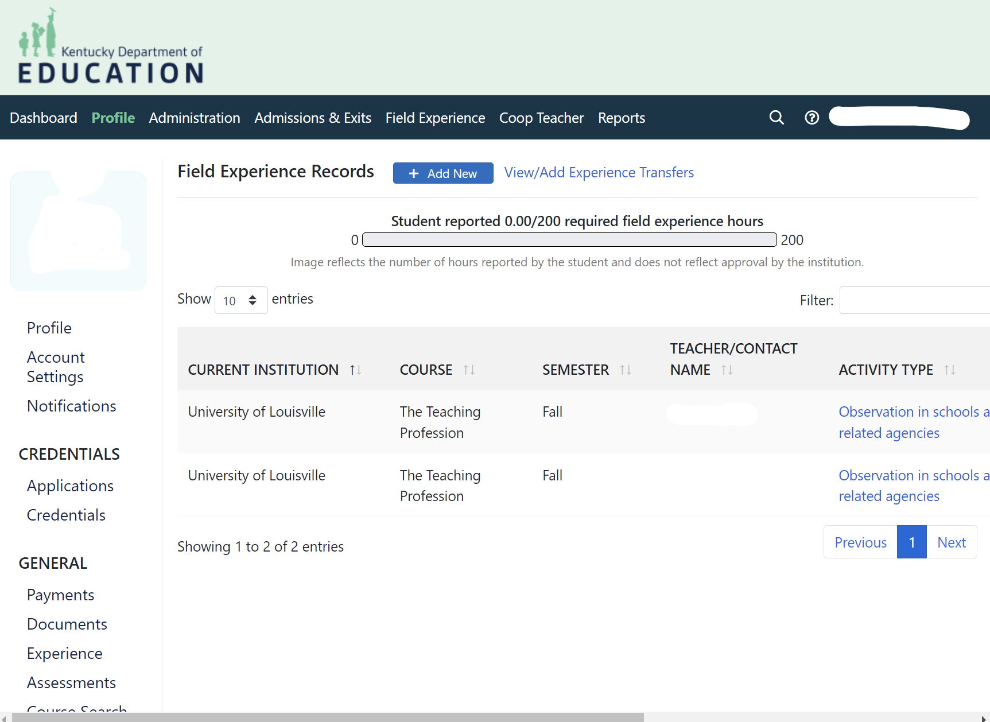
The Kentucky Educator Credentialing System (KECS)
The Kentucky Educator Credentialing System (KECS) is an online application for tracking field experiences of teacher candidates enrolled in a Kentucky teacher preparation program. Candidates in Kentucky are required to complete a minimum of 200 field experience hours, have documented experience in activities B-G], and documented experience at an elementary school, middle school, and high school, prior to student teaching REGARDLESS of content area or level.
** Note, in 107/201 you will not need to log these hours yet; this slide is more of an FYI of what’s to come in future courses

Slide 24
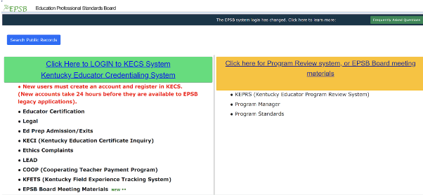
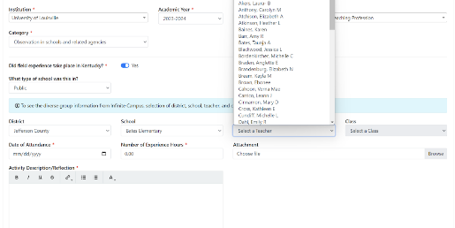
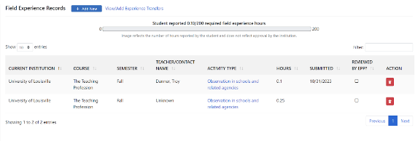
KECS
For further information, please visit the OEDCP website at OR look at our Frequently Asked Questions
Where you need to log at least 200 hours, showing all categories, levels, and activity types.
Remember to hang on to your logs, even after entering into the system.

Slide 25
KECS Field Experience Documentation Process
KECS
KECS

Slide 26
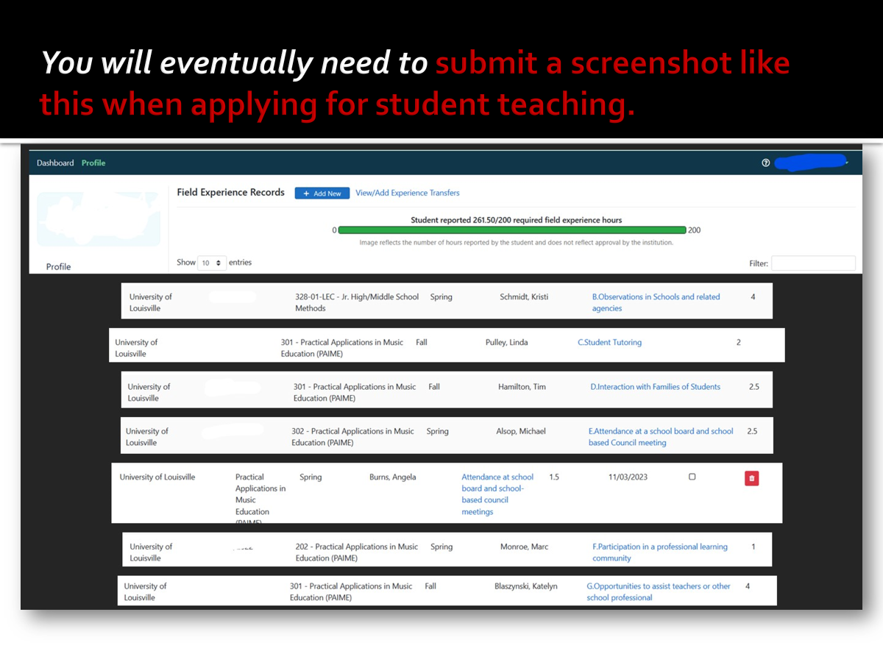
KECS
** Note, in 107/201 you will not need to log these hours yet; this slide is more of an FYI of what’s to come in future courses
http://www.epsb.ky.gov/

Slide 27
Field Experience Faqs/Important Links
OEDCP Helpful Videos and Links:
Field Experience Paperwork How-To: https://www.youtube.com/watch?v=x8D9hFQI_Ds
Field Experience Frequently Asked Questions: https://bit.ly/3JCClku
Field Experience Log How-To: https://youtu.be/6mjeV9Ney1Y
Field Experience Log .pdf: https://louisville.edu/education/field-placement/files/field-logv4.pdf
Digital Signature How-To: https://youtu.be/J_fu2hKvV4o
OEDCP Website: https://louisville.edu/education/field-placement
CAN .PDF How-To: https://louisville.edu/education/field-placement/files/can-check-how-to.pdf
For tech support, for issues such as receiving error messages while logging in, issues creating an account, or issues with passwords, the email address is: jcps.studentteacherit@jefferson.kyschools.us
For support with paperwork uploading, students should email: JCPS.Student-Teacher@jefferson.kyschools.us
Please remind students that the OEDCP cannot help with tech issues when it comes to account creation or document upload, as it is a JCPS-run system.

Slide 28
Questions? Concerns? Issues?
Check FAQ FIRST: https://bit.ly/3JCClku
U of L Contact information (in order of who to contact first):
Ashley Smith – Graduate Assistant ak.rice@louisville.edu
Amanda Lacey- Placement Coordinator amanda.lacey@louisville.edu
Cody Windhorst- Director of OEDCP cody.windhorst@louisville.edu
JCPS Contact Information:
Edris Humphrey- Recruitment Specialist edris.humphrey@jefferson.kyschools.us
For JCPS Portal tech errors: jcps.studentteacherit@jefferson.kyschools.us
For JCPS Portal paperwork uploads: JCPS.Student-Teacher@jefferson.kyschools.us

