Slide 1
Moving Beyond Mental Health Biases To Help Students In Distress
Dr. Angela B. Taylor
Assistant Provost For Student Affairs And Assistant Dean Of Students
Dr. Aesha L. Tyler
Clinical Psychologist and
Director, UofL Counseling Center

Slide 2
Overview
Understanding College Student Mental Health
Recognizing Mental Health Issues In Students
Responding Effectively To Student Distress
UofL’s Student Care Team (SCT)
Resources for Students in Distress
Departmental Responsibilities
Dean of Students Office (DOS)
Prevention Programs

Slide 3
Sources & Prevalence Of Student Distress
Understanding College Student Mental Health

Slide 4
Mental Health Difficulties Are Common In College Populations
At least 1 in 3 college students screen positive for a mental health issue
80%
of students have felt over-whelmed
40-50% of students report having been too anxious or depressed to function
45% have felt hopeless

Slide 5
Most Common Diagnoses Seen By UofL Counseling Center:
Anxiety Disorders
Mood Disorders (including depression and bipolar disorder)
Adjustment Disorders
Post-Traumatic Stress Disorder
Phase of Life Problems & Relationship Issues

Slide 6
Factors In Psychological Distress
Trauma history, including:
Emotional & physical abuse
Sexual assault
Combat trauma
Natural disaster
Life transitions & difficulty adjusting
Lack of social support/sense of belonging
Inadequate coping strategies
Genetic and environmental predispositions to mental illness
Social pressures
Maladaptive interpersonal patterns
Negative self-talk & criticism
Distorted beliefs/perception of the world
Underdeveloped sense of self
Discrimination & oppression
Hormones
Challenges in school, workplace, and/or relationships
Physical health
Diet
Exercise
Gut bacteria
Death of a loved one

Slide 7
Recognizing Mental Health Issues In Students
Signs A Student Is Struggling With Their Mental Health

Slide 8
Changes In Academic Behavior
Poor attendance
Tardiness
Several missed deadlines
Excessive procrastination
Poorly prepared work
Not turning in assignments
Decline in grades

Slide 9
Changes In Presentation & Interpersonal Behavior
Dramatic changes in appearance/weight
Marked changes in personal hygiene
Disheveled appearance
Lack of energy, high fatigue
Chronic health problems
Inappropriately high energy
High levels of irritability
Preoccupation w/disproportionate worries
Extreme displays of normal emotions
Bizarre speech or behavior that is inappropriate for setting
Regular substance use
Hopelessness &/or suicidal thoughts

Slide 10
Other Signs & Symptoms
What have you seen?

Slide 11
Responding Effectively To Student Distress
How You Can Help

Slide 12
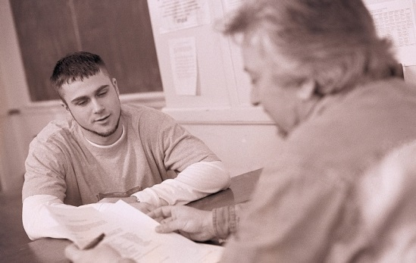
Role Of Faculty
In a position
to directly observe any changes in student functioning
to notice students struggling emotionally or psychologically
to help students access campus resources
Students may turn to you for advice and/or support before exploring other options
What biases could stand in the way of a faculty member reaching out to help a student in distress?

Slide 13
Referring A Student For Help
Consider the following:
The problem is more serious than you feel comfortable handling
You experience conflict between your professional role with the student and providing extensive personal support
You are either extremely busy, or experiencing stress in your own life, and are unable or unwilling to handle other requests for help

Slide 14
Referring A Student For Help, cont.
You have talked to the student and helped as much as you can, but further assistance is needed
You think your personal feelings about the student will interfere with your objectivity
The student admits that there is a problem, but doesn’t want to talk to you about it
The student asks for information or assistance that you are unable to provide
Feeling annoyed, irritated, or overwhelmed when a student wants to talk with you about a problem is a clue that it is time to refer them to other resources for help.

Slide 15
You Are Critical To Students Getting The Help They Need
You may be students’ ONLY point of contact with the system that has been put in place to help them

Slide 16
Interacting With A Student In Distress
If the student comes to you:
Talk to the student in private
Listen carefully
Show concern and interest
Believe the student
Validate and normalize as appropriate
Avoid criticizing or sounding judgmental
Reflective listening
Include empathic statements
Notes:
This is not the time to interrogate them about late assignments or missing class.
You don’t have to decide whether you believe them
They are coming to you for a reason (connection, comfort, trust, desperation)
Focus on the feelings the student is conveying (sadness, hopelessness, anxiety, etc.)
Empathic statements (that must be really hard for you; it sounds like it’s been a rough couple of months, I’m sorry to hear that, etc.)

Slide 17
Interacting With A Student In Distress, cont.
If you go to the student:
Express concern about their well-being
Identify concerning behaviors
Be careful to avoid taking a shaming or judgmental tone
Over 90% of communication is non-verbal
The behaviors you have seen sometimes indicate that a person is struggling
Give student space to discuss these behaviors and/or their circumstances
Provide suggestions for next steps
Assessment or counseling referral
Connect with other on-campus resources
You are not a mental health professional, and we don’t expect you to be!
Notes:
Reiterating non-judgmental interactions
Be aware of your non-verbals (stance/sitting, eye contact, facial expressions, etc.)
Talk about the behaviors you’ve observed being concerning
You can call us and ask us if you are not sure what to do!

Slide 18
Student Care Team (SCT)
SCT established at UofL in Fall 2007
Regular opportunity for communication; break down silos
Ensure all resources are available to students in crisis
Crisis--an emotionally significant event involving a student that threatens the well-being of one or more individuals or the university community as a whole.
A crisis may include personal crises and behavioral issues involving individual students or groups.

Slide 19
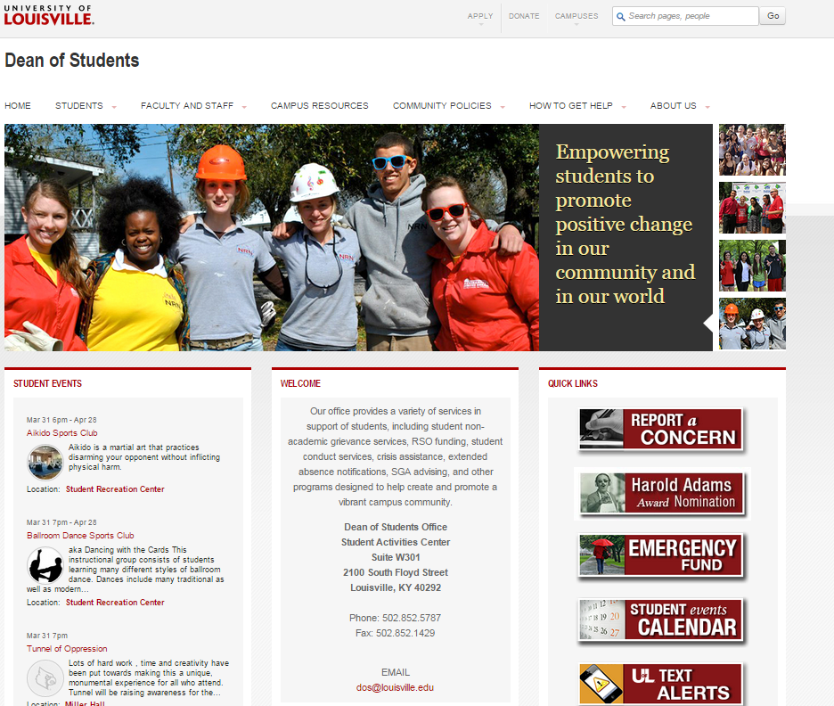
Institutional Concern
April 2007: “The tragic events at Virginia Tech were a tipping point in higher education and catalyzed the creation of practices, procedures, and policies on how higher education and student affairs administrators in particular assist students in various levels of distress (Jablonski, McClellan, & Zdziarski, 2008).”
Demand to respond
Methods of response still developing
Notes:
Safe Campus:
93% of crimes students experience occur off campus (Cornell, 2008).
Murder rate is 28 times higher off campus than on campus (Cornell, 2008).
“Colleges can’t assume a mental health gatekeeper function for every student enrolled. In light of budget constraints some colleges will be struggling to simply retain faculty members and conduct class.” (Pavela, 2011)

Slide 20
The SCT Focus
Respond to student needs, attempting to avoid student injury and/or disruption to the integrity of the learning environment
Specific examples include:
Suicide attempt or suicide ideation
Death of a student
Sexual assault
Physical assault or other act of violence
Threats of violence
Transport to hospital
Alcohol, drugs, eating disorders or serious injury
Classroom disruption
Any personal tragedy or significant event that might impact a student’s ability to stay in school

Slide 21
Members of UofL Student Care Team
Assistant Dean of Students, Chair
Director of the Counseling Center
University of Louisville Police Department
Faculty Representative
Campus Health Representative, Belknap Campus
Assistant Director of Residence Education
Coordinator for Student Rights and Responsibility, Campus Housing
Enrollment Management Representative
Student Care Manager
Dean of Students Office Staff
Academic Advising Representative
(Any of the members may in their absence send an appropriate designee)
Adjunct Members

Slide 22
SCT Campus Communication
Informing the Campus Community
Individual departments
Faculty Senate
Emergency Management Team
Deans Meeting
Academic Advisors Committee
HSC Unit Representatives
President and Provost offices
Media Relations
Provide perspective of what the SCT can and cannot do
Help others be able to identify and respond to students in distress
Make appropriate referrals

Slide 23
Functions of SCT
Respond to a crisis that threatens the well-being of a student or students.
Share information and resources among appropriate offices.
Serve as a local resource to the university-wide Emergency Response Team in the event of a critical incident.
Initiate internal review of the crisis situation and ensure appropriate follow-through.
Notes:
1. Offer appropriate assistance in various stages of the crisis.
2. To enhance staff effectiveness and ensure all University resources are made available to students.

Slide 24
Functions of SCT
Identify student behaviors that disrupt the learning environment.
Provide an opportunity for team members to identify trends and/or patterns of behavior.
Be proactive.
Advise University Officials on issues related to student crisis.
Notes:
5. That may impact the campus community by sharing information on a regular basis.
6. By exploring issues that occur on other campuses or in the Louisville community that could impact UofL students.
8. And how it may affect the integrity of the campus community and campus climate.

Slide 25
Resources For Students In Distress
Dean of Students Office 852-5787
Counseling Center 852-6585
University of Louisville Police 852-6111
Helping Students in Distress Reporting Guide for Faculty and Staff (red folder)
Online: Response Guide for Dealing with Difficult Student Situations
Centerstone Crisis and Information Center:
(502) 589-4313 or 1-800-221-0446 TTY, call via KY Relay @ 711
National Suicide Prevention Lifeline:
1-800-273-TALK (8255)

Slide 26
Departmental Responsibilities
Employees are expected to respond to student crisis situations based on their existing departmental policies and procedures.
When a crisis occurs outside of these normal policies and procedures, staff is expected to contact their Chair or Director.
If their Chair/Director is not available, they should contact the Dean of Students Office.
In an emergency situation, University Police should be contacted immediately.

Slide 27
Student Disruption
How to Respond

Slide 28
Overview Of Dean Of Students Office
A student should come see us if:
Believe student rights have been violated.
Dealing with a crisis situation.
Have been hospitalized and need help notifying professors of absence.
Friend who needs help; struggling with challenges in their life, depression, suicidal thoughts, eating disorders, etc.
Need to file a written student compliant.
Need assistance or advice on University policies and procedures.
Need assistance but are uncertain where to go for help.

Slide 29
Cards SPEAK (Suicide Prevention, Education, Awareness, and Knowledge) is a suicide prevention program that works to provide training and awareness campaigns to students, faculty and staff, provide information and resources, reduce stigma, and promote a community of caring individuals capable of assisting students in crisis.
Implementation of Cards SPEAK will increase UofL’s capacity to offer a coordinated and culturally competent campus message to increase the UofL community’s overall mental health awareness, with an emphasis on suicide prevention.

Slide 30
Question, Persuade, Refer Ask A Question, Save A Life
QPR is NOT intended to be a form of counseling or treatment.
QPR is intended to offer hope through positive action.
Notes:
QPR is a suicide prevention gatekeeper training. QPR stands for question, persuade, refer, three steps that anyone can take that might save a life. It’s not meant to take the place of counseling or treatment, but to help take action when risk is recognized.
How many of you are CPR trained? Did they teach you how to do open heart surgery? No? Same thing with QPR, gives you tools to keep someone safe until professionals can take over.

Slide 31
Online professional development simulation designed to help build confidence, knowledge, and skills to best support students exhibiting signs of psychological distress.
Program uses simulated conversations with virtual students to provide learners with hands-on practice in approaching students they are concerned about and, if necessary, how to refer them to support services.
http://resources.kognito.com/highered/standard/At-Risk-Student_Video_Clip.mp4
Notes:
Add link to demo

