Slide 1
Putting it All Together: Creating a Video Documentary of Your Celebration Journey
Aimee Greene
Assistant Director for Instructional Design and Technology
Beth Case
Program Manager for Digital, Emerging, and Assistive Technology

Slide 2
Objectives
Download and install Adobe Premiere Clip or PowerDirector
Shoot footage using a mobile device
Edit the footage to include selecting and trimming shots, adding titles and adding music
Upload finished video

Slide 3
Brainstorm: Ways to use video in your class

Slide 4
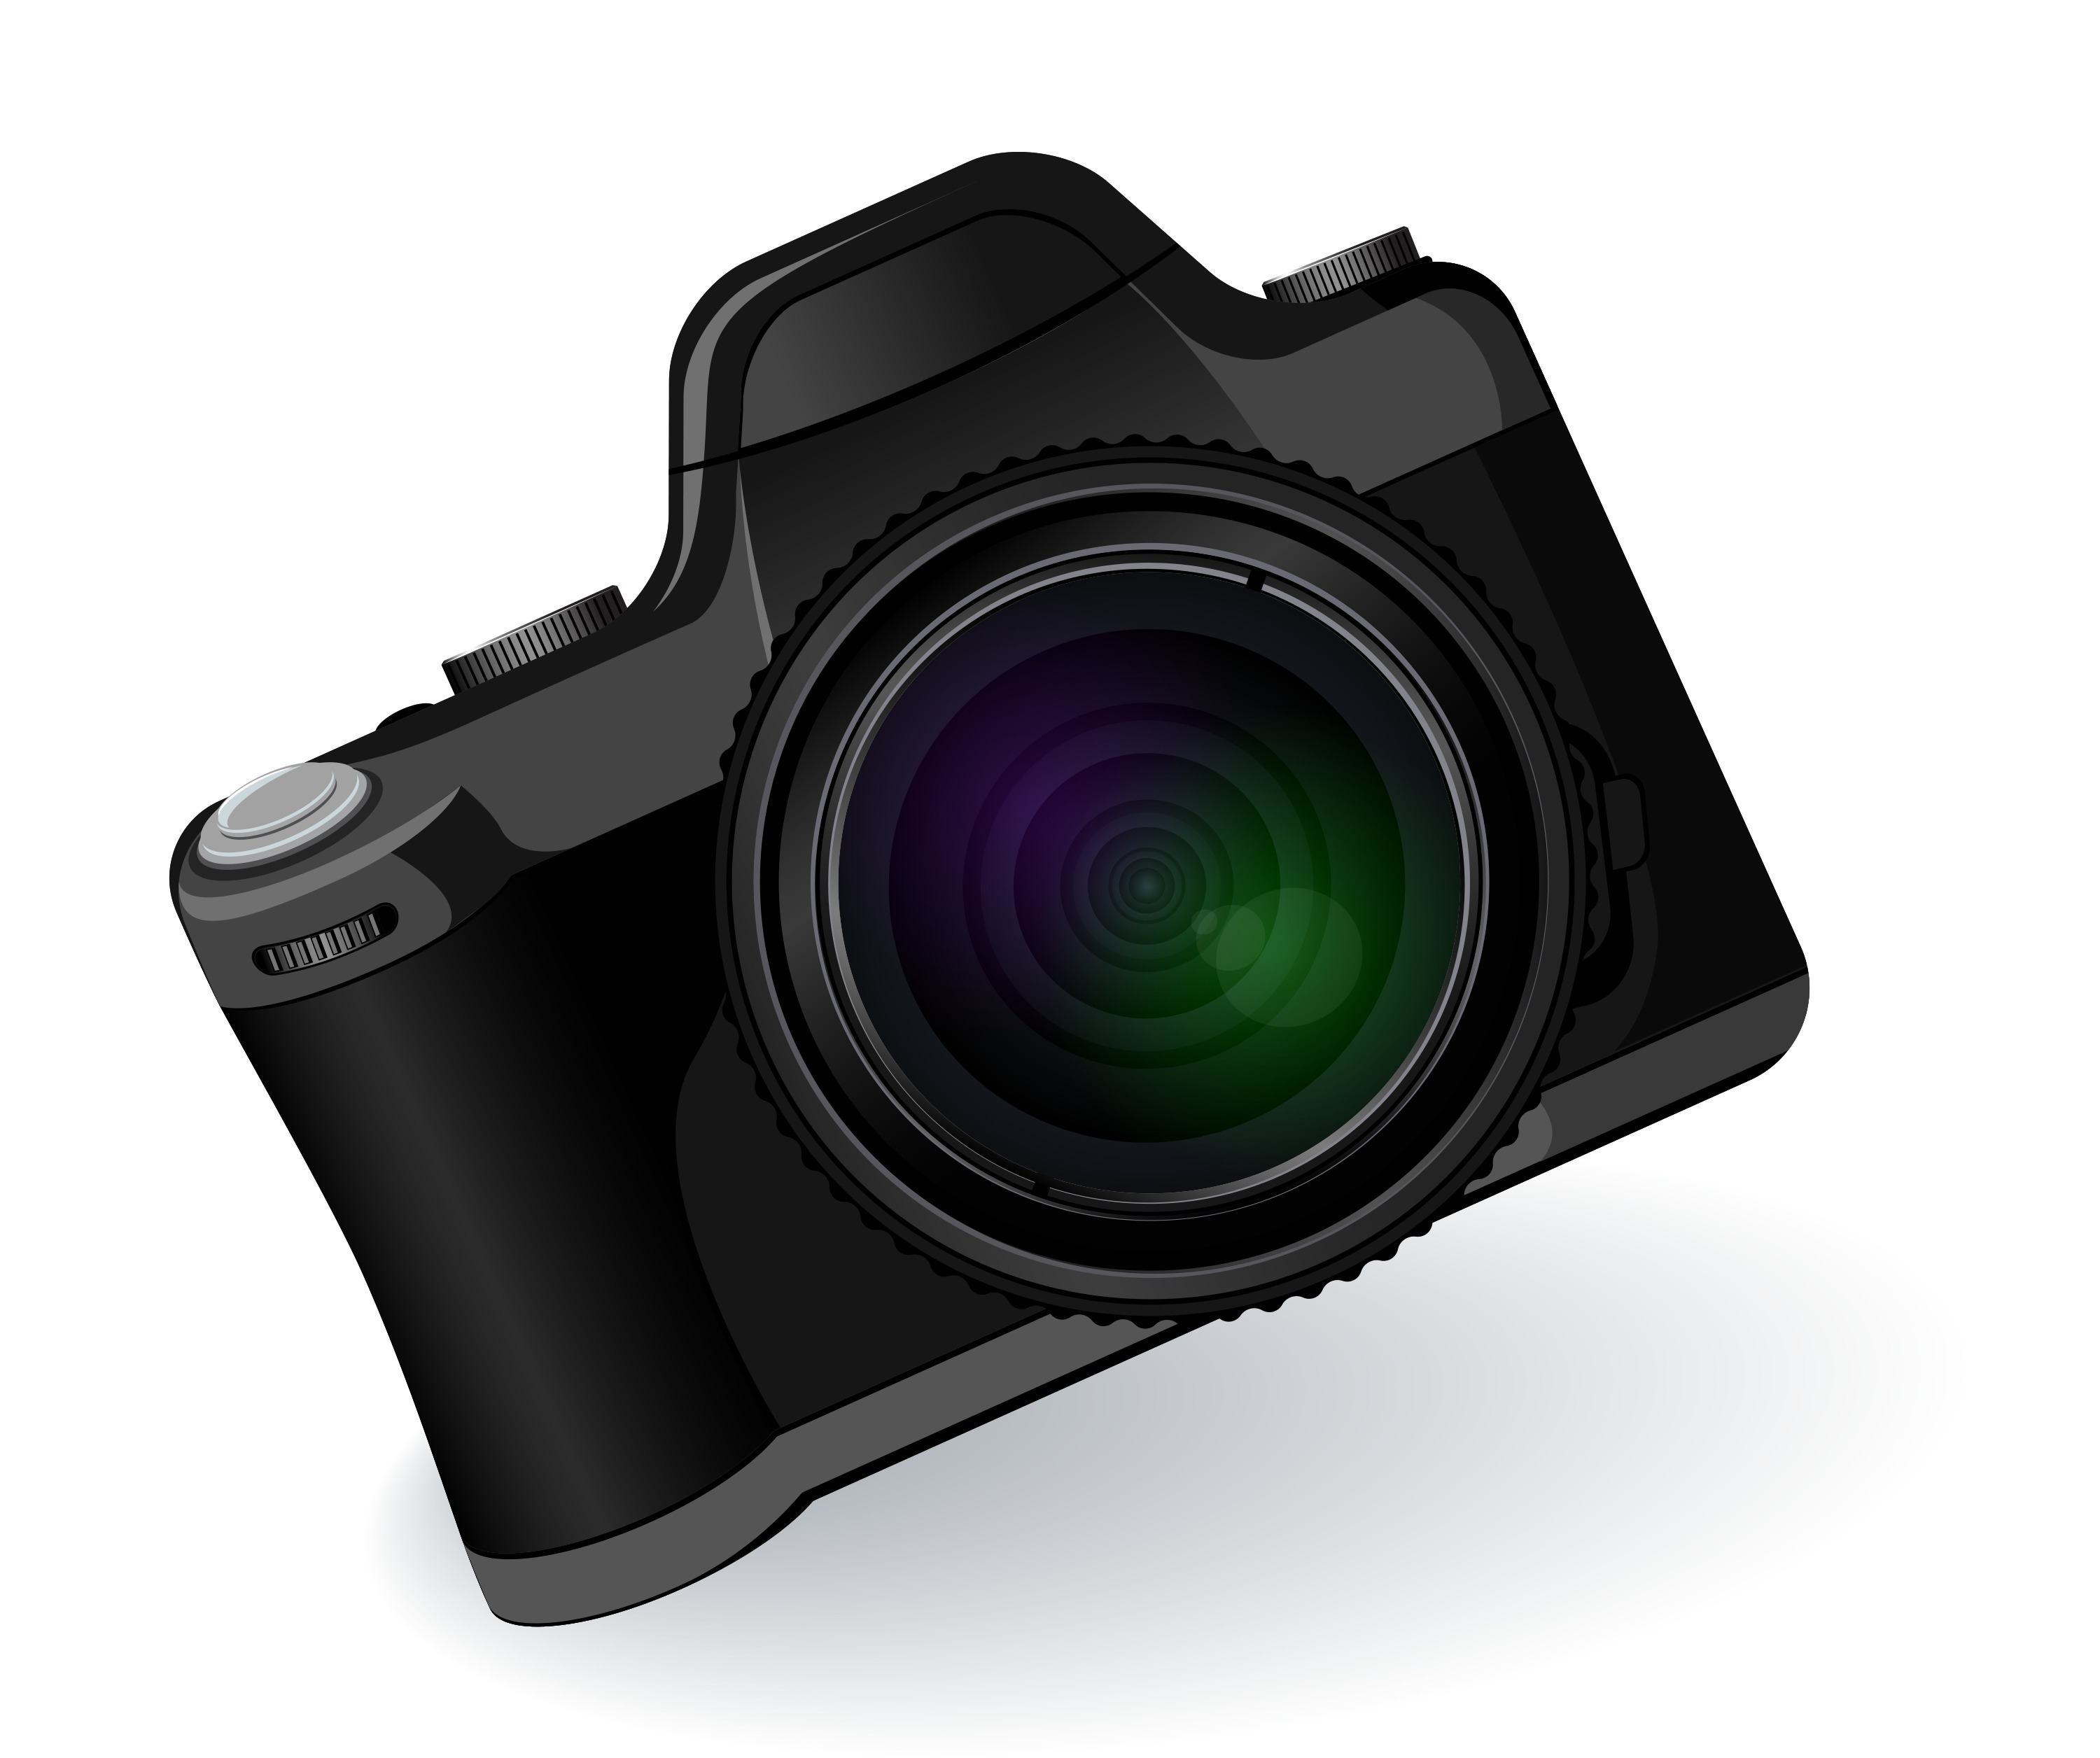
What Can You Include?

Slide 5
What app should you use?
Adobe Clip
iPad/iPhone
Android Phones
PowerDirector
Android Tablets

Slide 6
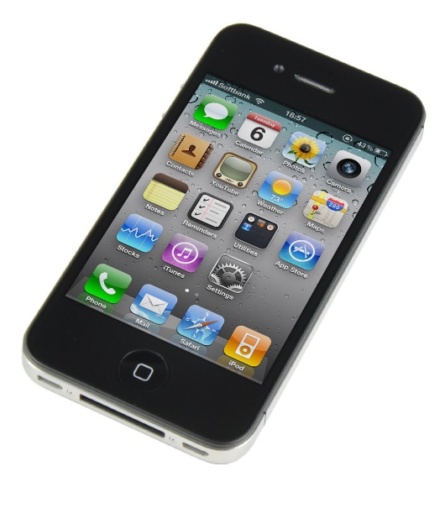
Time to Get Your Hands Dirty!!

Slide 7
Publish/Share Options (Adobe Clip)
Publish and Share Video
Publish to YouTube
VS

Slide 9
Contact Us
Aimee Greene
Assistant Director,
Instructional Design and Technology
(502) 852-4482
aimee.greene@louisville.edu
Beth Case
Program Manager for Digital,
Emerging, and Assistive Technologies
(502) 852-7689
beth.case@louisville.edu

