Slide 1
Emotional Intelligence in Physician Training: Implications for All Learners
Gerard P. Rabalais, M.D., M.H.A.
Chair, Department of Pediatrics
Associate Dean for Faculty Development
School of Medicine
Notes:
What is emotional intelligence?
Are EI skills important to physicians?
Can EI skills be taught?
How do we address EI training for medical students and residents?
Do EI skills in physicians translate into better patient care?
What about the importance of EI in our roles as teachers, as colleagues, as family members, as learners ourselves?
Relationship breakdown scenarios

Slide 2
Relationship failures are especially problematic in healthcare…
Notes:
A woman is dismissed by her physician as she raises concerns and fear about her risk for breast cancer given her family history
Your elderly father with terminal cancer in ICU; withdrawal of care decision interrupted by a non-treating physician
Your family is with you and your 3 year-old with an unexplained fever for 10 days; waits four hours in the hospital for the ID consultant who is late and, when he finally arrives without an apology, complains to them about how hard his chair makes him work
A brilliant physician-scientist with an international reputation in research displays extreme narcissistic behaviors; staff quitting; those who challenge him are shunned and dismissed; he accepts no responsibility for the problems he causes; resistant to coaching
A new physician at the hospital asserts his authority to develop new protocols for pediatric kidney transplantation; wont listen to others, alienates physician colleagues, staff, hospital administration; ultimately loses his leadership position because he could not be coached
The Doctor

Slide 3
Doctoring in the 19th Century was hard
“The Doctor” by Sir Luke Fildes, 1887
Notes:
1887 painting (Sir Luke Fildes, London) of a Victorian physician making home visit
Note the lighting…focused on the centrality of the physician-patient relationship, anguished mother being consoled by father of the sick child
This physician space remains the focal point today, but it is ever so much more complicated;
More technology, diagnostics, therapies
More individuals involved in care management
Faster pace of medicine now

Slide 4
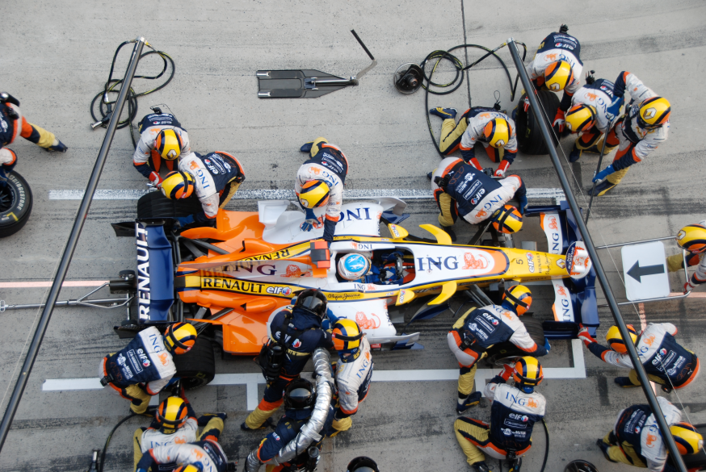
…but it is even more complicated
and fast-paced now
https://upload.wikimedia.org/wikipedia/commons/8/8b/Alonso_Renault_Pitstop_Chinese_GP_2008.jpg
Notes:
“we’ve celebrated cowboys, but what we need is more pit crews”…Atul Gawande
This is true not just in intensive care setting
True in bedside rounds, primary medical home
The pace, complexity of care decisions, the role of third-party payors, the electric medical records all can make medical care more challenging
Frustration for all…patients and doctors

Slide 5
…and frustrating for patients and doctors
Notes:
So, as physicians have to communicate with and lead teams,
As they work in an ever more complex environment,
As they are pressured by payers,
By use of electronic medical records,
By more documentation and compliance requirements,
What we need in health care are physicians who are :
Self-aware
Socially-aware
Able to manage themselves
Able to manage relationships
The EI illustration box

Slide 6
Emotional intelligence skills would help
Source: Bradbury, Greaves, Emotional Intelligence 2.0, 2009
Notes:
Wouldn’t it be great if we could avoid or prevent relationship failures with patients, with family members, with professional colleagues?
Can healthcare providers learn emotional intelligence?
Can we do a better job of selecting our trainees?
Training medical student and resident learners to be aware of and practice better EI.
Other EI definitions

Slide 7
Other definitions of emotional intelligence
“an individual characteristic that reflects the ability to monitor one’s own and others’ emotions, to discriminate among them, and to use this information to guide one’s thinking and actions”
What is EI? In: Emotional Development and Emotional Intelligence: Educational Implications. New York, NY: Basic Books, 1997:3-31.
“the means to perceive and express emotions and regulate emotions in self and others”
Educating for professionalism: trainees’ emotional experiences on internal medicine and pediatrics inpatient wards. Acad Medicine 2003;78:730-41
Notes:
The House

Slide 8
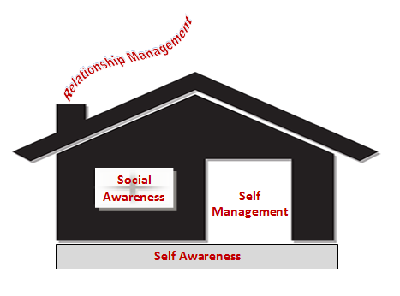
Notes:
Hiring for Attitude

Slide 9
Why do some employees fail at their jobs?
“overwhelmingly, the characteristics that define mishires (low performers) are attitudinal”
Notes:
Authors of book have company, Leadership IQ
Tracked 20,000 hires over 3-year period
In first 18 months:
46% fired, poor performance review, written up
Why they fail?
Coachability (26%)
Emotional intelligence (23%)
Motivation (17%)
Temperament (15%)
Technical competence (11%)
Just what defines success for a doctor?

Slide 10
A TV doctor with low EI skills
http://quotesgram.com/funny-house-md-quotes/
Notes:
Other House quotes:
“Wanting to believe the best about people doesn’t make it true”
“What’s the opposite of ‘thank you’?”
“Somewhere out there is a tree, tirelessly producing oxygen so you can breathe. I think you owe it an apology.”
Doctors need EI to be effective professionals

Slide 11
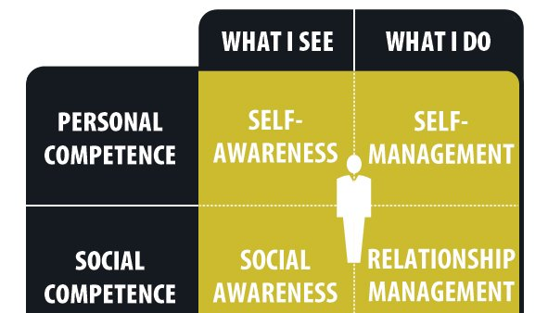
Doctors need emotional intelligence
to be effective caregivers
Source: Bradbury, Greaves, Emotional Intelligence 2.0, 2009
Notes:
Wouldn’t it be great if we could avoid or prevent relationship failures with patients, with family members, with professional colleagues?
Recall the patient/doctor scenarios I mentioned at the beginning of the talk?
Walk through them pointing our which quadrant they were deficient in
Better job selecting students?

Slide 12
Can we do a better job of selecting students?
“There is a lack of longitudinal evidence that more emotionally intelligent applicants become more emotionally intelligent doctors, or that an individual’s EI at selection affects his or her patient’s outcomes.”
Stability of emotional intelligence score in medical students: a four-year study from admission to graduation. Proc. of the Canadian Conference on Medical Education, May 2011, Toronto, ON)
Notes:
Selecting for high EI results in an inherent bias toward (in favor of ) women medical school applicants
This one study didn’t find a difference, but still it makes intuitive sense that students with higher EI will make doctors with higher EI….unless we drive it out of them
And there is some evidence that the process of medical education results in less compassion in our trainees…we drive it out of them…burnout
How could we do better?
Can we intervene and teach EI skills to them as a way of building resilience in them to prevent burnout?
Can EI skills be taught?

Slide 13
Can EI skills be taught to medical students?
“a flexible skill that can be learned”
“behavioral training feeds back into cognitive aspects of decision-making”
“decisions about how, when and what to say are skills that can be developed through organized practice”
Emotion skills training for medical students: a systematic review. Med Education 2007;41:935-41
Discourses of emotion within medical education: the ever-present absence. Med Education 2013:47;71-9.
Notes:
Evidence suggests that EI skills can indeed be taught to medical students
Raise awareness of its importance
Practice what, how and when to say things in patient care interactions
Self-awareness to inspire confidence
Social-awareness to make you a better listener,
to read the room effectively
Give example here of my work as a consultant
How do we assess our residents for competence?

Slide 14
EI skills training helps residents too
Six ACGME core competencies:
Patient care
Medical knowledge
Professionalism
Practice-based learning and improvement
Interpersonal and communication skills
Systems-based practice
Emotional intelligence in medicine: a systematic review through the context of the ACGME competencies. Med Educ 2010;44:749-64
Notes:
Cochrane Review (1980-2009)
16 articles in final review
8 related to GME competencies
GME competencies:
6 of 7 studies found EI higher in women
Higher EI positively contributes to:
Doctor-patient relationship (3)
Increased empathy (5)
Teamwork and communication skills (6)
Stress management, leadership (3)
How to use this information in hiring residents?

Slide 15
What are the components of good teaching?

Slide 16
Design
Human
Good Teaching
EI

Slide 17
What if we all had great EI skills at UofL?
Notes:
Success in any field not predicated on education, experience, knowledge or intellectual horsepower
Deans
Department chairs
Division chiefs
Faculty
Managers
Support staff
How much more fun, more efficient, more effective would your work environment be?
Would students learn better if you had better EI skills?
Would you learn better if you had better EI skills?

Slide 18
So… how do you stack up?
Notes:
What would your department chair say?
What about your co-workers say?
What would your learners say?
Emotional Intelligence 2.0

Slide 19
Get the book
Take the test
Pay attention to the recommendations
Practice the skills
Notes:
Why is there a gap between the popularity of EI as a concept and its application in society?
People just don’t understand it (its not charisma or gregariousness)
People don’t see it as something that can be improved
Not a “you have it or you don’t” issue
Book: 66 strategies for improving your EI skills tailored to fit you specific weaknesses from the test
Self-awareness
Quit treating your feelings as good or badj
Know who and what pushes your buttons
Stop asking yourself why you do the things you do
Don’t be fooled by a good (or bad) mood

