Slide 1
No Need to Flip Out! Lessons Learned from Flipping my Teaching
Jeffrey L. Hieb
Department of Engineering Fundamentals
Notes:
Disclaimers
I have experience, but not necessarily expertise
There are a number of don’ts in the literature, I have done them all.
I will grossly over-simplify some aspects of topics and possible mis – align the traditional classroom
While I embrace the inverted classroom model, I strongly resist characterizations of better than

Slide 2
Outline
What is the flipped classroom model
Why I decided to flip my class
First flips
Lessons Learned
Partially flipping Engineering Analysis I
Another Lesson Learned
Putting it all together
Fully Flipped Engineering Analysis I, II, and III
Assessment and Evaluation
Activity
Notes:
Feel free to ask questions at any time
I know when I come to presentations like this I tend to want practical and relevant opportunities.

Slide 3
Warm Up Activity (Think—Pair—Share)
Take 5 minutes to reflect on and answer the following question. There is space on the handout for you make some notes, write an answer or draw a figure.
How do students learn the content, material, concepts, etc. in your class or your discipline ? How is this reflected in the instructional design of your course?
Now pair up with someone near you and share your answers with each other.
Notes:
Have a few people report out.
I think this is a good exercise to start us off, because this is the perspective from which the flipped classroom model comes.
All teachers have a conceptual framework about how students learn
Explicit or implicit (When I started, mine was very implicit, and under developed).
All teachers participate in Instructional Design.
You can’t say you don’t do it.
I think it is fair to say, as is pointed by others in scholarly publications (Robert Talbert Grand Valley state), that What I will later define as the traditional Classroom (Class time is spent lecturing) is the predominant model for classrooms in most college courses.
For sure there is a wide variance on the practice, but one could argue that for many, the traditional classroom (Lecture) .
What is interesting is that in the later 20th century and early 21 century there have been substantial developments in the study of learning and we are entering a new era of relevance of science to the practice of teaching and learning.
This is subject on which I am ill equipped to speak, but I am learning about it more and more. I won’t go into it, but the recently formed GEARS group is good evidence of the relevance.
Cognitive science and Neuro-science and Educational Psychology
Some of my colleagues in the audience are much more knowledgeable than I, so I’ll follow Wittgenstein's advice on questions specifically about theories of learning and conceptual frameworks: “Somethings are better passed over in Silence”
So NOW; What is, with some precession and specificity, the Flipped Classroom Model.

Slide 4
How People Learn Framework Bransford, Brown, Cocking (1999)
Student-Centered – Driven by the knowledge, skills, attitudes, and needs of the learner
Knowledge-centered – focused on helping learners develop a deep understanding of the content and processes of the discipline
Assessment-centered – Keyed to both formative and summative evaluation with frequent feed back and revision
Community-centered – based in a community of learners within the learning situation and connected to the community at large.
Notes:
Also, Published by the National Academy of Sciences. PDF is free on the web and I put a link in your packet.
Four areas that instruction should include to maximize learning.

Slide 5
Instructional Design
The practice of creating instructional experiences that facilitate the efficient and effective acquisition of knowledge and skills.
Determining the current needs and state of the learner
Defining the end goal of instruction
Creating (designing, developing) interventions to assist in the transition from the initial state to the end goal.
Notes:
This seems obvious

Slide 6
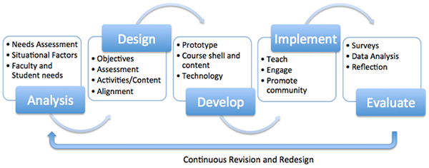
ADDIE
© University of Connecticut, http://ecampus.uconn.edu/course_development/addie.html

Slide 7
The Instructional Design Model of The Traditional Classroom
1 – Identify concepts and topics to be covered in the class, subdivide those into Units or Modules, and state a collection of learning objectives that will be assessed
2 – During class meeting time introduce information on the main concepts and topics to the students, usually through lecture
3 – Students work independently outside of class on activities intended to deepen their understanding of the content and master the learning objectives
Notes:
This is a very ingrained model.
I have found my self fighting this at every turn.
This is a point of view, one of many points of view
Ptolemy versus Copernicus.

Slide 8
The Instructional Design Model of The Flipped Classroom
1 – Identify concepts and topics to be covered in the class, subdivide those into Units or Modules, and state a collection of learning objectives that will be assessed
3 – Students work independently outside of class in structured activities where they encounter and learn the basic concepts and information of that lesson.
2 – During class meeting time students assess their basic knowledge and work cooperatively or collaboratively to deepen their understanding of the content and master the learning objectives
Notes:
Flips items 2 and 3
Possibly not a great name but we are stuck with it.
Maybe a better Name is the Interactively Engaged classroom
Lots of variations, possibly infinte

Slide 9
What are some of the advantages of the flipped classroom model compared to the traditional classroom model (from the literature)?
Traditional Classroom
Flipped Classroom
Difficulty of student work is inversely proportional to accessibility students have to the instructor
Students have little control over the stream of information
Little or no formal cooperative or collaborative learning
Instructor-centered
Difficulty of student work is directly proportional to accessibility students have to the instructor
Students have a great deal of control over the stream of information (videos).
Structured cooperative or collaborative learning are a key component
Student-Centered

Slide 10
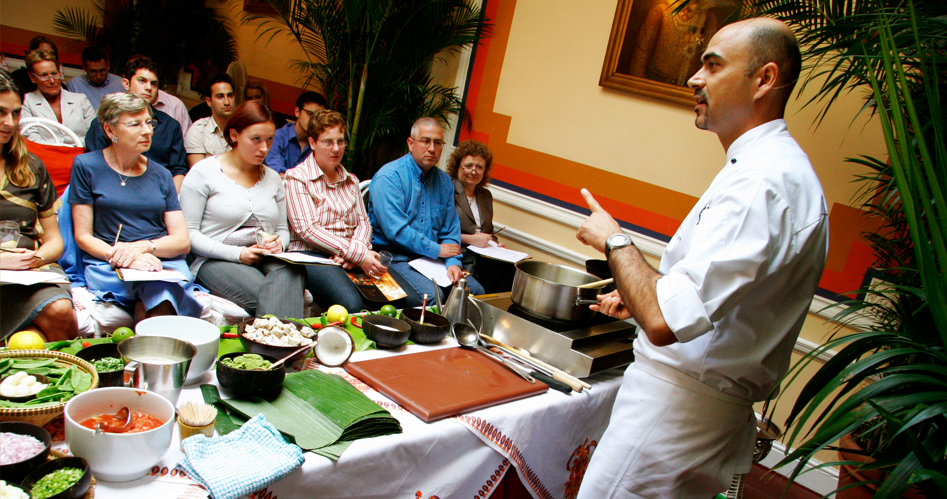
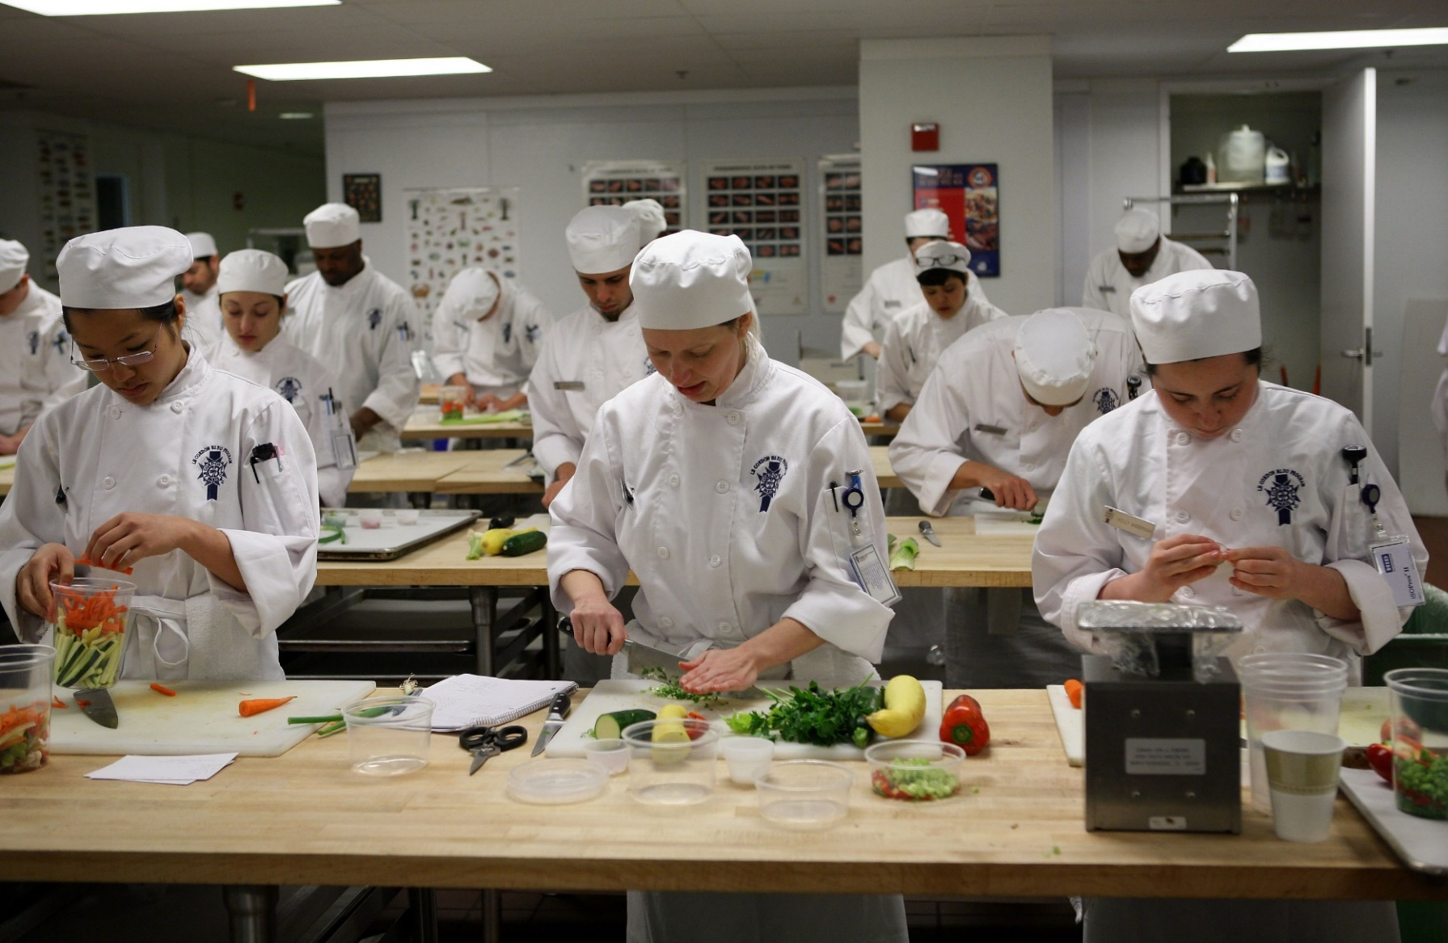
Why I decided to flip my class

Slide 11
Designing My First Flip: Linear Algebra
Use units and learning objectives from when I last taught the class
Create Tegrity videos of my lectures and assign these to be viewed before class
Work in OneNote, with Tegrity doing screen and audio capture.
Each class meeting begin with a short quiz over the assigned video material
Deliver and collect in DyKnow.
Use an example problems from video and easy homework problems
During class assigned students to work more advanced homework problems and submit their solutions in DyKnow.
Comment on and correct their submissions during class
Make all the homework problems assignments available, but don’t collect.

Slide 12
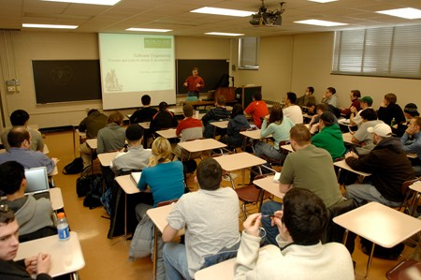
Implementing My first flipped class: Something is missing?
Some Lessons Learned:
Students listened to my video recording at 1.5x (student-centered!)
My expectations of where they would be after watching the videos was too high.
Given specific direction, students will do what ever you ask them to do, no matter how insane it seems.
Given vague directions with “no call to action” and no student interaction students will sit like bumps on a log.
Notes:
Video was a success, just not class.
Course evaluations, liked tegrity was the overwhelming response.
Lead me to conclude there were benefit for student learning.

Slide 13
Initial Revision and Redesign
Adjustments
Lessons Learned
Created DyKnow Notebooks to deliver before-class instruction
Scratch off answers
Embedded videos
Scaffolded notes
Assigned some “work” due before class
Not waste class meeting time with quizzes
Submit in Blackboard
SoftChalk learning modules
Embedded in Blackboard course shell.
Graded
Due before class
Called on students by name during class
Prior teaching experience lead me to focus pre-class material
I knew how to do this.
Students struggled to understand how to engage the material authentically during class
Self-regulated learning?
Not successful at getting students to “do” something during class
Flipping might be harder than I thought, not effective, or I was missing a key ingredient.
Notes:
Worked vary hard to make out of class materials really good.
Mistake was thinking they would get to some meaningful intermediate point on their own. My Expectation was out of alignment, and probably not well developed.
Still be influenced by the traditional model.
Candid conversations with some students encouraged me to continue, but I was really about to give up.

Slide 14
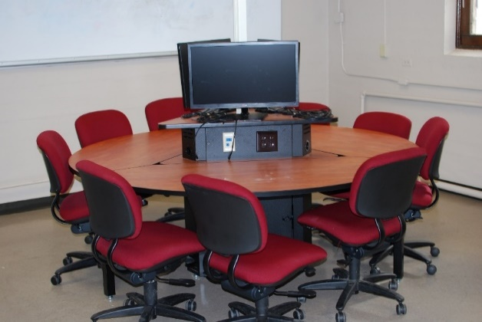
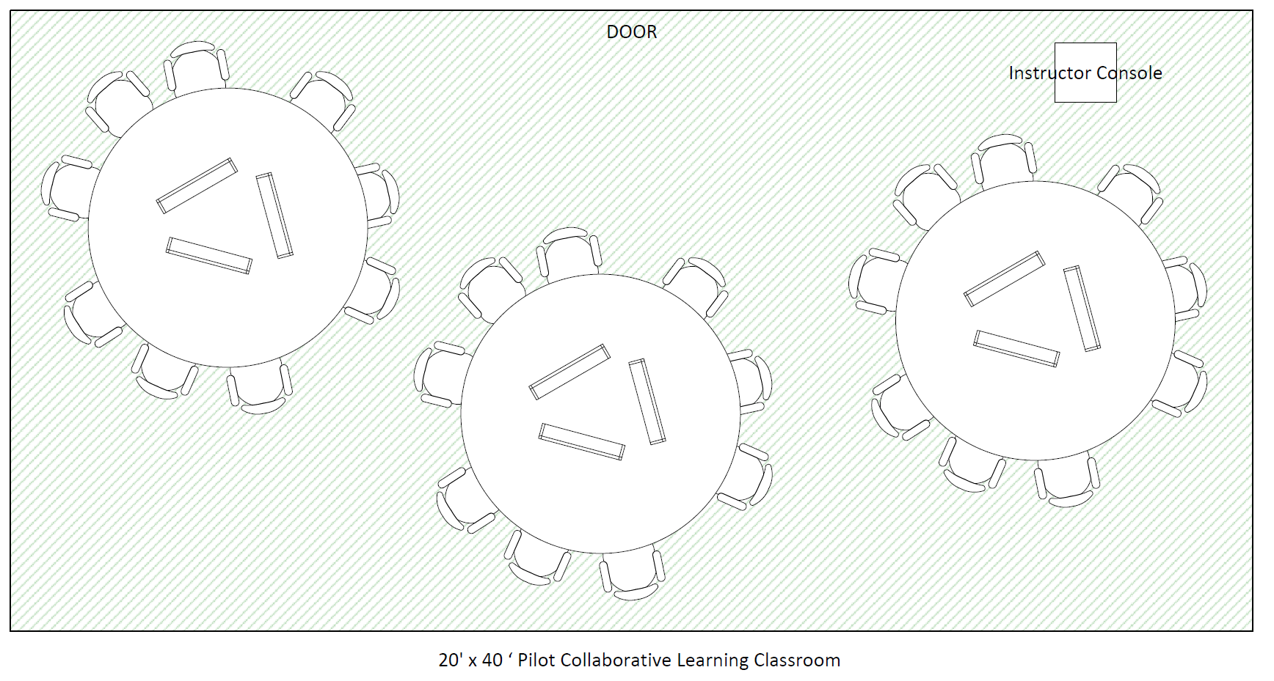
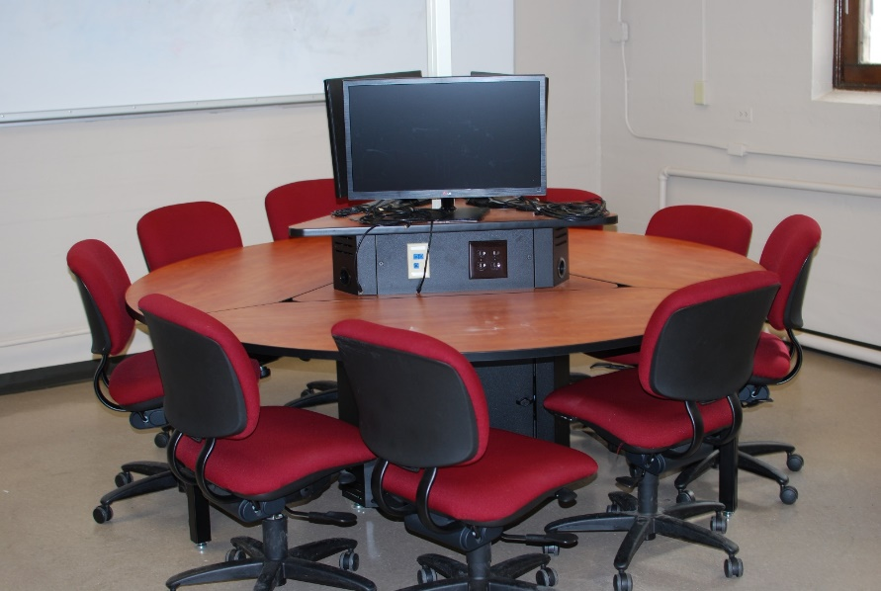
Learning Spaces: A new dimension
Speed School Center for Teaching and Learning Engineering: Pilot Collaborative Learning Classroom
Notes:
No front of the classroom
Room to circulate
Student face each other
Screens give me a push.
Wished students could use them

Slide 15
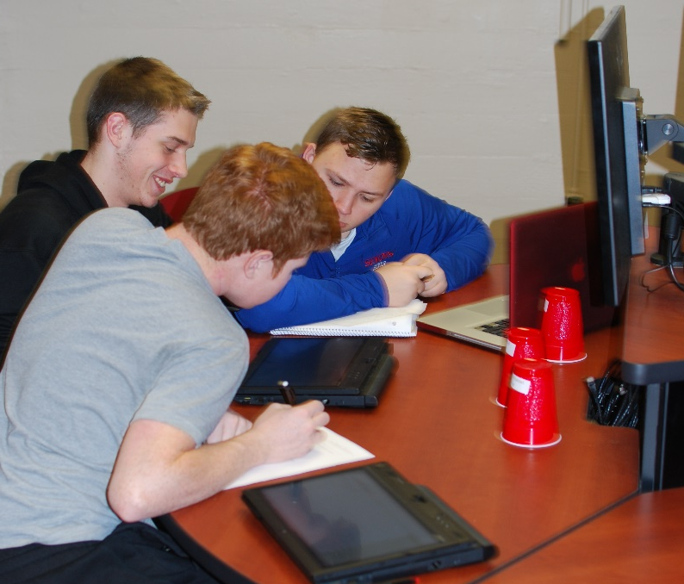
Design and Implementation for Partially Flipping Engineering Analysis I
3 days every 2 weeks meet in the collaborative learning lab (partial flip) (75 min)
Remainder of the class followed the traditional classroom model (meets everyday, 4 ch.)
Videos replaced the missing lecture period
Used pre existing videos
In the Collaborative Learning Lab
Work in random teams of 2-3 on selected homework problems (removed from assigned homework)
Group Work was collected and scores (check, check plus) with feedback
Good format and syntax.
Failure to attend was a 0, otherwise at least a 9.5/10
5% of the course grade
Ask three then me
Begin with 2-5 minute Ice-Breaker
Notes:
The space and the collaboration got them moving.

Slide 16
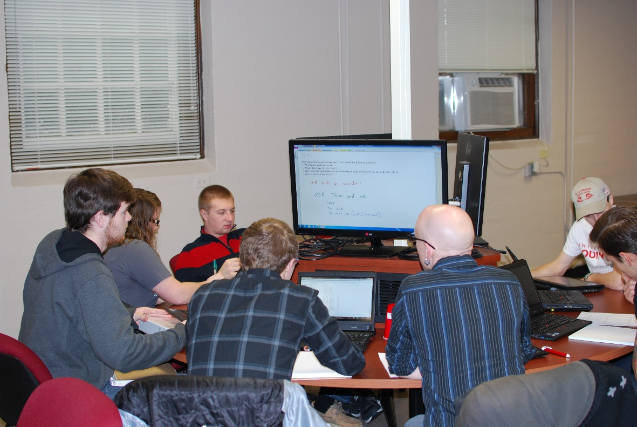
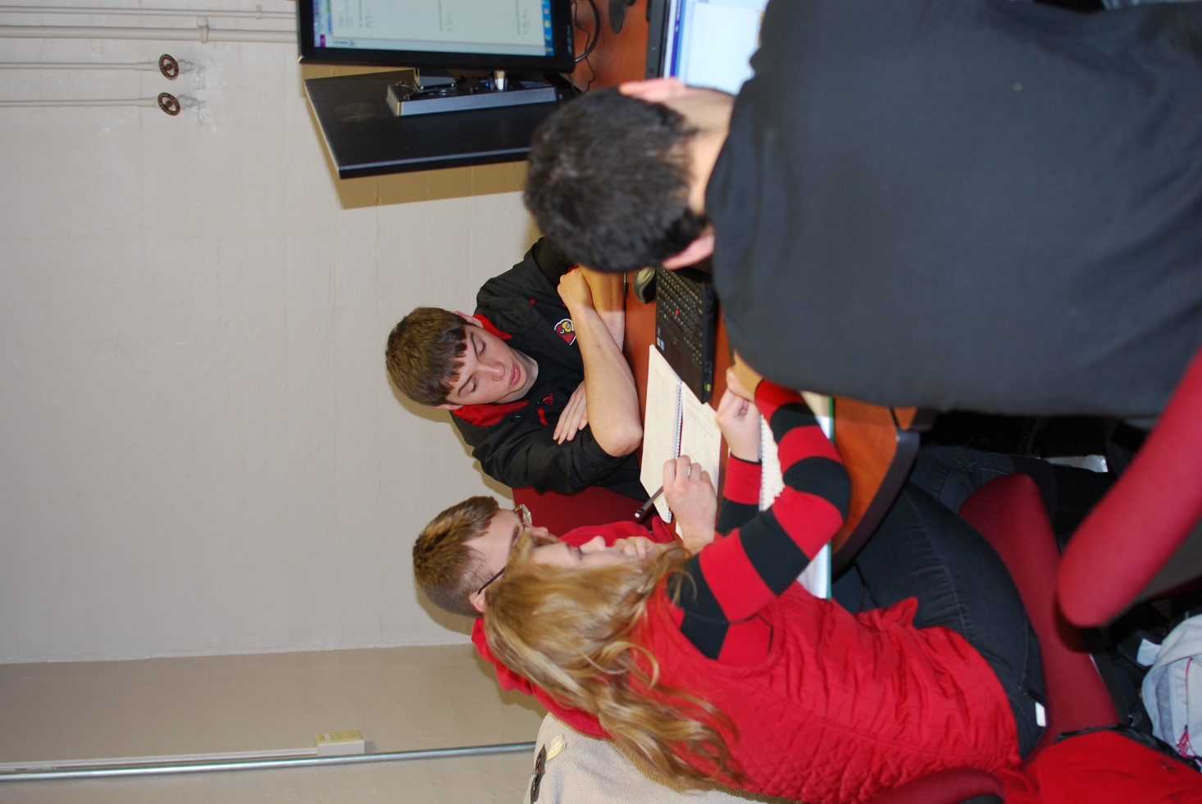
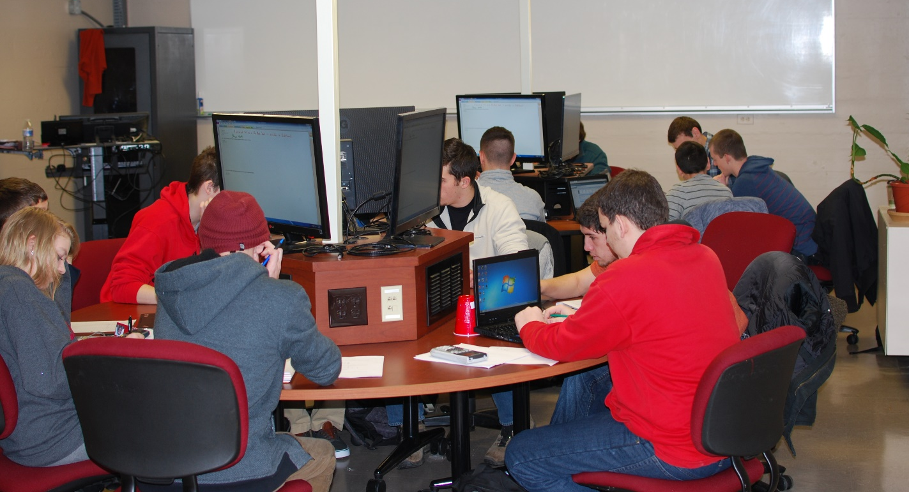
Notes:
Had to kick them out
Engaged and on task

Slide 17
Lessons Learned: My Flipped Classroom Model
Structured in-class Collaborative Activities
Readiness Assessment Tests
Before Class Materials
Learning Space

Slide 18
Lessons Learned: Before-Class Materials
Students like videos (some definitions require the use of videos for a flipped class).
Better if they have some active components
Practice questions, embedded quiz questions
Don’t have to be perfect
Use existing materials, give options
Multi-media from the textbook, others “open” sources.
Think mash-up.
This is the part of the flip to most heavily invest in the use of technology
Camtasia
Softchalk
LMS plugins
Microsoft OneNote
Lots of others (see hand-out)
Notes:
Low tech in class High Tech Out of class

Slide 19
Lessons Learned: Readiness Assessment Tests (RATs)
Absolutely a must!
Students may not be accustomed to the expectation that they are to engage the material prior to any structured class activity.
Need to be quick, delivery with paper (low tech) may be the best to start with.
Hold students accountable for preparing for class, but don’t punish them if they haven’t mastered the learning objectives.
For me, these are very different from other tests I give
Get creative
Possible Tools
Blackboard Quiz
Learning Catalytics
Clickers
others

Slide 20
Lessons Learned: In-Class Structured Activities
The Learning Space is an important part of a class.
Small group cooperative or collaborative learning
Use Icebreakers to get them started talking to each other.
Usually low tech (paper) makes the activity more acceptable to everyone.
I find a “repeatable” structure or plan helps students come to understand what to expect when they come to class.
Key word here is structured, you can’t have too much
However long you think it will take them to do the activity, multiply by 2
Don’t panic if students don’t complete the activity.
Technologies
Clickers, Top Hat, Learning Catalytics, Google docs, lots of others.
Don’t rely to heavily on technology.
Eventually – Everything becomes a teachable moment
Circulating and evenly distributing your time across groups happen naturally.
Notes:
Learning Space is part of the equation
Never paid that much attention before
You can overcome less than ideal spaces, but I think starting in a designed space is benficial
Small group cooperative or collaborative learning
Use Icebreakers to get them started talking to each other.
Activity needs to be genuine and authentic
Usually low tech (paper) makes the activity more acceptable to everyone.
Technologies
Since this is during class, if you rely too heavily on technology, one or two people can easily derail your class. I always have a paper back up
Eventually – Everything becomes a teachable moment
Read up on Socratic teaching
Students like to leave with something
Do you collect, do you return
Take pictures
DON’T COPY
SCRIBES

Slide 21
Other lessons learned
You have to have thick skin
Students are much more likely to be honest with you when you are the guide on the side.
It doesn’t feel like teaching
You have to be really flexible and nimble
Some students really resist working in groups
You need to have some way of addressing this
Students want to be “paid” for everything, so there can be a lot of accounting to do.
Gamification could help here.

Slide 22
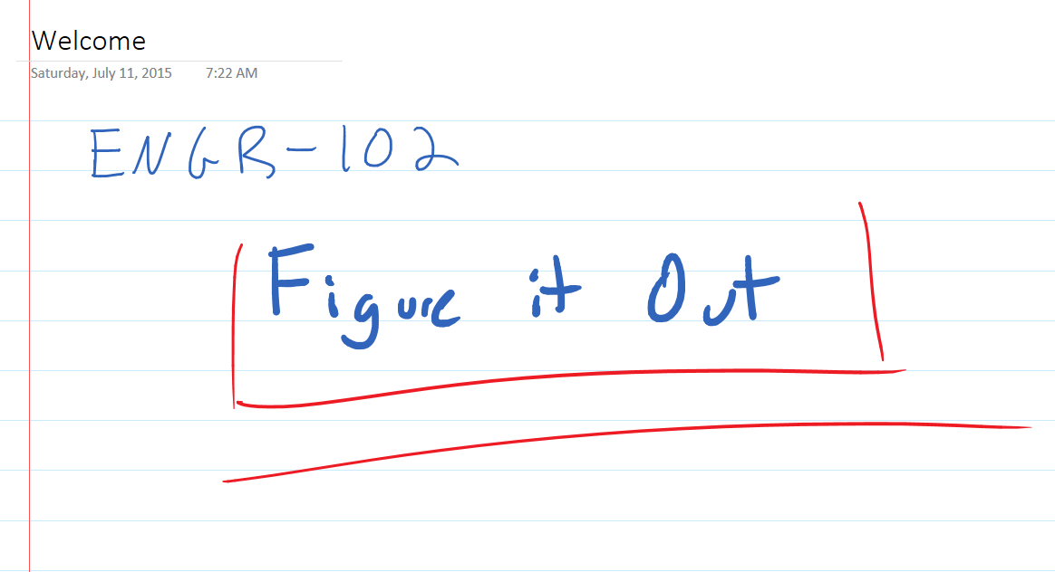
Putting it all together: Flipping Engineering Analysis I, II, & III
Before Class MyMathLab (LMS) assignment (Due date, not graded, required to access HWK)
OneNote Notebook Page with figures, definitions, Link to my Lecture Video, other links
Bring a One Page summary to class and turn it in (keep a copy for your self).
Link to the assigned reading in the Textbook
A few practice problems (easier problems, no learning aides)
At the beginning of class: RAT
Paper, variety of questions, graded using a simple rubric (~12 min to grade 100)
During Class
Show answers to RAT w/ mini-lecture.
Students work in groups to solve problems, in Learning Lab, students can put their work on the screen for their group.
Think Aloud Protocol
After class
Homework set (1 per ~ 3 class meetings) ~80% for full credit.
Spend the entire first day discussing and explaining the learning plan for the course
Notes:
Slide for the first day of class in ENGR-102

Slide 23
Assessment and Evaluation: My Impressions Before and After
Before
After
I felt like class was too short
25% of the physical space of the classroom was for me only, and I never left that space
New very few names (~100 students)
Instructor-Centered
Hoarse at the end of class period
I talked the whole time to the whole class
Students think class is too short
None of the classroom space belongs to me, but I visit 100 of the space in the room every class meeting.
Know nearly every students name by the end of the semester (~100)
Student-Centered, community-Centered, knowledge – Centered (?)
Physically tired from running around
Large percent of my time is now doing Socratic teaching to small groups
Notes:
What do I mean by assessment
Evaluation – is it working is it effective.
How did it go
My Imprisons
This is a very complicated question

Slide 24
Assessment and Evaluation : Student Input (60 responses)
44 like the flipped class format and most gave some reason why it benefited their learning
“I love actually working problems during class time because you have the people around you and the professor to help you when you get stuck on a problem. . . “
15 neutral responses
It is easy for students to fall behind,
you have to prepare for class for it to work
1 Negative – I don’t like it
Some interesting individual responses:
“The flipped class does not mean you don’t teach! Need to have some way for students to learn the material (videos, structured notes, etc.)”
“Things you should tell them
It holds the student accountable
Allows a reference to always return to when studying/preparing for a test
Gives students a chance to know what to expect when they come to class that day”
“A book can explain a concept, but a professor helps you understand it”
Notes:
I should note that my course evaluations have not suffered. In fact most recently they were higher than they have ever been,.
Student impressions of learning are not authoritative, but when you aggregate that information it is still relevant data.

Slide 25
Assessment and Evaluation: Student Performance
Currently collecting data
Only anecdotal evidence at this time, but positive.
In the literature there is very little genuine evaluation of the impact on learning of the flipped classroom
However, the benefits of active learning are reasonably well documented
When if comes to student performance, I have some concerns about simple comparisons to traditionally taught courses
Do exams from a traditional classroom context adequately assess all of the potential flipped class outcomes
What did I expect when I started?
What about life long learning?
Notes:
When I started experimenting with the flipped class room I think I had in mind singularly better test grades. Since I have been implementing flipped classes I have started to question whether that singular measure is the whole story or even the relevant story.

Slide 26
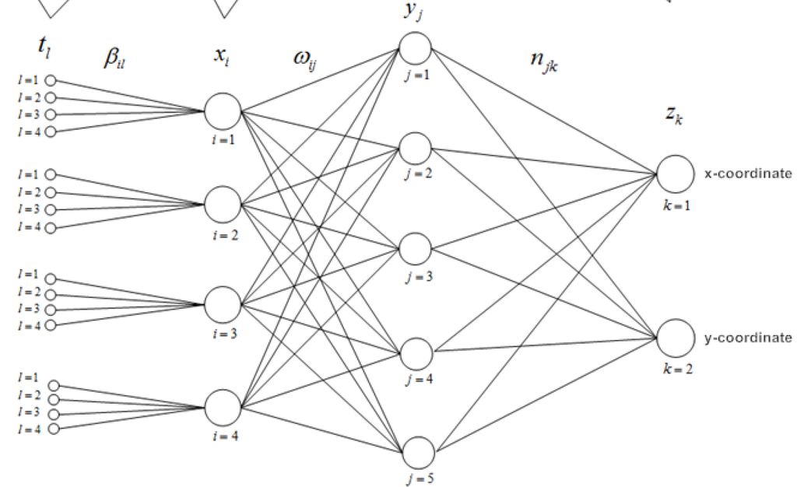
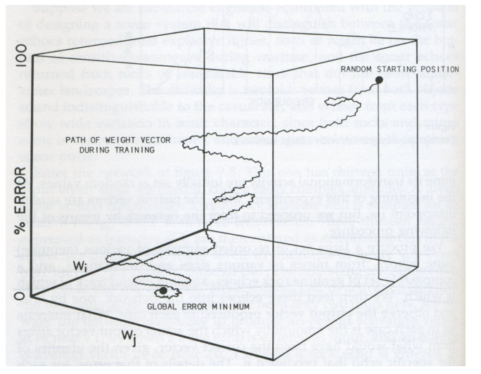
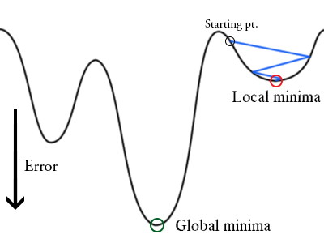
Some more thoughts on assessment and evaluation
Notes:
Escaping out of a local minimum
Gradient decent though weight space

Slide 27
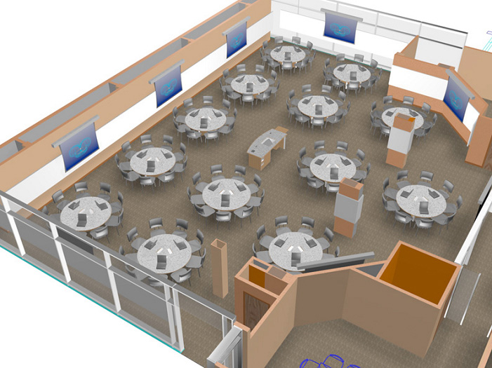
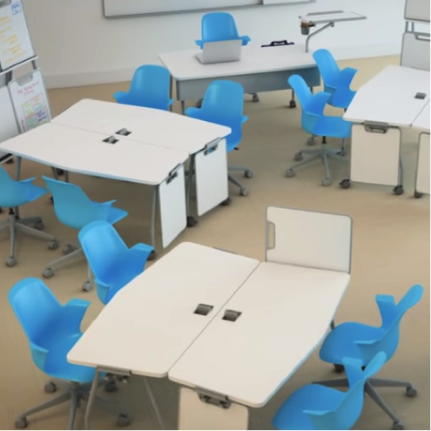
Learning Lab Classroom
Active Learning Classroom

Slide 28
Concluding Activity: Flipped Classroom Brainstorming
There is an opportunity for one of you to teach the class of your choice in a new learning space.
The learning space is either the learning lab set up or the active classroom set up from the previous slide
Assume that what ever technology you want in the learning lab is there
Assume the room is sufficient to hold any number of students you wish to have.
Assume that you will keep the same “units” and learning objectives
Assume that through some miracle of technology all of your lectures are now available to the students as assignable high quality videos
Come up with an innovative idea or ideas for how you would conduct your class as a flipped classroom in the space of your choice.
Now share your idea with the people at your table
Notes:
Delphi will be running a FLC on flipped classes
TILL
Please Feel free to contact me

Slide 29
Time Permitting
For your idea or ideas, or others’ ideas:
What technologies do you need?
What support services do you need?
What is the biggest barrier to implementation?
What impact do you think this might have on student learning?
How do you think students would react to this in your class?

Slide 30
Questions
Feel free to contact me via email
My email address is on the handout and my card.

