Slide 1
Lights, Cameras, Action!
Use of Contemporary Film to Stimulate Higher Level Learning

Slide 2
Barbara Head, PhD, CHPN, ACSW, FPCN Lisa Smith, MSSW, Doctoral Candidate

Slide 3
Let’s start with a scene….

Slide 4
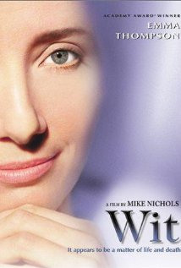
What Could you teach using this scene?

Slide 5
Our Experience
Graduate Social Work course – Death and Grief online
Need to expose students not only to theories and concepts
Create opportunities to apply concepts and theories to “messy,” unique, multifaceted scenarios
Films used as triggers to stimulate experiential, higher level learning

Slide 6
Our Course
SW636 “Death and Grief”
Graduate Level Course at Kent School of Social Work, University of Louisville
Offered Spring, Summer, Fall
Open to students in other disciplines
Taught Face-to-face and Online
Face-to-face
Film clips used to stimulate reaction/discussion/application
Interactive discussions, case studies, decisions cases
Online
Readings/online lectures before watching film
Complete critical thinking assignment after film

Slide 7
Student Feedback
Statement | Strongly Disagree | Disagree | Agree | Strongly Agree | Total
Using contemporary films as examples of course content is an effective way to teach this course. |  | 2 3% | 13 17% | 62 80% | 77
I learned more by applying course content to contemporary films than I would have learned by just reading the content. |  | 3 4% | 9 12% | 63 84% | 75
This course improved my critical thinking skills. |  | 1 1% | 37 49% | 38 50% | 76
I think I learned as much by taking this online course as I would have learned if it were delivered face-to-face in a classroom. | 2 3% | 20 26% | 24 32% | 30 39% | 76
I would recommend this course to other graduate students. |  | 1 1% | 20 26% | 57 73% | 78
Because I applied course content to actual scenarios, I will better remember what I learned in this class. |  | 4 5% | 26 34% | 46 61% | 76
The use of film to teach this course will make me a more reflective practitioner. |  | 7 9% | 30 41% | 37 50% | 74
The films chosen were realistic portrayals of what I learned in class. |  | 3 4% | 31 40% | 44 56% | 78

Slide 8
Theory
Experiential learning is a…
“holistic integrative perspective on learning that combines experience, cognition and behavior” (Kolb, 1984, p. 41).
Notes:
Levels of learning – as instructors we want to create a learning experience for our students that will engage them through this process of gaining knowledge, demonstrating skills, and internalizing the experience.

Slide 9
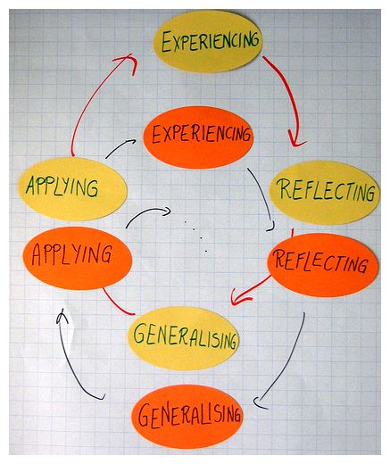
Theory
Kolb’s Learning Cycle
Experiencing
Concrete Experience
Reflecting
- Reflective Observation
Thinking
Abstract conceptualization
Acting
Active Experimentation
Notes:
Film can provide the concrete experience – of which stimulates the reflective process and application of abstract ideas/concepts

Slide 10
The Contemporary Student
Exposure to multimedia learning began early: Sesame Street, Mr. Rogers, Baby Einstein
Films are part of pop culture
Entertainment & enjoyment
Exposure & access to video & media
TV, Online, Mobile Phones/Tablets
Use of video to search for information
YouTube

Slide 11
Examples from the Literature
Film has been used to teach in a multitude of disciplines
Psychology
Geriatrics
Industrial-organizational Psychology
Management
Existentialism Theory Applied to Counseling
Organizational Behavior
Medical Ethics
Doctor/patient Relationships
Sports Psychology
Human Rights Issues
Employment Discrimination
Social Work Education

Slide 12
Support for Using Film
“Visual Textbook” (Russell, 2012)
Mimics Complex Environment and Human Experience (Liles, 2007)
Visual, Auditory, & Written Mechanisms (Karaski et al., 2014)
Medium for Critical Reflection (Ash & Clayton, 2009)

Slide 13
Pedagogical Approach Russell Model
Stage 1 – Preparation
Stage 2 – The Pre-viewing Stage
Stage 3 – The Watching Stage
Stage 4 – The Culminating Activity

Slide 14
Stage 1 - Preparation
Film selection
Develop of learning objectives & lesson plan

Slide 15
Stage 2 – The Pre-Viewing Stage
Prepare students to watch the film
Provide introduction to film or film options
Assignment description with learning objectives shared

Slide 16
Stage 3 – The Watching Stage
Students secure and watch the film
Informed that securing the film was required for class (just as textbooks are required)
Use of online streaming resources

Slide 18
Stage 4 – The Culminating Activity
Enables instructor to evaluate student outcomes
Student post as well as interactions in discussion board
Grading rubric
Extensive student feedback

Slide 19
SPIKES Protocol
Setting up the interview
Perception of the patient
Invitation of the patient
Knowledge & information giving
Emotional expression & empathetic response
Strategy and summary
Baile et al., 2000

Slide 20
Assignment – Giving Bad News

Slide 21
Learning/Teaching Opportunities
Compare to protocol
Compare to each other
Rewrite the script
Imagine emotions of receiver
Develop the story

Slide 22
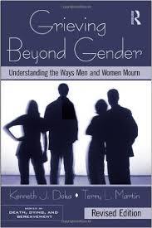
Assignment – Grieving Styles
Doka and Martin, Grieving Beyond Gender
Two dominant grieving styles

Slide 23
Two Styles
Instrumental
Intuitive
Thinking dominates
Action oriented, problem solvers
Reluctance to talk about feelings
Mastery of self and environment is priority
Thinking and doing dominate
Feelings intensely experienced
Grief expressed through ventilation of feelings, crying
Expression mirrors inner feelings
Expression and exploration of feelings dominate

Slide 24
Two Different Styles

Slide 25
Now It’s Your Turn

Slide 26
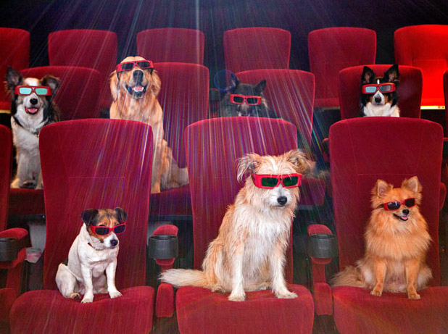
Where can you find more information?
Teaching with Movies – offers more than 390 learning guides and lesson plans www.teachwithmovies.org

Slide 27
Questions/Discussion

Slide 28
References
Ash, S., & Clayton, P. (2009). Generating, deepening, and documenting learning: The power of critical reflection in applied learning. Journal of Applied Learning in Higher Education, 1, 25-48.
Baile, W., Buckman, R., Lenzi, R., Glober, G., Beale, E., Kudelka, A. (2000). SPIKES – A six-step protocol for delivering bad news: Application to the patient with cancer. The Oncologist, 5, 302-311.
Doda, K., & Martin, T. (2010). Grieving Beyond Gender. New York: Routledge.
Karasik, R. J., Hamon, R., Writz, J., & Moddu Reddy, A. (2014). Two Thumbs Up: Using Popular Films in Introductory Aging Courses. Gerontology & Geriatrics Education, 35(1), 86-113. doi:10.1080/02701960.2012.749253
Kolb, D. A. (1984). Experiential learning: Experience as the source of learning and development. Journal of Management and Organization, 16(1), 100-112.
Liles, R. E. (2007). The Use of Feature Films as Teaching Tools in Social Work Education. Journal of Teaching in Social Work, 27(3-4), 45-60.
Russell, W. B., III. (2007). Using film in the social studies. Lanham, MD: University Press of America.
Russell, W. B., III. (2012). The Art of Teaching Social Studies with Film. Clearing House: A Journal of Educational Strategies, Issues and Ideas, 85(4), 157-164.

Slide 29
References for Use of Film in Other Disciplines
Alexander, M., & Waxman, D. (2000). Cinemeducation: Teaching family systems through the movies. Families, Systems, & Health, 18(4), 455-466. doi:10.1037/h0091869
Bluestone, C. (2000). Feature Films as a Teaching Tool. College Teaching, 48(4), 141. Blumer, M. L. C. (2010). And Action! Teaching and Learning Through Film. Journal of Feminist Family Therapy, 22(3), 225-235. doi:10.1080/08952833.2010.499703
Casper, W., Champoux, J., Watt, J., Bachiochi, P., Schleicher, D., & Bordeaux, C. (2003). Feature film as a resource in teaching I-O psychology The Industrial-Organizational Psychologist, 41(1), 83-93.
Dans, P. E. (2011). A personal journey using film to teach medical ethics. In H. G. Colt, S. Quadrelli, & L. D. Friedman (Eds.), The picture of health: Medical ethics and the movies. (pp. 11-18). New York, NY US: Oxford University Press.
Furst, B. A. (2007). Bowlby goes to the movies: Film as a teaching tool for issues of bereavement, mourning, and grief in medical education. Academic Psychiatry, 31(5), 407-410. doi:10.1176/appi.ap.31.5.407
Gorring, H., Loy, J., & Spring, H. (2014). Cinemeducation: using film as an educational tool in mental health services. Health Information & Libraries Journal, 31(1), 84-88. doi:10.1111/hir.12052
Huczynski, A., & Buchanan, D. (2004). Theory from Fiction: A Narrative Process Perspective on the Pedagogical Use of Feature Film. Journal of Management Education, 28(6), 707-726. http://dx.doi.org/10.1177/1052562903262163
Kalai, S. (2014). Cinema as an Effective Tool for Teaching Human Rights Issues and Problems: An Analytical Study of Samuel Goldwyn's Film: "The Whistleblower". International Journal of Multidisciplinary Approach & Studies, 1(5), 233-244.
Karasik, R. J., Hamon, R., Writz, J., & Moddu Reddy, A. (2014). Two Thumbs Up: Using Popular Films in Introductory Aging Courses. Gerontology & Geriatrics Education, 35(1), 86-113. doi:10.1080/02701960.2012.749253
Kirkpatrick, M. K., & Brown, S. (2004). Narrative pedagogy: teaching geriatric content with stories and the "Make a Difference" Project (MADP). Nursing Education Perspectives, 25(4), 183-187.
Lafferty, M. (2013). Using feature films in the teaching and assessment of sport psychology. Sport & Exercise Psychology Review, 9(2), 74-82.
Liles, R. E. (2007). The Use of Feature Films as Teaching Tools in Social Work Education. Journal of Teaching in Social Work, 27(3-4), 45-60.
Ozcakir, A., & Bilgel, N. (2014). Educating Medical Students about the Personal Meaning of Terminal Illness Using the Film, 'Wit'. Journal of Palliative Medicine, 17(8), 913-917. doi:10.1089/jpm.2013.0462
Pendo, E. (2013). Identifying with disability: Using film to teach employment discrimination (Vol. 58, pp. 143-154): Saint Louis University School of Law.
Smith, G. W. (2009). Using Feature Films as the Primary Instructional Medium to Teach Organizational Behavior. Journal of Management Education, 33(4), 462-489.
Whipple, J., & Tucker, C. (2012). Using cineama and literature to explore existentialism. Journal of Creativity in Mental Health, 7, 95-106

