Slide 1

Incorporating and Assessing Critical Thinking Skills in a Healthcare Environment: Online Training Modules and Rubrics
Celebration of Teaching and Learning
February 12, 2016
Jennifer Rudy, M.A., R.D.H
P. Gay Baughman, D.M.D.

Slide 2
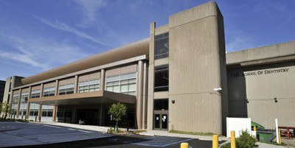
How Do We Teach These Skills….
Problems we encountered
  Problem solved!!
Target Audience:
  First Year Dental Students, First and Second Year Upper Division Dental Hygiene students and New Faculty

Slide 3

Module Construction
Soft Chalk
Identified faculty that would implement this in courses
Videos filmed by University of Louisville’s Ron Harrison
  Critical Thinking questions dependent upon videos and course
Assessment piece
  IRB pending

Slide 4
Show and Tell Time…

Slide 5


Slide 6



Evidence-based Dentistry/Critical Thinking Exercise
The purpose of this assignment:
Ask students to analyze and discuss work products to compare how outcomes correspond to best evidence.
Demonstrate the use of the active learning method, critical appraisal of scientific evidence in combination with clinical application and patient factors, in a structured session in which faculty and students reason aloud about patient care.

Slide 7
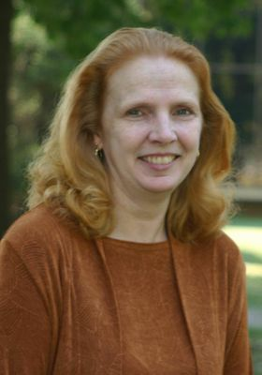
Dr. Cathy Bays

Slide 8
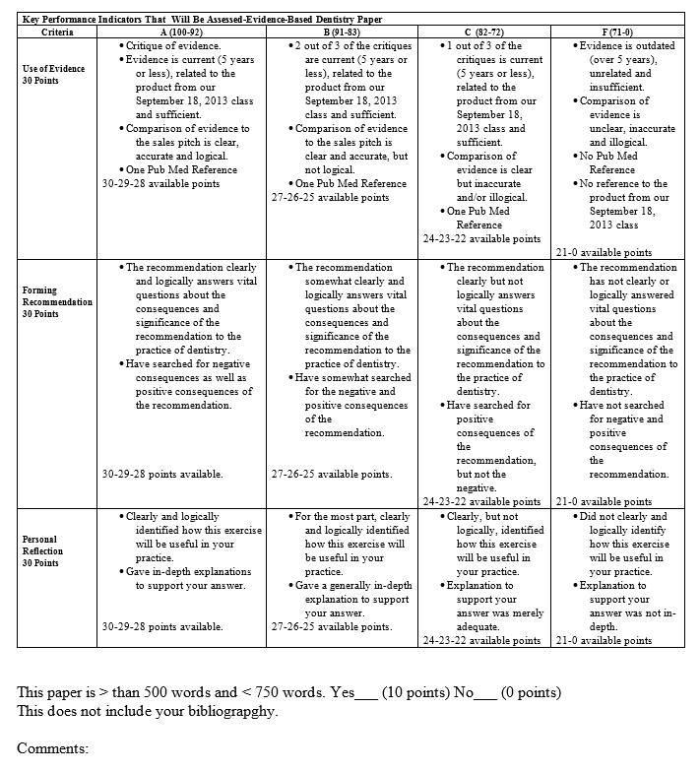
First
Attempt

Slide 9

Consistent assessment criteria
Clear guide
Easier GRADING

Slide 10
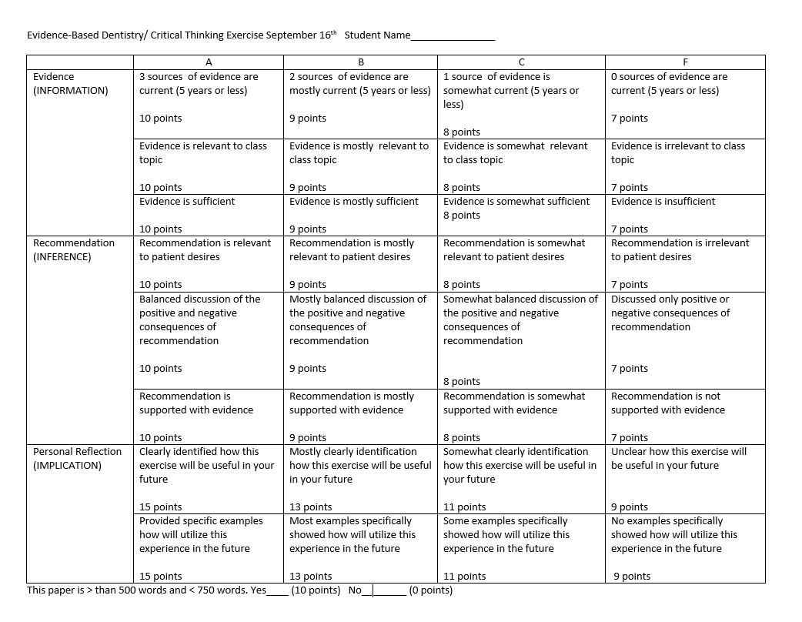
Better

Slide 11
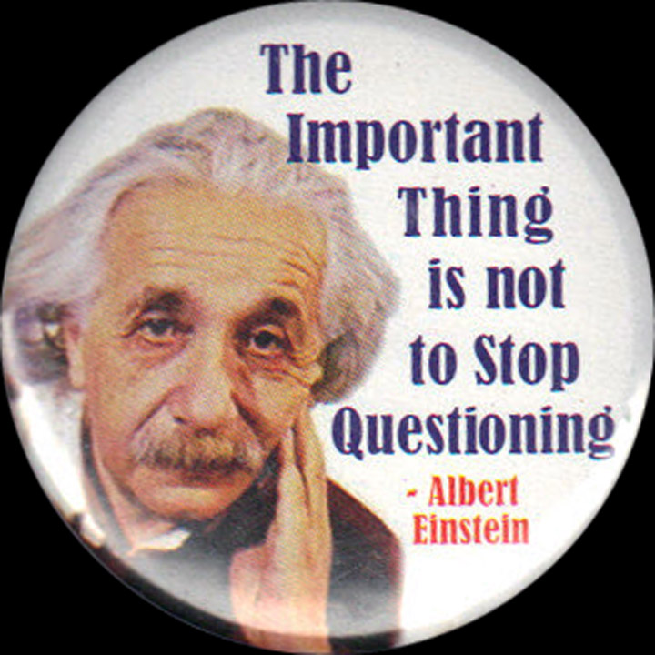
Asking The GOOD Question
Discussion Board Group Activity and Critical Thinking Skills
Random groups of approximately 6 students
Groups post 2-3 questions in the Blackboard Discussion Board
Assessed on the quality questions using Rubric
Allows us to go deeper without use of class time

Slide 12
Critical Thinking Rubric for Discussion Board Questions
Introduction to Clinical Dentistry I
 | 1-Needs Development | 2-Acceptable | 3-Superior
Elements and/or Standards | Uses less than 3 elements and/or standards |  | Uses 3 elements and or standards
Question Score:_________ | Unclear about what question(s) need to be asked. | Usually understands the important question(s) that need to be asked. | Consistently understands the important question(s) that need to be asked.
Depth Score: _________ | Brings little to no additional depth to the session. | Usually brings some additional depth to the session. | Brings a great deal of additional depth to the session.
Essential Intellectual Traits Intellectual Perseverance Score: _________ | Simple, superficial thinking that does not require struggling/ effort/or work to form questions. | Usually works their way through the complexities of the question. | Consistently works their way through the complexities of the question.
Intellectual Autonomy Score: _________ | Follows the thinking of the lecturer. | Usually thinks for oneself in a clear, accurate and logical manner. | Consistently thinks for oneself in a clear, accurate and logical manner.

Slide 13
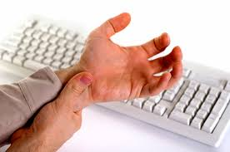
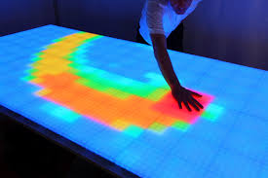
Thank You Linda Leake!

Slide 14


Critical Thinking is
USELESS
Unless It is Applied.

Slide 15

Clinical Competencies
The Traits
Intellectual Autonomy
Confidence in Reasoning
Intellectual Empathy
Intellectual Integrity

Slide 17
D4 Capstone Project
PURPOSE
Develop well-planned comprehensive treatments plan for a complex case without faculty assistance.
It is a tool for an assessment of individual professional growth
It allows students to reflect on their clinical experiences and to do a self-assessment.
Teaches them to critically think in different clinical situations and apply the information in new ways.

Slide 18
 | Student Score |  |  | Faculty Score
Category | 3 | 2 | 0 | 3 | 2 | 0
Understanding List of Data
Evidence/Information
Analyze and Evaluate
Create
Reflection/Self-Evaluation
TOTAL
FINAL GRADE
Comments:

Slide 19
5-grid Points | Numerical Grade | Letter grade | 5-grid Points | Numerical Grade | Letter Grade
5|0|0 | 100 | A | 0|4|1, 3|0|2 | 72 | D
4|1|0 | 96 | A | 2|1|2 | 68 | F
3|2|0 | 93 | A | 0|3|2 | 61 | F
2|3|0 | 89 | B | 2|0|3 | 58 | F
1|4|0, 4|0|1 | 86 | B | 1|1|3 | 54 | F
0|5|0, 3|1|1 | 82 | B | 0|2|3 | 51 | F
0|6|0, 3|2|1 | 82 | B | 1|0|4 | 44 | F
2|2|1 | 79 | C | 0|1|4 | 40 | F
1|3|1 | 75 | D | 0|0|5 | 30 | F

Slide 20
Capstone Treatment Planning Presentation Rubric
 | E- Exceptional (3) | A-Acceptable (2) | N-D-Needs Development (0)
Understanding List of Data | Collected all relevant info with elaboration on material | Collected all necessary information | Did not collect sufficient data
Evidence/Information | Evidence is current (5 years or less) related to the topic and sufficient. 3 references (no textbooks), one Pub Med reference. | 2 out of 3 of the critiques are current (5 years or less), related to the topic and sufficient. The evidence inaccurate but not clear and/or significant. One Pub Med reference. | Evidence is outdated (over 5 years), unrelated and insufficient. The evidence is unclear, inaccurate, and not significant. No Pub Med reference.
Analyze and Evaluate | Clearly/Logically analyze and evaluate all info, problem list, diagnoses. Provides precise rationale for tx. Objectives develop relevant/significant tx options. | Analyze and evaluate all info, problem list, diagnoses develop tx. Objectives, did not defend treatment options. | Did not analyze and evaluate all info.
Create | Accurately synthesized all info, created 2 or more realistic treatment planning choices, accurately predict outcome and provide diagnosis | Synthesized all info, created 1 tx planning choice, predict outcome and provide diagnosis | Did not synthesize all info, created 1 tx planning choice, did not predict outcome or provide diagnosis
Reflection/Self-Evaluation | Clearly reflects on how the assignment is relevant, practical or applicable to practice |  | Did not reflect of critique work.

Slide 22


