Slide 1
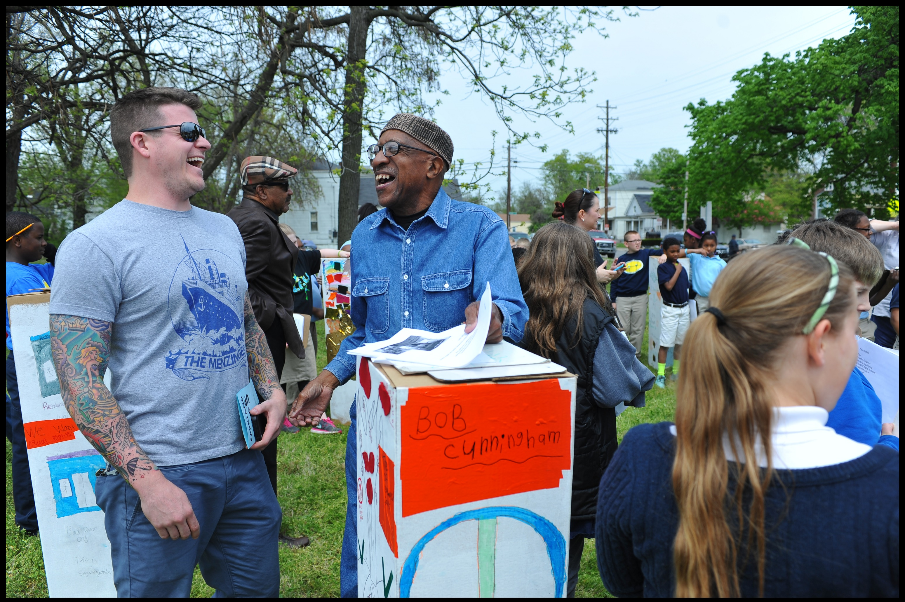
Community-Engaged Scholarship
2018 UofL FACULTY SURVEY

Slide 2
What is Community-Engaged Scholarship?
Community-engaged scholarship cuts across teaching, research [and creative activities], and service.
It involves generating, transmitting, and applying knowledge for the direct benefit of external partners in ways that are consistent with university and unit missions.

Slide 3
2018 Community-Engaged Scholarship Survey
Stratified sample
Project Audience 1,258
Responses Received 189
Response Ratio 15.02%

Slide 4
Involvement with Community-Engaged Scholarship by Faculty rank
Total 555
Total 531
Total 709
Total 138
Total 437

Slide 5
During the semester, how much of your time do you spend on
Community-Engaged Scholarship?

Slide 6
“CES has had a positive impact on my teaching”
89% agreed involvement in
CES has had a positive impact on their teaching

Slide 7
“CES has had a positive impact on my research”
73% agreed involvement in
CES has had a positive impact on their research agenda

Slide 8
“CES has had a positive impact on my plans for scholarly work”
74% agreed involvement in
CES has had a positive impact on their plans for future publications and presentations

Slide 9
“CES has had a positive impact on my relationship with faculty colleagues”
71% agreed involvement in
CES has had a positive impact on their relationships with fellow faculty members

Slide 10
“CES has had a positive impact on my relationship with students”
74% agreed involvement in
CES has had a positive impact on their relationships with students

Slide 11
“CES has had a positive impact on my relationship with community partners”
92% agreed involvement in
CES has had a positive impact on their relationships community partners.

Slide 12
“CES led to new focus for publication”
65% agreed that CES led to new focus for publication.

Slide 13
“My involvement in CES led to increased number of scholarly products”
50% agreed that CES led to increased number of scholarly products.

Slide 14
“My involvement with CES resulted in improved teaching methods”
76% agreed that CES resulted in improved teaching methods.

Slide 15
“My involvement with CES positively impacted promotion or tenure”
28% agreed that CES positively impacted promotion or tenure within dept, college, or school

Slide 16
“My involvement with CES resulted in an award or professional recognition”
37% agreed that CES resulted in an award or professional recognition

Slide 17
“My involvement with CES led to new or different mentoring roles with students”
74% agreed that CES led to new or different mentoring roles with students

Slide 18
CES impact
Met project goals (53)
Increased value of services (50)
Completed community project (48)
Increased capacity for partner (47)
Created new services or products (43)
New funding for partners (35)

Slide 19
CES impact comments
better access to care
Identity priorities that are congruent with my scholarly work
Improved cultural awareness and sensitivity
increased donations to UL
Increased visibility of university in community
student employment with the community

Slide 20
NO!!
86 out 188 responded they are NOT involved in CES

Slide 21
Which of the following influenced you in not participating in Community-Engaged Scholarship?

Slide 22
Other reasons
Never heard of it
Not compensated sufficiently
Not connected to my research interest/expertise
recent arrival
I already have a full agenda of my own.
I do basic science research
I have been, but there is just not a project now

Slide 23
How important is it to you to be involved with Community-Engaged
Scholarship at some point in your career?”
55% indicated that it is very or moderately important to be involved with CES at some in their career.

Slide 24
Are you interested in attending trainings or workshops on Community-
Engaged Scholarship?
49% are interested in attending trainings or workshops

Slide 25
Conclusion
Clearer picture of CES at UofL
Major impact on teaching and student relationship
Helping new faculty get started
More recognition for the work being done
Many faculty not currently involved in CES are interested in getting involved. How can we help?

