Slide 1
Partnership Data Collection Manual
Office of the Vice President for Community Engagement
The purpose of the Community Engagement Partnership data collection system is to enable the University of Louisville to report on its outreach and engagement activities. It allows academic and administrative units to explore UofL partnership activities through a range of categories, and to share reports about the work we do with the community. The database provides information that demonstrates the ways in which faculty, staff, and students are partnering with the community and the ways in which the university serves the local community, the state, the region, the nation and around the world.
This data is critical for reporting on Community Engagement across the institution and is used for reporting and assessment processes related to the President’s 2020 Plan Scorecard, the SACS Institutional Accreditation process, and for affirmation as a Carnegie Foundation Community Engagement University.
http://louisville.edu/communityengagement/community-engagement-partnership-1/community-engagement-partnership

Slide 2
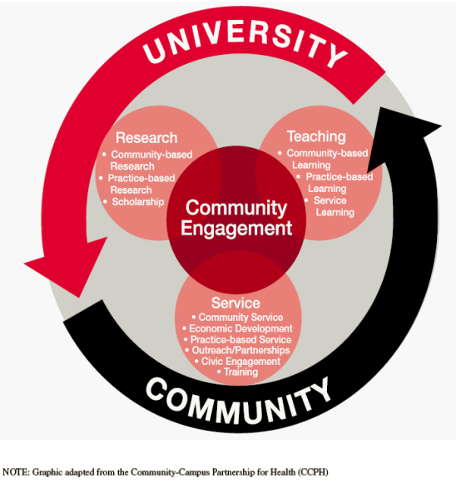
Community Engagement Activities
involve relationships between UofL faculty, staff, or students and an external partner related to service, research and/or teaching. Community Engagement activities can include applied research; support services to education, business, non-profit organizations, government, and community groups.
UofL Community Engagement projects break down into the following categories:
PARTNERSHIP: Ongoing collaboration with community partners for the mutually beneficial exchange of knowledge and resources in a context of partnership and reciprocity.
OUTREACH: Providing direct services, time, or resources to benefit a community or its institutions. This includes instances of public intellectualism such as talks, lectures, presentations, performances, etc.
CURRICULAR ENGAGEMENT: Describes the teaching, learning, and scholarship that engages faculty, students, and community in mutually beneficial and respectful collaboration.
ENGAGED SCHOLARSHIP: Scholarly work done in full partnership with the community. It consists of research, teaching, and the application of scholarship for the mutual benefit of the institution and community partner.

Slide 3
Notes about reporting activities
An activity with an external partner is the unit of data collection
If a unit has 2 distinct projects with a single external partner, then each of the 2 projects will be entered on a separate form
For example, CEHD may have a Teacher Training project with Bloom Elementary, and also a project to help 5th grade students learn to garden. These are 2 different activities. Each of thesea will have its own entry/form in the reporting system.
In some cases, partnership projects may not have an ‘formal’ organizational partner, but partners with the community-at-large.

Slide 4
Contact Pat Smith at the Office of Community Engagement to get the link to your unit’s reporting site pat.smith@Louisville.edu

Slide 5
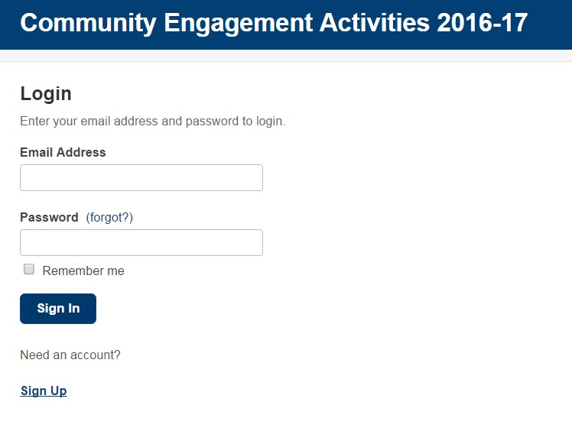
Logging in for the first time
IMPORTANT: You are not yet registered in the system.
Do not enter your UofL email and password yet.
You will need to sign up by clicking on the link below.
IMPORTANT: You are not yet registered in the system.
You will need to click ‘Sign Up’ and register with an email and password that you will remember
Click ‘Sign Up’ to establish an account in the system.

Slide 6
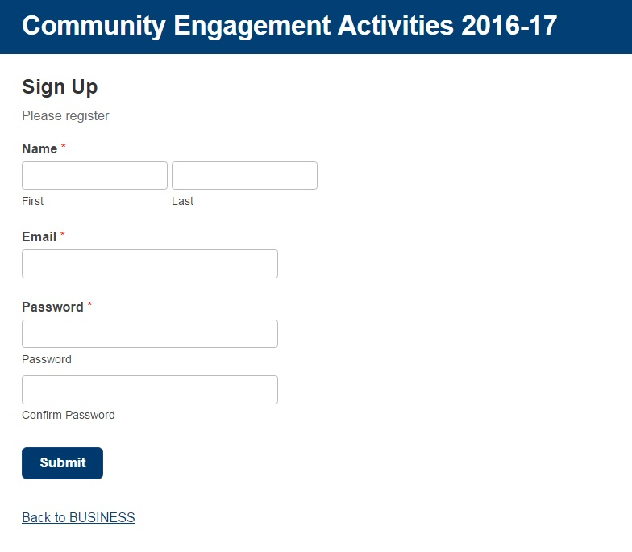
Logging in for the first time
Enter your name, and register with an email and password that you will remember, then click ‘Submit’

Slide 7
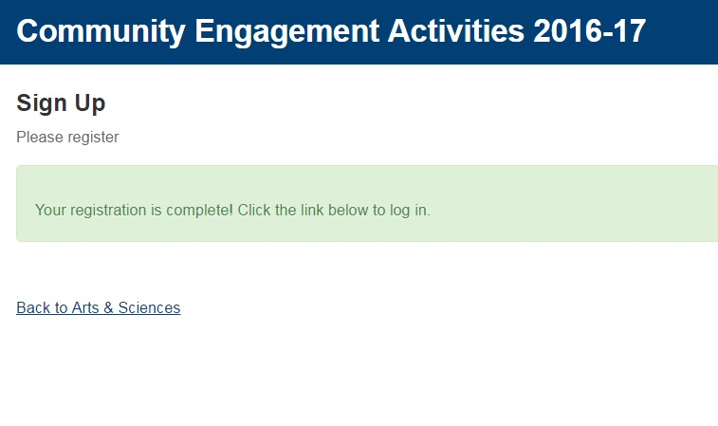
Logging in for the first time
Click the link back to the Log in

Slide 8
Logging in for the first time
Login with the email and password that you used for the Sign Up

Slide 9
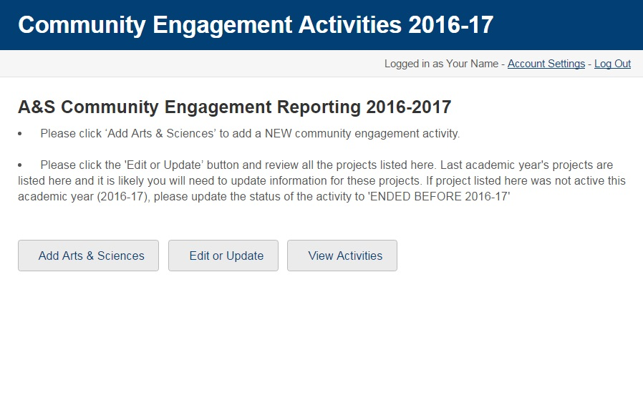
Now you are logged in!!
Click here to edit your activities or update last year’s activities
Click here to start adding new activities for 2016-17

Slide 10
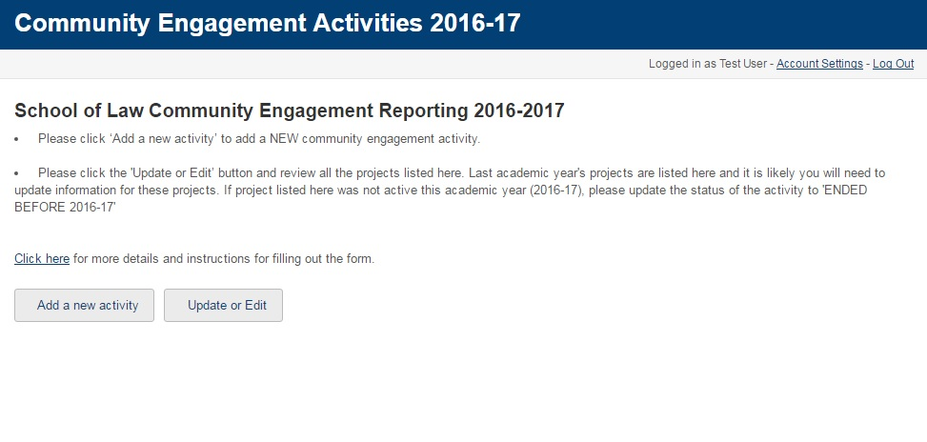
Unit Home Page
Email Pat Smith, Coordinator of Community Partnership Assessment at pat.smith@louisville.edu to sign up for the Community Engagement Reporting system
Add a new project by clicking this button

Slide 11
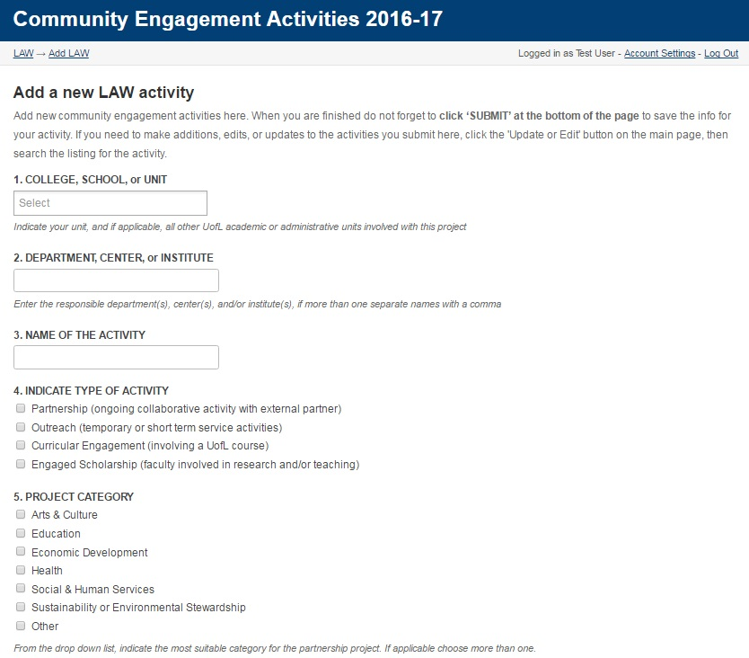
Adding new
activities
Choose your unit and any other associated unit for the activity with this drop down
Indicate the applicable activity types.
Click here for more detailed definitions for these types.

Slide 12
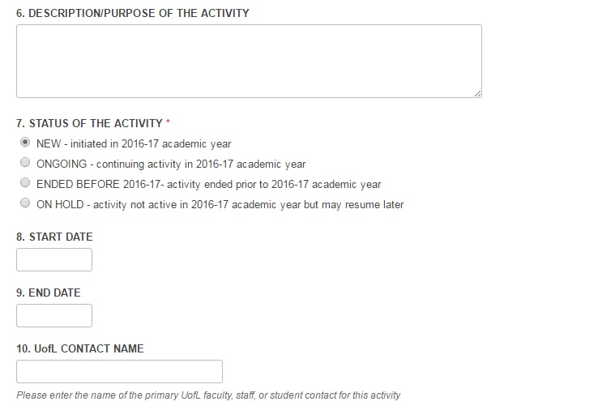
Adding new
activities
(continued)
Please provide as much detail as possible explaining the methods and purpose of the activity
You will be adding activities that occurred at any point in the 2016-16 Academic Year (summer 2016, fall 2016, spring 2017). This item will default to NEW when adding a form for new activities.
Enter the name of the primary organizer for the activity here

Slide 13
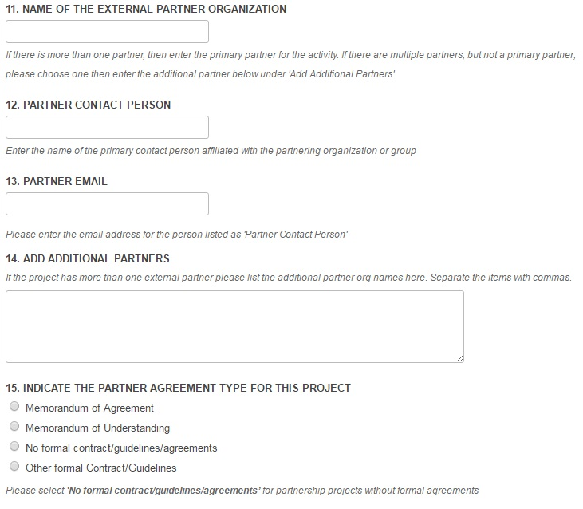
Adding new
activities
(continued)
Community engagement activities should have an external partner. If you work with multiple partner organizations on the activity, then choose one partner for this item. If your project serves the community, but does not have a specific partner, then please enter “Community at-large”.
Please provide an email for the partner contact.
This should be the name of an individual at the above external organization. Please do not list a UofL faculty or staff person under this item.
If you are working with additional partner organizations, please list them here, separated by a comma.

Slide 14
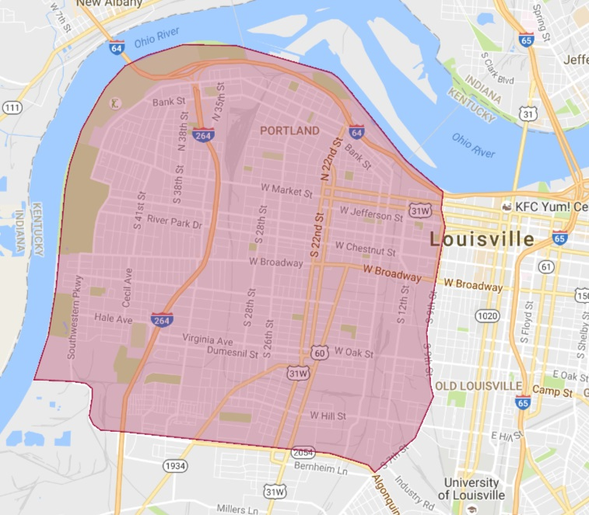
Adding new
activities
(continued)
All activities in West Louisville are Signature Partnership Projects. Click the hyperlink to see a map of the area and search for the address of the project to determine if its in West Louisville.

Slide 15
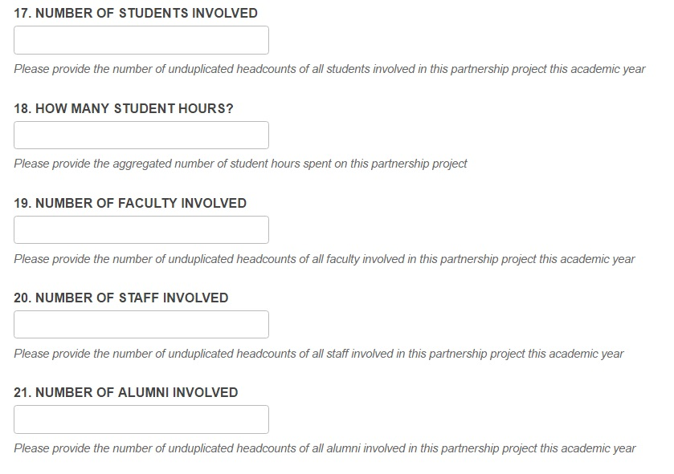
Adding new
activities
(continued)
Provide the number of people involved this academic year.

Slide 16
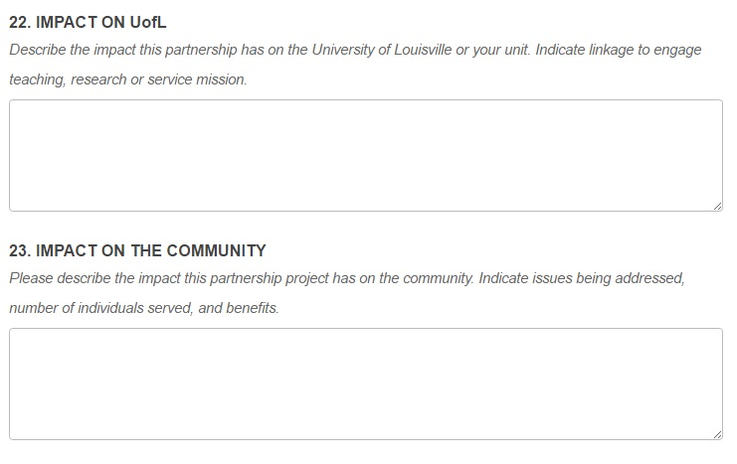
Adding new
activities
(continued)
The narrative for ‘Impact on UofL’ should describe the difference or outcomes observed or expected related to students, faculty, staff, the unit, and or the institution as a whole.
The narrative for ‘Impact on the Community’ should describe the difference or outcomes observed or expected in the community of service, as a result of the activity.

Slide 17
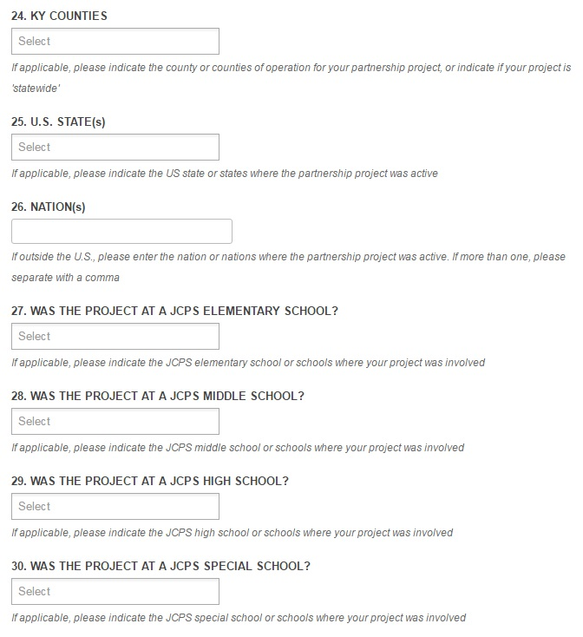
Adding new activities
(continued)
Let us know the KY counties, states, or nations where your activity occurred.
If your activity involved any JCPS schools, please choose all that apply.

Slide 18
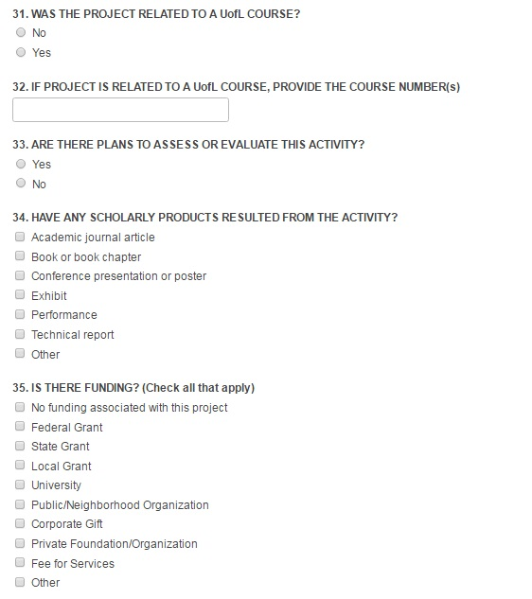
Adding new activities
(continued)
Let us know if the activity was related to UofL course work (community-based learning), and provide the course number(s)
Let us know if there are plans to assess or evaluate the activity.
Select all applicable types of products resulting from the activity.
Select all types of funding related to the activity if applicable.

Slide 19
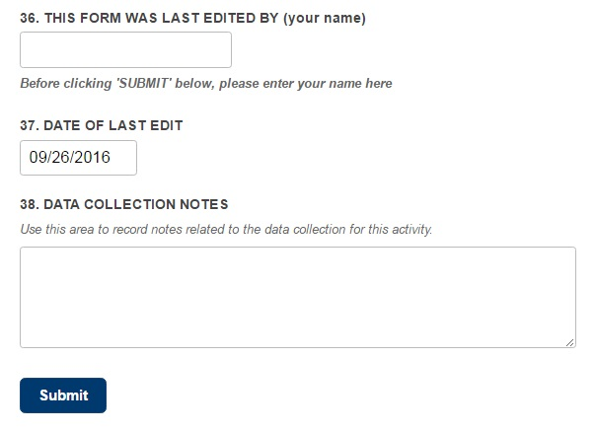
Adding new activities
(continued)
Sometimes the person filling out the form is not the primary contact in charge of the activity. Please let us know who is completing the form here.
Be sure to click to ‘Submit’ after entering the data for the partnership project or the data will not be recorded.
After you click ‘Submit’ you will be able to Update or Edit your new projects via the process described on the next page of this document.
Add any additional information about the activity here

Slide 20
Update or Edit an Activity
ACTIVITIES FROM THE PREVIOUS ACADEMIC YEAR NEED TO BE UPDATED IN THE SYSTEM!
Update or Edit a project by clicking this button

Slide 21
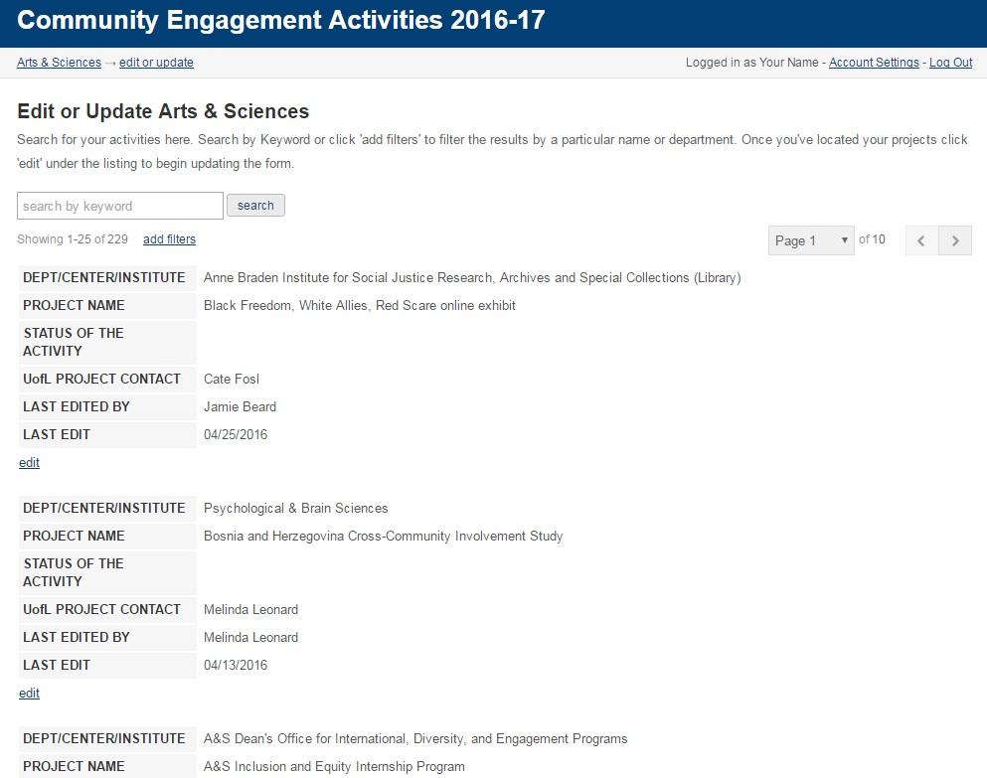
Update or
Edit an Activity
(continued)
Last year’s activities will need to be updated in the system.
You can search for your activities from last year on this page.
Search for your activities by using a keyword such as your last name
Or filter the results using your name and the ULCONTACT variable
WHEN YOU HAVE FOUND YOUR ACTIVITY OR ACTIVITIES, CLICK ‘edit’ to OPEN THE FORM

Slide 22
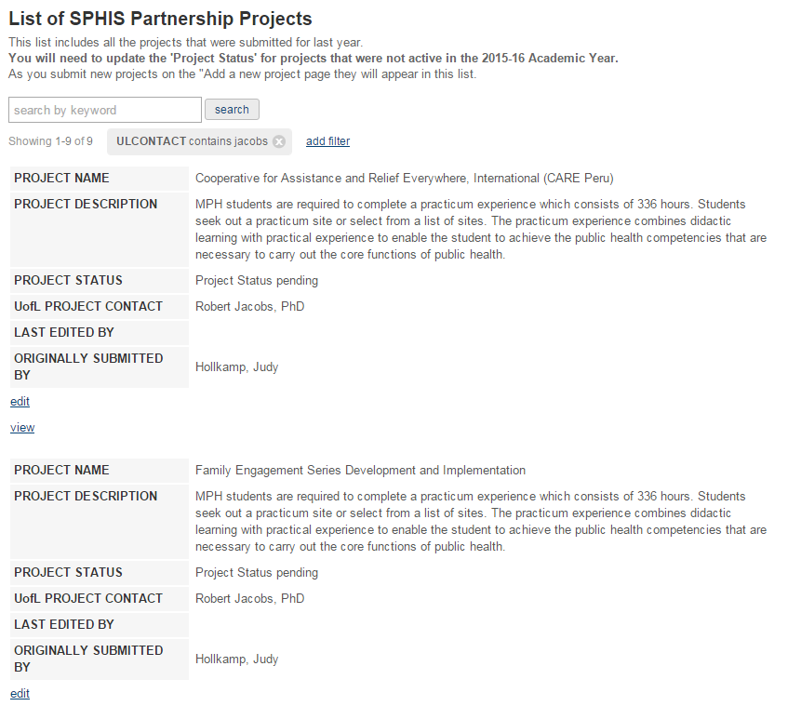
Update or
Edit a Partnership
Project
(continued)
Once you have located your project, click here to access the form and begin updating.

Slide 23
Update or
Edit an Activity
(continued)
Be sure to at update the status of these activities to ONGOING, ENDED, or ON HOLD.
If the activity is ongoing into the current 2016-17 academic year, you may need to update other items in the form. See the above sections on ‘Adding a new activity’ for more information about the items.

Slide 24
Reporting Period and Deadline
The reporting period now lasts through most of the entire academic year, beginning at the start of fall semester, with the deadline for reporting on the last day of April.
For example, all activities occurring in summer 2016, fall 2016, and spring 2017 can be reported anytime through the year, with a deadline for reporting of April 30th, 2017.

Slide 25
Questions or Assistance?
Contact Pat Smith at pat.smith@louisville.edu
We can run custom reports for you that help you update existing partnership projects
We are available to meet with you about refining the data collection process within your unit, and in looking for opportunities to simplify processes

