Slide 1

UofL Health
Research Update May 2025
Jiapeng Huang MD, PhD
Chief Scientific Officer, UofL Health
Associate Dean for Clinical Research, UofL School of Medicine

Slide 2
Joint Research Leadership Mission
Joint Research Leadership for UofL Health & UofL
Chief Scientific Officer for UofL Health
Associate Dean for Clinical Research
To intentionally align UofL Health and UofL on mutual academic missions with a focus on clinical and translational research.

Slide 3
UofL Health/UofL Clinical Research
Process Improvement Project
Information
Regular meetings of many groups, increased transparency and accountability
Separation of Duties
UofL CTU to handle the work and conduct the studies
UofL Health Research Office oversight, working with IT & patient care teams
Strategy
Identifying interventional studies and investigators for marketing & publicity
Systems Standardization
Reviewing Clinical Trial Management System (CTMS)
Expanding use of Cerner orders and Inbox messages for study participants
Resources Needed
New FTE Research Systems Administrator for ARC, Cerner, STAR, Epic
Need Patient level field in STAR & Cerner to drive patient accounting, Power BI
Need CTMS on UofL Health side
Including patient care teams to plan for studies, identify problems early
Create structure to access UofL Health / ULP patient data for research
Build UofL Health Data Warehouse

Slide 4
Research Funding
﻿Louisville Clinical and Translational Research Center (LCTRC)
﻿$24M to build capacity in clinical research
﻿Cancer Center - Center of Biomedical Research Excellence (COBRE)
﻿$11M to fund Center for Cancer Immunobiology and Immunotherapy for 5 more years

Slide 5
Clinical Study Enrollment Improvement Plan
Flag studies no enrollment 2 months
Meet with PIs with slow enrollment
UofL Health reports
Involve fellows in screening
Bi-weekly coordinator meetings
Enhancement of trials app
Involvement of LCTRC CEO
Enhance social media presence
Enrollment reports from ULH
PI involvement
More selective about trials
Inclusion/exclusion analysis
Less trials per coordinator
Better start up timelines
More integration of UofL and UofL Health processes
Research Coordinator Accountability
Build Research PowerPlan
Needs for success

Slide 6
Community Medical Group (CMG) Research Infrastructure Building
UofL Clinical Trial Unit (CTU) to manage CMG research
Create CMG PI and Group RIF Accounts under Louisville Clinical and Translational Research Center (LCTRC)
LCTRC to manage CMG PIs for research finance, logistics, and compliance
Redefine/Realign faculty status for CMG physicians with ULSOM-Vice Dean Michelle Stevenson

Slide 7
ULH/ULP Consent to Treatment
Add Research Language
I understand that UofL Health is a research and teaching institution and my data and body parts, including organs, tissue, bone, or bodily fluids removed for diagnostic and/or therapeutic purposes may be used for teaching and research purposes. My data and body parts will be treated carefully so that I cannot be identified, except as required or permitted by law. I agree that I do not own my body parts after removal and I have no rights to the research products from these parts.

Slide 8
Memorandum of Understanding on Research Data among UofL, UofL Health, Third Party
Memorandum of Understanding has been drafted by UofL Health legal team
Will send to UofL Legal team for review/negotiation
Address data ownership, IP, patents, licenses

Slide 9
Research Clinical Impact
All pipeline clinical studies will have clinical impact statement
Translate into clinical impact for KY communities
Goal is to promote clinically impactful studies at UofL Health

Slide 10
Research Marketing
Regular meetings/coordination UofL Health, UofL SOM, EVPRI Office on research marketing
Promote both AMG and CMG research
Monthly UofL Health calendar marketing theme tied to clinical, translational and basic research
Dr. Huang on WHAS 11 to discuss clinical trials and research on May 21 2025
UofL Health/UofL Research Booth at State Fairs Aug 14-24, 2025

Slide 11
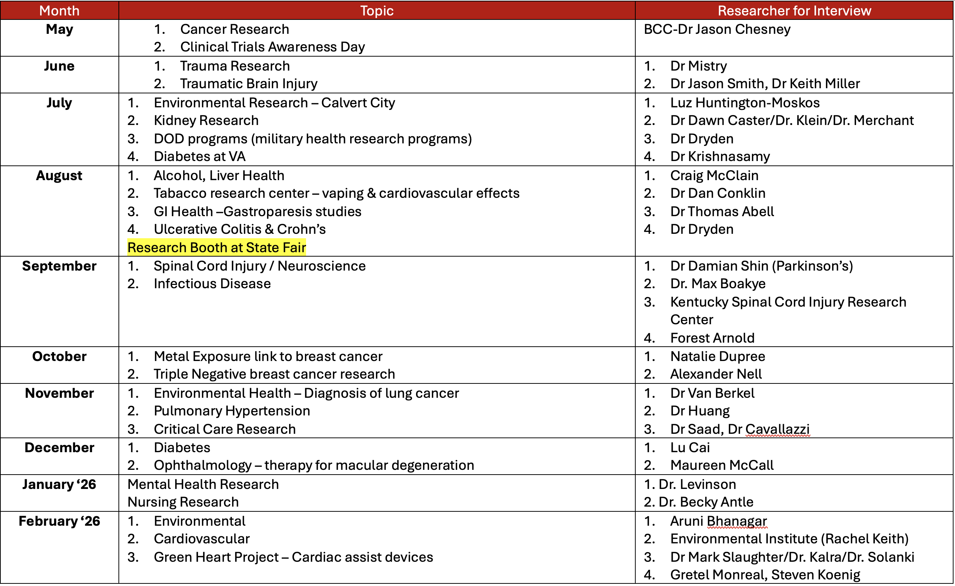
UofL Health/UofL Research Calendar

Slide 12
UofL Graduate Students Clinical Shadowing at UofL Health
Non-credit, semester long course for clinical shadowing with UofL Health Physicians
Approved by SOM leadership
Initiated discussion to include engineering students
Post-Doc, fellows are eligible
Serves as a bridge between physicians and engineers/basic researchers
Students meet all requirements to shadow at UofL Health (liability insurance, criminal background check, handbook)
Prepare graduate students for non-traditional entry to MD/PhD program
Enhance communications for this program
Internal channels
External channels
Celebration of graduates

Slide 13
Promote Multidisciplinary Research
Nursing research mandatory for ULH magnet status
Monthly meeting with UofL Health CNO, Leader in Research with SON Dean Dr. Nash and Associate Dean for Research Amanda LeBlanc
CRNA Research
DNP, PhD in Nursing research

Slide 14
UofL Health Data Warehouse
Legal documents to guide research between UofL and UofL Health (both UofL and UofL Health teams are on board)
Build a deidentified data warehouse for UofL Health
UofL Health owns the data warehouse
Facilitates research and screening for all researchers (CMG + AMG)
Puts UofL Health on maps for more clinical trial opportunities
Applied for NIGMS supplement grant with LCTRC, and Associate Vice Provost Dr. Arora

Slide 15
Clinical Trial Management System (CTMS)
Much needed to perform clinical research
Currently no standard system at UofL and UofL Health
Millions of dollars might be missed from research billing
Improves research efficiency
Working with Misty Hooper, CTU, UofL Health IT to finalize CTMS recommendation

Slide 16
CTMS Needs
Manage trials in standard way
Report between systems what’s happening with each project (procedures, enrollment, etc)
Ensure compliance by tracking study team & who’s doing what
Utilize system to full capabilities – not just pieces and parts
Interface with all our systems
Identify where patients are within the study (screening, treatment, follow up, long-term follow up)
Track performance: meeting milestones in project, report on data putting into system
Robust reporting system
Dashboard to track where the study is in the lifecycle: big picture overall summary of where we are
Pull data from the EMR automatically
Data analytic capabilities
Different levels of access: patient level, professional level, PI level, etc
  Patient portal – able to check where things are, reach out if interested in a trial, input their information
  Portal for basic researchers to be able to search for what trials are going on & who leads
House and manage UofL Biorepository
  allow PI to see what we have & what they have access to
  ability to track what we currently have

Slide 17
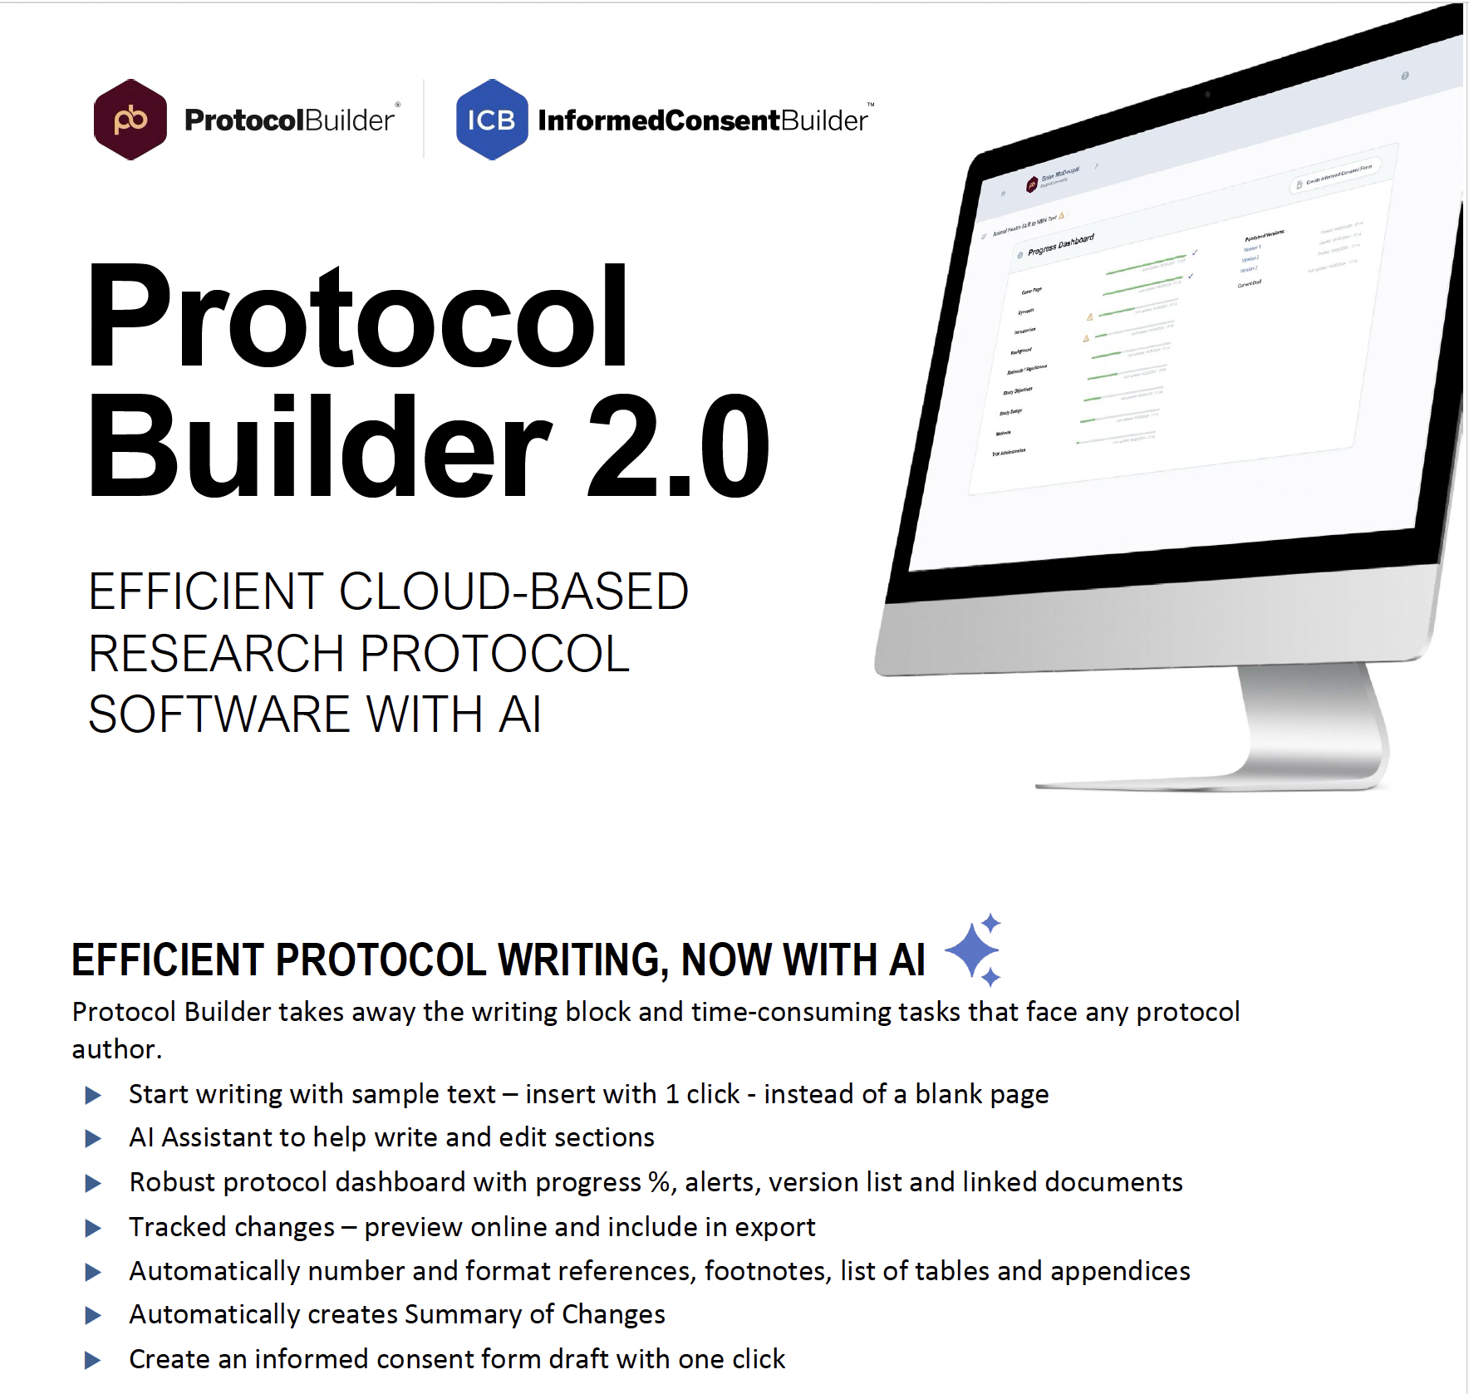
Improve IRB Process with AI

Slide 18
AI in Clinical Research

Slide 19
PI Training on Key Clinical Research Topics
Training on how to perform clinical research
Compliance
Documentation
Informed Consents
Publication
Internal and external funding
Publish on UofL Health intranet, out-facing website, LCTRC website and present at multiple physician meetings

Slide 20

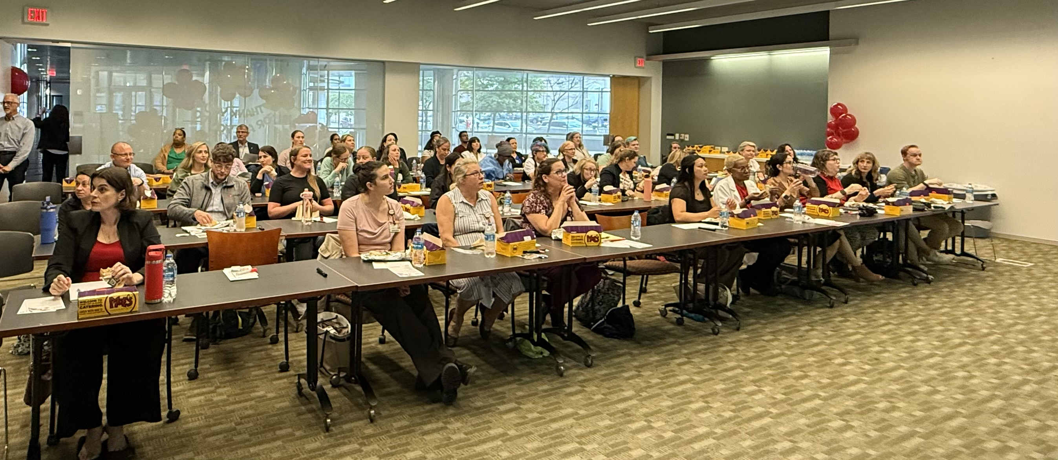
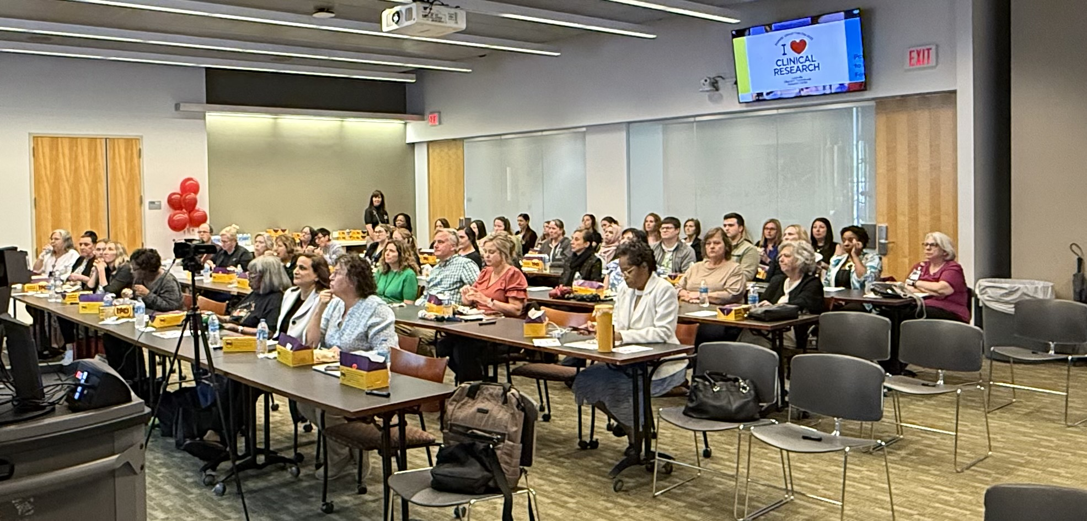
Clinical Trials Day-May 20, 2025

Slide 21
Incorporate Research into
UofL Health Service Line
UofL Health Brain and Spine Institute
UofL Health Sports Medicine-Envirome Team
UofL Health mental Health Service Line

Slide 22
Mental Health Research Portfolio
Cheri Levinson-Eating Disorders
Hunt Rowan-Eating Disorder
Mikawi Yara-Mindfulness intervention
Becky Antle-Trauma/PTSD/Recovery
Craig McClain-Addiction
Connect with Peace Hospital/UofL Health Psychiatry/Psychology
Elizabeth Cash - Cancer psychology

Slide 23
SWOT Analysis for Research by UofL Health Service Line
Cardiovascular Service Line
Neuroscience Service Line
Oncology Service Line
Mental Health Service Line

Slide 24
Service Line
Research Strategy FY 2025-2026
Expand clinical trials and innovations by improving research infrastructure, patient enrollment, and clinical engagement
Foster interdisciplinary and multi-institutional collaborations among physicians and researchers
Leverage Big Data and AI in clinical research
Build deidentified UofL Health Data Warehouse
Identify and implement a unified clinical trial management system (CTMS)
Develop a solid professional development program for clinical researchers.

Slide 25
Questions?

