Slide 1

Translational Research Support Core (TRSC) Seminar Series Update on Pediatric Research Services
Janice E. Sullivan, MD, VCR
Professor and Vice Chair for Research
Department of Pediatrics
University of Louisville, Louisville, KY
Assistant Chief Scientific Officer
Norton Children’s Research Institute
August 21, 2024

Slide 2
Agenda
Introduction
PIRATs
Overview of Pediatrics Basic Science Research Services
Overview of Pediatrics Clinical Research Service
Faculty development

Slide 3
Introduction
February 2024, Dr. Huang presented a TRSC Overview and the TRSC Clinical Research Services.
July 2024, Matt Cave and colleagues led a seminar providing a TRSC Overview, and Basic Science Research Services, and a CTR-D update
TRSC:
Continues to build on previous success in facilitating translation of research, using funding renewal to further expand, connect, and streamline efforts using the NIEHS Translational Research Framework (TRF) as a guide.
Provides infrastructure, integration, and financial support for research in four areas related to the elements of the NIEHS TRF where CIEHS has needs and expertise: Basic Science, Clinical Science, Geographic Information Sciences (GIS), and Epidemiology & Population Health.
Strives to develop/support research projects which will involve at least 2 of these areas

Slide 4
Research: Department of Pediatrics
Clinical Research and Clinical Trials
Basic Science Research
Norton Children’s Research Institute (NCRI)
Kyle Brothers, MD, PhD, CSO
Matthew Hawthorne, JD
CAO
Department
of Pediatrics
Pediatric Research Institute (PRI)
Lu Cai, MD, PhD

Slide 5
PIRATs: Pediatric Innovation & Research Advisory Team
Created in 2019
Membership: 14 members from Dept of Pediatrics and other Pediatric Subspecialties
Mission: create new knowledge with the goal of improving health and disease outcomes of children and their families.
Vision: be a leader in the discovery and validation of new knowledge in a way that improves child health and health care delivery locally, nationally, and globally.
Meet monthly
Created SPRC: Scientific Protocol Review Committee
Review proposals
Rotating membership
Includes junior (2) and senior faculty (3)

Slide 6
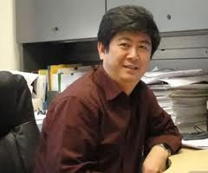
Pediatric Research Institute (PRI) Lu Cai, Director

Slide 7
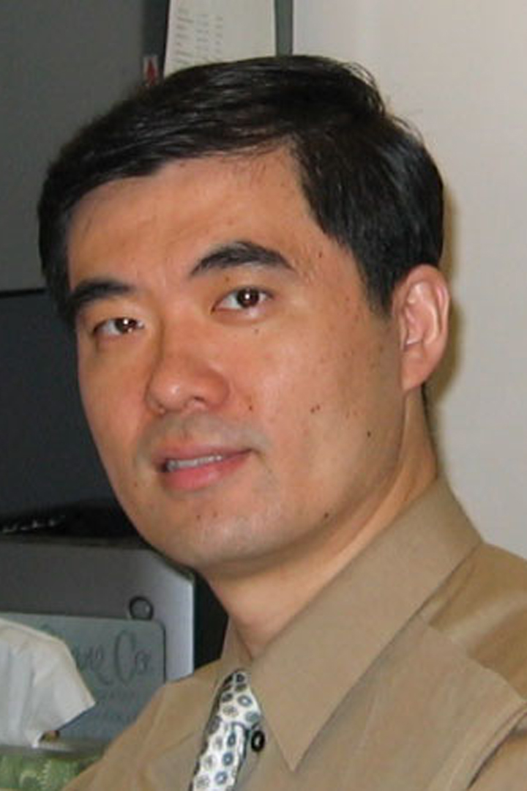

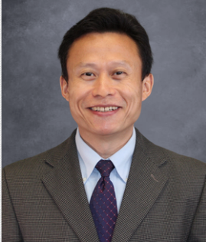
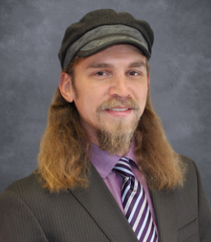
PRI Faculty
Jun Cai, MD, PhD
Lu Cai
MD, PhD
Evelyne Gozal, PhD
Yi Tan,
PhD
John Wise, Jr.
PhD
Neuron-glia communication in neurodevelopmental disorders, traumatic injury, and neurodegenerative diseases
Pediatric brain tumors
Obesity-related brain pathogenesis
Environmental metal neurotoxicity
Mechanisms and innovative therapies to prevent diabetic complications
Trace elemental nutrition
Environmental impact on children’s health
Radiation biology
Developmental consequences of intermittent hypoxia on CNS maturation and cell survival.
Neurovascular Signaling in Autism Spectrum Disorders
Endothelial dysfunction in systemic and neuro-inflammatory disease
The role of SDF-1/CXCR4/CXCR7 axes in diabetic complications.
The role of FGFs (e.g.: FGF1, FGF5, FGF6，FGF14，FGF16, FGF21, etc.) in diabetic complications.
Anti-oxidative mechanisms of metallothionein and Nrf2 in diabetic complications.
Neurotoxicology of heavy metals (hexavalent chromium, cadmium)
Interaction of neuro-toxicology and age
Role(s) of heavy metals as teratogens
Environmental toxicology of heavy metals in wildlife populations
Interactions between DNA damage responses and protein quality control pathways

Slide 8
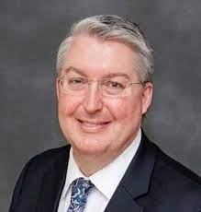
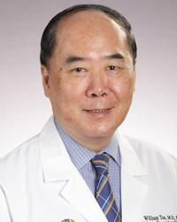
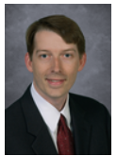
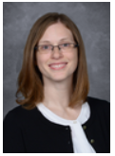
Other PRI Faculty
Kupper Wintergerst, MD Professor of Pediatrics Chief, Division of Pediatric Endocrinology Director, TrialNet Diabetes Studies Co-Director, Children's Metabolic Bone Center Norton Children's Hospital Profile
Greg Barnes, M.D., Ph.D.
Genomics, Neuron-glia communication and neuro-inflammation in neuro-developmental disorders
Diagnostic AI in Autism Spectrum Disorder (ASD)
Neurovascular Signaling in ASD
Environmental neurotoxicity in ASD
CIEHS member and leads the Environmental Justice & Health Disparities and Climate Change & Health Research Interest Group
William T. Tse, MD
Stem cell transplant and cellular therapy for pediatric cancers
Translational collaboration with PRI faculty
Sara Watson, MD Associate Professor of Pediatrics Division of Pediatric Endocrinology Norton Children's Hospital Profile

Slide 9
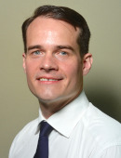
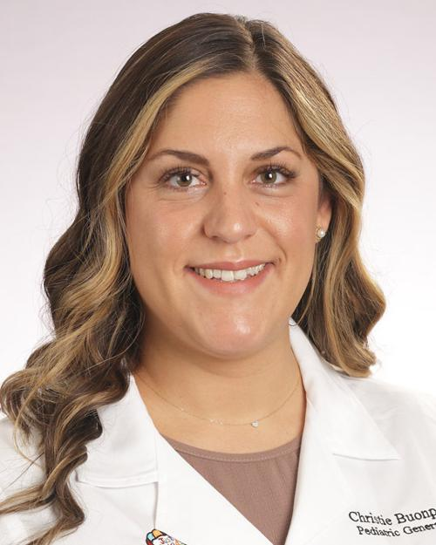
Other PRI Faculty
Stewart R. Carter, MD
Assistant Professor, Pediatric Surgery
Research Interests: Non-invasive monitoring in critically ill infants and children, pulmonary inflammation in the surgical patient, neonatal Extracorporeal Membrane Oxygenation
Grant: Exhaled Breath Condensate as a Non-Invasive Monitoring Technique in Severe Pediatric Pulmonary Inflammatory States
Christie L. Buonpane, M.D.
Assistant Professor, Pediatric Surgery
Research Interests: Investigating the impact of environmental contaminant exposure during pregnancy on premature birth and neonatal health
Grant: Funding to establish Pediatric Basic Science Research lab

Slide 10
PRI
Collaborations (Dept of Peds, within UofL, and outside institutions)
Endocrinology: zinc and metals in children with diabetes
Autism
Pilot grants
Collaboration with speed school (AI)
Cancer: multiple basic science awards from PCRTF
NIH grants (Yi Tan—3)
Publications: average 27.8/yr over the past 10 years
Grant Specialist to assist with grant preparation and submissions
Sarah Eustice

Slide 11
Norton Children’s Research Institute (NCRI)

Slide 12
What is NCRI?
A “joint venture” of Norton Healthcare and the University of Louisville School of Medicine (July1, 2021) to support pediatric clinical research including clinical trials:
Norton Healthcare
University of Louisville
Norton Healthcare Research Office
University of Louisville
Department of Pediatrics

Slide 13
NCRI
One of the academic research programs of Norton Healthcare Research Office:
Norton Healthcare Research Office
Norton Infectious Disease Institute
Norton Institute for Health Equity
Norton Neuroscience Institute

Slide 14
NCRI
Has a mandate to support pediatric faculty for clinical research across all service lines:
Norton Children’s Acupuncture
Norton Children’s Allergy & Immunology
Norton Children’s Autism Center
Norton Children’s Behavioral & Mental Health
Norton Children’s Cancer Institute
Norton Children’s Critical Care
Norton Children’s Dermatology
Norton Children’s Development Center
Norton Children’s Emergency Medicine
Norton Children’s Endocrinology
Norton Children’s ENT & Audiology
Norton Children’s Eye Care
Norton Children’s Gastroenterology
Norton Children’s Genetics Center
Norton Children’s Gynecology
Norton Children’s Heart Institute
Norton Children’s Infectious diseases
Norton Children’s Inpatient Care
Norton Children’s Neonatology
Norton Children’s Nephrology
Norton Children’s Neuroscience institute
Norton Children’s Medical Group
Norton Children’s Orthopedics of Louisville
Norton Children’s Pediatric Protection Specialists
Norton Children’s Physical Medicine & Rehabilitation
Norton Children’s Pulmonology
Norton Children’s Radiology
Norton Children’s Research Institute
Norton Children’s Rheumatology
Norton Children’s Sleep Medicine
Norton Children’s Surgery
Norton Children’s Urology
Wendy Novak Diabetes Center
Wendy Novak Diabetes Center- Christensen Family Sports & Activity Program

Slide 15
Motivation for research within NCRI:
Research will help improve care for children locally, nationally, and internationally!
Clinical research can help provide access to cutting edge therapies for patients!
For certain conditions, participation in research is important enough to patient families that they will travel elsewhere to get it!
Participating in research and receiving support for research are STRONG motivators in recruiting many pediatric subspecialists
Important for academic career for faculty members
Important for institution recognition

Slide 16
NCRI ORG CHART
Steve Wyatt
Executive Director
Matthew Hawthorne, JD
CAO
Sarah King
Director of Research Regulatory Affairs & Manager of Research Operations
Allyson Turner
Director Research Grants Dev & Finance
Kyle Brothers, MD, PhD
CSO
Sara Watson, MD, MS
Medical Director
Debbie Davis, PhD
IRG Director
Janice Sullivan, MD
Asst CSO
Marti Gardner
System Director Clinical Research
Jen Comings
Director NCRI & Clinical Research

Slide 17
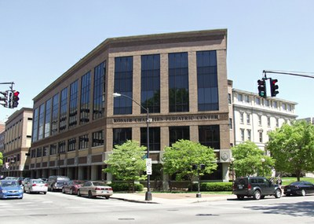
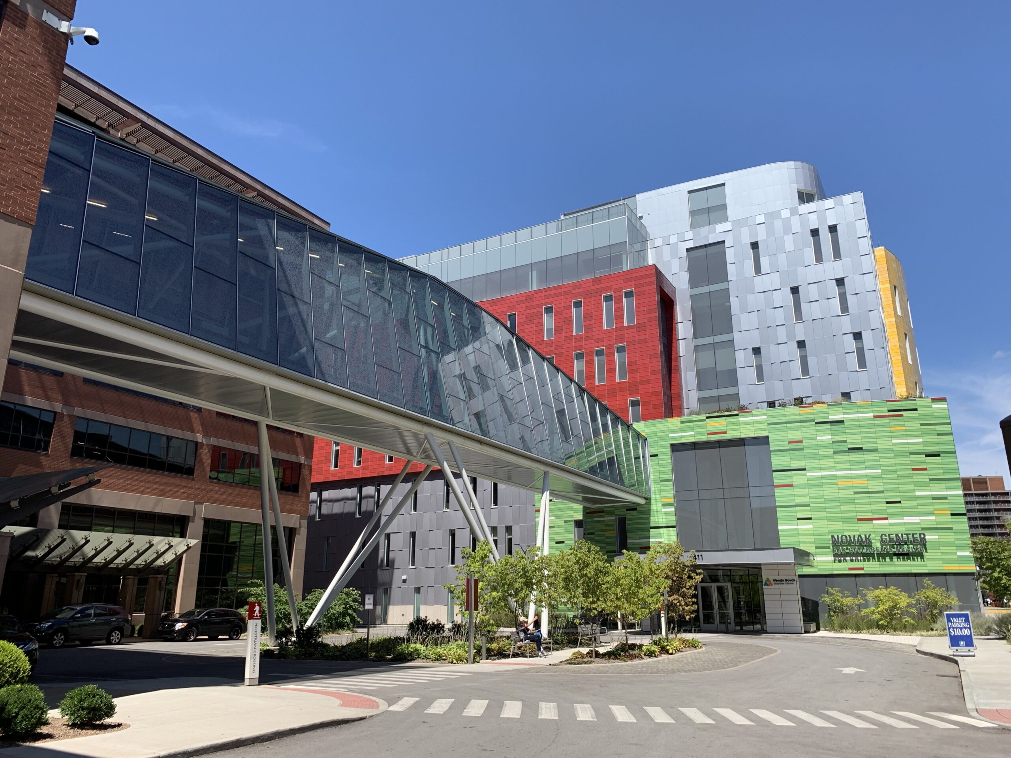
NCRI Locations
Administrative Offices
Norton Healthcare, 224 E. Broadway
UofL Kosair Charities Pediatric Center (KCPC), 571 S. Floyd, 2nd floor
Inpatient Team
UofL KCPC, 571 S. Floyd, 2nd floor
Outpatient Team: Novak Center for Children’s Health
411 E. Chestnut, 6th floor
Endocrine Team: 7th floor

Slide 18
Infrastructure of NCRI
Regulatory Team
Financial Team
Inpatient Clinical Research Team
Outpatient Clinical Research Team
Interdisciplinary Research Group
Support research
Develop and Conduct research

Slide 19
Teams and responsibilities
Regulatory
Feasibility analysis team
Work with PI, sponsor, and clinical team to determine feasibility of a study
Coordinate pre-site visits
Development of study related documents including eConsent
IRB, NHRO, and UofL Health submissions
Organize “hand-off” meeting when study is ready for site initiation visit (regulatory, finance, and clinical teams meet to ensure a smooth transition to startup).
Organize and coordinate site initiation visit when study is ready to “go live”
Maintain investigator site file (Complion)
Remote monitoring
Audit support
Other: IRB amendments, CARs, AE/SAE submissions to IRB, DOA logs, etc.

Slide 20
Teams and responsibilities
Finance
Budget development/negotiation
Coverage analysis
Contract negotiation and submission
Post-award account management
Reconciliation and closure
Grant submission team (Maria Hill)
Organizes planning meeting with PI, financial team, clinical team (if applicable), members of Dept of Peds administrative team and other potential collaborators
Coordinates grant preparation and submission

Slide 21
Teams and responsibilities
Clinical Teams (Inpatient and Outpatient)
Pre-screening, screening, recruitment, and retention
Schedule and conduct study visits and procedures/coordinate procedures
Source documentation and verification
Data entry in eCRF or on paper
Sponsor/monitor visit coordination and conduct
Participant stipends
Drug/device accountability and administration
Coordinate dispensing with pharmacist
Specimen processing, packing, and shipping
Data query resolution
AE and SAE reporting (including keeping PI informed)
Close-out visit coordination
Attend Investigator meeting, site initiation visit, monitor visits, audit visits, and close-out visits

Slide 22
Teams and responsibilities
Interdisciplinary Research Group (IRG): led by Debbie Davis, PhD
Formerly known as Child and Adolescent Health Research Design and Support Unit (CAHRDS)
Goal: improve effectiveness, quality, safety, and delivery of health care and promote optimal health for all children in Kentucky.
Purpose: maximize departmental scholarly productivity
Collaborations
Study design and methodology development
Study implementation
Data analysis
Manuscript preparation
Submit request through Access to Services: https://HelpMeNCRI.org/

Slide 23
Teams and responsibilities
IRG Staff:
Manager: Sarah Deans
Cohort Study Team (Twins Study-NIH funded) (2)
Psychometricians (2)
Qualitative team (2)
Program managers (3)
PPN study HRSA—Dr. Mary Fallat
Biostatistians through NCRI

Slide 24
Teams and responsibilities
Domains of IRG research:
Comparative effectiveness studies
Economic/cost analysis studies
Patient-centered outcomes
Medical informatics
Implementation/dissemination research
Epidemiological
QI
Medical education research
Outcomes research

Slide 25
How do faculty get support from NCRI?
https://HelpMeNCRI.org/

Slide 26
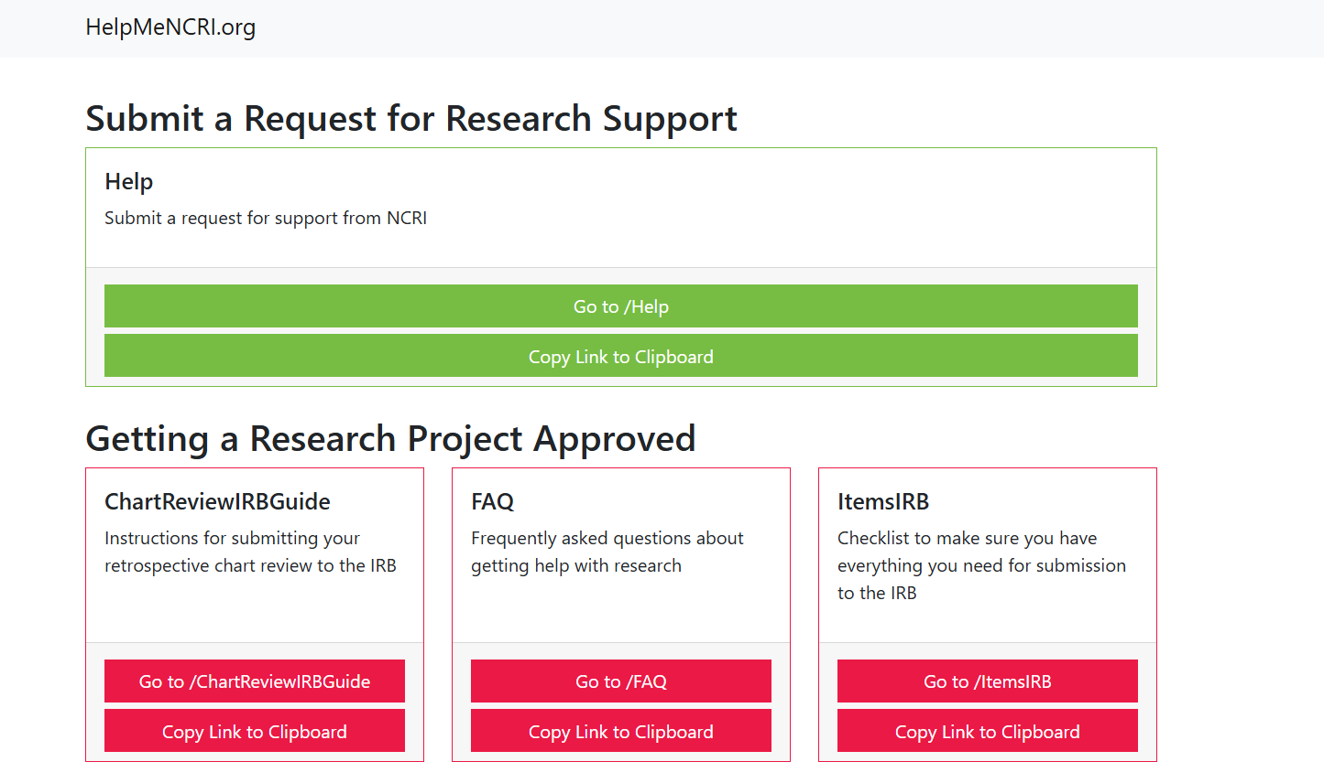
How do faculty get support from NCRI?

Slide 27
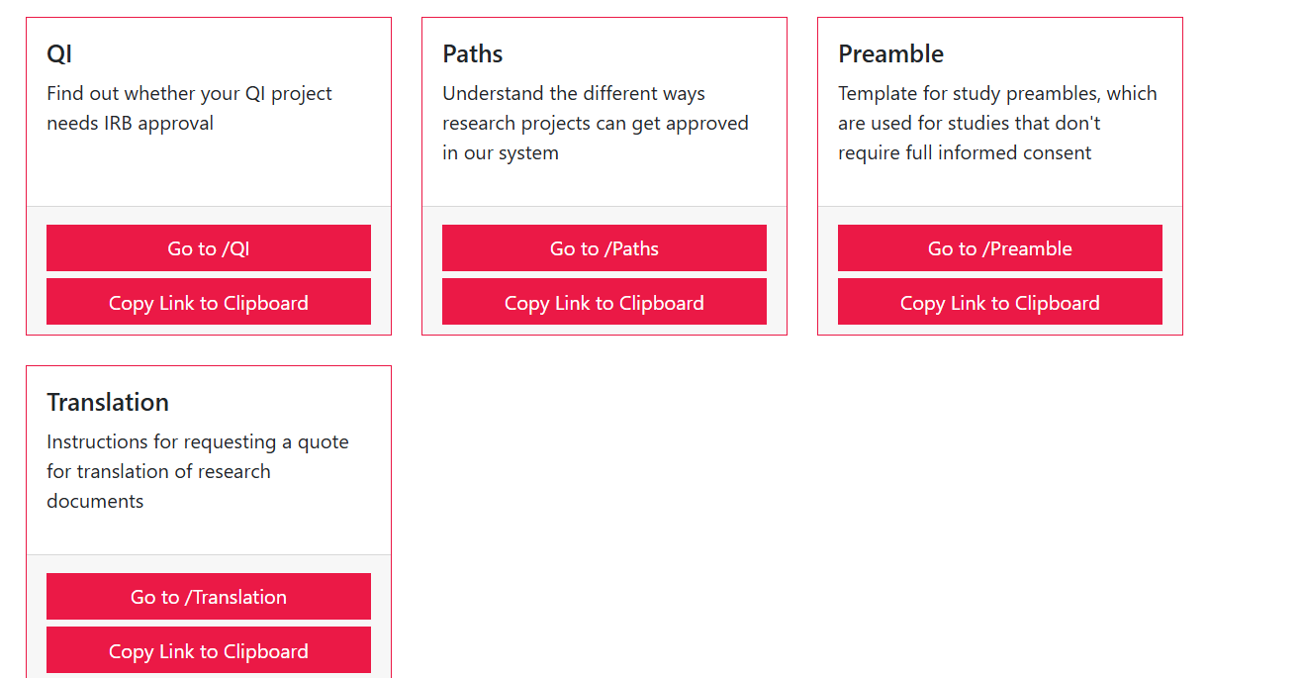
Support from NCRI

Slide 28
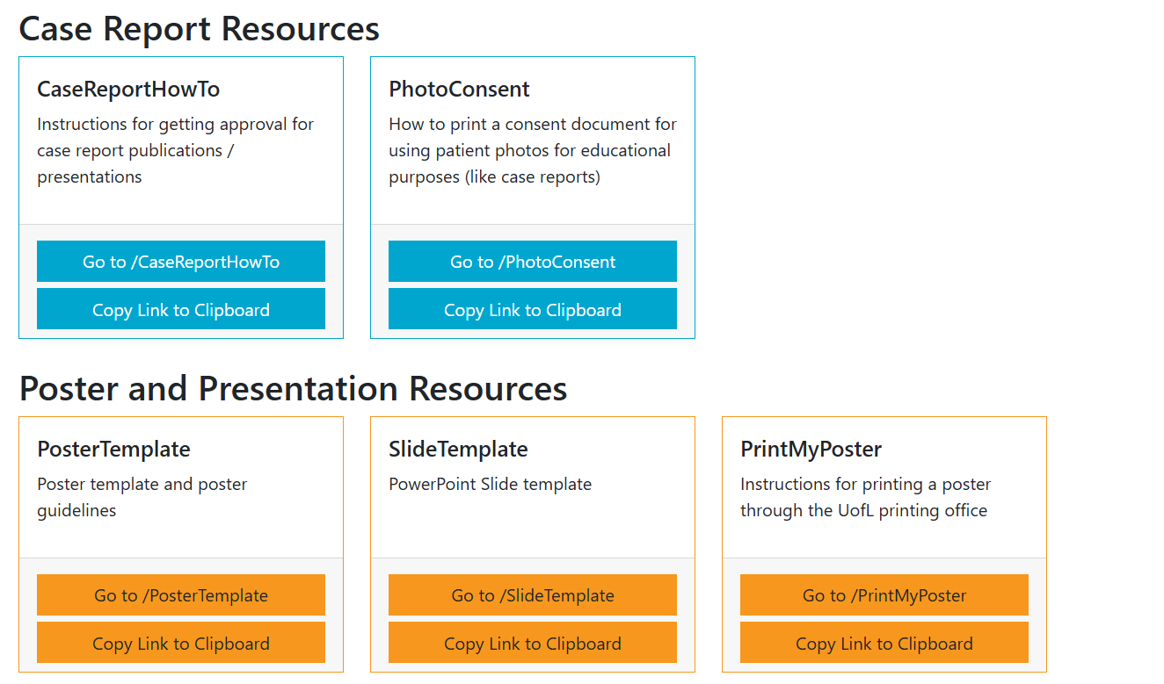
Support from NCRI

Slide 29
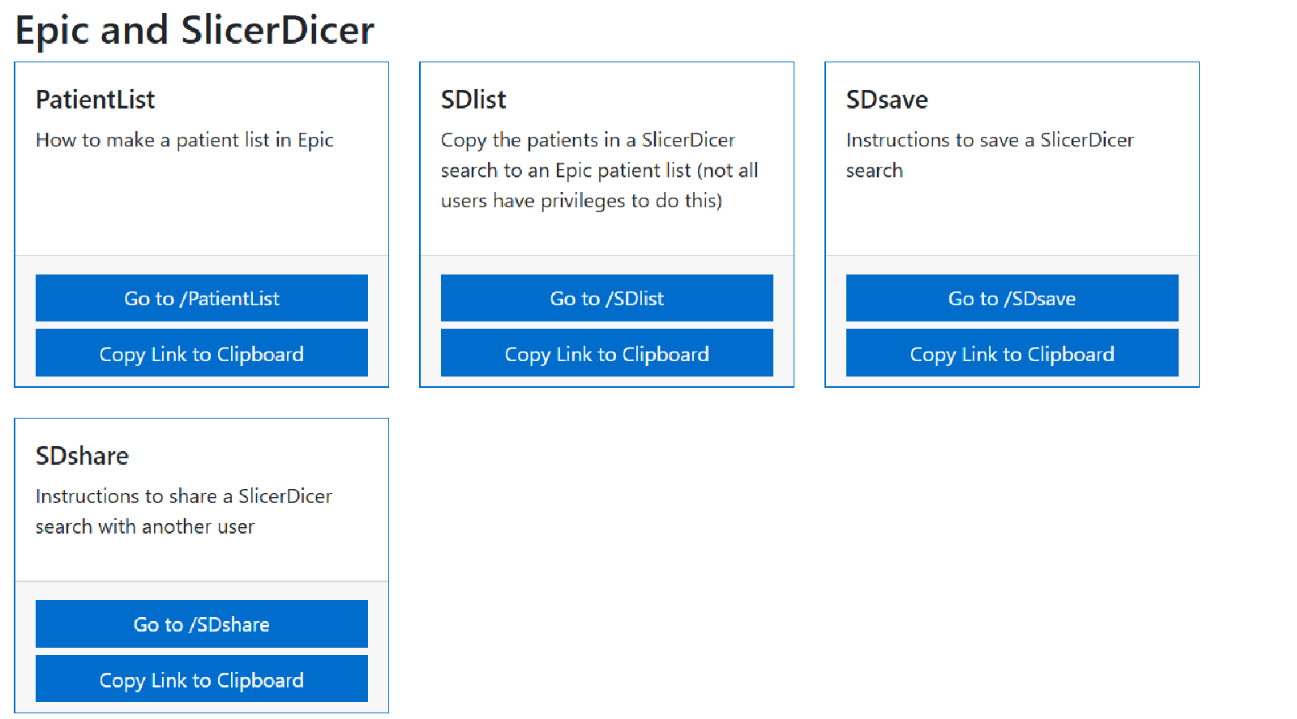
Support from NCRI

Slide 30
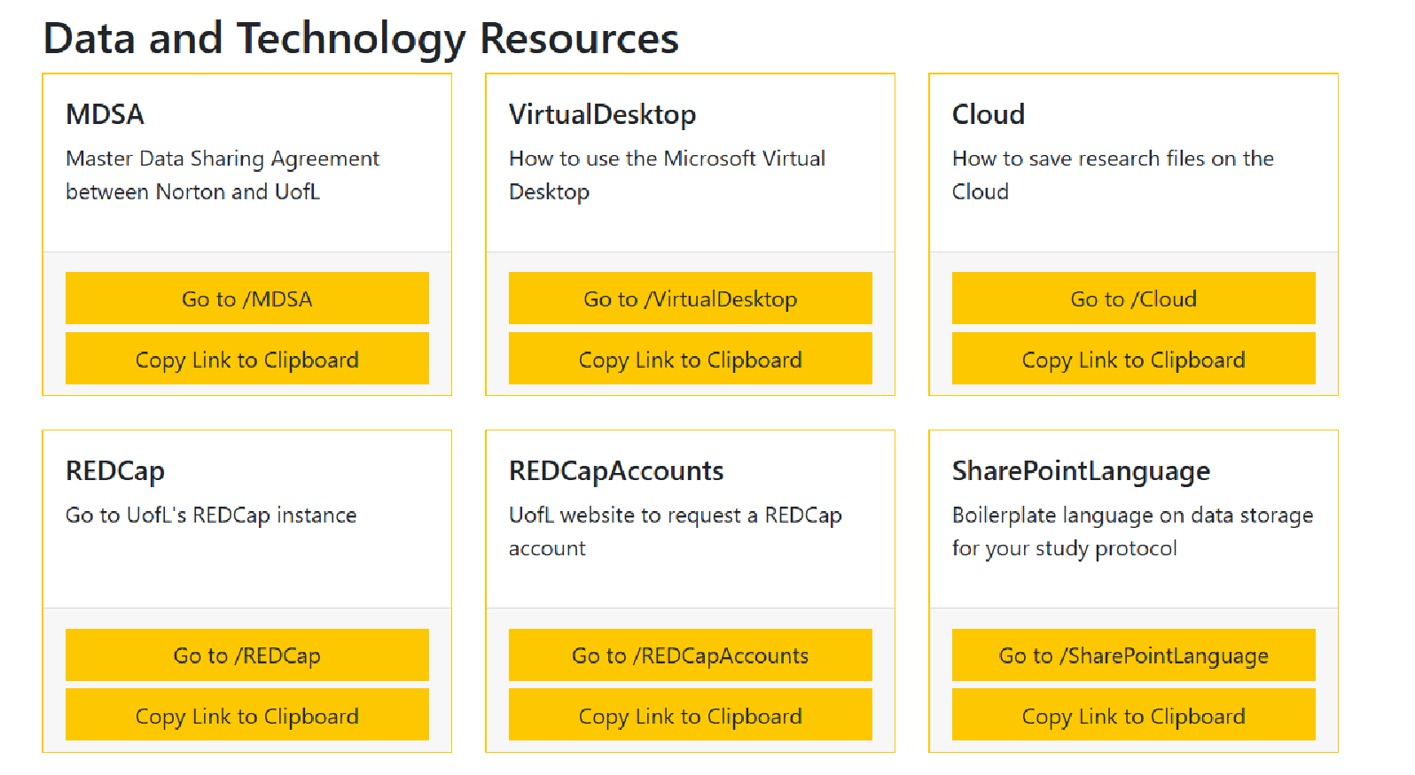
Support from NCRI

Slide 31
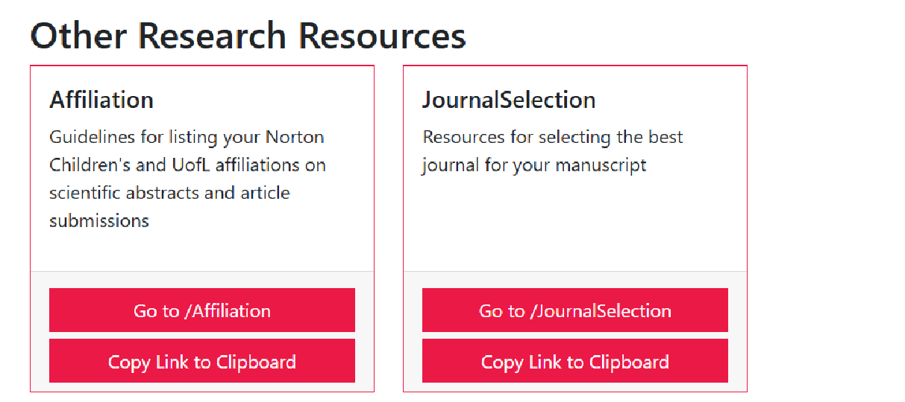
Support from NCRI

Slide 32
Pathway for a Data Collection Study
HelpMeNCRI.org/
48 hours
Email confirming receipt, names/contact info of people who will work with you
Regulatory Team submits protocol to IRB and NHRO
All investigators sign NHC “PI Acknowledgement form”
If needed, NCMG leader sends approval email
IRB sends notification of approval
NRI sends for any necessary internal approvals, such as:
Legal (DUAs and consistency check)
HR (employee survey)—can add 6 months
Unit leadership approval
NRI approval
Epic Data Pull
Study Personnel
(if applicable)
Analysis by Statistician
Notes:
Again, the data team will not begin the request until both U of L and Norton approval are obtained. It’s also important to remember that Norton has several steps in the process. Although Norton HR and clinic operations managers are not usually involved in retrospective data projects, Norton Legal will review these projects and your team might encounter a delay if you are proposing to use any financial data and/or any safety data. Our team is working on processes to streamline these requests but you should be aware that Norton does not release charge/collections data. The blue box then outlines another step where some investigators experience delays – the “PI” acknowledgement forms. These are emailed from Hannah Diehl in NCRI to all invesitgators (not just the PI) and NHC approval cannot be granted until they are all returned.

Slide 33
Feasibility and other support
Solicitations from industry sponsored trials:
Submit in access to services (preferred) or email Feasibility Team: Dr. Sara Watson (NCRI Medical Director)/Missi Thomas/Erin Wyles
Work with sponsor, PI, and clinical teams to determine if study is feasible
Grants and other projects needing clinical support:
Submit an Access to Services Request. The grants process includes looping in feasibility team when appropriate.
https://helpmencri.org/

Slide 34
Access to Services Requests
Submit a request: https://helpmeNCRI.org/
Protocol Development
Grant preparation / budget development
Feasibility assessment
IRB submission
Access to national/state/other institutional data sets
Access to local clinical data (Epic)
Statistical support
Need study personnel to conduct research
Grant assistance (when funded)
Other services required

Slide 35
Access to Services Requests
Within 2-3 business days an email is sent to submitter:
Services requested specified
Individual assigned to each request
Schedule planning meeting to address requests

Slide 36
Life-Cycle of Research Project Approval

Slide 37
Timelines
Access to Services Requests: Go into NCRI queue
If you submit everything ready to go, typically takes 1-2 weeks until submission to IRB
(Highly dependent on complexity, whether informed consent needs to be written, etc.)
IRB Approval: Also variable, depends on exempt vs. expedited vs. full review

Slide 38
Timelines
Some approvals are outside our control, and can take a LONG time:
HR approval for Norton employee survey (can take 6 months)
Negotiation of contracts and DUAs (sponsors sometimes have delayed responses)
Norton IS approval for any hardware/software on the Norton network

Slide 39
Faculty Development
Training the next generation of clinician scientists!
Opportunities
Mentorship
Ongoing educational opportunities
CIEHS and CTR-D
NIH ECHO IDeA State Grant (now in cycle 2)
Faculty development
Grant writing seminars
Writing from a readers’ perspective seminar
Mentor-mentee dyads
DCOC: professional development opportunities--asynchronous
Certificate program nearing completion for junior faculty
https://ideapedtrials.uams.edu/researchers/professional-development/

Slide 40
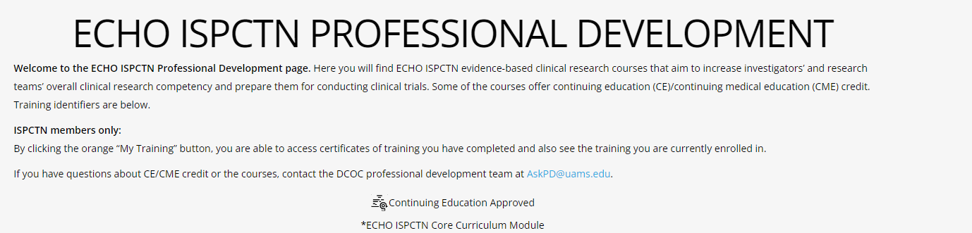
ECHO ISPCTN Website: training available for non-members

Slide 41
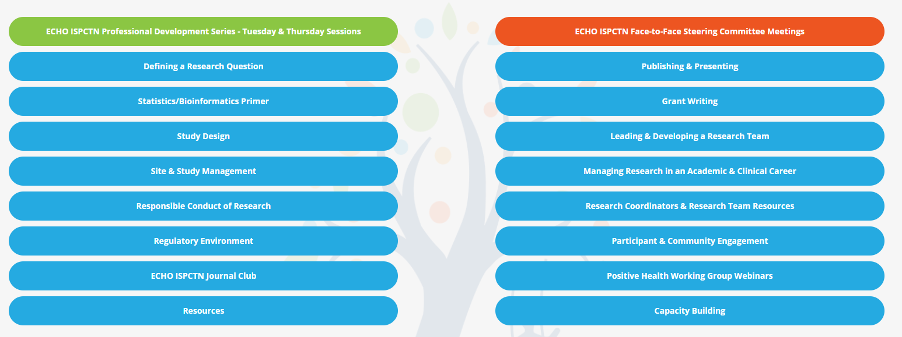
ECHO ISPCTN Website: training available for non-members

Slide 42
NCRI Current Process Improvement Priorities
Feasibility and start-up process for industry-sponsored clinical trials
Monthly invoicing for funded projects
Building grant submission support team
Creating do-it-yourself options for unfunded research
Working to shorten the HR approval times

Slide 43
Summary
Expanded services available for both basic science and clinical research
Grant assistance
Clinical research: Submit request for assistance through Access to Services: https://helpmencri.org/ and specify services needed
Mentorship for faculty to create the next generation of clinician scientists is key
Mentorship for research staff also essential for having efficient and well-trained staff and for retention
Ongoing process improvement

Slide 44
We welcome collaboration with you!!!
THANK YOU!

