Slide 1

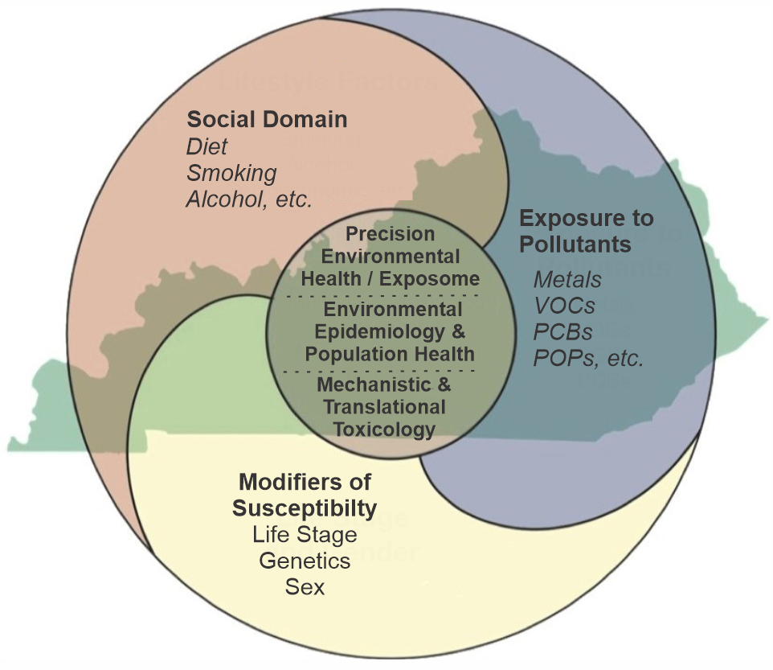

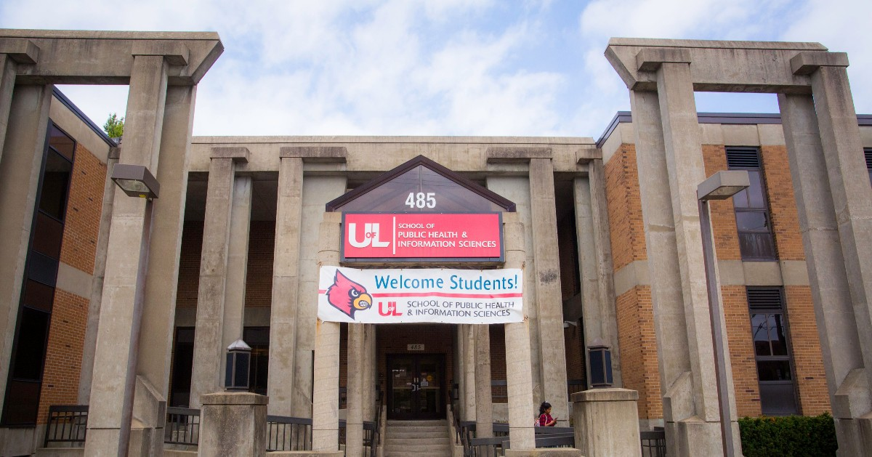
Epidemiology and Population Health Services available in the Translational Research Support Core
Dr. Kira Taylor, Associate Professor of Epidemiology and Population Health
University of Louisville
School of Public Health and Information Sciences
March 25, 2025

Slide 2
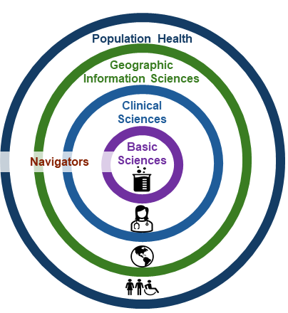
The TRSC

Slide 3

The School of Public Health and Information Sciences
Mission & Vision
MISSION
We are a metropolitan school that pursues excellence and inclusiveness through bold, strategic, and collaborative approaches to education, research, community engagement, policy, and practice.
We strive to protect and improve public health and healthcare delivery systems in Louisville, the Commonwealth of Kentucky, the United States, and with our global partners.
VISION
To be a leader in advancing health equity and social justice to ensure optimal health and well-being for all.

Slide 4
Population-Based Health Research at SPHIS
Our faculty have expertise in designing, conducting, analyzing, and communicating observational population-based research
Environmental epidemiology
Observational studies. Why?
Typically researching harmful exposures: pollution, VOC’s, heavy metals, etc.
Clinical trial for these exposures is not ethical or feasible
Many investigators conducting environmental population-based research at SPHIS
Some designing and conducting their own studies, as PI or co-PI
Some using large databases, either publicly available or available by application

Slide 5
Special considerations for observational studies
Threats to validity:
Selection bias
Looks different for different study designs
This occurs when the probability of inclusion (or retention) in the study is associated with BOTH the exposure AND the outcome of interest
Information bias (i.e. misclassification)
Confounding (“mixing of effects”)
All of these can cause bias either toward or away from the null!
How can you best design your study with these in mind?
Do you want to predict the outcome? Or assess the etiology of the outcome?
Want to minimize biases at the study design stage
Can also reduce some bias with proper analytic methods

Slide 6
Special considerations for observational studies
Can also use epidemiologic methods to examine:
Effect modification
Is the effect of X on Y different, depending on your value of Z?
Example: is the effect of VOC exposure on endothelial function modified by sex, age, race, SES, or genotypes?
This is distinct from confounding
Effect modification is interesting; confounding is a nuisance and a bias
Mediation
Is the effect of X on Y mediated by M? If so, how much of the effect is mediated by M?
X → M → Y
There are sophisticated methods to examine mediation in longitudinal studies
Causal Inference
What can, and cannot, be inferred from your results?

Slide 7
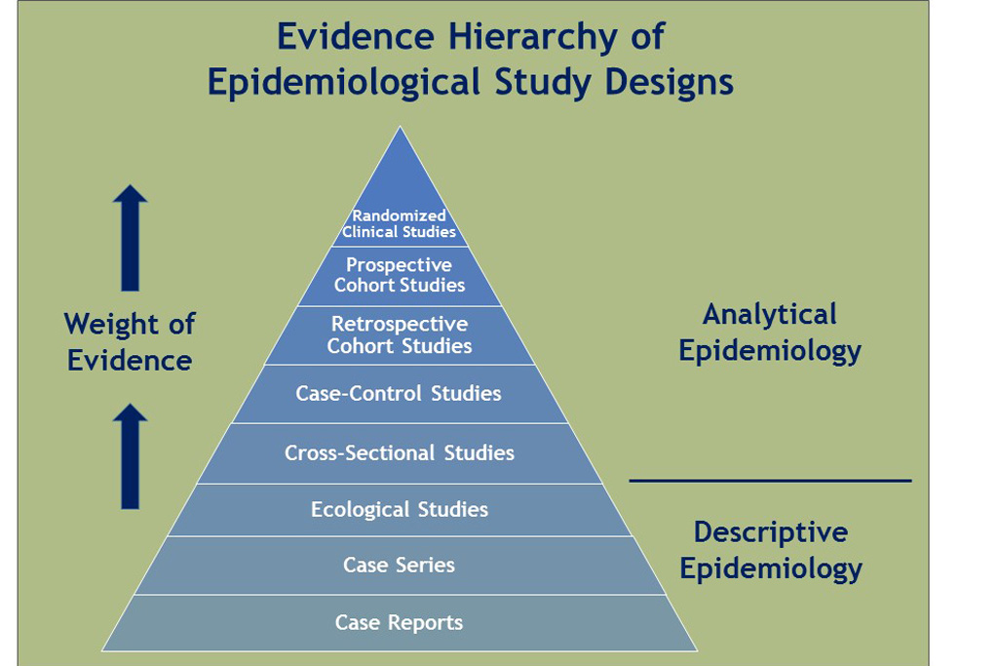
Epidemiologists as co-investigators
We can help with study design for observational research
Prospective cohort study
The gold standard of observational studies
Retrospective cohort study
More efficient, but relying on previously collected data
Case-control study
Efficient, but temporality sometimes difficult to determine
Cross-sectional study
Best at measuring prevalence
Ecological study
No individual-level data

Slide 8
Epidemiologists as co-investigators
We can help you to…
Refine hypotheses and specific aims for a review panel of population health researchers
May be particularly helpful if your background is in experimental research (in vitro, in vivo, clinical trials, etc.)
Implement a study
Sampling techniques for selecting participants
Survey methods
Appropriate statistical analysis and interpretation of results
Reduce bias!
Contextualize results
Evaluate and discuss internal and external validity
IRB application

Slide 9
The School of Public Health and Information Sciences
Department of Bioinformatics and Biostatistics
Department of Epidemiology and Population Health
Department of Health Management and Systems Sciences
Department of Health Promotion and Behavioral Sciences

Slide 10
Department of Bioinformatics and Biostatistics Maiying Kong gave a presentation for the TRSC highlighting the Biostatistics and Bioinformatics core.
Cerner Learning Health Network EHR databases
Epic Cosmos EHR database
UofL Health local Electronic Data Warehouse
SEER Medicare projects
NHANES
Kentucky hospital databases (2015-2021)
Help with study design and analysis, power, big data, omics data, RedCap, etc.
Contact the BIFC: https://louisville.edu/ciehs/cores/bifc/bifc-services-form

Slide 11
Department of Epidemiology and Population Health
Substantive expertise in:
Cancer epidemiology (K. Baumgartner, S. Boone, N. DuPre, Q. Zhang)
Reproductive epidemiology (K. Taylor, A. Wallis, T. Ali)
Global maternal/child health (Wallis)
Genetic epidemiology, gene-environment interaction (Taylor)
Cardiovascular disease (Taylor, Boone)
Infectious disease (T. Ali)
Nutrition (R. Baumgartner)
Social and behavioral epidemiology; survey methods (N. Peiper)
Causal inference and mediation analysis (DuPre)
Environmental epidemiology (B. Guinn, DuPre, Taylor, Zhang)
Former SPHIS students now at the Envirome institute: Dan Riggs, Clara Sears

Slide 12
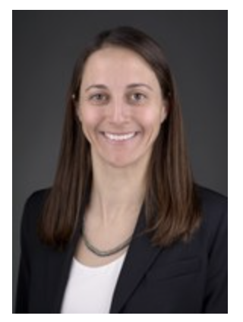
Dr. Natalie DuPré
Using epidemiologic methods to examine how the environment influences health and disease, and whether environmental injustices are influencing health disparities
Neighborhood SES and urban/rural status
Air pollutants
Ambient neighborhood exposures to air pollutants
Natural vegetation
Noise exposure
Metals
Radon
Main health outcome of interest:
cancer incidence and survival (breast, colon, prostate mainly)
Other outcomes:
Mammographic Density
COVID-19
Hepatitis A
Opioid overdose mortality
Behavioral health

Slide 13

Louisville Environmental Assessments Pilot Study in Colorectal Cancer (LEAPS-CRC)
Clinical Case-Control study at UofL Health in Dr. Kavalukas’ colorectal surgery clinic (August 2023 - present)
Controls: Surgery Patients without CRC
Cases: Patients with CRC
Exposure of interest: heavy metals in blood, urine
Detailed 8-page questionnaire on:
Demographics
Current residence and Residential history
Housing information
Colon health history
Socio-economic status markers
BMI, Smoking, Physical activity
Dietary information
N. DuPré S. Kavalukas

Slide 14

Dr. Qunwei Zhang
Laboratory scientist and environmental epidemiologist
Mechanistic studies
Pulmonary toxic, genotoxic and carcinogenic effects induced by exposure to various environmental and occupational particles including nanoparticles, particulate matter, cigarette smoke, etc.,
Invites collaborations on these areas

Slide 15

Dr. Stephanie Boone PI for Kentucky for the RURAL study
The Risk Underlying Rural Areas Longitudinal (RURAL) Cohort Study
Prospective cohort study in select rural counties in Alabama, Kentucky, Louisiana, and Mississippi.
Enrolling 4,600 participants from these communities, examining several different aspects of their health, including heart and lung function
Enrollment is complete in Alabama, Louisiana and Mississippi; enrollment in progress in KY
Interviews and biospecimens; mobile exam units (MEU)
https://theruralstudy.org/research/
Ancillary Study Information
RURAL Ancillary Studies: Second Examination Cycle
Publications And Presentations Policy
https://theruralstudy.org/research-data-collection-forms/#1715178390613-c8b5c4dc-b5e7

Slide 16

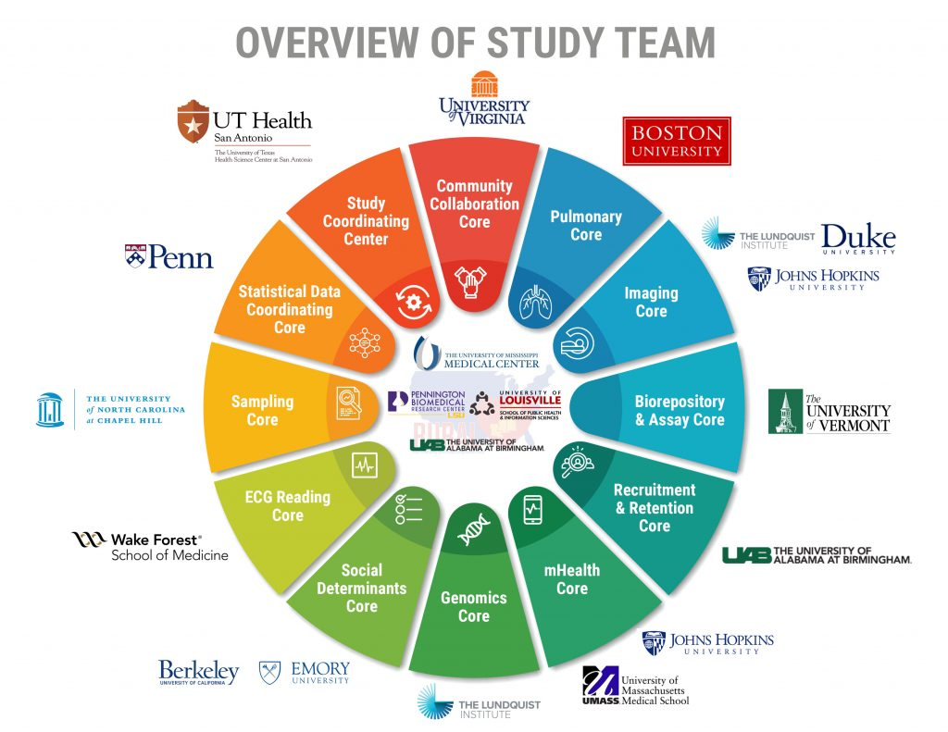

Dr. Stephanie Boone PhD, MPH (Associate Professor) Core PI
A new prospective epidemiology research project focused in 10 select rural counties/parishes in Alabama, Kentucky, Louisiana, and Mississippi.
Target enrollment is 4,600 participants
n=1,600 from 4 counties in KY (35%)
Goals: To bridge the rural research gap of heart and lung disorders in Southeastern United States through longitudinal assessment several different aspects of their health, including heart and lung function (subclinical disease detection).
Community Engagement Activities and Projects
www.theruralstudy.org
Funded by National Institutes of Health: National Heart, Lung, Blood Institute (U01)
Notes:
To bridge the rural research gap of heart and lung disorders in the Southeastern United States by:
Identifying the frequency of and risk factors for heart and lung diseases in the RURAL communities
Identifying unique factors contributing to health disorders in these communities — including psychosocial, economic, and familial factors — and how they interact together.
Identifying potential solutions by examining differences between higher and lower risk rural counties
Concentrating on communities and geographic areas not adequately studied previously – Appalachian and Mississippi Delta regions

Slide 17
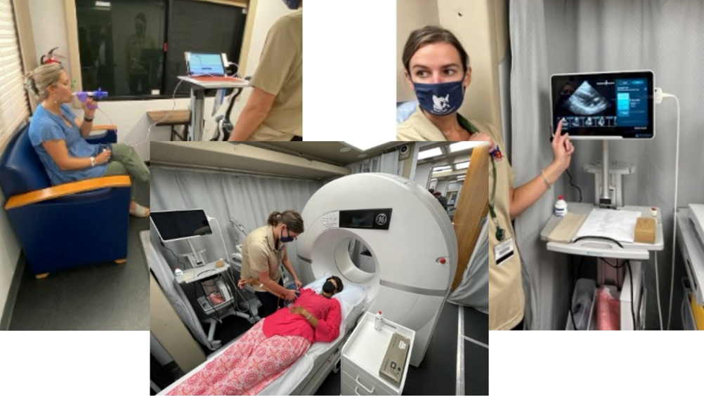

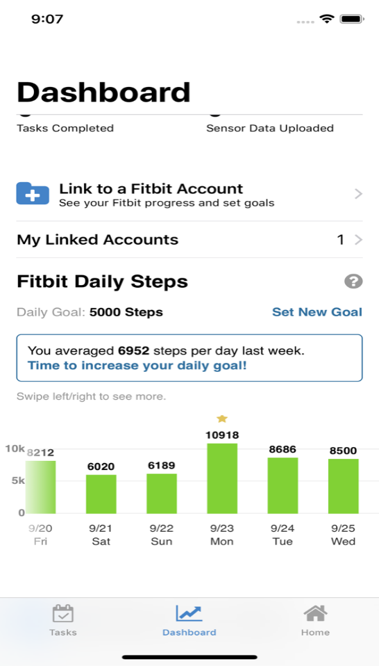
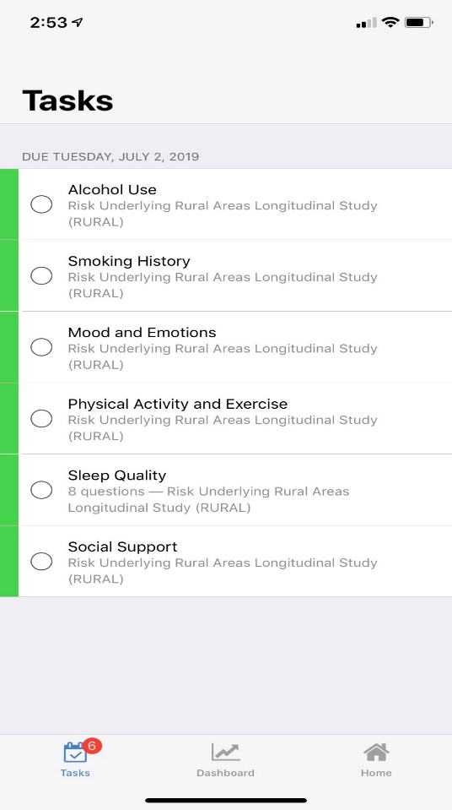
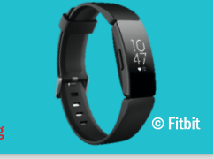
What are we asking people to voluntarily do?
Baseline Data Collection:
Anthropometry (Height, Weight)
Test/ Exams related to Heart, Lung, and Blood vessel health (spirometry, echocardiogram, CT scan, ankle-brachial index, blood pressure)
Collection of blood and urine
Surveys
Follow-up Data Collection
1-,3-,6- month surveys
6-mo FitBit data
Annual telephone interviews
Medical records linkage/adjudication
Baseline recruitment/exams expected completion is Spring ’26
Funding for Round 2 In-person Exams announced by NHLBI; will take between 2027 and 2031
*This is not a clinical/diagnostic study

Slide 18
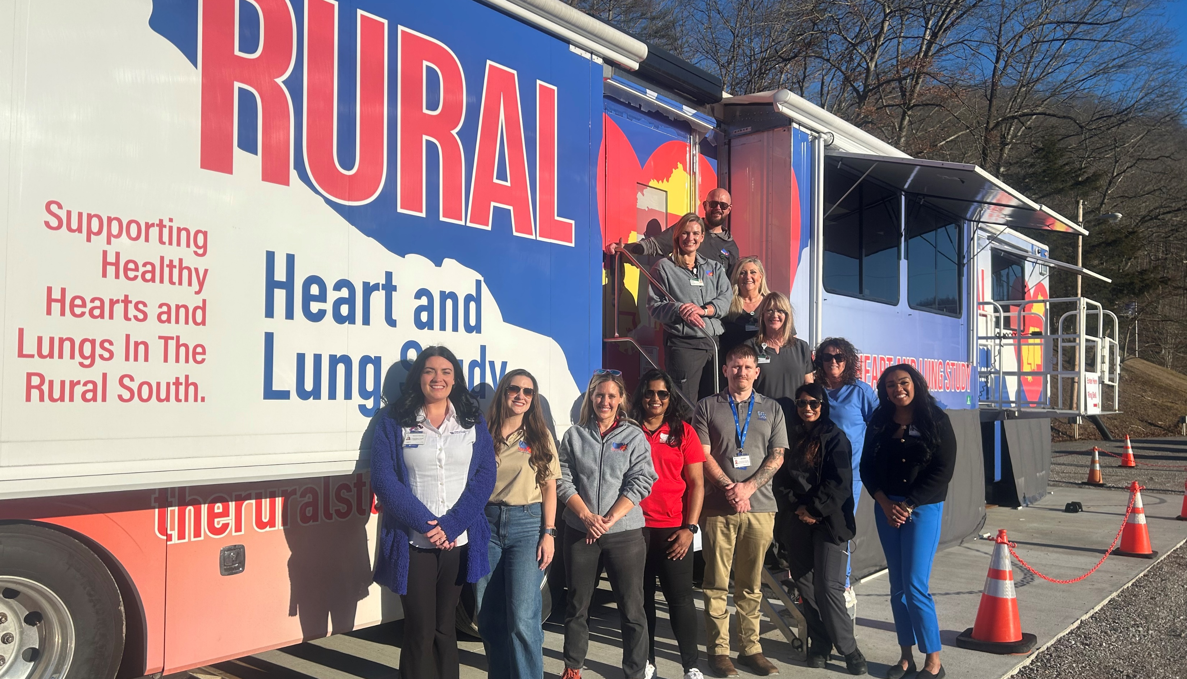
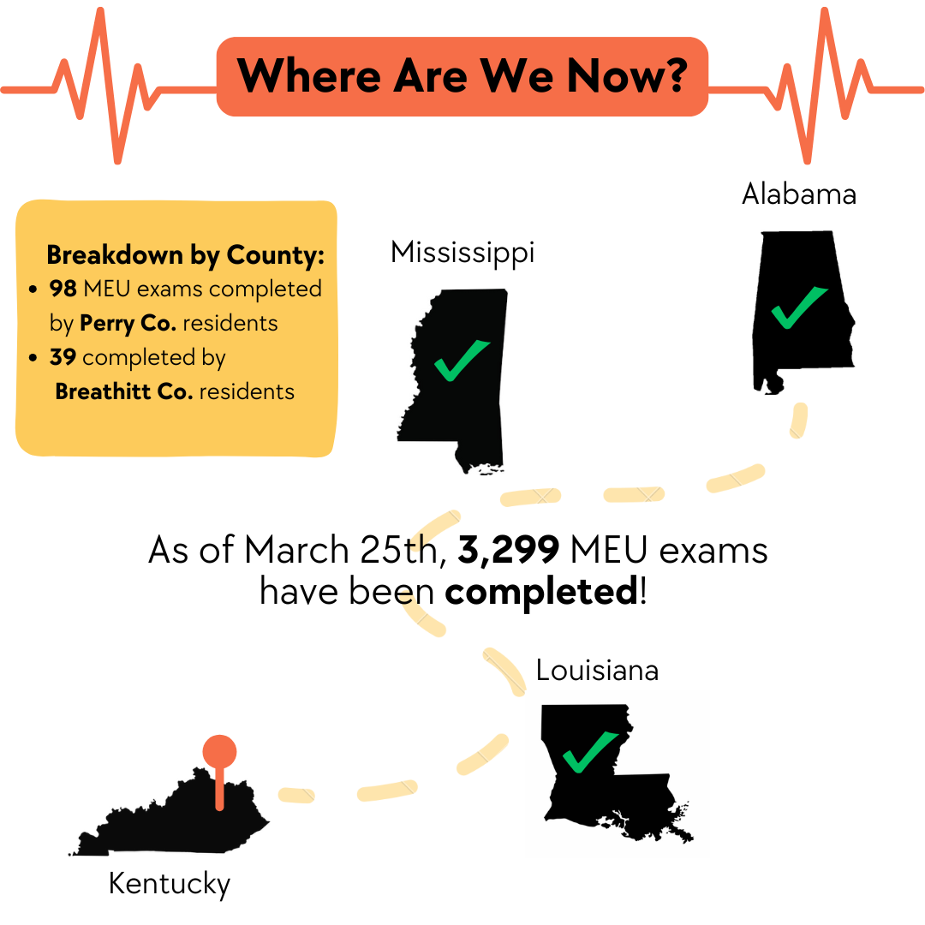

Where are we now?
Accepting Proposals for Abstracts/Manuscripts and Ancillary Studies for Second In-person Exam
RURAL Ancillary Studies - The RURAL Cohort Study
stephanie.boone@louisville.edu (KY-Core PI; Leads Community Engagement and Cardio-Oncology Working Groups)
Rural Heart and Lung Study – Kentucky Core
Ruralstudykentucky
Anticipated move to Boyle/Garrard Co is October 2025

Slide 19
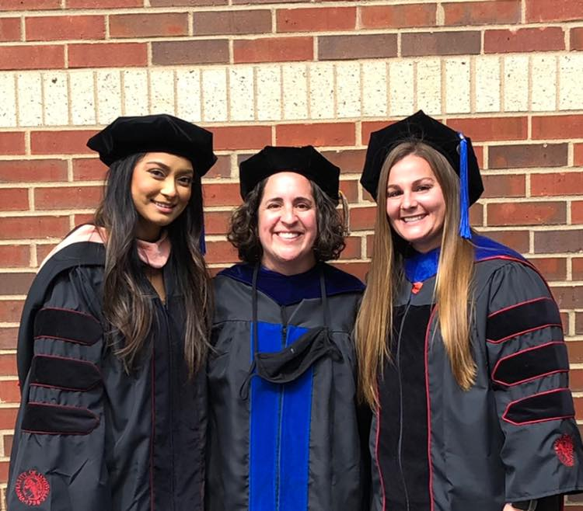
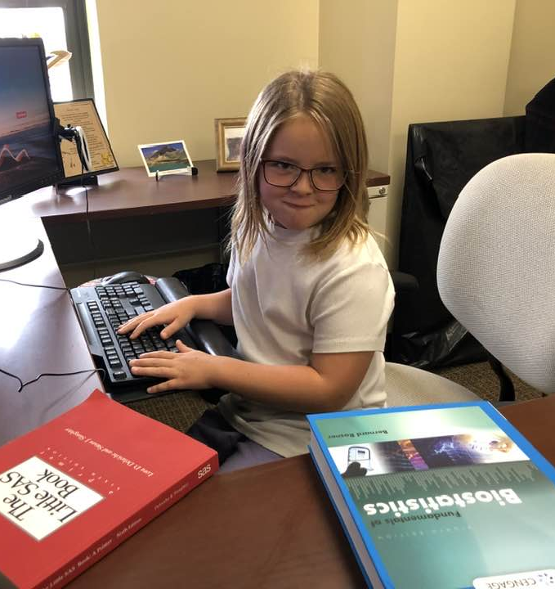
Dr. Kira Taylor
Effects of environmental and genetic exposures on reproductive and obesity-related outcomes, using prospective or cross-sectional study designs
Exposures: PCB’s, PBB’s, tear gas, secondhand smoke, genetic risk factors, genetic risk scores, gene-environment interactions
Outcomes:
Age at menarche
Menstrual function
Cycle length, cycle variability
Bleed length
Ovulation
Fecundability
Reproductive hormone levels
Adverse birth outcomes
PCOS
Male reproductive outcomes
BMI, waist-hip ratio

Slide 20

Dr. Brian Guinn
Associations between environmental lead exposure and human health and behavior.
Assessing the magnitude of topsoil lead contamination throughout Louisville, to identify at-risk communities.
Works in health policy with local, state, and federal agencies to fund lead abatement programs applicable to Louisville, KY.

Slide 21
Collaborations of the Department of Epidemiology with other large cohort studies
REGARDS study
National cohort study sponsored by the NIH.
Between 2003-2007, the study enrolled 30,239 black and white participants from the continental United States.
Main outcome: stroke
Jackson Heart Study
Cohort study of cardiovascular disease among 5300 African-Americans
Nurses’ health study
Women’s health initiative
Breast Cancer Health Disparities Study
4 Corners Cancer Study (Arizona, New Mexico, Utah, Colorado)

Slide 22
Department of HMSS - Health Management and Systems Sciences https://louisville.edu/sphis/departments/hmss
Big data analytics
Data mining
In-house algorithms to convert ICD codes to indicator values in analytical datasets
Cerner dataset (180 million patients)
Requires training in relational databases
Data from 2000-2019
Includes labs
NHANES data
HCUP (Healthcare Cost and Utilization Project) – inpatient and outpatient hospitalization data through 2020

Slide 23
The Commonwealth Institute of Kentucky
“Our mission is to inform policy and practice that will improve the health of populations in Kentucky and beyond by facilitating and supporting transdisciplinary collaborations for research and data analytics.”
The CIK has collected a number of national and state-level databases. They include:
American Hospital Association (AHA) Annual Survey
Behavioral and Risk Factors Surveillance Surveys (BRFSS)
Healthcare Cost and Utilization Project (HCUP)
The Healthcare Cost and Utilization Project (HCUP) data is the biggest longitudinal hospital care data collection in the United States (U.S.).
Kentucky Health Facility and Services (KHFS)
Kentucky Health Issues Poll (KHIP)
National Survey of Children’s Health (NSCH)
Data briefs can be found here: https://louisville.edu/sphis/departments/cik/data-briefs
Contact Seyed Karimi for more information.

Slide 24
Department of Health Promotion and Behavioral Sciences https://louisville.edu/sphis/departments/hpbs
Research methods include:
Qualitative research
Mixed methods
Community-based participatory research
Thematic analysis
Areas of expertise in the department include:
Social equity
Structural violence
The impact of health policies and practices on marginalized populations
Structural determinants of health
Health-related decision making
HPV-associated cancers and cervical cancer screening

Slide 25
Thank you!
Contact: trsc@louisville.edu
Kira.taylor@louisville.edu

