Slide 1
Applications of Geotechnologies in Environmental Health Research at UofL
CIEHS Translational Research Support Core (TRSC) Quarterly Seminar Series, November 12, 2024
Charlie Zhang and DJ Biddle
Department of Geographic & Environmental Sciences
University of Louisville

Slide 2
Profiles of Presenters
Charlie Zhang, Ph.D.
Professor of geography and Ph.D. faculty member of Urban and Public Affairs (UPA)
GIS navigator of the Center for Integrative Environmental Health Sciences (CIEHS)
Health geographer with interests in environmental pollution, exposure to heavy metals, environmental justice, health disparities
Donald J. Biddle, MS, GISP
Director, Center for Geographic Information Sciences (ULCGIS)

Slide 3
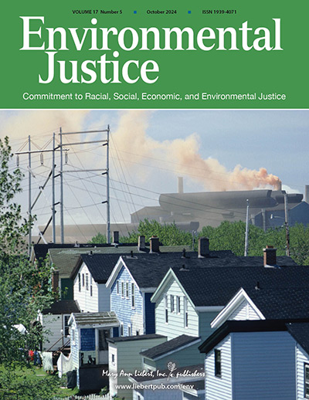
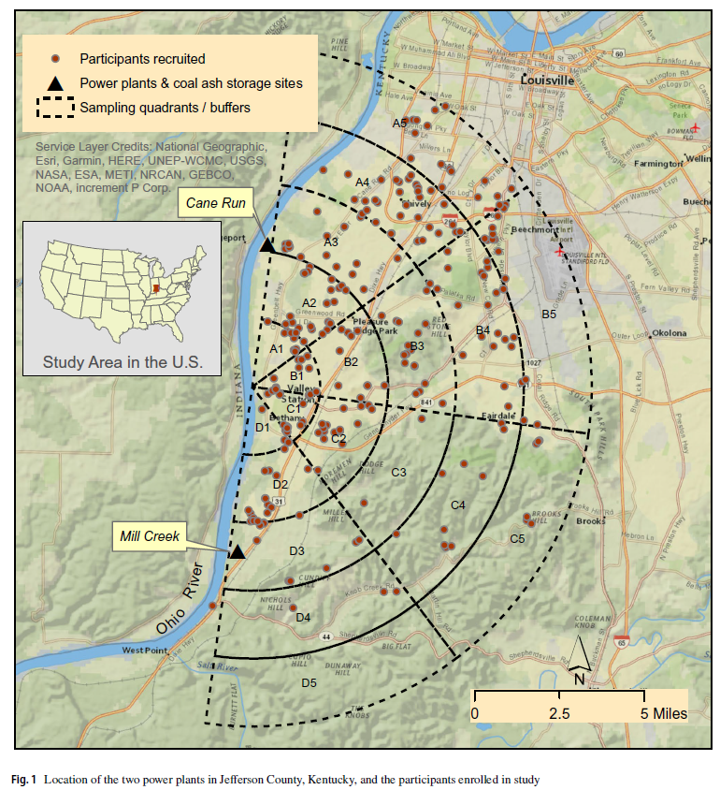
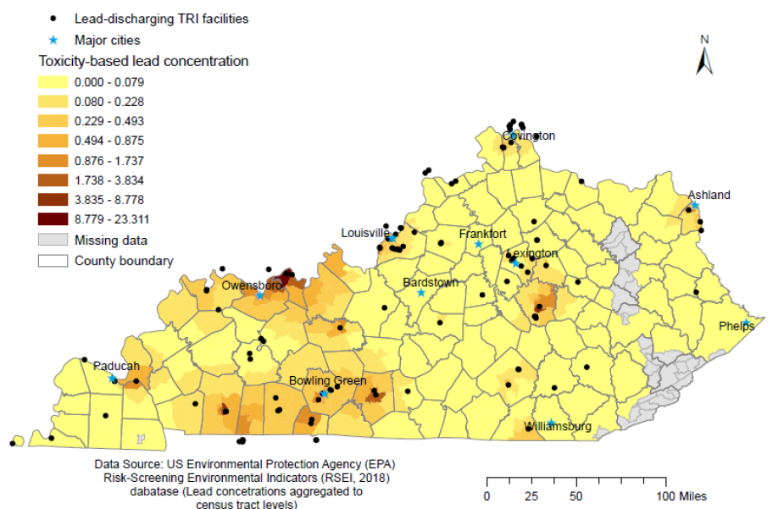
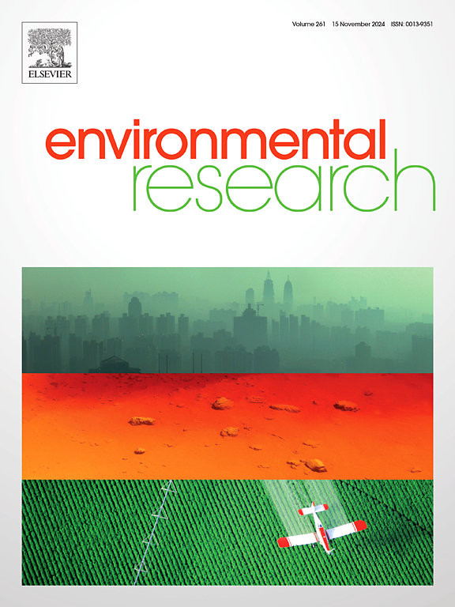
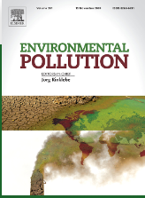
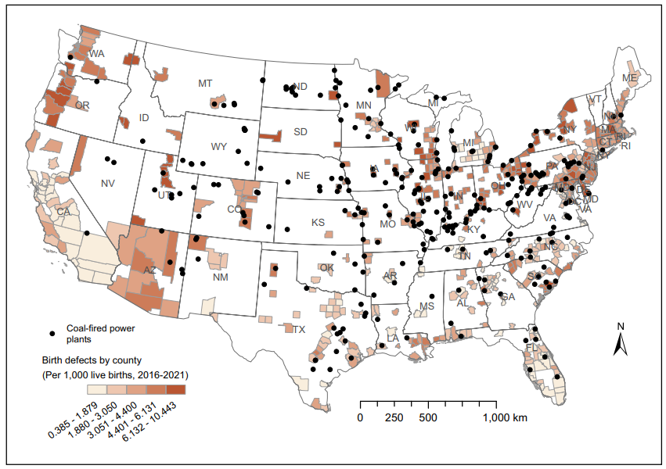
Major Publications in Recent Years

Slide 4
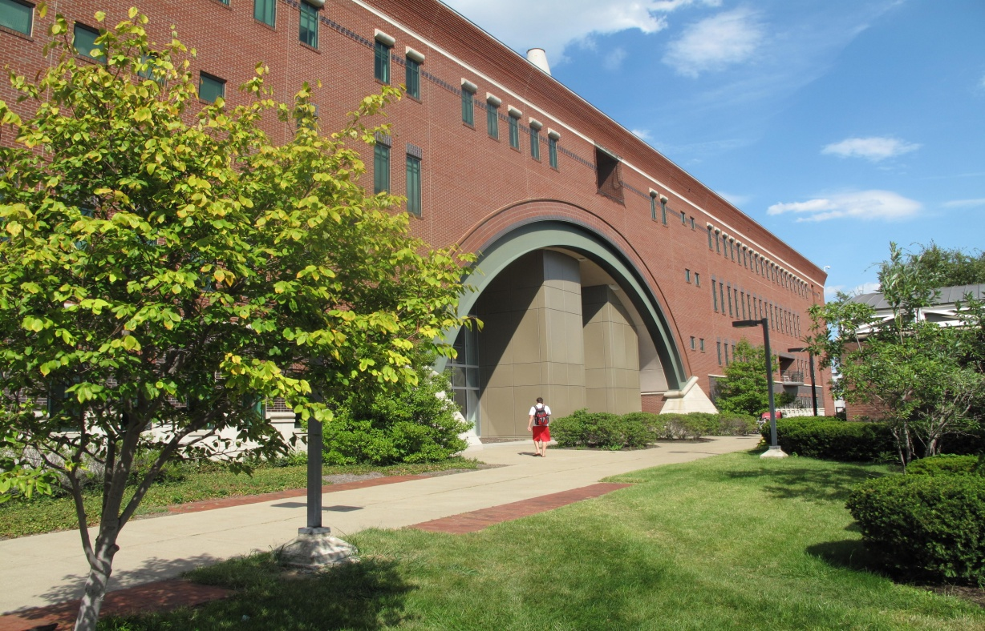
http://louisville.edu/geogeo
facebook.com/UofLGeography
2nd Floor, Lutz Hall

Slide 5
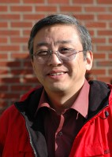
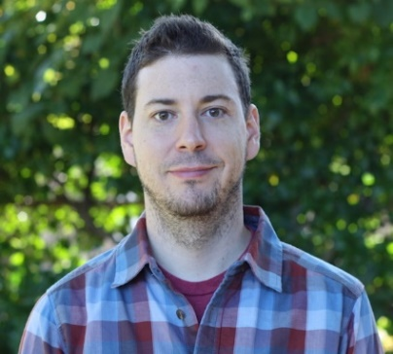
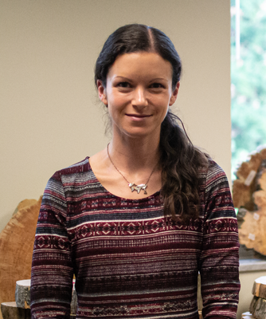
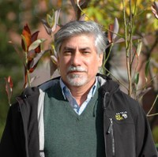
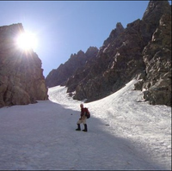
Dr. Wei Song,
Chair
Dr. Andrew Day, Graduate Director
Dr. Andrea Gaughan,
Undergraduate Director
Dr. Forrest Stevens
Dr. Carrie Mott
Dr. Margath Walker
Dr. Charlie Zhang
Dr. Jason Naylor
Dr. Maegen Rochner
Dr. Scott Gunter
Dr. Jafar Hadizadeh
Dr. Kalpana
Venkatasubramanian
Laura Krauser,
GIS Research Coordinator
Donald Biddle,
Director of CGIS

Slide 6
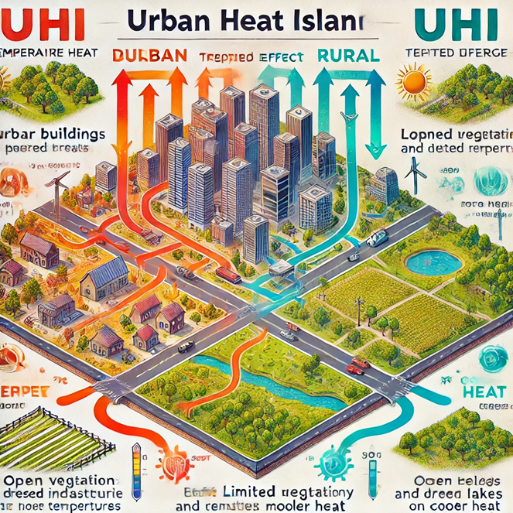
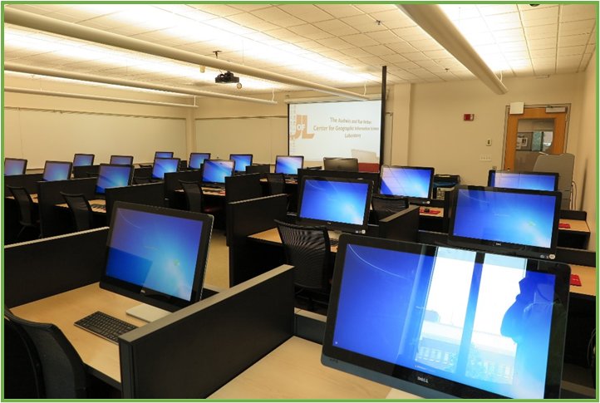
Research Labs and Facilities
Center for Geographic Information Sciences (ULCGIS)
Environmental Remote Sensing Lab
Urban Heat Lab
Spatial Analysis and Modeling
Climate change and natural disasters
Tree-Ring Lab

Slide 7
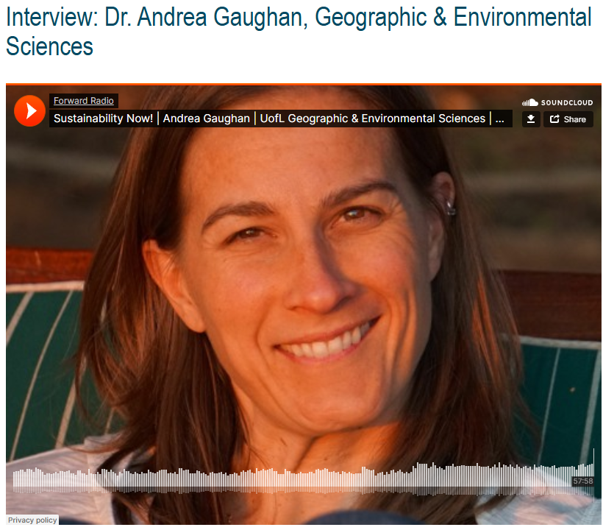
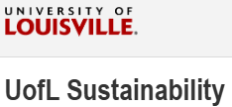
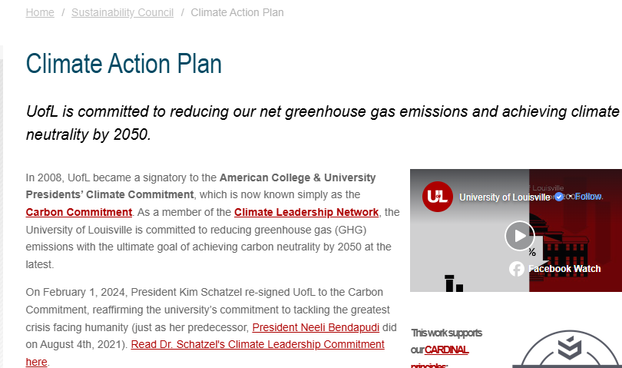
Dr. Andrea Gaughan and team helps Louisville Metro in tackling climate change crisis
Notes:
https://louisville.edu/sustainability/news/interview-dr-andrea-gaughan-geographic-environmental-sciences

Slide 8
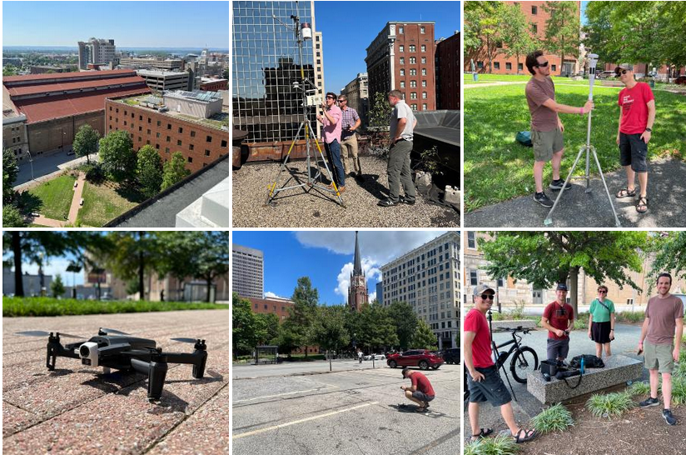
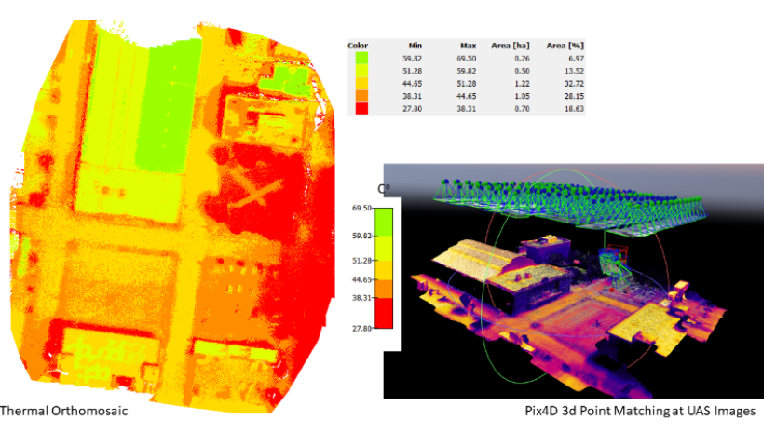
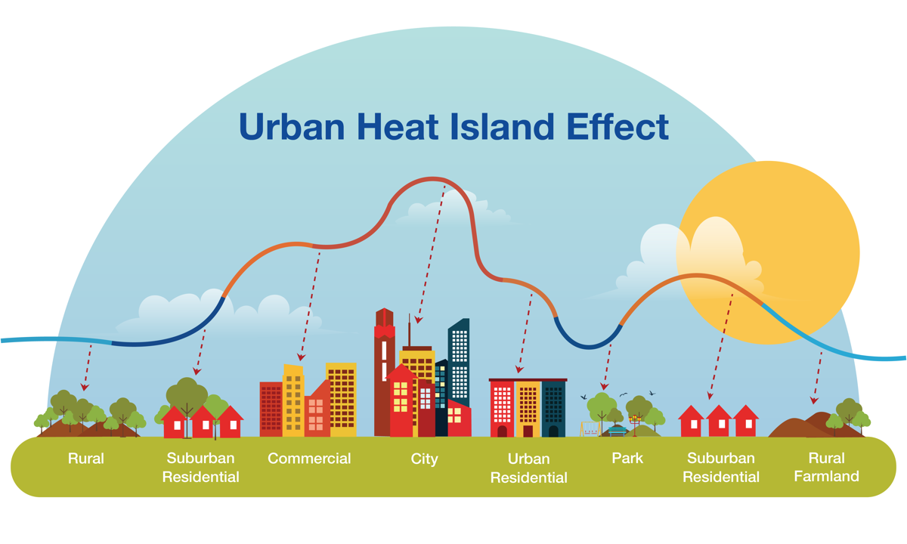
Mapping urban heat - DGES research team launched an unmanned aircraft system (UAS)-based thermal imaging study of a two-block radius surrounding Founders Square Park in downtown Louisville.
Notes:
UAS- Unmanned aircraft system or UAV – Unmanned aerial vehicle.

Slide 9
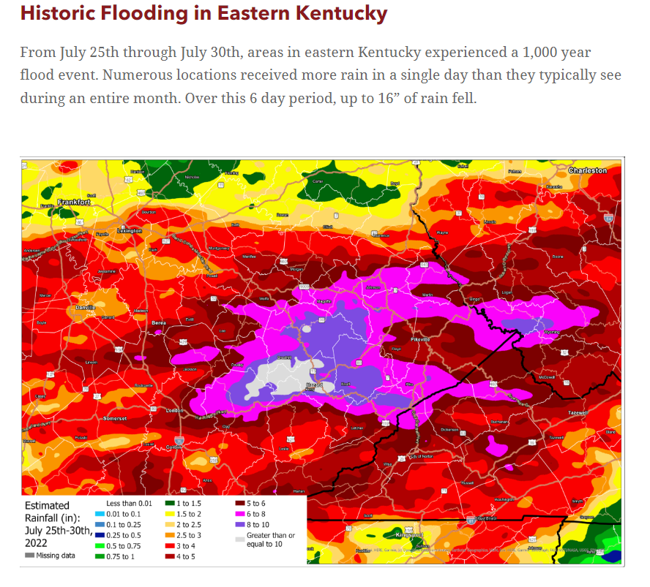
Notes:
Fall 2022, Geographic & Environmental Sciences Department

Slide 10
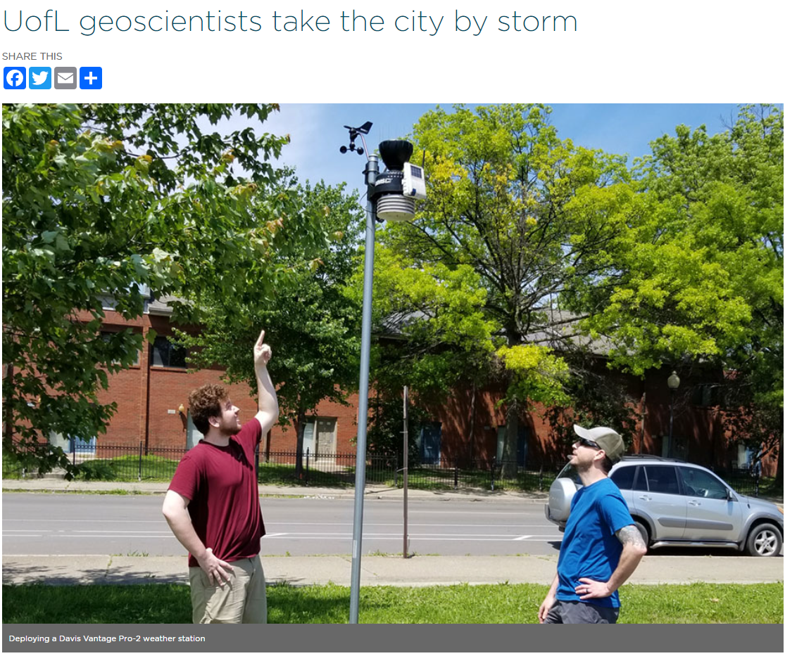
Notes:
UofL geoscientists take the city by storm — College of Arts & Sciences

Slide 11
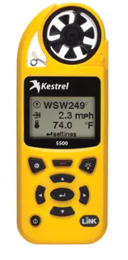
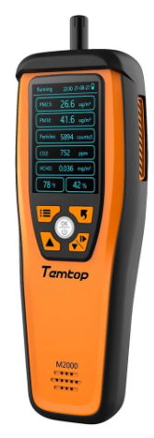
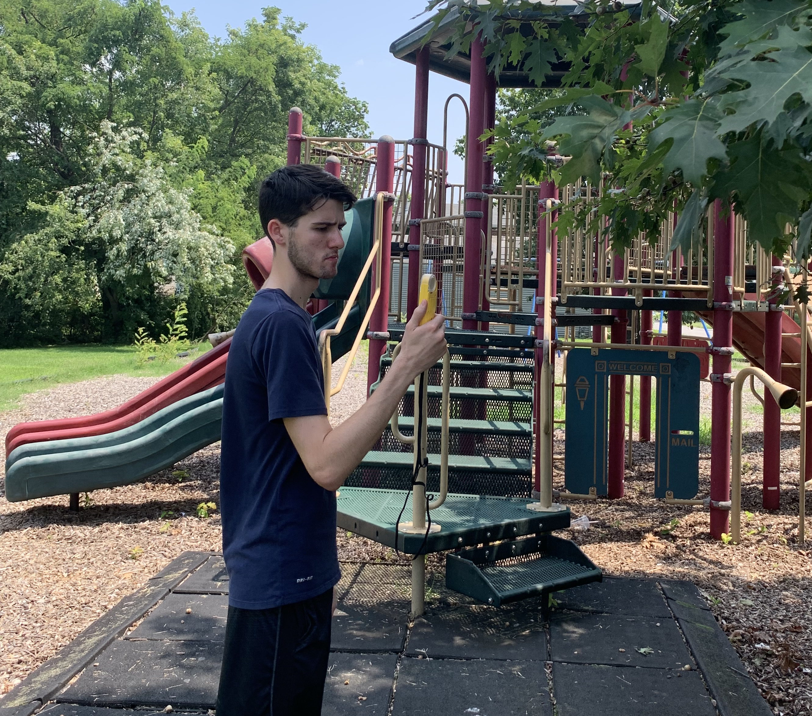
Weather Meter and Air Quality Meter for Field Sampling
Temtop M2000 air quality monitor
Kestrel 5500 weather meter
Notes:
Formaldehyde is a colorless, flammable, and strong-smelling chemical that is known to cause cancer:
Formaldehyde is used in many products and processes, including Building materials: Used in plywood, particleboard, and other pressed-wood products
Preservative: Used in medical laboratories and mortuaries
Germicide and disinfectant: Used to kill germs

Slide 12
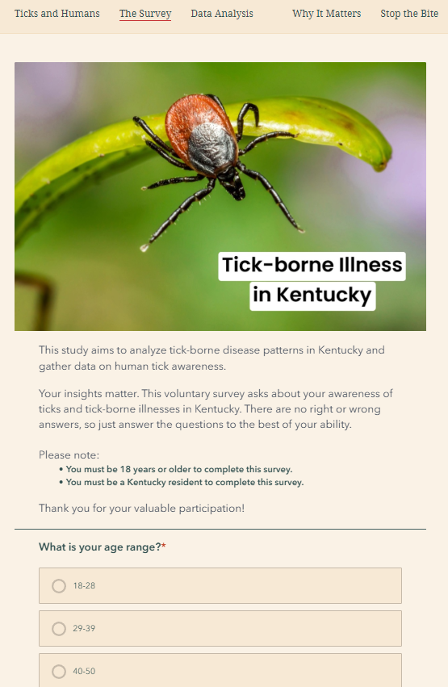
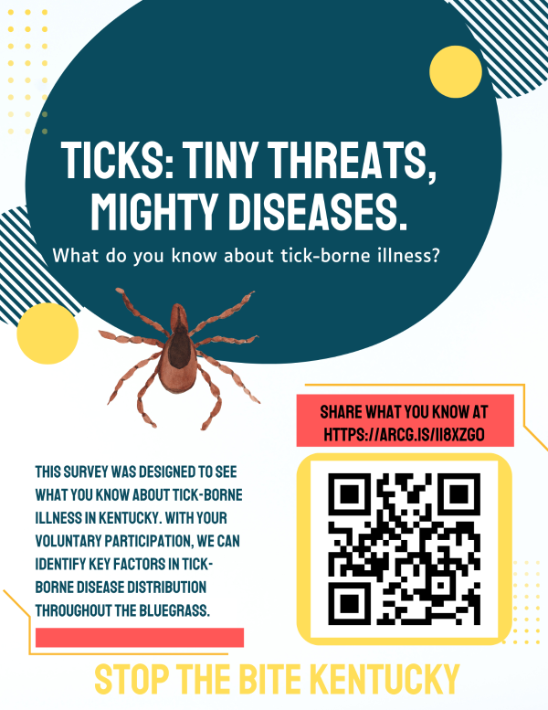
Credit: Jada Mckenzie,
UofL GEOG/ENVS graduate (2024)

Slide 13
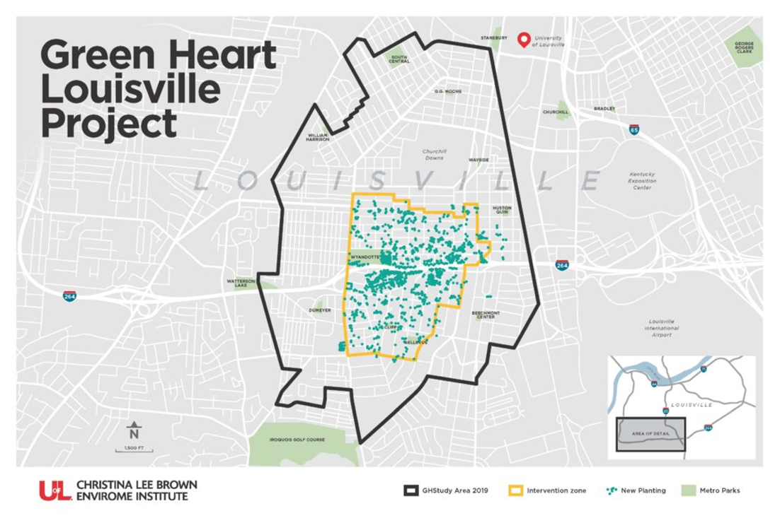
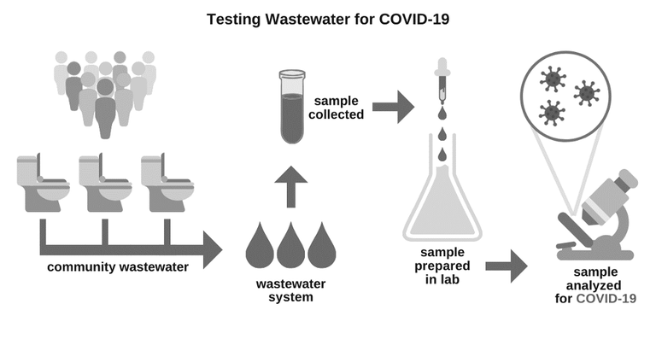
Other Resources on UofL Campus
The Christina Lee Brown Envirome Institute
UofL Center for Heathy Air, Water, and Soil
Louisville Aire Pollution Control District
The Louisville/Jefferson County Information Consortium (LOJIC)
The Louisville Metro Open Data

Slide 14
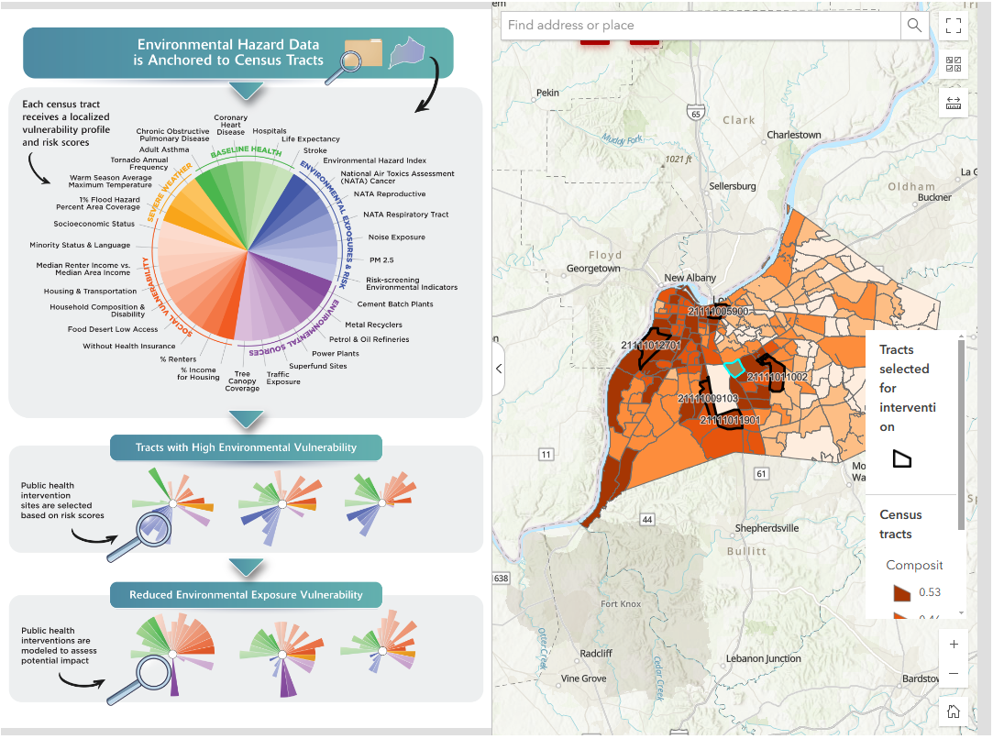
Notes:
https://louisville.edu/envirome/healthyairwaterandsoil/environmental-vulnerability-index

Slide 15
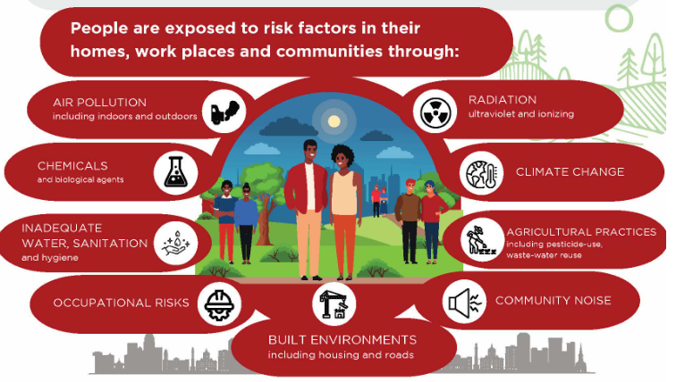
Environmental Health Sciences

Slide 16
Applications of Geotechnologies in Environmental Health Research
Field sampling and investigations
Disease surveillance, modeling, and mapping
Disease etiology and determinants of health
Environmental risk factors and exposure assessment
Inequalities in health outcomes
Health service use and access to healthcare
Environmental justice
Climate change related health problems

Slide 17
Field Sampling in Environmental Health Research
Air or meteorological factors (temperatures, humidity, and wind; PM_{2.5} or PM₁₀)
Water samples
Soil or other solid waste (e.g., coal ash)
Housing paint
Plants or worms
Biomarkers
Human subjects
https://www.amazon.com/Heavy-Metals-Laboratory-Analysis-Everything/dp/B0C3WPR576
Notes:
PM2.5 and PM10 are both types of particulate matter (PM), or particle pollution, that can be inhaled and cause adverse health effects:

Slide 18
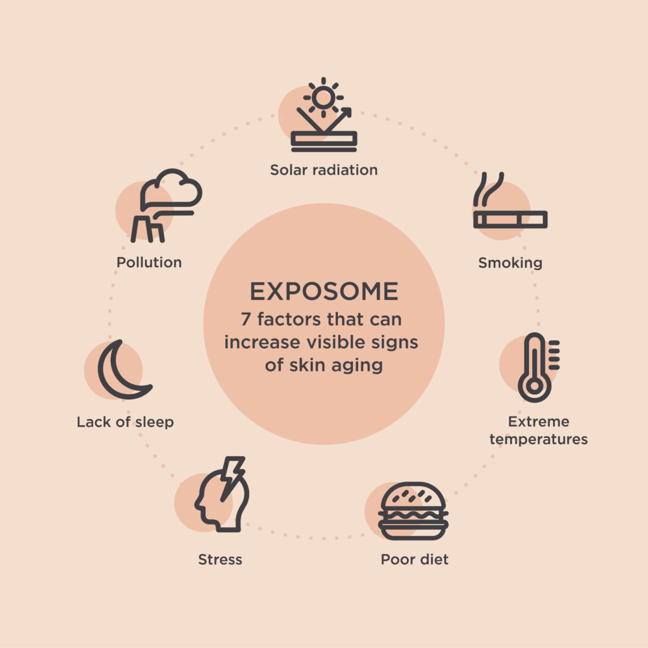
Risk Factors for Disease
To date, most environmental health studies assessed the environmental exposure at a single time-point and, therefore, might not cover the highest risk exposure window.
Exposome measures the lifelong exposure history and therefore calls for changes in exposure over time to be considered.
Built environment – the housing/streets/sidewalks/traffic, etc.
Social environment – Segregation, crime, poverty, etc.
The physicochemical environment – pollution and pesticides
The lifestyle/food environment – food deserts and obesities
Natural environment – Natural disasters and climate change

Slide 19
Environmental Health Disparities
Environmental health examines how the environment affects human health/well-being.
Communities located near polluting industrial sites or hazardous waste sites may experience higher rates of environmental exposures and related health risks.
Environmental justice issues often intersect with spatial health disparities, as marginalized and low-income communities bear a disproportionate burden of environmental risk factors.

Slide 20
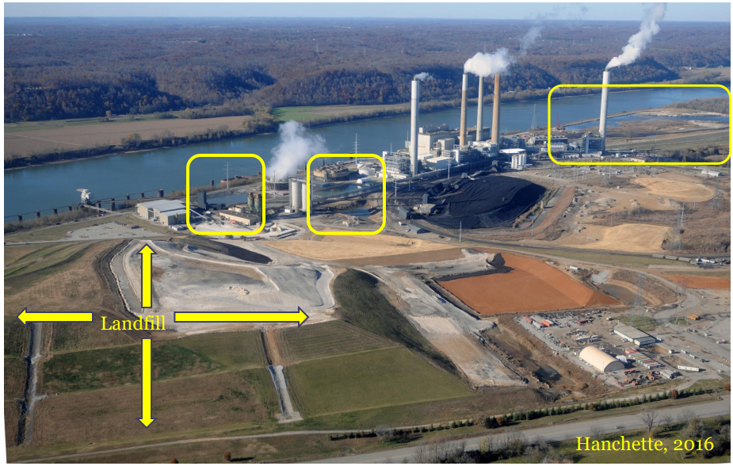
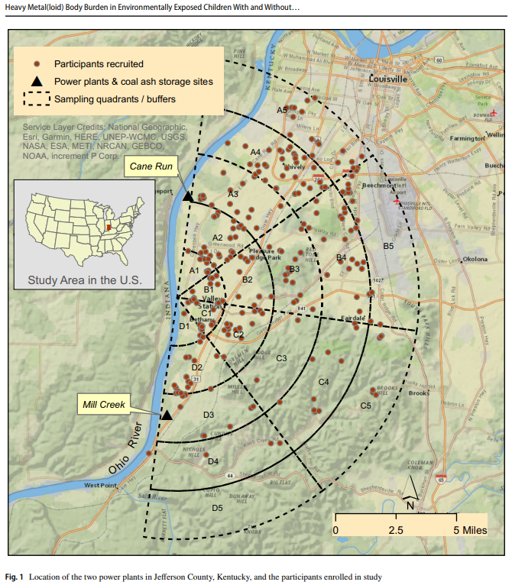
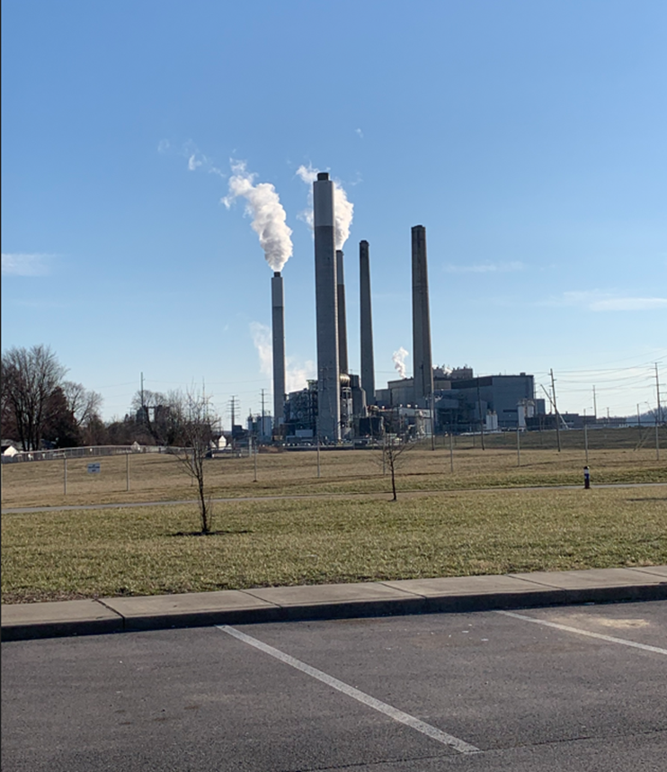
Funding: NIEHS R01ES024757, PI: Zierold

Slide 21
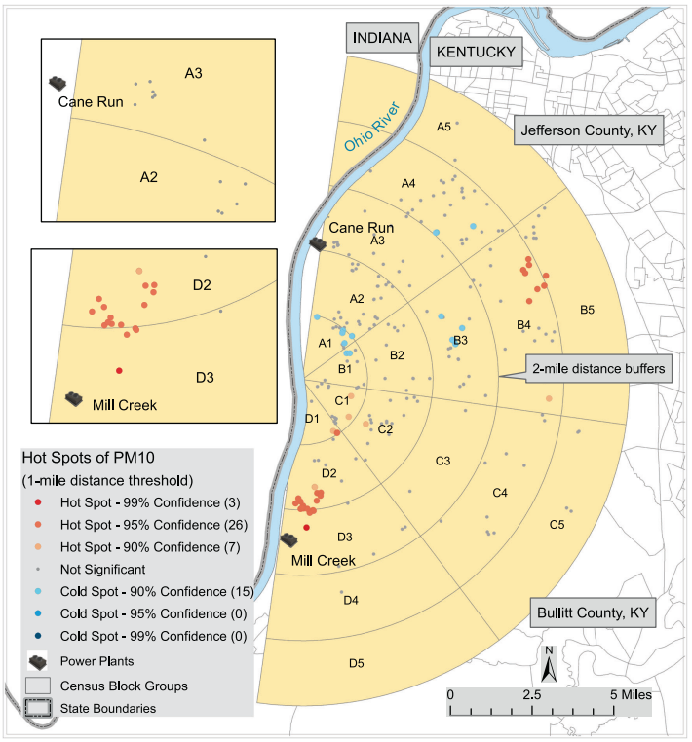
Collecting Nail and PM Samples
Over 250 participants were recruited from western portion of Jefferson and Bullitt counties
Samples for particulate matter (PM) and nails were collected
Samples sent to labs for assessment of heavy metals

Slide 22
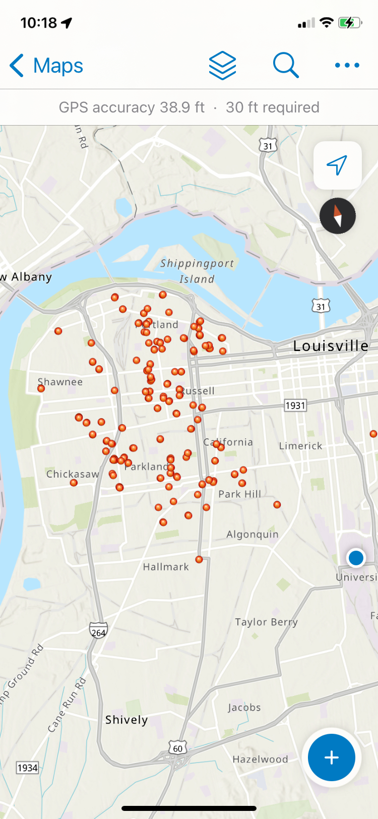
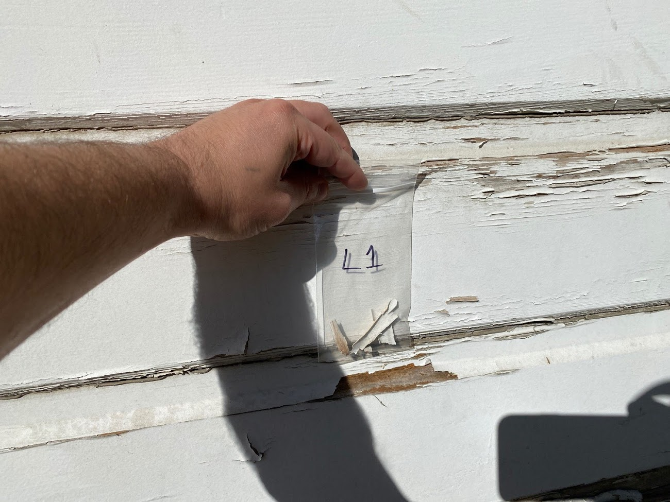
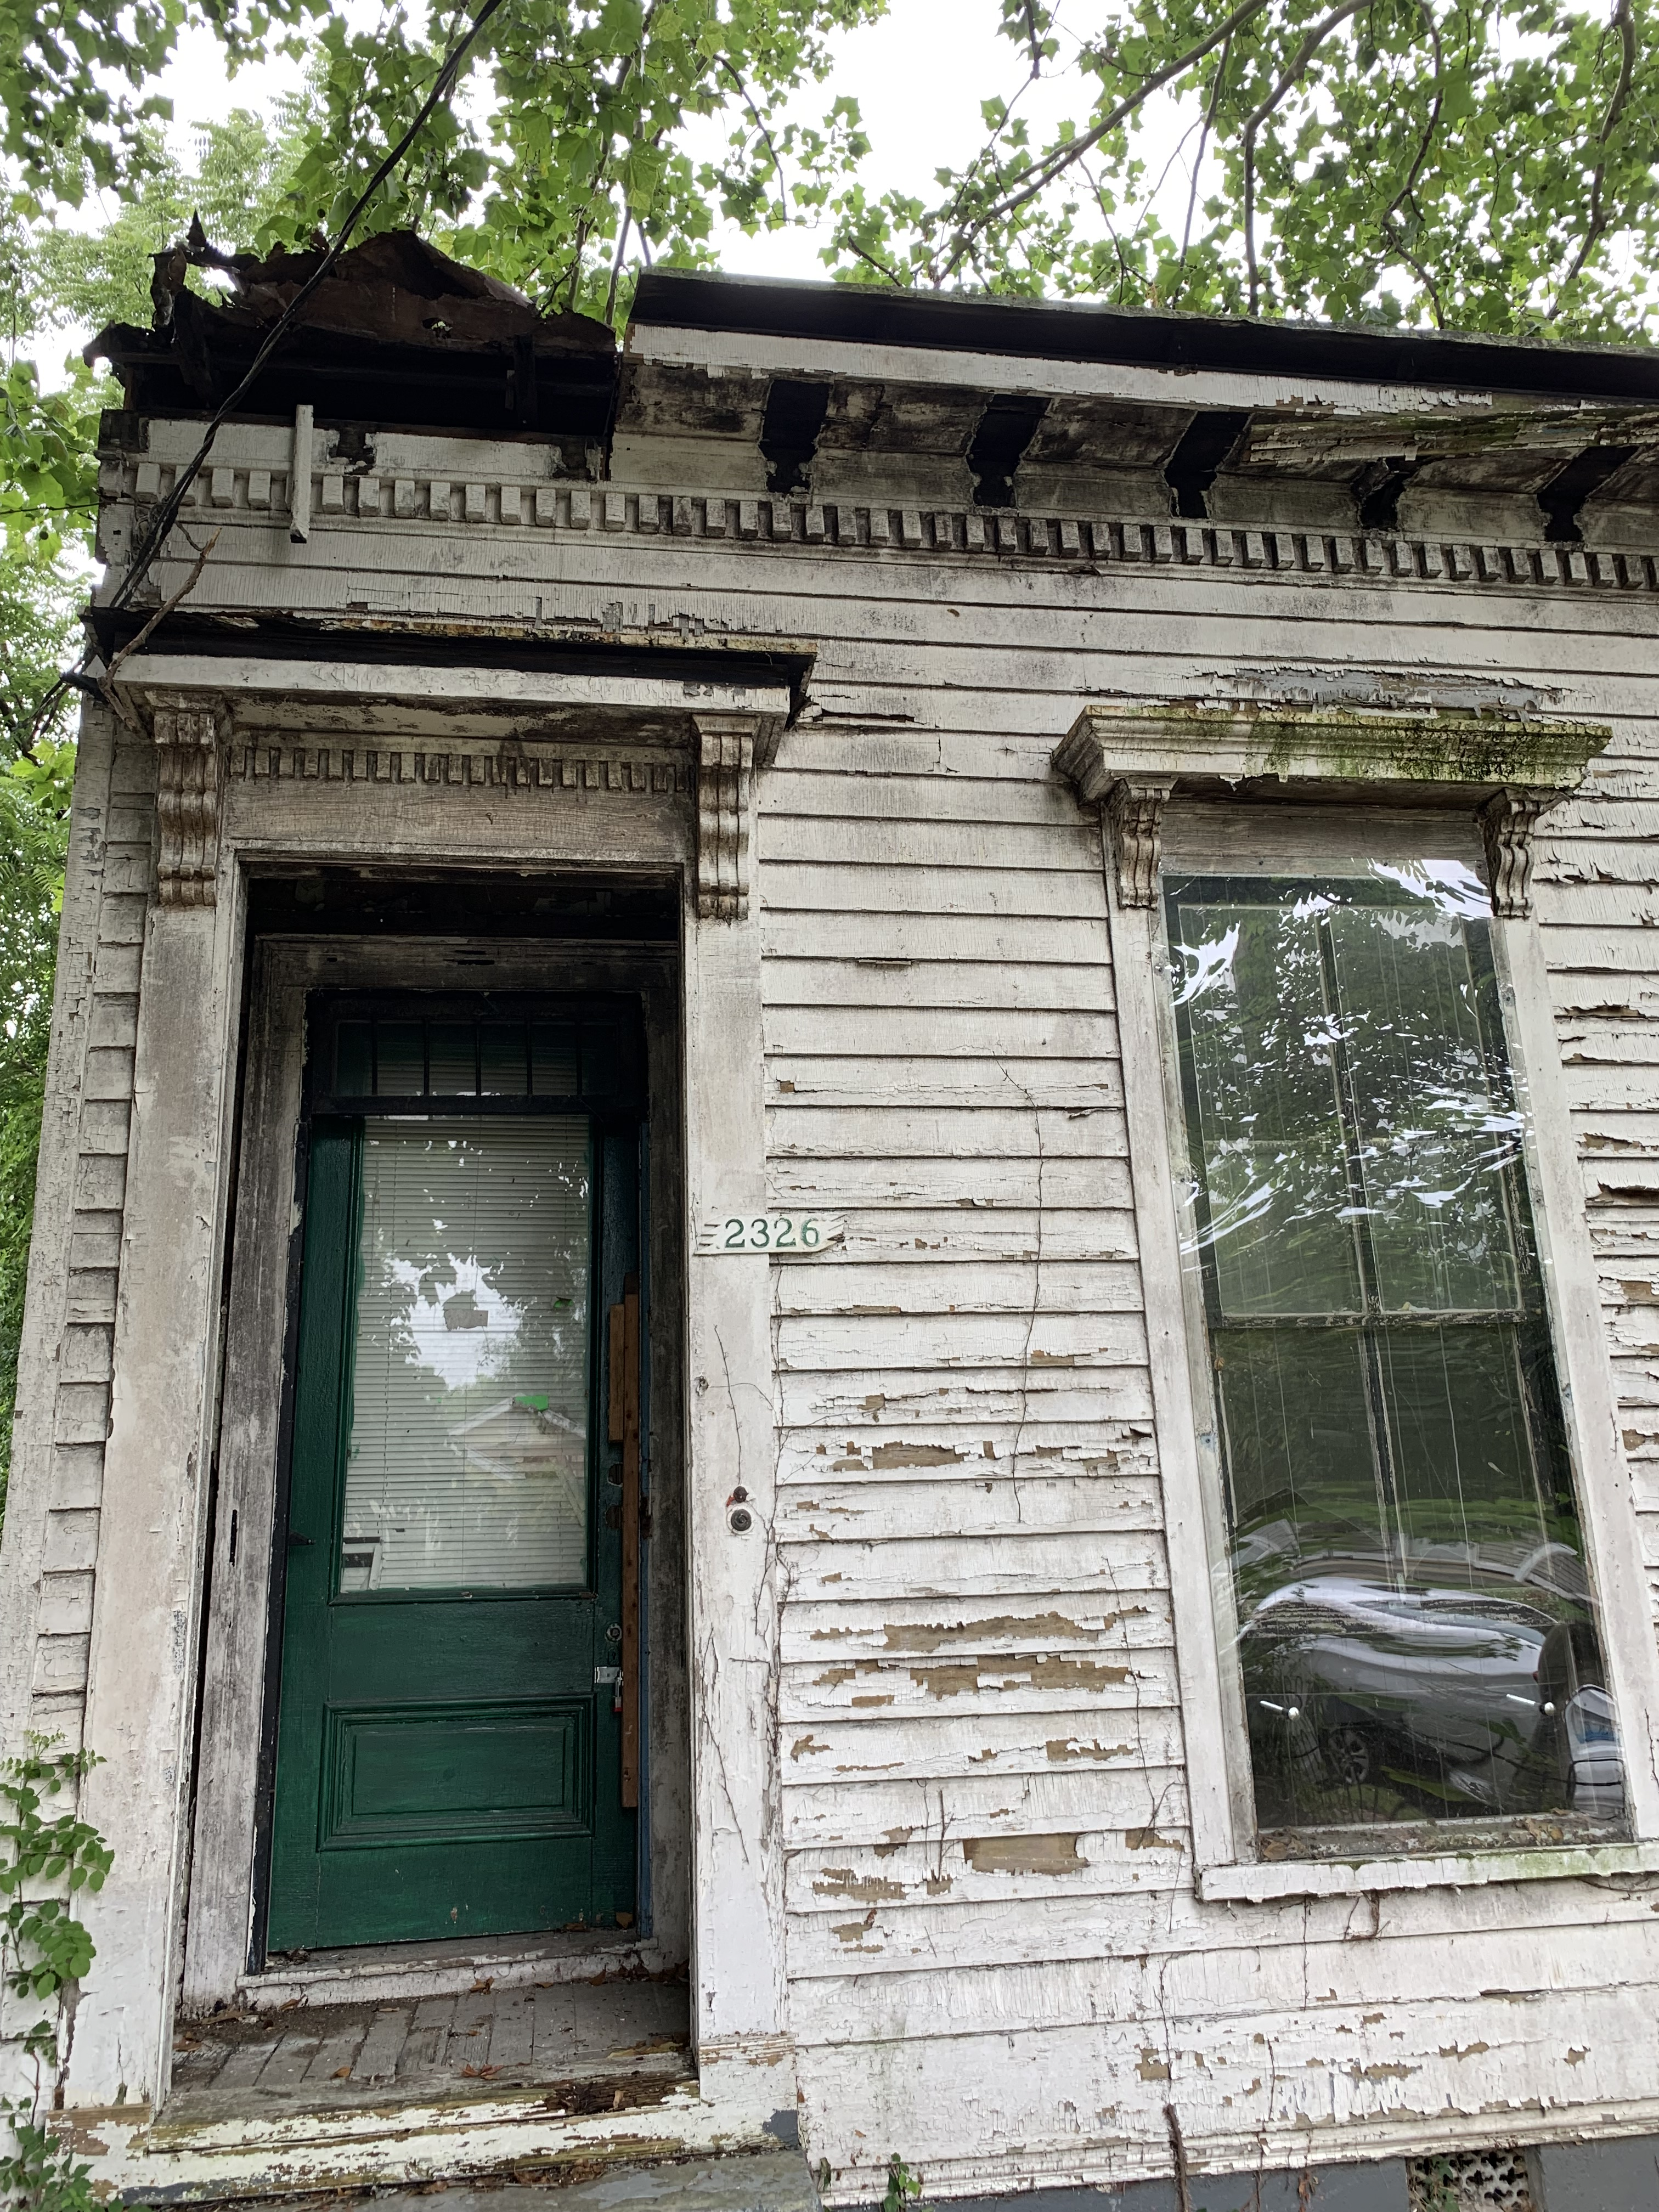
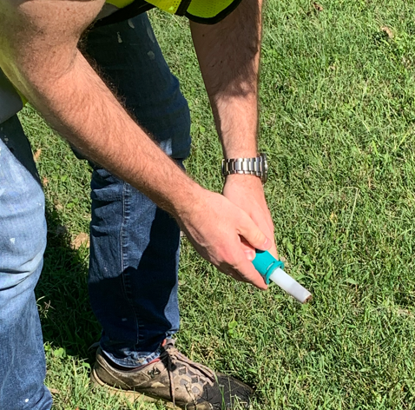
Collecting Soil & Paint Samples in West End
- The EPA recommends a screening level of 200 parts per million (ppm) for lead in soil at residential properties. In some sampled sites, lead concentrations were nearly 50 times higher than the EPA’s reference level.

Slide 23
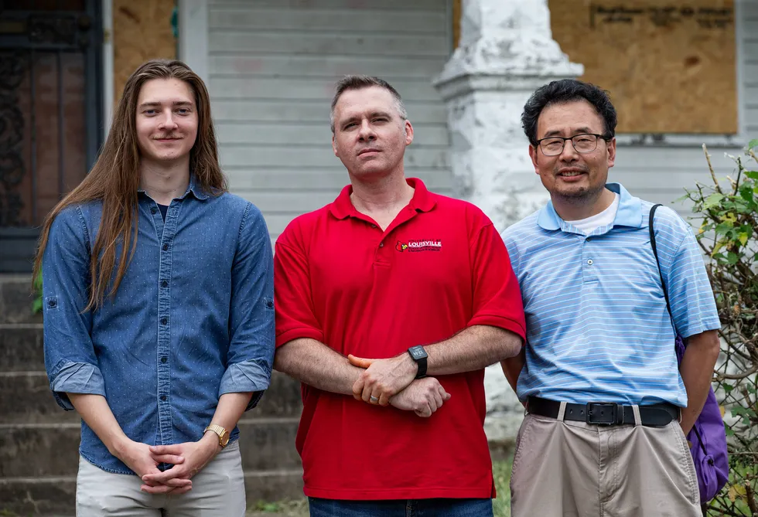
Field Investigation of Lead Poisoning in Louisville's West End
https://www.courier-journal.com/story/news/investigations/2023/12/13/courier-journal-investigates-lead-paint-poisoning-in-louisville-kids/71812795007/

Slide 24
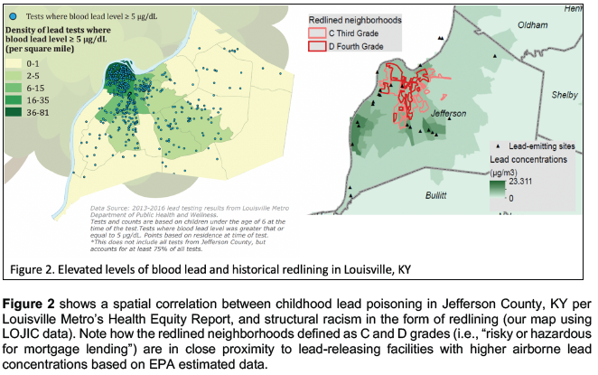
Redlining and Environmental Injustice in Louisville
Guinn and Zhang: Assessing risk factors associated with childhood lead poisoning in Jefferson County, KY - Structural racism and a legacy of lead (Funded by Health Equity Innovation Hub 2022-24).
Notes:
As of October 28, 2021, CDC uses a blood lead reference value (BLRV) of 3.5 micrograms per deciliter (µg/dL) to identify children with blood lead levels that are higher than most children’s levels.

Slide 25
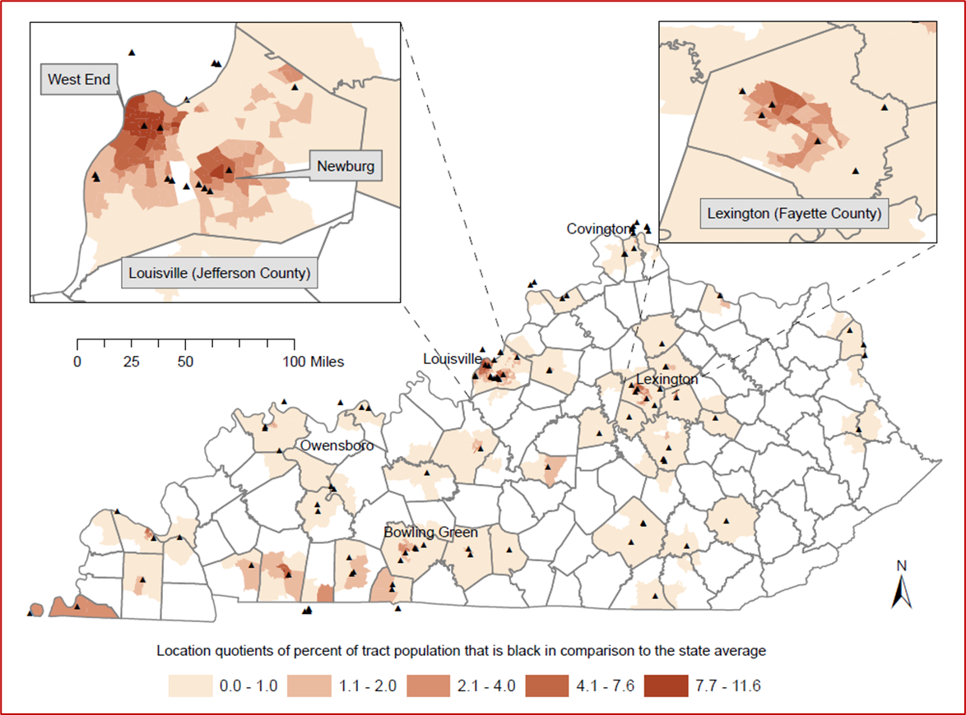
Environmental Injustice in Exposure to Airborne Lead from TRI Facilities

Slide 26
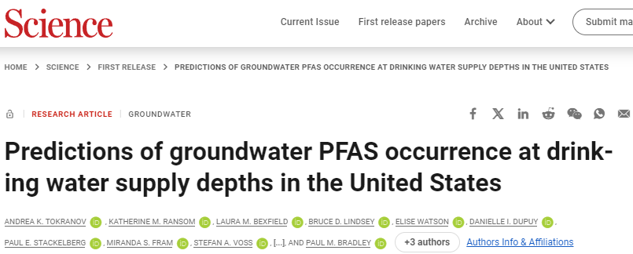
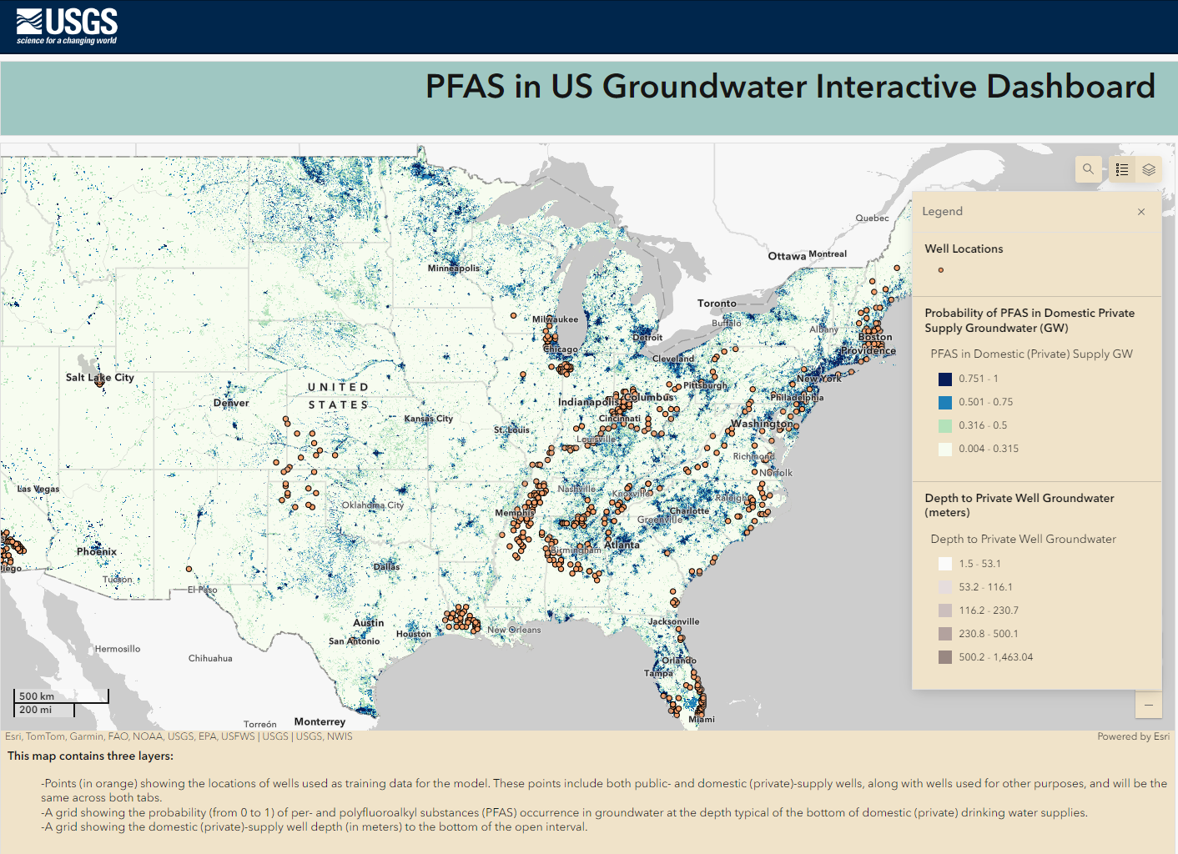
PFAS are widely used, long lasting chemicals, components of which break down very slowly over time. They are also known as "forever chemicals" because they do not break down in the environment.
Notes:
https://phys.org/news/2024-10-millions-groundwater-contaminated-pfas.html

Slide 27
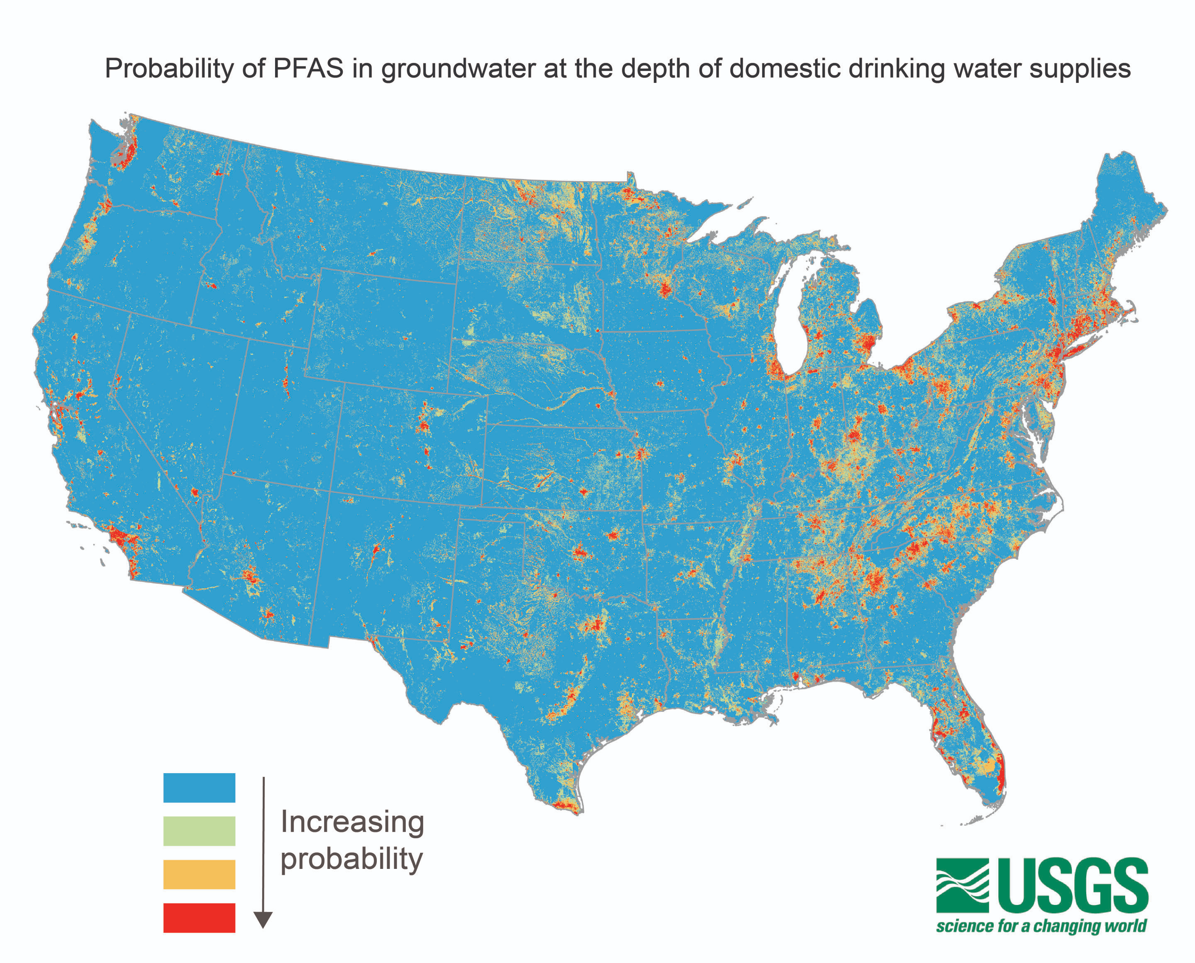
https://phys.org/news/2024-10-millions-groundwater-contaminated-pfas.html
Notes:
https://phys.org/news/2024-10-millions-groundwater-contaminated-pfas.html

Slide 28
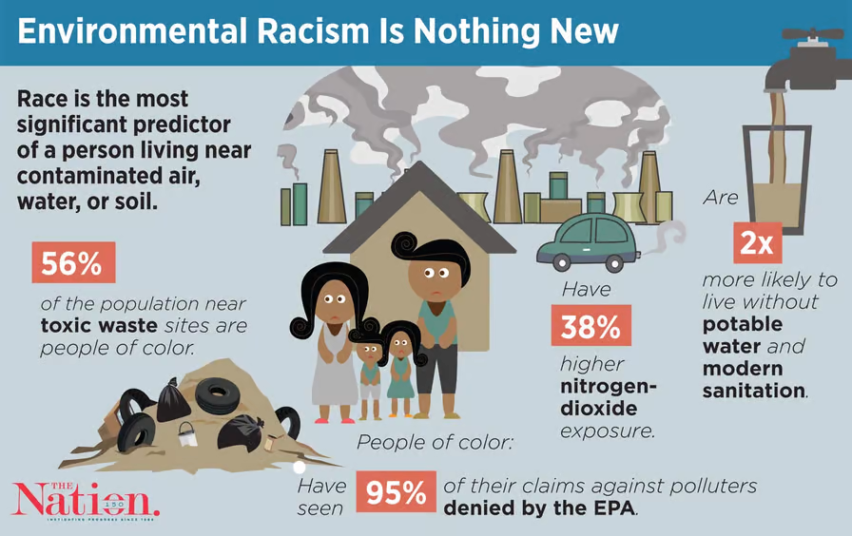
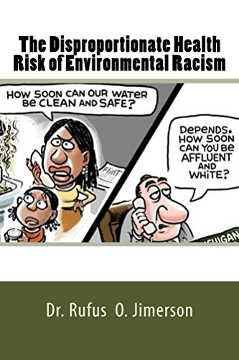
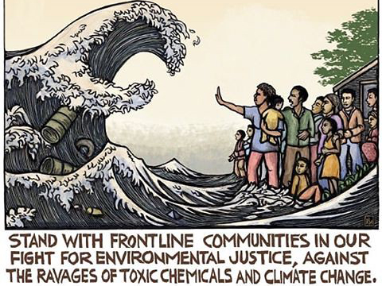
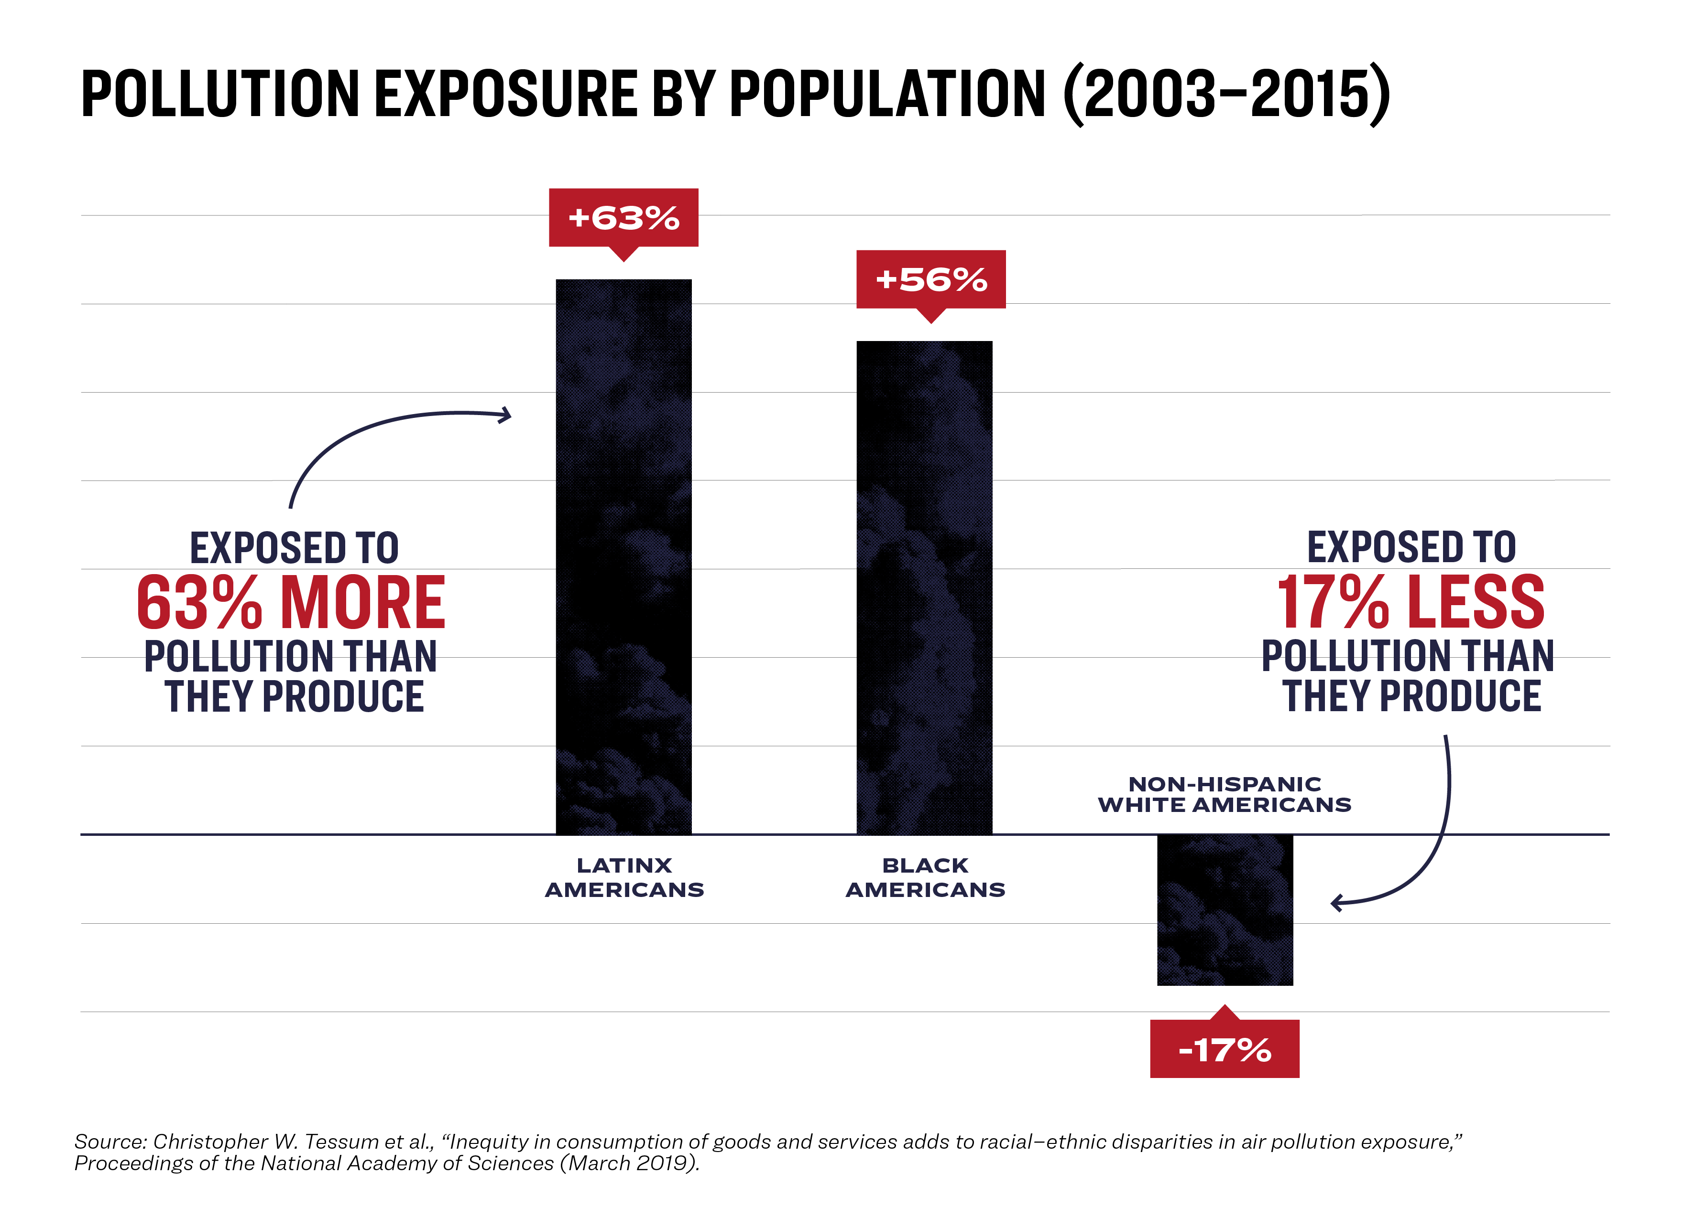

Slide 29
Cancer Alley in LA

Slide 30
EPA AirToxScreen
https://experience.arcgis.com/experience/a0deb771dbcd40d0a46fbe83adc51747/

Slide 31
EPA’s Environmental Justice Screening

Slide 32
Redlining and Climate Change-Induced Urban Heat
Climate change imposes additional challenges to public health, particularly for marginalized communities.
https://www.arcgis.com/home/item.html?id=1d7c77f1b13c4a688bf123fd469d9792

Slide 33
Notes:
Climate change refers to long-term shifts in temperatures and weather patterns. Such shifts can be natural, due to changes in the sun’s activity or large volcanic eruptions. But since the 1800s, human activities have been the main driver of climate change, primarily due to the burning of fossil fuels like coal, oil and gas.
Burning fossil fuels generates greenhouse gas emissions that act like a blanket wrapped around the Earth, trapping the sun’s heat and raising temperatures.
The main greenhouse gases that are causing climate change include carbon dioxide and methane. These come from using gasoline for driving a car or coal for heating a building, for example. Clearing land and cutting down forests can also release carbon dioxide. Agriculture, oil and gas operations are major sources of methane emissions. Energy, industry, transport, buildings, agriculture and land use are among the main sectors causing greenhouse gases.

Slide 34
Notes:
https://www.nature.com/articles/s41467-021-22799-5

Slide 35
Confidentiality Issues for Mapping Health Data
It is crucial to comply with the Privacy Rule specifically when mapping point data to maintain the confidentiality of individuals
Geomasking refers to additional techniques that preserve the confidentiality of individual health records.
Aggregating data
Calculating point densities or interpolating point data

Slide 36
Zandbergen, P.A., 2014. Ensuring confidentiality of geocoded health data: assessing geographic masking strategies for individual-level data. Advances in medicine, 2014. https://www.ncbi.nlm.nih.gov/pmc/articles/PMC4590956/
Spatial aggregation of individual cases using census enumeration units
The red dot indicates the original location, and the blue dot is one of the many possible masked locations.

Slide 37
https://www.sciencedirect.com/science/article/pii/S0048969718329541
Notes:
24,515 WLL measurements recorded over the period 1/1/2016–10/13/2016 were downloaded from http://www.michigan.gov/flintwater (residential testing results). Records with an address that was incomplete or located outside the city of Flint were discarded, leading to a total of 22,672 observations: 18,701 collected by voluntary sampling and 3971 recorded at sentinel sites. Data were then allocated to an individual tax parcel unit on the basis of their postal address, and only residential tax parcels were retained for the subsequent analysis (e.g., commercial and industrial parcels were excluded). A detailed description of sampling procedures and analysis of temporal variability can be found in Goovaerts, 2017a, Goovaerts, 2017b, Goovaerts, 2017c.

Slide 38
Acknowledgements
National Science Foundation
NIEHS and CIEHS
American Cancer Society (ACS)
NASA
EPA
Kentucky Cabinet for Health and Family Services
Louisville Metro
UofL Health Equity Innovation Hub
CIEHS

