Slide 2
Our mission is to be the beacon of GIS and geospatial technology for the University of Louisville. We offer high-impact learning opportunities; lead and support innovative interdisciplinary research; and foster positive change in the community through the inclusive and creative application of geospatial technology. As a comprehensive resource for geospatial software, data, and training, the ULCGIS puts the power of maps into the hands of UofL students, faculty, and staff as they address the big challenges confronting society today.

Slide 3
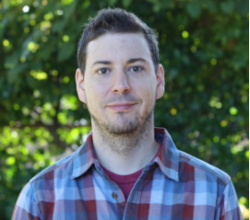
Program Overview
Sole provider of introductory GIS courses at UofL
Transferable/job-ready skills
Students from every college on campus
Cutting edge geotechnology applications
Enhanced DE offerings/Certificate Program integrations
Interdisciplinary collaboration
Kent School: Demographic Analysis
History: Civil Rights Mapping in KY
English: Mapping the Literary Landscape of Louisville
Civil Engineering: sUAS/drone mapping and survey
Teaching
Research
D.J. Biddle, GISP
Director: GIS Applications, Remote Sensing Outreach
Wei Song, Ph.D. Chair of Geographic and Env. Sci.
Assoc. Prof: Transportation, Logisitics
Laura Krauser
GIS Research Coordinator, GIS Applications and Outreach
Community Engagement
Administration
Haifeng (Charlie) Zhang, Ph.D.
Prof: Demographic Analysis, Crime Analysis
Andrea Gaughan, Ph.D.
Prof: Remote Sensing, Modeling
Strong ties to community partners (Gov’t, Non Profit, Industry)
Volunteer work (National Safe Place Network/RHYTTAC, JCPS)
Successful GIS Day Outreach
Student internships with local government and NGOs
Manage UofL ESRI Site License Program
Support hundreds of GIS users, in every college across 3 campuses
Provide GIS/Mapping support for administration (DEHS, DPS, UPDC, etc.)
Christopher A. Day, Ph.D.
Assoc.. Prof: Water Resources GIS, Spatial Hydrology
Forrest Stevens, Ph.D.
Assoc. Prof: Programming, Remote Sensing, Modeling
Jason Naylor, Ph.D.
Assoc. Prof: Extreme Weather Events, Climate Change

Slide 4
Instruction in Geospatial Technologies
Broad curriculum of courses in fundamentals and applications of geospatial technology
Students from all disciplines, both undergraduate and graduate level
Technical skills training and emphasis on critical thinking position students for job market or advanced degrees

Slide 5
Undergraduate Certificate in Geospatial Technologies
Offered online or hybrid modalities
Available to all students pending application approval
12 hours- 4 Classes-2 core courses & 2 electives
Additional credential for job seekers (stackable w/ UG or grad degree)

Slide 6
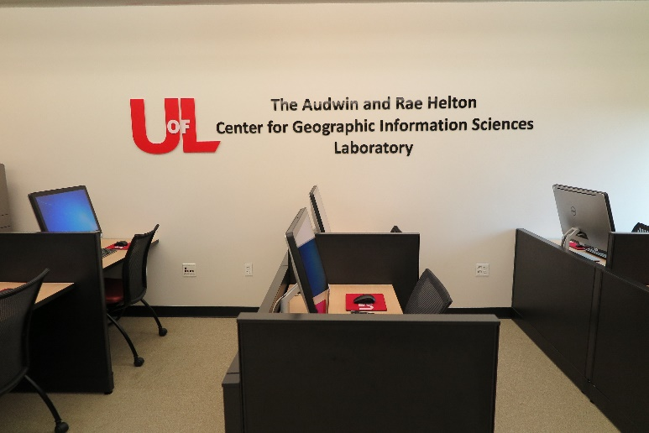
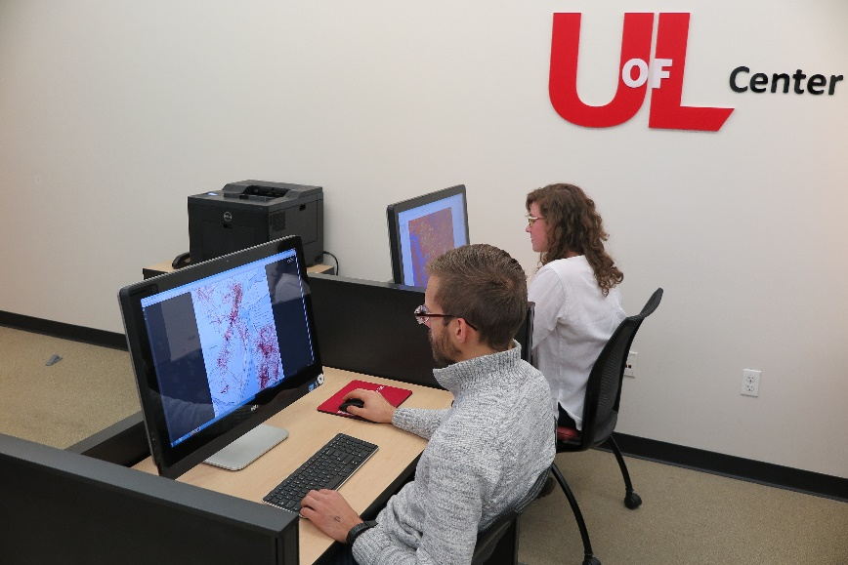
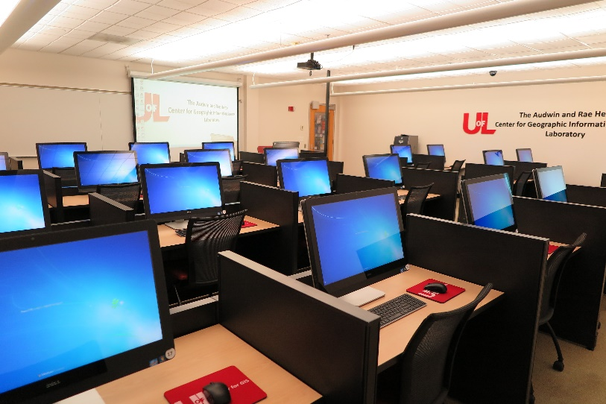
The Audwin & Rae Helton Center for GIS Laboratory

Slide 7
Intern Program Over the Years
NASA Develop
Louisville Metro Government
Bernheim Arboretum and Research Forest
Envirome Institute
City of Monroe, OH
Trees Louisville
USGS
Census Bureau
VHB Civil Engineering Firm
GoodMaps

Slide 8
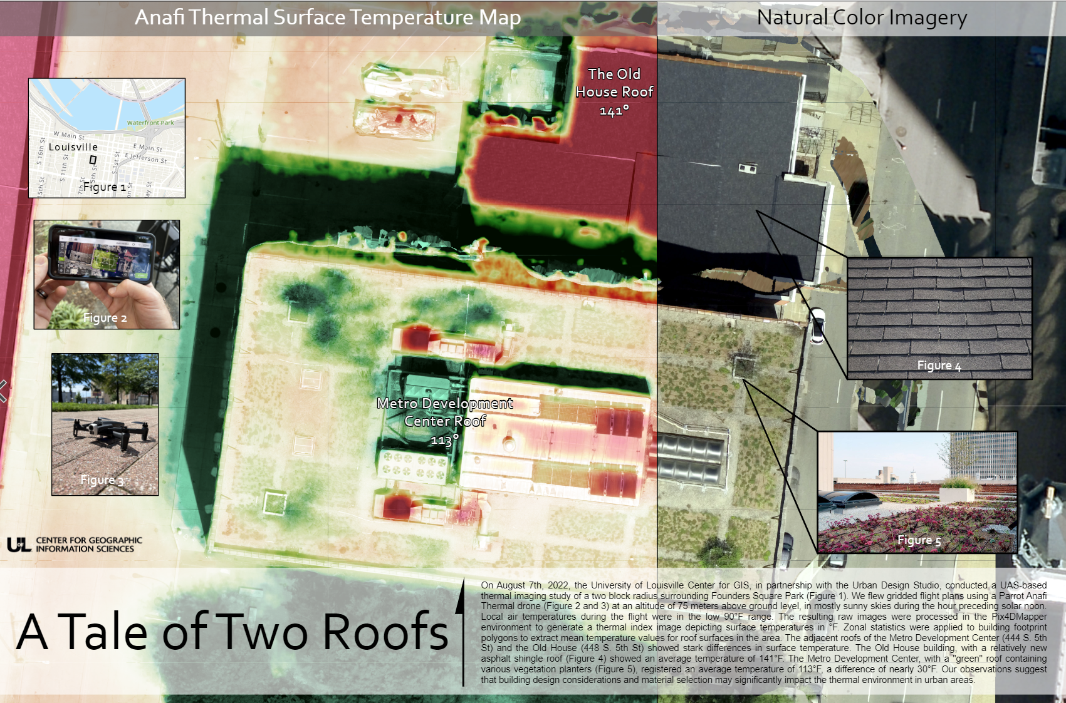
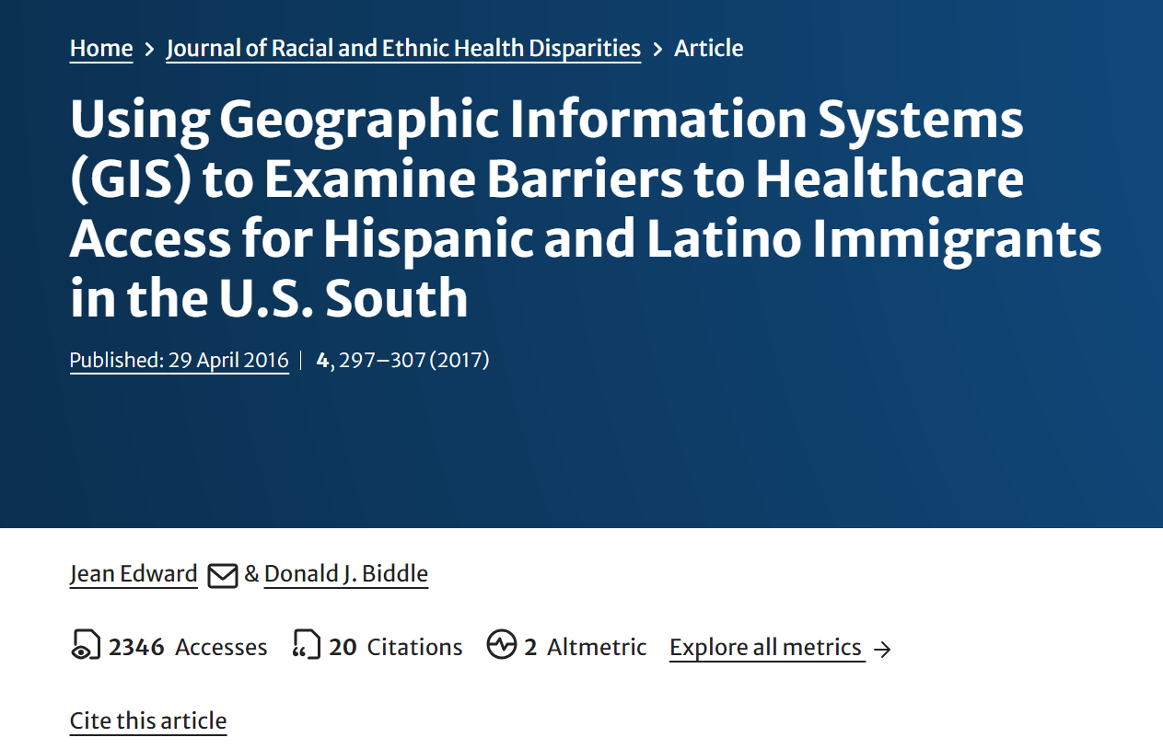
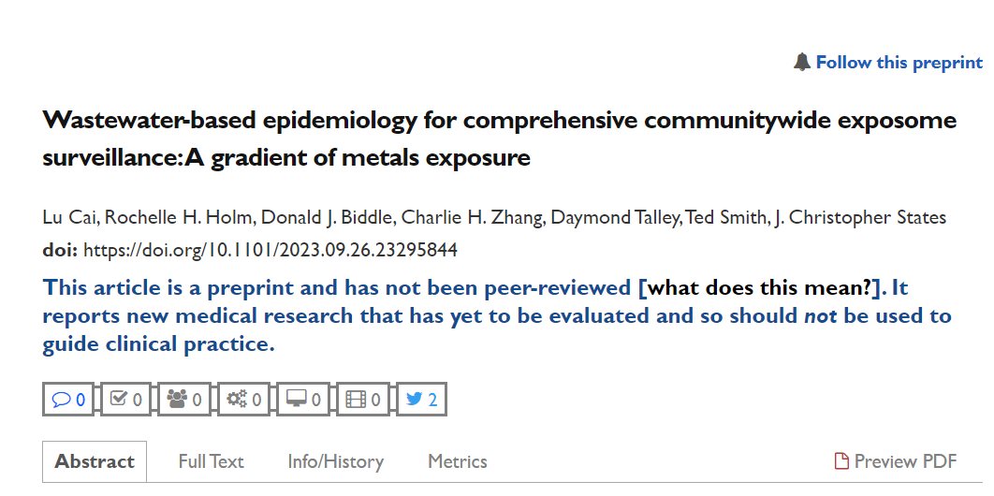
Interdisciplinary Research: Environmental Health/Justice

Slide 9
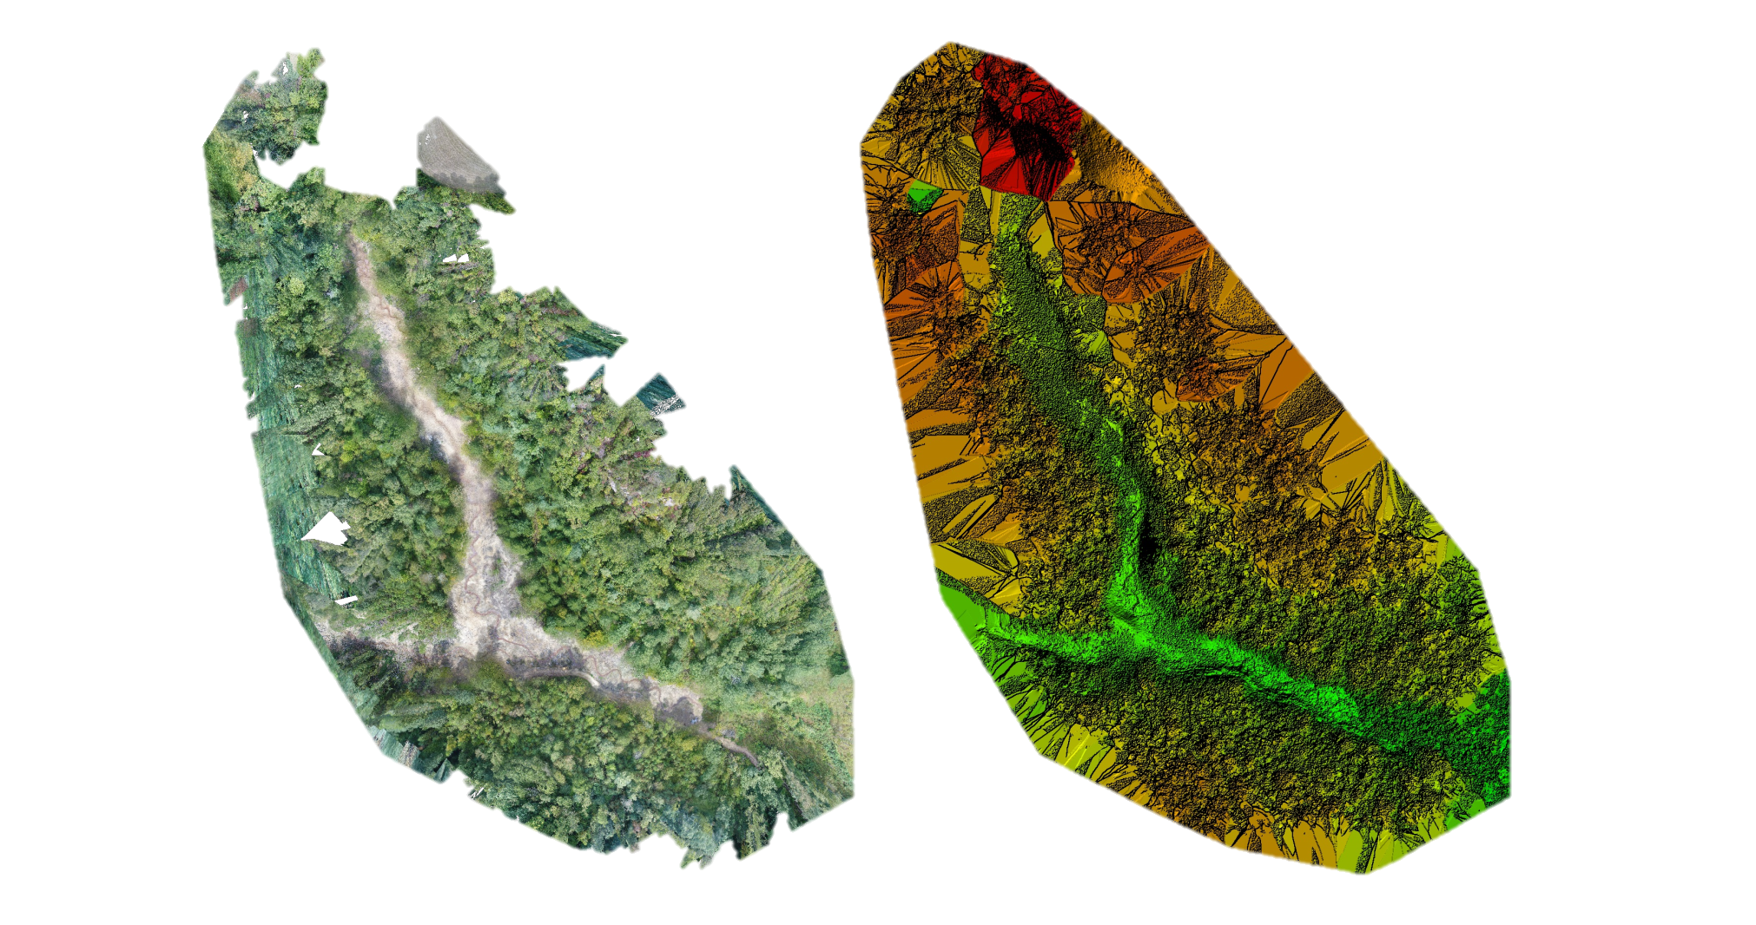
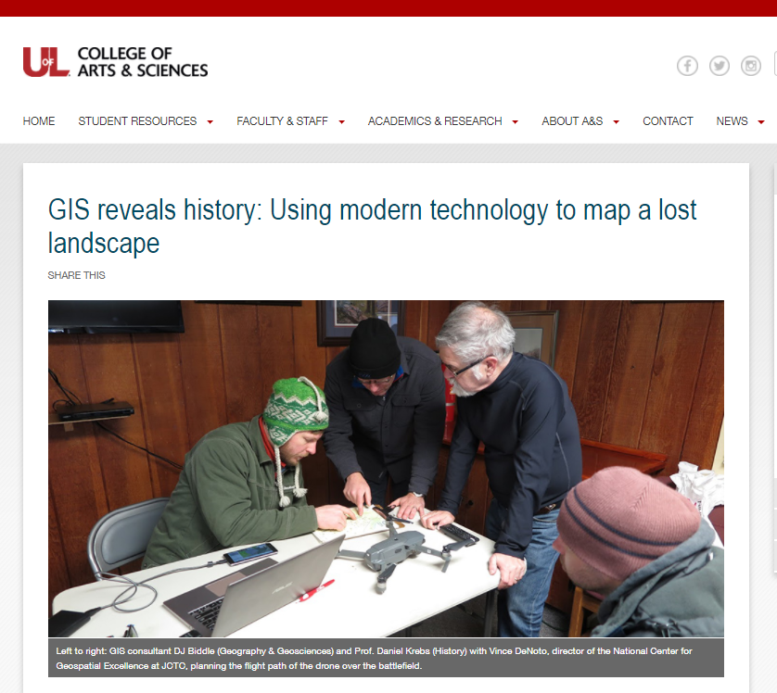
Interdisciplinary Research: UAS/drone mapping & survey
1” resolution orthophoto
1” resolution digital surface model

Slide 10
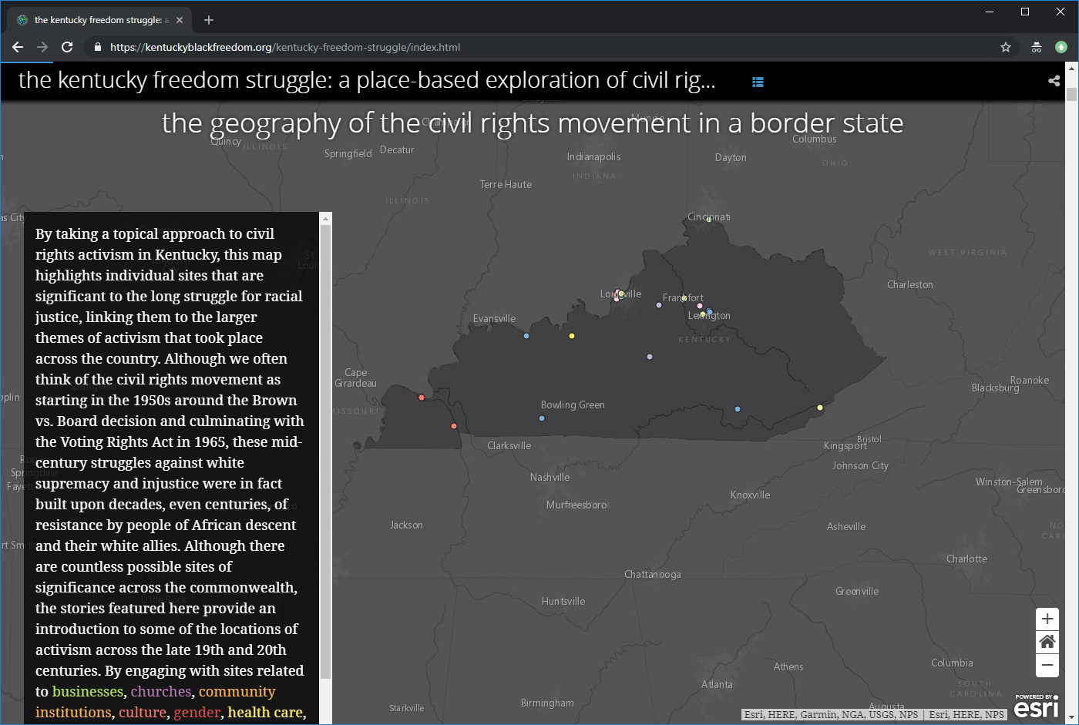
Interdisciplinary Research: Digital Humanities

Slide 11
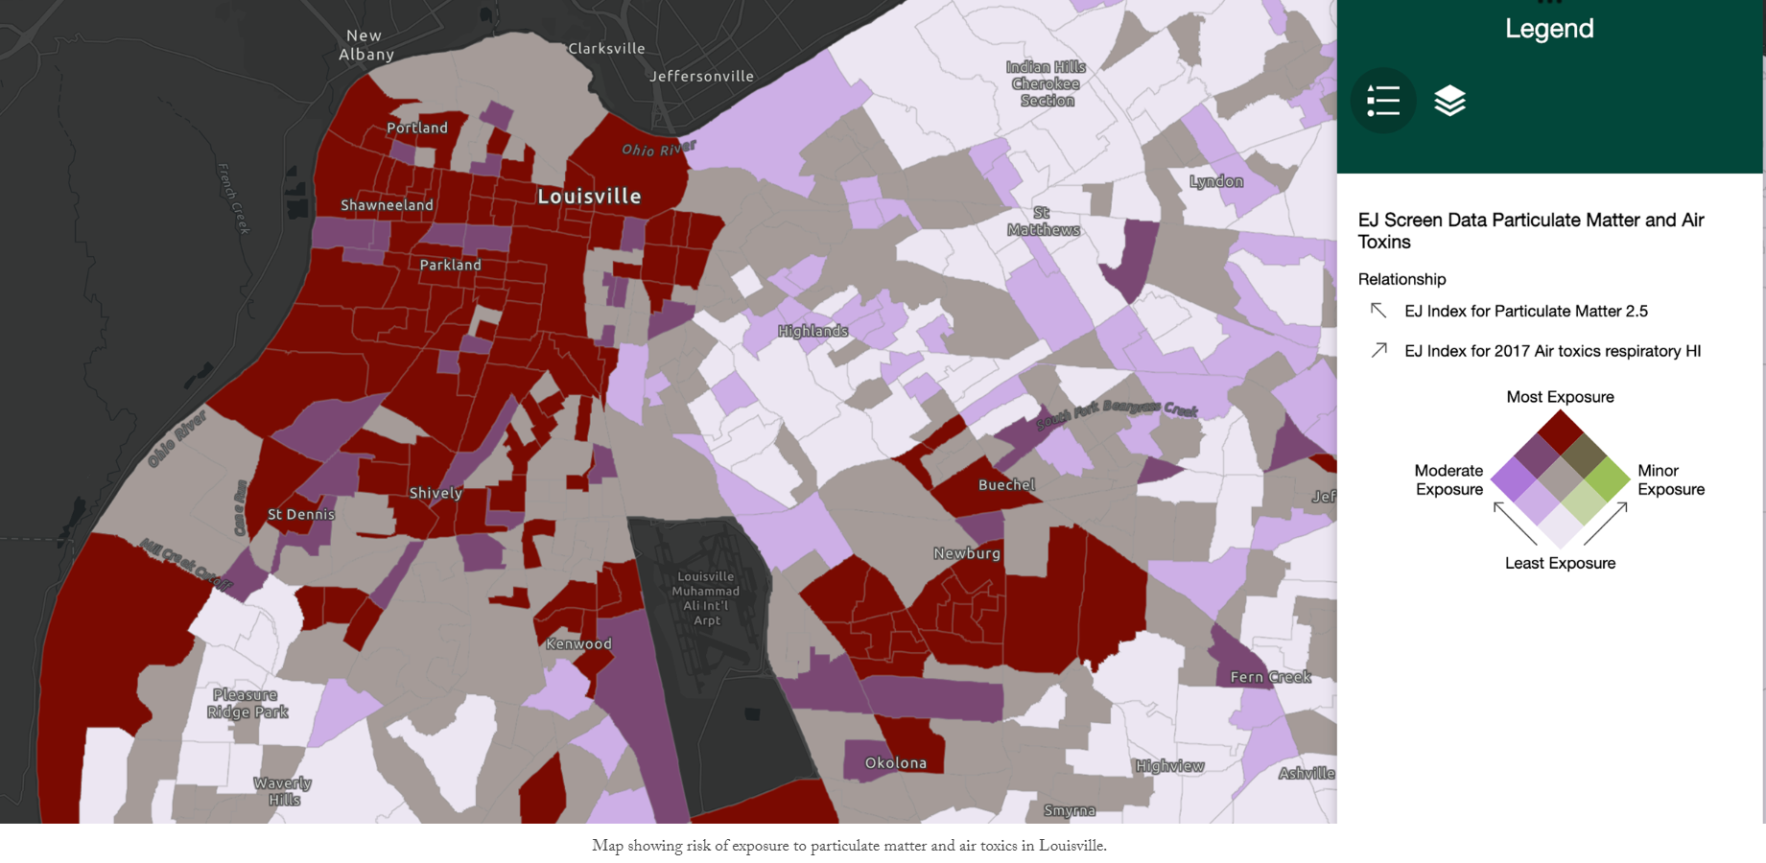
Community Engagement: AirJustice

Slide 12
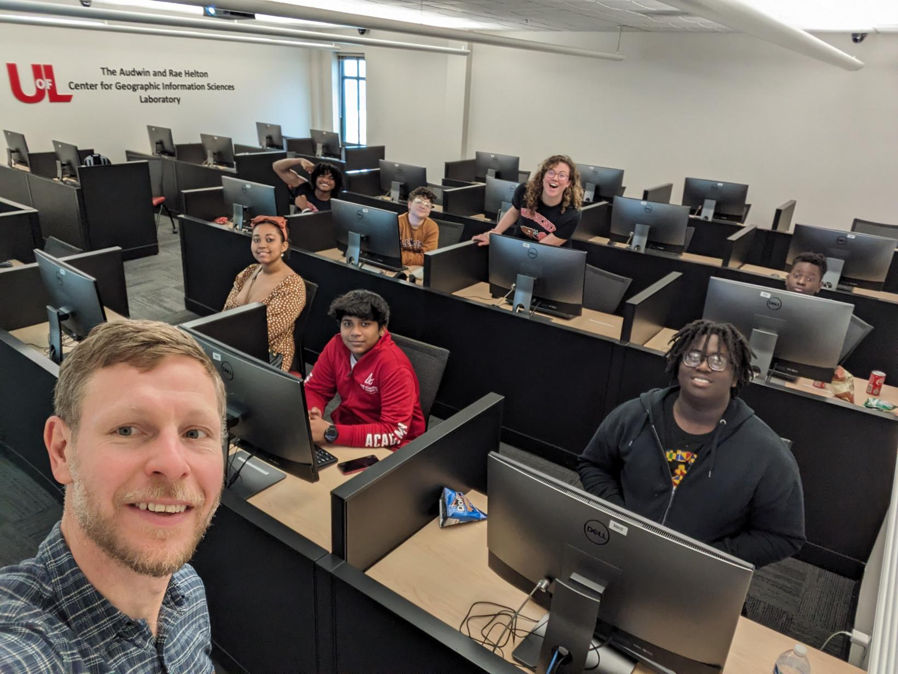
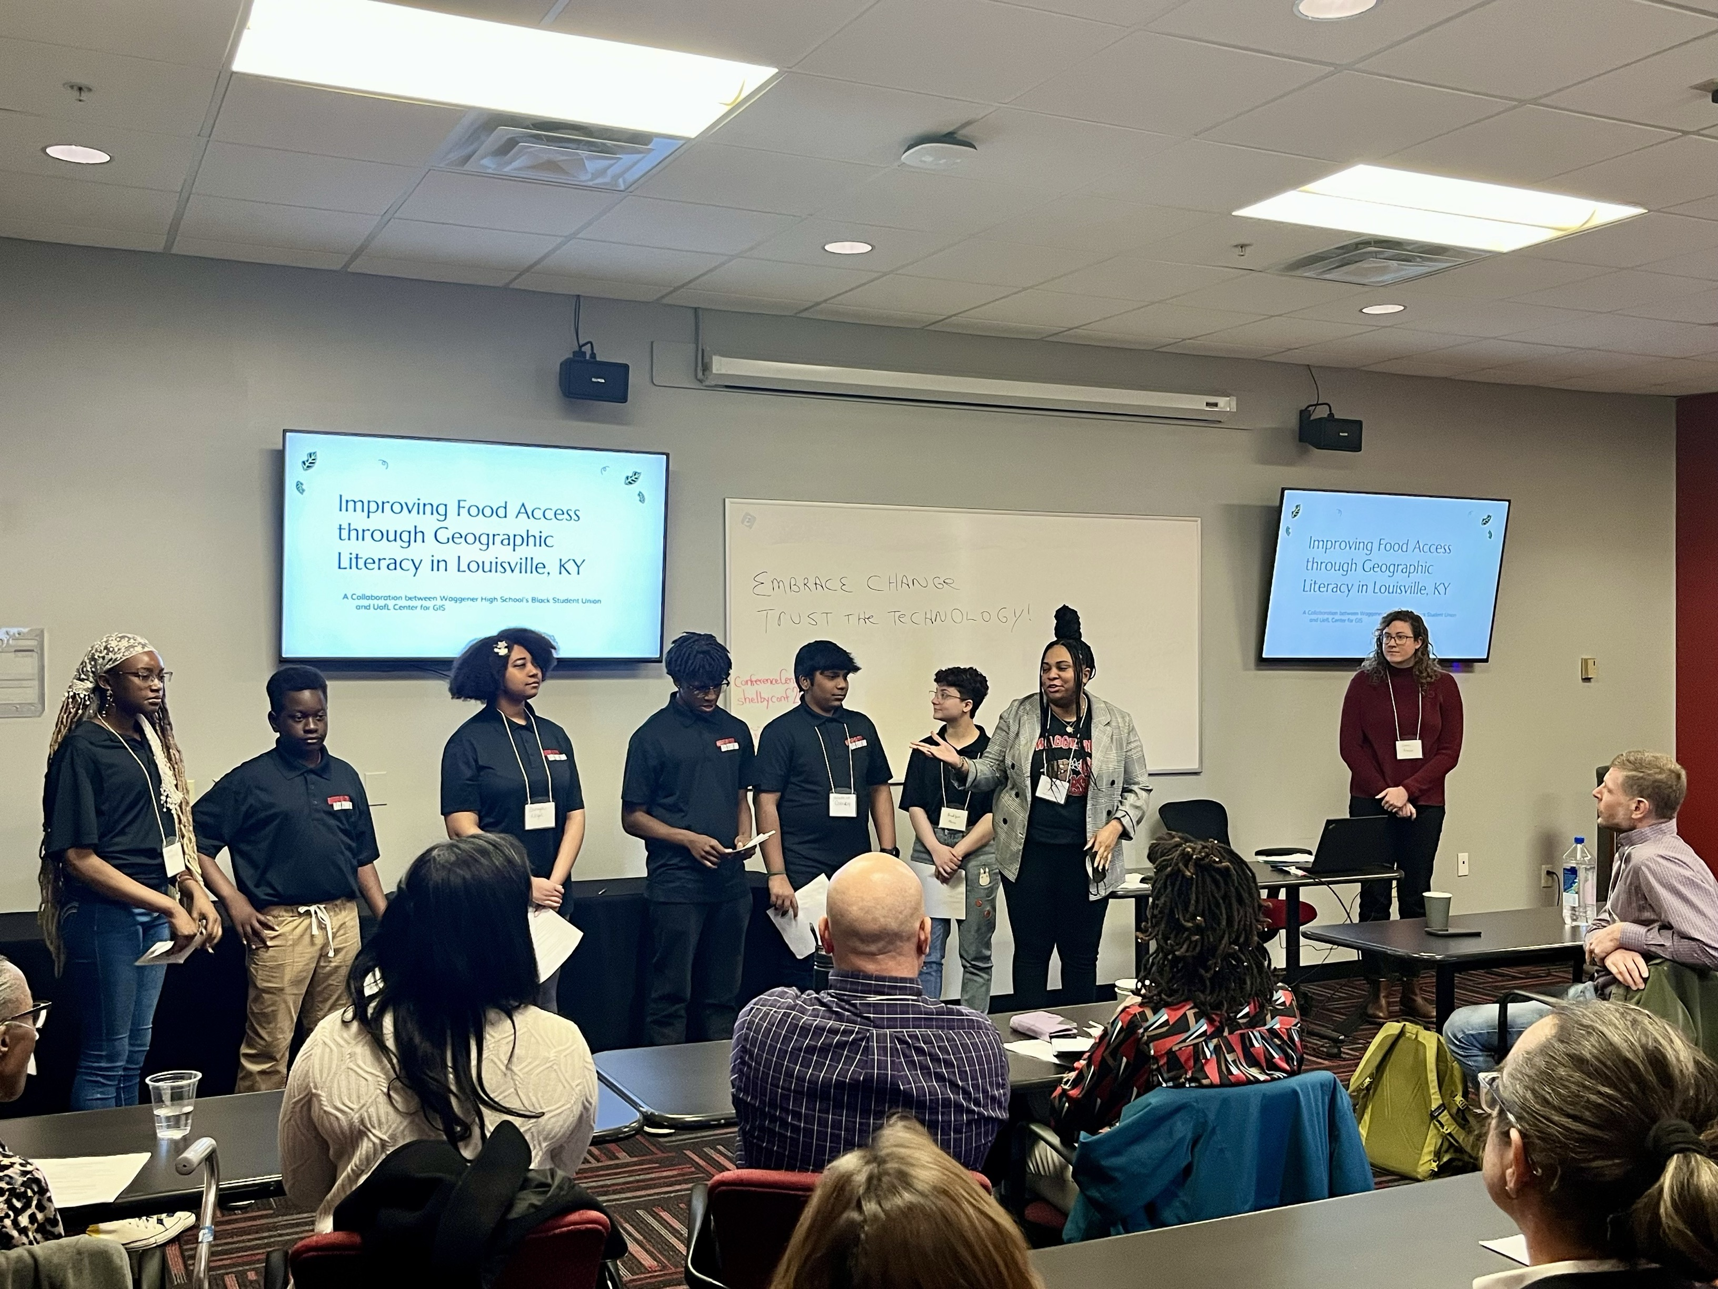
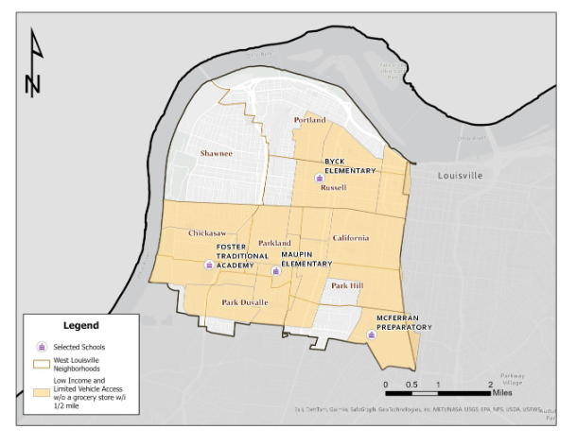
Community Engagement: Food Justice - Waggener HS Black Student Union

Slide 13
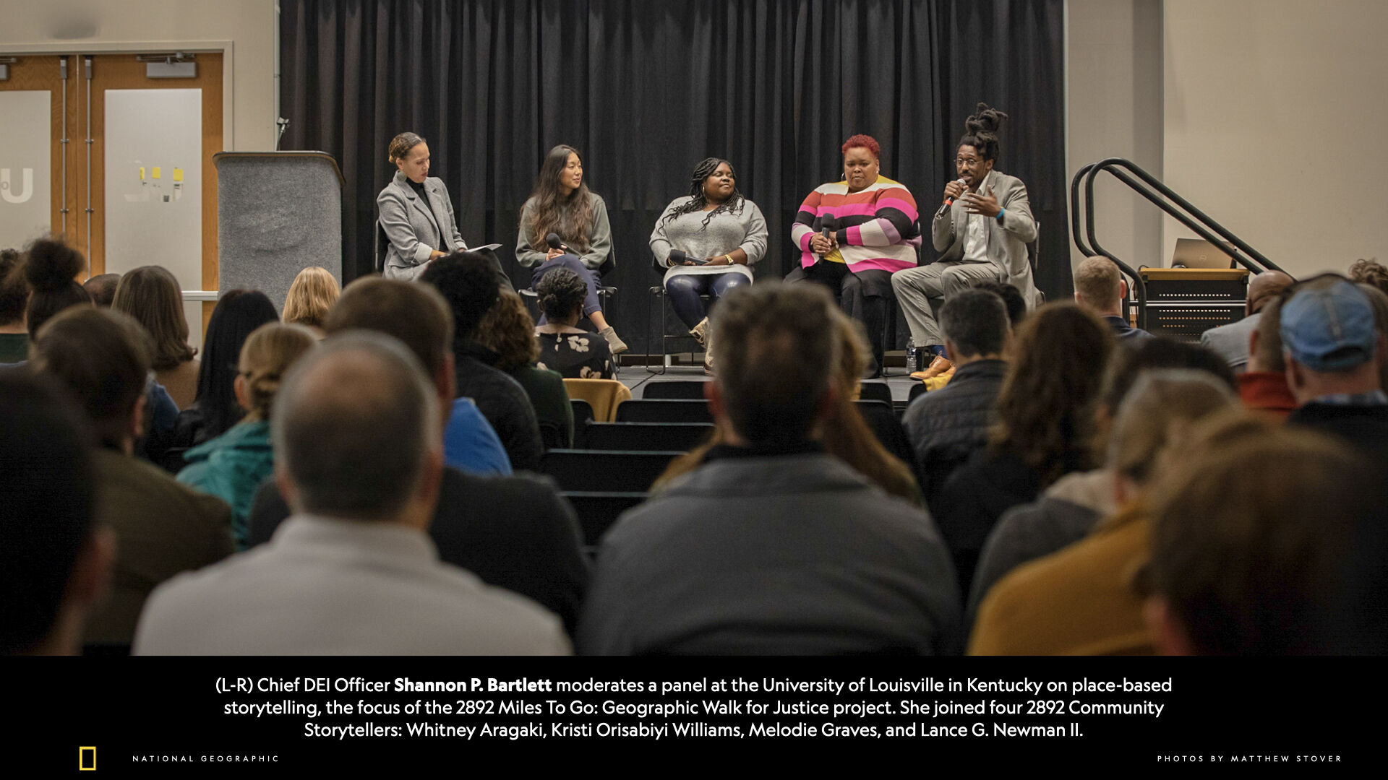
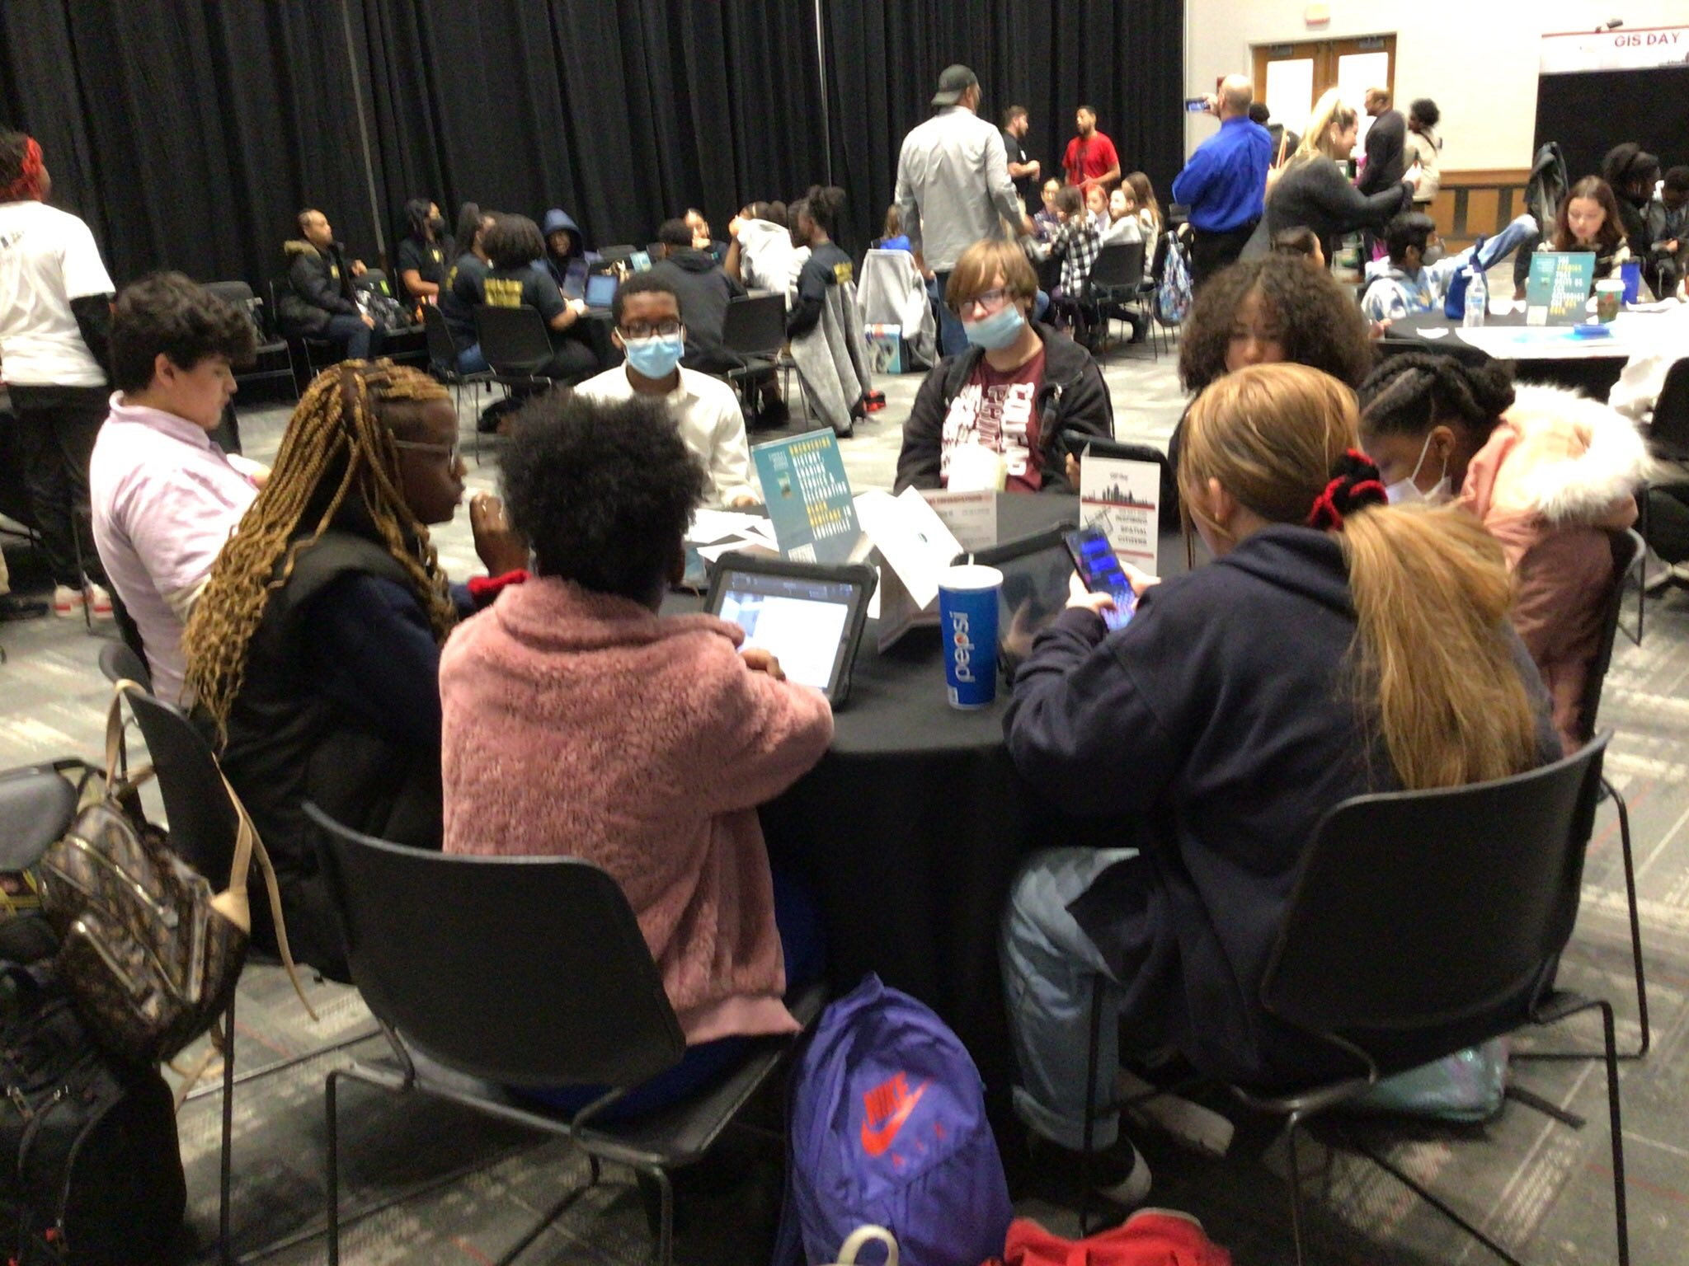
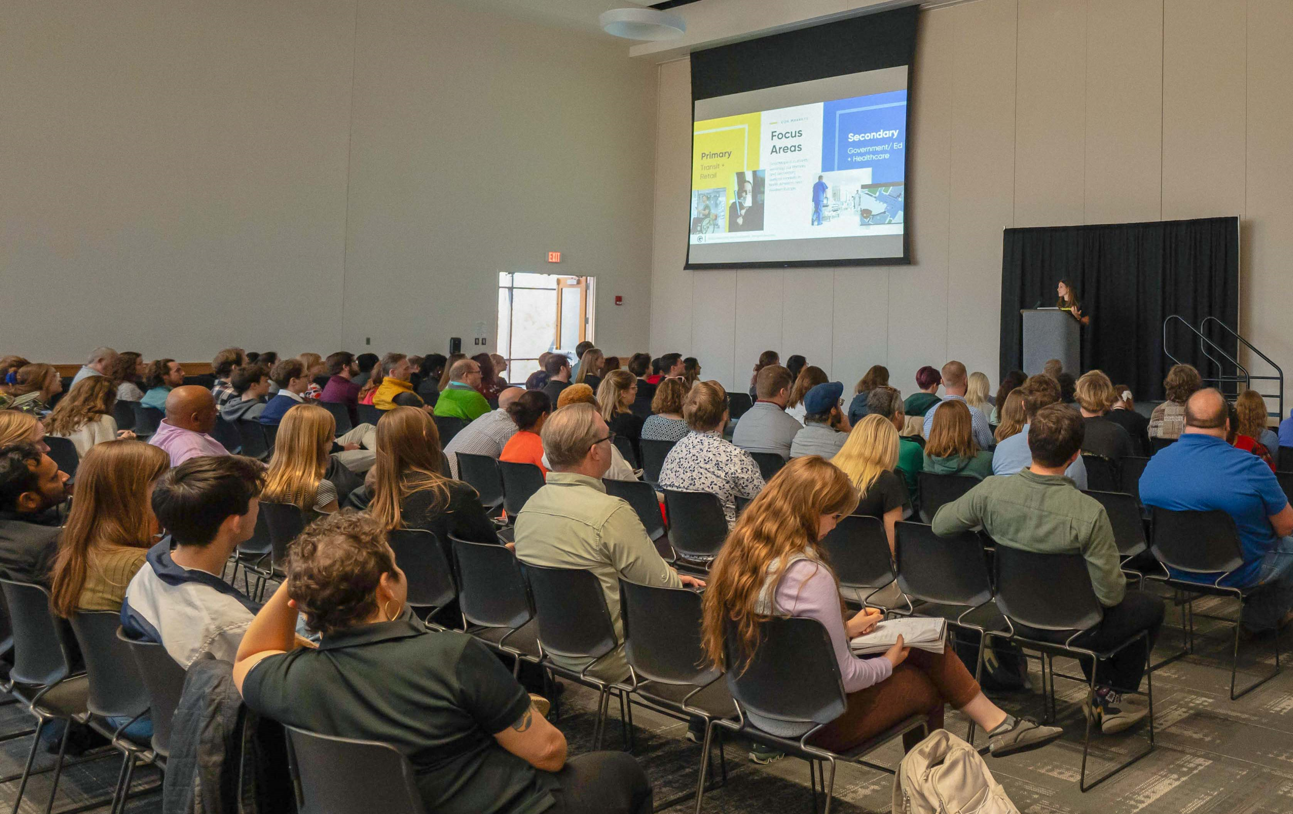
Community Engagement: GIS Day

Slide 14
Community Engagement: GIS Day

Slide 15
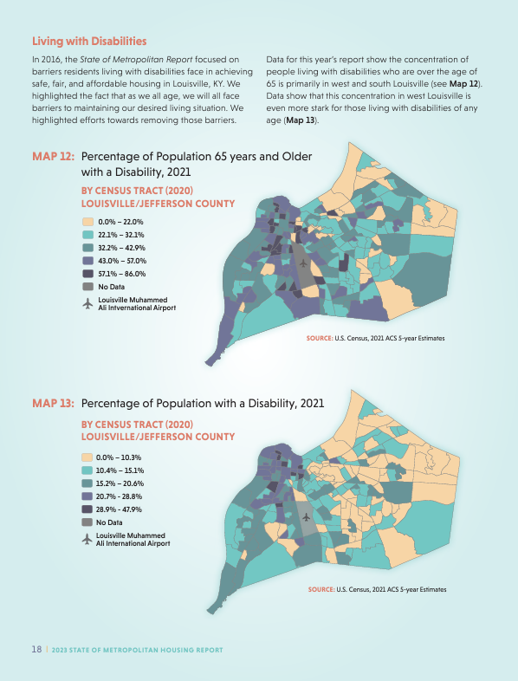
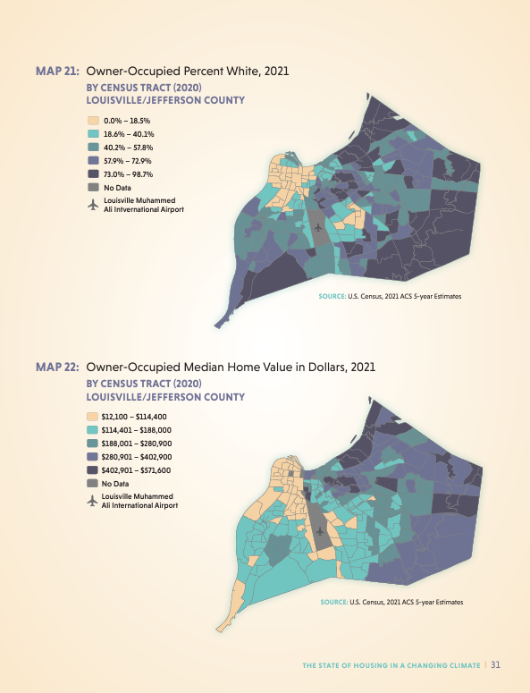
Community Engagement: Metro Housing Coalition

Slide 16
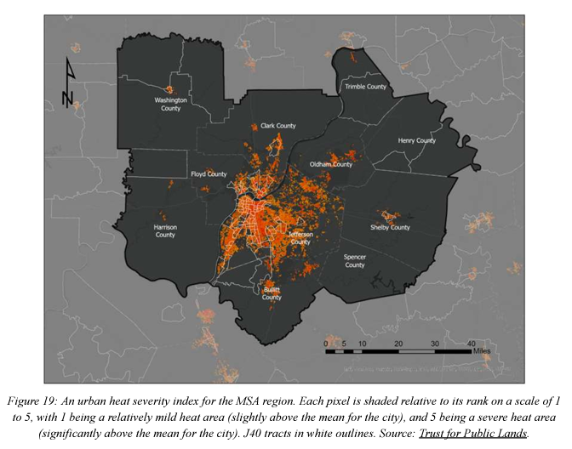
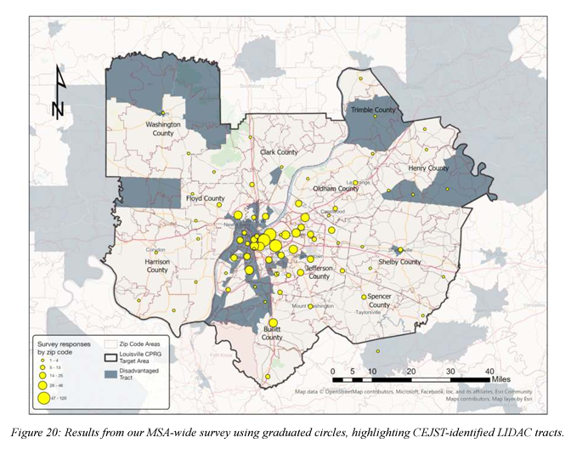
Community Engagement: Metro Government

Slide 17
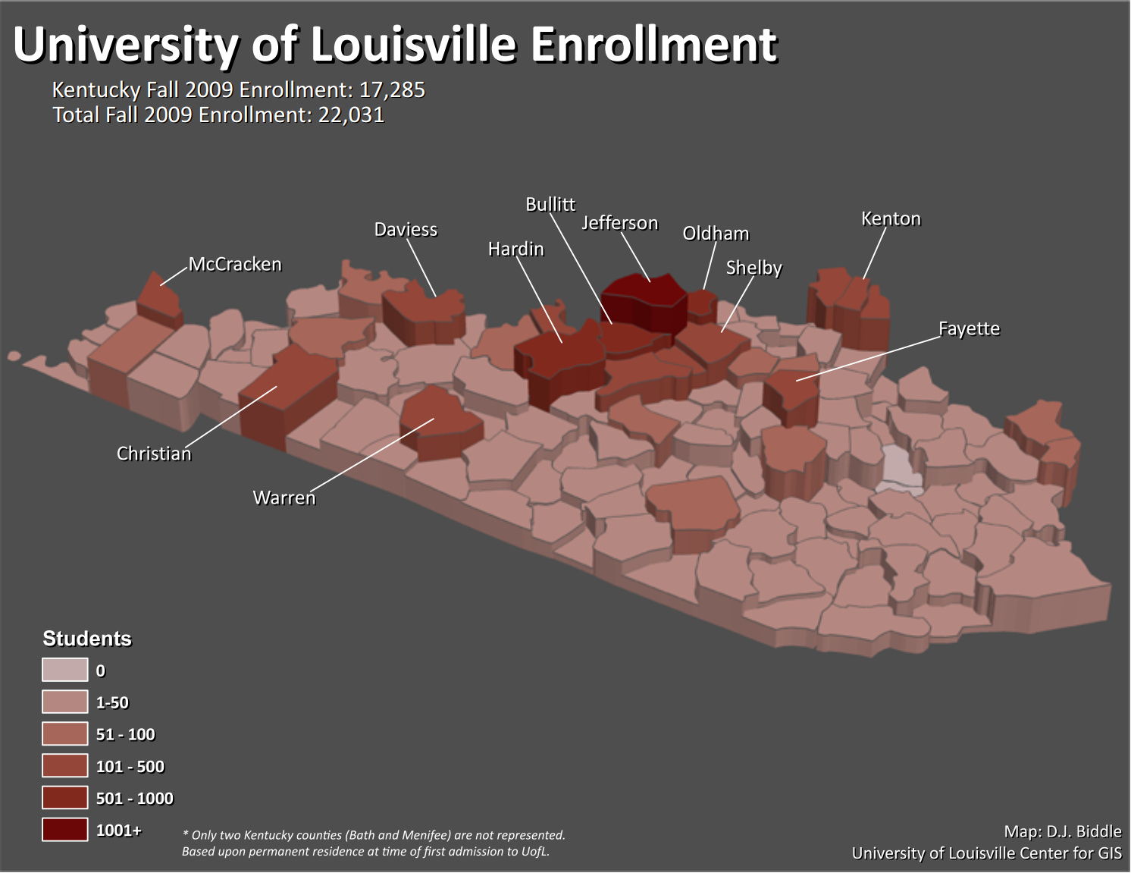
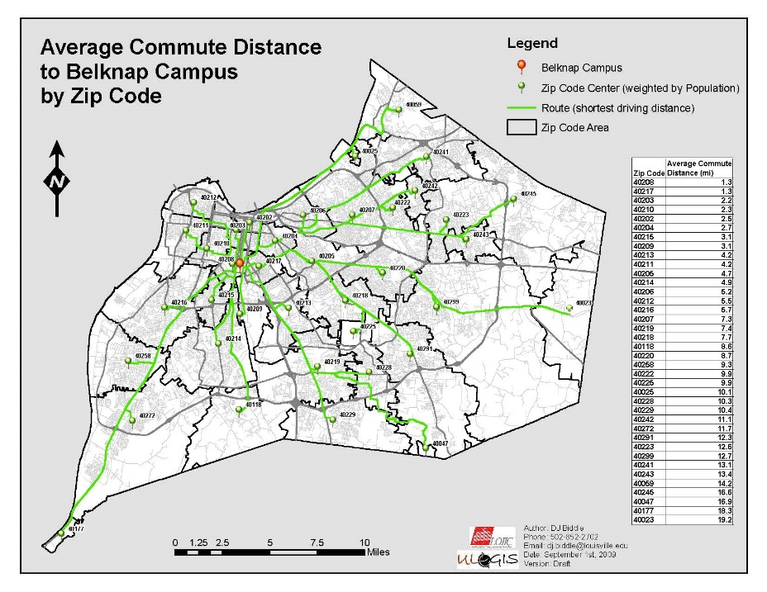
Administration: Consulting for internal clients: Office of Institutional Research and Planning

Slide 18
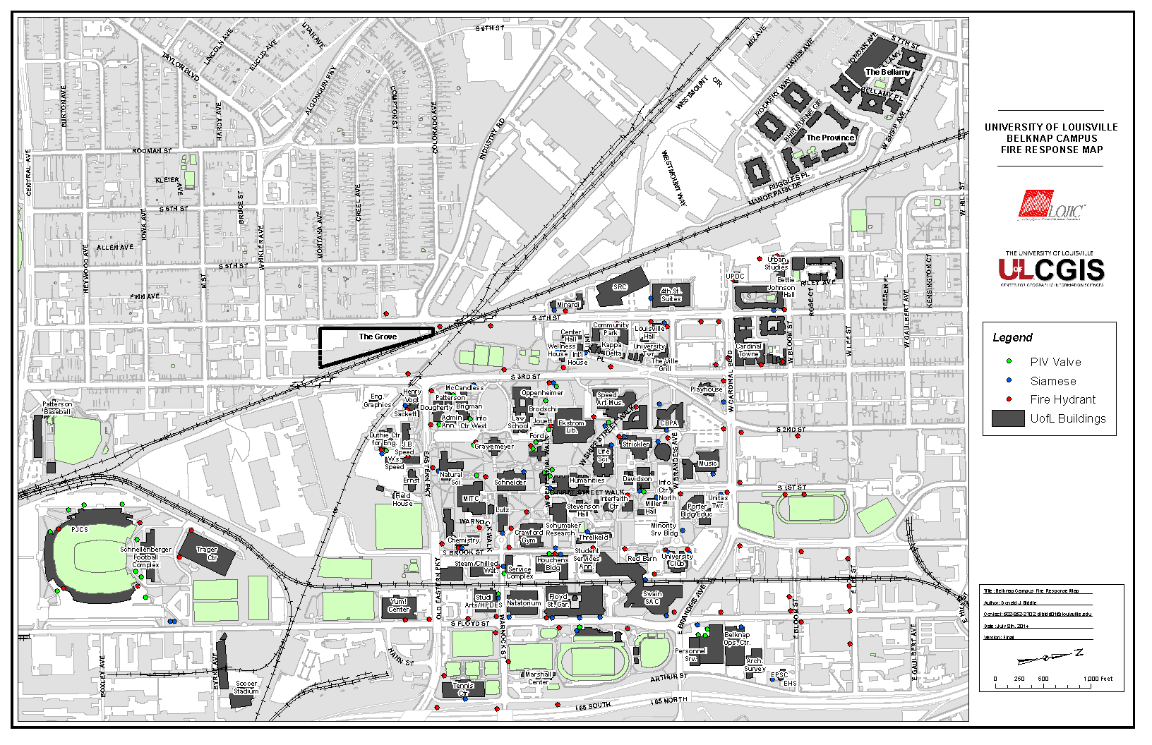
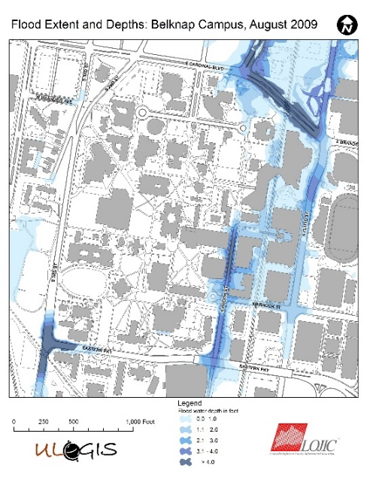
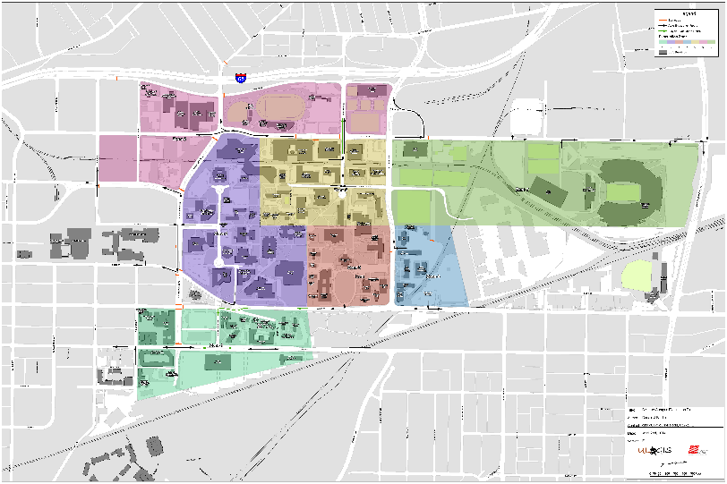
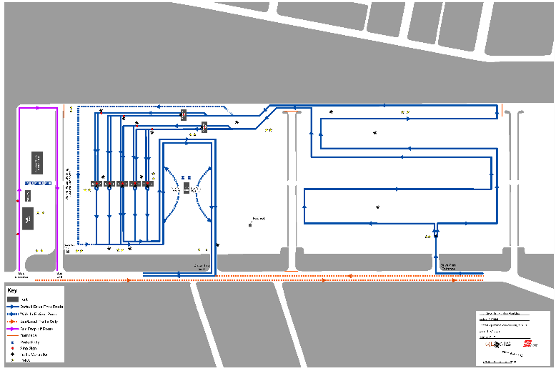
Administration: GIS Consulting for internal clients DEHS

Slide 19
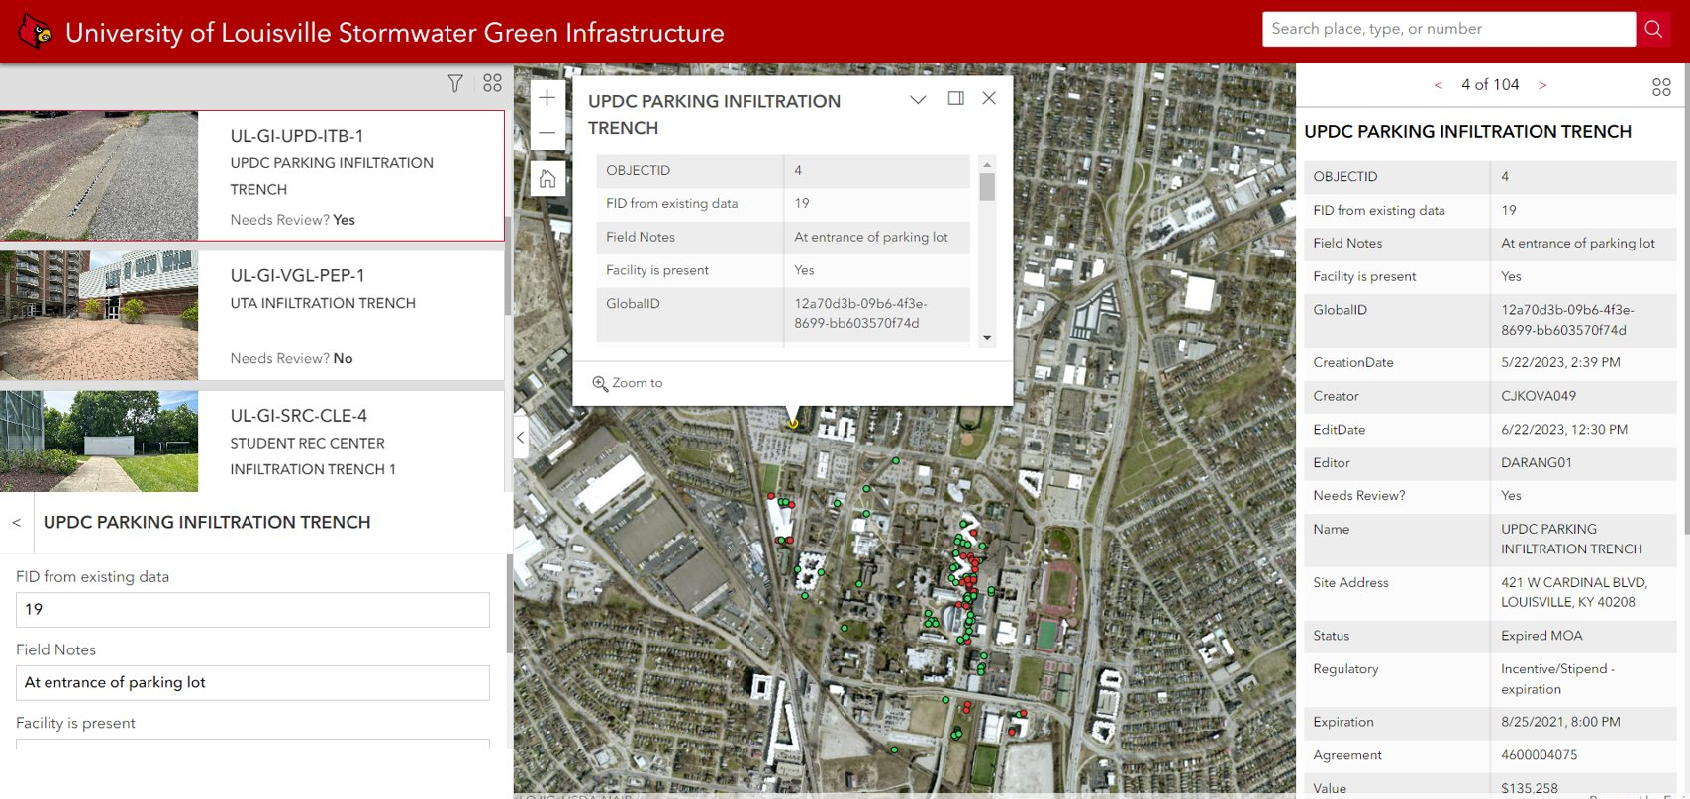
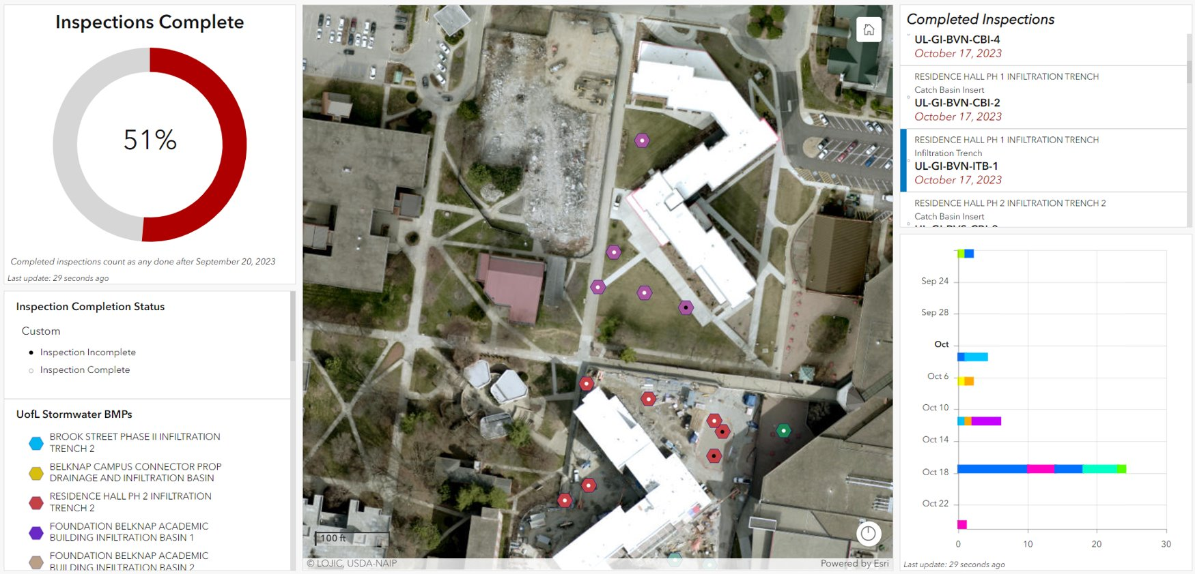
Administration: Consulting for internal clients: Cardstorm Stormwater Management GIS

Slide 20
Geospatial Technology Services via ULCGIS
Research support via fee for service or grant salary support
Data visualization
Spatial statistics/modeling
Field data collection
Data services – sourcing/acquisition, transformation/cleaning, hosting/maintenance, LOJIC data liaison
Software support – ESRI License Management
Student support
ULCGISHelpDesk@louisville.edu

Slide 21
ESRI Site License
CPE negotiates reduced cost licenses for all higher-ed institutions in KY (UofL share = ~$22k annually)
"Site License" provides unlimited licenses for desktop, web-based, and server ArcGIS software titles
ArcGIS Pro
ArcGIS Online
Free access to ESRI Academy Courses

Slide 22
ESRI Site License
Participation in the ESRI License program is by department.
FY25 High-level (unlimited licenses): $3,500
FY 25 Low-level (two desktop licenses): $1,100
Current Health Sciences partners:
Envirome Institute
Pediatrics
SPHIS

Slide 23
ArcGIS Online

Slide 24
Living Atlas of the World

Slide 25
ArcGIS Business Analyst

Slide 26
ESRI Academy

Slide 27
Questions?
Email me at dj.biddle@Louisville.edu
Visit: https://www.ulcgis.org

