Slide 1
Clinical and Translational Research Development
JON KLEIN, MD, PhD, Director
JIAPENG HUANG, MD, PhD, Deputy Director

Slide 2
Louisville Clinical & Translational Research Center (LCTRC)
VISION: Build a high impact and durable Clinical and Translational research program at the University of Louisville (UofL) to improve the health of Kentucky communities.
Impact:
Build and grow an integrated clinical & translational research program, single point of access to research resources
Develop and encourage community participation at all stages of clinical and translational research
Develop the personnel and physical infrastructure to exponentially grow clinical and translational research

Slide 3


Louisville Clinical & Translational Research Center Partners
UofL Health:
UofL Health (ULH), a fully integrated regional academic health system created in 2019
UofL Health and its expanding geographic footprint and patient volume has challenged the capacity of UofL C&T infrastructure
Owensboro Health:
Owensboro Regional Hospital & 3 other regional hospitals: multiple outpatient care sites; only 1 clinical research specialist
Lacks systemic support for C&T research and mechanisms for community- engaged research
Potential to lead and/or participate in C&T research activities at UofL and ULH
Lead efforts to understand community health/research needs through community-based participatory research

Slide 4
Louisville Clinical & Translational Research Center Transformation & Innovation
Through a single point of access: expand C&T research capacities at UofL, affiliated healthcare systems, and our community partners for C&T education, funding, community engagement, professional development, and mentoring
Provide a hub for LCTRC Cores and UofL COBRE/INBRE Cores
Create a Center for Clinical Research Innovation (CCRI) to assess and develop training in the use of novel clinical trial technologies
Generate commitment of faculty in conducting C&T research on health challenges that impact the regional patient population served by the LCTRC
Develop and strengthen collaborations across participating LCTRC organizations and with community partners
Expand outreach to regional Clinical and Translational Network (CTR-N) and Clinical Translational Science Awards (CTSA) programs

Slide 5
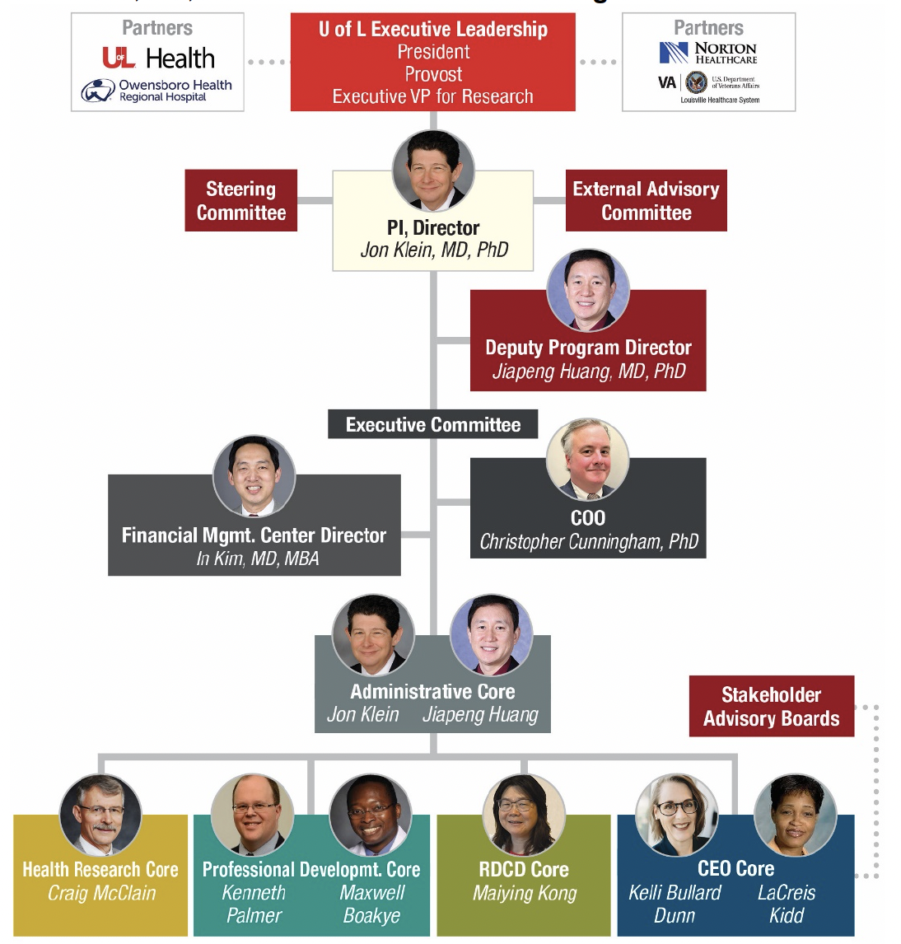
Louisville Clinical & Translational Research Center (LCTRC)
Organizational Chart

Slide 6
Health resources core

Slide 7
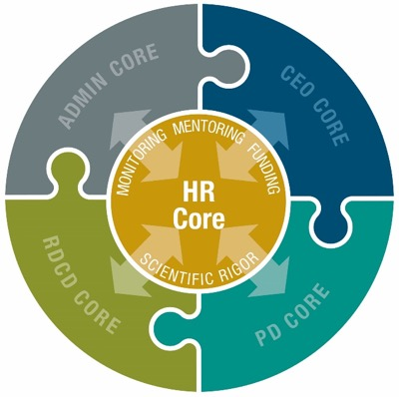
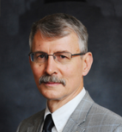
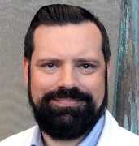
Louisville Clinical & Translational Research Center Health Resources Core
Craig McCain, MD
Director
Matt Cave, MD
Associate Director

Slide 8
Louisville Clinical & Translational Research Center Health Resources Core
Aims:
Identify and select new Pilot Projects for investigators to test ideas with the potential to develop independent applications: NIH career development (K-series) or developmental research project awards (R21).
Identify and select new Developmental Projects for 2 years of support for independent investigators with the requisite background and scientific expertise
Pair project leads of HR Core projects that involve clinical trials with experienced clinician scientists who serve as mentors and make core resources available
Monitor HR Core projects to ensure study participant safety and that all federal, state, local, and organizational regulatory requirements are met. Track projects for abstract, paper, grant application, and external funding productivity.

Slide 9
Louisville Clinical & Translational Research Center Health Resources Core
Aim #1:
Identify and select new Pilot Projects for investigators to test ideas with the potential to develop independent applications: NIH career development (K-series) or developmental research project awards (R21).
1 year duration
6 in year 1
4 thereafter
$75,000 for 1 year (50/25)
Fellow or Junior Faculty

Slide 10
Pilot Projects
Abecassis, Isaac CFD Modeling of Intracranial Aneurysms Using Neurosurgery 4D Flow MRI
Gallo, Michelle Pericardial fluid characterization in Heart Failure Patients CV Surgery
Lynn, Andrew Examining attentional enhancement of visual perception Psychology/Brain
across childhood Sciences
Malovichko, Marina Vascular toxicity of Synthetic Nicotine Analog Metatine Medicine/Env
Tomlinson, Cammie Sleep disturbances as a mechanism linking child Kent School
maltreatment and psychopathology
Vanzhula, Irina Development of Digital Self-Guided Mealtime Psychology/Brain
Intervention (eBite): Improving Access to Care Sciences

Slide 11
Louisville Clinical & Translational Research Center Health Resources Core
Aim #2:
Identify and select new Developmental Projects for 2 years of support for independent investigators with the requisite background and scientific expertise
2 year duration
2 per year
4 thereafter
$125,000/year (75/50)
Senior Faculty

Slide 12
Developmental Projects
Buonpane, Christie Harnessing microbial metabolite Peds Surgery
analogs: Urolithin A as a preventative
and therapeutic avenue for necrotizing
enterocolitis
Mistry, Akshitkumar Phase 1 Trial of No Perioperative Dex in Neurosurgery
Brain Metastases

Slide 13
Professional development core

Slide 14
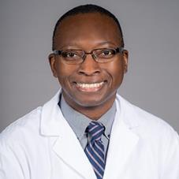
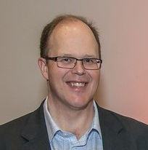



Louisville Clinical & Translational Research Center Professional Development Core
School of Medicine
Physician Scientist Development Programs
Co-Directors
Maxwell Boakye MD MPH MBA
Kenneth Palmer, PhD
HSC Office of Educational
& Professional Development
Kristi Treitman, M.Ed. Instructional Designer

Slide 15
Professional Development Core Aims
Specific Aim 1: Develop a core of well-trained and supported early-stage clinician-investigators capable of securing grant funding to sustain UofL's commitment to research and translation to practice.
Specific Aim 2: Build interdisciplinary teams and networks of investigators to promote innovation in C&T Research.
Specific Aim 3: Nurture our pipeline of clinician scientists by developing C&T research skills and competencies in our clinical professional students.
Specific Aim 4: Train clinical research coordinators and research nurses in best practices and policies and mentoring practices to better support UofL’s clinical research enterprise.

Slide 16
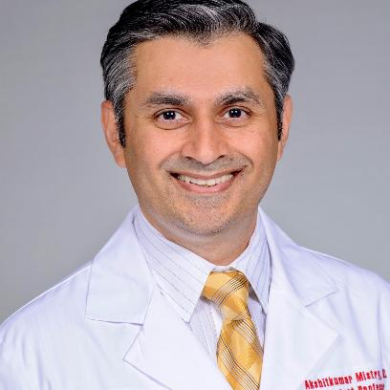
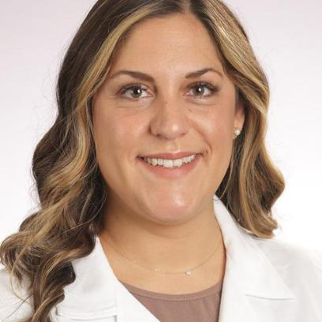
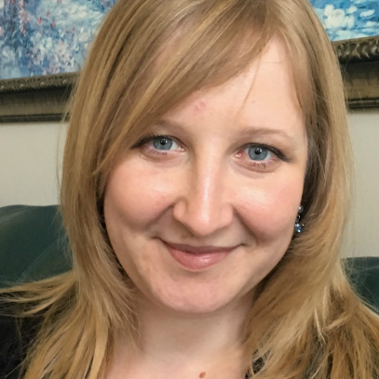
Presidential Scholars
Three awarded in first half of 2025. Two additional to be awarded summer 2025.
Akshitkumar Mistry
Christie Buonpane
Irina Vanzhula
Neuroscientist
Research: Brain tumors
Pediatric Surgeon
Research: Pediatric gastro
Psychologist
Research: Eating disorders

Slide 17


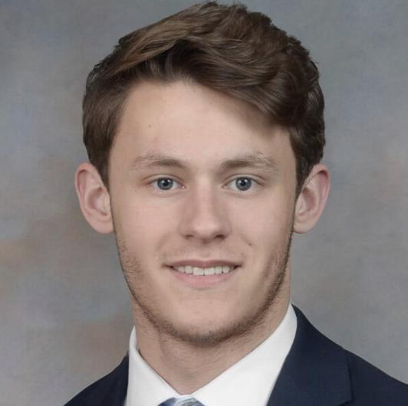


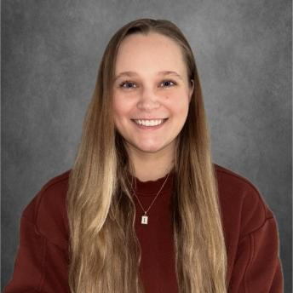


Pipeline of Clinician-Scientists
DEAN’S RESEARCH SCHOLARS, a one-year paid research fellowship for 3rd year medical students
2025
2029
Three medical students were selected and two awarded: Iona Palmer and Grayson Stinger.
By 2029, our pipeline will include approximately 14 to 15 exceptional up-and-coming clinician-scientists.

Slide 18
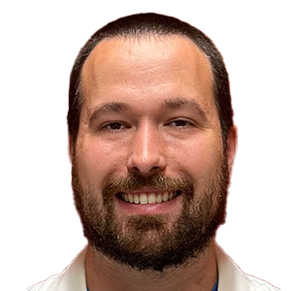
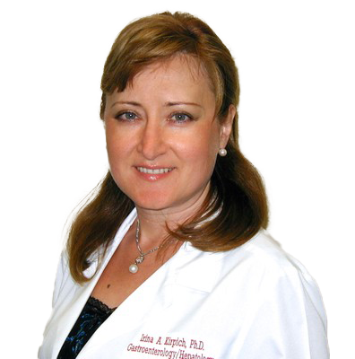
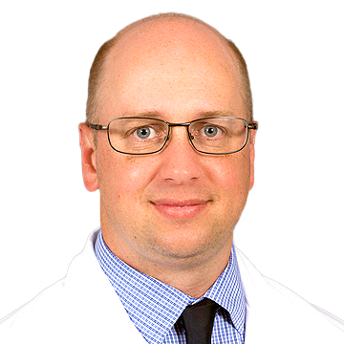
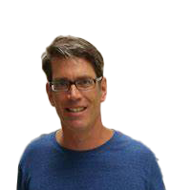
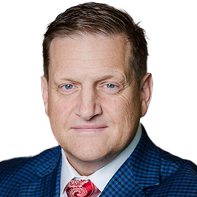

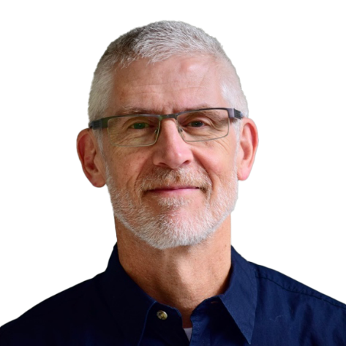
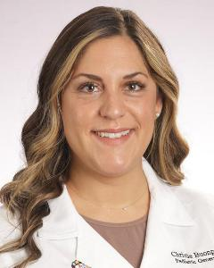
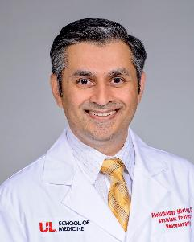
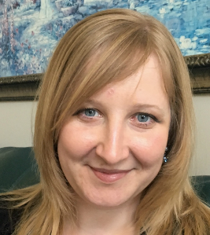
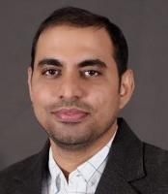
Competitive Major Grant Funding (NIH)
K COHORT, one of our 4 expected cohorts being initiated to increase competitiveness for major funding.
The K Cohort started this spring, providing individualized feedback on application materials from UofL faculty with K awards/experience.
K Mentors: left
K Cohort Spring Scholars: below

Slide 19
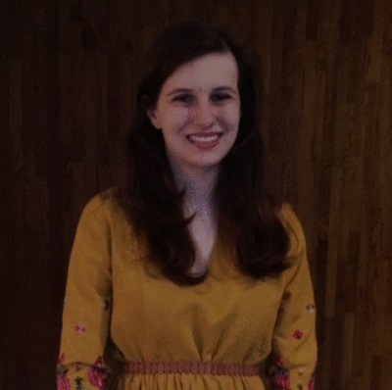
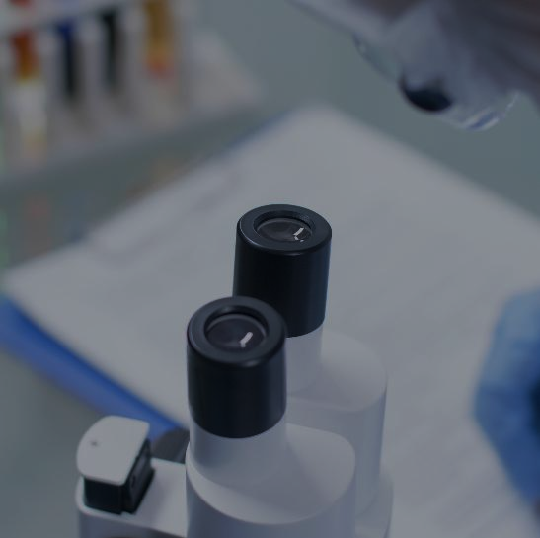
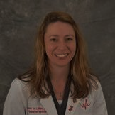
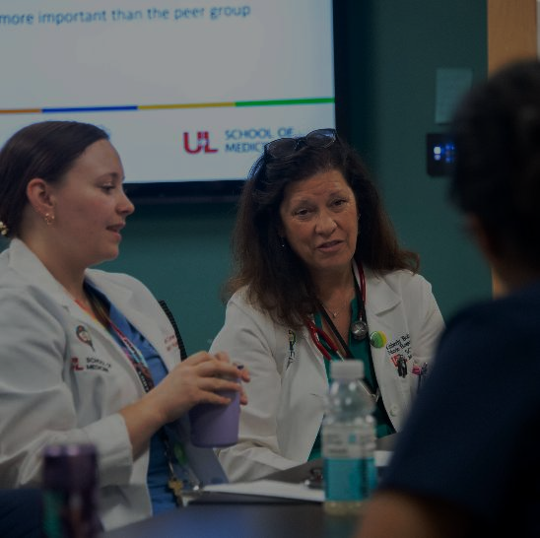
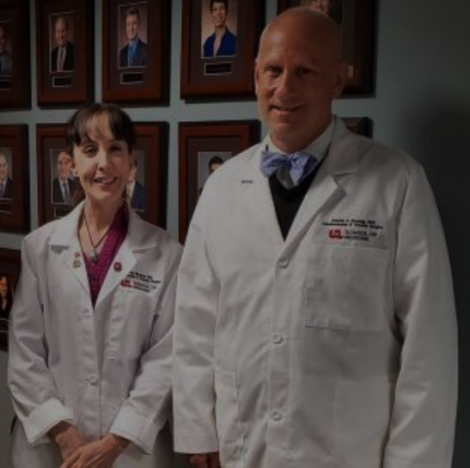
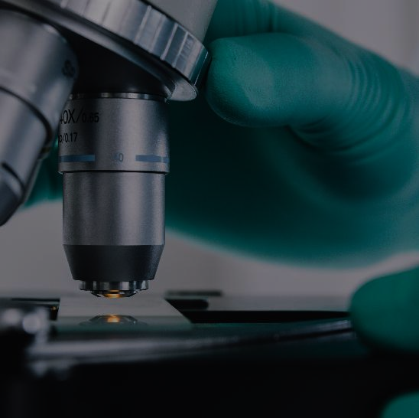
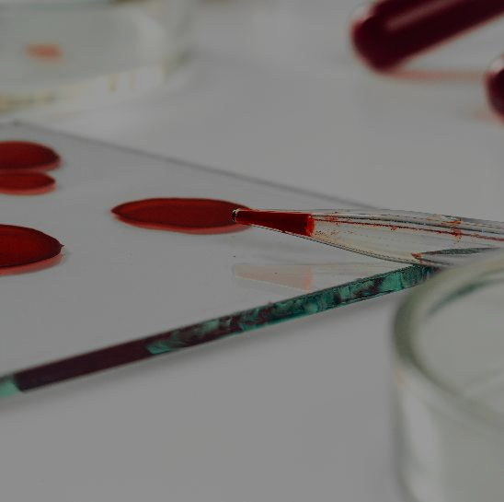
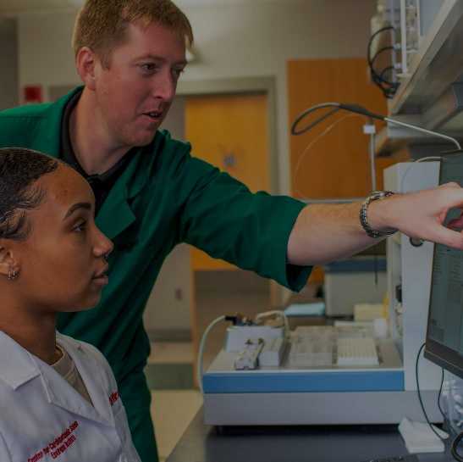
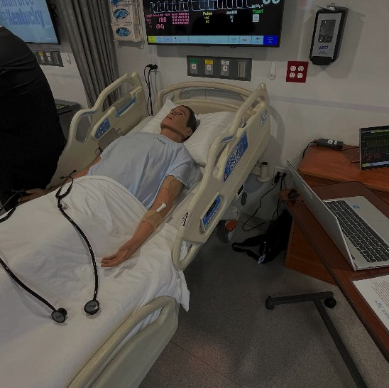

S
E
M
Professional Development
The PD Core has a variety of professional development initiatives underway:
Monthly Professional Development Seminar Series for Clinician-Scientists
Hot Topics (i.e. Nature Portfolio guest speaker, Dr. Shirley, on Scientific Writing)
Mini-Series: Community Based Participatory Research (coming this fall), Roles of the Research Team, Research Design Methodologies
Mentorship Training MD/PhD
iSCORE CRC Training
Nature Masterclasses Subscription
I
N
A
R
S
and more
Registered Users
125
Modules
Started
130

Slide 20

Events
ANNUAL SYMPOSIUM
July 11, 2025
Women’s Health in Medicine
INSPIRE FORUM – Clinical Trials Day
May 20, 2025
Clinical Trials Round Tables

Slide 21
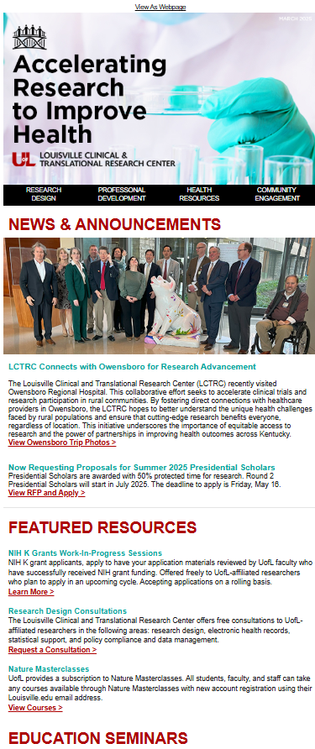
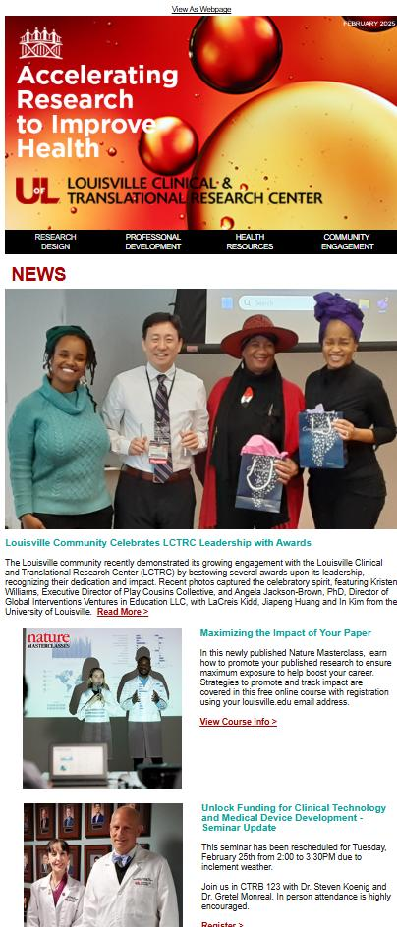

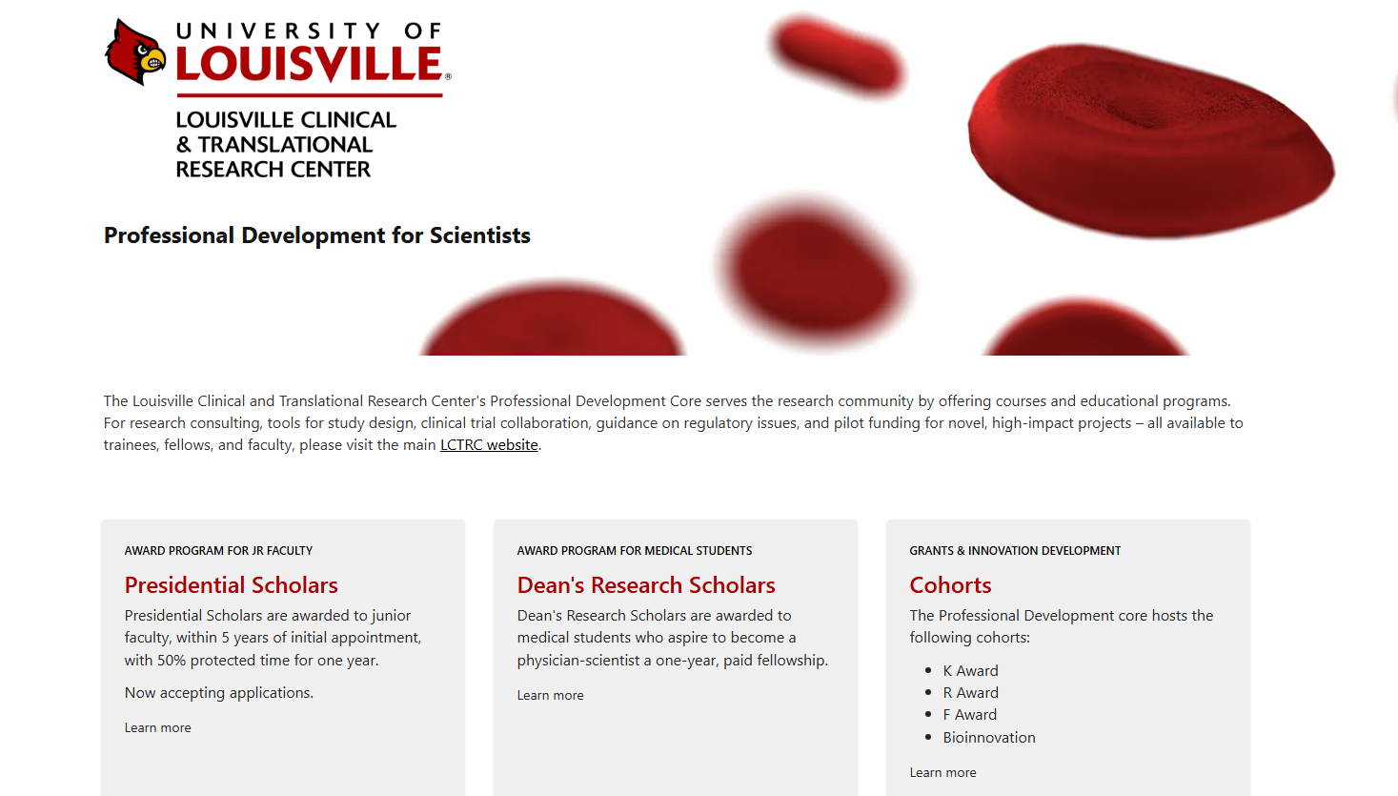
Outreach
Professional Development Core
Newsletter
5 editions
39% open rate, 6% click rate
Website (SharePoint)
Launched Nov 2024
315 unique visitors, 2124 views
https://cardmaillouisville.sharepoint.com/sites/ctrprofessionaldevel

Slide 22
Research design, compliance and data management core

Slide 23
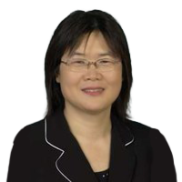
Louisville Clinical & Translational Research Center Research Design, Compliance and Data Management Core
Maiying Kong, PhD
Research Design & Statistics Support
Research Design
Clinical Trails Design
Consultations
Guidance
Resources
Training
Director
Data Analysis &
Statistical Support
Policy Compliance
& Data Management
Policy Compliance
Clinical Trials & Data Management
Electronic Health Records

Slide 24
Louisville Clinical & Translational Research Center Research Design, Compliance and Data Management Core
Aims:
Provide state-of-the-art statistical support in design, analysis, and dissemination of findings across a spectrum of basic science, translational, clinical, and population health studies.
Facilitate and provide guidance on the use of Electronic Health Records (HER) and other large clinical datasets to ensure compliance with NIH and institutional data management policies to safeguard protected health information.
Provide guidance, resources, and training to enhance the competency of LCTRC researchers in conducting human subjects research.

Slide 25
RDCD Core Achievements
Staff recruitment: Recruited a full-time Biostatistician II within the first three months of the funding period and jointly recruited a 50% FTE Biostatistician IV in the first month, significantly enhancing our capacity to support UofL clinical and translational (C&T) researchers.
Provide state-of-the-art statistical support in design, analysis, and dissemination of findings (Aim 1):
26 consultations on research design and data analyses plans were provided to pilot/developmental grant applicants.
The RDCD core supported 12 projects on research design and data analysis for C&T researchers, providing services that were previously unavailable. The infrastructure developed through LCTRC has significantly improved researchers' access to these critical resources.
A weekly study group on clinical trial design and analyses has been in place since the inauguration of LCTRC. The result of the weekly study group has greatly enhanced RDCD capacity to design various trials and analyzing the resulting data.
Biweekly study group on data integration has been implemented, which has greatly enhanced the RDCD core’s capacity to analyze data from multi-omics, image mass cytometry, and other high-dimensional data.

Slide 26
RDCD Core Achievements (Continued)
Facilitate and provide guidance on the use of EHR and other large clinical datasets (Aim 2)
Establishing a UofL Research Data Warehouse: Collaborated with UofL and UofL Health IT departments, the legal office, and leadership to advance the development of a UofL research data warehouse.
Utilizing the Cerner Learning Health Network (LHN) Database: (i) Conducted two projects using the LHN database, resulting in a manuscript. (ii) Developed instructional materials on database usage.
Developing an Inherited Retina Disease Database: Partnered with UofL Librarian and REDCap Administrator, David King, and UofL Vitreoretina/Uveitis Specialist, Dr. Wei Wang, to create a REDCap-based inherited retina disease database.
Other key activities and achievements.
Collaborated with the administrative core to develop a project intake form, which has been in use since January 2025.
Building a Catalog for Biorepositories: Developed a survey to assess available biorepositories across UofL for research use.

Slide 27
Community engagement and outreach core

Slide 28
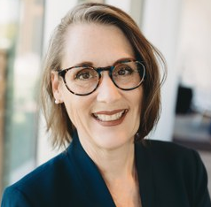
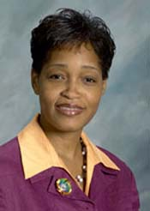
Louisville Clinical & Translational Research Center Community Engagement & Outreach Core
Kelli Bullard Dunn, MD
La Creis Kidd, PhD, MPH
Co-Director
Co-Director
Community Advisory Boards (CAB) & Committees
Community Knowledge Exchange Sessions (CKES) – all stakeholders
Community liaisons (CHRC, CHW, student assistants)
Coordinate LCTRC e-cohort
streamline recruitment, enrollment, consent, data collection, eHR access, wearable activity trackers
Articulate community needs & priorities
Be the voice of our targeted audience
Commitment to culturally competent & linguistically accessible health/research messaging
Notes:
The CEOC team will overcome these barriers to health lifestyle choices & participation to CTR by strengthening existing and forming new community partnerships.
The core-leaders and community partners will co-create a CAB with the mission to co-identify, co-prioritize, and co-translate community health needs/research ideas using community-engaged approaches.
We will also co-host CKES to build community trust and engage in multi-directional communication in an inclusive, culturally sensitive, and language-appropriate manner. This will provide the basis for an engaged community integrated into C&T research with researchers who value and use community inputs in their research as well as translate their research findings back to the community to improve health outcomes.
We will also have community liaisons, including (CHRC, CHW, public hlth/community student assistants), to coordinate a new LCTRC e-cohort to streamline participant recruitment, enrollment, consent, survey data collection, as well as access to data from both wearable activity trackers and eHR records (mydatahelps).

Slide 29
Louisville Clinical & Translational Research Center Community Engagement & Outreach Core
Goal:
Improve the overall health and well-being of Kentuckians by raising awareness of community health research needs and improving access to relevant research studies and data, while addressing the needs of at-risk subgroups, including health education, health literacy, and trust.
Aims:
Promote understanding of community health/research needs and disseminate knowledge, health research education, and share C&T research and resources with communities
Develop and support community-led and clinical investigator-initiated community-based participatory research

Slide 30
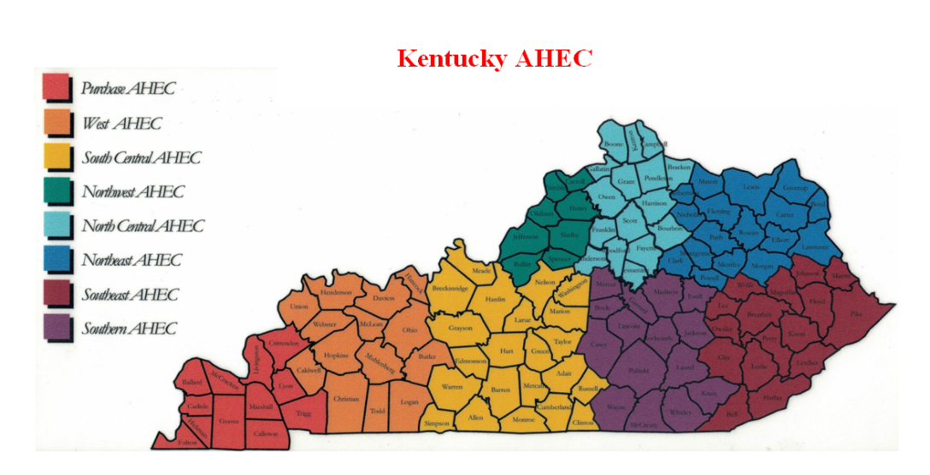
Louisville Clinical & Translational Research Center Community Engagement & Outreach Core
Goal:
Improve the overall health and well-being of Kentuckians by raising awareness of community health research needs and improving access to relevant research studies and data, while addressing the needs of at-risk subgroups, including health education, health literacy, and trust.
Aims:
Promote understanding of community health/research needs and disseminate knowledge, health research education, and share C&T research and resources with communities
Develop and support community-led and clinical investigator-initiated community-based participatory research

Slide 31
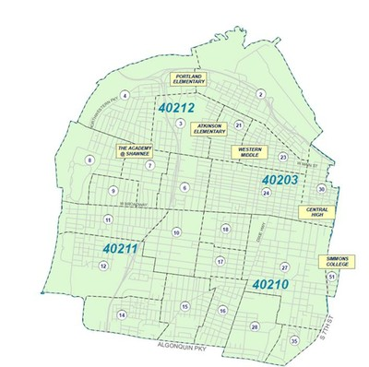

CEOC Accomplishments - Urban (W/S Louisville)
Building Community Trust & Connections
We hosted/co-hosted, sponsored, or attended six events every 2-4 weeks throughout the initial budget period. [West Jefferson County Community Task Force (WJCCTF), WJCCTF conference, and a health and wellness event with NAN Louisville Chapter, Play Cousin’s & GIVES’s Kwanzaa]
Expanded Community Liaison Team
Hired Community Health Research Coordinator in Louisville
Received 17 applications for Community Health Workers in Louisville
Established Community Advisory Board with 16 members (12 community members Q4 of year 1.1st Meeting held on March 27th, 2025 w/ 25% attendance)
Established a CEOC Newsletter that’s linguistically appropriate
Opportunities for training and professional development has the project provided
Working with the Prof Dev Core to Develop a Community-based Participatory Research Seminar Series involving faculty and a community leader (Founder of Play Cousins Collective)
Develop LCTRC initiated Community Participatory Research Projects and Community Scientists to lead projects
In partnership with the bioinnovation lead on the LCTRC leadership team, the CEOC has developed a pilot project proposal to explore feasibility and acceptability of wearable technology for health monitoring and related research by community members.

Slide 32
CEOC Accomplishments - Rural (Owensboro)
Hiring Community Health Research Coordinator
Received 46 applications for Community Health Research Coordinator
Interviewing 5 CHRC applications on April 7th & 8th
Community Advisory Board (CAB)
Establishing a CAB consisting of Owensboro Health Leaders and Community Members
Had our 1st meeting in January 2025 with Owensboro leaders and community engagement & outreach experts
Developing LCTRC initiated Community Participatory Research Projects and Community Scientists to lead projects

Slide 33
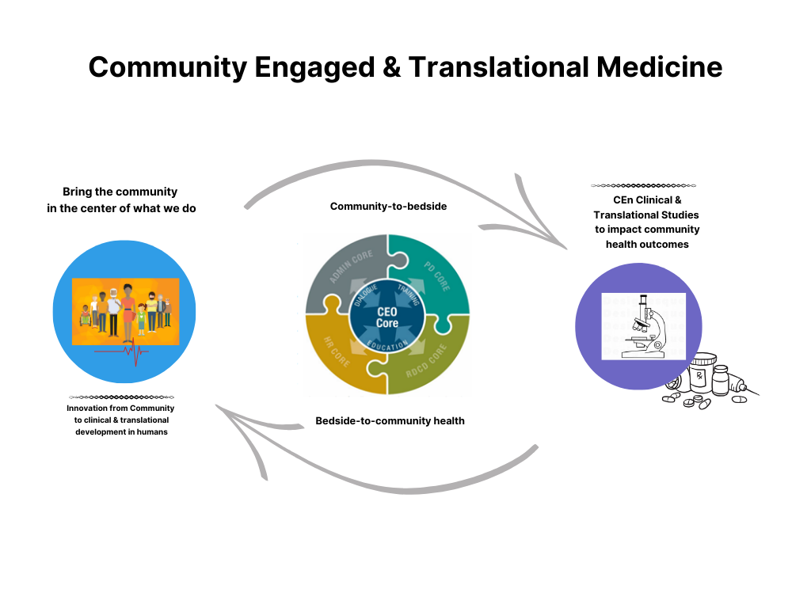
CEOC Accomplishments
Integration into all LCTRC Cores
Community-based participatory research seminar series
Community-engaged study on wearable health monitoring devices
Other support needed for Community Engaged & Translational Research

Slide 34
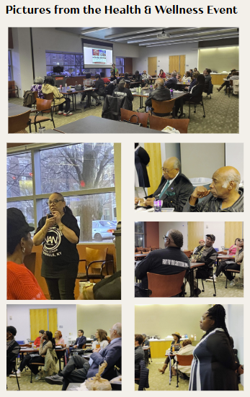
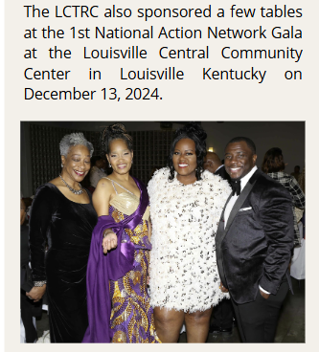
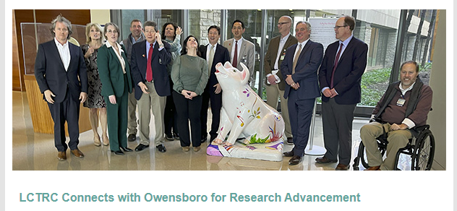
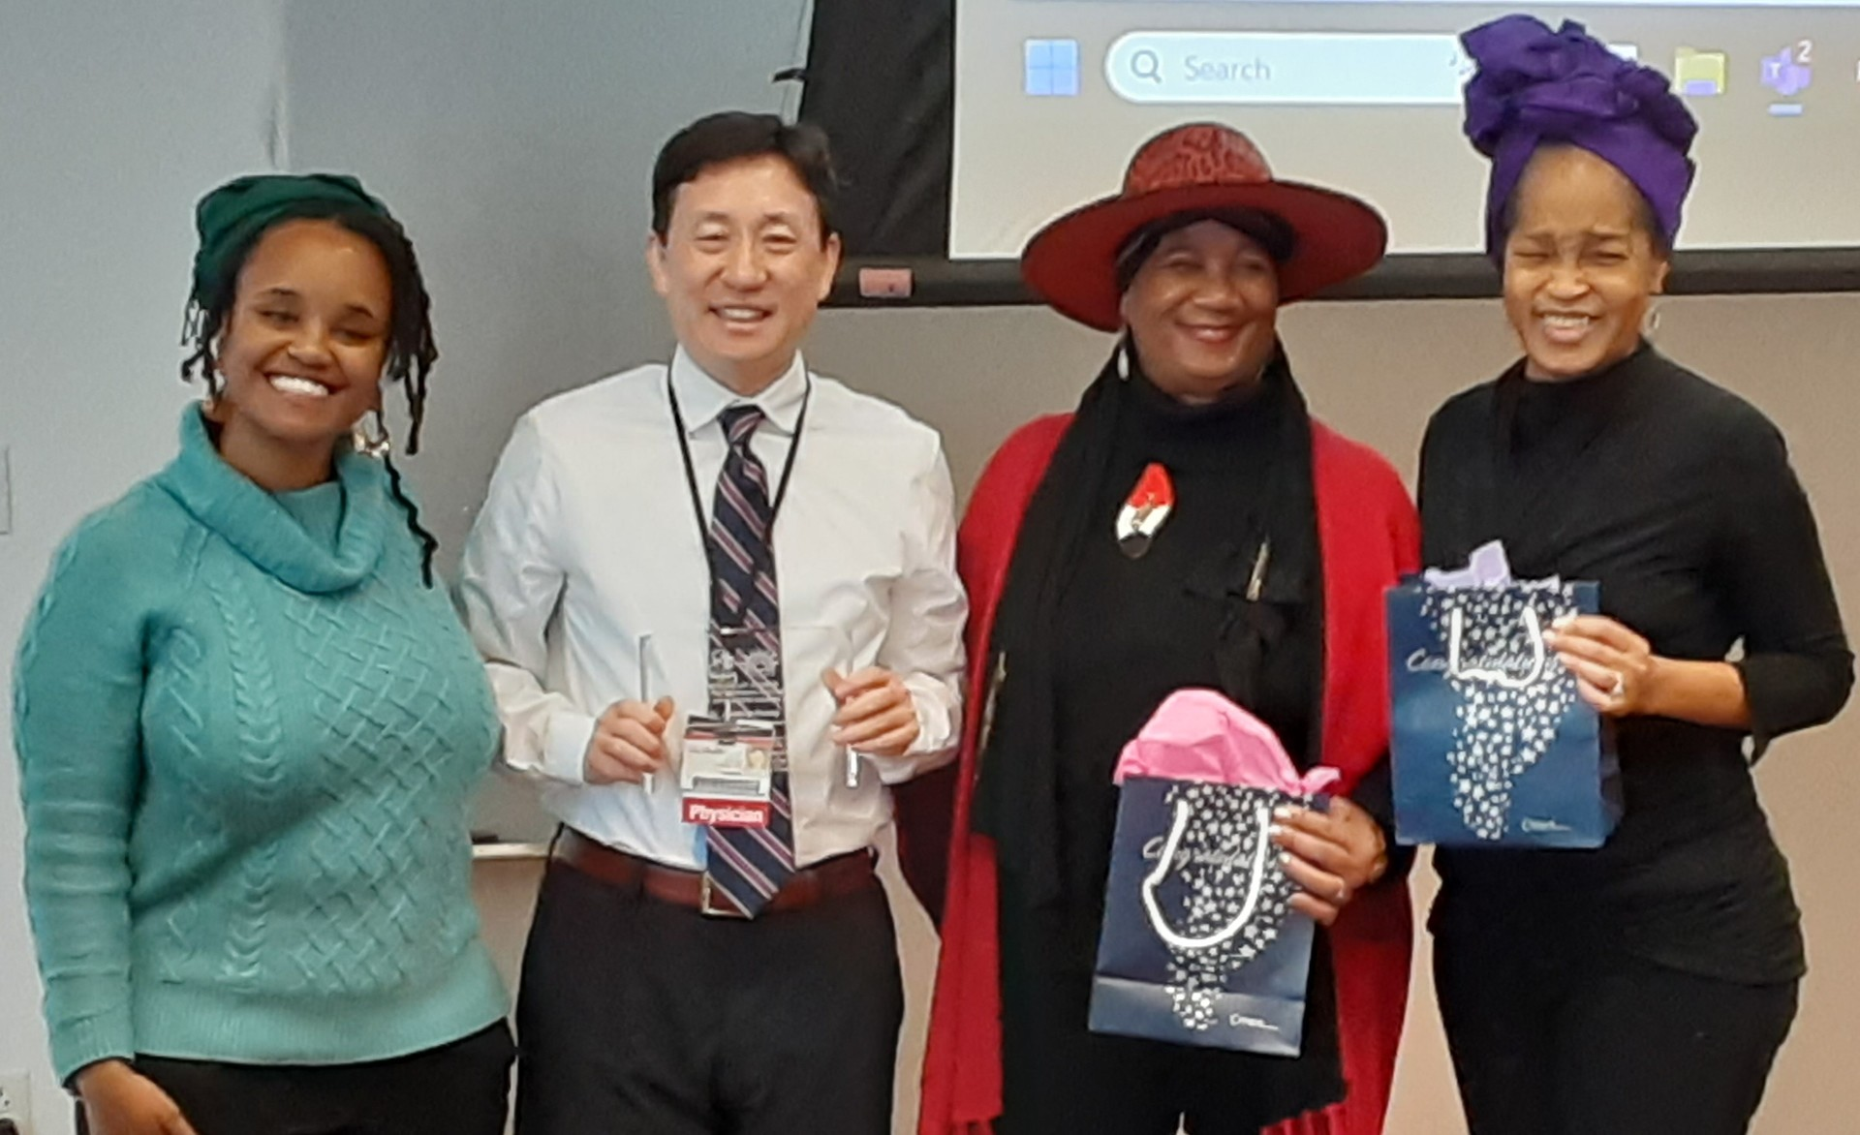
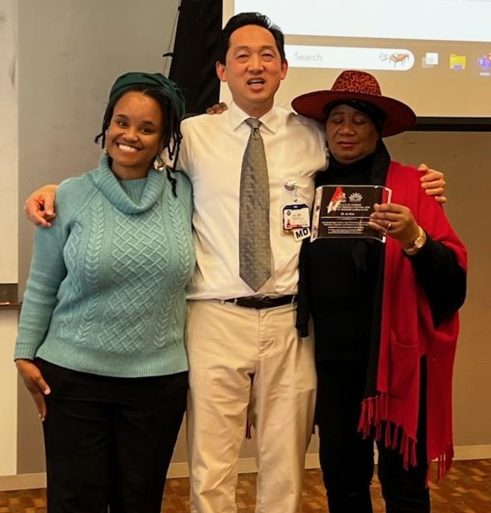
CEOC Accomplishments
Community members presenting awards to CTRD members

Slide 35
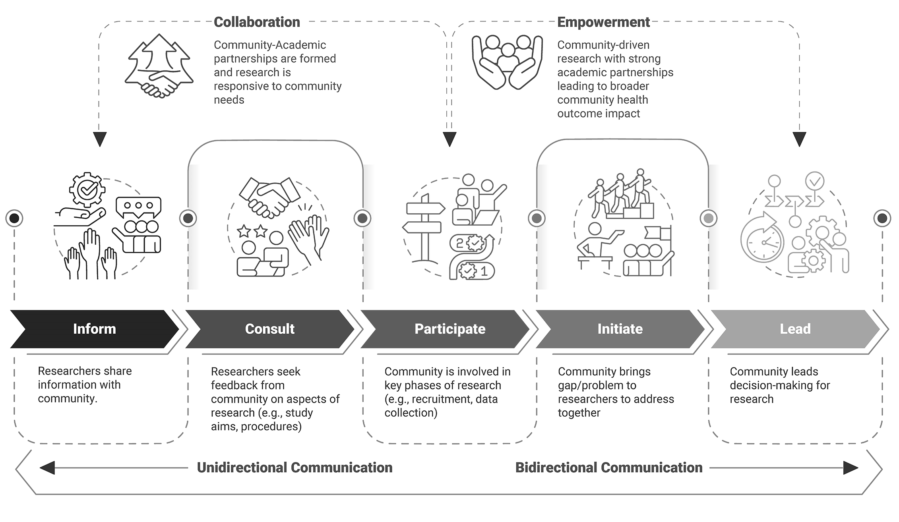
Louisville Clinical & Translational Research Center Community Engagement & Outreach Core
Integration into all LCTRC Cores
Community Engaged Research, Cultural Competency training
Other support needed for CEn CTR
New & multi-faceted Community-to-Bedside approach to address health issues in diverse communities
Notes:
We will co-develop and co-support multi-directional partnerships for CEn CTR that’s mutually beneficial for our targeted communities, researchers and citizen scientists.
This slide represents at CEn Research Continuum that summarizes the level of community involvement in the research process, ranging from zero to high levels of community participation (e.g., CBPR, community-driven research)
Unlike traditional one-way communication, where information flows from researchers to the community, multi-directional communication emphasizes a more collaborative and inclusive approach.
In the previous slide we mentioned a few ways the community can participate and initiate CEn Research by playing an active role in key research areas including recruiting/retaining study participants, identifying community health needs, and setting health/research priorities.
In addition, we want researchers and citizen scientists to communicate their research ideas and key study findings to the CKES board. Moreover, The community liaisons will use culturally competent and linguistically appropriate messaging to share health messages and research findings at community events, on social media and other platforms.
Multi-directional communication in community-engaged research refers to the dynamic exchange of information and ideas among all stakeholders involved in a research project, including researchers, citizen scientist, community members, community organizations, policy makers, and other relevant parties. The five key components of MDC: include inclusive dialogue, mutual learning, shared decision-making, continuous feedback and empowerment.
MULTI-DIRECTIONAL COMMUNICATION (MDC)
Inclusive Dialogue - All stakeholders share, ensuring the research is relevant and responsive to community needs
Mutual Learning - Researchers, community members & partners learn from each other, leading to a deeper understanding of the issues and more effective solutions.
Shared Decision-Making - Decisions about the entire research process are made collaboratively.
Continuous Feedback – ongoing communication helps to refine the research
Empowerment – Involving the community in the research process. Use MDC & mentoring to empower them to take an active role in addressing the issues that affect them & their community.

Slide 36

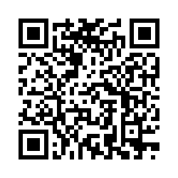
Thank you
Give feedback:
Questions?
Email: in.kim@louisville.edu
Email: jon.klein@louisville.edu

