Slide 1

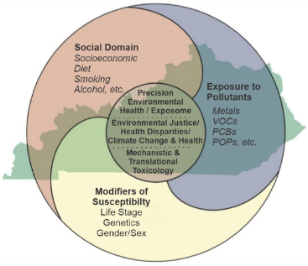
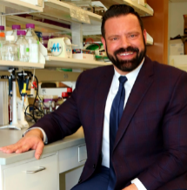
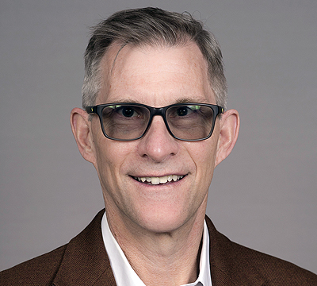
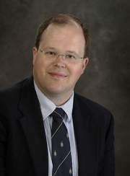
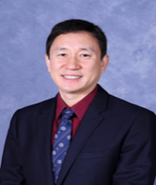
Translational Research Support Core (TRSC) Seminar Series
Update on TRSC’s Basic Science Research Services and CTRD
Matt Cave, Dan Conklin, Ken Palmer, Jiapeng Huang ihsfc@louisville.edu

Slide 2
Agenda
Introduction to CIEHS and the TRSC (Cave)
Overview of TRSC’s Basic Science Research Services (Cave)
Animal Phenotyping and Histology (Cave)
Animal Inhalation Exposure Facilities and Phenotyping (Conklin)
Animal Pathogen Exposure Facilities (Palmer)
Update on CTR-D (Huang)

Slide 3
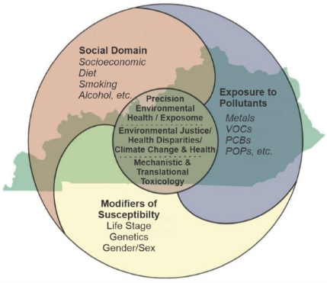

Introduction to the CIEHS
The CIEHS explores the etiology of chronic diseases as driven by interactions of environmental toxicants with the social domain, and influenced by life stage, genotype and sex/gender.
CIEHS’s identity is forged by Kentucky’s urban:rural environmental pollution exposure paradox and the Research Interest Groups (RIGS).
The Translational Research Vision is to create streamlined connections between these EHS ideas and researchers to the materials, subjects, and tools needed to further translate their work in ways that are collaborative, efficient, ethical, and relevant to the community.
TRSC supports the CIEHS Strategic Vision.

Slide 4
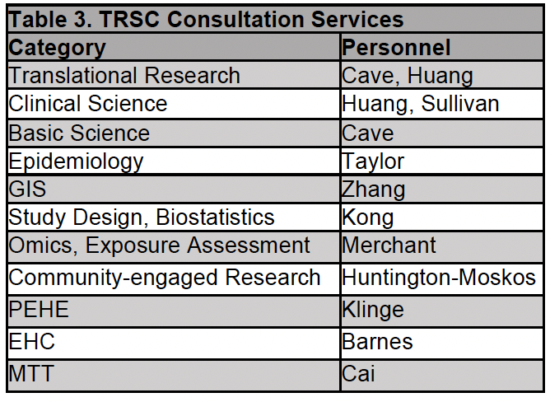
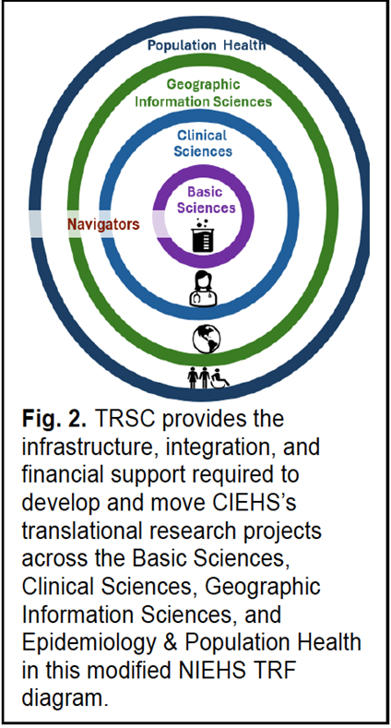
Introduction to TRSC - Specific Aims
Recruit and engage investigators to translational environmental health science research. (inclusive of this TRSC seminar series)
Enhance extramurally-funded EHS research projects and foster the development of new interdisciplinary Center research through intellectual support, team science approaches, and core utilization subsidies.
3) Provide access to services and resources that foster integrated and translational
research and manage TRSC operations.

Slide 5

Introduction to the TRSC
TRSC continues to build on its previous success in facilitating translation of research, using funding renewal to further expand, connect, and streamline our efforts using the NIEHS Translational Research Framework (TRF) as a guide.
TRSC provides infrastructure, integration, and financial support for research in four areas related to the elements of the NIEHS TRF where CIEHS has needs and expertise: Basic Science, Clinical Science, Geographic Information Sciences (GIS), and Epidemiology & Population Health (Fig. 2).
TRSC strives to develop/support research projects which will involve at least two areas in Fig. 2.
Earlier in 2024, Dr. Huang gave seminars on: TRSC Overview; and TRSC Clinical Research Services.
Today we will focus on TRSC Basic Science Research Services and provide a CTR-D update including its potential impact on clinical and translational EHS research at UofL.

Slide 6
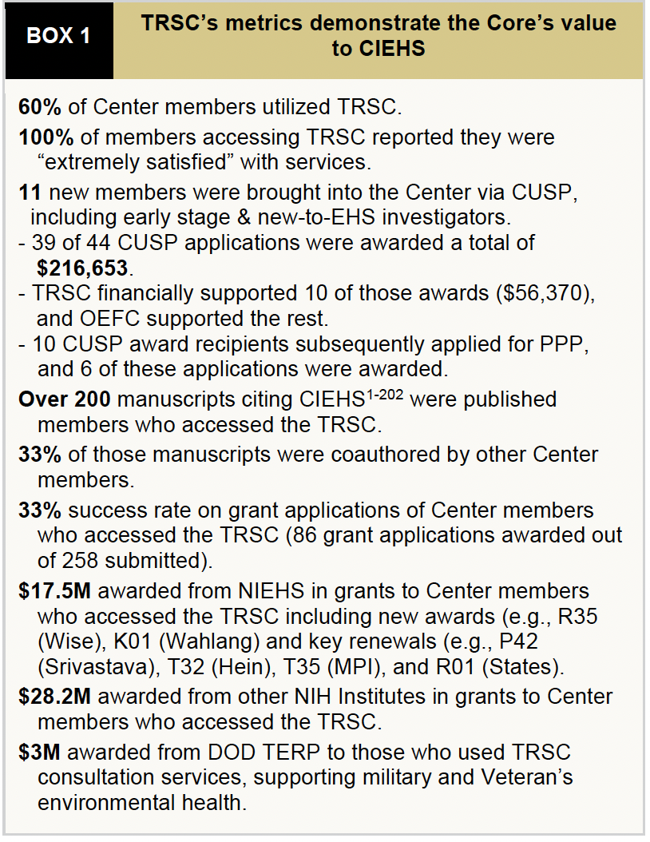
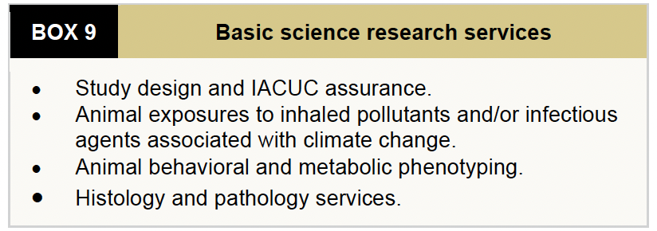
What are TRSC’s basic science research Services and why should you use them?

Slide 7

TRSC Basic Science Research Services
Study Design, Model Systems, Animal Phenotyping and Pathology (Cave)
Primarily support rodent studies based on CIEHS members’ needs.
Consultation Services: exposures and potential therapies including nutritional therapeutics - TRSC; sample size and power - BIFC; selection of exposure assessment and disease biomarker assays - OEFC; clinical translation - TRSC; community relevance - CEC; financial support considerations including CUSP and PPP - AC.
IACUC Assurance (LeBlanc)
Alternative strategies/future directions: wildlife sentinels (e.g., marine mammals and songbirds) of environmental exposures are available through the laboratories of CIEHS members. Rodent imaging development for EHS research is being supported by the PPP. A mobile animal exposure facility is being constructed by the Center for Cardiometabolic Science.

Slide 8
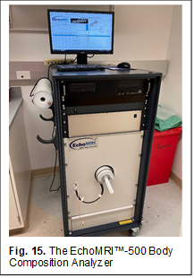
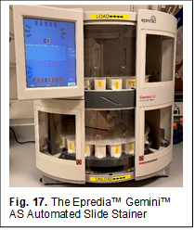
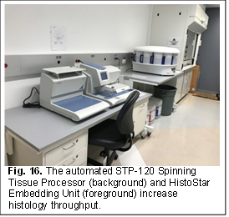
TRSC Basic Science Research Services
Study Design, Model Systems, Animal Phenotyping and Pathology (Cave)
Basic Science Research Services via linkage to the Hepatobiology and Toxicology COBRE’s Animal Model and Biorepository Core.
Body composition: EchoMRI™-500 Body Composition Analyzer.
Histology: STP-120 Spinning Tissue Processor; HistoStar Embedding Unit; Epredia™ Gemini™ AS Automated Slide Stainer. Linkage to board-certified anatomic pathologists is provided.

Slide 9

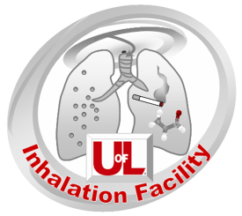

TRSC Basic Science Research Services
Animal Exposure to Inhaled Pollutants and Behavioral/Metabolic Phenotyping (Conklin)
THE EXPOSURE STUDIES AND TOXICOLOGY CORE (ESTC: Conklin, Dir.)
Exposures (particulate matter, VOCs, tobacco products, biogenics, etc…)
Monitoring (total suspended particulate, PM2.5, photoionization, electrochemical)
Biomarkers of exposure (blood and urine; pharmacokinetics)
Phenotyping in exposures real-time w/ telemetry: ECG, BP, blood glucose, EEG/EMG, temp., activity
Phenotyping post-exposure in vivo and ex vivo: telemetry and metabolic profiling (DEXAscan; GTT/ITT/PTT; food/water intake, activity, VO₂/VCO_{2;} cardiovascular phenotyping: blood pressure tail cuff, echocardiography, Langendorff, aortic and tracheal myography, ToxScreen, CBC, flow cytometry, etc… in collaboration with CCS’s Imaging and Bioanalytical Cores)

Slide 10
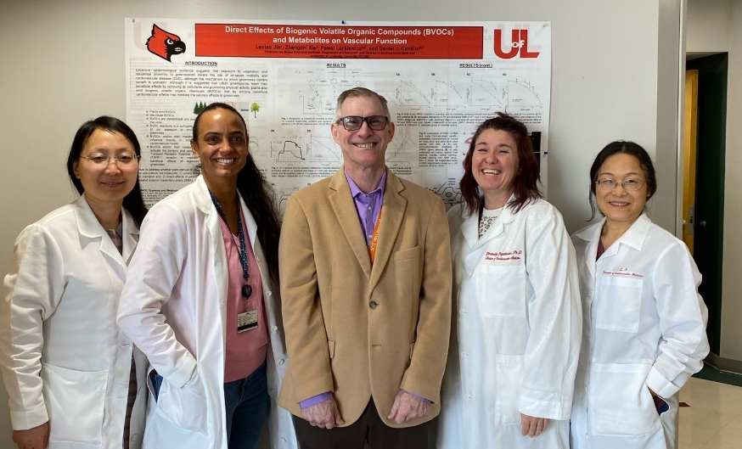
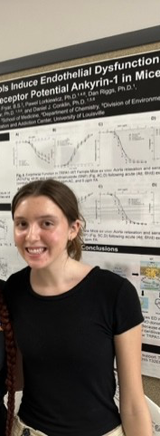
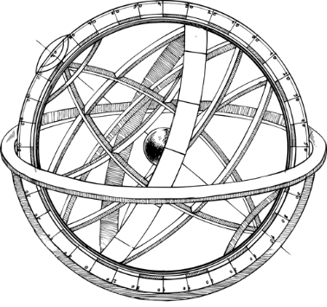

Snapshot of Ongoing Use of
Inhalation Facility
Exposure & Phenotyping Core
(L to R) Lexiao Jin, Alexis Miller, DJC, Heather Stowers, Fenge Li,
Sarah Barnett (UofL Chemistry undergrad)
Current Conklin (PI/Co-Inv. Funding that uses Inhalation Facility)
R01 HL171763 Conklin, D.J. (PI) Cardiopulmonary Toxicity of Electronic Nicotine Delivery Systems
DoD TX230189 Conklin, D.J. (PI) Mechanisms of Inhaled Combustion Product-induced Cardiopulmonary and Systemic Toxicity
R21 ES033323 Conklin, D.J. (PI) Cardiovascular Benefits of Inhaled Biogenic Volatile Organic Compounds (bVOCs; NCE)
P42 ES023716 Srivastava (PI) Environmental Exposure and Cardiometabolic Disease
U54 HL120163 Bhatnagar (PI) AHA-Tobacco Regulation and Addiction Center (ATRAC 2.0; NCE)
P30 ES030283 States (PI) University of Louisville Center for Integrative Environmental Health Sciences (CIEHS)
T35 ES014559 States/Cave/Conklin (MPI) Environmental Health Sciences Summer Research Program

Slide 11
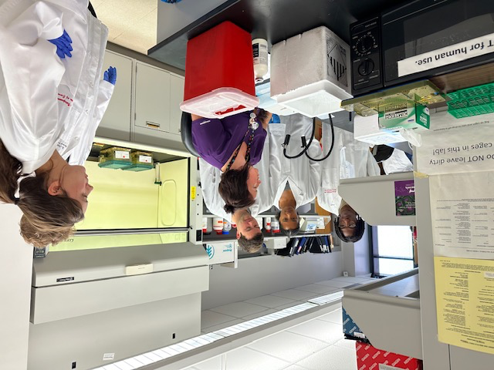
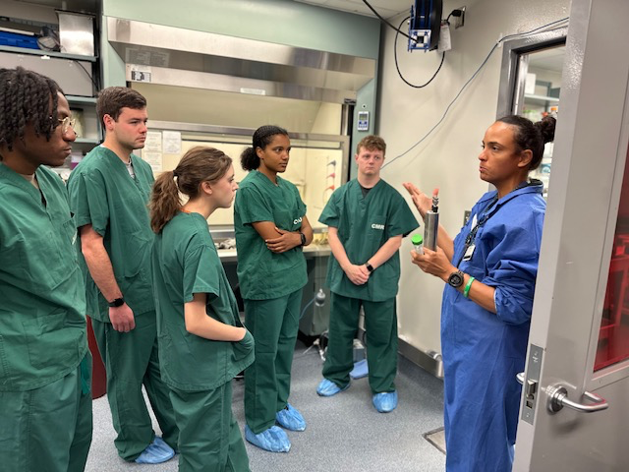
Training and Mentoring (Faculty, Staff, Graduate students, Post-docs, T32/Superfund trainees, T35 trainees, SRSP, Undergraduates, etc…)
THE EXPOSURE STUDIES AND TOXICOLOGY CORE (ESTC)
Ms. Heather Stowers w/ T35 & AHA trainees
Ms. Alexis Miller, M.S., RLATg w/ T35 & AHA trainees

Slide 12
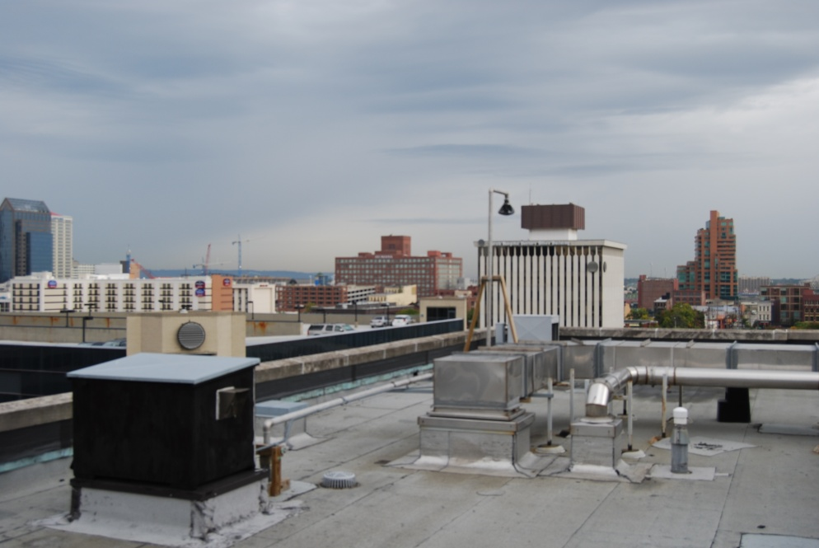
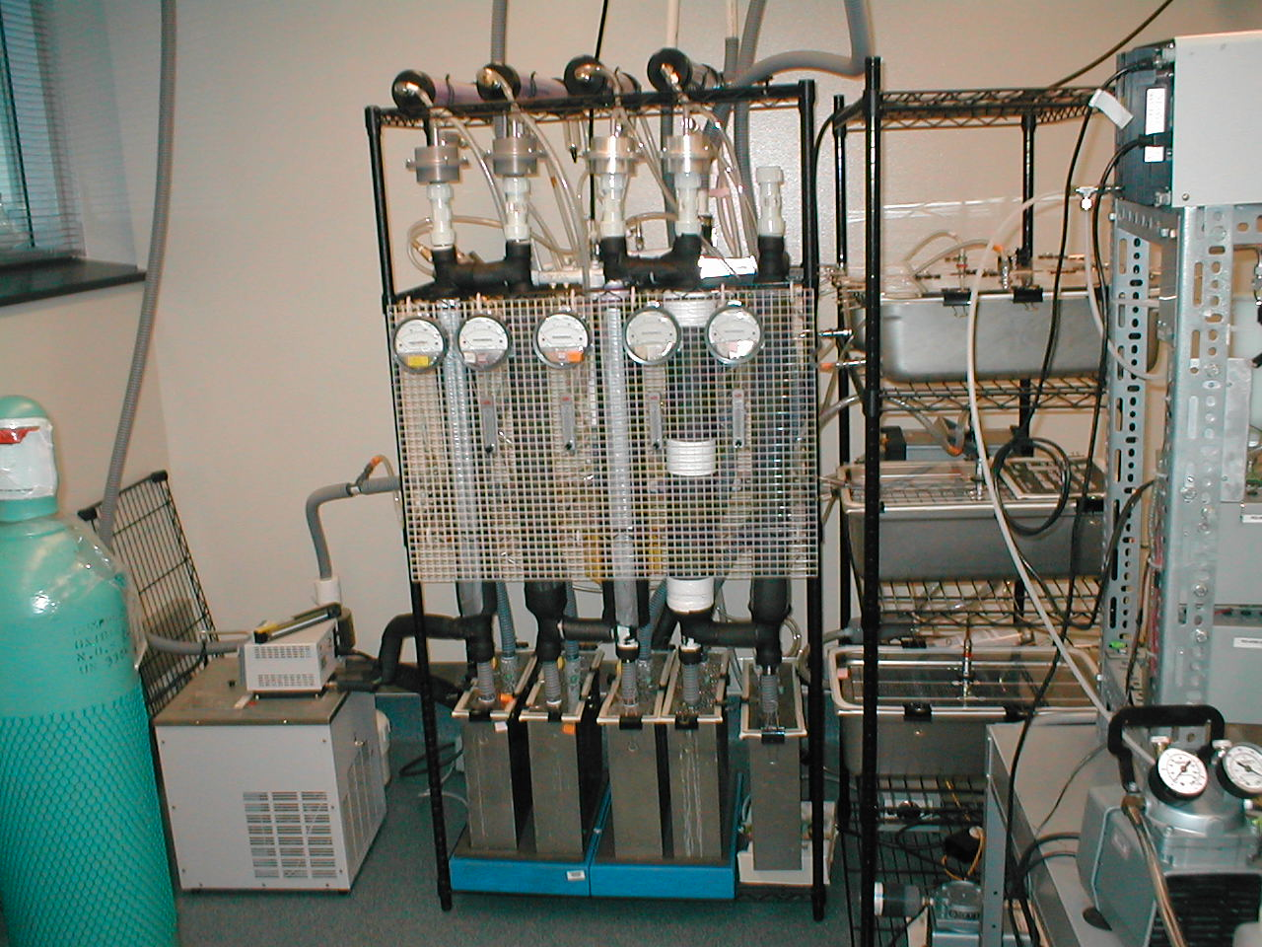
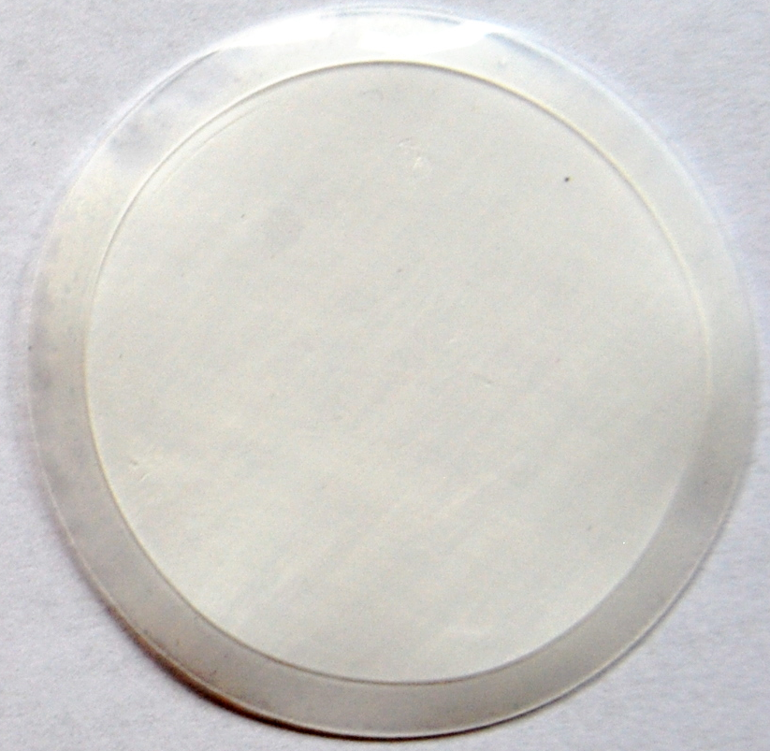
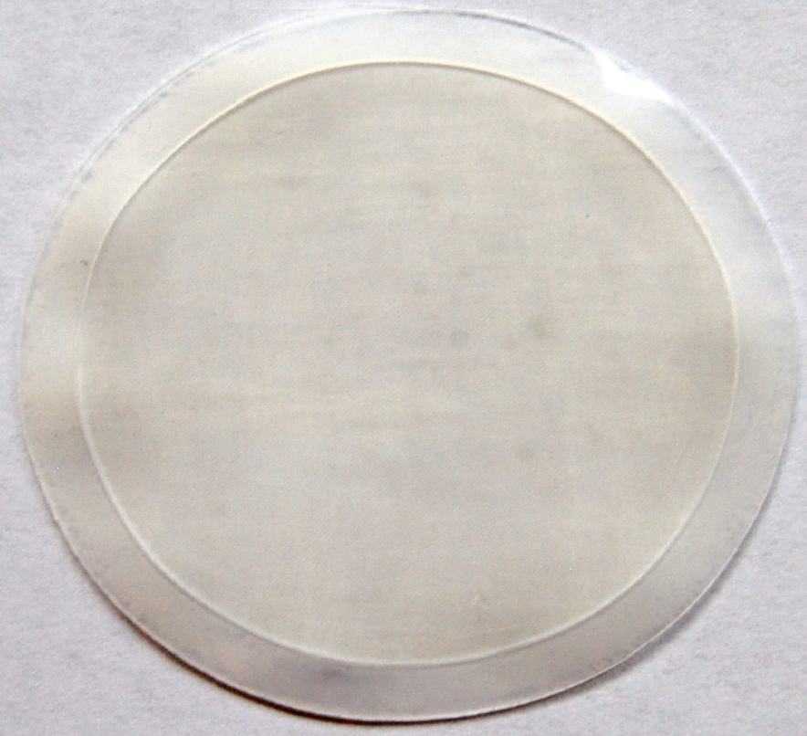
In 2008, with EPA support, we built the Inhalation Facility Suite, MDR 7th floor
where exposures are conducted.
Ambient PM_{2.5} + Versatile Aerosol Concentration Enrichment System (VACES) =
Concentrated Ambient Particles (CAP)
VACES Inlet
N
Downtown Louisville
VACES
VACES Pump Housing
Ambient PM_{2.5}: ≈6 µg/m³
CAP: ≈38 µg/m³ (6-10x)
HEPA (control)
PM_{2.5} (CAPs)

Slide 13
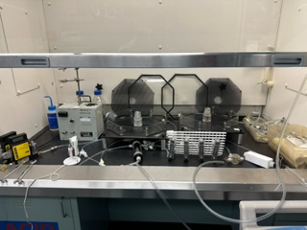
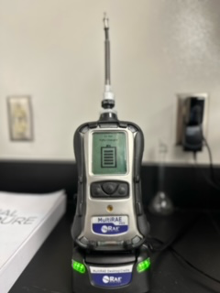
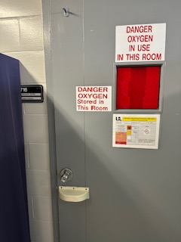
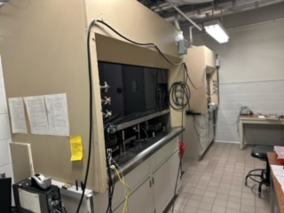
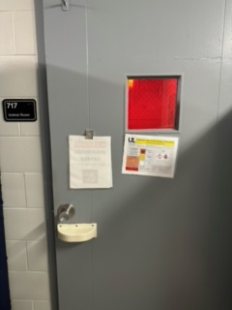
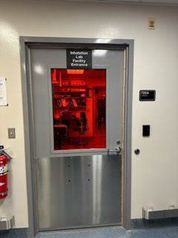
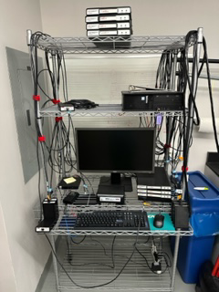
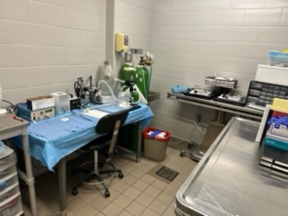
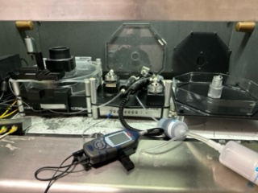
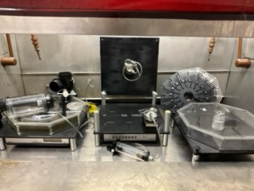
TRSC Basic Science Research Services
Animal Exposure to Inhaled Pollutants and Behavioral/Metabolic Phenotyping (Conklin)
The Inhalation Facility Suite (MDR: 722, 717, 716)
Card only access to 4-room suite (changing, animal, procedure, exposure rooms)
Surgery and telemetry room
Tobacco product exposure room

Slide 14
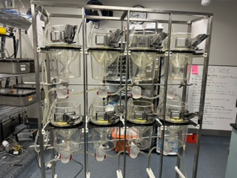
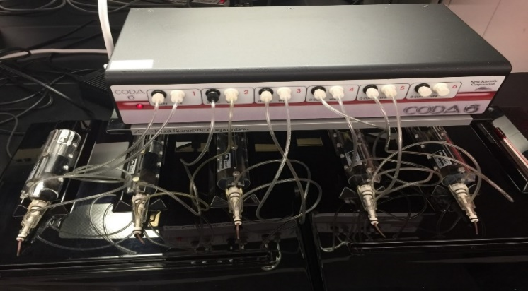
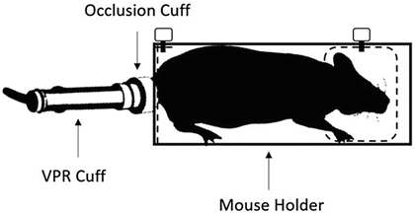
TRSC Basic Science Research Services
Animal Exposure to Inhaled Pollutants and Behavioral/Metabolic Phenotyping (Conklin)
Biomonitoring: telemetry, non-invasive blood pressure, urine collection
Add’t systems (Bax II: CCS):
Sable Promethion
DEXAscan
Vevo Ultrasound

Slide 15
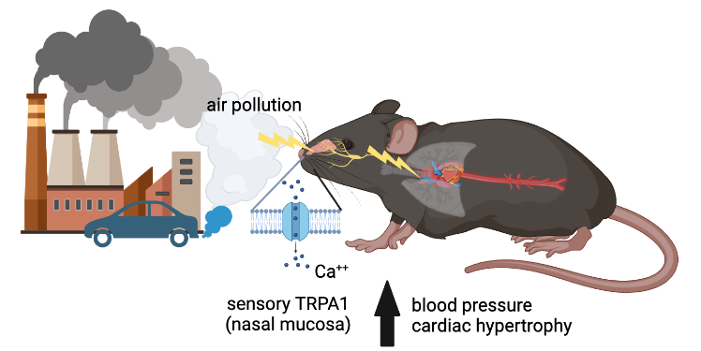
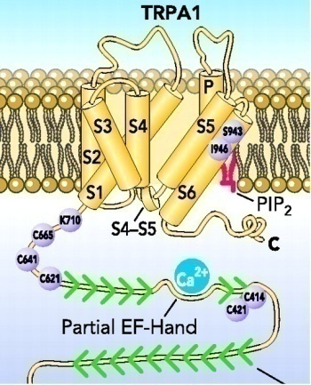

Hypertensive Animal Model of Increased
Cardiovascular Disease Risk: Susceptibility to Air Pollution?
ANGII-induced Hypertension
Transient Receptor Potential Ankyrin-1
CIEHS-funded Pilot Award
Notes:
The WHO estimates air pollution causes 7 million premature deaths or about 1 in 8 global deaths. Epidemiological studies indicate that 60-70% of the premature mortality attributed to exposure to air pollution are cardiovascular deaths (CVD) especially in those with pre-existing conditions such as hypertension and heart failure. However, the underlying pathophysiological mechanisms by which air pollution exposure worsen cardiovascular dysfunction are unclear.

Slide 16
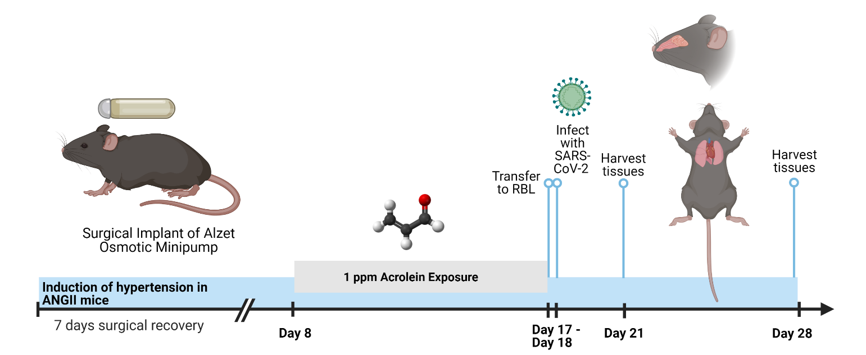
One Way to Test This Hypothesis and Model Complex Exposures
with Real World Stress is to Use Animal Models
Use Susceptible State (Hypertensive Model);
Perform Complex Exposure (CAP; E-cig; etc…); and,
3. Challenge Resilience (Controlled Stress: SARS-CoV-2 infection; @RBL)
CIEHS-funded Pilot Award (K. Palmer, Dir. RBL)

Slide 17
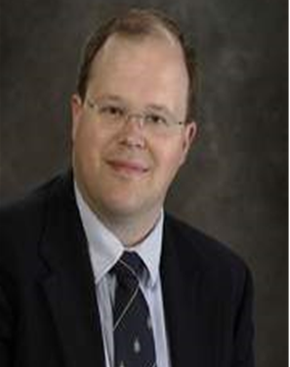

TRSC Basic Science Research Services
Animal Exposure to Infectious Agents Associated with Climate Change (Palmer)
Improve human health through basic and translational research leading to the development of effective vaccines, antivirals, therapeutics, and diagnostic biomarkers, for emerging, neglected or rare infectious diseases.
Shared-use facility designed to support research activities with RG2/RG3 agents
  UofL/CPM Faculty research programs
  Direct acquisition of federal contracts
  “Fee-for-service” projects for outside academic and private-sector clientele
10 – 12 regular onsite personnel
  Facility operations
  Vivarium operations
  Biosafety
  CPM Shared Resources Unit

Slide 18
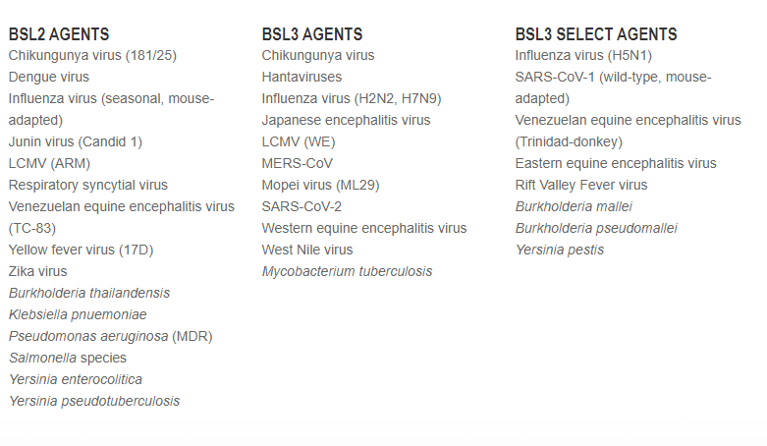
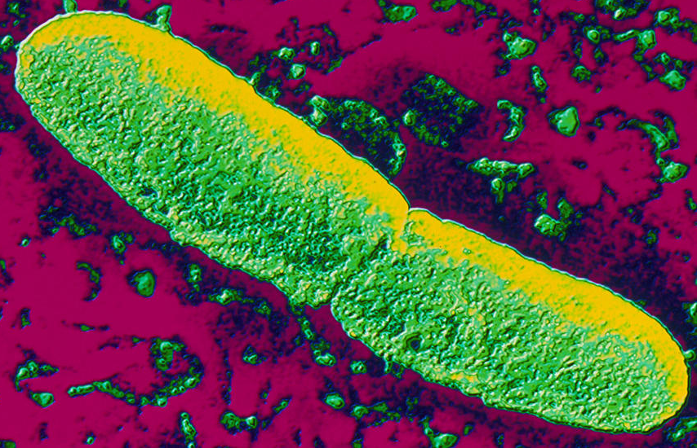
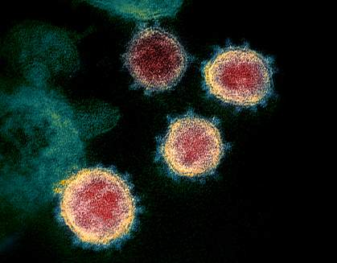
Emerging infectious diseases: available agents

Slide 19
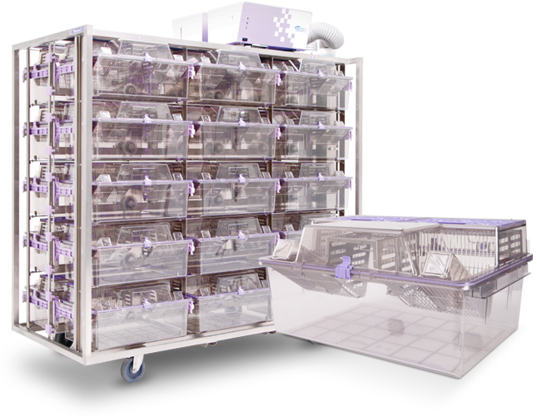
Research Animal Models
Mouse
Hamster
  Golden Syrian
  Roborovski Dwarf
Ferret
Guinea Pig
Cotton Rat
Rat
Rabbit

Slide 20
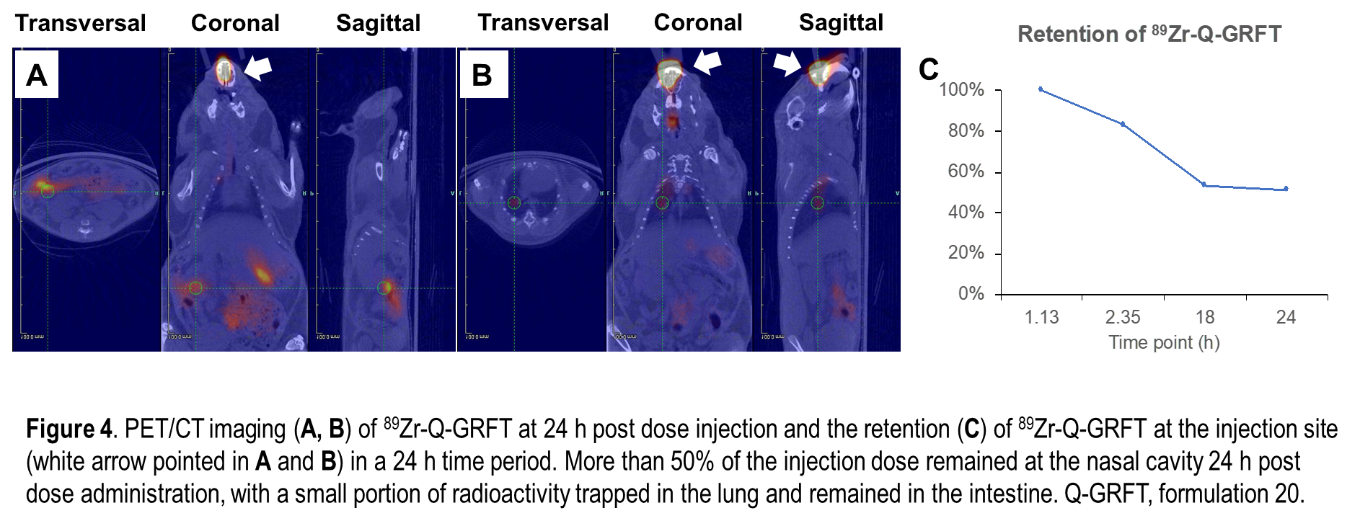
Equipment and capabilities…
Live, whole-body imaging
  IVIS Lumina S5 (fluorescent/luminescent)
  MOLECUBES
    X-CUBE (CT)
    β-CUBE (PET)
Sensory Perception
  SR-LAB Startle Response System
In vitro research instrumentation
  BD FACSAria II (cell sorting)
  BD FACSymphony A3 (phenotypic analysis)
  Luminex FLEXMAP 3D (cytokine/chemokine analysis)
  Hemavet 950FS (CBC sampling)
  Standard scientific lab equipment

Slide 21
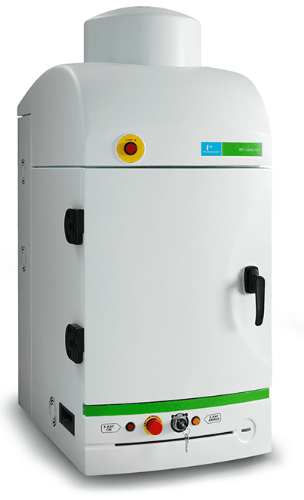
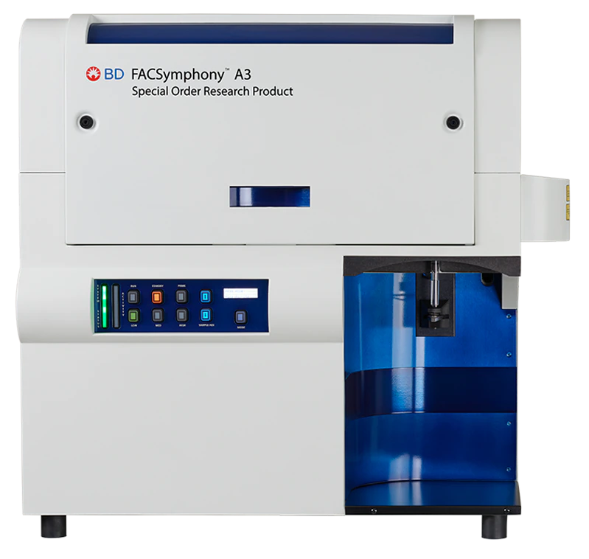
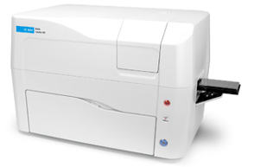
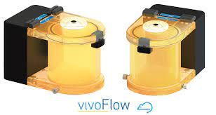
New Cutting-Edge Equipment …
Recently acquired analytical equipment for use in A/BSL3:
  Telemetry system
  Metabolic containment caging
  Whole-body plethysmography
  Aerosol delivery system
  Cytation C10 confocal imager
  BD FACSymphony A3 analyzer

Slide 22
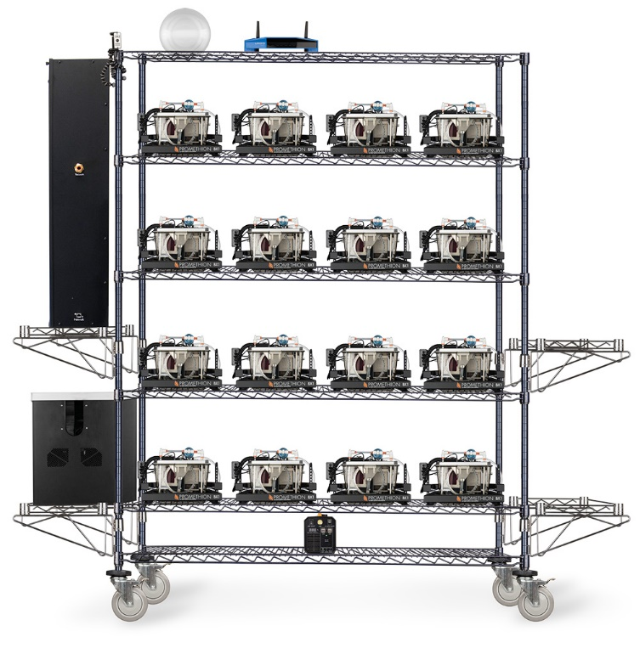

Sable Systems Promethion Core Metabolic system
  Mass and activity monitoring
  Gas analyzers for respiratory output
  Modified caging for use in biocontainment

Slide 23


SCIREQ vivoFlo™
  Whole body plethysmography
  4 chambers
    Hamster (golden Syrian) or mouse

Slide 24

SCIREQ inExpose™
  Nose-only aerosol delivery
  12 animals
  Conscious delivery
  Test Article delivery

Slide 25

Clinical and Translational Research
Development
LOUISVILLE CLINICAL AND TRANSLATIONAL RESEARCH CENTER
Jon Klein, MD, PhD, Director
Jiapeng Huang, MD, PhD, Deputy Director

Slide 26

LOUISVILLE CLINICAL AND TRANSLATIONAL RESEARCH CENTER
Louisville Clinical and Translational Research Center (LCTRC)
Vision: Build a high impact and durable Clinical and Translational research program at the University of Louisville (UofL) to improve the health of Kentucky communities.
Impact:
Build and grow an integrated clinical and translational research program, provides a primary single point of access to research resources
Develop and encourage community participation at all stages of clinical and translational research
Develop the personnel and physical infrastructure to grow exponentially clinical and translational research

Slide 27


LOUISVILLE CLINICAL AND TRANSLATIONAL RESEARCH CENTER
Partners:
Owensboro Regional Hospital & 3 other regional hospitals: multiple outpatient care sites; only 1 clinical research specialist
Lacks systemic support for C&T research and mechanisms for community- engaged research
Potential to lead and/or participate in C&T research activities at UofL and ULH
Lead efforts to understand community health/research needs through community-based participatory research
UofL Health (ULH), a fully integrated regional academic health system created in 2019
UofL Health and its expanding geographic footprint and patient volume has challenged the capacity of UofL C&T infrastructure
Notes:
In 2019, the university created ULH, a fully integrated regional academic
health system with more than 13,000 team members, 11 hospitals, four medical centers, nearly 200 physician
practice locations, and more than 1,000 providers; it includes the Frazier Rehab Institute, ULH Cancer
Center and the Lion Eye Institute. Among ULH-affiliated hospitals, UofL Hospital is a key component and is home
to the region’s only Level 1 Trauma Center and Bone Marrow Transplant Program. A new tower is under
construction that will add additional beds, operating rooms, and new ICU space in late 2024. ULH Jewish Hospital
and the adjacent ULH Heart Hospital is a 442-bed regional referral center and is an internationally renowned
specialty center, developing leading-edge advancements in heart and lung care, hand and microsurgery,
rehabilitation medicine, neuroscience, kidney and live care, and organ transplantation. It is a leader in
transplantation, performing all five solid organ transplants (heart, liver, lung, kidney, and pancreas), as well as
hand transplantation. A number of UofL clinical programs, including transplantation, cardiovascular surgery,
gastroenterology motility, and neurorehabilitation are based
Norton Healthcare (NHC): NHC is a not-for-profit healthcare system based in Louisville that is the state’s largest
healthcare system. NHC has seven adult hospitals, a children’s hospital, and multiple outpatient facilities. UofL
and NHC together created the Norton Children’s Research Institute which is the research home for UofL Pediatric
faculty. NHC is an important clinical partner of UofL and has great potential to expand C&T research in the
Louisville area. NHC has committed $250,000 annually to support LCTRC pilot and developmental projects
focused on pediatrics and neuroscience. (Letter from Dr. Stephen Wyatt, Chief Research Executive, NHC).
Veterans Affairs Medical Center (VAMC): The Louisville VAMC is an acute care hospital housing the inpatient
population and multiple primary and subspecialty outpatient facilities. Affiliated primary care clinics are located
throughout Central Kentucky and Southeastern Indiana. All VA facilities are linked by a single nationwide
electronic health record, allowing care at any VA facility. The ULSOM CTU provides C&T infrastructure for
research at the VAMC. A new Louisville VAMC will be completed in 2024 and will contain 15,000 square feet of
space for clinical research projects.

Slide 28
LOUISVILLE CLINICAL AND TRANSLATIONAL RESEARCH CENTER
Transformation and Innovation
Through a single point of access: expand C&T research capacities at UofL, affiliated healthcare systems, and our community partners for C&T education, funding, community engagement, professional development, and mentoring
Provide a hub for LCTRC Cores and UofL COBRE/INBRE Cores
Create a Center for Clinical Research Innovation (CCRI) to assess and develop training in the use of novel clinical trial technologies
Generate commitment of faculty in conducting C&T research on health challenges that impact the regional patient population served by the LCTRC
Develop and strengthen collaborations across participating LCTRC organizations and with community partners
Expand outreach to regional Clinical and Translational Network (CTR-N) and Clinical Translational Science Awards (CTSA) programs

Slide 29

LOUISVILLE CLINICAL AND TRANSLATIONAL RESEARCH CENTER
LCTRC Organizational Chart

Slide 30
LOUISVILLE CLINICAL AND TRANSLATIONAL RESEARCH CENTER
Health Resources Core
Identify and select new Pilot Projects for investigators to test ideas with the potential to develop independent applications: NIH career development (K-series) or developmental research project awards (R21).
Identify and select new Developmental Projects for 2 years of support for independent investigators with the requisite background and scientific expertise
Pair project leads of HR Core projects that involve clinical trials with experienced clinician scientists who serve as mentors and make core resources available
Monitor HR Core projects to ensure study participant safety and that all federal, state, local, and organizational regulatory requirements are met. We will also track projects for abstract, paper, grant application, and external funding productivity.

Slide 31
LOUISVILLE CLINICAL AND TRANSLATIONAL RESEARCH CENTER
Professional Development Core
UofL Presidential Scholars: Develop well-trained and supported early-stage clinician-investigators capable of securing grant funding to sustain UofL’s commitment to research and translation to clinical practice.
Build Interdisciplinary Teams and Networks of investigators to promote innovation in C&T Research.
MD/PhD students, Dean’s Scholar Program: Nurture our pipeline of clinician scientists by developing C&T research skills and competencies
Enhance Infrastructure: train clinical research coordinators and research nurses in best practices, policies, and mentoring to support UofL’s clinical research enterprise
Notes:
Creation of Presidential Scholars: Each year, the Deans of Clinical Schools will award two
Presidential Clinical and Translational Research Scholars with 50% protected time for research. Fig. 3 describes
the career development progression of Presidential Scholars. At the end of the first year in the program, selected
scholars will submit a proposal for one of the HR Core Pilot Projects. Scholars awarded a pilot project will receive
an additional year of protected time and are encouraged to submit a proposal for a clinical research career
development award, which could extend their research-protected time for three to five more years

Slide 32

Change the Culture and Work on the Pipeline
Presidential Scholars
Dean’s Scholars
Complete the Certificate in Clinical Investigational Sciences between med school years three and four
Write and defend a research thesis to fulfill the requirements for an interdisciplinary Master of Science degree
Required to attend the PD Core C&T research competency seminar and workshop series
Trainees must develop an individual development plan (IDP) to plan a student’s
professional development and to facilitate communication between mentees and mentors

Slide 33


LOUISVILLE CLINICAL AND TRANSLATIONAL RESEARCH CENTER
Research Design, Compliance, and Data Management Core

Slide 34
LOUISVILLE CLINICAL AND TRANSLATIONAL RESEARCH CENTER
Community Engagement and Outreach Core
Goal: improve the overall health and well-being of Kentuckians by raising awareness of community health research needs and improving access to relevant research studies and data, while addressing the needs of at-risk subgroups, including health education, health literacy, and trust.
Specific Aims:
Promote understanding of community health/research needs and disseminate knowledge, health research education, and share C&T research and resources with target communities
Develop and support community-led and clinical investigator-initiated community-based participatory research

Slide 35
Summary
Introduction to CIEHS and the TRSC (Cave)
Overview of TRSC’s Basic Science Research Services (Cave)
Animal Phenotyping and Histology (Cave)
Animal Inhalation Exposure Facilities (Conklin)
Animal Pathogen Exposure Facilities (Palmer)
Update on CTR-D (Huang)

Slide 36
Thank you
Questions
Contact info: ihsfc@louisville.edu

