Slide 1
Clinical & Translational Research Resources at UofL & UofL Health
Jiapeng Huang MD, PhD, FASA, FASE Associate Director, Translational Research Support Core (TRSC)
Center for Integrated Environmental Health Sciences (CIEHS)
Tenured Professor & Vice Chairman
Medical Director of Operating Rooms
Department of Anesthesiology & Perioperative Medicine
University of Louisville, Louisville, KY

Slide 2
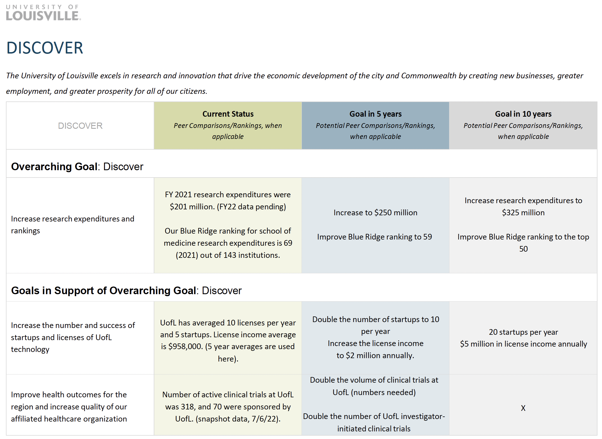
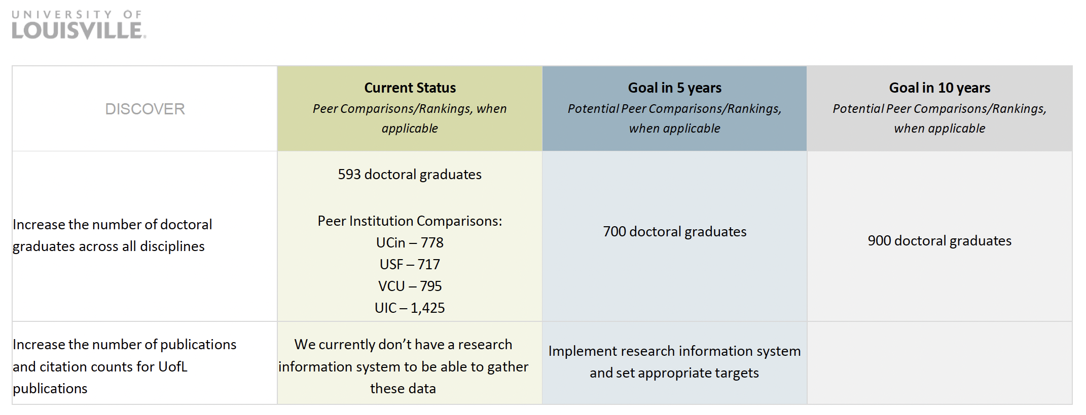
UofL 2023-2025 Strategic Plan-Research

Slide 3
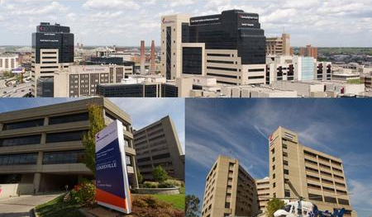
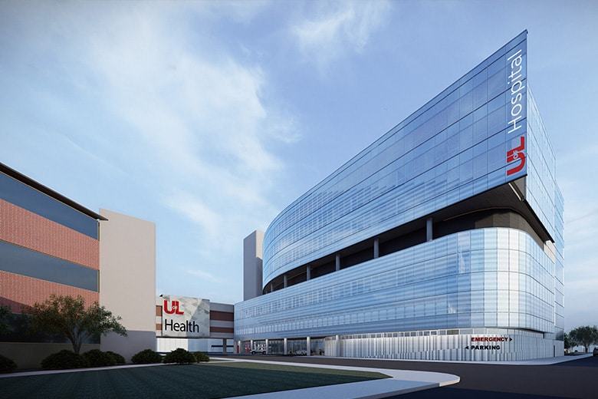
UofL Health
UofL Health: In 2019 the university created UofL Health (ULH), a fully integrated regional academic health system with more than 13,000 team members, 8 hospitals, four medical centers, nearly 200 physician practice locations, Rehab Center, Cancer Center, Eye Institute, and more than 1,000 providers. Among ULH affiliated hospitals, UofL Hospital is a key component and is home to the region’s only Level 1 Trauma Center and Bone Marrow Transplant Program. A new $144M tower is under construction that will add additional beds, operating rooms, and new ICU space in late 2024. ULH Jewish Hospital and the adjacent ULH Heart Hospital is a 442-bed regional referral center and is an internationally renowned specialty center, developing leading-edge advancements in heart and lung care, hand and microsurgery, rehabilitation medicine, neuroscience, kidney and liver care, and organ transplantation. It is a leader in transplantation, performing all five solid organ transplants (heart, liver, lung, kidney, and pancreas), as well as hand transplantation. A number of UofL clinical programs, including transplantation, cardiovascular surgery, gastroenterology motility, and neurorehabilitation are based at Jewish Hospital. Other facilities include: the Frazier Rehabilitation Institute, ULH Cancer Center and the Lion Eye Institute. ULSOM faculty are an integral part of the clinical mission of ULH at all its locations.

Slide 4

UofL School of Medicine
The UofL School of Medicine (ULSOM), located in downtown Louisville, offers master’s, doctoral and first professional degrees in 23 clinical and basic science departments and consists of approximately 914 full-time, 49 part-time faculty members and 1,154 volunteer faculty.
The Health Sciences Center now teaches and mentors about 1,744 graduate and professional students including 97 residency programs and 750 residents.

Slide 5
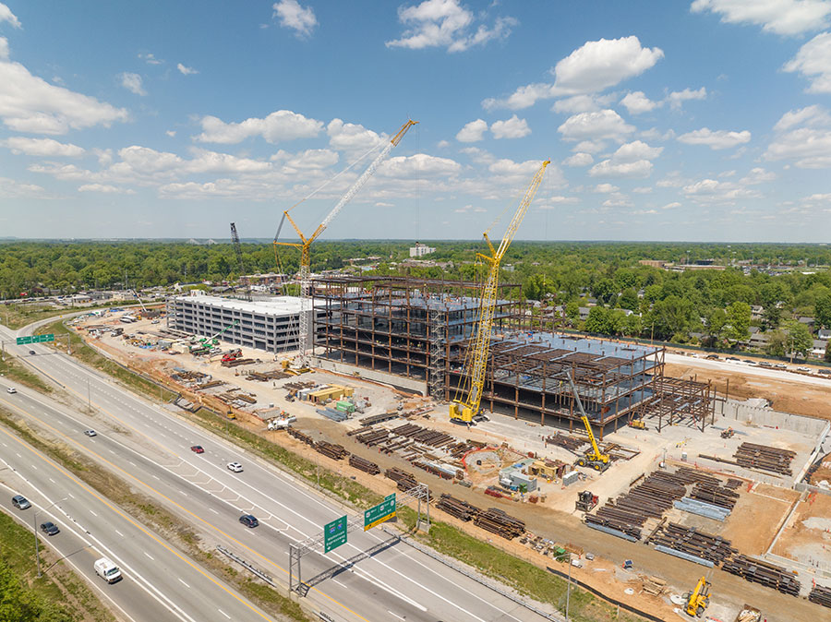
The new $1B Louisville VAMC currently under construction will have 15,000ft² clinical research space. The Louisville VAMC is an acute care hospital housing the inpatient population and multiple primary and subspecialty outpatient facilities. Affiliated primary care clinics are located throughout Central Kentucky and Southeastern Indiana. All VA facilities are linked by a single nation-wide electronic health record allowing care at any VA facility. The ULSOM CTU provides C&T infrastructure for research at the VAMC. A new Louisville VAMC will be completed in 2024 and will contain 15,000 square feet of space for clinical research projects.
Louisville Veterans Affairs Medical Center

Slide 6

UofL’s New Vision of Health Campus
Innovative downtown urban campus (133,000 ft² with outdoor green space) that is currently under construction. It is made possible by a recent $30M philanthropic gift to UofL’s Christina Lee Brown Envirome Institute affiliated with CIEHS. The New Vision of Health Campus will include specially designed laboratories and that will engage researchers and community members to learn how natural, cultural and personal environments impact health. Institute researchers work with community partners to discover how to build healthier cities, creating insights and models to improve health in Louisville and around the world. It is expected to house exposure and metabolic facilities for human subjects and other resources.

Slide 7
Louisville Clinical and Translational Research Center (LCTRC)
The Louisville Clinical and Translational Research Center (LCTRC) is currently being developed through UofL’s pending NIH IDeA-CTR application. The LCTRC was established by UofL, partnering with UofL Health, Norton Healthcare, Owensboro Health, Veterans Affairs Medical Center, and Family Qualified Health Centers to address key needs in clinical and translational research in Kentucky. LCTRC will be a single point of access for the community and clinical/translational investigators that will increase research infrastructure capacity, enhance community engagement, and improve research workforce training.
LCTRC has incorporated a scaffold of governance, communication, and community to ensure LCTRC can adapt over time as the LCTRC grows and community needs change.
In the future, CIEHS TRSC will interact closely and seamlessly with LCTRC Professional Development Core, Community Engagement and Outreach Core, Health Research Core, and Research Design, Compliance, and Data Management Core to navigate CIEHS members and investigators for each facet of clinical translational research including education, professional development, funding, research design, and community engagement in conducting environmental translational research.

Slide 8
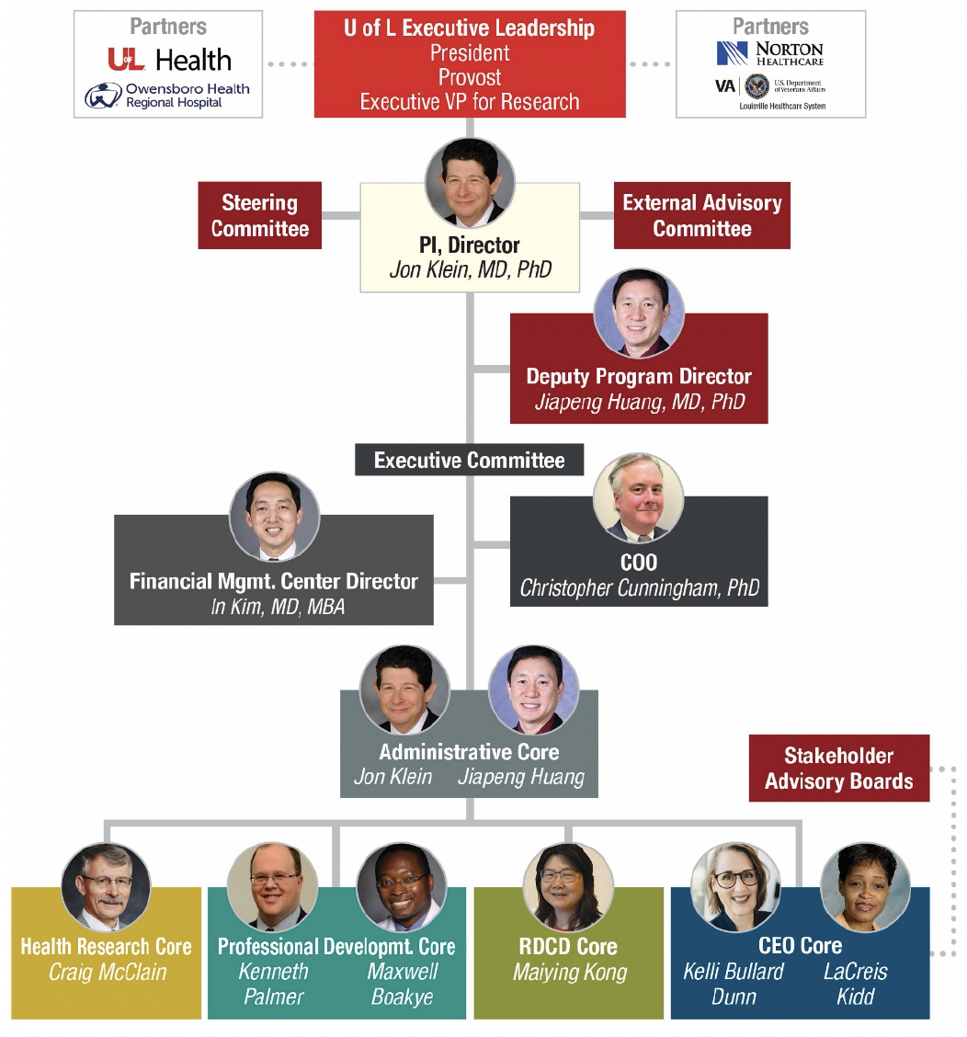
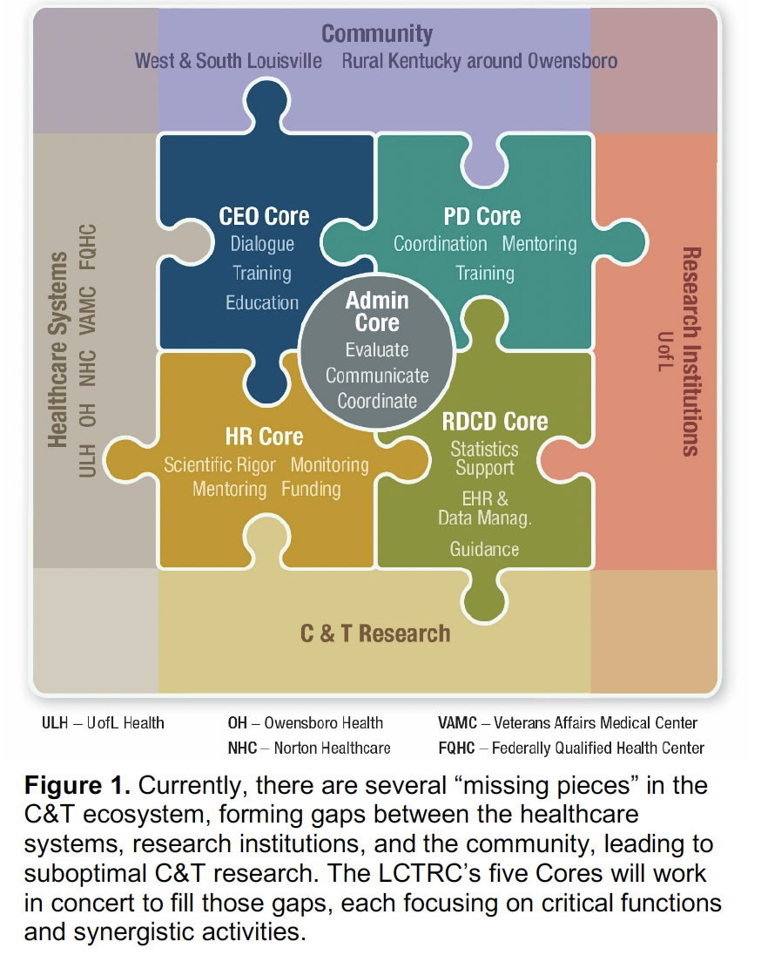
Louisville Clinical and Translational Research Center (LCTRC)

Slide 9
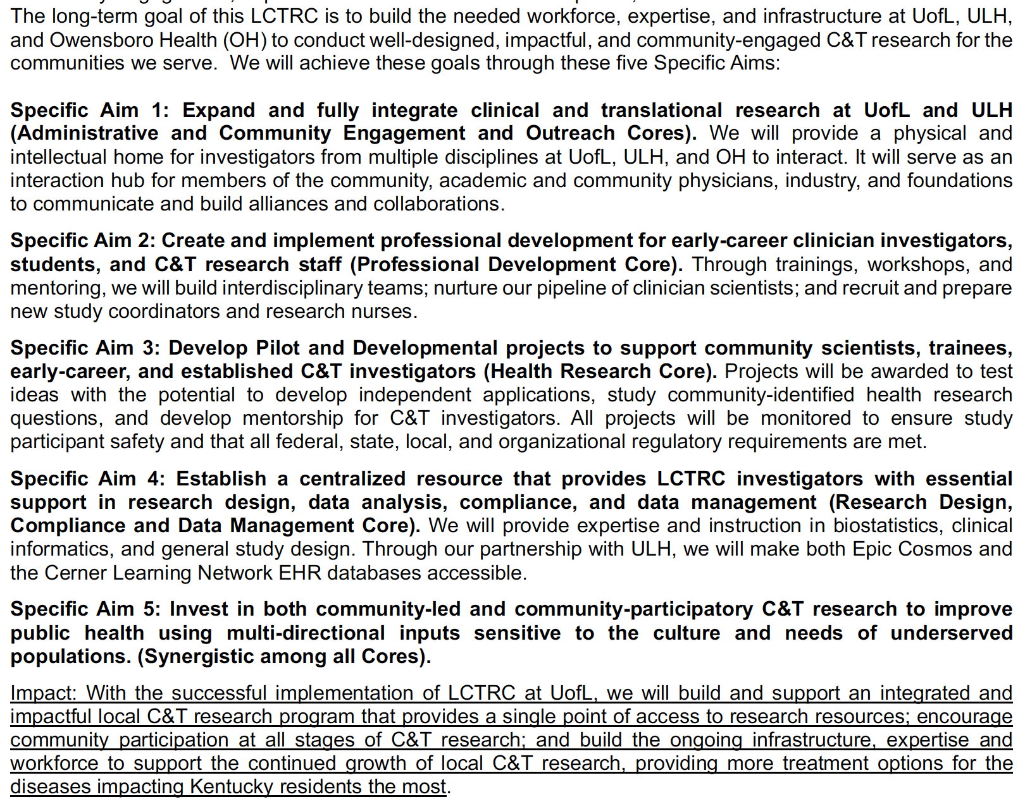
Louisville Clinical and Translational Research Center (LCTRC)

Slide 10
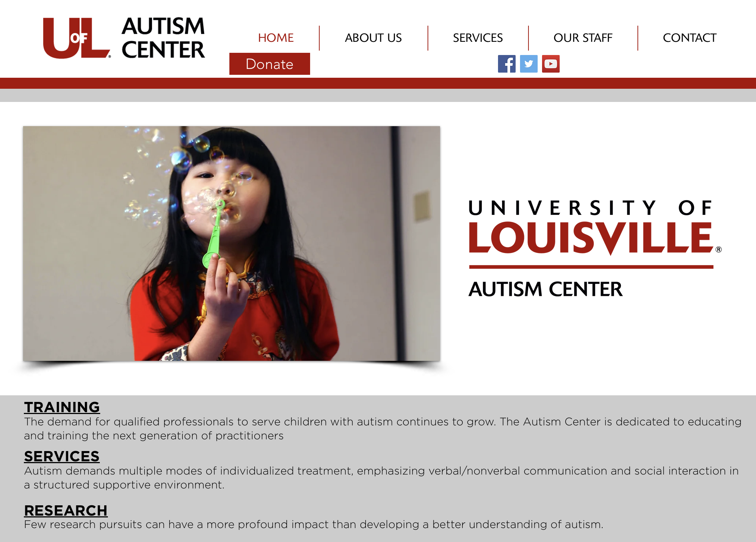
• University of Louisville Autism Center (ULAC), supporting autism research. ULAC is directed by Greg Barnes, M.D. Importantly Dr. Barnes is a CIEHS member and Leader of the Environmental Justice & Health Disparities and Climate Change & Health Research Interest Group;

Slide 11
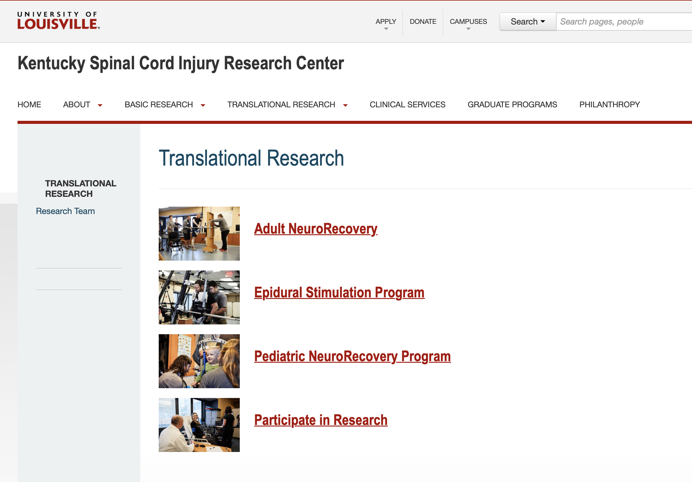
The Kentucky Spinal Cord Injury Research Center (KSCIRC), supporting paralysis clinical research; The mission of the KRSIRC is to develop successful spinal cord repair strategies in the laboratory that can be taken to the clinic in a timely and responsible fashion.
The Center's growth has been made possible by funding and excellent cooperation between the State of Kentucky, University of Louisville, Norton Healthcare, and a recent $5.5 million grant from NIH.
KSCIRC is in a unique position to conduct research that, through close association with clinical colleagues in the Department of Neurological Surgery, will ultimately lead to effective treatments for spinal cord injury.
This goal will be facilitated by planning to double the size and scientific impact of the Center over the next five years.

Slide 12
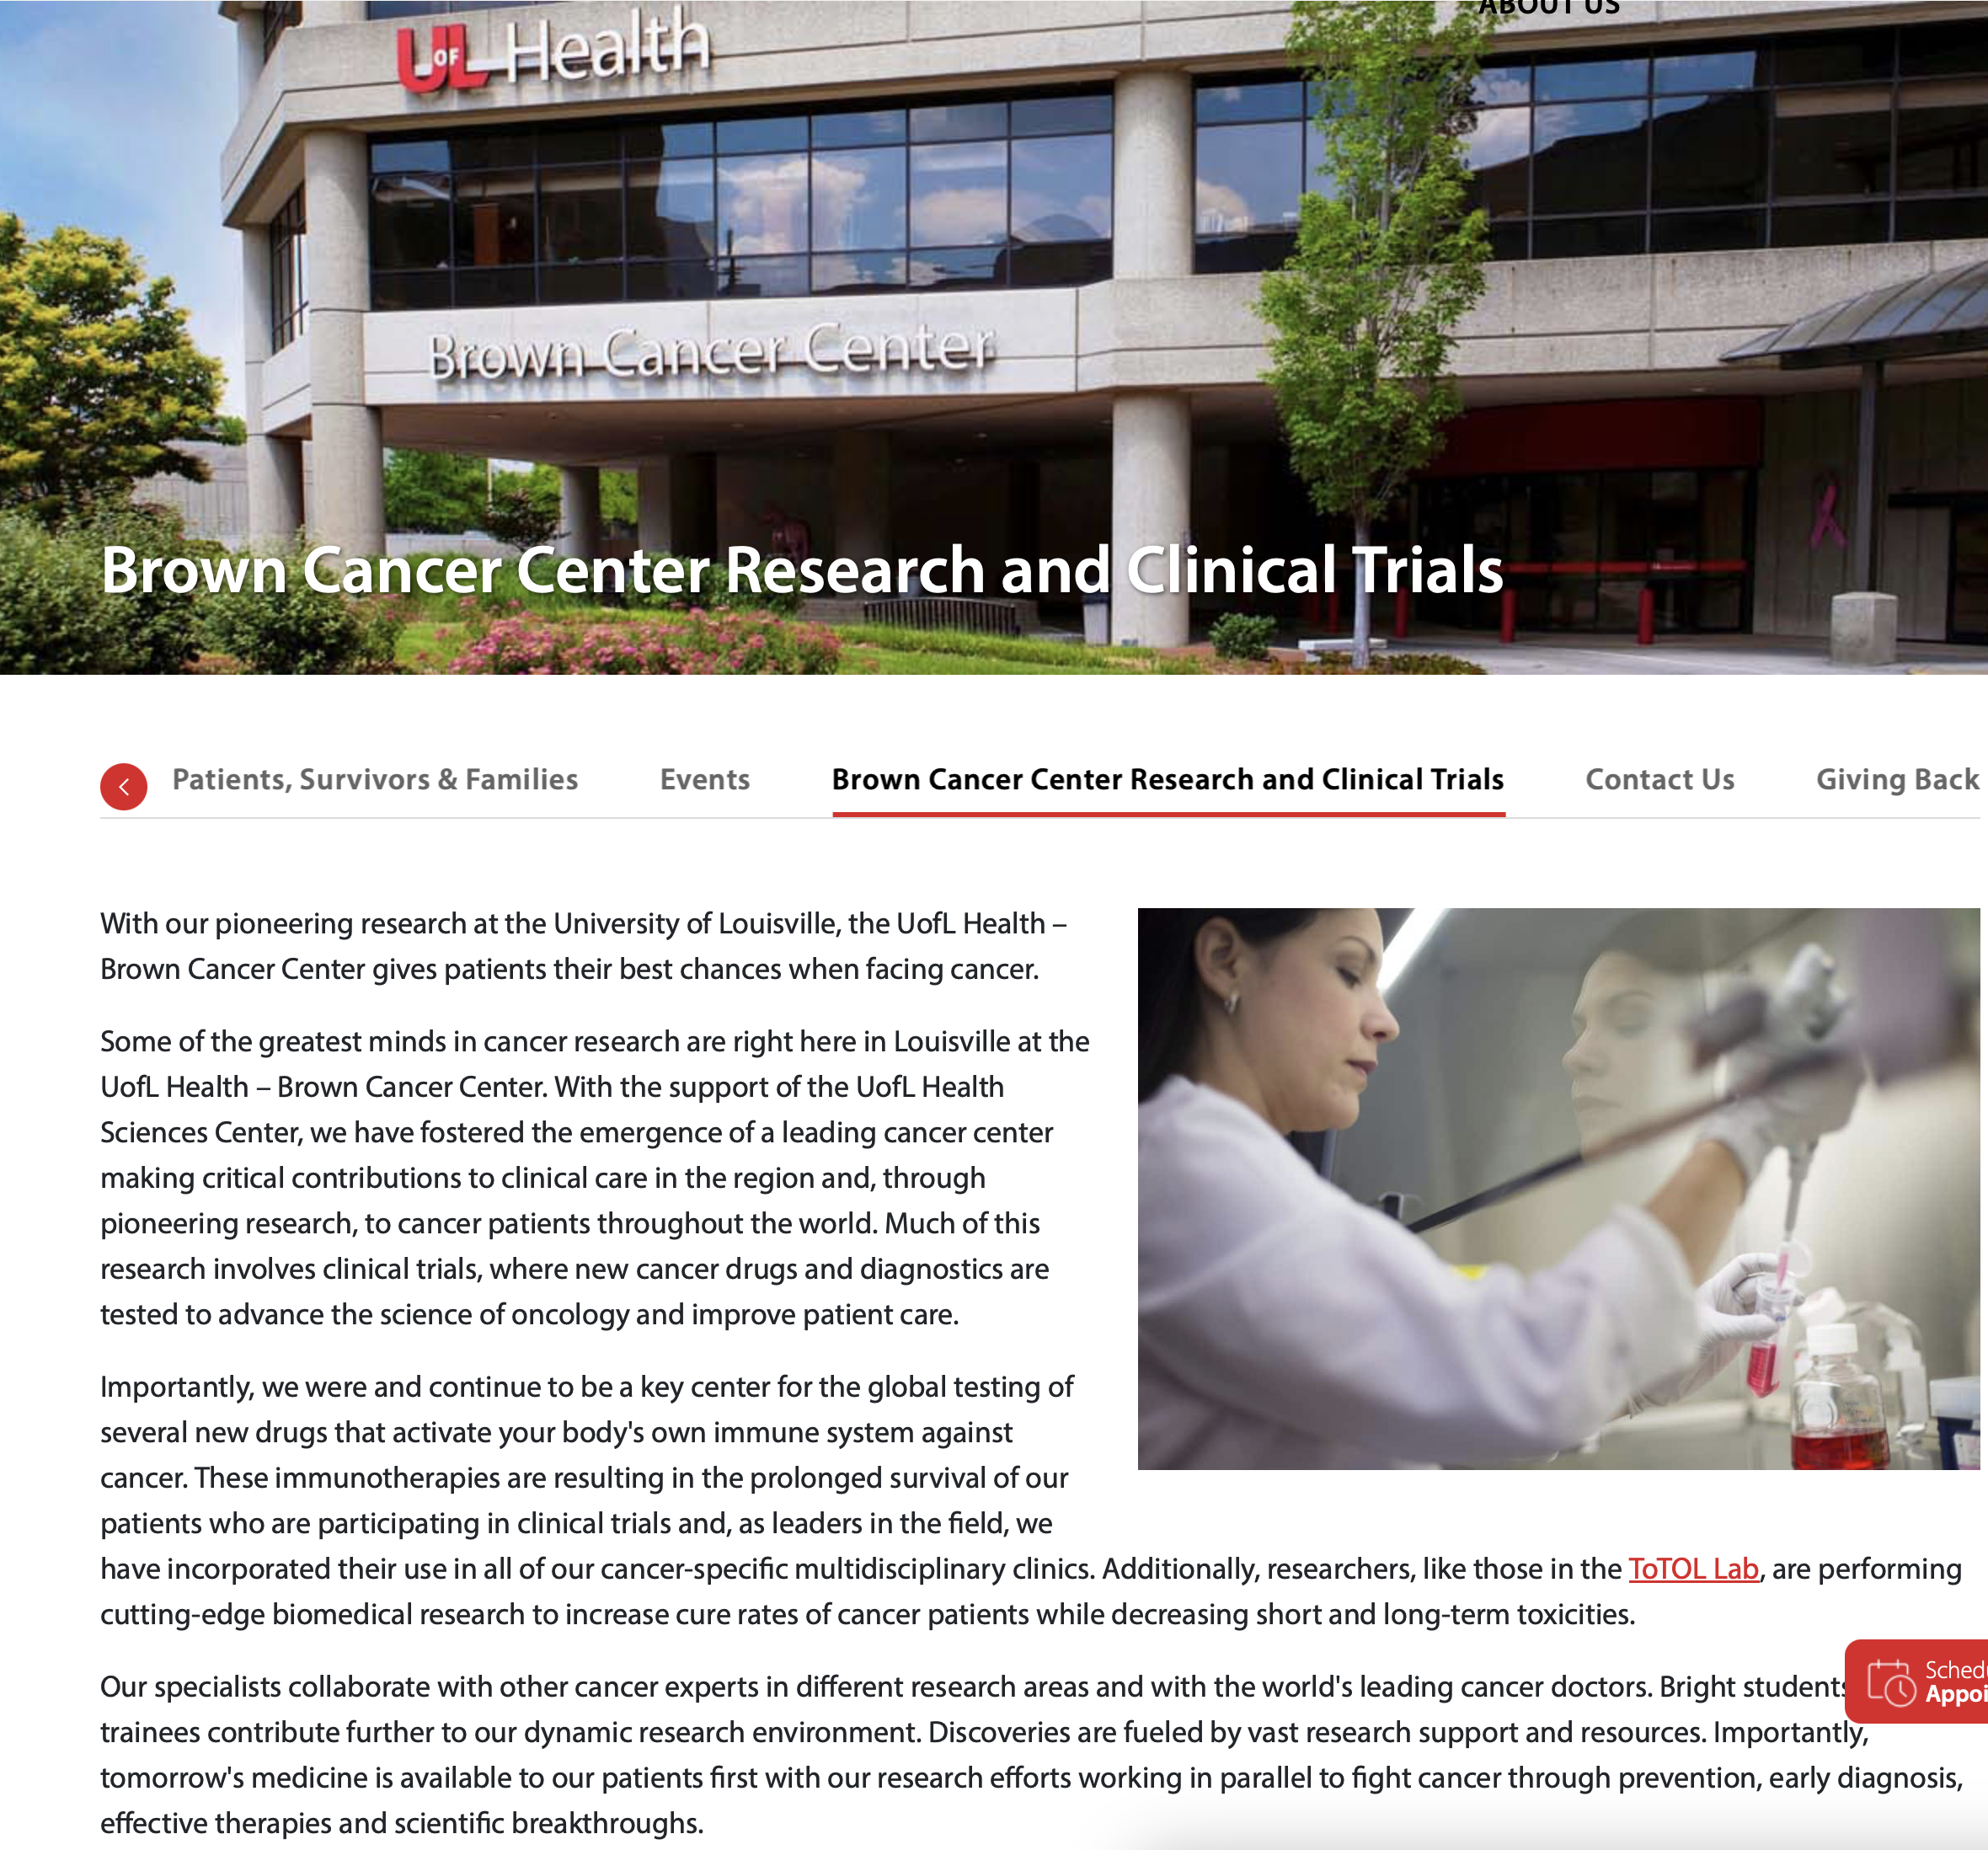
The J. Graham Brown Cancer Center Clinical Research Program
The J. Graham Brown Cancer Center Clinical Research Program, supporting adult cancer clinical trials; The mission of the James Graham Brown Cancer Center is to generate new knowledge relating to the nature of cancer, and to create new and more effective approaches to prevention, diagnosis and therapy, while delivering medical advances with compassion and respect to cancer patients throughout our region.
Facilities include Biophysics, Medicinal Chemistry, Molecular Modeling, NMR (nuclear magnetic resonance) and Protein Expression and Purification.

Slide 13

UofL Institutional Review Board (IRB)
Preparing and submitting research to the UofL IRB
Resources available through the Human Subjects Protection Program
Notes:
Hi and thank you for joining me today! The HSPPO provides administrative support to the UofL IRB. Today we are going to walk through what an IRB is, why it’s important, and how to submit a study for review. Let’s get started!

Slide 14
What is an Institutional Review Board (IRB)?
Federally mandated committee composed of scientists, non-scientists, and community members
Conducting an ethical review of research projects
Protecting the rights and welfare of the human participants
UofL IRBs
Biomedical
Social, Behavioral, Educational
Research Conducted by:
UofL Faculty, Staff, Fellows, Residents, Students

Slide 15
Why are IRBs needed?
Ensure the safety and well-being of human participants.
Ensure adherence to the ethical values and principles underlying research.
Ensure ethical and scientifically valid research is conducted.

Slide 16
What Requires IRB Review?
Research that involves human subjects requires prior IRB review and approval.
Definitions:
--Research - a systematic investigation designed to develop or contribute to generalizable knowledge.
--Human Subject (aka Participant)- a living individual about whom an investigator conducting research
Obtains information or biospecimens through intervention or interaction with the individual, and uses, studies, or analyzes the information or biospecimens;
Obtains, uses, studies, analyzes, or generates identifiable private information or identifiable biospecimens.
When unsure, contact the IRB/Human Subjects Protection Office

Slide 17



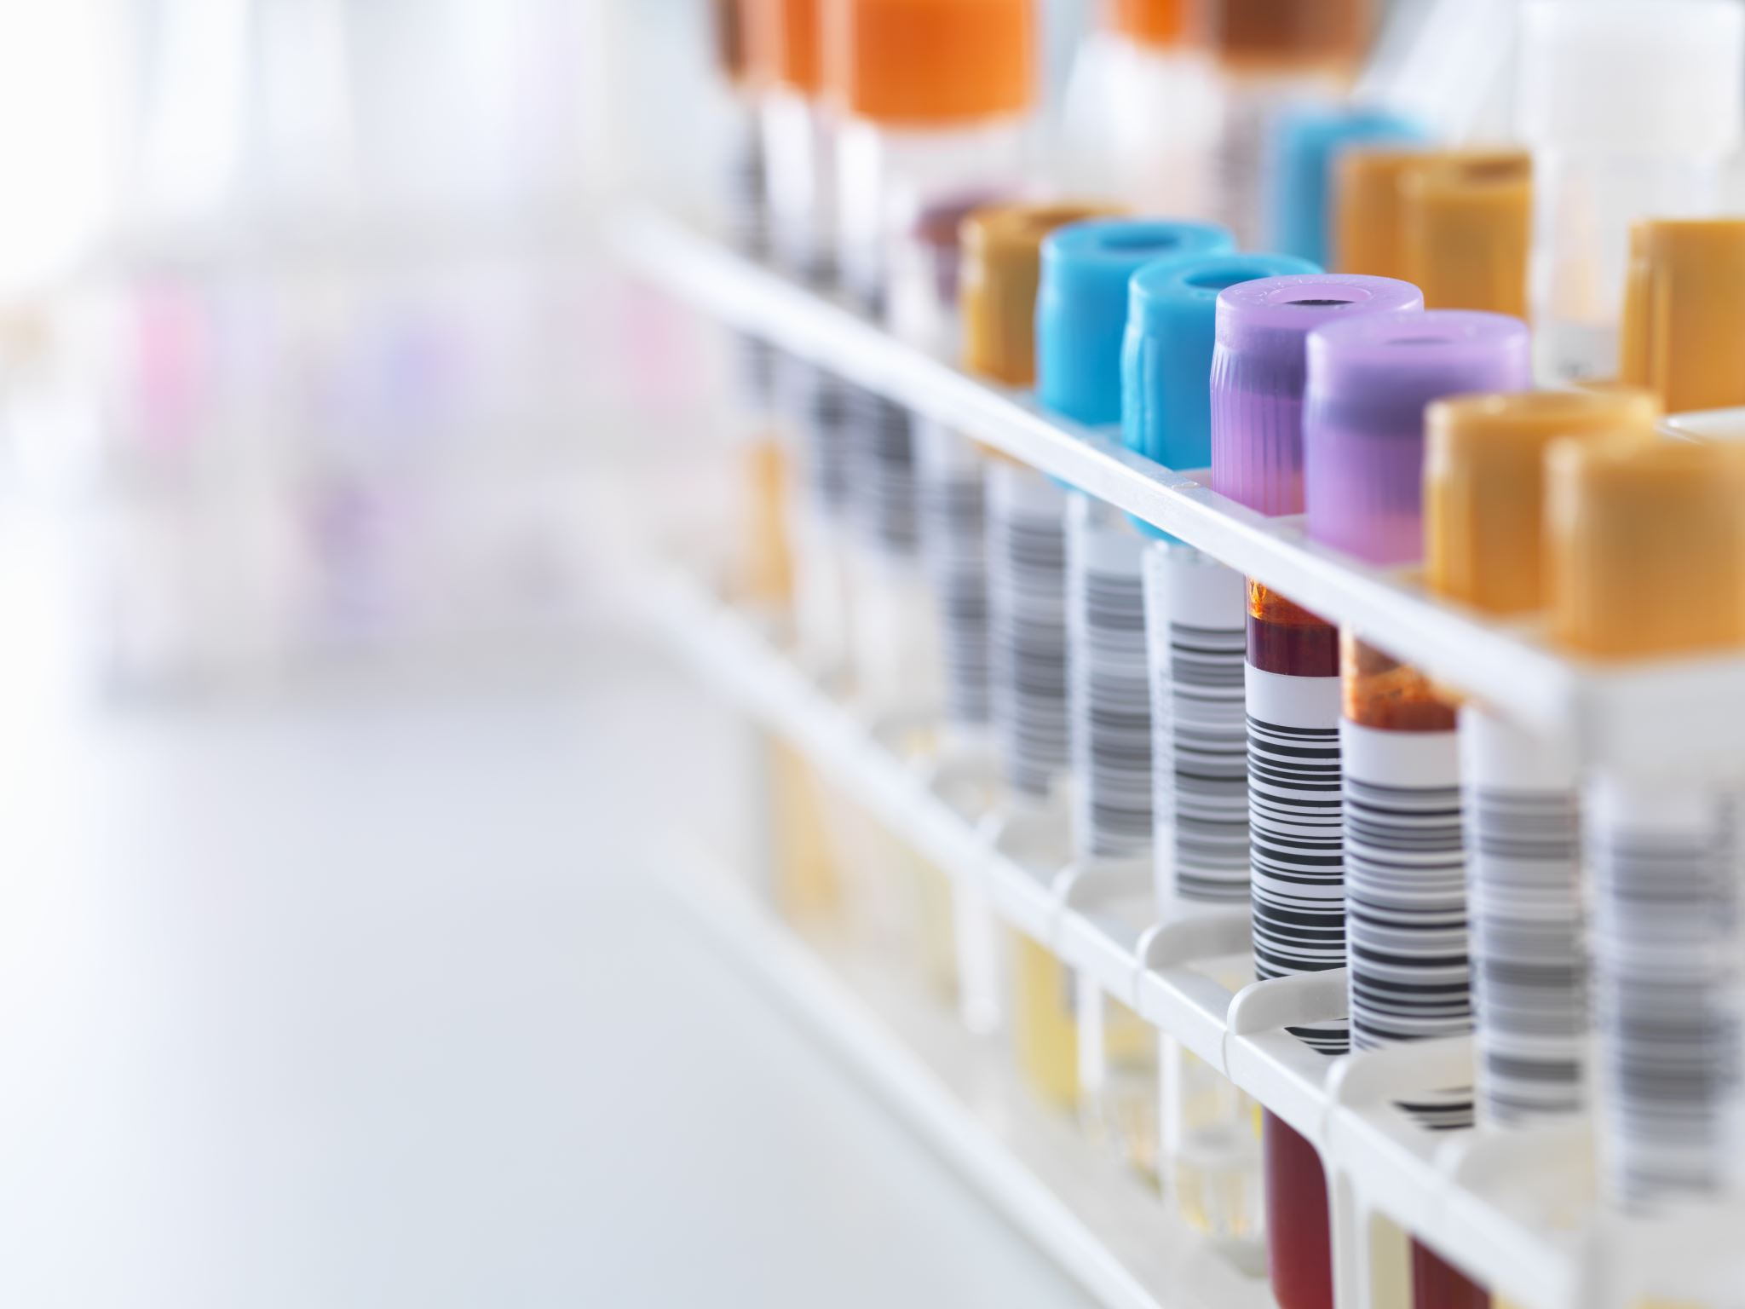
Minimal Risk Research
The level of IRB review is related to the risks of the study.
The IRB can review research that is considered “minimal risk” through an “expedited review” procedure – which doesn’t mean faster – but means it can go to an IRB chair for review versus the full committee for review.
Exempt Research Examples: some low risk surveys/interviews, some research with existing data, research on normal education practices, some benign behavioral interventions
Expedited Research Examples: collection of specimen by non-invasive means, collection of identifiable data, some surveys/interviews/focus groups, research involving low risk medical procedures.
Notes:
The level of IRB review a project receives is related to the risks of the study. The IRB can review research that is considered “minimal risk” through an “expedited review” procedure – which doesn’t mean faster – but means it can go to an IRB chair for review versus the full committee for review.
Minimal risk is defined as…. Summarize definition
If the IRB determines a project is minimal risk they can review it to see it if fits into one of the federally defined exempt categories – examples are
If the project does not fit into an exempt category the IRB will review to see if it fits into one of the federally defined expedited categories – examples are
If the project is greater than minimal risk or it doesn’t fit into an exempt or expedited category – then the research requires full committee review.

Slide 18
Full Board Research
Full IRB committee review required for studies that are:
Greater than minimal risk
Minimal risk, but do not fit in an expedited review category
Medical devices that require a “non significant risk” determination by the IRB
Examples:
-Investigational drugs/devices studies
-Behavioral studies involving risky interventions, observations of illegal behavior, or very sensitive data/questions.

Slide 19
Study Oversight
The Principal Investigator (PI) is responsible for the overall conduct of the study.
UofL Faculty and Staff can serve as PI.
Fellows, Residents and Students require a faculty/staff advisor serve as PI.
Notes:
The Principal Investigator is responsible for the overall conduct of the study.
UofL Faculty and Staff can serve as PI.
Fellows, Residents and Students require a faculty/staff advisor serve as PI.

Slide 20
What is required to be on research study team?
Human Subjects & HIPAA Research Training (CITI)
Annual Attestation & Disclosure Form on file in iRIS (ADF) (also referred to as Conflict of Interest (COI) form)
CV uploaded to iRIS profile
Instructions for completing the requirements and checking individuals training can be found at: https://louisville.edu/research/researchers/compliance/irb (under Study Personnel Requirements)
The IRB uses an electronic submission system, iRIS. Login with your UofL email/password. https://iris.louisville.edu/

Slide 21
Where are resources and document templates located?
1) Step by Step IRB submission process (with template links)
2) Researcher Resources:
IRB Document Templates (protocol, consent(s), HIPAA documents)
iRIS application routing instructions for signoff by scientific reviewer and department chair
Guidance documents/Study Management Tools
Regulation links
3) Guidance Documents
4) HSPPO Website Overview (next slide)
Notes:
When you are ready to submit to the IRB, start with the HSPPO website.

Slide 22
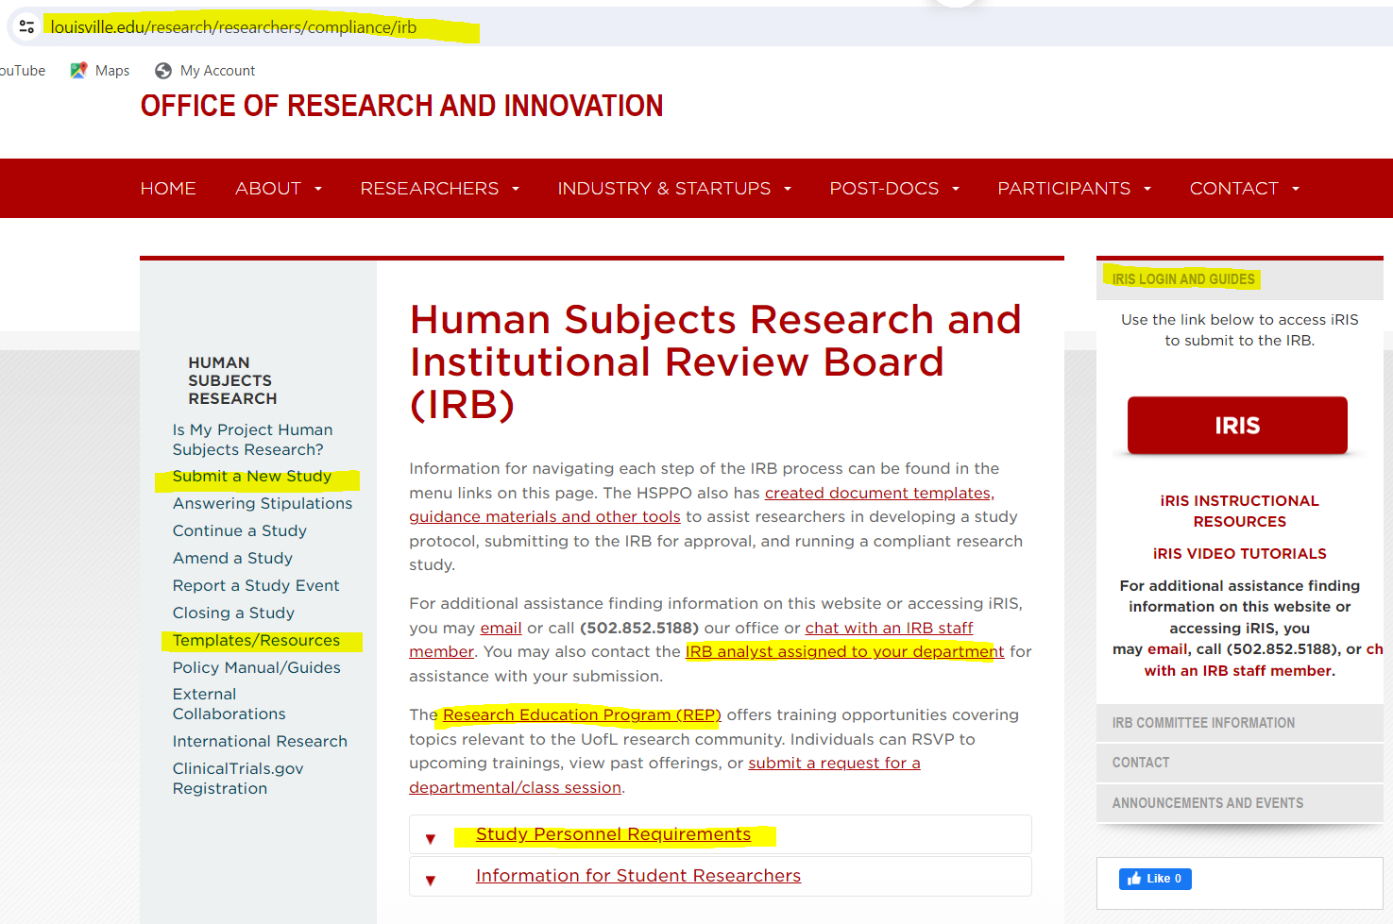
HSPPO Website
Notes:
Pointing out key items on our website to be used as resources as they begin their IRB application process.

Slide 23
Review Ready Submissions
-Check the HSPPO website for tools and tips.
-Use current templates from the HSPP website for the protocol and consent forms.
-Proofread your documents –have others proofread your documents
-Review your submission –application vs protocol vs consent documents vs everything else. When you make a change to one, how does it change another?
-Include/update your version numbers and/or dates on all documents; use consistent file names
-Avoid redundancies across your documents/submission components.
-Attach all documents, including research surveys, questionnaires, recruitment materials.
-Contact the HSPPO office with questions. Connect with the IRB Analyst for your department.

Slide 24
Study Compliance Tips
Use the IRB approved documents to conduct the study. Follow the IRB approved protocol. Do not change your study or study documents or protocol without IRB approval.
Stamped “approved” consent documents must be used for expedited and full board studies. Download the and use the stamped version when consenting participants.
Ensure the consent document is completed appropriately by the participant (all signatures/dates/etc…).
Obtain permission from any facility you plan to conduct research in.
Store data and documents according to UofL information security and data retention policies.
Be familiar with the IRBs amendment process, continuation review requirements, reportable events, and study closure process.

Slide 25
Post-Approval IRB Submissions
Amendments (changes to any part of the research plan that the IRB previously approved)
Amendment submission applies for all study types, including exempt research. The amendment changes could potentially alter a type and/or category.
Continuing Reviews (submitted 30 days before the studies expiration date).
Not required at UofL for exempt research.
May be yearly or every 3 years for expedited studies.
Yearly (or sooner) for full board studies.
You will see the expiration date in iRIS
Other reportable events:
Serious Adverse events
Protocol Violations/Deviations (non-compliance)
Unanticipated Problems
Study Closeout Amendment
Not required for exempt research
Notes:
After you receive initial IRB approval, you are not finished with the IRB. In most cases, you are just beginning. Other types of submissions that are made to the IRB are outlined on this slide.

Slide 26
Important Links
iRIS Login for IRB submission: https://iris.Louisville.edu
HSPPO Website Homepage: https://UofL.me/irb
HSPPO Service Email Account: hsppofc@louisville.edu

Slide 27
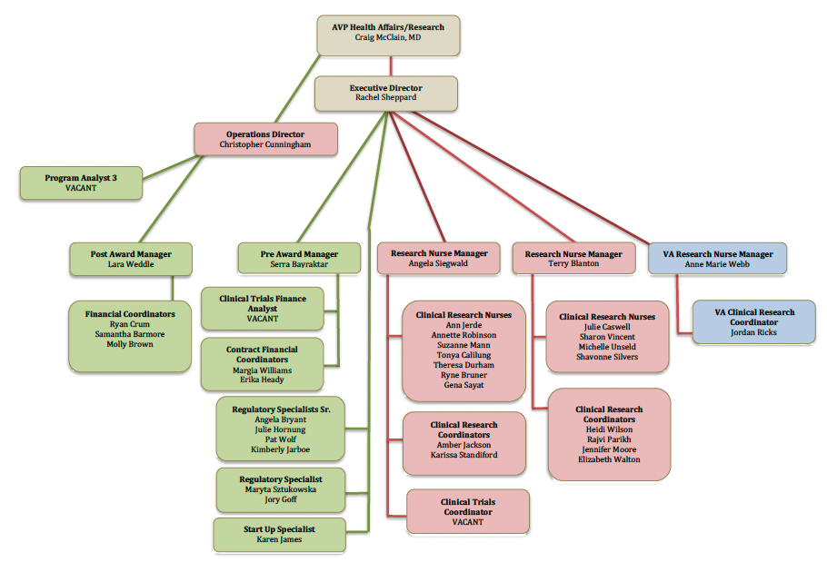
UofL Clinical Trial Unit

Slide 28
Financial services
CTU Financial Services
Feasibility analysis
Budget development
Coverage analysis
Billing compliance planning and oversight
Budget negotiation
Contract submission
Post-award account management
Reporting

Slide 29
Regulatory services
CTU Regulatory Services
Institutional Review Board submission
Development of Essential documents
Maintain Investigator Site file
Data monitoring and management
Audit support
Remote monitoring
eConsent

Slide 30
CTU Clinical Services
Sponsor visit coordination
Source documentation obtention and creation
Pre-screening, screening, recruitment, and scheduling study subjects
Subject participation and payment reporting
Study visit conduct and procedure coordination
Paper or electronic case report form (CRF) completion
Drug/device accountability and administration
Specimen Processing, packing, and shipping
Clinic/hospital logistics, as needed
Data query resolution
AE and SAE reporting

Slide 31
CTU Locations
CTU Locations
U of L HCOC , 401 E. Chestnut St., Suite 460
MedCenter One, 501 E. Broadway, Suite 210
Jewish Hospital, Rudd Heart and Lung, Suite 1103

Slide 32
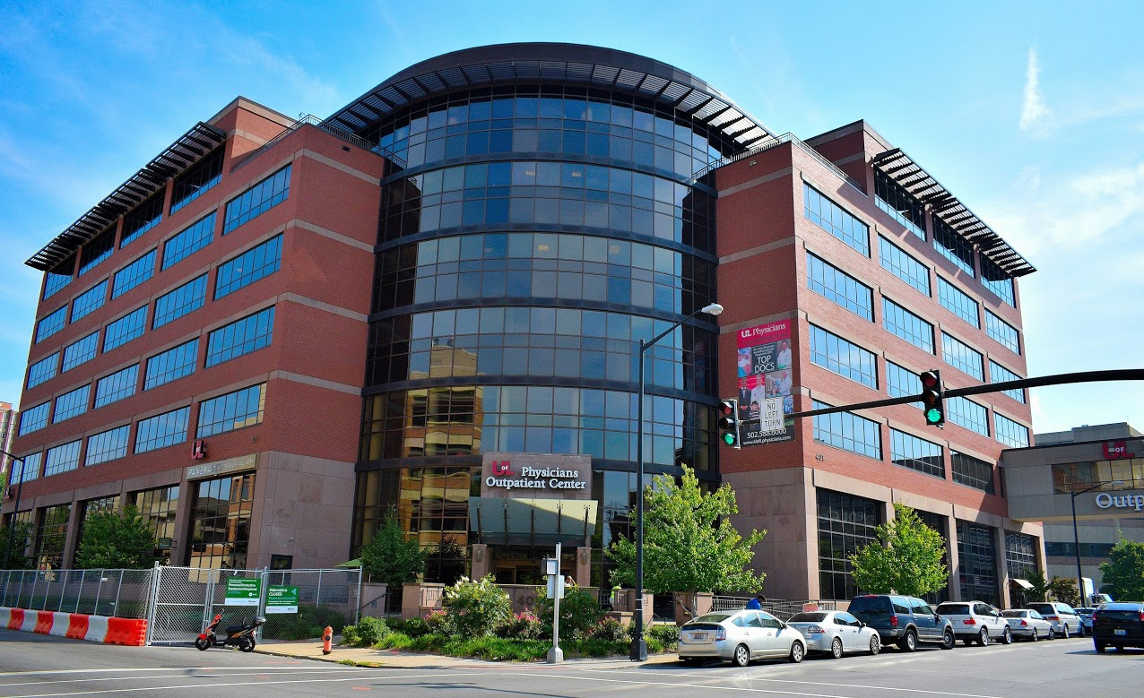
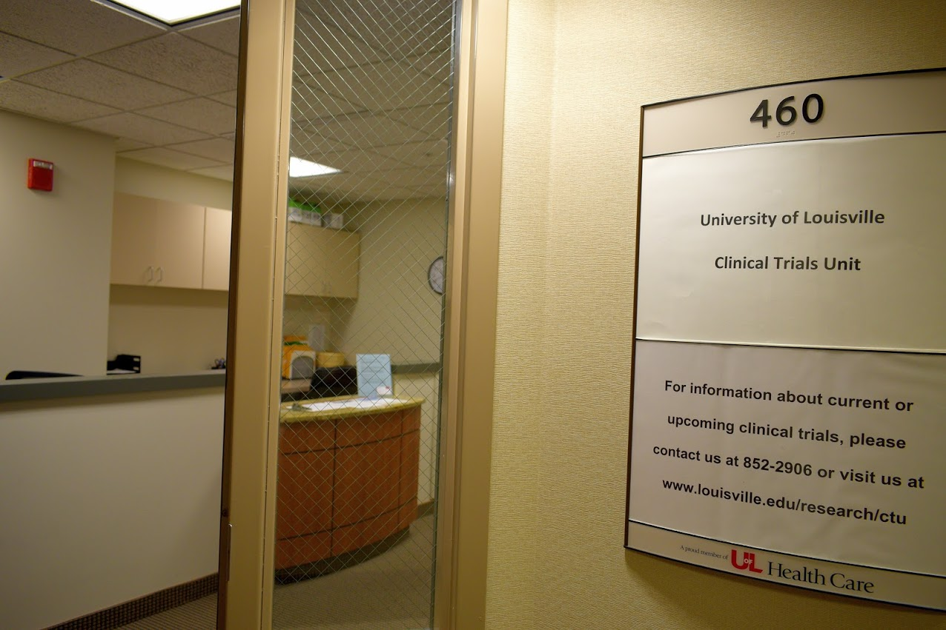
CTU UofL HCOC Location

Slide 33
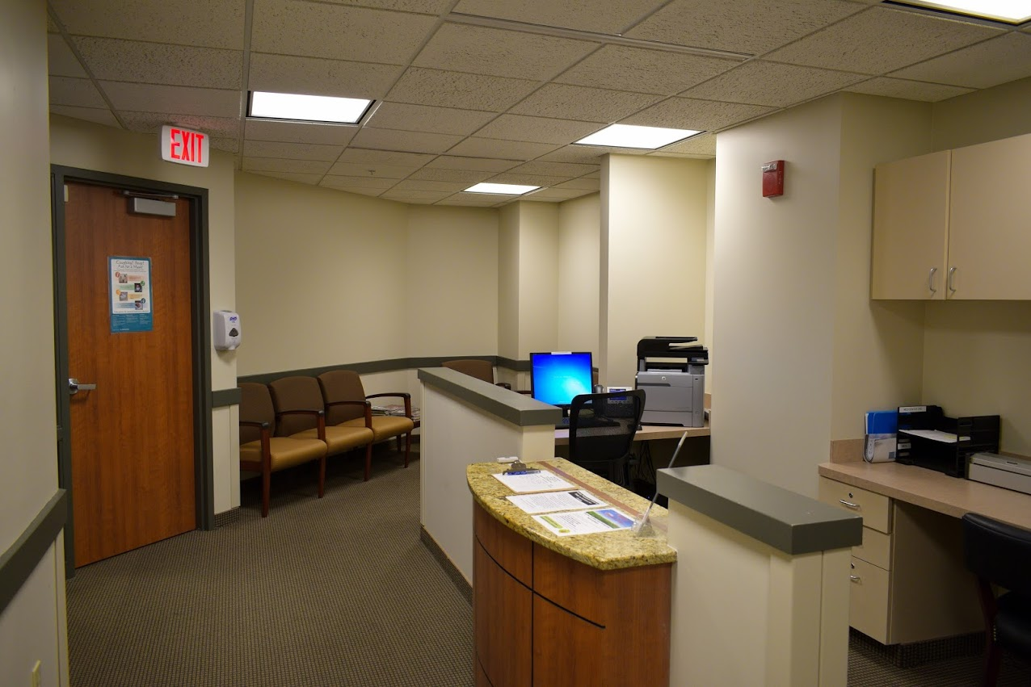
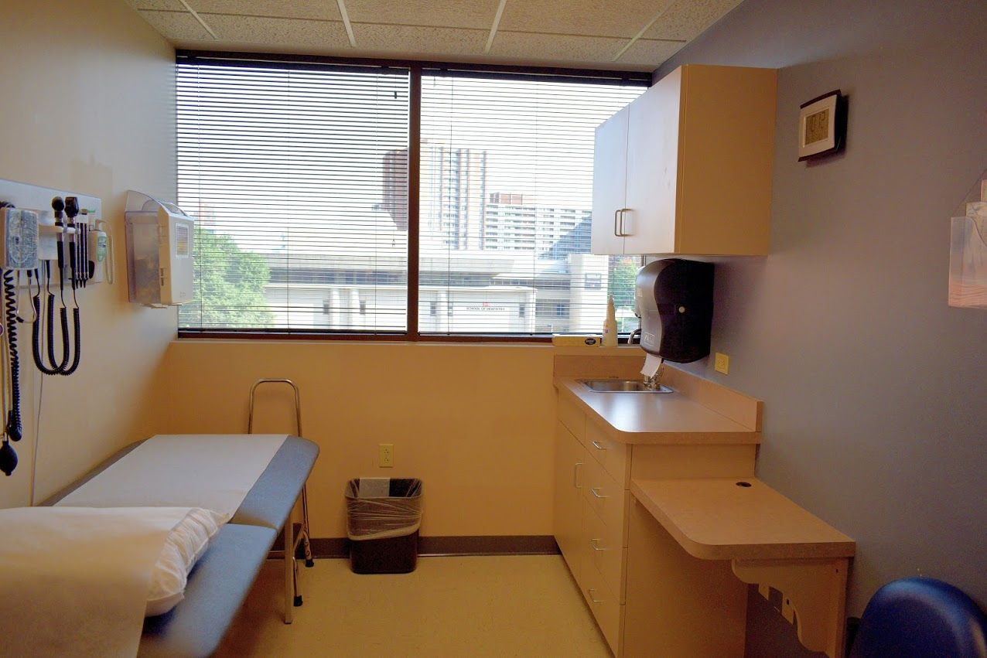
CTU UofL HCOC Location
Waiting Area
Exam Rooms

Slide 34
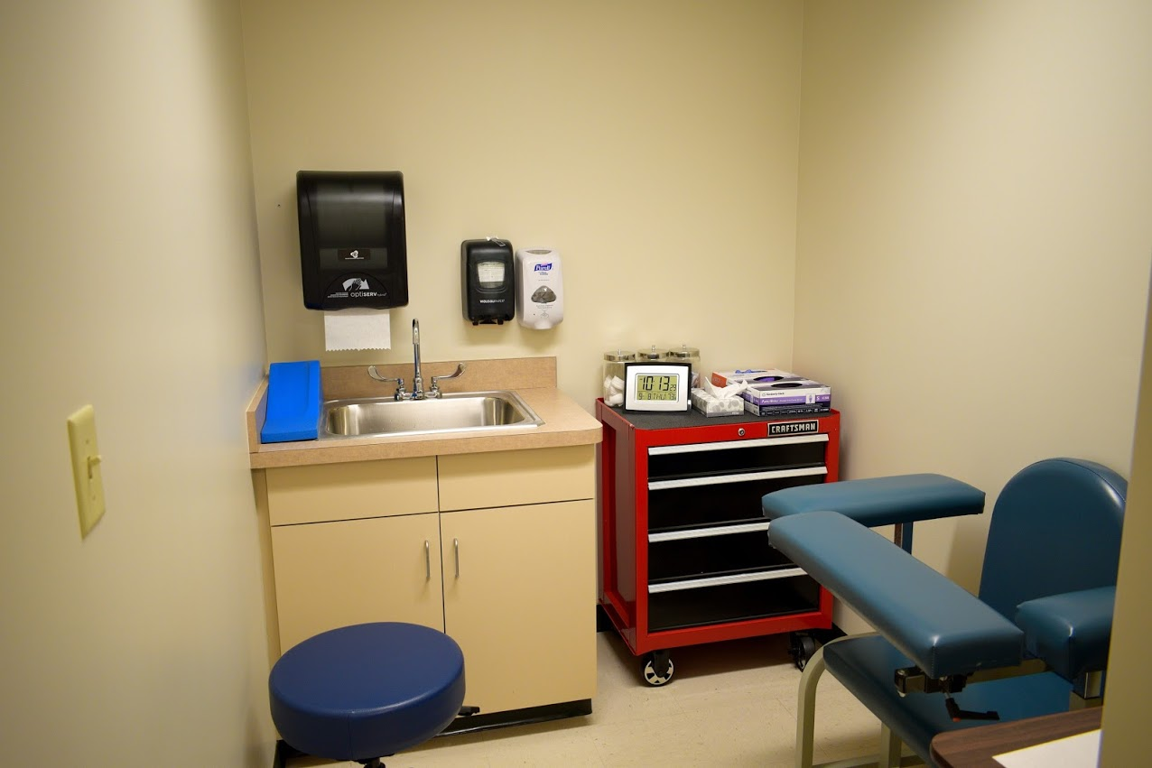
CTU UofL HCOC Location
Dedicated Phlebotomy Area

Slide 35
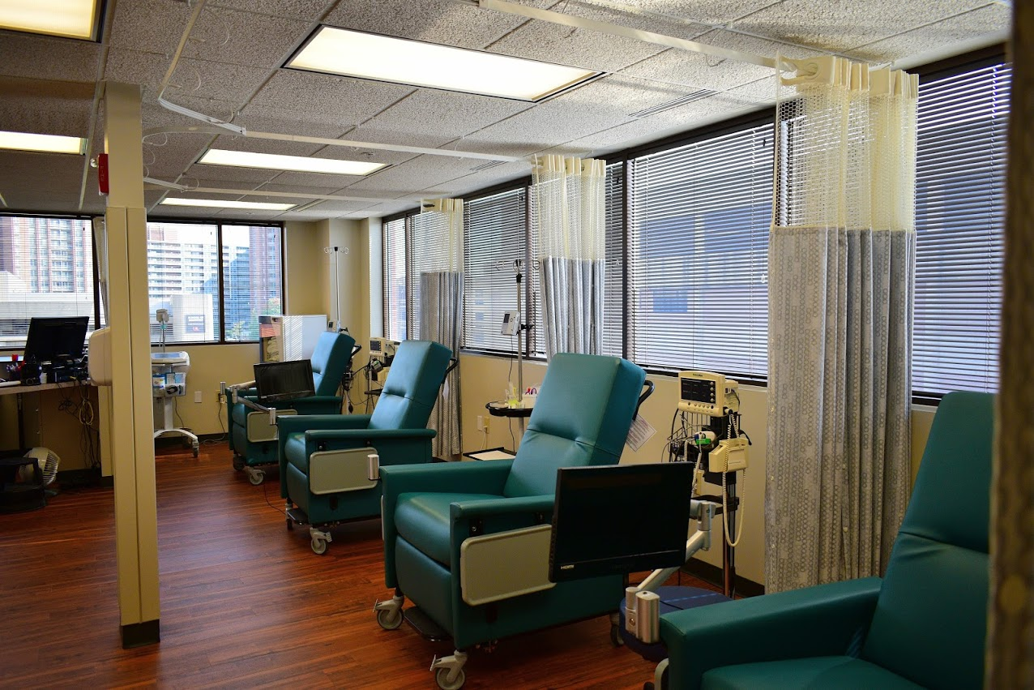
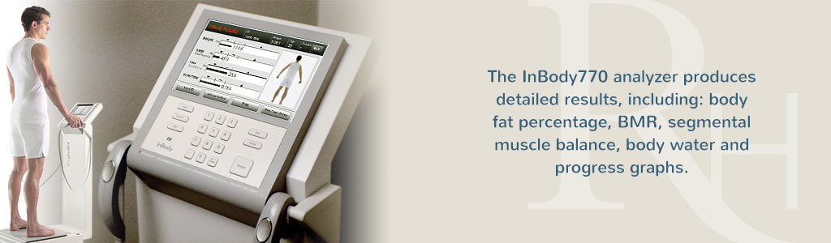
Four Infusion Bays
InBody 770 Body Composition Analyzer

Slide 36
CTU Contact Information
CTU@louisville.edu
http://louisville.edu/research/ctu
Rachel.sheppard@Louisville.edu
(502) 852-1006

Slide 37


Slide 38
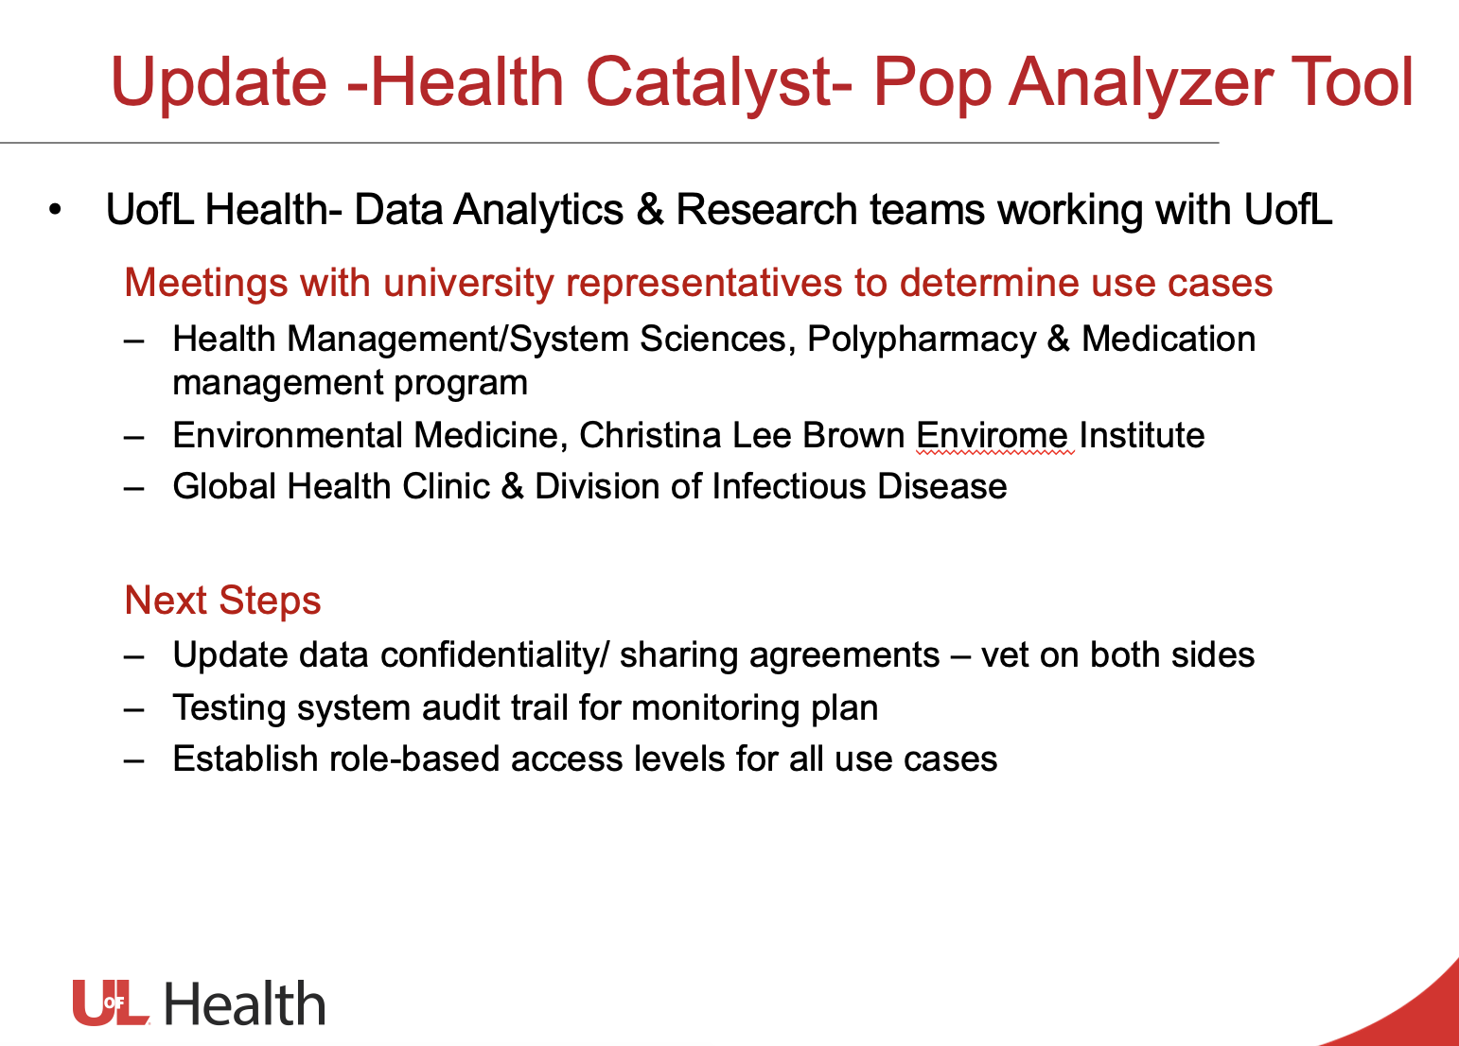

Slide 39
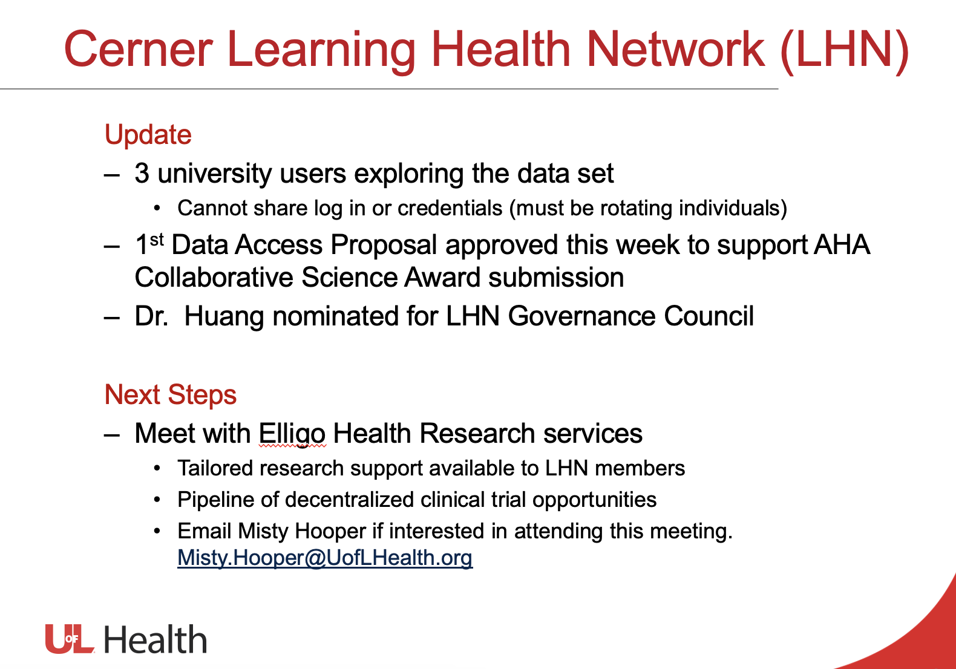

Slide 40
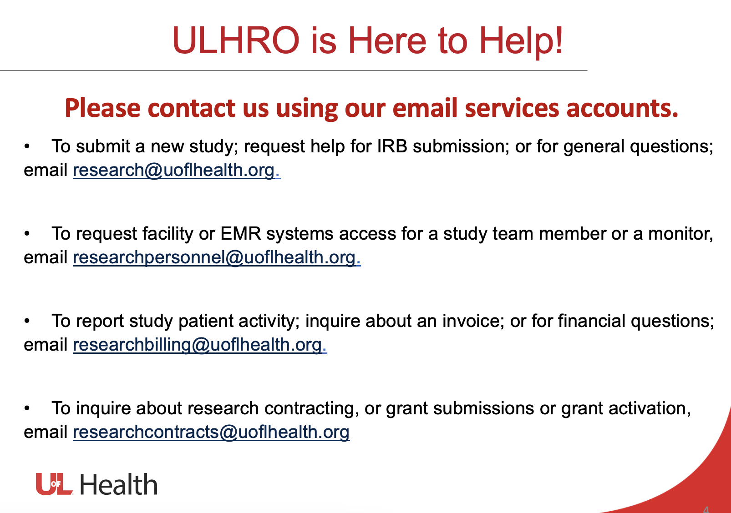

Slide 41
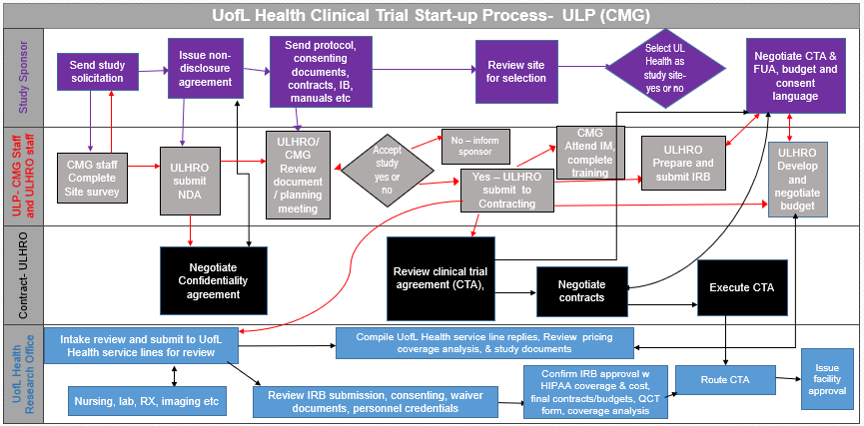
Current State: ULHRO CMG Process
FUA=Facility Use Agreement
IB=Investigator Brochure
NDA=Non Disclosure Agreement

Slide 42
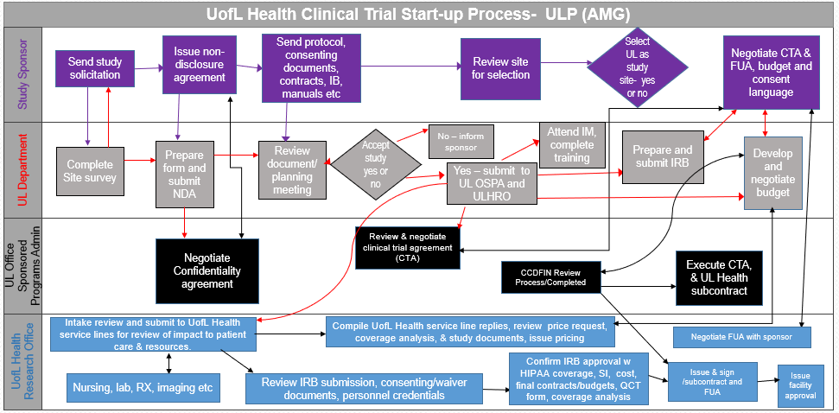
Current State: ULHRO AMG Process
CCDFIN=Clinical Contracting Division of Finance
SI=Subject Injury

Slide 43
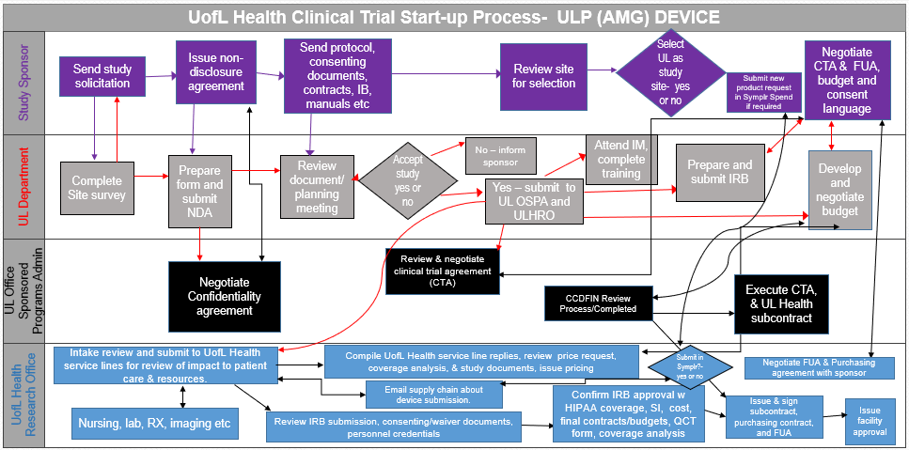
Current State: ULHRO AMG Device Process

Slide 44
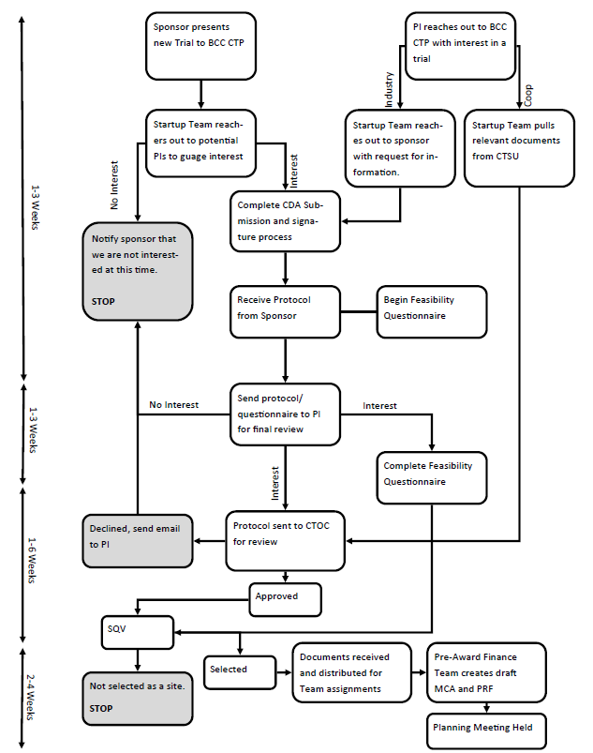
Cancer Center Study Selection Process
PI=Principal Investigator
CTOC: Clinical Trial Oversight Committee
SQV: Site Qualification Visit

Slide 45
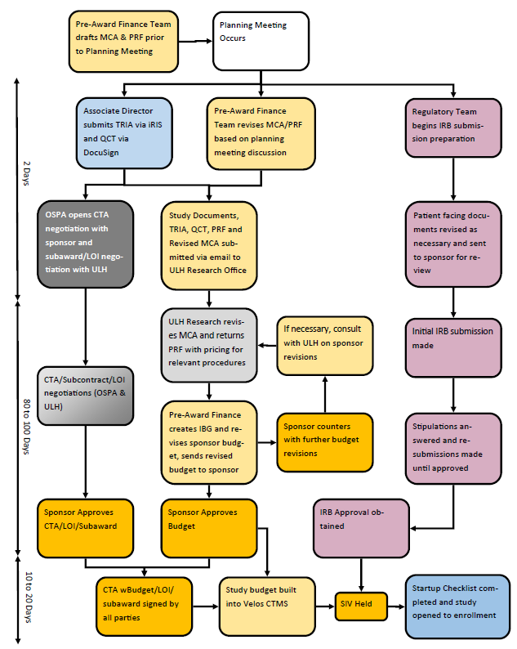
Cancer Center Pre-Award Process
MCA=Medicare Coverage Analysis
PRF=Proposal Routing Form
SIV: Site Initiation Visit
QCT: Qualified Clinical Trial
LOI=Letter of Intent

Slide 46
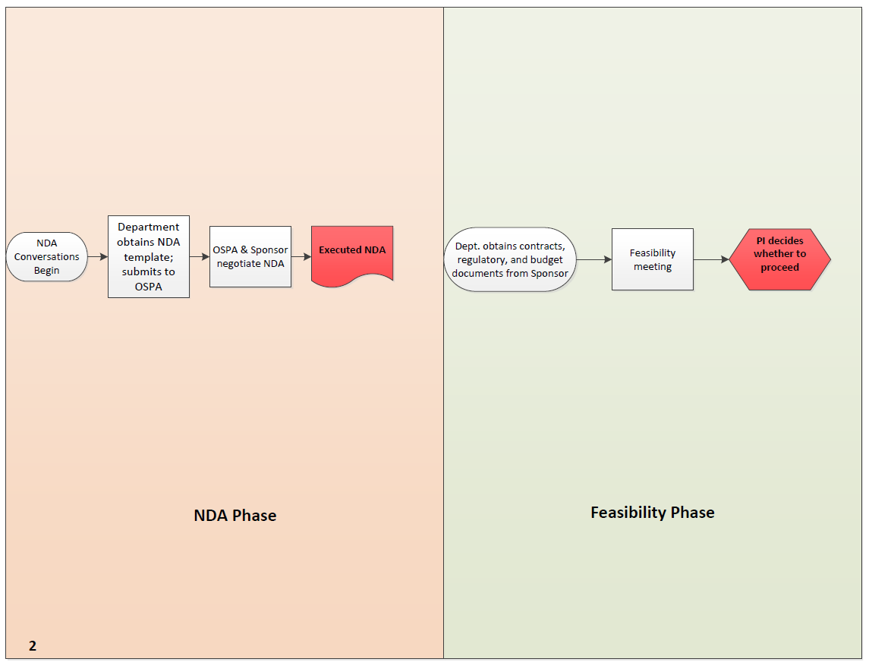
Current State: Sponsored Programs
Feasibility Phase
NDA Phase

Slide 47
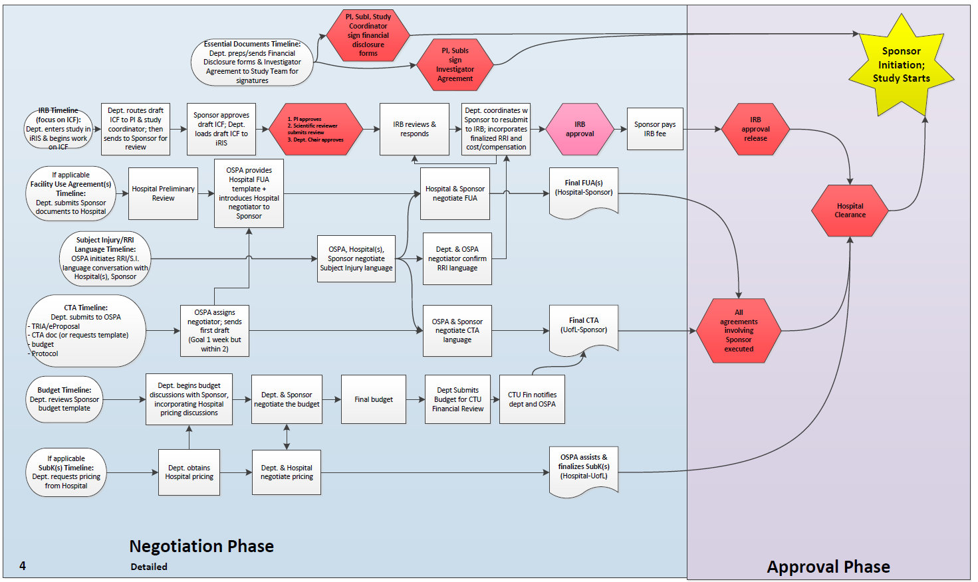
Current State: Sponsored Programs

Slide 48
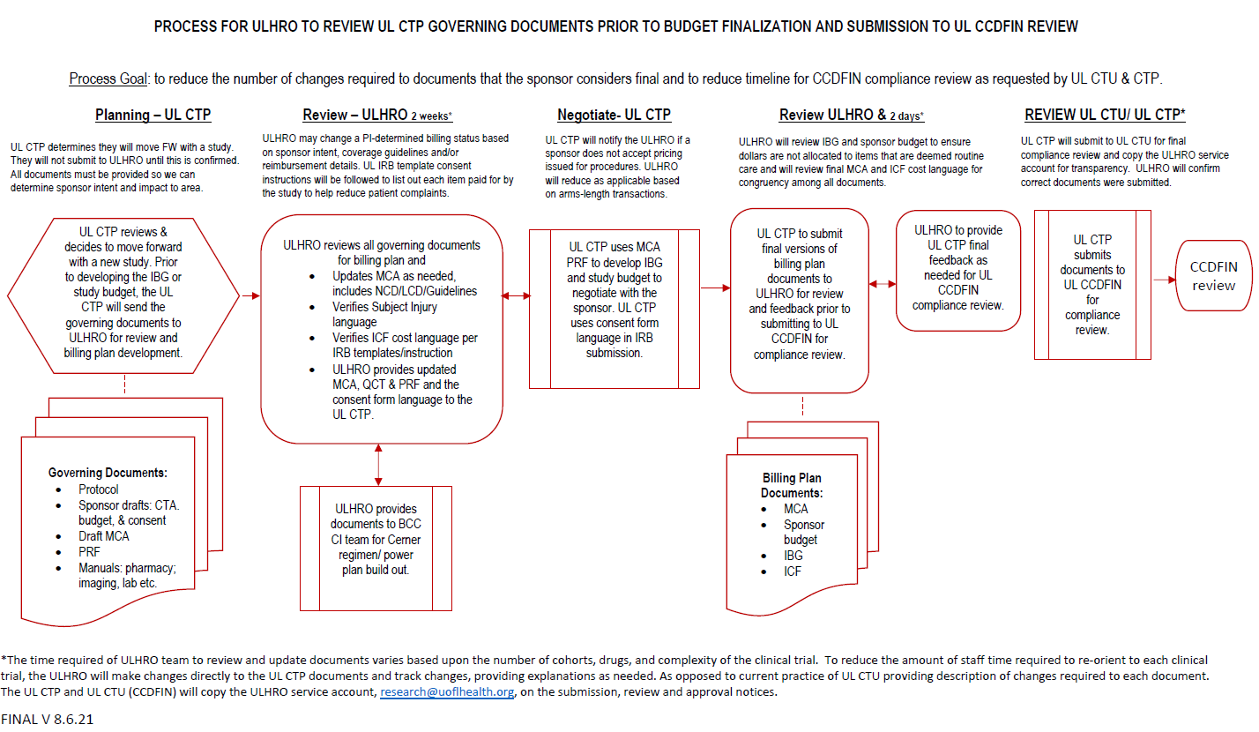
ULHRO/CTP Process for Cancer Trials

Slide 49
Summary
Abundant clinical research resources at UofL and UofL Health
Please reach out to TRSC for navigation and guidance
Director, Matt Cave MD
Associate Director Jiapeng Huang MD, PhD
Working on optimizing clinical and translational research at UofL and UofL Health

