Slide 1
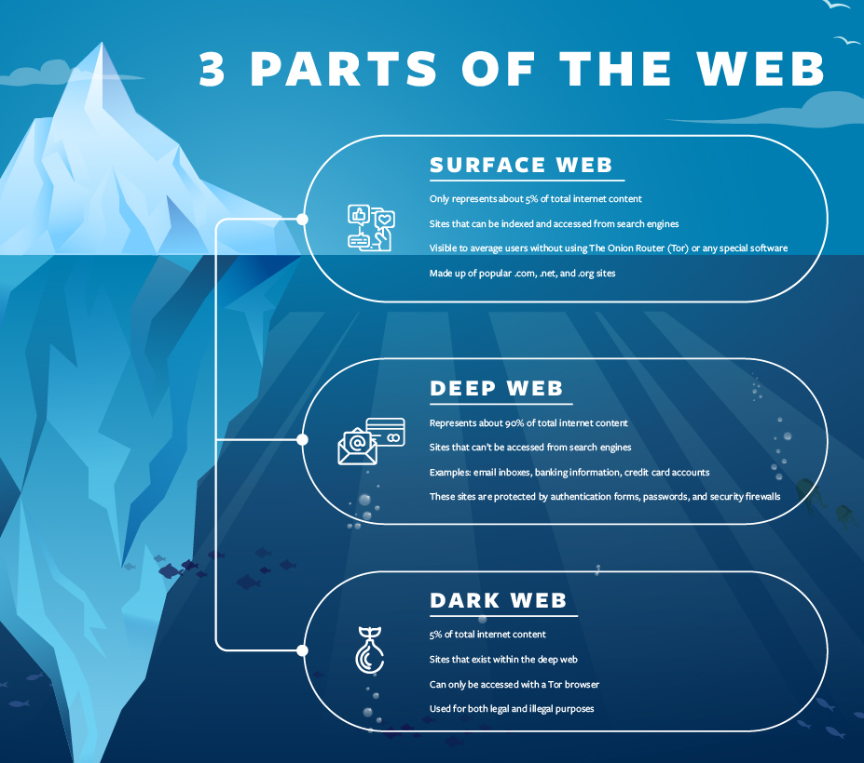
Originally used by the United States Department of Defense to communicate anonymously, the dark web has now become a hub for users wishing to remain anonymous around the world. People use the dark web for both legal and illegal purposes. It uses a technology called "onion routing," which protects users from surveillance and tracking through a random path of encrypted servers. When users access a site through Tor, their information is routed through thousands of relay points that cover the user's tracks and make their browsing virtually impossible to trace.

Slide 2
Peer to Peer vs Client Based Servers. Peer to Peer image transfer is only about 40% of the CSAM.
Peer to Peer File sharing is not new, the first notoriety was in 2001 when Napster was sued for sharing music.
In 2007 the Wyoming Internet Crimes Against Children ICAC Task Force captured 377.044 unique computers sharing CSAM.
Some of the less popular P2P servers are FastTrack, BitTorrent, eDonkey, and Freenet.
The Gnutella network is the most common now and it is a decentralized network.

Slide 3
Since no centralized server hosts files, the Gnutella network depends on each client computer to share information about the files available to other users. When a computer connects to the Gnutella network it is designated as either an ultrapeer (sometimes referred to as a supernode) or a leaf. Ultrapeers are the backbone of the Gnutella network and act as traffic cops, directing incoming search requests to the appropriate computers that contain files or information that a user wants. Leaves are computers that do not have the capacity to support the Gnutella network and connect to ultrapeers to share files.
The only way users can keep track of all their files is to create hashtags. Then the program searches for the hashtags.
This is important for forensic examiners to understand because it is different from the traditional base 16 hash values normally used in forensics. If a forensic examiner attempts to “hash” a file with traditional forensic software he or she will come up with a completely different hash value from the base 32 SHA-1 value Gnutella uses. Free software applications are available to convert the base 32 SHA-1 to a base 16 SHA-1.
Notes:
To make this easy to under stand basically the person sends out a set of different codes so the images can not be tracked. Different pieces of the code and images are on different computers so they can be tracked.

Slide 4
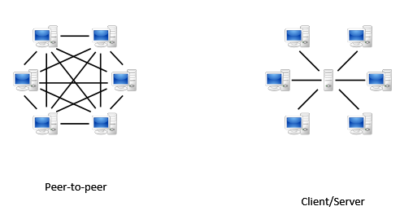

Slide 5
Minors sharing explicit-images with other minors

Slide 6
Child Sex Abuse Material
Who are the victims?
According to a study from ECPAT:
56.2% of cases depicted were prepubescent children.
25.4% were pubescent children.
4.3% were very young children (infants and toddlers).
14.1% of cases featured children in multiple age categories.
The younger the victim, the more severe the abuse was likely to be.
84.2% of videos and images contained severe abuse
Notes:
Basically Investigators now have the codes to search these networks to locate the images.
Many investigators around the world conduct undercover online investigations using P2P. ICAC task forces and other law enforcement agencies have specialized software to search for and identify individuals involved in the sharing of child pornography. These programs allow law enforcement officers to use common search terms for child pornography to locate images and videos of child sexual abuse on the Gnutella network. Once a list of files returns based upon the investigator’s search term, the SHA-1 hash value is compared to known or suspected child pornography files in the ICAC database. Any files actively being shared that match a file in this database are viewable by the investigator. The investigator is also able to select a user who is actively sharing content and determine his or her Internet Protocol (IP) address and obtain a rough geographical location of the suspect so the investigator can focus on that jurisdiction

Slide 7
Studies have shown that the majority of those possessing and distributing CSAM also commit hands-on sexual offenses against minors. Most of the time, the abuse has been committed by someone that the child knows and trusts. Offenders often use grooming techniques to normalize sexual contact and encourage secrecy.

Slide 8
Child sexual abuse material, or CSAM, is widely distributed online. In 2021 alone, more than 29 million reports of suspected child sexual exploitation were reported by online platforms to the National Center for Missing & Exploited Children’s CyberTipline, and that number is growing. Those 29 million reports included 84.9 million images and videos of CSAM.

Slide 9
Victims of CSAM often report feeling
Guilt, shame, and blame
Intimacy and relationships
Self-esteem
Post traumatic stress disorder
Obesity and eating disorders
Sexual behavior and oversexualization behavior problems
Depression

Slide 10
Commercial Sex Ads
In the past year in the state of Tennessee there has been 3,421,347 commercial sex ads posted from 603,603 Profiles. These ads contain explicit pictures of men, women, and minors. Some of the minors photos are explicit, others are CSAM.
There is approximately 88 different companies that host commercial sex sites.
A few of the major sites are mega persons.com, Adultlook.com, Adultsearch.com, Onebackpage.com, etc.

Slide 11
NCMEC https://www.missingkids.org/HOME
NCMEC is the nation’s largest and most influential child protection organization.
We lead the fight to protect children, creating resources for them and the people who keep them safe.

