Slide 1
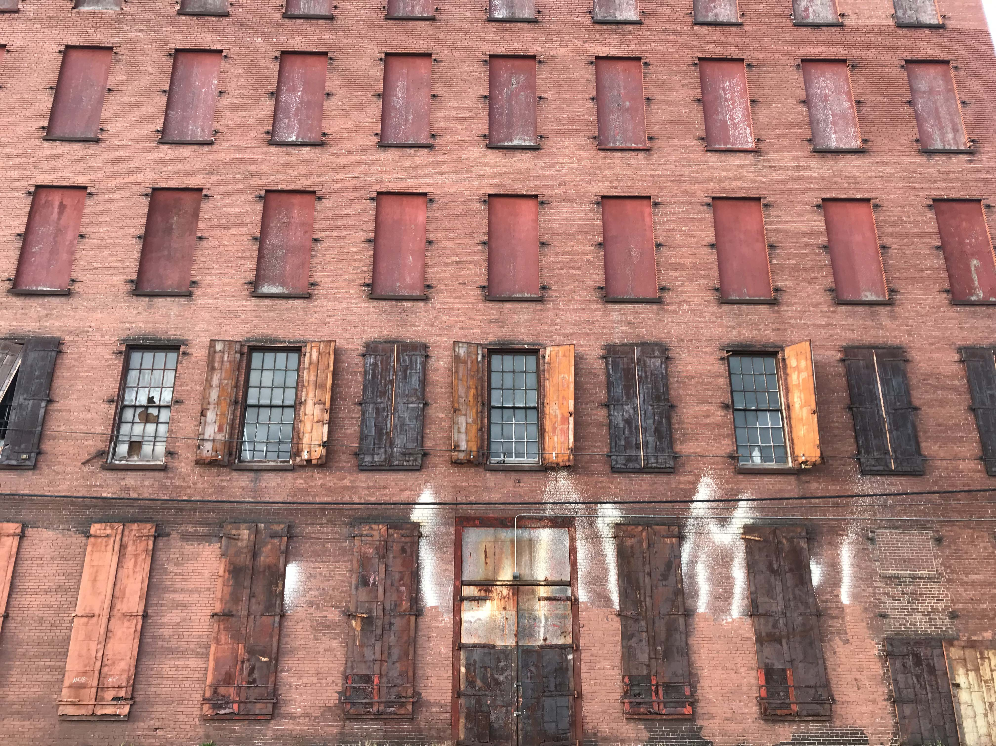
Brownfield Area Benefits Estimator (BABE)
Projecting Neighborhood Benefits and Impacts from Site-Specific Brownfield Redevelopment
University of Louisville Center for Environmental Policy and Management Team
Notes:
Welcome to part II of our introduction to the Brownfields Area Benefits Estimator Toolkit.
Brief Introductions to Presenters

Slide 2
BABE Training Part 2
THE BENEFITS ANALYSIS TOOL (BAT)
  REVIEW of the BABE project
  OVERVIEW of the BAT tool.
  SCENARIOS for making the case.
  GETTING STARTED and what users need to make full use of the tool.
Notes:
ASK IF DONE ON A DIFFERENT DAY: How many of you were able to attend the previous meeting about the Brownfields Tracker? [determine level of summary intro]
Depending on answers….
Today’s presentation will briefly review the BABE toolkit.
Provide an overview of the desktop Benefits Assessment Tool.
Walk you through a few examples of how someone might use the BAT.
Get you started with how to access the BAT.

Slide 3

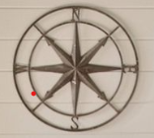

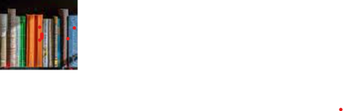
                National Site: https://brownfieldbenefits.com/index.html?
                Russell Demo: http://bit.ly/3a1xjge
What is BABE?
The Brownfields Area Benefit Estimator
Asking how do current residents benefit from redevelopment?
Brownfields Tracker (mobile app)
Easy to use to create a baseline brownfields inventory of “hyperlocal” data
http://bit.ly/3iIGZA2
Benefits Analysis Tool (desktop app)
Analyze a variety of existing national data in conjunction with project specific local data
Project Deliverables
Mobile App
Desktop App
User Guide and Codebook
Story Maps
Louisville
Demonstration
https://arcg.is/19mira0
https://arcg.is/WmGSb0
Notes:
The Brownfields Area Benefit Estimator, or the BABE, empowers communities to ask, how will CURRENT residents benefit from urban redevelopment?...and then provides those communities with some resources for action.
BABE consists of two component apps (one each for desktop and phone), but it is really a SUITE of tools used to PROJECT AND TRACK A VARIETY OF COMMUNITY BENEFITS ASSOCIATED WITH BROWNFIELDS REDEVELOPMENT
As you learned in Part I, the MOBILE APP, the Brownfields Tracker, uses ESRI’s Survey123 platform, for real time - on the ground data collection of community brownfields conditions. This tool could be used by city officials and environmental professionals, as well as crowdsourced to neighborhood residents and activists, non-profits, and other community organizations. As such it provides invaluable local data as to environmental hazards and their reduction and builds relationships across organizations and allows residents to hold officials and professionals accountable to local input. In this way, we see the tool as promoting a bottom-up approach to planning and development. [SHORTEN DEPENDING ON PARTICIPATION IN PART I]
During this portion of the training, we will introduce you to the DESKTOP APP, the Benefits Analysis Tool (BAT) which allows the user to input project specific information in a guided online platform. The tool produces an analysis of the users’ selected area/neighborhood using data from national sources and user entered local data such as their local brownfields inventory developed using their Brownfields Tracker app. The tool provides the user with a report in a pdf format that includes area profiles pre-redevelopment and projections for post-redevelopment changes in table form with narrative to guide interpretation and select maps that help spatially visualize the impacts. The user can take the report can be used to make the case with other decision makers. It can be used as a conversation starter and supplement to discussions about future development plans.
The BABE also includes a toolkit guidebook, story maps, and a demonstration project that includes a BAT project site and BT data we conducted with Louisville using data collected in the Russell neighborhood.

Slide 4
Who is BABE for?
Anyone focused on the well-being of residents in an area of brownfield redevelopment.
City Staff
CDOs
Community Development Organizations
City Staff and Managers
Grant recipients, Universities and Partners
$
NAs
Neighborhood Associations
Notes:
[DEPENDING ON AUDIENCE and if they were in Part I]
The Brownfields Tracker you heard about earlier and the Benefits Analysis Tool have similar audiences but may have different project leads and users. In general though, they are intended for individuals and groups who work in brownfields redevelopment at a neighborhood/area level. It centers community, not the developer or city as the point of inquiry.
So as you listen to the presentation today, put on the hat of the community development organization leaders, the brownfields coordinator for a city tasked with increasing community engagement and input, the neighborhood organizer who wants to help get a grocery store into their neighborhood, a city council person who needs to hear that brownfield redevelopers need to be held accountable for the benefits they claim will happen.

Slide 5
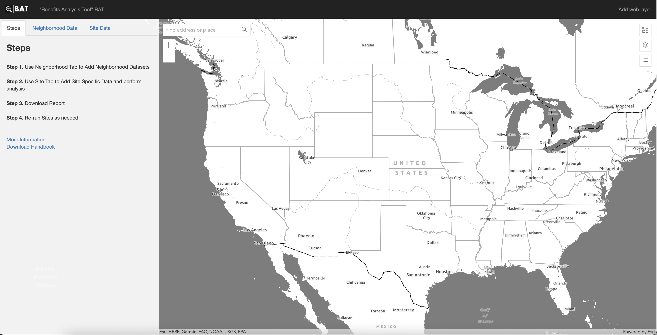
What is the Benefit Analysis Tool (BAT)?
Notes:
This is what the BAT looks like when you open the desktop application.
This is a gis based data analysis tool that can be used to look at neighborhoods and small areas anywhere in the U.S.

Slide 6
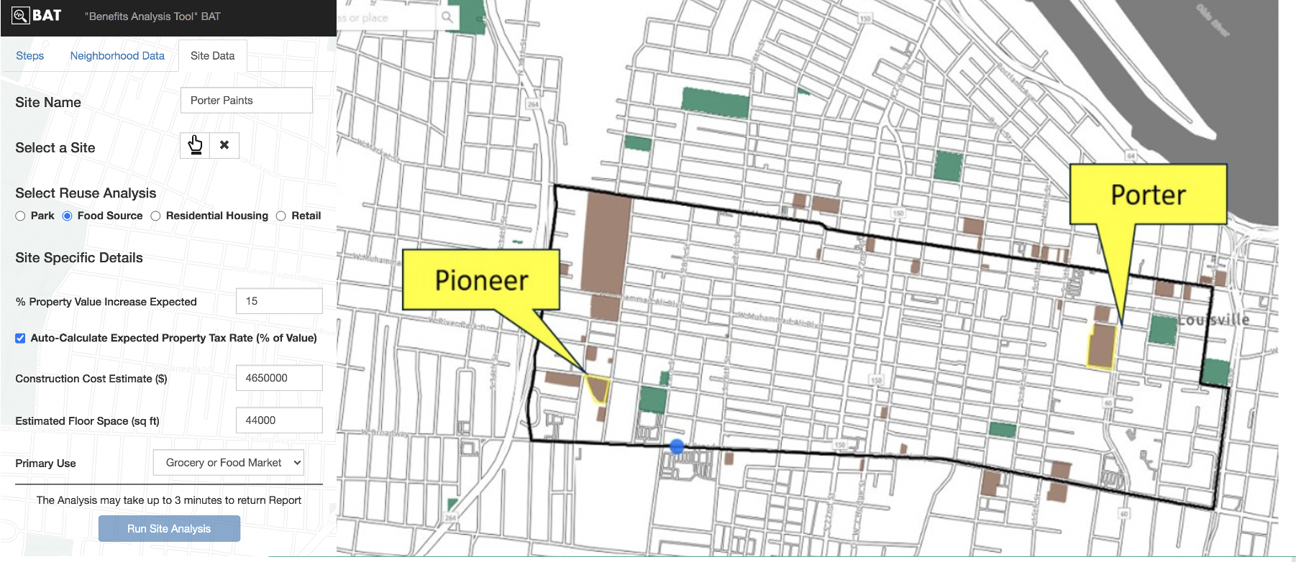
What can you do with the BAT?
Notes:
BAT allows a user to see the impacts of redeveloping brownfields in different locations and for different end uses.
BAT is intended to compliment other types of benefit analyses and scenario planning tool by providing more information about impacts on existing residents.
BAT can help users make the case for brownfield redevelopment in areas that the market-based incentives have not succeeded.
BAT can help users make the case for a particular reuse that the area residents want.
What does that look like? I have two examples of how users might include the BAT as they develop project proposals, confront alternative proposals for development, carry out site assessments, or evaluate outcomes of finished projects.

Slide 7
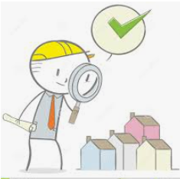
How is BAT Applied?
Scenario 1. Increase access to fresh food
A staff member / brownfield coordinator might use the Brownfield Tracker to create or amend its brownfield inventory, and then use the that inventory in the BAT to demonstrate to the city manager that redeveloping a particular site as a grocery would increase access to fresh food.

Slide 8
Scenario 1. Increase access to fresh food
Notes:
Once the user has uploaded their BF inventory, they they can begin comparing sites for redevelopment, and in this case redevelopment as a grocery store. In this scenario we look at two different sites at the west side and east side of the Russell neighborhood. The user is asked to enter in approximate construction costs, floor space, and can select from three types of grocery store categories and they can run the analysis.
When the user runs the site analysis, a PDF report is created and appears at the bottom of the input page.

Slide 9
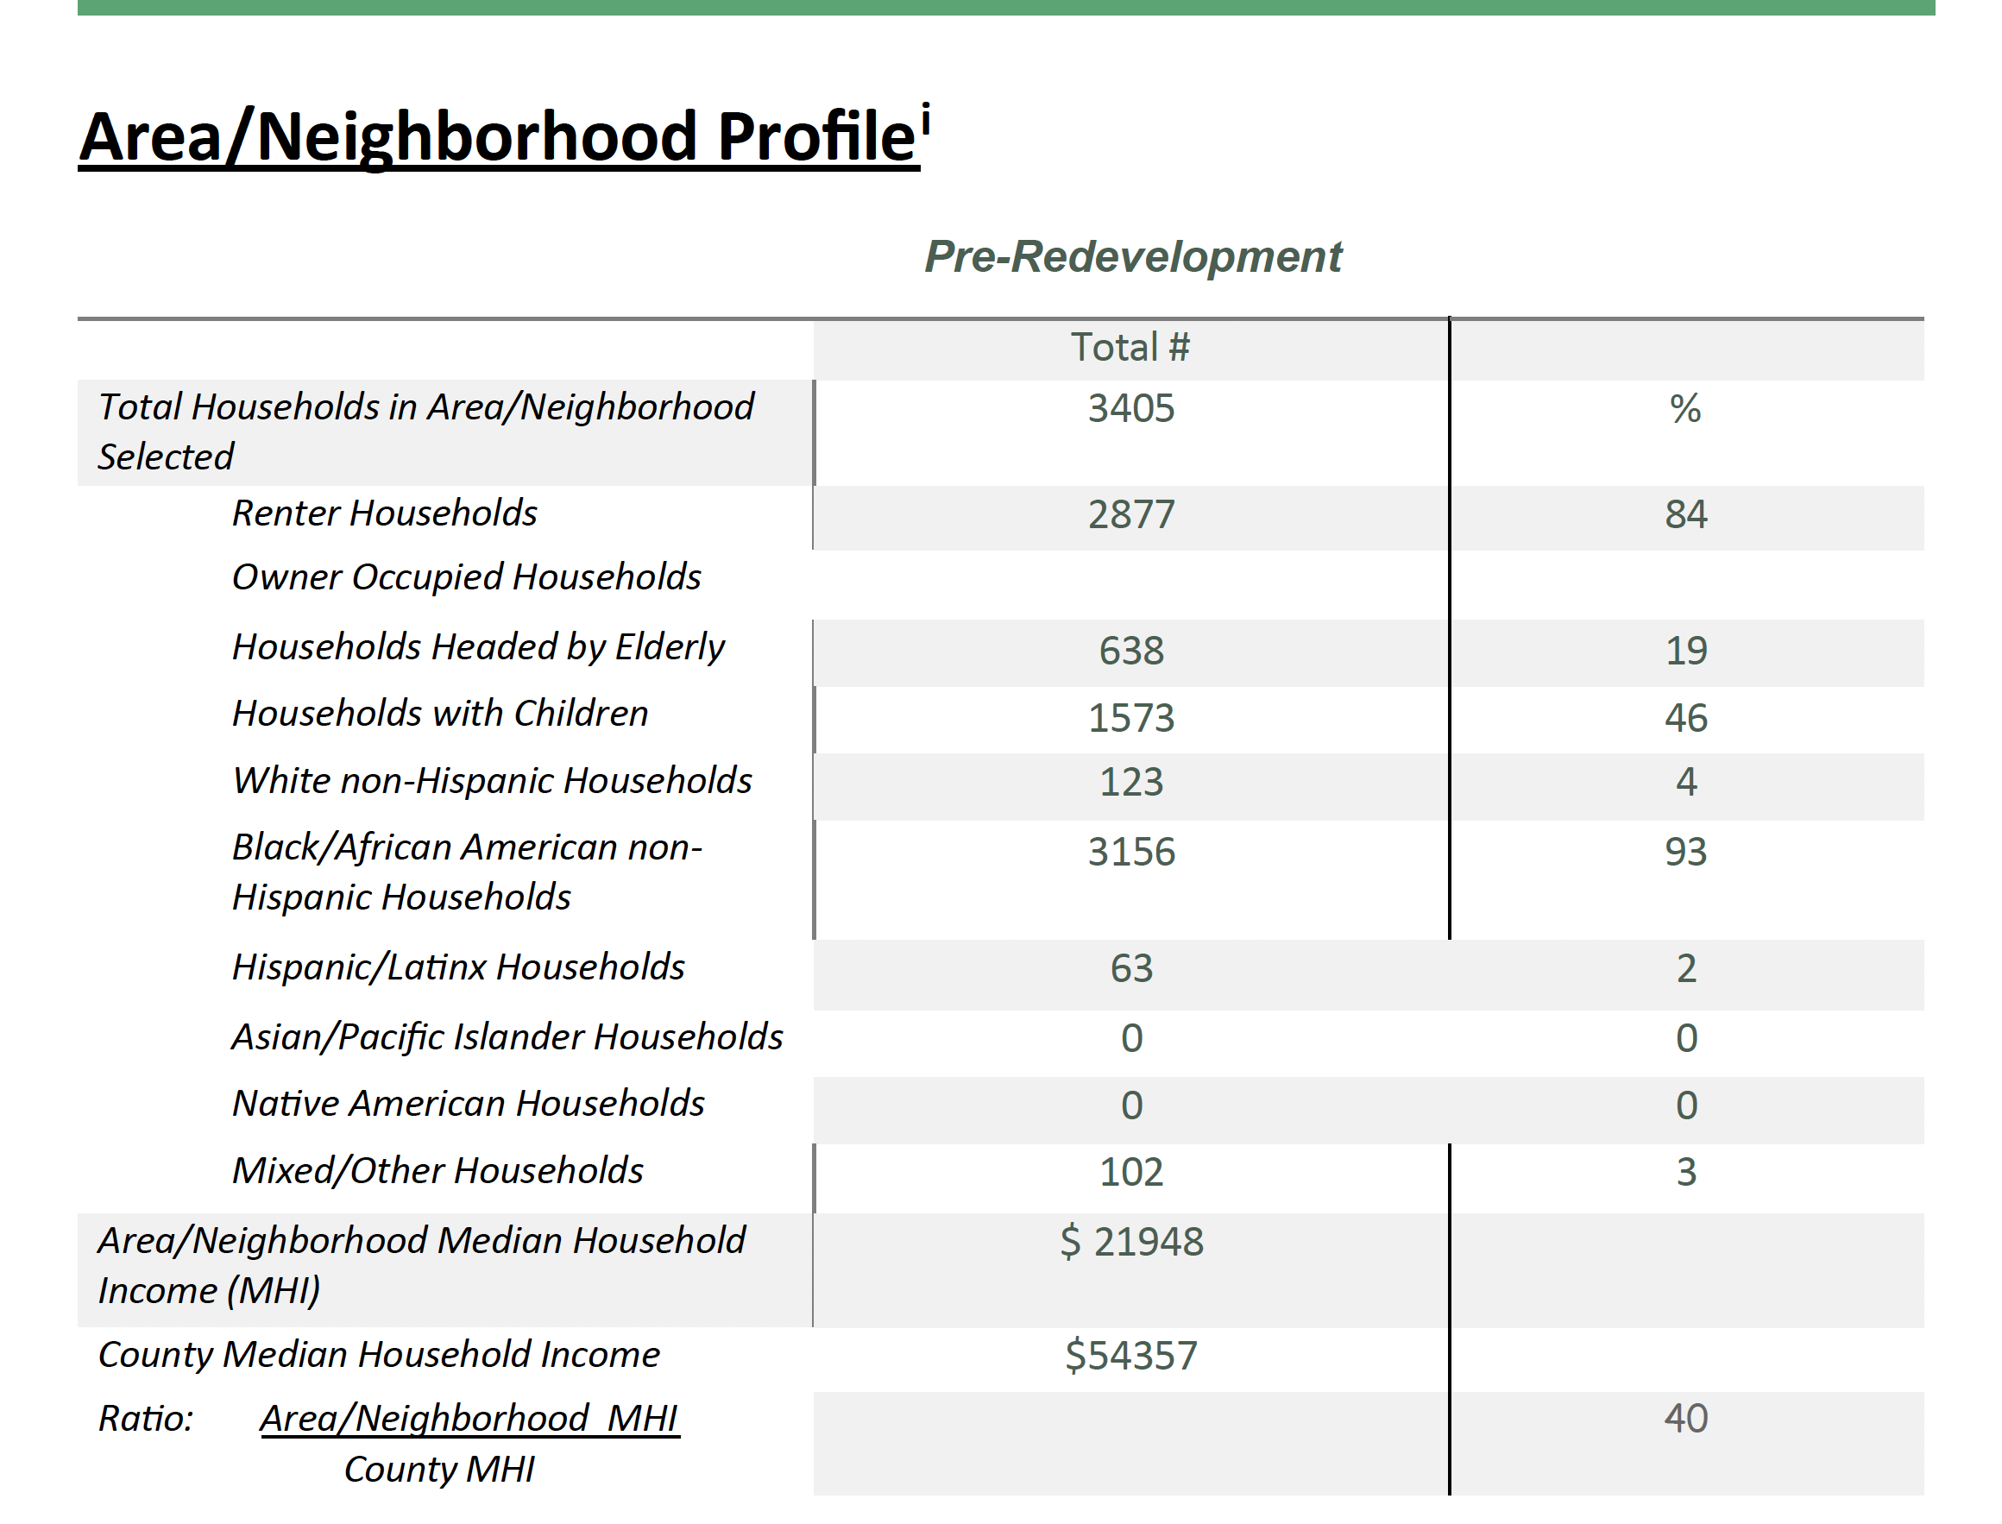
Scenario 1. Increase access to fresh food
Notes:
Included in the report is a table that provides a summary of demographics of the Russell neighborhood that we identified and a narrative that goes along with the numbers. At the end of each analysis report the user runs is also a set of relevant maps for printing.

Slide 10
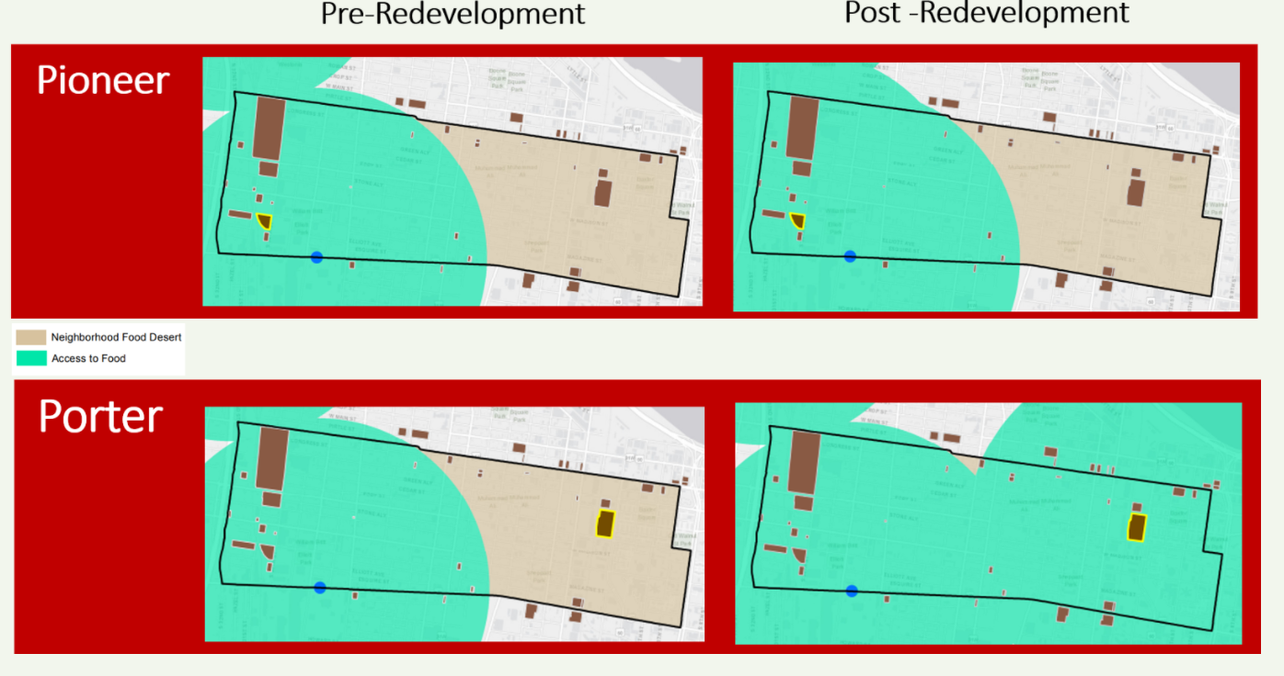
Scenario 1. Increase access to fresh food
Notes:
In this case, the user ran two site analyses that they can use to compare the share of households within the selected neighborhood that would no longer be living in an area with low access to full service grocery store and fresh food if each site were redeveloped as a grocery store.
The reports include the data behind the maps as well.

Slide 11
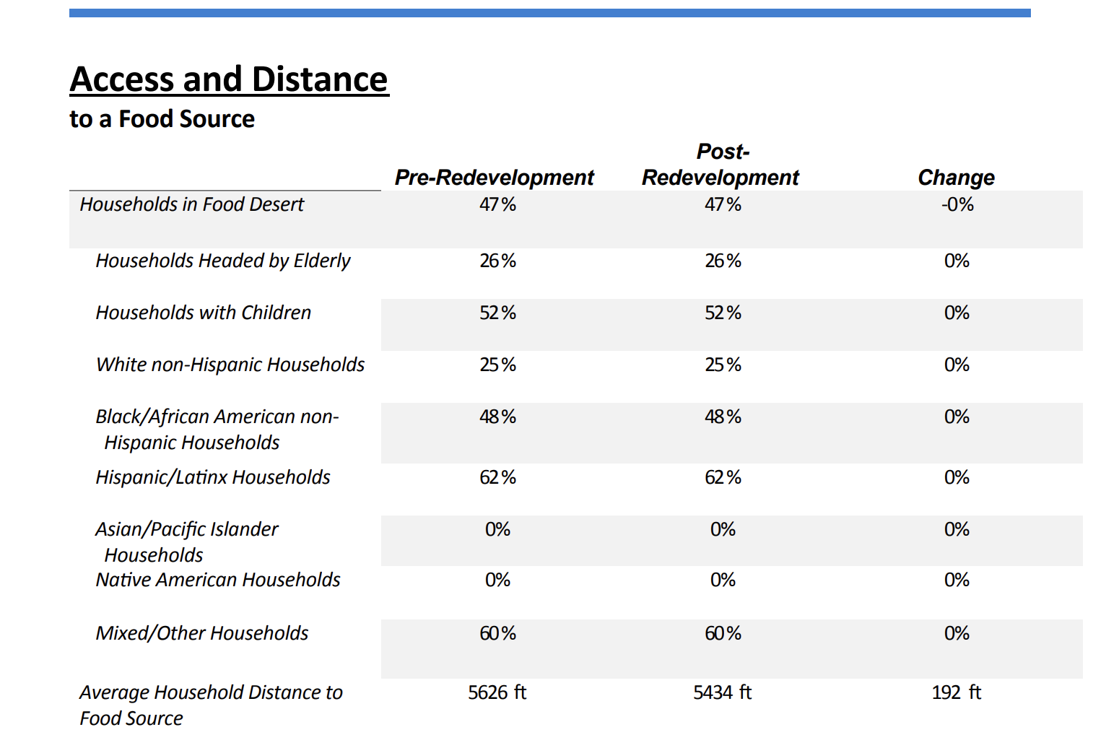
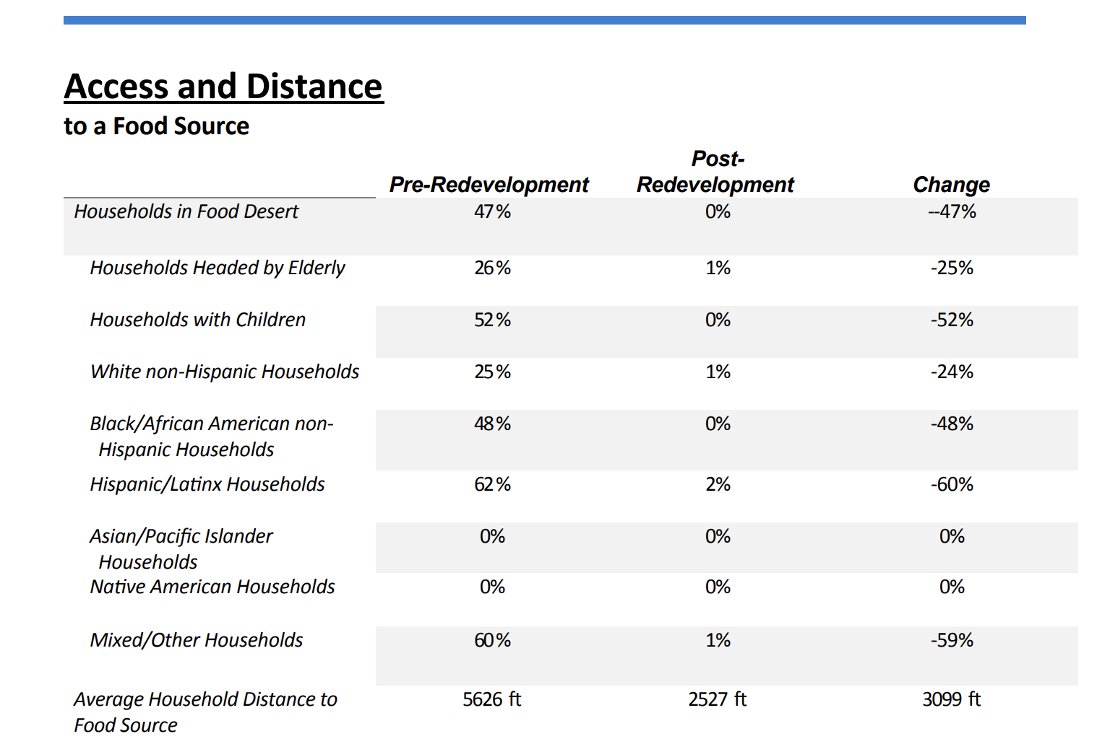
Scenario 1. Increase access to fresh food
PIONEER SITE
PORTER PAINT SITE
Notes:
In addition to the maps for each site analyzed there is a data table that shows the share of households the remain in a food desert. This shows the results for the Pioneer Site next to the Porter Paint site.
The narrative in the report that accompanies the tables provides a definition of “Food Desert”, includes key data points reported in the tables, a discussion of the contribution to improved community health, and citations to relevant research. The table and maps provide the user with a quantification of the households that would benefit, along with visuals and narrative to begin to compare with alternate locations and alternate uses.
Another use for this information is a way to help communities talk about cost and benefits of particular projects. A community development nonprofit, for example, might use the tool in discussions or plans that address racial disparities in access to fresh food and green space. The printed report along with the graphics provides a way to visualize the location and share of residents without adequate food access and those who would benefit from a brownfield site's redevelopment a full-service grocery store.

Slide 12

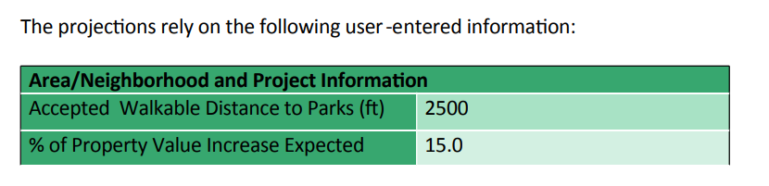
Scenario 2. Reduce health risks
How is BAT Applied?
A municipality intends to redevelop a brownfield as a park. They know better access to parks reduce health risks. They also know that cleaning up contaminated land reduces risk of exposure to hazards. They know the residents want a small park.
Notes:
Scenario #2 shows how the construction on of a new park on Madison Street Gas could affect the area/neighborhood and its current residents. A new park will improve area/neighborhood air quality if it provides new green space and may also provide recreational opportunities that are not otherwise available to current residents. The tool will estimate the share of the households who gain new access to a park. But remember, any site that has earned the label “brownfield” from local officials indicates that people may be at risk of exposure to potential hazardous contaminants from being on or near that site. The clean-up and remediation of a brownfield is intended to reduce the risk of human exposure to harm.
So our tool also estimates the number of households that would experience a reduction in the risk of exposure that occurs as a result of clean up and reuse, based on the demographics of the current residents.

Slide 13
Scenario 2. Reduce health risks
Notes:
Remember the Desktop tool provides a demographic profile of the area selected. So the user can easily show the distribution by race, household type, and the presence of elderly or children in the households for the entire area/neighborhood as they consider layers of the social determinants and root causes of health risks in combination with proximity to brownfields. For those wanting to address Environmental Justice issues, this provides a first step at understanding the demographics of a particular area.

Slide 14
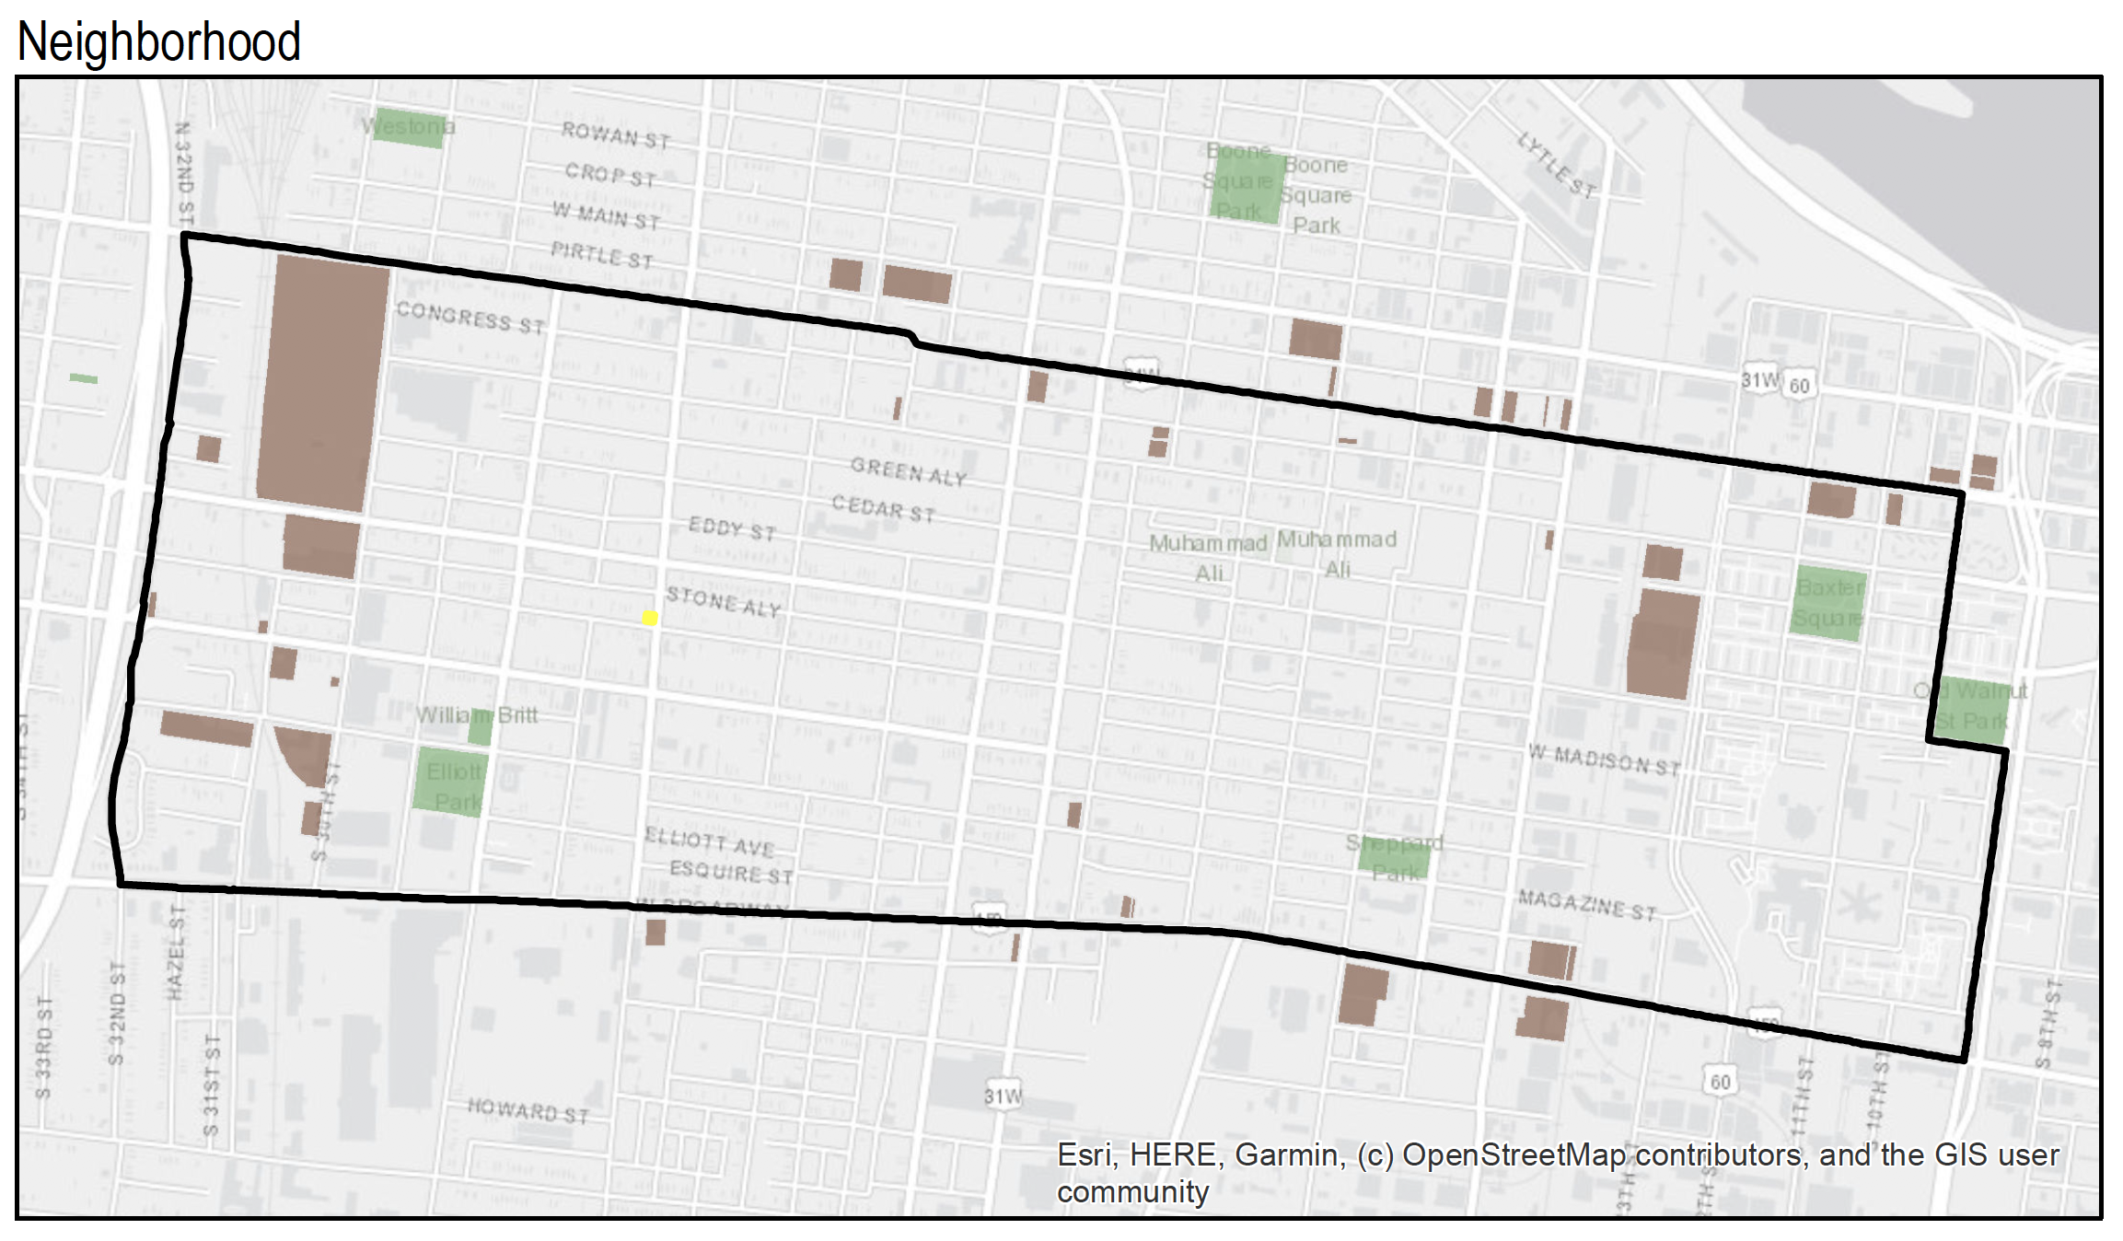
Scenario 2. Reduce health risks
Future Small Park
Notes:
This is the location of the future little park, perhaps a pocket park with exercise equipment. Or maybe just a nice green space to sit.

Slide 15
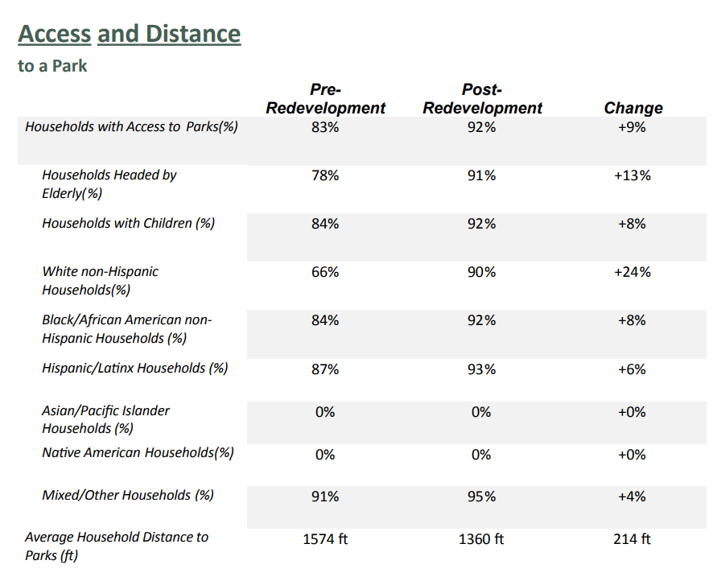
Scenario 2. Reduce health risks
Notes:
The output in the Desktop AP provides the user with this table that shows the share of households in Russell that are within walking distance (2500 feet) from a park. It’s not bad, 83%. By putting a park in we increase the share of households w/in walking distance by 9%. However, we also can look at the share of households that have other health risks decreased by removing this one little brownfield.

Slide 16
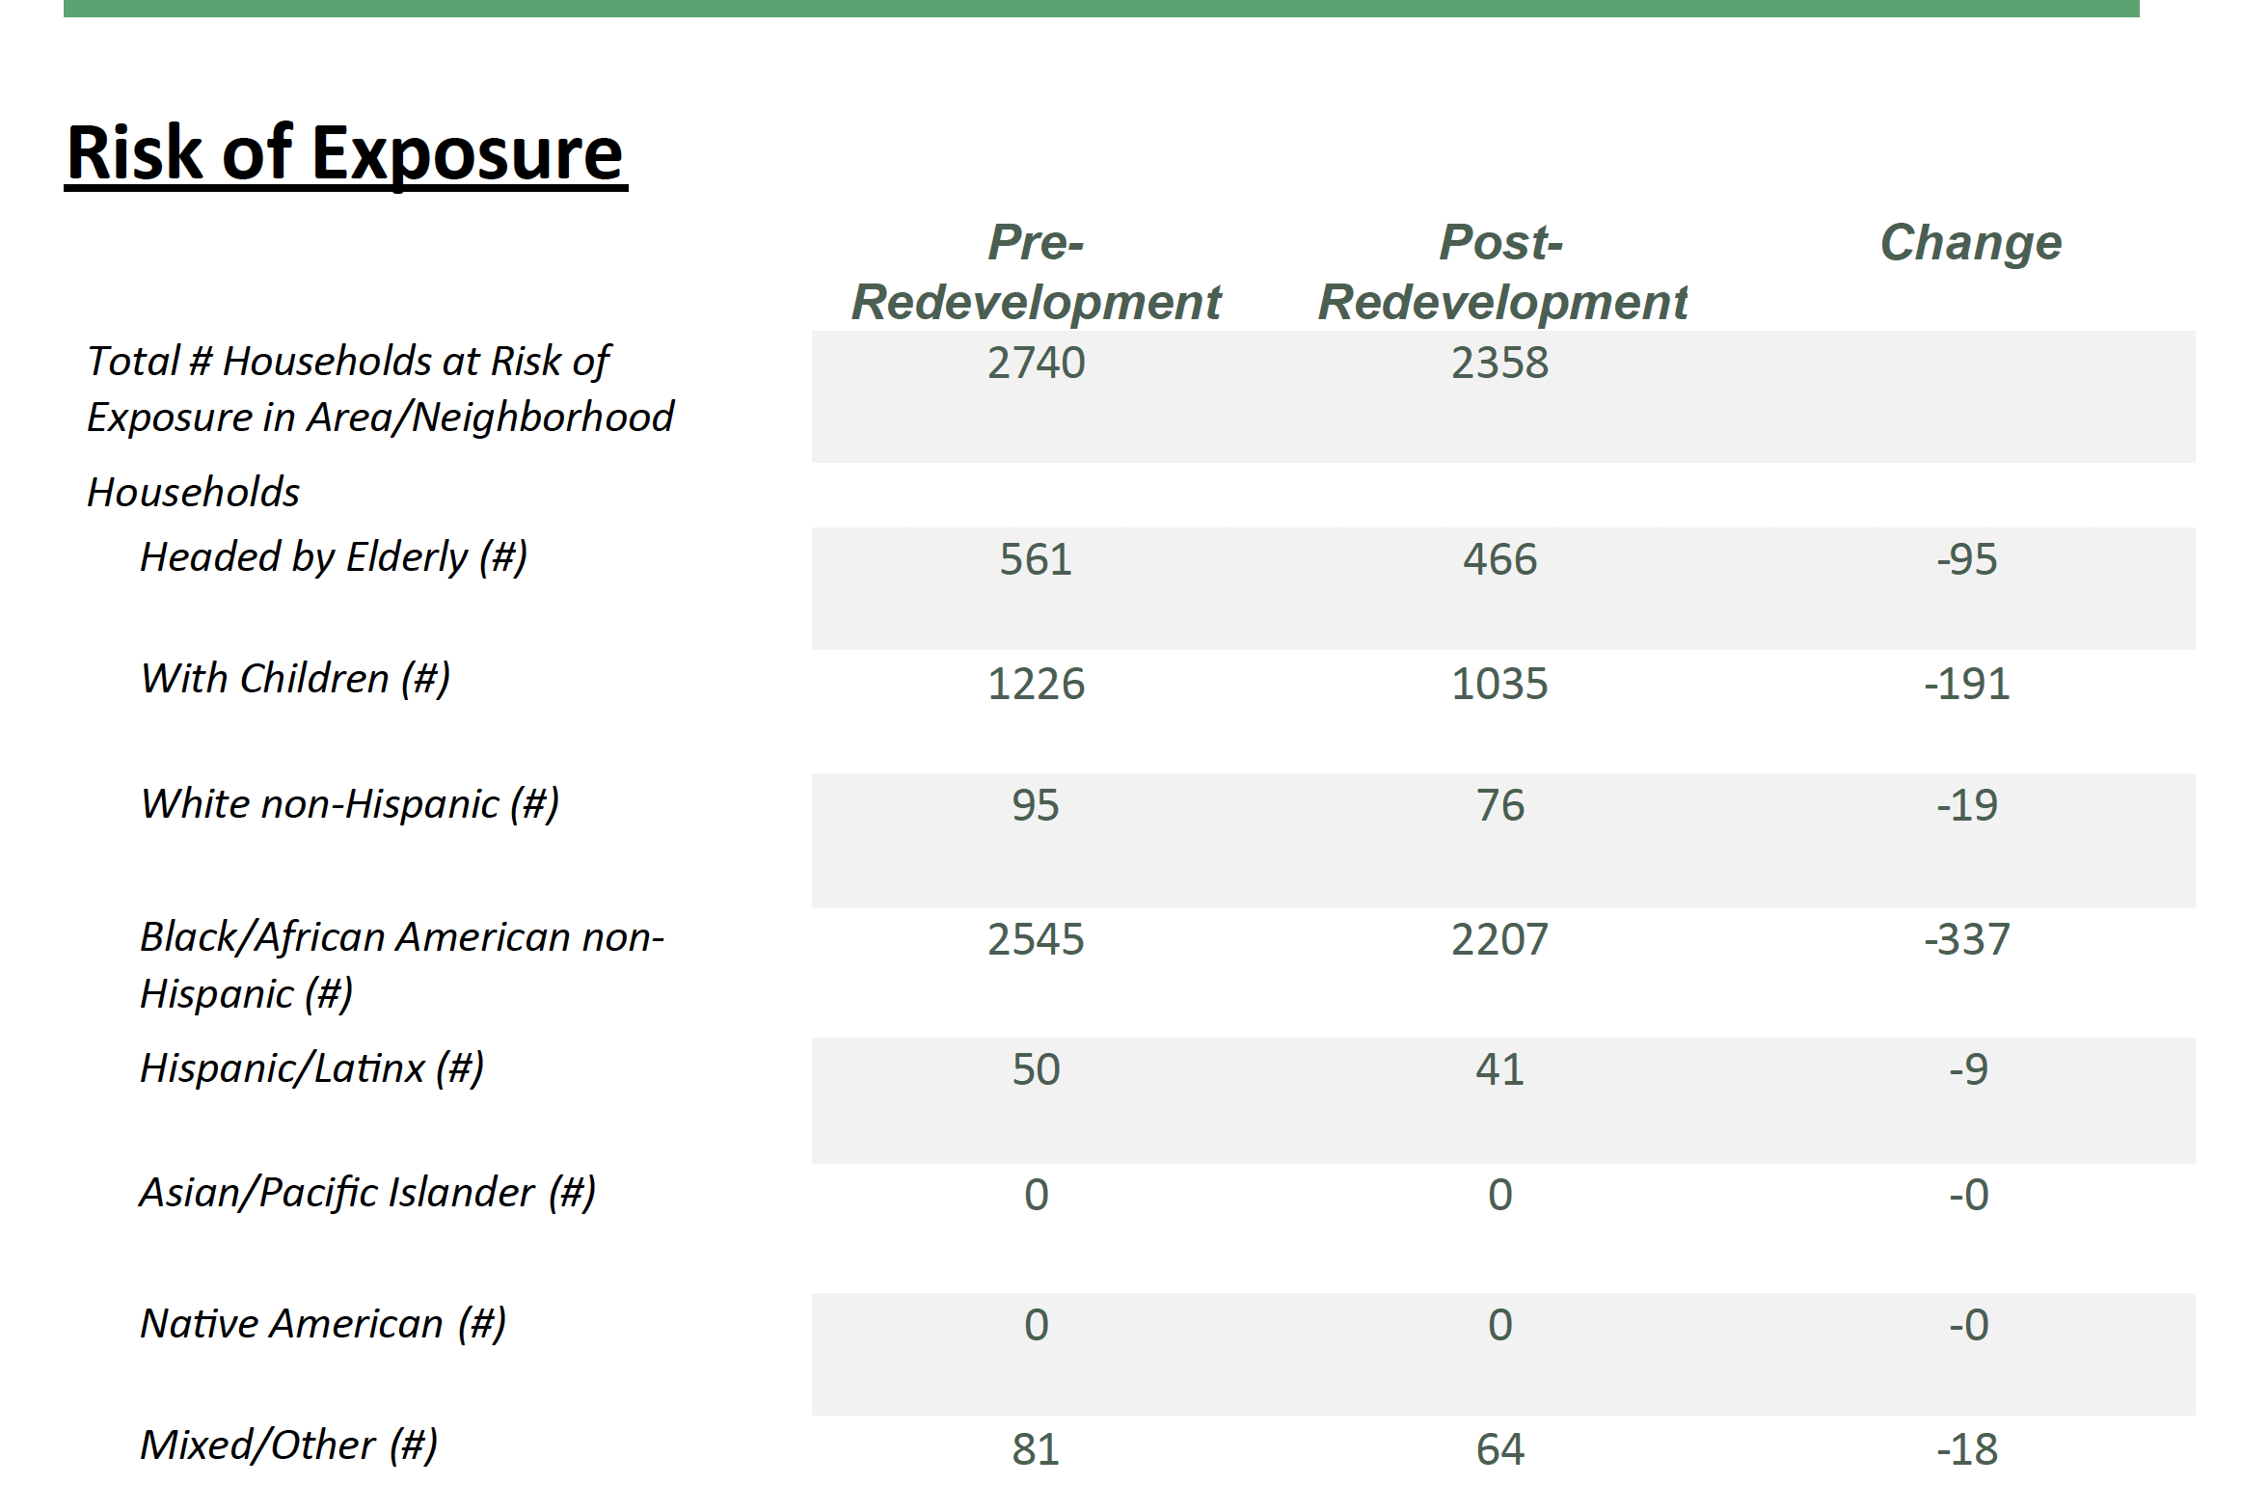
Scenario 2. Reduce health risks
Notes:
This table shows the number of households in the neighborhood that are ¼ mile from a brownfield site boundary before redevelopment and the decrease in those numbers after cleanup and redevelopment. The table also includes the number of households that may be more vulnerable due to racial or age group and the impact the redevelopment might have on reducing their risk of exposure. The benefits of cleaning up nearby brownfields for these groups is magnified due to assumed cumulative health risks. However, the numbers here take into account the risk that the continued presence of any other contaminated site may pose to households that remain within a ¼ mile proximity. When there is a cluster of brownfields in an area, any remaining brownfields could undermine risk reduction gained from the cleanup of only a single site. BUT it gets better, there are maps included!

Slide 17
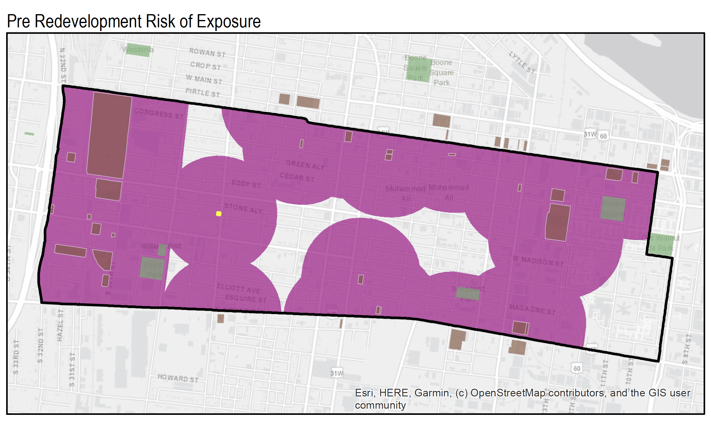
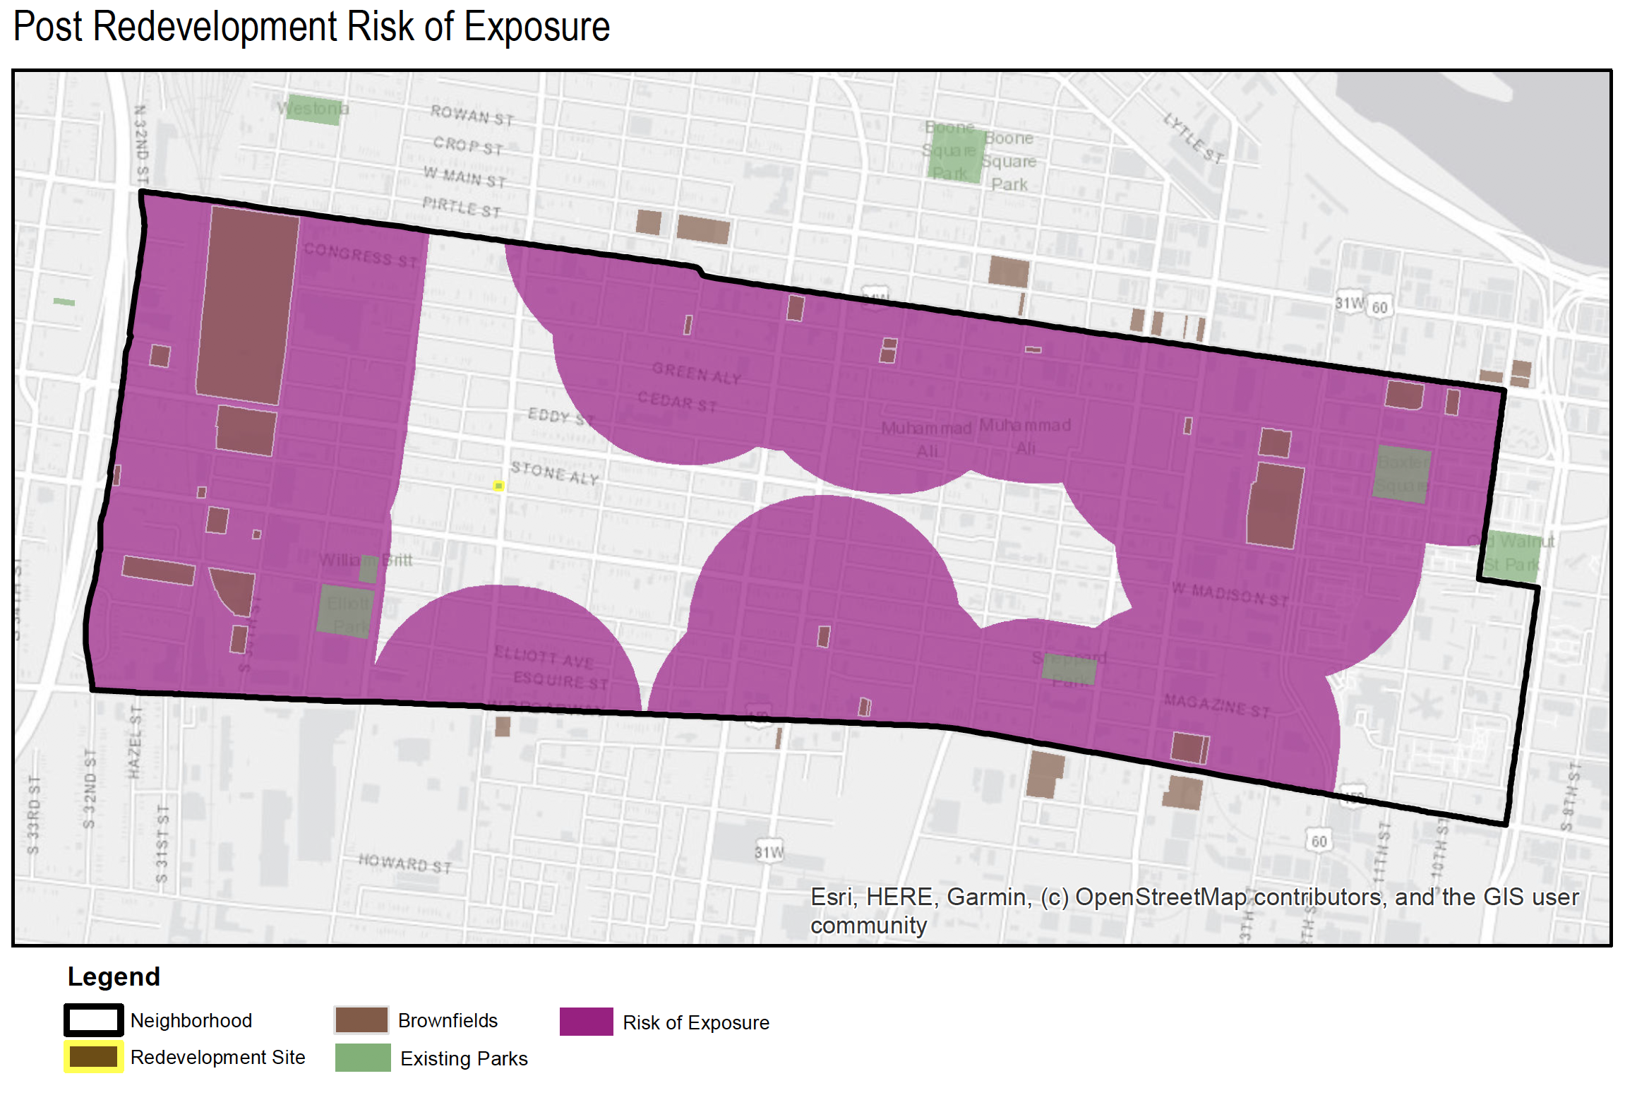
Scenario 2. Reduce health risks
Notes:
So the user gets a map, a visualization, that shows the area where the households are located that will have some level of risk reduction estimated because this little brownfield was turned into a little park.

Slide 18
HOW DO I START? What do users need?
Notes:
This is the screen folx see when they open up the BAT.

Slide 19
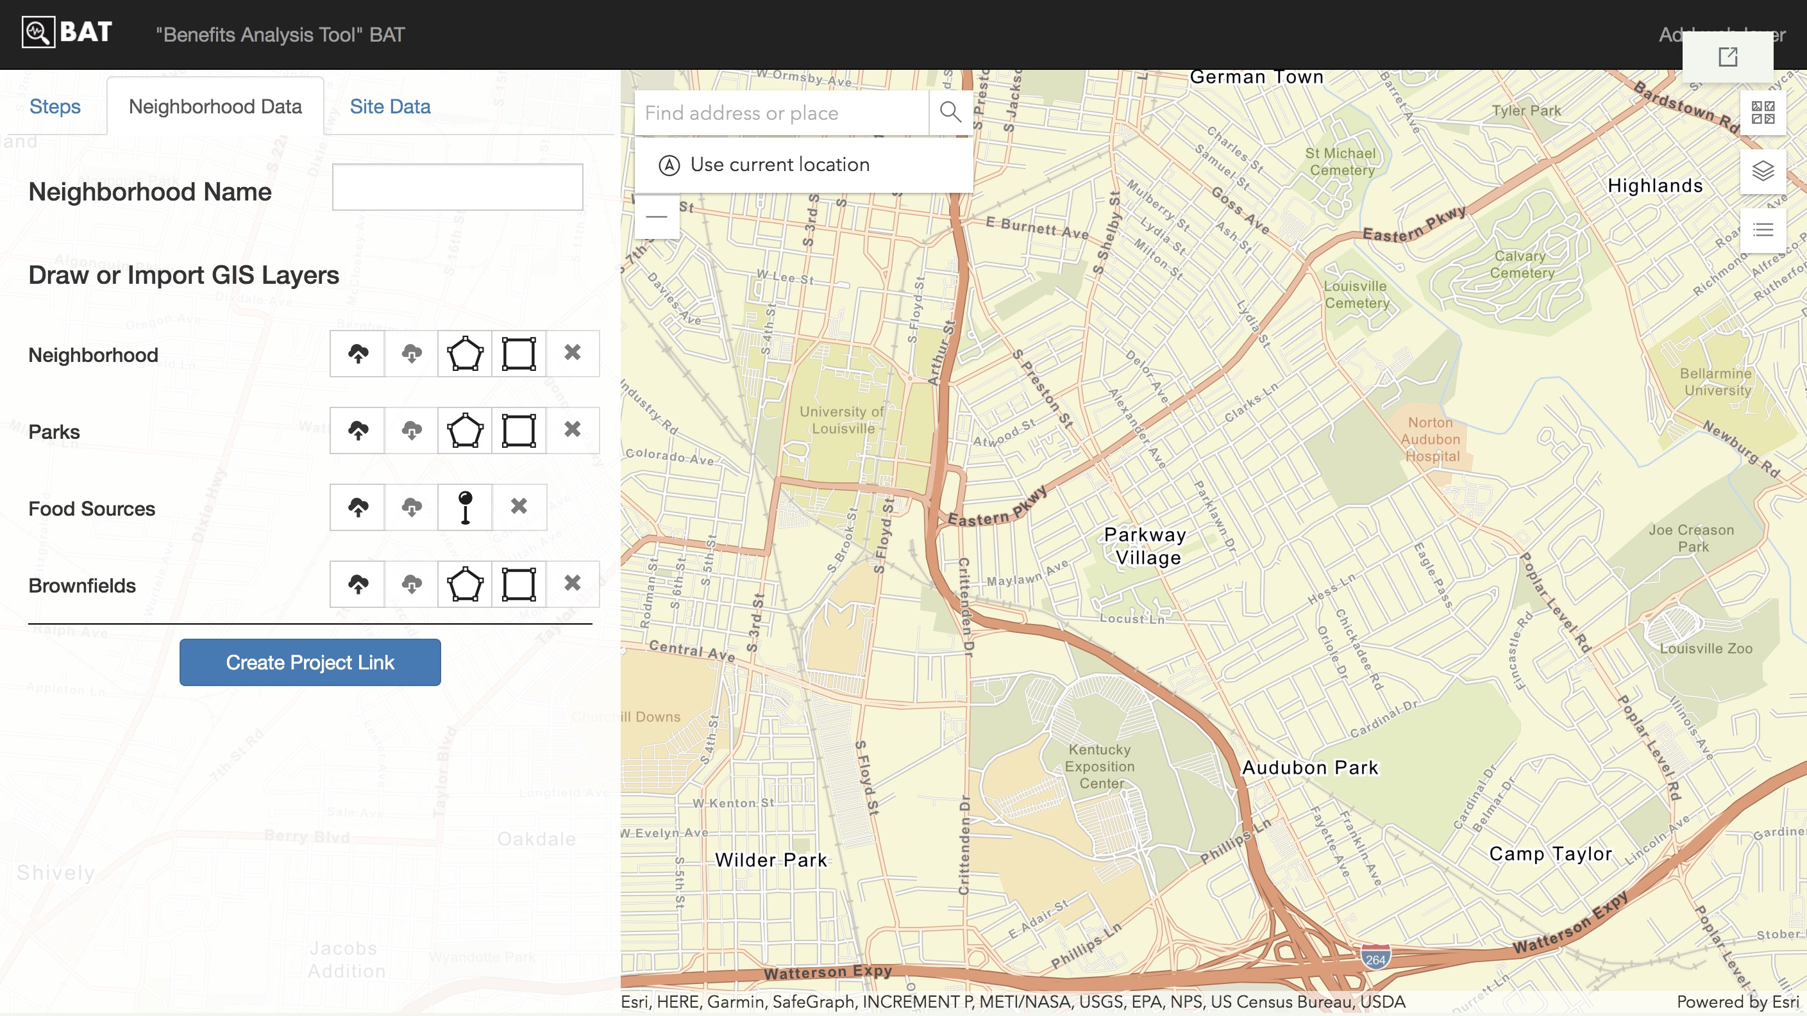
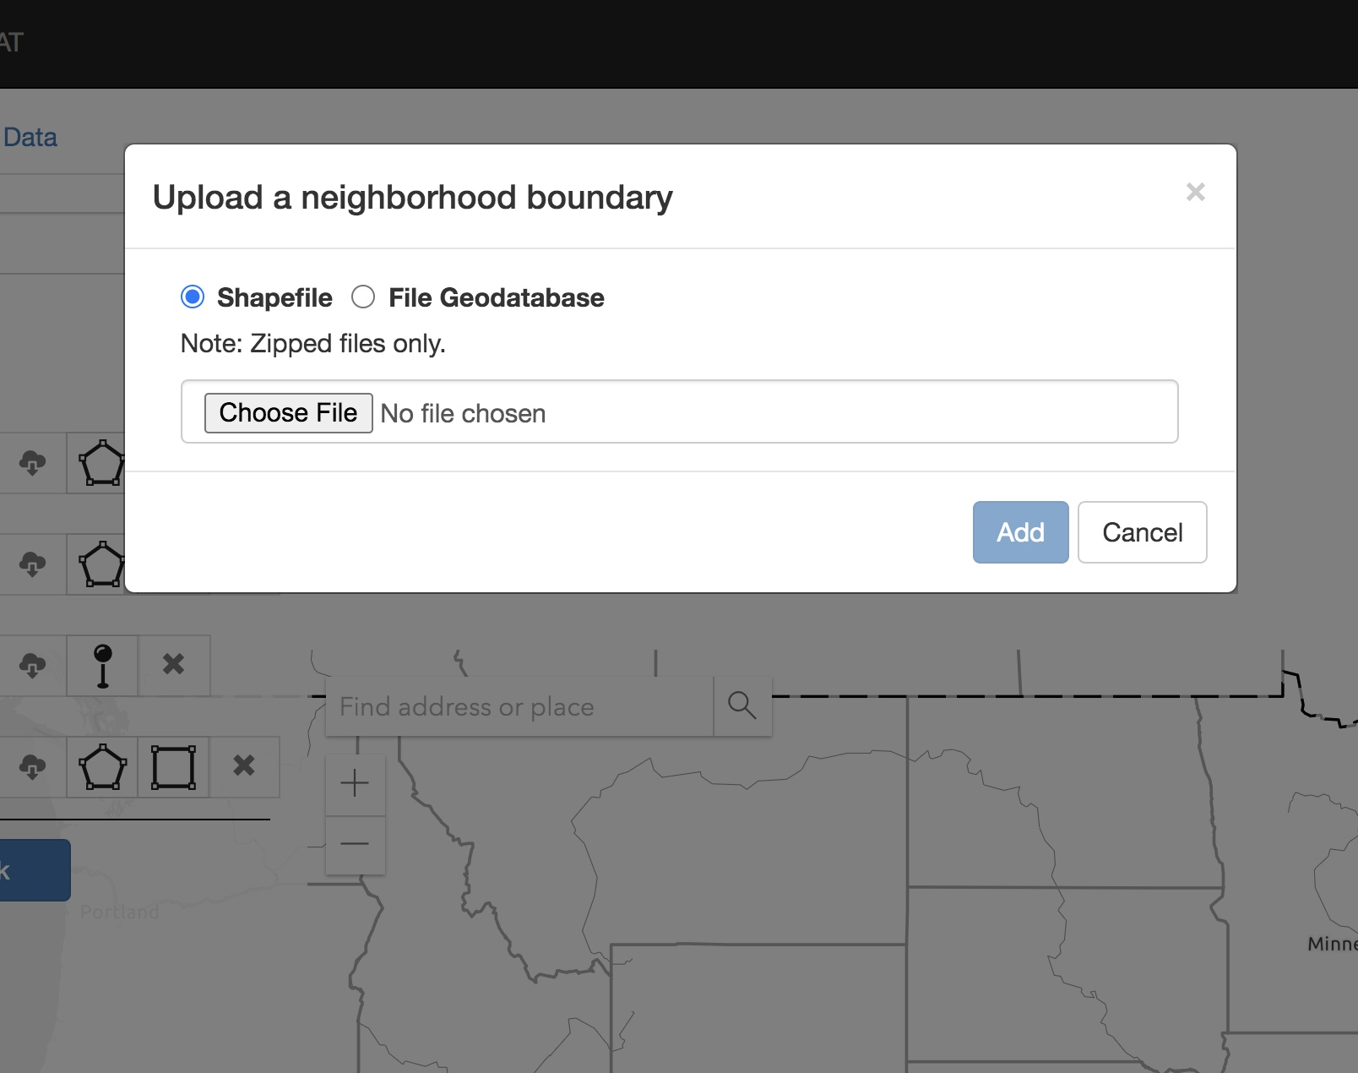
Users define area of interest
Notes:
What users need to use it (ideal for full use)
Know the boundaries of the area/neighborhood you are interested in.
You can draw them using the tool or you can upload a shapefile/geocoded file of the boundary.
You will also need to have access to your brownfield inventory for the area you are examining. Ideally that inventory will already be converted into shapefiles (not points). However there is a way to use the point files so that you can draw parcels yourself around the points.
The zipped shapefiles would be entered in the upload window you see here.
If the file is point data, you would add that file as a web layer and you would then use the “draw” function to draw the boundaries of each brownfield.
File paths/names for: Geocoded BF Inventory (Can be point data but preferably parcel/shapefile)
You will also want a data file with parks in your area. Or you can use the basemaps available to identify parks and then use the ’draw’ function to identify the boundaries of each existing park.
Geocoded Park Inventory (Can be point data but preferably parcel/shapefile)
Finally, you will want grocery store data points. These can be point data and can be uploaded from the best source you have. Or you can also use the basemaps to identify grocery stores and add your own pins.
Geocoded Grocery Stores Point data

Slide 20
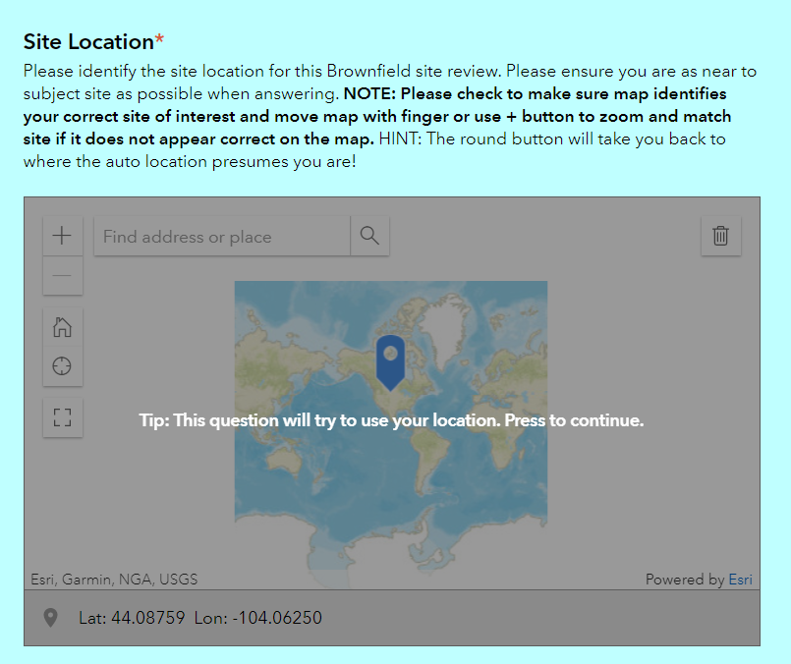
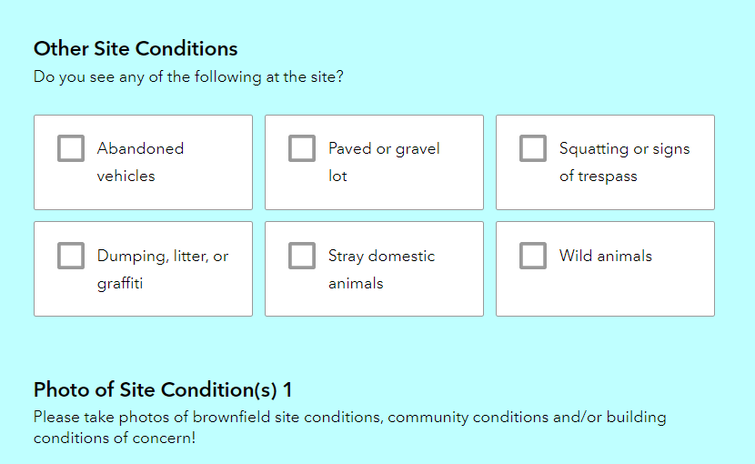
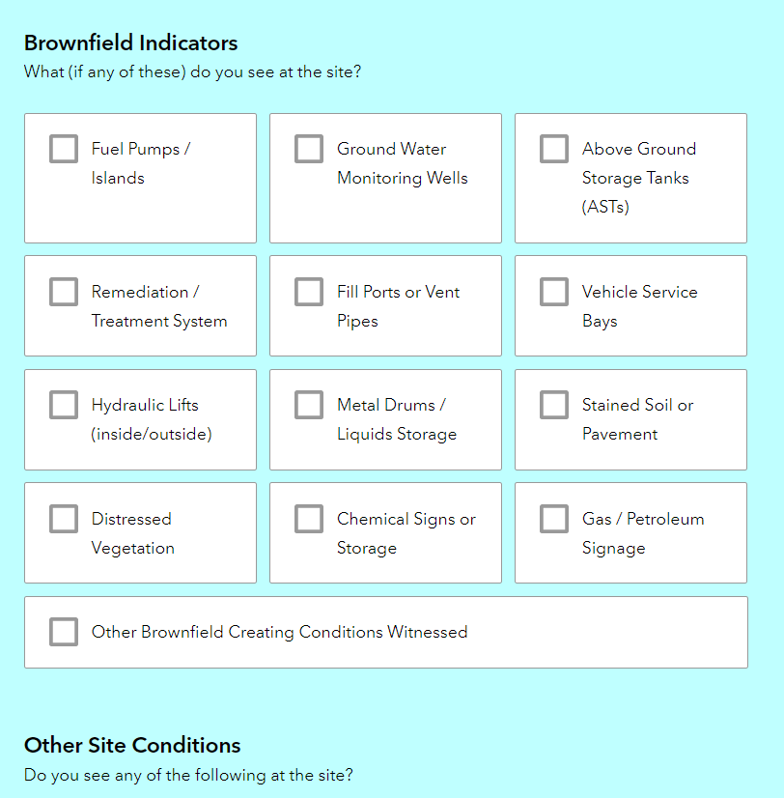
Brownfields Tracker
https://arcg.is/WmGSb0
Notes:
So backing up a minute to the discussion of brownfields inventories, this is the point in which we connect the BF Tracker to the BAT.
If a user (city or neighborhood organization) does not have an inventory of BFs for the area they are considering they can partner with a local university and community neighborhood organization to send folks out into the neighborhood to collect observational data about brownfields in the neighborhood using the Brownfield Tracker to collect this information. If they already have an inventory, but it needs updating and ground truthing, they can send folks out using the Tracker to verify and update an existing list. OR they might have an inventory they are happy with, and simply upload that into the Benefits Analysis Tool (BAT).

Slide 21
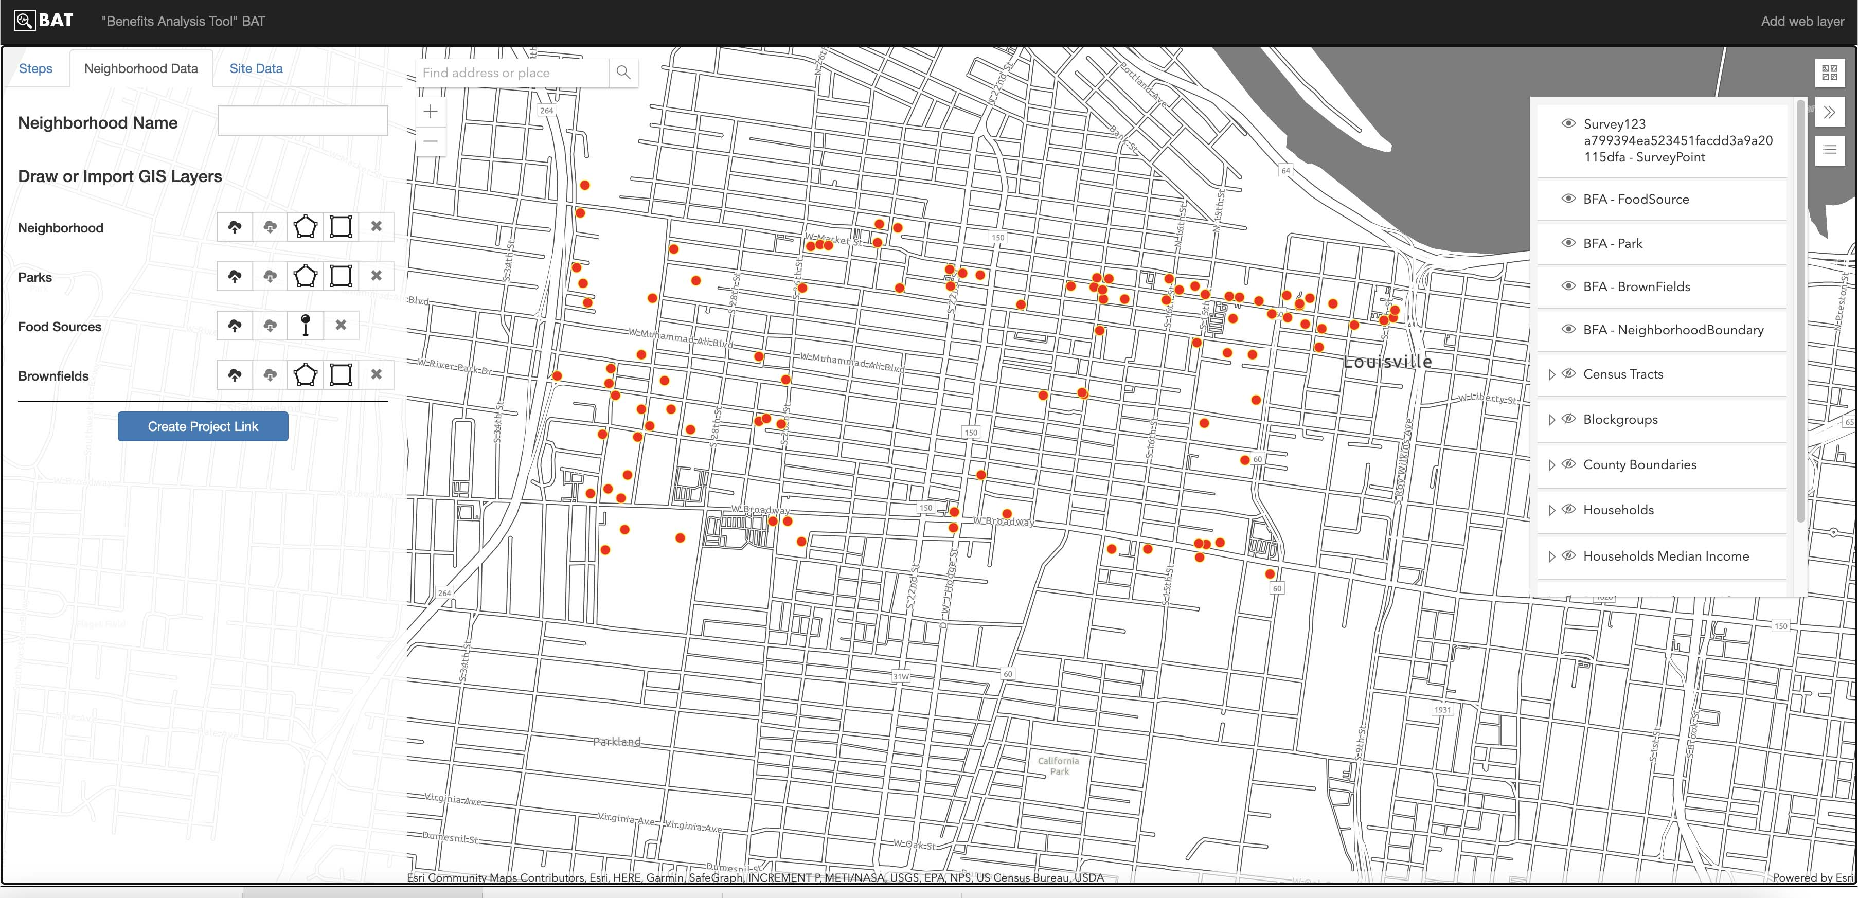
Converting Brownfields Point Data into Parcels/Polygons
Notes:
As I mentioned earlier, if you don’t have your point data converted to polygons, you can add the point data as a web layer and draw the polygons yourself. This slide gives you an idea of what that would look like once you load it as a web layer.
[This is a link to the Russell Data in this slide to use in a live demo of the tool.
https://services1.arcgis.com/cRvLdSPAsRupRo7I/arcgis/rest/services/survey123_a799394ea523451facdd3a9a20115dfa/FeatureServer
https://brownfieldbenefits.com/index.html?projectID=106408#

Slide 22
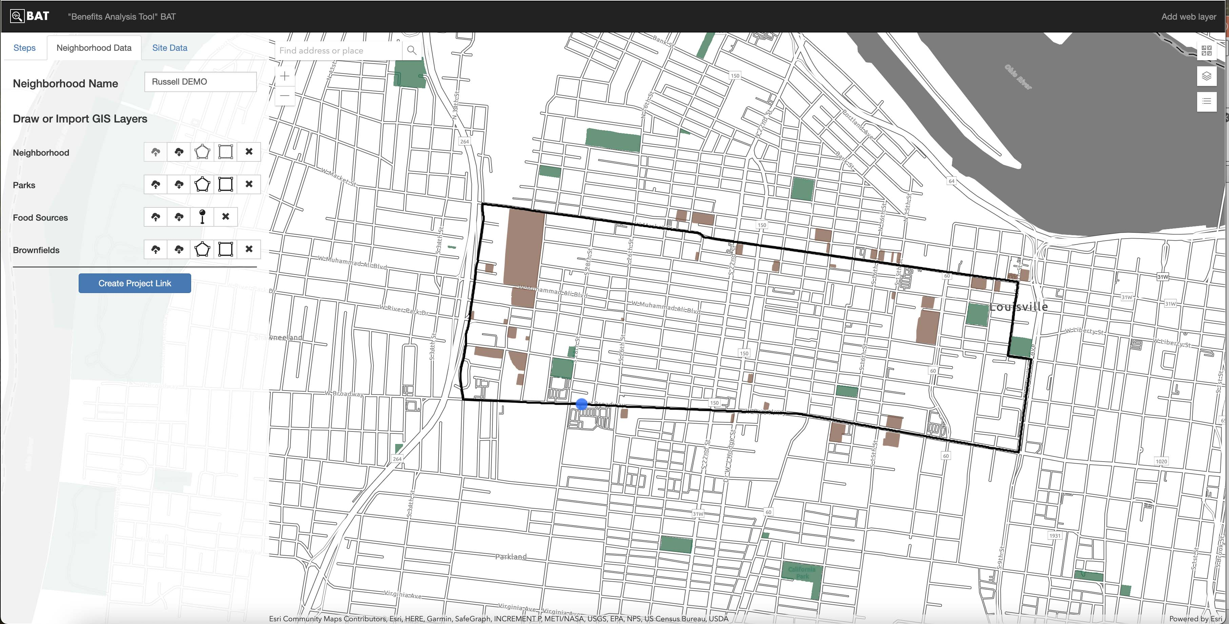
BAT with neighborhood, parks, food sources, and brownfields data entered.
Notes:
Once you have your neighborhood drawn and you have loaded or identified your parks, grocery stores, and brownfields, the user will see an interactive map with their data loaded and will be able to save a Project Link to be able to return to their specific data for their neighborhood.

Slide 23
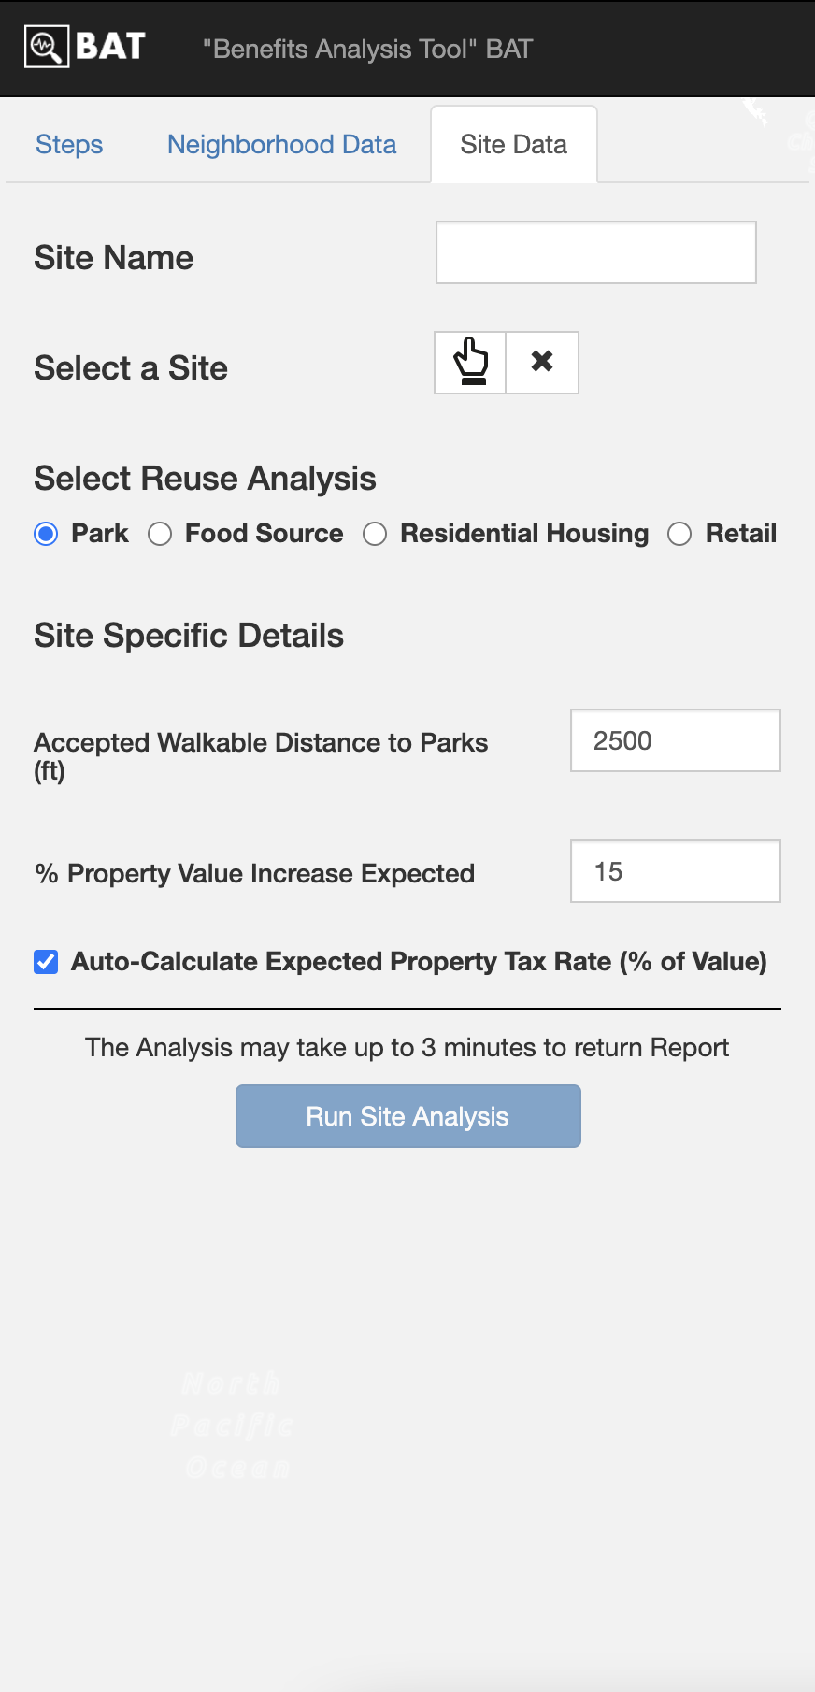
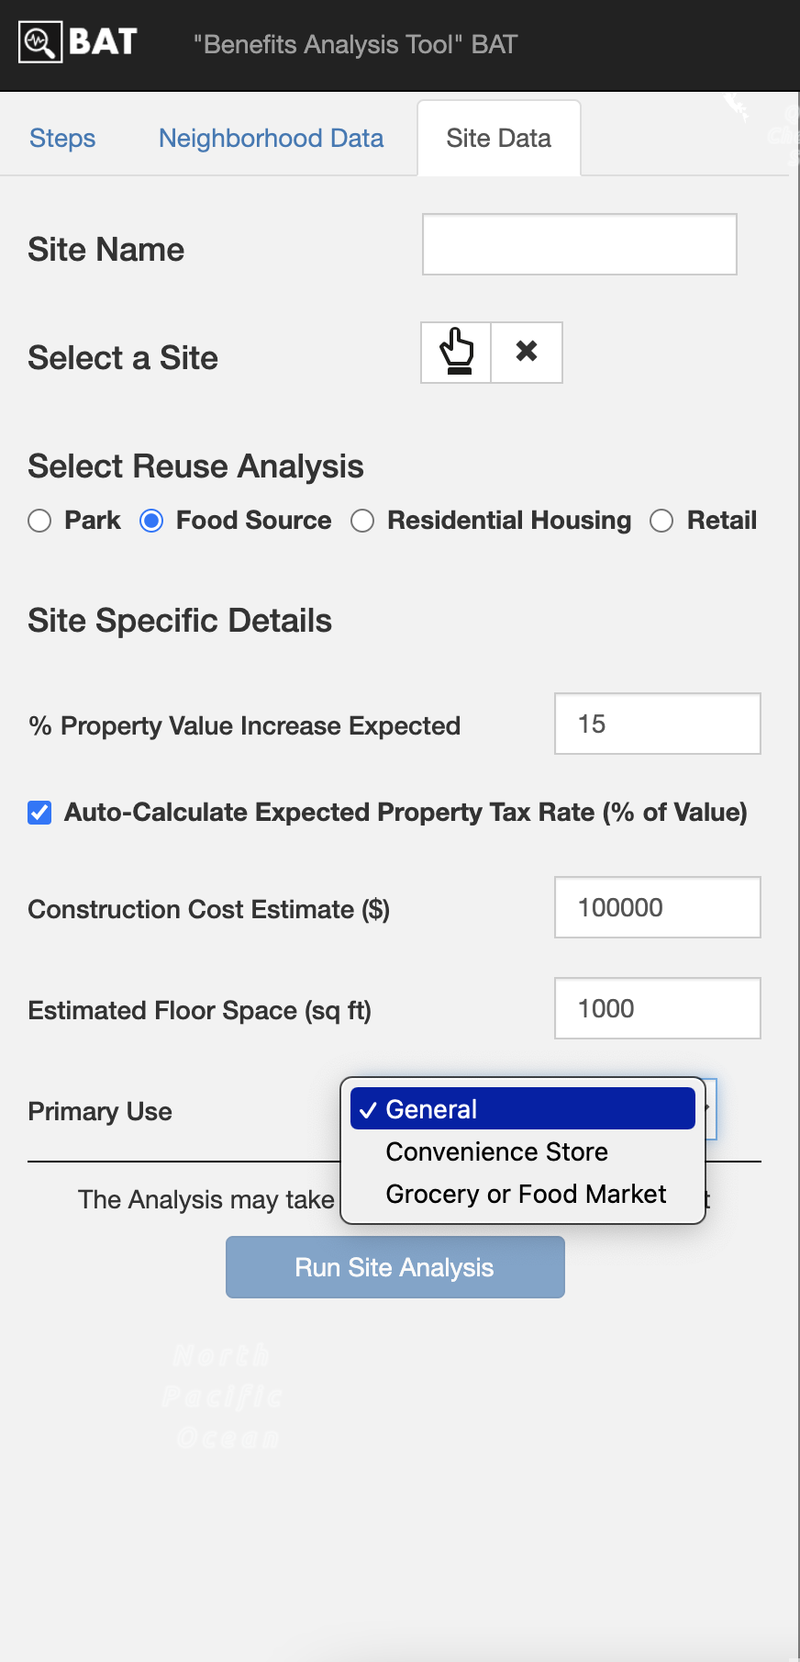
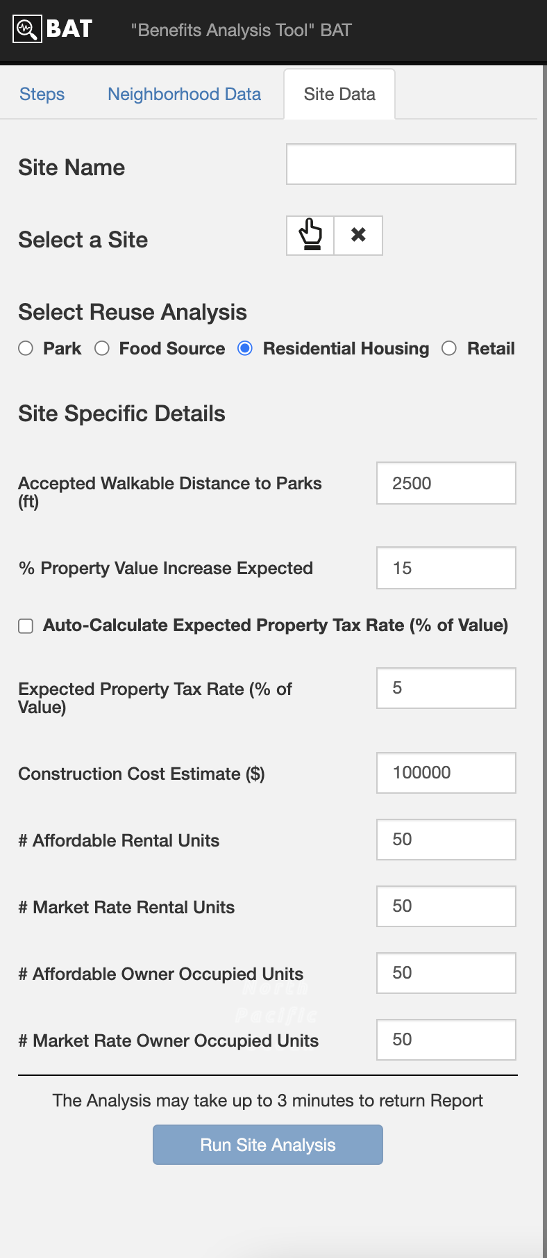
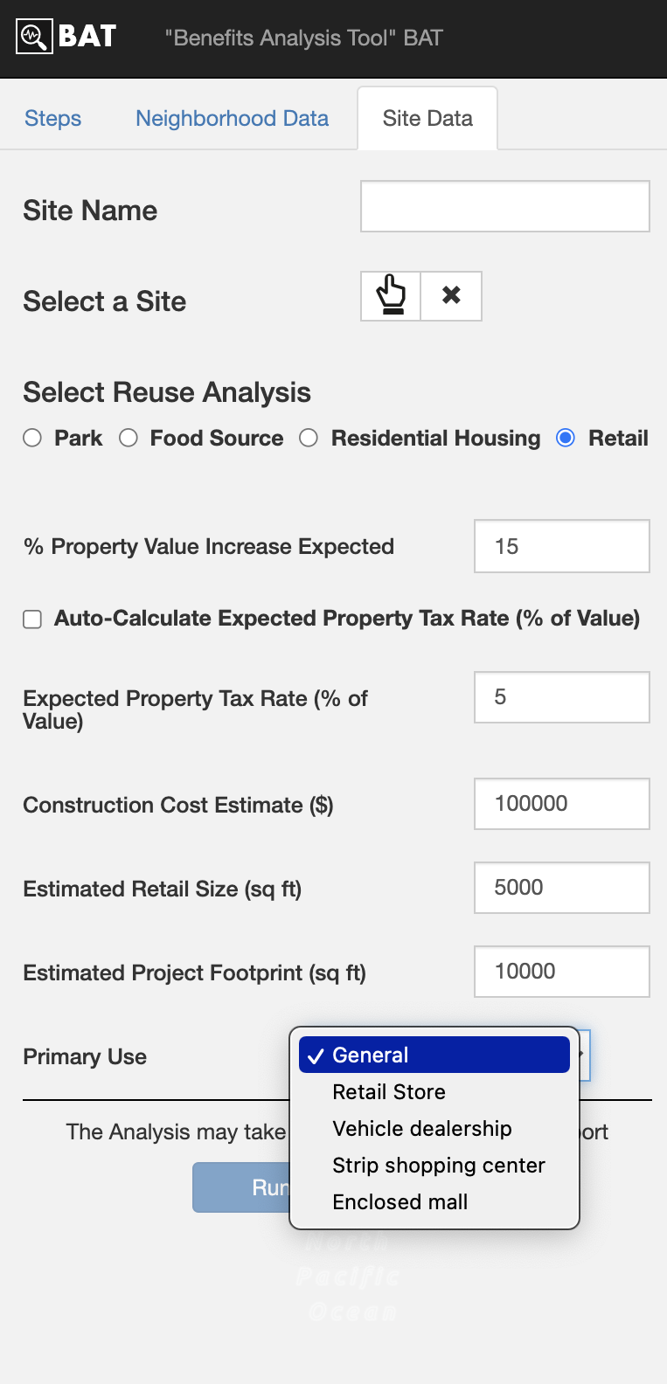
Notes:
Then you get to decide what type of reuse analysis you want to do, Park, Food Source, Residential, or Retail.
Each of these columns give you a sense of the information the user will need to have on hand to have a more robust analysis.
The BAT projects neighborhood changes associated with each of these reuse types.
Users can certainly play with the tool without specific information, but the more accurate they are the better the projections.
The user guide will walk the user through each of these windows and includes documentation about how the projections are calculated and what assumptions we use for each calculation.

Slide 24
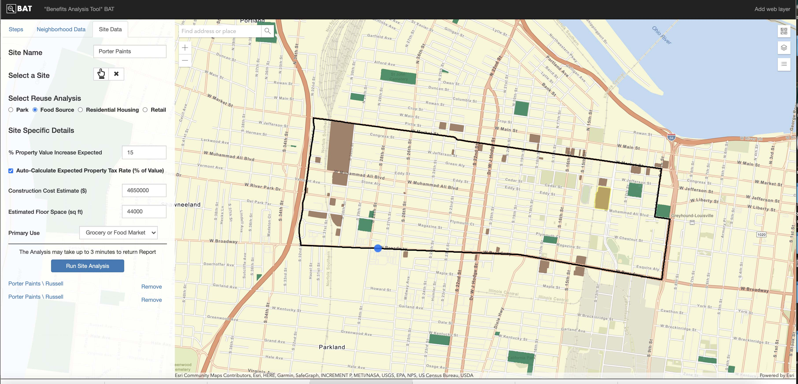
RUN SITE ANALYSIS FOR GROCERY STORE
Notes:
Finally you run the site analysis. The screen here shows data entered for putting a grocery store on the site highlighted in yellow. It is the same site that I showed you in earlier slides. After the site analysis runs, you’ll see a line appear below that button. (Here you see two because I ran it twice).
You can click on the item and it will open a PDF in a new window that is your unique report for your area and selected re-use.

Slide 25
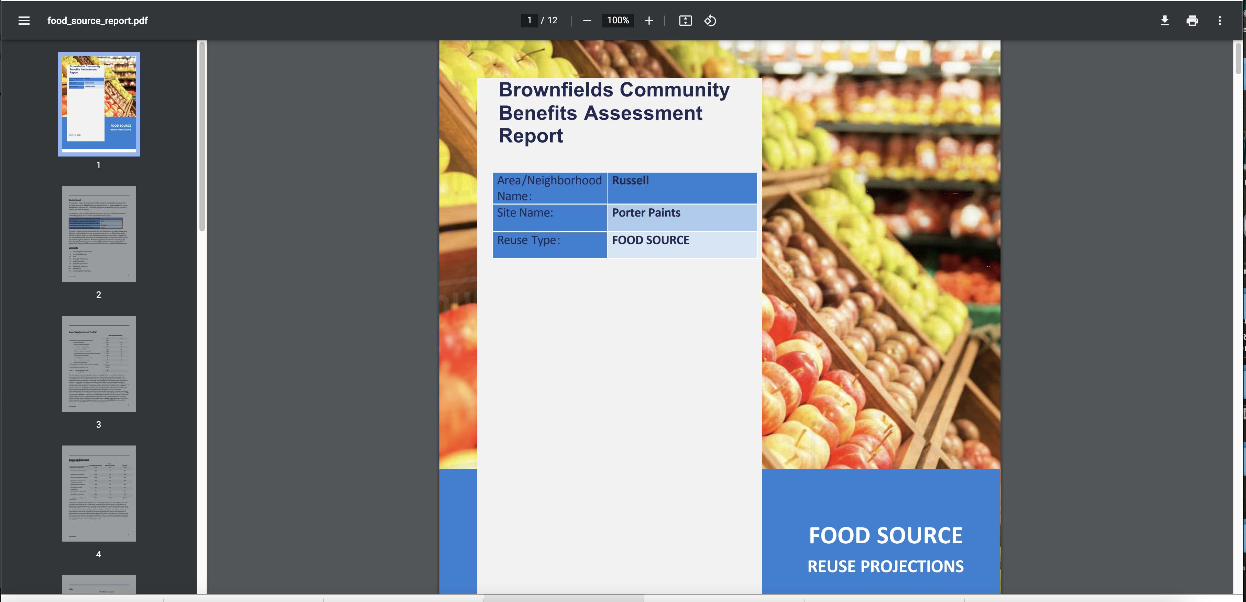
REPORT OUTPUT SCREEN
Notes:
You can save it and use it how ever you think best works for you.

Slide 26
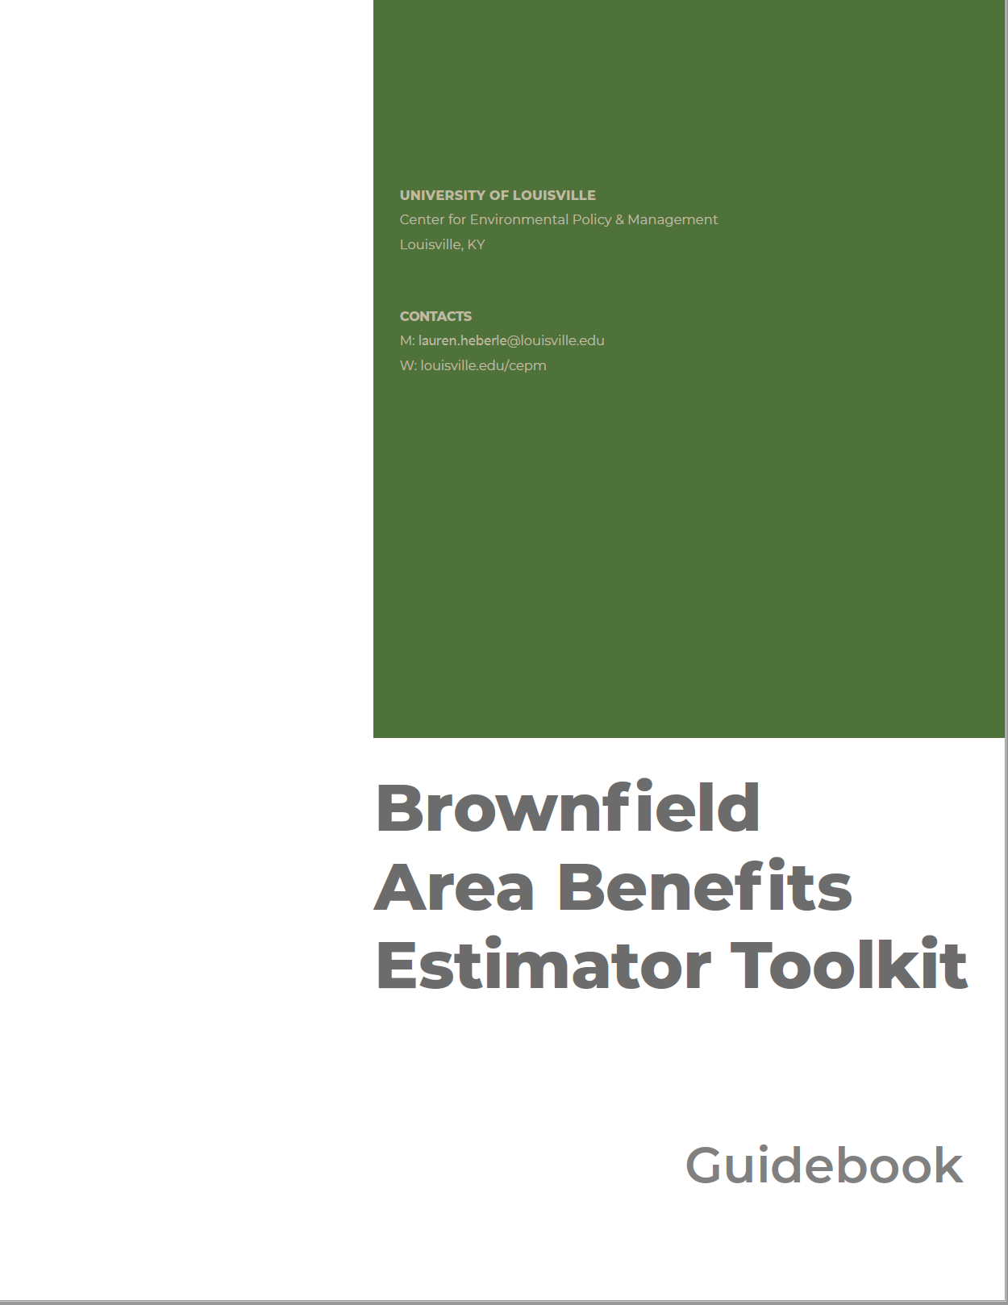
WHAT’s NEXT?
and
Questions
PILOTS:
Louisville
St. Louis
Others
ROLL OUT:
R4
KDEP
EPA HQ, REGIONS, STATES, AND TRIBES
TABS
SUSTAINABILITY PLAN:
Host @ UofL
Iterations/Modifications
Contact: lauren.heberle@Louisville.edu
Notes:
We are happy to have more demonstrations with other Regions, States, and Tribes, the TABs, and any other EPA office that might be interested.
Our guidebook and user instructions are getting closer to being finished. We have established the AWS server space at UofL and will be pursuing sustained support to maintain the server cost at minimum and help with thenecessary staffing/work effort. Happy to take questions.

Slide 27




Our Team Members
Dr. Lauren C. Heberle, Associate Professor of Sociology, Director of the Center for Environmental Policy and Management, University of Louisville
Dr. Peter B. Meyer, President and Chief Economist of The E.P. Systems Group, Inc. and Professor Emeritus of Urban Policy and Economics, University of Louisville.
Joseph Schilling, LL.M., Senior Research Associate, The Urban Institute
Chris Harrell, J.D., M.P.A., Center for Environmental Policy and Management; Founder and Director of Redevelopment for Lazarus Group LLC
Ryan Eckdale-Dudley, Director of Business Development, Symbiont
Danielle Rohret - UofL CEPM, UPA Graduate Research Assistant
Dr. Allison Smith - Louisville Metro Government
Em Nordling - UofL CEPM
Dr. Brandon T. McReynolds - UofL CEPM, Sociology
Dr. David Adam Sizemore - UofL CEPM, Sociology
Dr. Jamar Wheeler – UofL CEPM, Sociology
Dr. Kent Pugh – UofL CEPM, Sociology
Carol Norton - UofL CEPM, Sociology
Dr. Steven Patrick Sizemore - UofL CEPM, UPA
Jimena Pinzon - Virginia Tech
Parker Sherwood - UofL Law & UPA

Slide 28
Additional Scenario

Slide 29
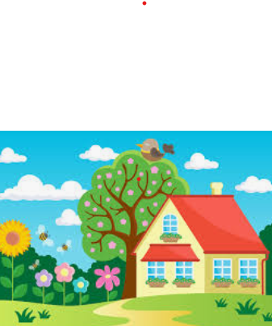

How is BAT Applied?
Public Revenue and Displacement
A Community Housing Development Organization uses the tool to demonstrate to the municipality how redeveloping a brownfield site for housing can increase public revenues keeping risk of displacement in mind.
Notes:
All of our reuse options include an estimate of increased public revenues and a risk of displacement measure for renters in the area. This example highlights what that might look like for redeveloping a site for residential use.

Slide 30
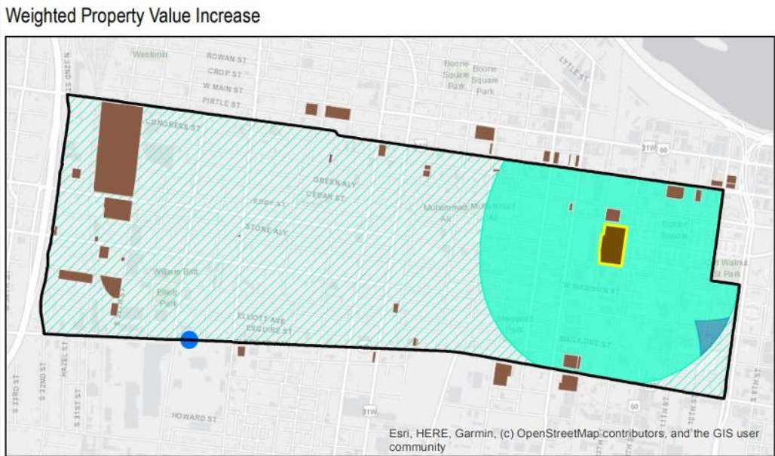
Scenario 2. Property Tax Revenue
Property Tax revenues increase by 1.16% post-redevelopment for a gain of $17,575 in total revenue
Notes:
Redeveloping a brownfield increases the value of the site in question. However, research also shows that property values tend to rise in the surrounding area post-redevelopment thus contributing to potential increased property tax revenues from the area near the brownfield. Our example assumes a 5% property tax rate, but the user can override that number, that will be used in combination with the property value increase to get an estimate of property tax revenue increase. Our calculations take into account the rise in value of the redeveloped property (in this case 15%) within a buffer zone of the property based on what current research has shown. In addition, the default value used in the calculation of property value increase is based on a comparison of the median income of the residents in the selected area with the median income of the county in which the area is located. This is because research has shown that property value increases are higher in poorer areas, or areas where the median income is much lower than the county median income. Furthermore, our formula also takes into consideration the dampening effect of the remaining brownfields that would continue to depress property values. So, a brownfields development coordinator can use the tool to show the magnitude of estimated increased property tax revenues while also making an argument for the redevelopment of multiple brownfields in order to get a bigger bang for their buck. (The Blue triangle, represents the portion of the area that gets a full 15% increase whereas those that are still within a radius of any other identified brownfield is halved. BUT what about displacement of residents due to increased housing costs that are bound to happen due to property value increases? This is particularly important in the work happening right now in the Russell neighborhood.

Slide 31
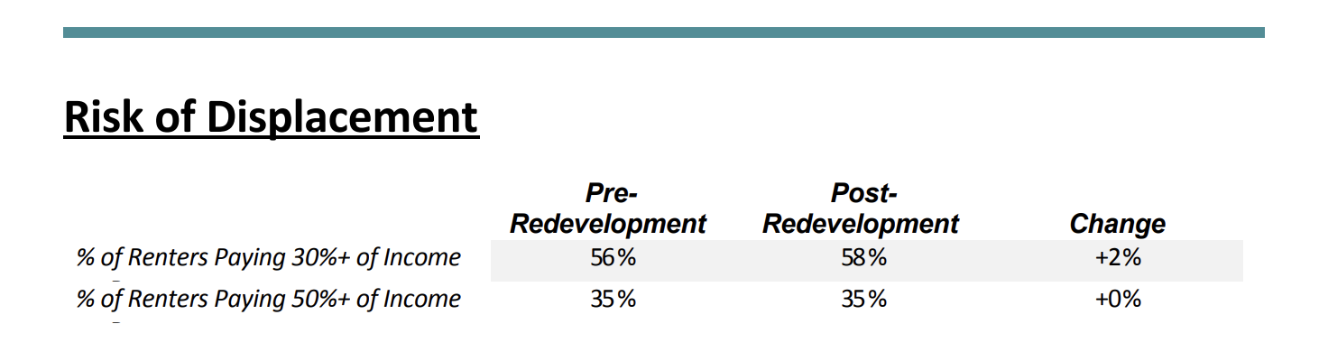
Scenario 2. Risk of Displacement
This area was already at risk of displacement with any redevelopment project.
Notes:
The report output includes a table that shows data for renter households present prior to redevelopment. We focus on existing renters because we can not make assumptions about incoming household cost burdens. We do know, however, that it is existing renter households that tend to be most vulnerable to involuntary displacement as a result of new development. We there fore estimate the share of households who are considered “cost‐burdened” with housing costs that exceed 30% of a household’s yearly income and therefore may be at risk of displacement from their home. They are considered severely cost‐burdened when paying more than 50% of their income. So you see here that this area is already cost burdened and therefore anti-displacement measures should be part of the discussion.

