Slide 1
Paying Your Bill
What you need to know about the Bursar’s Office

Slide 2
The Bursars Office
The Bursar’s office is responsible for:
Student Billing
Electronic billing
Viewing the bill on ULINK
Payment Processing
Cash, Check (personal or cashier’s) or money order accepted in office
E-check or credit/debit card accepted online only
Refund Processing
Payment plans

Slide 3
First Things First-
Set Up Your PIN!!
The Bursar’s Office uses the PIN to be compliant with FERPA privacy and security policies.
Please note the Bursar’s office cannot, and will not, release information to anyone without a PIN.
When a student establishes a PIN, the student can share the PIN with a parent or any other individual, enabling them to have access to the student’s account. It also allows our office to speak about the account over the phone.
You may set up your PIN via ULINK

Slide 4
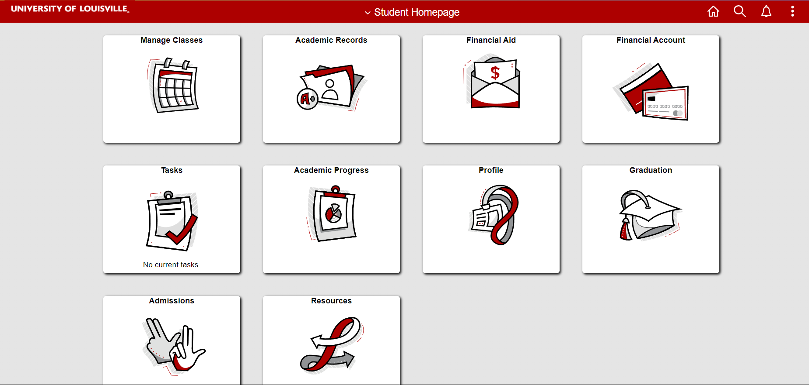
How do I set up the PIN?

Slide 5
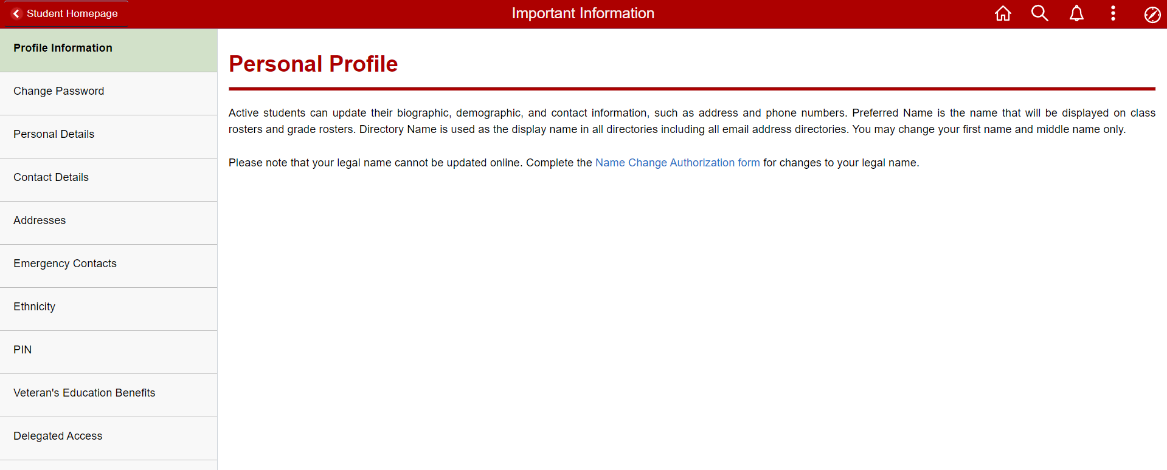
How do I set up the PIN?

Slide 6
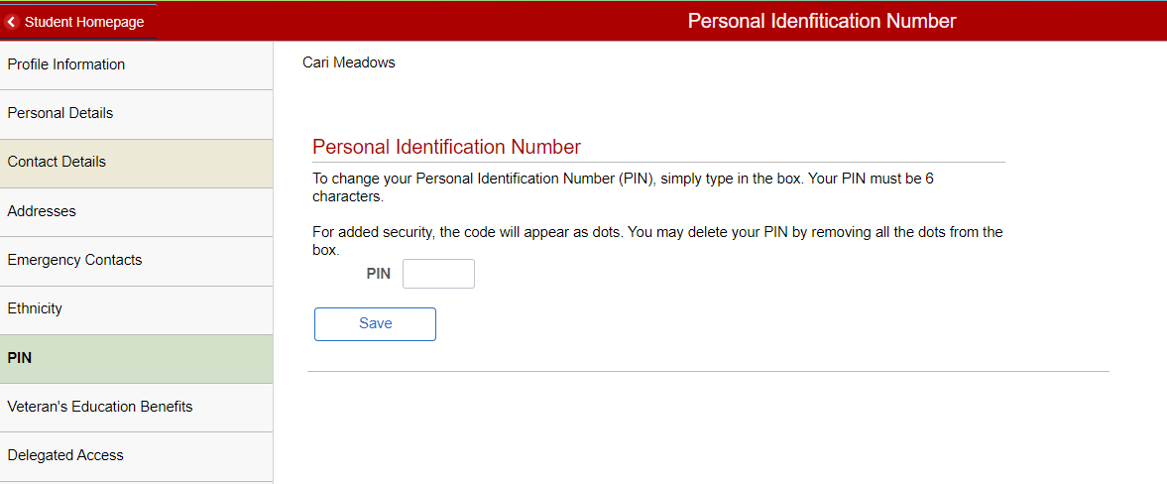
How do I set up the PIN?

Slide 7
Set Up Delegated Access!
We know that students often rely on the support and counsel of the people they trust to help navigate campus finances. We want to be able to talk with whoever you've chosen to represent you. At the same time, we're committed to honoring privacy rules, like FERPA.
Students, we need your permission to talk with anyone other than you about your University of Louisville account. UofL makes it easy for you to grant and maintain this permission through delegated access.
Add a delegate, or make changes, through Ulink.

Slide 8
Set Up Delegated Access!

Slide 9
Set Up Delegated Access!

Slide 10
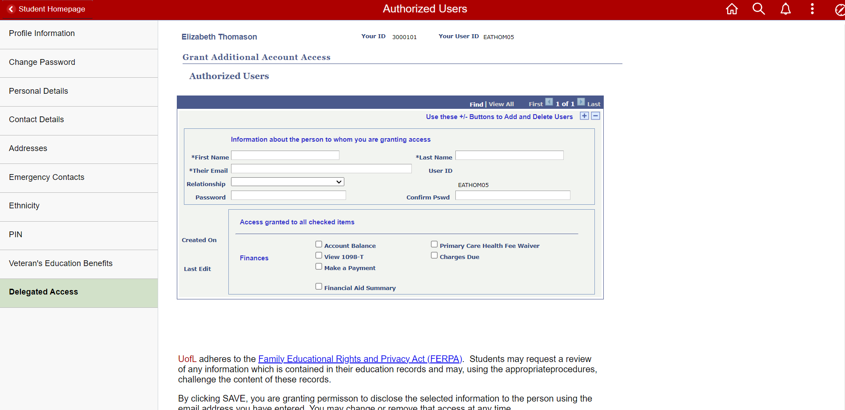
Set Up Delegated Access!

Slide 11
Email Notification Policy
The official method of communication with the University of Louisville Bursar's Office is via the University issued email account. In order to stay informed and aware, students are required to set up and maintain their email accounts. You should check your email frequently.
No paper billing statements will be issued. One may find their tuition statement in the ULINK account under Financial Account
We recommend that you add the following email address to your "safe" list within your email system's spam filters: bursar@louisville.edu
If our office does need to mail a check, document, form or notice, we will use the mailing address from your ULink account.

Slide 12
Review Student Account

Slide 13
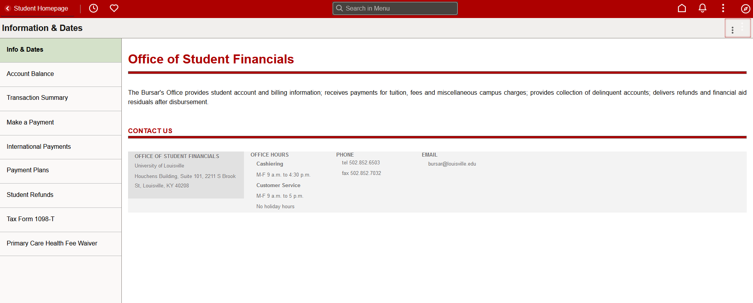
Review Student Account

Slide 14
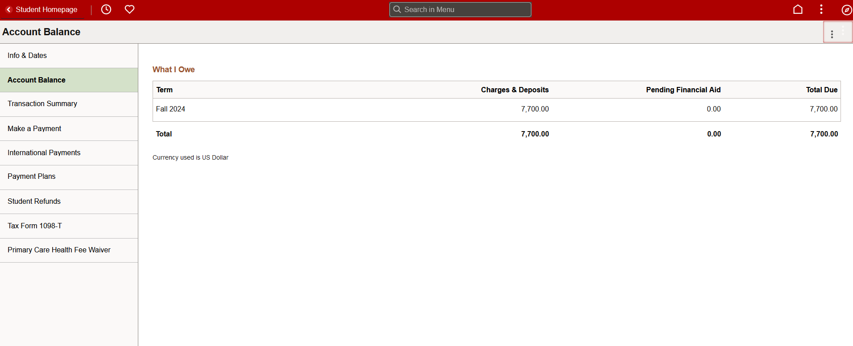
Review Student Account

Slide 15
Review Student Account

Slide 16
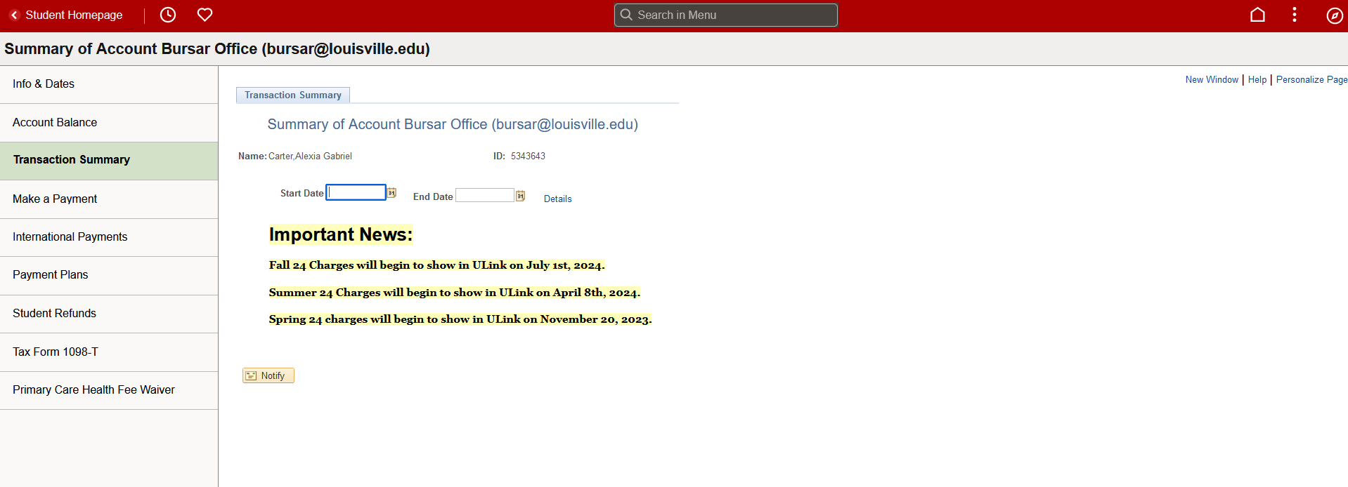
Review Student Account

Slide 17
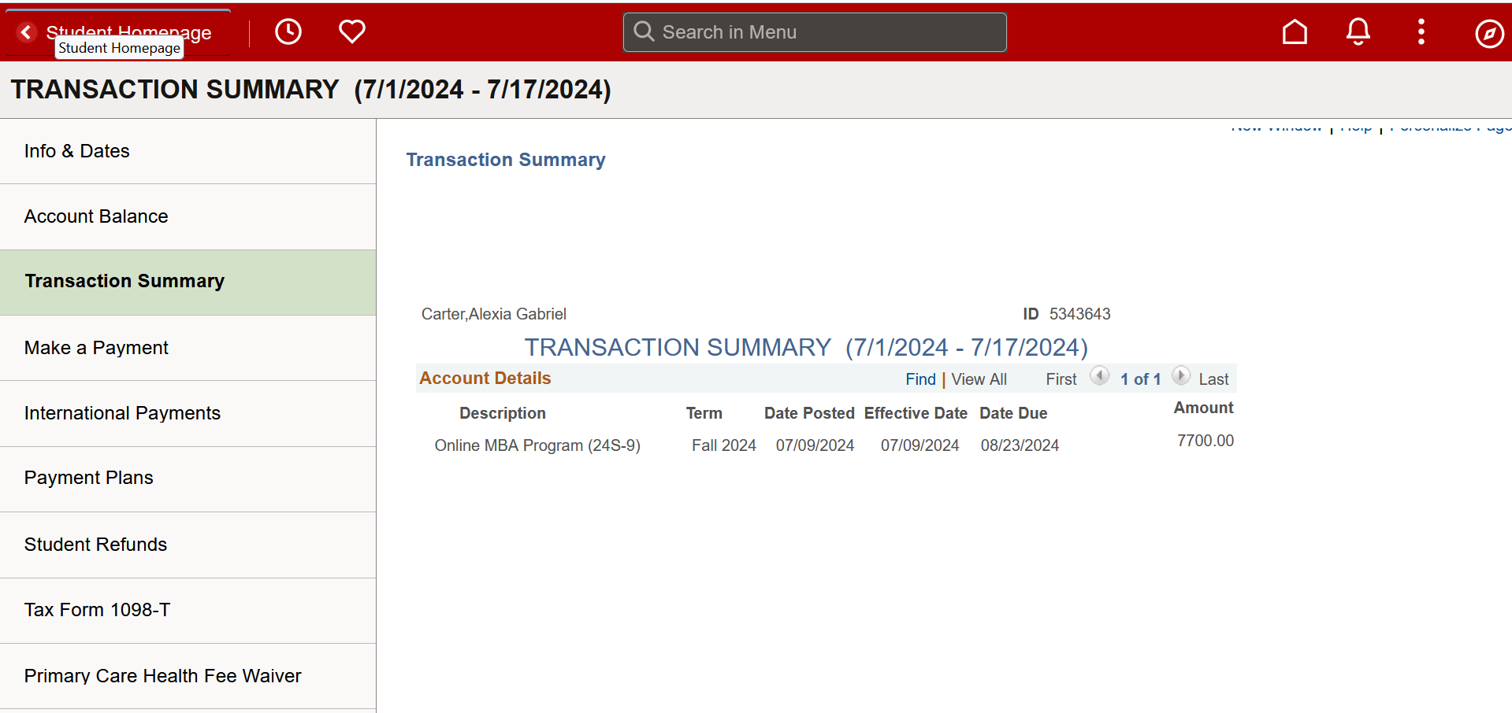
Review Student Account

Slide 18
Making Payments
Payment Methods
ONLINE: Go to Ulink>Student>Financial Account>Make A Payment (*TIP* Do NOT use the Safari browser and make sure your Pop-Up blockers are turned OFF) – You may pay either via Bank Account (FREE!) or pay by Credit/Debit card (NOTE: ALL CARD PAYMENTS ARE ASSESSED A 2.75% SERVICE FEE)
IN OFFICE: Our office is open Monday-Friday from 9:00am to 4:30 pm for payments. You may pay with Cash, Check, or Certified Funds (money orders, certified checks, etc.) Our office is unable to process credit/debit card in person. *Please note the Bursar’s office cannot assist students with the online credit card payment process due to Payment Card Industry-Data Security Standards regulations.*
WIRE TRANSFER: Use the Bursar’s website to acquire wire transfer instructions. https://louisville.edu/bursar/payment/wire
Mail: You may send a check or certified funds in the mail. Be sure to include your student ID number in the memo line! Our mailing address is:
Bursar Office
University of Louisville
2211 S Brook Street Louisville, KY 40292

Slide 19
Making Payments

Slide 20
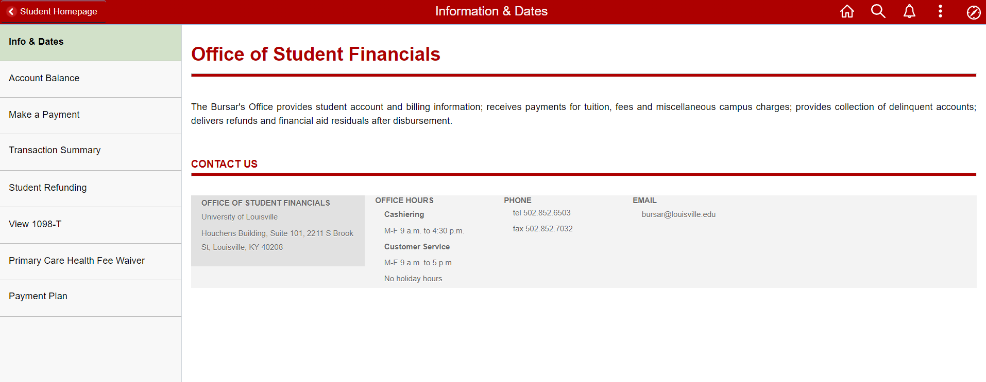
Making Payments

Slide 21
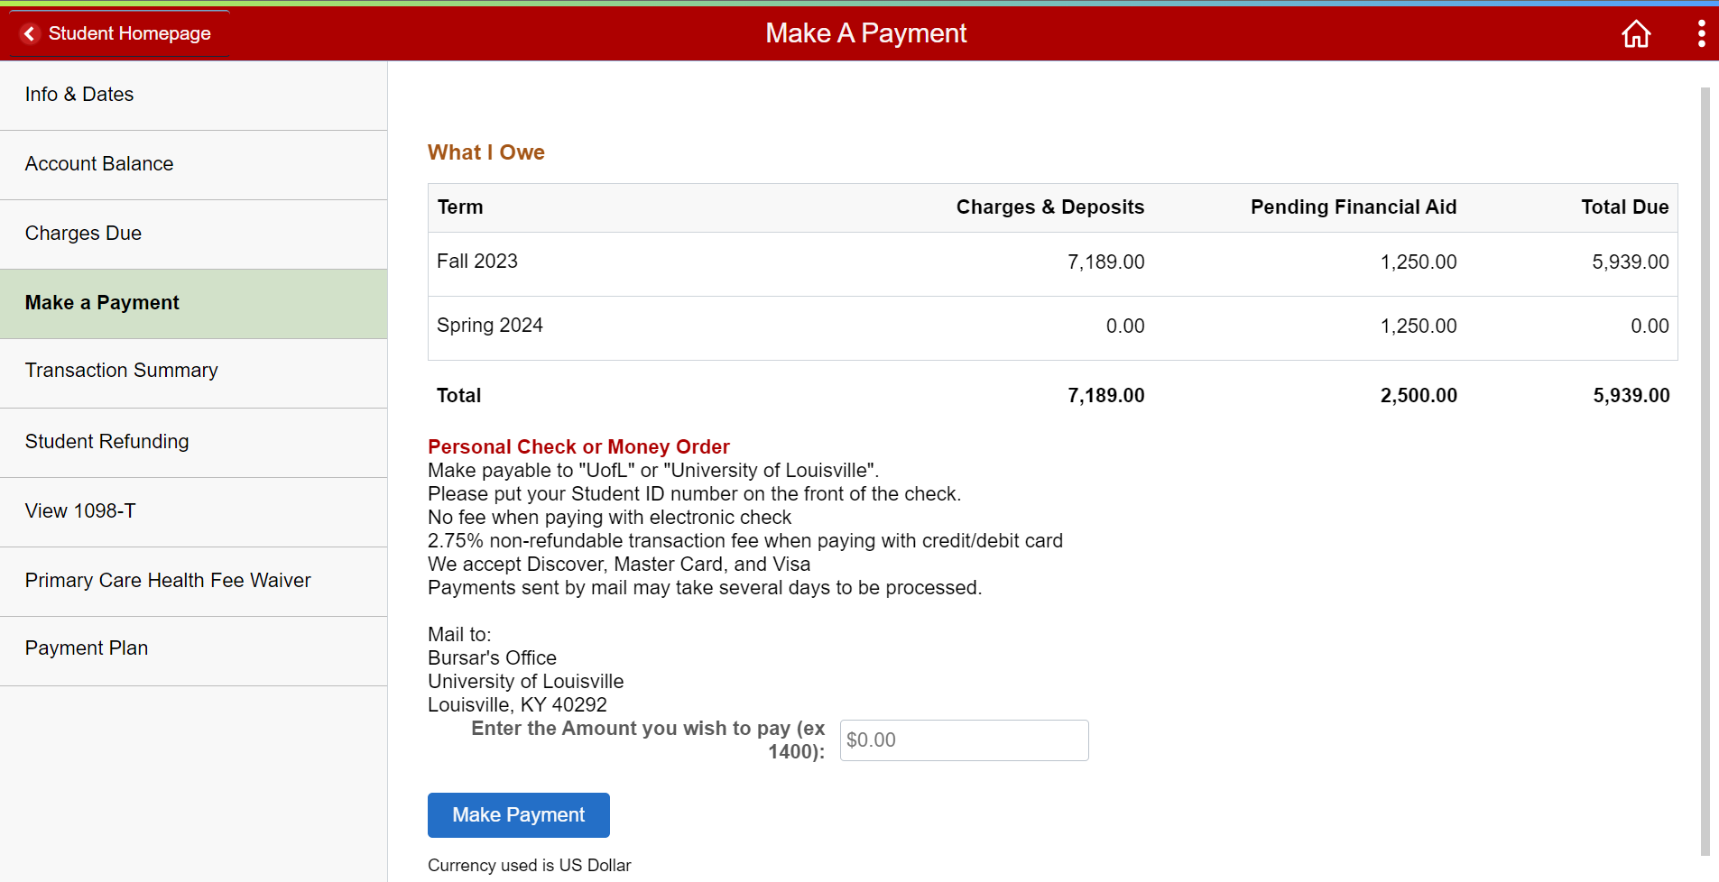
Making Payments

Slide 22
Making Payments
Fall 2024 Tuition Due Date | Spring 2025 Tuition Due Date
August 23, 2024 | January 14, 2025

Slide 23
Payment Plans
The University of Louisville offers interest-free monthly payment plan options for the current semester. When students there is an enrollment fee
We partner with Nelnet for our payment plans, and you are able to conveniently set it up through Ulink. You may choose from a 5-month plan (July-Nov) or a 4-month plan (Aug – Nov).

Slide 24
Payment Plans
PAYMENT METHODS | COST TO PARTICIPATE
Automatic Bank Payments (ACH) Credit Card/ Debit Card | $30 nonrefundable enrollment fee $30 returned payment fee, should a payment be returned by your financial institution

Slide 25
Payment Plans
FALL 2024
Payment plan available on July 12, 2024.
NOTE: All down payments and enrollment fees are processed immediately.
Last Day to Enroll | Required Down Payment | Number of Payments | Months of Payments | Enrollment Fee
Aug,1,2024 | 20% | 4 | Aug - Nov | $30
Aug,29,2024 | 25% | 3 | Sept - Nov | $30

Slide 26
Refunds
What is a Refund?
As Financial Aid is credited to your account, it is applied to all the charges and fees that exist on the account. If a credit balance remains after all charges and fees are paid, you will be refunded the amount of the credit.
What is the difference between Disbursement and Refund?
Disbursement is the process in which your aid is released to the school to pay toward you tuition and fees.
A refund is the process in which any remaining funds not used for your tuition and fees are paid to you.
Refunds will be released to the refund method that you have selected through Nelnet (Direct Deposit or Mailable Paper Check).

Slide 27
Refunds
Who is Nelnet?
Nelnet Financial Solutions is the company we partner with to provide the students their refunds.
Nelnet offers two options for students to receive their refunds
Direct Deposit
Mailable Paper Checks

Slide 28
Refunds
How do I set up my Refund Preference?

Slide 29
Refunds
Nelnet Student Choice Refunds
Click “Select Refund Method” to define your refund method.

Slide 30
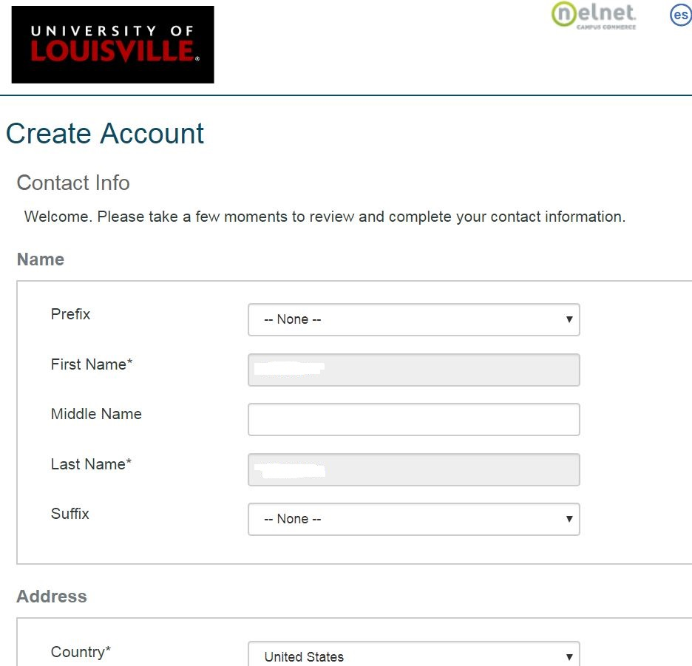
Refunds

Slide 31
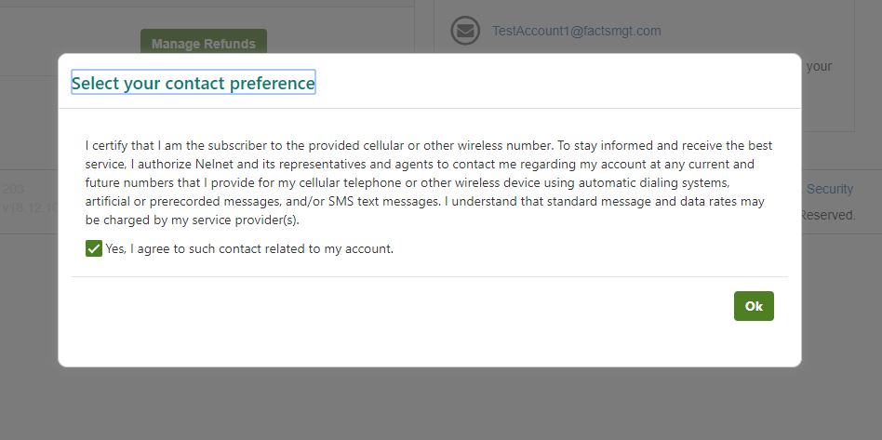
Refunds
Nelnet Student Choice Refunds

Slide 32
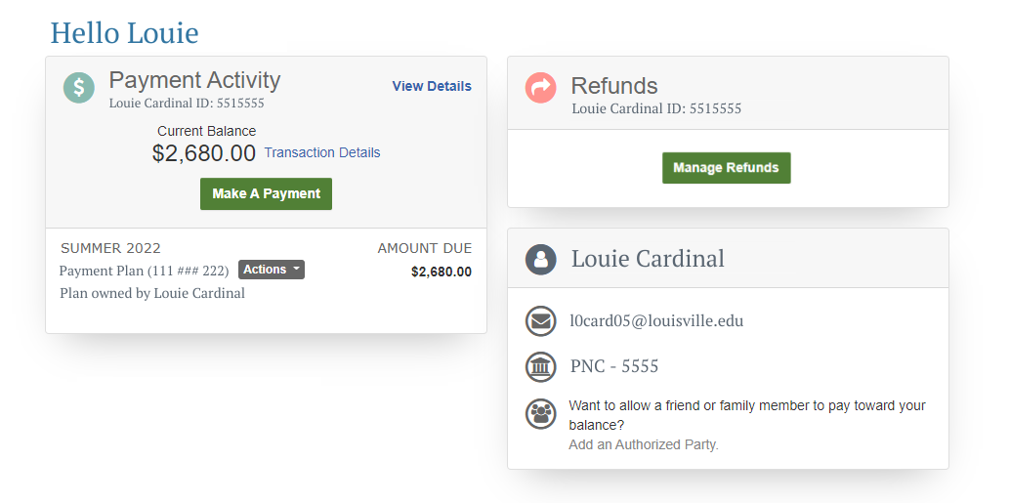
Refunds
Nelnet Student Choice Refunds

Slide 33
Contact Us
Office of the Bursar
Houchens Building
Room 101
Customer Service Lobby Hours Monday-Friday
9:00am– 5:00pm
Cashier Office Payment Hours and Customer Service Phone Hours Monday – Friday
9:00am – 4:30pm
Contact Information
Telephone
502-852-6503
Email
bursar@louisville.edu

