Slide 1
Student Fellowships FAQ
Cooperative Consortium for Transdisciplinary Social Justice Research

Slide 2
Cooperative Consortium for Transdisciplinary Social Justice Research
Dedicated to understanding and finding new, innovative solutions to complex, intransigent social justice problems with a special emphasis on structural inequality
Will incubate, support, and promote faculty and student involvement in University-wide social justice transdisciplinary research (TDR) including research teams, projects, creative activities, and community-engaged scholarship.

Slide 3
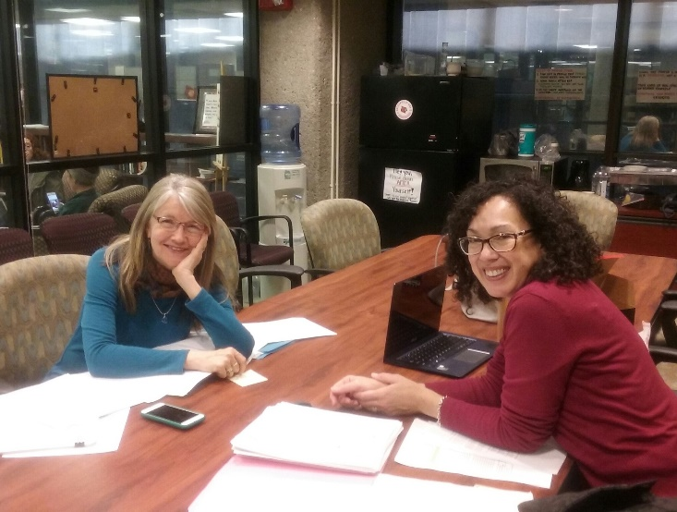
Consortium Leadership
Lead Partner Working Group:
A&S Anne Braden Institute: Dr. Cate Fosl, Co-PI
Muhammad Ali Institute: Prof. Enid Trucios-Haynes, Co-PI
Brandeis Laboratory for Democracy and Citizenship: Prof. Cedric Powell, Co-Investigator
HSC Office of Health Affairs, Diversity, and Inclusion: Dr. Faye Jones, Co-Investigator
SPHIS Commonwealth Institute of Kentucky: Dr. Monica Wendel, Co-Investigator
Co-PIs, Professors Cate Fosl (left) and Enid Trucios-Haynes (right)

Slide 4
Types of Fellowships Available
Funded
Unfunded
PhD Fellowship
Undergraduate Fellowships (7)
Student Scholar Activists

Slide 5
Application Process
All application forms can be found at on the Anne Braden Institute website:
http://louisville.edu/braden/research/transdisciplinary-social-justice-research-consortium-cfp
Funded
Unfunded
The deadline for applications to be received is 5:00 p.m. on the date listed on the application
Applications may be submitted by mail if received by the deadline, or may be hand delivered to the Anne Braden Institute, 258 Ekstrom Library, University of Louisville, Louisville, Kentucky, 40292.
Finalists will be invited for interviews over the course of one week.
The final decision and offers made two weeks after the last day in the interview week.
There are three upcoming deadlines for Scholar Activists. Apply for the deadline that corresponds to the semester you want to begin working for the Consortium. All applications are due at 5:00pm.
Applications may be submitted by mail if received by the deadline, or may be hand delivered to the Anne Braden Institute, 258 Ekstrom Library, University of Louisville, Louisville, Kentucky, 40292.
Students will be matched to ongoing research projects.

Slide 6
Doctoral Fellowship
Applications are due March 20th at 5:00pm
Description
Seeking Applicants with Demonstrated Experience . . .
This position's primary responsibility will be to assist in operations and support multiple research and program activities.
Applicants must be full-time UofL students accepted into a PhD degree-granting program.
Applicants are required to have earned above a 3.0 cumulative GPA during their Master’s career or most recent full-time graduate semester
The Doctoral Fellow will work 20 hours/week
This position includes full tuition and provides a monthly stipend (the amount of which depends on the school/dept of the candidate chosen)
At minimum, this is a two year commitment
The position starts as soon as the fellow is able to begin.
1) in effective interpersonal relationship-building and communication skills, orally and in writing, with diverse constituencies;
2) in organization-building including exercising discretion and judgment in balancing a wide range of academic and community-based tasks;
3) in developing and maintaining priorities in order to conduct multiple tasks in a given time frame; and
4) as team player with a positive, outgoing attitude, as well as commitment to diversity and to social justice issues of the sort that underpin the Consortium.

Slide 7
Undergrad Fellowships
Applications are due March 27th at 5:00pm
Expectations
Basic Information
Spend an average of 5-10 hours per week, devoted to Consortium activities
Select an “expert area” on which to focus. Each student will develop expertise in an issue related to social justice research. This will happen through working with a research team to provide students with exposure to practitioners in that area and hands-on participation.
Provide service to the university community as well as local, national, and/or international organizations and efforts related to social justice.
Conduct research activities on and off the University of Louisville Campus
Help design projects related to student’s interest area(s)
Be recognized and celebrated for their efforts
Two year commitment (Four Semesters
Total program scholarship of $2000 ($500 each semester)
Must maintain a 2.7 GPA to be admitted to and continue in the program
Expected to work 5-10 hours/week on Consortium activities
UGRFs will be matched with a research team that fits into their interests and/or academic goals.
Offered to 7 Students

Slide 8
Student Scholar activists
Student Scholar Activists positions are open to both undergraduate and graduated students interested in social justice research.
Student Scholar Activists are not funded by the Consortium, but may be funded through other means.
Applicants can list their preferred research team in their cover letter; otherwise they will be matched to a research team. The Consortium will attempt to match applicants with research teams that align with their research interests. However, the research focus of the various research teams changes and we cannot always guarantee applicants will be placed on a team that aligns with their interests.
Student Scholar Activists may be counted towards academic credit if the student enrolls in an internship course and their placement at the Consortium is approved by their department.
There will be three initial opportunities to apply to become a Student Scholar Activist:
Fall 2017 : August 1, 2017
Spring 2018 : November 1, 2017
Summer 2018: April 2, 2018
The length of Student Scholar Activists tenure is flexible and can be negotiated.

Slide 9
FAQs
What if I’m already an Doctoral Fellow (or in a similar funded position)? Can I still apply for this fellowship?
Yes. During the remainder of the Spring 2017 semester we ask that you work up to an additional 10 hours for the Consortium. You will be compensated with ex-pay. You will transition from your current position to Consortium Doctoral Fellowship officially on July 1st, 2017.
Will the Consortium work with to set a schedule that works with my other commitments?
We will make every attempt to work with students and will accommodate class schedules.
Can I apply if I’m an international student?
Yes. All full-time, UofL students are eligible to apply. We will offer you any assistance and connect you to the proper resources to ensure that your paperwork is in order.
I’m not in one of the seven participating schools or colleges. Can I still apply?
Yes. All full-time, UofL students are eligible to apply.

Slide 10
FAQs cont.
I’m already working with a faculty member on one of the Consortium’s research teams. What does this mean for me?
If the faculty member submits a proposal and receives funding support, a stipend for you may be part of what they request. Or if not, you may request assignment on that team when you complete the appropriate Consortium student application.
How should my application be submitted?
Applications can be submitted in-person/mailed to the Anne Braden Institute or emailed to transdis@Louisville.edu. Letters can be addressed to CCTSJR Review Committee.
Applications submitted in-person/mailed in should have the student’s name on each page and arrive by 5:00pm on the deadline date.
Emailed Applications should include the student’s name and the position they are applying for. Please attach the complete application to the email as a single document.
Will my application still be considered if my recommendation letters and/or transcripts are submitted shortly after the submission deadline?
Complete applications, including transcripts and recommendation letters must be submitted by the deadline for the application to be considered.

Slide 11
For more Information
Email: transdis@louisville.edu
Office(s):
Anne Braden Institute, Ekstrom Library Room 258, University of Louisville, Louisville, KY 40292.
Muhammad Ali Institute, Ekstrom Library Room 280, University of Louisville, Louisville, KY 40292.
Permanent Office location COMING SOON!

