Slide 1
College of Arts & Sciences 2022 STATE OF THE COLLEGE

Slide 2
OVERVIEW
1) Context of the Past Year
2) Achievements and Current Situation
3) Goals for the Academic Year
4) Looking Ahead

Slide 3
CONTEXT OF THE PAST YEAR
The Pandemic
The Search for a Dean
Interim Provost and Interim President

Slide 4
FACULTY RETIREMENTS
Paul Salmon, Psychological & Brain Sciences, 7/16/2022
Thomas Mackey, History, 7/1/2022
Rhonda Buchanan, Latin American and Latino Studies, 7/1/2022
Michael Williams, Comp Hum, 7/1/2022
Leslie Friesen, Fine Arts, 7/1/2022
Wendy Yoder, Classical and Modern Languages, 7/1/2022
Dave Brown, Physics, 7/1/2022
Geoffrey Nelson, Theatre Arts, 7/1/2022
D. A. Masolo, Philosophy, 7/1/2022

Slide 5
STAFF RETIREMENTS
John Hale, Asst. to Dean – A&S Special Projects
Kim Hosburgh, Program Asst., Sr., Psychology
Virginia Munden, Program Manager, Criminal Justice
Juli Wagner, UBMI, Dean’s Office

Slide 6
IN MEMORIAM
Michael Hottois (Theatre Arts)
Arnold J. Karpoff (Biology)
Charles Trapp (Chemistry)
Lee Shai Weissbach (History)
Arlene Brannon (Staff, Political Science)

Slide 7
NEW TENURE TRACK FACULTY
Morgan Balabanoff, Chemistry
Catron Booker, Biology
Rafael S. Demarco, Biology
Austin Hubner, Communication
Siddhant Issar, Political Science
Felicia Jamison, History/Comp Hum
Matthew Kolmann, Biology
Jennifer Pennington, Theatre Arts
Olivia Schuman, Philosophy
Nathan Smith, Art and Design
Marc Tamarit-Galdón, Classical and Modern Languages
Patricia "Trysh" Wahlig, Art and Design
Jasmine Whiteside, Sociology

Slide 8
NEW TERM FACULTY
Sheryl "Sheri" Squires, Art and Design
Mariella "Mollie" Weisberg, Art and Design
Vilde Lid Aavitsland, Philosophy
Ryan Froese, Philosophy
Florence Goulesque, Classical and Modern Languages
LaShondra Hood, Theatre Arts
Katie Hughes-Taylor, Criminal Justice
Francisco Meizoso, Classical and Modern Languages
Ajith Rajapaksha, Physics and Astronomy
Samiyyah Sledge, Biology
Sanaya Stocke, Biology
Kalpana Venkatasubramanian, Geographical and Earth Sciences

Slide 9
PROMOTIONS TO ASSOCIATE PROFESSOR WITH TENURE
Angela Storey (ANTH)
Yi (Jasmine) Wang (COMM)
Remington Smith (COMM)
Jason Naylor (GEOG)
Bradley Bowman (HIST)
Adam Enders (POLS)
Maria Kondaurova (PSYCH)
Sara Bufferd (PSYCH)
Janna Segal (THEA)

Slide 10
PROMOTIONS TO FULL PROFESSOR
Jinjun Liu (CHEM)
Simona Bertacco (COMP HUM)
Judith Danovitch (PSYCH)
Karen Christopher (SOC)

Slide 11
TERM FACULTY PROMOTIONS
Promotion to Senior Instructor (Term): Khaldoun Almousily (CML)
Promotion to Full Professor (Term): Lora Haynes (PSYCH)

Slide 12
NEW DEPARTMENT CHAIRS
Richard Baldwin (CHEM), taking over from Frank Zamborini (interim)
Christopher Reitz (Art & Design), taking over from Mary Carothers
Linda Fuselier (BIOL), taking over from Perri Eason
Yuxin Ma (WGST), serving as a one year acting chair, filling in for Dawn Heinecken
David Roelfs (SOC), taking over from Gul Marshall

Slide 13
ASSOCIATE DEANS
Cara Cashon, Graduate Education, replacing Latrica Best
Jason Gainous, Undergraduate Education, replacing Linda Fuselier
Michael Menze, Research, replacing Bob Buchanan
Susan Ryan, promoted to Senior Associate Dean of Faculty Affairs
David Schultz, Interim Senior Associate Dean of Finance and Strategy
Jason Sievers, Interim Assistant Dean for Enrollment Management, replacing Duaine Pruitt
Sherri Wallace, DECC Office (Interim), replacing Cherie Dawson-Edwards

Slide 14
NEW PROGRAM AND INSTITUTE DIRECTORS
Lt. Col. David Mott, Director of the Air Force ROTC program
Maj. Philip Duff, Director of the Army ROTC program
Jason Gainous, Interim Director of Liberal Studies, replacing John Hale
Mike Bassi, Director of the Southern Police Institute

Slide 15
DEAN’S OFFICE STAFFING CHANGES
Ramonia Brents, Coordinator of International Programs
Allison Buchanan, Communications and Alumni Relations Coordinator, begins Oct. 31
Rae Stilwell, Web Developer, began September 19

Slide 16
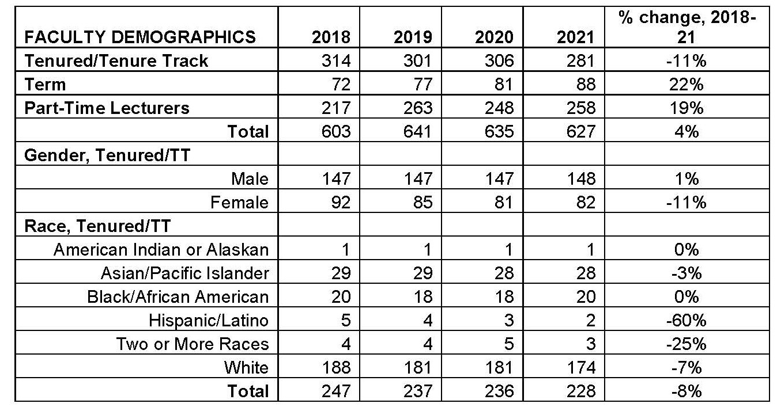
FACULTY DEMOGRAPHICS

Slide 17
Diversity Analysis 2016-20: BENCHMARKS
ALL RANKS | 2016 | 2017 | 2018 | 2019 | 2020 | 5-year % Change
ACC | 46,127 | 46,948 | 47,858 | 48,836 | 49,000 | 6.2%
1. BLACK | 964 | 1,031 | 1,084 | 1,130 | 1,146 | 18.9%
2. HISPANIC | 1,069 | 1,103 | 1,079 | 1,240 | 1,266 | 18.4%
3. WHITE | 18,818 | 18,950 | 19,214 | 19,352 | 19,471 | 3.5%
4. TOTAL | 25,276 | 25,864 | 26,481 | 27,114 | 27,117 | 7.3%
CPE | 59,595 | 61,293 | 62,670 | 63,873 | 64,720 | 8.6%
1. BLACK | 1,325 | 1,396 | 1,465 | 1,516 | 1,568 | 18.3%
2. HISPANIC | 1,555 | 1,627 | 1,711 | 1,704 | 1,848 | 18.8%
3. WHITE | 23,212 | 23,778 | 24,020 | 24,438 | 24,534 | 5.7%
4. TOTAL | 33,503 | 34,492 | 35,474 | 36,215 | 36,770 | 9.8%
UOFL | 3,337 | 3,283 | 3,200 | 3,113 | 3,176 | -4.8%
1. BLACK | 112 | 115 | 103 | 99 | 112 | 0.0%
2. HISPANIC | 51 | 48 | 52 | 52 | 56 | 9.8%
3. WHITE | 1,332 | 1,306 | 1,269 | 1,234 | 1,256 | -5.7%
4. TOTAL | 1,842 | 1,814 | 1,776 | 1,728 | 1,752 | -4.9%

Slide 18
DECC OFFICE INITIATIVES
Diversity & Equity Advocates on hiring committees, faculty & staff
8 A&S faculty received GHEENS Foundation grants to conduct research with community partners

Slide 19
Budget Impact of Enrollment – Five-Year Trends
Undergraduate
Dual Credit

Slide 20
Budget Impact of Graduate Tuition – Five-Year Trends

Slide 21
Budget Impact of Enrollment – Budget to Actual

Slide 22
FY22 Budget to Actuals
and FY23 Budget

Slide 23
FY22 and FY23 Endowment and Gifts Summary

Slide 24
FUNDRAISING
FY22 Total: $4,326,970, a 110% increase over FY21
Effective July 1, 2022, Asma assumed a new position at UofL in Corporate and Foundation Relations, replaced by April Waddell.
Raise Some L (preliminary) : A&S had over 331 donors for a total of $73,885

Slide 25
2022 PRESTIGIOUS STUDENT SCHOLARSHIPS
Goldwater Scholars
Lori Porter, Physics and Astronomy
Afi Tagnedji, Chemistry
Christopher Trombley, Mathematics
Mitchell Scholarship
Samuel Kessler
Rangel Fellowship
Cornelius Sanford
Pickering Fellowship
Benjamin Anderson
Fulbright Awards
Henrietta Ransdell – Thailand
Lauren Reuss – Thailand
Jessica Sanders – Thailand
Farhiya Shaban – Jordan
Emily Spicer - Czech Republic
Boren Scholarships
Jacob Foushee: to study Turkish in Azerbaijan
Aditya Mehta: to study Portuguese in Brazil
Lexi Raikes: to study French in Senegal
Zharia Yeast: to study Korean in South Korea

Slide 26
UNDERGRADUATE MENTORED RESEARCH AWARDS
Spring 2022 14
Summer 2022 16
Fall 2022 6
Number of unique A&S programs supported 9
Total number of awards 36

Slide 27
RESEARCH, SCHOLARSHIP, AND CREATIVE ACTIVITY
Category | 2021
Total publications | 445
Books | 22
Book sections | 25
Refereed journal articles | 315

Slide 28
GRANT FUNDING
Category | 2021-22
Grant funding for lead PIs only | $4.81 million
Grant funding, including PIs, Co-PIs, and Co-Is | $10.51 million
Total number of active grants lead PIs only | 106
Total number of active grants, including lead PIs, Co-PIs, and Co-Is | 179

Slide 29
RANKINGS: U.S. NEWS & WORLD REPORT
2022 America’s Best Online Programs
Criminal Justice: #16 (graduate)
Criminal Justice (best online Criminal Justice for veterans): #12 (graduate)
Specialty Ranking (bachelor’s) – Psychology: #13
2023 America’s Best Graduate Schools
Biological Sciences: #175 (tie)
Biostatistics: #59 (tie)
Chemistry: #128 (ranked in 2022)
Clinical Psychology: #64 (ranked in 2020)
Criminology: #29 (ranked in 2021)
English: #89 (ranked in 2021)
Mathematics: #146 (ranked in 2022)
Physics: #149 (ranked in 2022)
Psychology: #111 (ranked in 2022)
Public Affairs: #88 (ranked in 2022)
Sociology: #106 (ranked in 2021)

Slide 30
A&S AWARDS: Distinguished Faculty Awards
Distinguished Faculty Award for Teaching
Matthieu Dalle, Associate Professor, French
Distinguished Faculty Award for Scholarship, Research, and Creative Activity (Social Sciences)
John Gilderbloom, Professor, Urban and Public Affairs
Distinguished Faculty Award in Scholarship, Research, and Creative Activity (Career Achievement)
Frederick Luzzio, Professor, Chemistry
Distinguished Faculty Award for Service to the Profession
Yuxin Ma, Associate Professor, History
Distinguished Faculty Award for Scholarship, Research, and Creative Activity (Creative & Performing Arts)
Kristi Maxwell, Associate Professor, English
Distinguished Faculty Award for Scholarship, Research, and Creative Activity (Humanities):
Andrew Rabin, Professor, English
Olorunsola Scholarship
Yara Mekawi, Assistant Professor, Psychological and Brain Sciences

Slide 31
A&S AWARDS: Other Faculty & Staff Awards
Innovative Teaching Awards
(Individual) Danielle Franco, Associate Professor, Chemistry (Team) Mikus Abolins-Abols, Assistant Professor (Term), Biology; Rachel Pigg
Assistant Professor, Biology; Shira Rabin, Associate Professor (Term), Biology
Outstanding Performance Awards
Kimber Fogelman, Scientific Instrument Specialist, Chemistry
Clest Lanier, Program Coordinator, Senior, Office of Diversity, Engagement, Culture & Climate
Steve Riley, Instrument Specialist, Chemistry
Joshua Rimmer, Machine Shop Staff, Physics
Bethany Smith, Fellowship Coordinator, Honors Program
Outstanding Supervisor Awards
Danielle Dolan, Assistant Dean for Advising and Student Services (staff)
Regina Roebuck, Chair, Classical and Modern Languages (faculty)

Slide 32
A&S AWARDS: Other Faculty & Staff Awards (continued)
Community Engagement Awards
Thomas Wayne Edison, Associate Professor, Spanish
Lauren Heberle, Associate Professor, Sociology
Taleia Fisher Willis, Interim Director of Finance and Lead Fiscal Officer
Diversity Champion Award
Yara Mekawi, Assistant Professor, Psychological and Brain Sciences
Outstanding Director of Undergraduate Studies Award
Judith Danovitch, Professor, Psychological and Brain Sciences
Outstanding Graduate Mentor Award
Lee Thompson, Assistant Professor, Chemistry
Outstanding Director of Graduate Studies Award
Tamara Sluss, Associate Professor (Term), Urban and Public Affairs

Slide 33
ALUMNI AWARDS
A&S Alumni Fellow: Lois Cronholm (Ph.D. Biology)
former Biology Chair and A&S Dean
UofL Alumna of the Year: Lucy Helm (B.A. Political Science, J.D.)
former Starbucks executive
Diversity Leadership Award: Sadiqa Reynolds (B.A. Psychology, J.D. Kentucky)
former President and CEO of the Lousville Urban League

Slide 34
Priorities for 2022-2023
1) Developing a culture of trust
2) Fostering student success and improving retention

