Slide 1
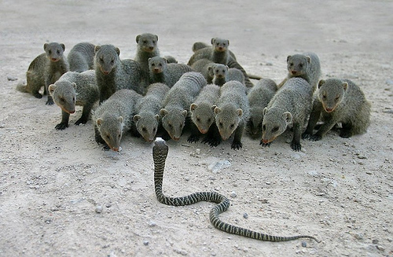
Robert Topp, RN, PhD
Introduction
Purpose of this meeting
What is nursing & nursing research
Order of presentations
  SoN Faculty, SPHIS Faculty & Collaboration Targets
Deliverables
Valerie, Virginia, Lee, Sandra, Carlee, Diane, Said & Peggy

Slide 2
Research Area of Interest:
A New View of Successful Aging
Valerie Lander McCarthy, PhD, RN

Slide 3
Background on Successful Aging
Successful aging, most commonly defined as the absence of disease and disability (Rowe & Kahn, 1998), excludes 4 out of 5 older adults with some degree of chronic disease
Social and environmental determinants of health aren’t adequately considered; instead the focus is on behavioral factors, disproportionately affecting low-income and minority populations (Holstein & Minkler, 2003)
Existential or spiritual factors, such as a sense of meaning or purpose in life, reported by elders as important to successful aging, have not been considered (Sadler & Biggs, 2007)
A better understanding of how older adults adapt to the challenges of aging and the perspectives that shape their values and priorities is necessary for effective health and social policy, program development, and clinical practice

Slide 4
A New View of Successful Aging
“An individual’s perception of a favorable outcome in adapting to the cumulative physiologic and functional alterations associated with the passage of time, while experiencing spiritual connectedness, and a sense of meaning and purpose in life” (Flood, 2003; p. 36)
Two primary factors contribute to this new view of successful aging:
  Adaptation, reflecting older adults’ strategies for coping with the challenges of aging
  Transcendence, a developmental stage encompassing older adults’ unique perspectives on life based on accumulated experience and wisdom gained over a lifetime (Flood, 2005)

Slide 5
Recent Studies of Successful Aging
FEASIBILITY STUDY: Mixed method cross-sectional survey study examined recruitment techniques, data collection methods and potential instruments among a convenience sample of adults aged 65+ (µ age= 86.7, range 65 – 100) in an urban, moderate-income independent and assisted living retirement community (N=20)
  Identified data collection methods, including consent, dementia screening and investigator-administered survey questionnaires in a single session, for small groups (n=5-7) versus one-on-one interviews
  Operationalized major study variables based on a regression model that explained 36.5% (F= 4.592, p= .027) of the variance in successful aging
DISSERTATION STUDY: Cross-sectional descriptive survey study examined relationships of adaptation and transcendence with successful aging, controlling for age, income, function, and health among a random, stratified sample of adults aged 65+ (µ age= 80, range 65 – 95) in an urban, low-income independent and assisted living retirement community (N=123)
  Significant regression model found proactive coping and self-transcendence explained almost half of the variance in successful aging (Adjusted R²= 45.4, F=10.22, p= .000), independent of age, income, function, and health
  Transcendence (β= .199) accounted for 2.5 times the effect of adaptation (β= .523)
  92% self-identified as aging successfully, regardless of objective scores on the SAI

Slide 6
Future Study of Successful Aging
Multi-site study to examine factors that influence the decision to move into an independent and assisted living retirement community
  Sample: Non-demented older adults aged 65+
  Settings: (1) Adults living in own homes, (2) low-income and (3) upper-income independent and assisted living retirement communities
Variables of interest:
  Perceived factors considered in the decision
  Proactive coping, self-transcendence, and successful aging
  Age, race, function, income, health
  Social support, self-efficacy, resilience, optimism, empowerment
  Environment: neighborhood safety/crime, walkability, community services, access to healthcare
  Comparative morbidity, mortality and costs

Slide 7
Communicating Well in End-of Life care
Virginia (Burton) Seno, PhD RN
University of Louisville
School of Nursing

Slide 8
What we Already Know
Ineffective End- of- Life Communication Pattern
Evasive Flight From Death Pattern (Martin Heidegger)
  Concealing Reality
  Hedging
  Drawing to the ordinary
  Soothing Clichés
  Separating
These communication patterns create notable unmet needs for dying patients and their families (unrelieved pain, symptoms and unaddressed psycho-social spiritual needs)

Slide 9
What we Already Know
Effective End- of- Life Communication Pattern
Authentic Being-Toward Death Pattern (Heidegger)
  Experience has brought Insight, acceptance (Death is) →
  Freedom from anxiety →
  Calm Quiet Mind →
  Able to call forth patient/family needs →
  Situate and regulate the environment
These communication patterns facilitate a good death, better end-of-life experiences for patients and families.

Slide 10
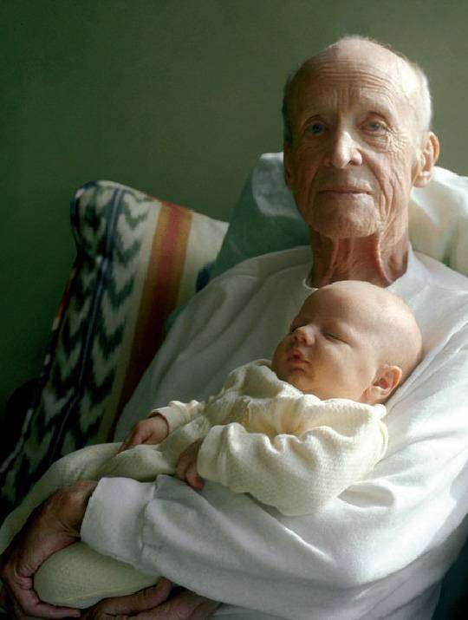
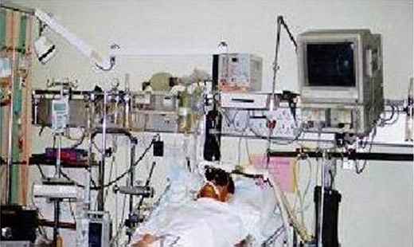
Picture the Difference

Slide 11

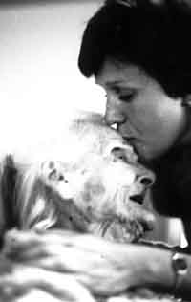
Picture the Difference

Slide 12
Picture the Difference

Slide 13
How we Know
Immense body of literature shows that to die in America, especially in the health care system is a harrowing experience (showing ineffective communication and being-with)
Interpretive Phenomenology was used to elicit tactic knowledge imbedded in the experiences of nurses who attend to dying (showing effective and communication and being-with.

Slide 14
How we Know
Martin Heidegger’s philosophy provides the philosophical background and structures to interpret being-toward death.

Slide 15
Now What?
Demonstrate the differentials between and among providers of effective and ineffective end-of-life communication.
What are the barriers faced by providers who experience ineffectiveness in end-of-life encounters?
How do providers who are effective in end-of-life encounters do that? How did they get that way?
Of special interest are the mental mechanisms that account for a person moving toward more effective communication abilities.

Slide 16
S. Lee Ridner

Slide 17
Current Research
College health/risk behaviors
  Smoking
    Predictors
    Tobacco marketing
    Sexual minorities
    Smoke-free laws
  Nutrition
  Exercise

Slide 18
Current Research
Approach
  Quantitative
  Qualitative
Theoretical Approaches
  Transtheoretical Model
  Social Cognitive Theory
  Theory of Planned Behavior

Slide 19
Current Research
Tobacco Marketing among College Students
  Explores direct and environmental marketing in night clubs and bars in cities with and without smoke-free laws
Fit into College
  Educational program for incoming college freshmen to improve diet and exercise

Slide 20
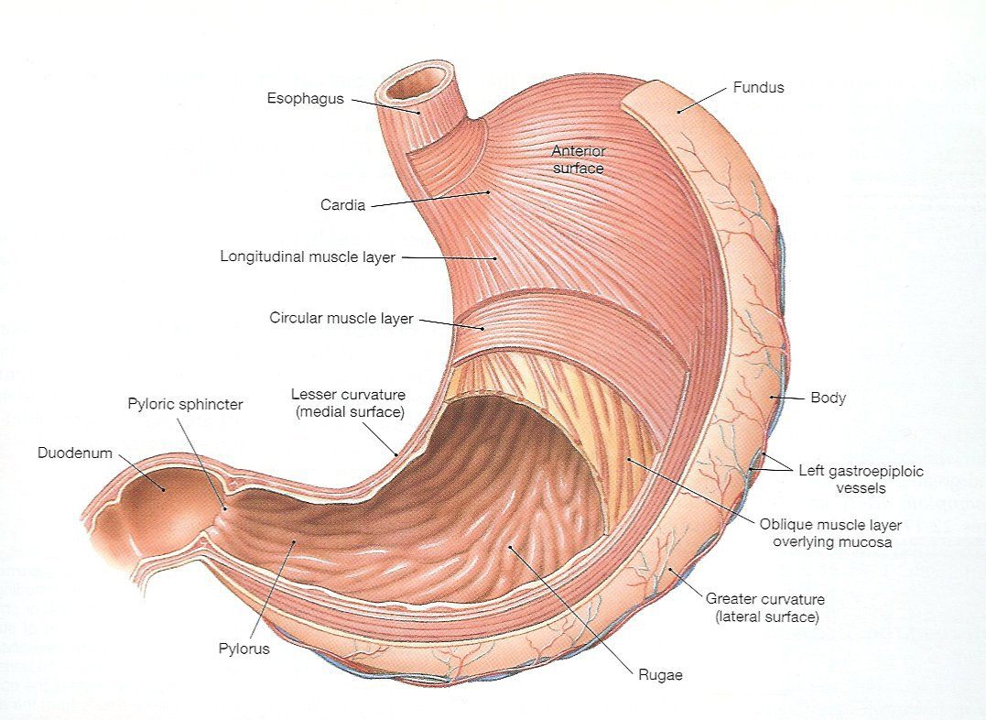
Research Interest
Sandra L. Holmes, Ph.D., APRN-BC, RN-BC
Notes:
20

Slide 21
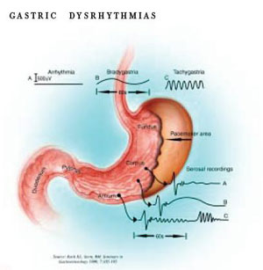
Research Interest
Functional Gastrointestinal Disorders
  Gastric Motility
    Gastroparesis
      Diabetic Gastroparesis
Notes:
Define FGID
Explain how and why gastric motility is important
Define gastroparesis
Define diabetic gastroparesis
State why diabetic gastroparesis is a problem
Present framework and identify some areas of research on diabetic gastroparesis
21

Slide 22
Research Interest
Diabetes mellitus is a chronic disease that negatively affects morbidity and mortality
Diabetes is the most common cause of gastroparesis
Gastroparesis is a motility disorder that occurs when damage to the vagus nerve and muscles of the stomach cause it to empty too slowly
Gastroparesis complicates the care of patients with diabetes
Notes:
Diabetes is a chronic disease of carbohydrate, fat, and protein metabolism caused by a defect in the secretion or activity of insulin. It is a leading cause of morbidity and mortality in the U.S. Resources utilized in caring for patients diagnosed with diabetes continue increase as the disease becomes more and more prevalent.
In 2007, 23.6 million people had diabetes. In 2008, Kentucky ranked 9th in the nation for its prevalence of adults with diabetes. In 2006, over 445, 000 persons in Kentucky, with 10.1% of those cases occurring in Jefferson County were living with diabetes.
Diabetes was the 6th leading cause of death in Kentucky and the 5th leading cause of death by disease in 2003. It accounted for 17.9% of all hospitalizations.
Diabetic gastroparesis (DGP) occurs in 25-30% of patient with diabetes
Over time the incidence increases up to 50%
40-50% of patients with type 1 diabetes
30-40% of patients with type 2 diabetes
Makes harder to control blood glucose levels - (Increases risk of other complications)
Creates an imbalance in insulin-nutrient availability
Affects drug availability and metabolism
Contributes to upper gastrointestinal (GI) symptoms (e.g., nausea, vomiting, early satiety, bloating, anorexia, abdominal pain)
Can’t eat or digest nutrients normally
Negatively affects their quality of life (QOL)
Can’t participate in normal activities i.e., work, home management, social activities, etc
Increases resource utilization (e.g. hospitalizations, LOS, tests).
Data from the 1998 North Carolina Hospital Discharge database of gastroparesis discharges over a 1-year period showed that 1476 discharges accounted for $11, 378,446 in total charges and 7850 hospital days. Medicare was the primary payer in 52.1% of the cases.
The engine and all of its parts must work in concert for the machine to run efficiently and effectively. One missing part may cause a problem or be the result of one. It is hard to determine which sometimes comes first, which further complicates finding the best solutions.
22

Slide 23
Research Interest
Patient Factors
Difficulty Managing Blood Glucose
GI Signs & Symptoms
Gastroparesis
Environmental Factors
Other
Resource Utilization
QOL
Healthcare Factors
Notes:
Why does gastroparesis occur?
Who is likely to get it?
What can we do to prevent it or slow its progression?
When should interventions begin? What type(s) are most effective?
How can we improve outcomes and decrease resource utilization for patients with gastroparesis?
Patient factors: age, gender, genetics, cultural or behavioral norms, psychosocial stability & support
Environmental factors: exposure to some outside factors that predispose certain individuals/groups to gastroparesis
Healthcare factors: access to care, timely and proper diagnosis, initiation of interventions, followup care, financial burden (including cost of supplies, dietary changes)
Woman’s disease… 50-85%
Minorities disproportionately affected by DM and its complications…why? Patient factors or healthcare practices?
What is the relationship between variables? Which ones have the highest impact on patient ability to cope with gastroparesis?
What kind of nursing directed teaching, follow-up, or support is needed to ensure that patients with gastroparesis comply with recommended treatments? (Improve glucose control, pharmacological therapy, nutritional therapy, pre- or post-surgical interventions)
23

Slide 24



Carlee Lehna, PhD, ARNP-BC
Notes:
24

Slide 25
Research Interests
Families caring for a child with a chronic illness
  PhD 2008, UT Houston Health Science Center
  Dissertation: Sibling Experiences after a Major Childhood Burn Injury
    Purpose: To understand siblings’ experiences after a major childhood burn injury
    Design: Mixed method/qualitative dominant design
Notes:
25

Slide 26
Sibling Experiences
Articles In-press:
    Sibling Experiences after a Major Childhood Burn Injury. Pediatric Nursing.
    “Sibling Closeness,” a Concept Explication Using the Hybrid Model, in Siblings Experiencing a Major Burn Trauma. Southern Online Journal of Nursing Research.
Article under review:
    Family Members Perceptions of Sibling Relationships after a Major Pediatric Burn Injury

Slide 27
Sibling Experiences
Proposed research:
  Purpose is to understand sibling relationships in families experiencing a childhood spinal cord injury (SCI)
  Mixed Method research
    Observational, prospective at 3, 6, and 12 months
    Quantitative: Demographic variables, sibling relationship factors, family coping, health related QOL, and stress indicators
    Qualitative: Ethnographic interviews with narrative analysis
Notes:
The project’s specific aims are to:
Evaluate the effect an individual’s SCI has on their sibling relationship and the siblings’ HRQOL over time.
Examine relationships among selected demographic variables, sibling relationship factors, siblings’ perceived and biologic stress, family coping and HRQOL.
Explore whether a family’s coping and HRQOL can be predicted from demographic variables, sibling relationship factors, or siblings’ perceived and biologic stress.
This mixed-method study will use both quantitative and qualitative methods to examine the sibling relationship experience in families having a child with a SCI (Creswell & Plano-Clark, 2007). The study will be an observational, prospective design in which data will be collected upon hospital discharge, 3 months, 6 months, 1 year post injury. A mixed method approach (e.g., quantitative, biological, and qualitative) incorporating demographic variables, sibling relationship factors, family coping, health related quality of life (HRQOL) and stress indicators will be utilized. The experimental units for analysis will be the child experiencing the SCI, their sibling, and one of their parents.
Quantitative methods will involve the use of the Sibling Relationship Questionnaire Revised (SRQ-R), the Peds QL (HRQOL), and the F-Copes (family coping). Level of biological stress will be measured through 24 hour urine collections of cortisol and perceived stress through rating on a 10-point scale.
Qualitative methods will involve conducting interviews with siblings (the child with the SCI and their sibling) and a parent to obtain in-depth information about the sibling experiences from more than one family member.
27

Slide 28

Research Interests
Burn Prevention (BP)
  Nurses’ Knowledge regarding BP
    Purpose: Explore nurses’ perceived burn prevention knowledge, their perceived ability to teach burn prevention, and their actual burn prevention knowledge, and test if their actual burn knowledge could be predicted by these perceived measures

Slide 29
Nurses’ Knowledge
  Article: Lehna, C., & Myers, J. (In-press). Does a nurse’s perceived burn prevention knowledge, and ability to teach burn prevention correlate with their actual burn prevention knowledge? Journal of Burn Care and Research.

Slide 30
Nurses’ Knowledge
  Funding:
    Intramural Research Initiation Grant: Measuring Nurses’ Burn Prevention Knowledge, Principle Investigator, University of Louisville, Research Initiative Grant, $2,645, 2008-2009.
      Instrument testing, just completed
    International Association of Firefighters Burn Foundation Grant: Measuring Changes in Nurses’ Burn Prevention Knowledge, Principle Investigator, University of Louisville, $24,072, November, 2009-2010.
      Pre & post testing after an educational intervention at 3 sites (KY, AK, & OH)
Notes:
Looking for RA to help in Web site design & setting up pre & post testing on survey monkey
30

Slide 31
Home Fire Safety Education Evaluation Pilot
Hazard House purpose:
    The primary purpose of this project is to evaluate students’ (pre-K through 8th grade) and possibly their parents’ home fire safety knowledge after seeing a standardized 30-mintue interactive home fire safety program
    A second purpose is to test age-appropriate quizzes
    An additional outcome would be to decrease the number of children injured in home fires within Jefferson County

Slide 32
Home Fire Safety Education Evaluation Pilot
Initial testing completed at one JCPS elementary
Preliminary data analysis begun
THE END

Slide 33
Diane Orr Chlebowy, PhD, RN

Slide 34
Research Interests
Type 2 diabetes mellitus self-care management
Behavior change in adolescents and adults
Health disparities research
Motivational interviewing
Metabolic syndrome and prevention of type 2 diabetes mellitus

Slide 35
Research Funding
Chlebowy, D.O. Impact of social support, self-efficacy, and outcome expectations on self-care behaviors and glycemic control in Caucasian and African American adults with type 2 diabetes, Kate Doyle New Investigator Award, American Association of Diabetes Educators, $5,000; Research Award, Sigma Theta Tau International, Delta Psi Chapter, $640.
Purpose - to examine the relationships of psychosocial variables (social support, self-efficacy, and outcome expectations) to diabetes self-care behaviors and glycemic control in Caucasian and African American adults with type 2 diabetes mellitus
Theoretical framework - Social Cognitive Theory
Quantitative study - use of various instruments

Slide 36
Research Funding
Chlebowy, D.O. (2007). Facilitators and barriers to self-management of type 2 diabetes among urban African American adults: Focus group findings, Intramural Research Incentive Grant, University of Louisville, $4,958.
Purpose - to identify the facilitators and barriers to self-management of type 2 diabetes among urban African American adults
Qualitative study - use of focus group sessions

Slide 37
Research Funding
Byers, D., Manley, D., Garth, K., & Chlebowy, D.O. (2008). Facilitators and barriers to self-management of type 2 diabetes among rural African American adults, Murray State HSCS, $1,000.
Purpose - to identify the facilitators and barriers to self-management of type 2 diabetes among rural African American adults
Qualitative study - use of focus group sessions

Slide 38
Research Funding
Chlebowy, D.O., El-Mallakh, P., Cloud, R., Myers, J., Kubiak, N., Wall, M.P., & Burns, V. (2008). The effects of motivational interviewing on type 2 diabetes management in African American adults: A pilot study, Passport Health Plan’s Improved Health Outcomes Program, $50,000.
Purpose - to determine the effect of a motivational interviewing intervention on adherence to prescribed treatment regimens, diabetes markers, and number of unscheduled health care visits among African Americans with type 2 diabetes mellitus
Theoretical framework - Stages of Change Model
Mixed method study - use of self-report logs, blood glucose monitoring print-outs, accelerometer print-outs, telephone calls; focus group sessions

Slide 39
Recently Submitted Proposals
Chlebowy, D.O., Cloud, R., El-Mallakh, P., Jacks, D., Kubiak, N., Myers, J., Topp, R., Wall, M.P., & Wedig, R. (2009). Enhancing self-care management among African Americans with type 2 diabetes, National Institutes of Health, $397,153.
Chlebowy, D.O. (co-PI), Lehna, C. (co-PI), Topp, R., Myers, J., Wedig, R., & Jacks, D. (2009). A family centered intervention program for adolescents with metabolic syndrome or type 2 diabetes, National Institutes of Health, $428,454.

Slide 40
Research Interest
Said Abusalem, PhD, RN
University of Louisville
School of Nursing

Slide 41
Patient Safety in Long term care
Dissertation
The degree home health nurses have been affected by the patient safety movement.
Nurses and Healthcare perceived types and causes of care.
Long term nurses coping with care errors and the effects of errors on their practice.
How home health agencies deal with care errors.

Slide 42
Research Interest
Nurses Job satisfaction in home healthcare.
The degree of home health nurses' job satisfaction, and the differences in job satisfaction among home health nurses employed full time, part time, and per diem.
Patient satisfaction measurement paper in home healthcare

Slide 43
Predictors of Adverse Events in Nursing Homes
Aim 1: To identify predictors of adverse events in nursing homes
RQ1: What are the rate of staff turnover, organizational commitment, staffing ratio, job satisfaction, leadership style, communication openness, and patient safety of nursing homes (rate of falls, skin breakdown/wounds, and nosocomial infections)?
RQ2: What are the relationships between staff turnover, staffing ratios, type of shift worked, job satisfaction, , leadership style, communication openness, and adverse events in nursing homes (rate of falls, wounds and bed sores, cross infections)?
RQ3: Are the rate of staff turnover, organizational commitment, staffing ratio, job satisfaction, leadership style, communication openness, and type of shift worked predictors of adverse events in nursing homes?

Slide 44
Predictors of Pneumonia and Influenza Vaccination Programs in Nursing Homes
(Fall, 1999)
Secondary data analysis study of the 1995 National Nursing Home Survey.
This study will examine the ability of several variables (type of ownership of facility, member of a chain or group, beds available, certification under Medicare and Medicaid, Medicare and Medicaid per diem rates, home health and hospice services, total full-time employees, the number of registered nurses on staff and the Metropolitan statistical area (MSA)) to predict the existence of influenza and pneumonia vaccination programs and the percent vaccinated in nursing homes.

Slide 45
Pediatric Home Health Care
(Spring, 2002)
Secondary data analysis of the National Home and Hospice Survey (NHHCS)1998.
Characteristics of children receiving home health care.
Different types of services provided to children through home healthcare.
The relationship between selected home health characteristics and charges of care.

Slide 46
Research Program
Peggy El-Mallakh, PhD, RN
School of Nursing
University of Louisville

Slide 47
Research Program
Co-morbid chronic mental illness and chronic physical illnesses
  Schizophrenia and diabetes mellitus
Implementation Research
  Evidence-based Practices
  Interventionist adherence to study protocols

Slide 48
Schizophrenia and Diabetes
Dissertation Research:
Qualitative study
Research questions:
  How to people with schizophrenia and diabetes develop an understanding of diabetes?
  What are the factors that influence their diabetes self-care?

Slide 49
Schizophrenia and Diabetes
Dissertation Findings:
  Successful self-care depended on patients’ ability to understand schizophrenia, understand diabetes, and understand how symptoms of schizophrenia influenced their ability to care for their diabetes
  Family members played a crucial role in diabetes self-care

Slide 50
Schizophrenia and Diabetes
  Poverty and material deprivation prevented patients from acquiring the resources they needed for adequate self-care
  Desire for health motivated adherence to self-care for both schizophrenia and diabetes

Slide 51
Schizophrenia and Diabetes
Current research: IRIG
Family caregiving for people with schizophrenia and diabetes mellitus
  What do family caregivers know about diabetes and diabetes management targets?
  What is the perceived burden of the caregiving role for family members?
  What are barriers and facilitators to the caregiving role?

Slide 52
Family Caregiving Study
Quantitative:
  Michigan Diabetes Knowledge Test
  American Diabetes Association ABC Test
  Family Burden Interview Schedule
Qualitative:
  What are the problems and issues related to the caregiving role?

Slide 53
Schizophrenia and Diabetes
Future studies:
  In people with schizophrenia and diabetes mellitus:
  What are the relationships between:
    Cognitive functioning
    Diabetes knowledge
    Diabetes-related distress
    Diabetes problem-solving style

Slide 54
Schizophrenia and Diabetes
Future studies:
Intervention Development
  How can a diabetes educational/wellness intervention be tailored to meet the individual needs of people with schizophrenia?

Slide 55
Implementation Research
Previous study:
  Prescriber fidelity to implementation of a medication management evidence-based practice in a community mental health clinic
Current study:
  Interventionist fidelity to a motivational interviewing intervention for African Americans with Type 2 diabetes

Slide 56

Collaboration

