Slide 1

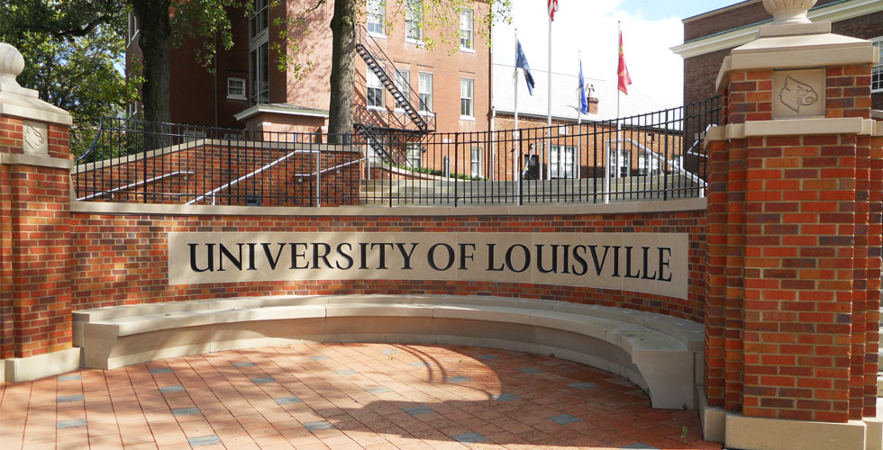
My name is Julie and
I like to EAT
THINK GLOBAL
ACT LOCAL

Slide 2
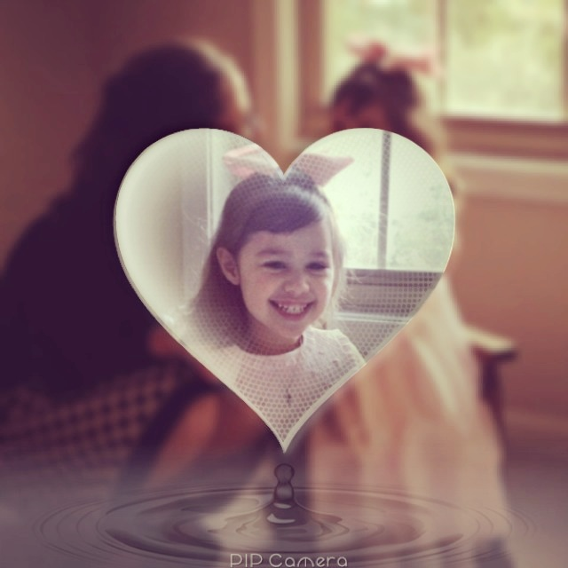
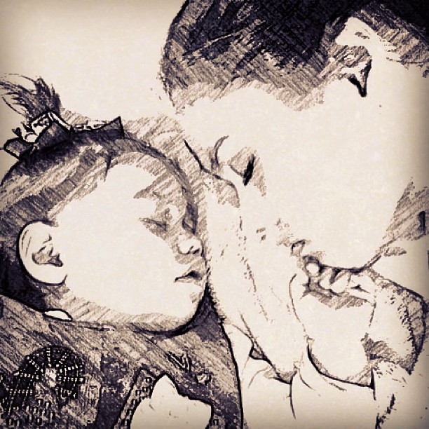
This is my entire world. She makes me want to not only do better, but to BE BETTER.

Slide 3

Project to combine:
Bread for the World Institute
1,000 Days

Slide 4

*Inclusive faith-based organization that works with political leaders to address hunger across the globe to help combat poverty and the issues that accompany it.
“Bread for the World members write personal letters and emails and meet with our members of Congress. Working through our churches, campuses, and other organizations, we engage more people in advocacy.”
http://www.bread.org/about-us/

Slide 5


The 1,000 days from pregnancy through a child’s second birthday are the most crucial for a child’s development. But many women around the world don’t have access to proper nutrition for themselves or their children. Without adequate nutrition during this critical period, children suffer permanent cognitive and physical delays.

Slide 6
Women of Faith
The Goals seek to improve nutrition, eradicate hunger, improve maternal health, and reduce child mortality by improving nutrition for women and children during this critical 1,000-day window. We are also calling on the U.S. government to support the 16 million children in the United States who are at risk of hunger.

Slide 7
Better nutrition in first
1,000 days =
*children grow taller
*have better vision,
*stronger immune systems
*improves intellectual capacity better success in school and work
*also earn 10 percent more income throughout contributes to a 2-3 % increase in a country’s GDP.

Slide 8
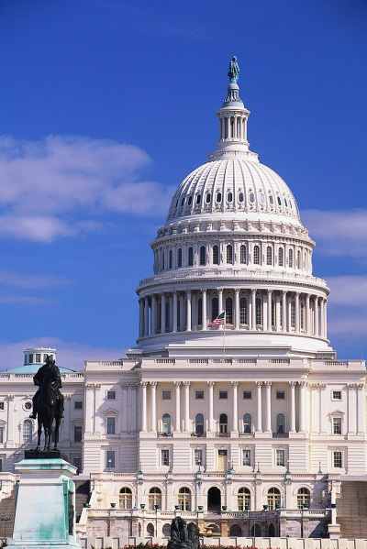
What can we do?
“Bread for the World members write personal letters and emails and meet with our members of Congress. Working through our churches, campuses, and other organizations, we engage more people in advocacy.”
http://www.bread.org/about-us/

Slide 9

Take Action NOW
As college students, donating money can be difficult and so can finding time in our busy schedules…
So…
Letter to kentucky politicians from peace 325 class at university of louisville
Will you sign it?

Slide 10
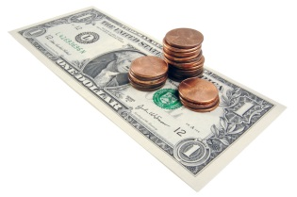

What can we do?
Donate @ www.bread.org
Make it special---donate in someone’s honor
My aunt Nunu loved to cook for her family and she passed away at age 49 the day after her daughter Caroline’s 8th birthday in 2009, so I donated in her honor.

Slide 11
GETTING INVOLVED
No act of kindness, however small, is ever wasted. ~ Aesop
Join on Facebook at www.facebook.com/womenoffaith1000days.
Pledge at www.bread.org/go/1000days to have 1,000 conversations.
Engage members of Congress in conversation.
Pray for women and children who struggle

Slide 12
GETTING INVOLVED
Give a presentation about maternal and child nutrition.
Include a letter about maternal and child nutrition in your holiday cards.
Share information in posts on your Twitter or Facebook account or write an article on your blog. Include links to websites where more information is available.
Have a conversation with parents at your child’s play group or “Mommy and Me” program.

Slide 13


My Checklist
Donate in nunu’s memory
Like on facebook
Share information with others
Write politicians
Pledge conversations – our group is named peace!
Share on social media
Pray

Slide 14
TIMELINE
Phase 1: 4/13/13
Donated in Nunu’s memory
Created PEACE pledge group for 1,000 convos
Phase 2:
4/17/13
Share information with group via presentation
Phase 3:
9/21/13
Completed at least 100 conversations about the importance of nutrition by Peace Day
Social Media Action
Write Congress – Church presenting letters 4/27-28
Continue to pray, donate, and be involved
Get classmates involved

Slide 15
Budget Analysis
Personal contributions to date: $25.00
Bread for the World campaign has helped increase fundraising toward feeding the poor dramatically over the past decade.
Location | Time Frame | Amount | To | Amount
Global | 2000-2010 | $8 Billion |  | $28 Billion
United States | 2000-2009 | $33 Billion |  | $80 Billion
http://www.bread.org/about-us/annual-reports/three-year-plans/three-year-plan-2010.pdf

Slide 16
OBSTACLES
&
DIVIDERS
*lack of funding
*Politicians with other priorities
*charity mistrust
*entitlement “fatigue”
“It’s easy to get people to donate to charity, like buy a coat at Christmas, but people are extremely resistant to advocacy.”
Rosemary Cavanaugh

Slide 17
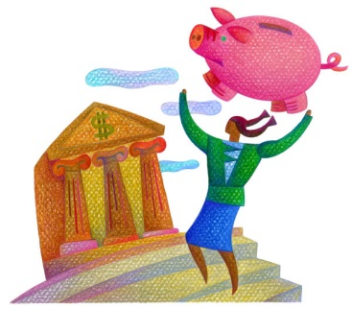
STRATEGIES TO OVERCOME OBSTACLES
*EMOTION
*PUBLIC PRESSURE
*Awareness
*FINANCIAL REASONING
*Every dollar spent on pregnant women in wic produces $1.92 to $4.21 in Medicaid savings for newborns and their mothers.
http://www.bread.org/hunger/maternal-child-nutrition/women-of-faith-for-the-1000.html

Slide 18

CONNECTION
WITH PEACE STUDIES
“A ruler’s power is ultimately dependent on support from the people he would rule.”
Conversion mechanism of change---result of advocacy, people/politicians support cause (emotional and moral factors)
gene sharp on nonviolent action

Slide 19

CONNECTION
WITH PEACE STUDIES
CREATE HOPE
CREATE DIAOLGUE
EXCHANGE EXPERIENCES
INCLUDE LOCAL AUTHORITIES
STRENGTHEN CIVIL ORGANIZATIONS
PAUL VAN TONGEREN, REFLECTIONS ON PEACE BUILDING

Slide 20
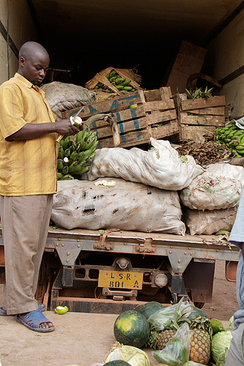
CONNECTION
WITH PEACE STUDIES
GOOD INTENTIONS – MARY B. ANDERSON
WHY FOOD AID MUST BE FLEXIBLE
http://notes.bread.org/2013/04/why-food-aid-programs-must-be-flexible.html
“God save us from people who mean well.” Vikram Seth

Slide 21
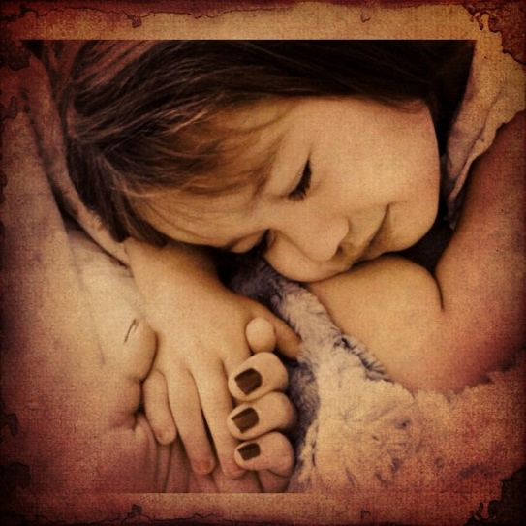
BAROMETER OF OVERALL SUCCESS
IF ONE CHILD DOES NOT GO TO BED HUNGRY BECAUSE OF BREAD FOR THE WORLD, THEN IT HAS BEEN A SUCCESS.

Slide 22
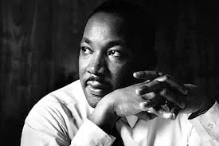
“The function of education is to teach one to think intensively and to think critically. Intelligence plus character - that is the goal of true education.”
Martin Luther King, Jr.

