Slide 1
Micro/Nano Technology Center Orientation and Safety Training
University of Louisville

Slide 2
This Orientation
Is going to teach you basic rules and regulations, preventative safety measures, and how to respond to safety incidences.
This presentation will be available online: http://louisville.edu/micronano/users/lab-safety

Slide 3
Responsibilities
As a user of the MNTC facilities you must follow all of the rules listed in the presentation.
If you fail to follow these rules, consequences can happen – including the potential loss of facility access.

Slide 4
General Rules

Slide 5
MNTC Cleanroom Access
To enter the cleanroom you should complete:
General Lab Safety Training (DEHS - suggested)
Hazardous Waste Safety Training (DEHS - suggested)
Safety Training followed by a Safety Quiz (MUST pass)
Users must provide a Speedtype number and complete a process review with a staff member.
Process Specific Training (Provided by the MNTC Staff)

Slide 6
MNTC Cleanroom Safety
Only trained individuals may enter the cleanroom.
All equipment usage must be logged both digitally and in logbooks where applicable.
In order to use equipment you must be a certified user through FOM.
Review Safety Data Sheets (SDS) for any chemicals you may use.
Check any item used (especially gowns and PPE) for contamination before use.
Do not bring non-essential items into the cleanroom.
NEVER, EVER WORK ALONE!

Slide 7
Cleanroom Integrity
No food, drinks, smoking, chewing gum or pencils.
Only necessary items are allowed in the cleanroom (such as laptops, notebooks, pens, and samples)
Leave it cleaner than you found it!

Slide 8
Appropriate Attire
Contacts can be a safety concern.
Full length pants must be worn at all times.
Only closed-toed shoes are allowed. No heels, sandals or flip flops allowed.
Bunny suit, head garment, safety glasses, boots, mustache/beard nets and nitrile gloves must be worn at all times inside the cleanroom.

Slide 9
Hours of Operation
Open 24/7 during the week and upon request during weekends.
Staff hours are 9AM-5PM, Monday through Friday (with the exception of U of L holidays).
Never work alone or without a buddy!!

Slide 10
Laundry
Place contaminated or soiled gowns in the blue bin in gowning room.
Wash head garments after 2 weeks of usage.

Slide 11
Micro/NANO technology Center Safety Training

Slide 12
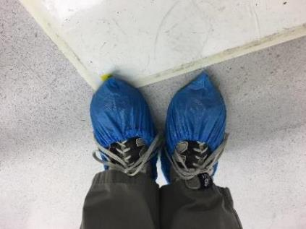
Entering the Cleanroom
Put on blue shoe covers (in a box outside the cleanroom door).
Step on the sticky pad to remove any dust from your feet.
Scan your ID card to unlock the door.
Place backpacks, jackets or unnecessary items in the lockers in the gowning room.
Do not leave items on the floor of the gowning room.

Slide 13
Basic Gowning Procedure
Put on head garment and a beard cover (if necessary).
Find an appropriate sized bunny suit off the rack and adorn.
Tuck in the tails of the head garment inside the bunny suit.
Find an appropriate sized pair of boots (color coded according to foot size)
Adorn safety glasses and gloves located near the door. Make sure your gloves are covering the cuffs of your bunny suit.

Slide 14
Personal Protective Equipment (PPE)
Always wear PPE when working with chemicals.
PPE is chemical resistant, NOT chemical proof.
Always inspect PPE before and after use. Check for holes, stains and other indicators of contamination.
Dry gloves before removing.
Do not leave gloves inside out for the next person.
Do not wear PPE outside of the wet bay.
Users need Wet Bench training before they are allowed to process in the Wet Etch Bay.

Slide 15
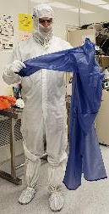
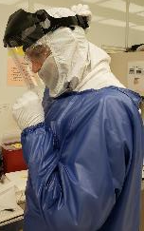
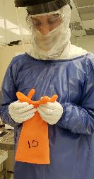
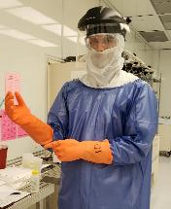
How to Wear Personal Protective Equipment
1. Inspect Apron | 2. Tie apron in the back only. | 3. Use 10% IPA + Water on towel to clean Face Shield. | 4. Put on the Face Shield.
5. Adjust Face Shield. | 6. Inspect Gloves for cracks |  | 7. Put on Chemical Resistant Gloves over apron sleeves

Slide 16
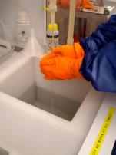
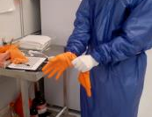
1. Check gloves, apron and face shield for contamination. If they are not easily cleaned then them throw away. | 2. Wash gloves | 3. Dry gloves using a towel.
4. Remove and hang face shield. | 5. Remove and hang apron.
Removal of PPE

Slide 17
Safety Data Sheets (SDS)
An SDS will give you valuable information about the chemical, its safety protocol and how to handle accidental exposure.
You must thoroughly review the chemical’s SDS before using the chemical.
Copies of SDS’s for all chemicals can be found in:
Gowning Room (SDS)
Online

Slide 18
Rules for Working with Chemicals
If you need a container for chemical processing you must first know what type of container to use (i.e. Pyrex or Nalgene).
Always wear appropriate PPE.
Always stand when working at any bench.
Only work with chemicals in their designated areas.
Chairs are not to be in front of the benches at any time.

Slide 19
Most chemicals are clear and appear as water. Assume all liquids are potentially dangerous if you do not know what they are.
Only use dedicated tanks/baths as they are labeled.
Uncap only one bottle at a time.
Pour chemicals slowly.
Keep gloves dry and clean.
Common solvents: acetone, methanol, Isopropyl Acohol (IPA)
Rules for Working with Chemicals

Slide 20
Rules for Working with Chemicals
When mixing chemicals:
Pour acids into water. NEVER pour water into acids.
Do not mix acids and solvents.
Do not mix halogenated solvents with non-halogenated solvents.
Do not leave chemicals unattended without being clearly labeled with the chemical name, date and your name.
Do not pour chemicals back into original container due to contamination issues.

Slide 21
Rules for Working with Chemicals
Always put the cap on securely on to containers and wipe away any drips on the side of the bottle.
Make sure you know understand how to dispose of the chemical before processing.
Leave it cleaner than you found it.
Place empty bottles on the bottom shelf of the cabinet that it came from.

Slide 22
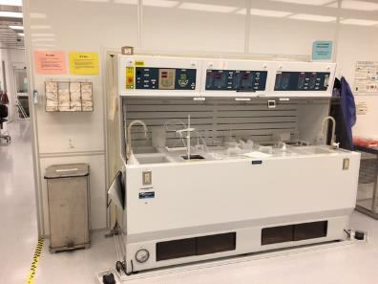
Waste
Wipes, cotton swabs and solid waste must be disposed into the appropriate and designated trash containers.
Hazardous waste trash bins are located in the wet etch and photolithography bays.
Wafers are to be disposed placed in the sharps bins located through the cleanroom.
Acid waste only
Acid Bench

Slide 23
Responding to Safety Incidents

Slide 24
Buddy System
You are never allowed to work alone in the cleanroom.
A cleanroom buddy is required before 9 am, after 5 pm Monday through Friday and on all weekends.
A cleanroom buddy is someone who also has access and is trained how to use the cleanroom.
If you see someone in distress you will automatically become their safety buddy.
Call 911.
Be sure you are wearing PPE before helping the victim.
Take the appropriate SDS to the ER.

Slide 25
Safety Station = Fire Extinguisher + Safety Shower + Eye Wash Station
There are safety stations located on the windowed wall at the end of every bay.
Pull down the handle to engage the safety shower.
Pull out the drawer to engage the eye wash station.
Safety Shower
Eye Wash Station
Safety Shower Handle

Slide 26
Responding to Emergencies
LEAVE IMMEDIATELY!!
You Hear: Horns going off
You See: Flashing White or Blue Lights
You DO: Evacuate the Building Immediately!!
Warn others as you exit and assist them if needed.
Do not attempt to de-gown.
Do not try to finish an experiment or understand why the alarm is sounding.
Fire Alarm
(white strobe)
Hazmat Alarm (Blue Strobe)

Slide 27
Responding to Emergencies
An emergency poster is placed in the gowning room for quick reference, but the basic idea is to just get out of the building as quickly as possible.
Two important phone numbers:
911 – Emergency Services
502-589-8222 – Poison Control

Slide 28
Minor Chemical Spill on a Person
Minor chemical spills are not life threatening, are not a health hazard and do not pose long-term health risks or risks of disfigurement.
Call the MNTC staff and/or Poison Control.
Place the affected skin under running water for 15 minutes.
Remove any contaminated clothes or jewelry.
If ER trip is needed, call 911, contact the MNTC staff and bring the SDS of the exposed chemical with you.

Slide 29
Major Chemical Spill on a Person
Major spills are immediately life threatening, a health hazard or pose long-term health risks or risk of disfigurement.
Get under a running safety shower and pull the handle. There will be a lot of water and alarms will go off. This will also notify the MNTC staff.
Have your buddy call 911 and request an ambulance.
Remove all contaminated garments and jewelry.
Have your buddy bring the SDS of the exposed with you to the ER.

Slide 30
Chemical Splash in the Eyes
If you are wearing contacts – take them out!
Flush eyes in eyewash fountain for 15 minutes. There will be a lot of water and alarms will go off. This will also notify the MNTC staff.
Have your buddy call 911.
Go to the ER and bring the SDS of the chemical that was exposed.

Slide 31
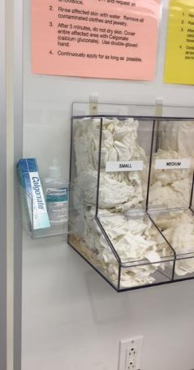
Hydrofluoric Acid (HF)
HF is a very dangerous chemical. If contact occurs:
Immediately rinse affected skin with water.
Remove all jewelry or clothing exposed to HF.
Have your cleanroom buddy CALL 911.
After washing for 5 minutes, do not dry the skin.
Cover entire affected area with calcium gluconate gel (Calgonate).
Continuously apply fresh gel while on the way to the ER and while waiting.

Slide 32
Hydrofluoric Acid (HF) in Eyes
Flush eyes at eyewash station for 5 minutes
After 5 minutes, switch to calcium gluconate (Calgonate) eyewash.
Have your cleanroom buddy call 911 and request an ambulance.
Continue flushing until reaching the ER.
Bring the HF SDS to the ER.

Slide 33
Chemical Spills
If the spill did not come into contact with your body then contact the MNTC staff for cleanup protocol.

Slide 34
Mercury Spills
If a Mercury Lamp explodes in the Suss Aligner:
Evacuate the cleanroom and activate the blue HAZMAT alarm.
Warn others as you exit.
Do not attempt to de-gown.
Do not try to finish an experiment.
Call 911 and alert them if anyone is injured.

Slide 35
Flammable Solids on Skin
Brush off as much solid material as possible.
Treat the exposure like a small spill on the skin.
Check the SDS before using any chemical – some flammable solids react with water!

Slide 36
First Aid for Other (Minor) Incidents
Thermal Burn
Immerse burned area in cold water.
Cover with sterile dressing.
Call 911 if the burn is severe.
Bleeding
Place clean pad and pressure on the wound.
If excessive get medical attention.
Clothing Fire
Douse victim with safety shower or smother with fire blanket.
If unsure - CALL 911!

Slide 37
Equipment Usage

Slide 38
Facility Online Management (FOM)
Set up your FOM account.
Request for training on specific tools.
Reserve the tools you need for processing.
Communicate with the MNTC staff, other users and supervisors.
Generate financial and usage reports and keep access of your tab.
Create your FOM account at: http://louisville.edu/micronano/users/fom

Slide 39
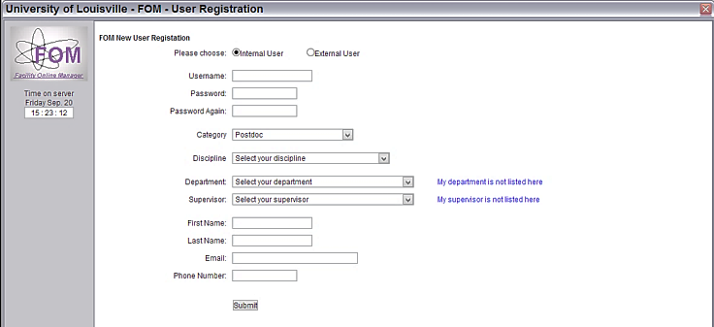
FOM Registration

Slide 40
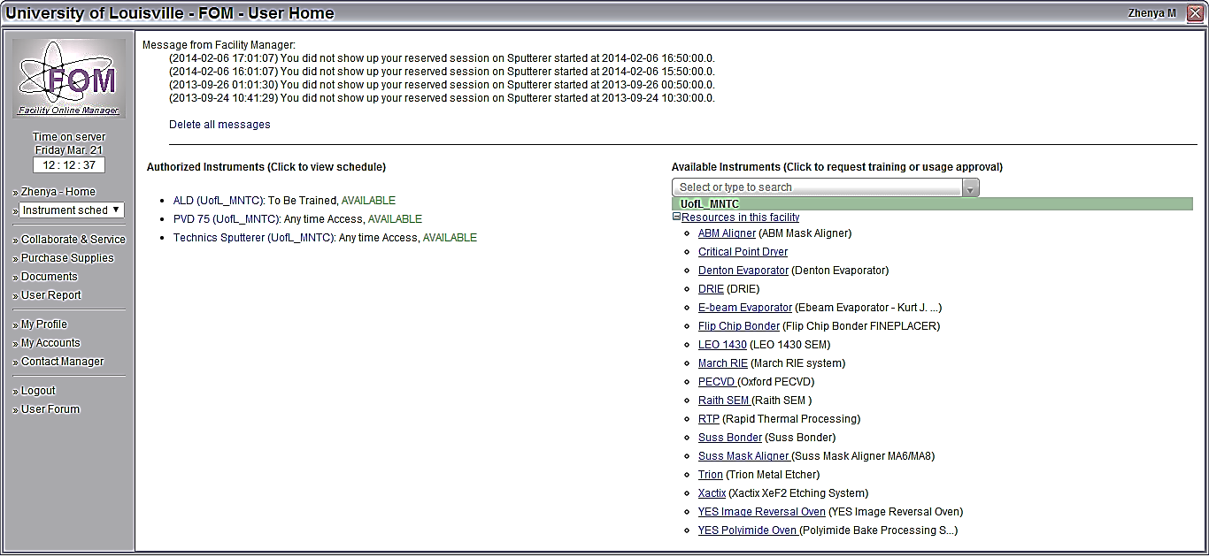
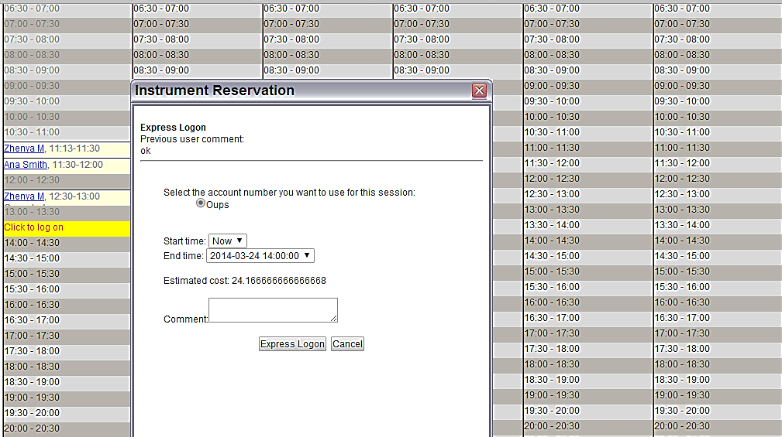
FOM Reservations

Slide 41
More Information
Check out our website for more information: http://louisville.edu/micronano/users/lab-safety
You can access SDS’s, standard operating procedures (SOP’s), the safety quiz and safety presentation, request equipment training and schedule use of equipment.

Slide 42
So… When do I get my access?
Complete your safety quiz and return it to the MNTC Staff.
Make sure to provide your advisor’s speedtype on your quiz!
Go through a process review with an MNTC staff member to learn more about which equipment you will need for your process
You will then be given cleanroom access and can sign up for training on specific tools.

Slide 43
Appendix I – Chemical Classifications
Acids: Acids have a pH of less than 7. Chemicals can be identified as acids if they have a name ending in ‘acid’ or if their chemical formula is of the form HX(aq) or HaXbOc.
Bases/Caustics: Bases have a pH of greater than 7. Chemicals can be identified as bases if they contain hydroxide (OH-), or hydrogen carbonate (HCO3-) anions. Ammonia (NH3) is also a base.
Corrosives: Corrosives have the tendency to cause deterioration of metal surfaces. Strong acids and bases are corrosives. Corrosives are chemicals which erode the skin and the respiratory epithelium and can be very damaging to the eyes. When inhaled, the vapors of corrosives can cause severe bronchial irritation.

Slide 44
Appendix I – Chemical Classifications
Flammables: Compounds whose vapors are easily ignitable at room temperature. Flammables can be identified by looking at the MSDS sheet for the chemical.
Halogenated Solvents: Halogenated solvents contain an element from the halogenated (second to last) column on the periodic table. These elements are: Fluorine, Chlorine, Bromine, Iodine, and Astatine.
Non-Halogenated Solvents: Any solvent that does not contain an element from the halogen class (second from last column of the periodic table).
Inorganic Acids: acids have chemical formulas that do not contain carbon.
Organic Acids: acids have chemical formulas which contains carbon.

Slide 45
Appendix I – Chemical Classifications
Oxidizing Agents: Materials which gains electrons when they react with other substances. This reaction may result in explosion or fire.
Peroxide Forming Compounds: Peroxides form by the reaction of the chemical with oxygen allowed in the headspace of chemical containers once the container is opened for the first time. Peroxide formation in laboratory solutions and reagents by auto-oxidation has caused many laboratory accidents, including unexpected explosions of residues remaining after solvent distillation.
Reducing Agents: which become an electron donor when they react.
Solvents: The component of the solution that is present in the greatest amount and is capable of dissolving another substance.
Toxic: Containing or being poisonous material especially when capable of causing death or serious debilitation. Exposure to chemicals in the laboratory can occur by several different routes: (1) inhalation, (2) contact with skin or eyes, (3) ingestion, and (4) injection. Toxicity information is available on the material safety data sheet of each chemical.

Slide 46
Appendix II – HCS Label
Health Hazard: Carcinogen, Mutagenicity, Reproductive Toxicity, Respiratory Sensitizer, Target Organ Toxicity, Aspiration Toxicity
Flame: Flammables, Pyrophorics, Self-Heating, Emits Flammable Gas, Self-Reactives, Organic Peroxides
Exclamation Mark: Irritant (skin and eye), Skin Sensitizer, Acute Toxicity (harmful), Narcotic Effects, Respiratory Tract Irritant, Hazardous to Ozone Layer (Non-Mandatory)

Slide 47
Appendix II – HCS Label
Gas Cylinder: Gasses under Pressure
Corrosion: Skin Corrosion/Burns, Eye Damage, Corrosive to Metals
Exploding Bomb: Explosives, Self-Reactives, Organic Peroxides

Slide 48
Appendix II – HCS Label
Flame over Circle: Oxidizers
Environment: Aquatic Toxicity
Skull-and-Crossbones: Acute Toxicity (fatal or toxic)

Slide 49
Appendix III – Common Acids in the Cleanroom
Chemical | Formula | Concentration
Acetic Acid | CH3COOH | 95%
Hydrofluoric Acid | HF | 49%
Hydrochloric Acid | HCl | 36%
Nitric Acid | HNO3 | 68%
Phosphoric Acid | H2PO4 | 85%
Sulfuric Acid | H3SO4 | 96%
Hydrogen Peroxide | H2O2 | 30%
Buffered Oxide Etch | NH4 / HF | 50% / 10%

Slide 50
Appendix IV – Common Bases in the Cleanroom
Chemical | Formula | Concentration
Ammonium Hydroxide | NH4OH | 25%
Ammonium Fluoride | NH4F | 40%
Potassium Hydroxide | KOH | 45%
Sodium Hydroxide | NaOH | 50%
TMAH | (CH3)4NOH | 25%

Slide 51
Appendix V – Common Solvents in Cleanroom
Chemical | Formula | Concentration
2-Propanol | CH3CHOHCH3 | 100%
Acetone | CH3COCH3 | 100%
Chlorobenzene | C6H5Cl | 100%
Methanol | CH3OH | 100%
Toluene | C6H5CH3 | 100%
Trichloroethylene | C2HCl3 | 100%
Xylene | C6H4(CH3)2 | 90%

Slide 52
Appendix VI – Common Corrosives
Ammonium Fluoride
Ammonium Hydroxide
Ammonium Hydroxide
Buffered Oxide Etch (BOE)
Hydrochloric Acid
Aluminum Etch 80-15-3-2
Hydrofluoric Acid
Phosphoric Acid
Potassium Hydroxide
Resist Developer
Sulfuric Acid

Slide 53
Appendix VII – Incompatible Chemicals
Acetic Acid
Ferric Chloride
Hydrogen Peroxide
Mercury
Nitric Acid
All Acids (ex. Hydrochloric, hydrofluoric)
Oxidizers (ex. Permanganates, inorganic peroxides, persulfates, perchlorates)
Water Reactives (sodium, potassium, metal hydrides, hydrolysable halides)
NANO-STRIP
Sulfuric Acid
Nitric Acid, Ethylene Glycol, Peroxides, Permanganates
Aluminum
Copper, Chromium, Iron, Alcohols, Acetone, Organics
Ammonia
Photoresist Developer, Acetic Acid, Flammable Liguids, Flammable Gases
All Bases (ex. Sodium cyanide, potassium hydroxide, sodium hydroxide)
Flammables, organic materials, reducing agents (ex. Zinc, alkaline metals, formic acid)
Water
Solvents
Solvents

Slide 54
Appendix VII – Incompatible Chemicals
Chemical | Chemical
Acetic Acid | Nitric Acid, Ethylene Glycol,
Ferric Chloride | Peroxides, Permanganates Aluminum
Hydrogen Peroxide | Copper, Chromium, Iron, Alcohols, Acetone, Organics
Mercury | Ammonia
Nitric Acid | Photoresist Developer, Acetic Acid, Flammable Liquids, Flammable Gases
All Acids (ex. Hydrochloric, hydrofluoric) | All Bases (ex. Sodium cyanide, potassium hydroxide, sodium hydroxide)
Oxidizers (ex. Permanganates, inorganic peroxides, persulfates, perchlorates) | Flammables, organic materials, reducing agents (ex. Zinc, alkaline metals, formic acid)
Water Reactives (sodium, potassium, metal hydrides, hydrolysable halides) | Water
NANO-STRIP | Solvents
Sulfuric Acid | Solvents

