Slide 1
It’s a Wild World
University of Louisville Global Health Lecture series
Sarah Couch, MS4
“Life’s tough…Wear a helmet”

Slide 2
The High Points
Travel preparation – Steps before you go
Packing: the What and How
Your health
Food and Water preparation
How to promote the general welfare – Choices to promote safety.

Slide 3
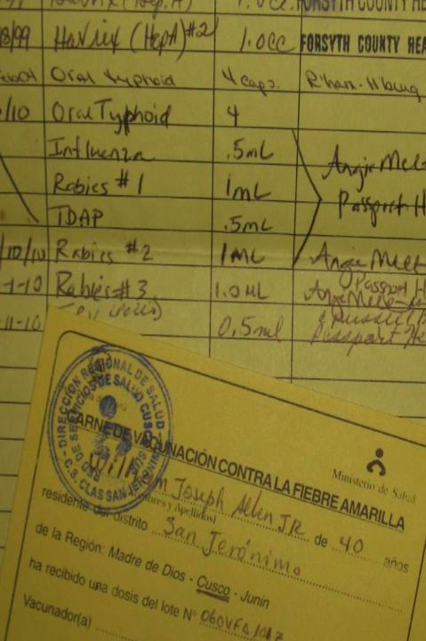
Before you Go:
Vaccines
You’ll need the basics
Plus what is common in your destination
Where to get them? U of L Student Health or U of L Travel Clinic
http://louisville.edu/campushealth
http://www.uoflvaccinesandtravel.com
Good Resource:
http://wwwnc.cdc.gov/travel/destinations/list
Medications
Malaria prophylaxis
Travelers Diarrhea Medication
Altitude sickness medication
HIV prophylaxis kit (one per team)
Your Personal Medications

Slide 4
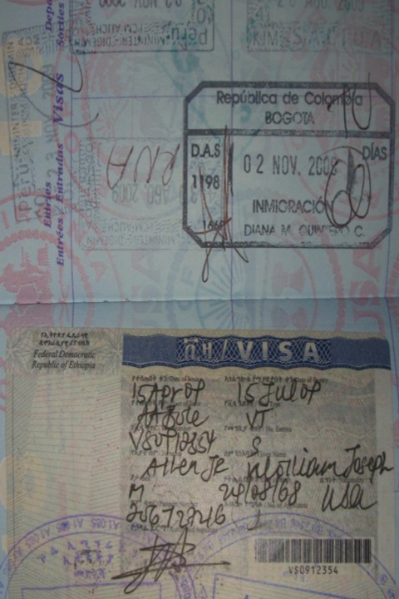
Before you Go:
Trip details:
Do you need a visa before you land?
What is your flight itinerary? PRINT IT OUT
Where are you staying? Who are your contacts in country? PRINT THESE OUT
Insurance
Evacuation insurance (most US health policies do not cover services abroad) Required by UofL
Malpractice insurance
Emergency contact information

Slide 5
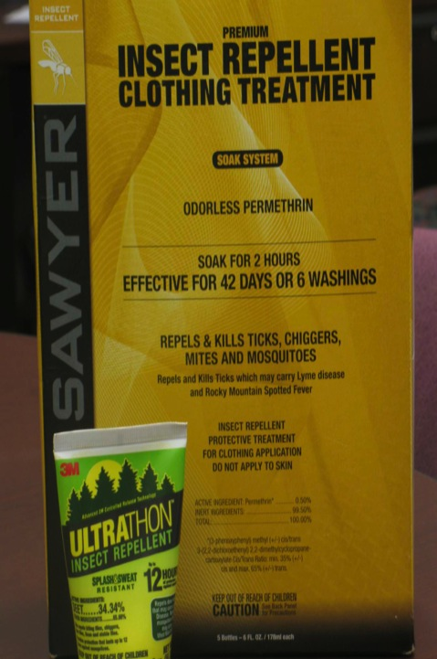
Before you Go:
Treat clothes to repel mosquitos with Permethrin solution
Other paper work:
Copies of: Passport, Credit Cards you are taking, other Identification
Register with the Department of State STEP program
They will keep you update with travel warnings for your destination
https://step.state.gov/step/

Slide 6
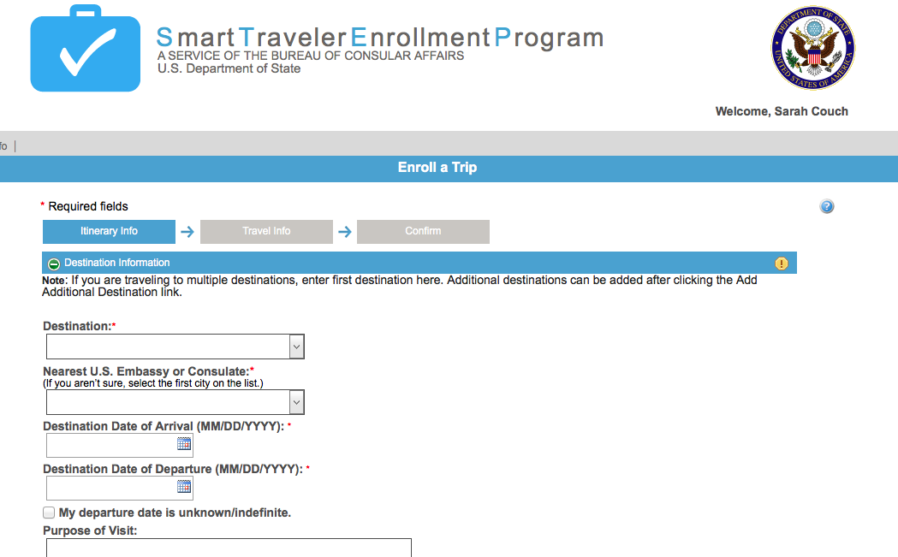
STEP
“Smart Travelers Enrollment Program”
You’re Smart!

Slide 7
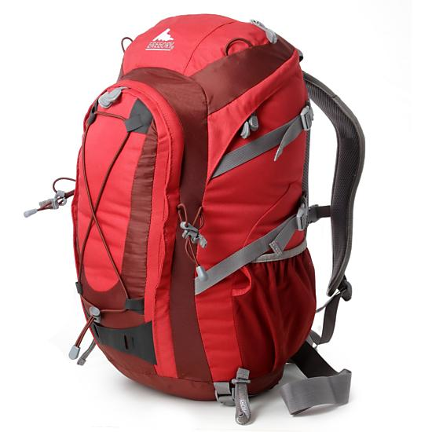
What and HOW to pack
The general approach is dividing between your carry on and checked bags.
Different Trips different approaches:
Personal items
Medical supplies
KNOW YOUR AIRLINE baggage requirements
They sometimes make you prove the size!
Weigh bags—usually 50lb limit

Slide 8
Your Carry-On:
“What if I don’t get my luggage when we arrive”
All of those Copies:
Travel Itinerary, in country contacts, insurance information, travel agent information, credit cards, passport
And the Originals:
Passport (check expiration date)
With a visa if required before entry
Proof of immunization (yellow fever card)
Personal money, credit card/debit card
Airline Tickets

Slide 9
Your Carry-On:
ALL of your medications: OTCs, malaria, tummy medicine, etc
Valuables: Camera (with batteries), small electronics if you are taking them, outlet converter
CLOTHES: bring at least one extra day of cloths and probably some extra underwear, sun glasses!
Medical equipment you need to do your work—stethoscope, otoscope, etc
Letter of Invitation or Declaration

Slide 10
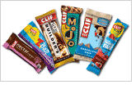
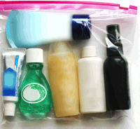
Your Carry-On
Basic Toiletries
1 or 2 empty water bottles – nalgene, camelbak, etc and water purification items
Some snacks
Travel entertainment: light reading or the such
Phones?
Look into short term international phone plans
Does yours work internationally? Cost? Disable by removing SIM card if unsure.

Slide 11
“Other” Luggage
A note on your clothes:
What is the culture? Head, Shoulders, Knees and Toes
Will you need a clothes line?—YES.
Shoes: Toes
Light: you will probably need a personal light
Gifts for your hosts/ new friends
Toiletries: Ziplocks are your friend!
Duct tape: it’s just good to have around

Slide 12
Ladies:
How long will you be gone?
Will you need any tampons/pads/Diva cups etc?
Pack it all. Not available at the corner store in many places.
If on a pharmacologic agent..
Consider skipping placebo week
Pills, NuvaRing or patch
Contraception medication = Increased risk of DVTs and PEs

Slide 13
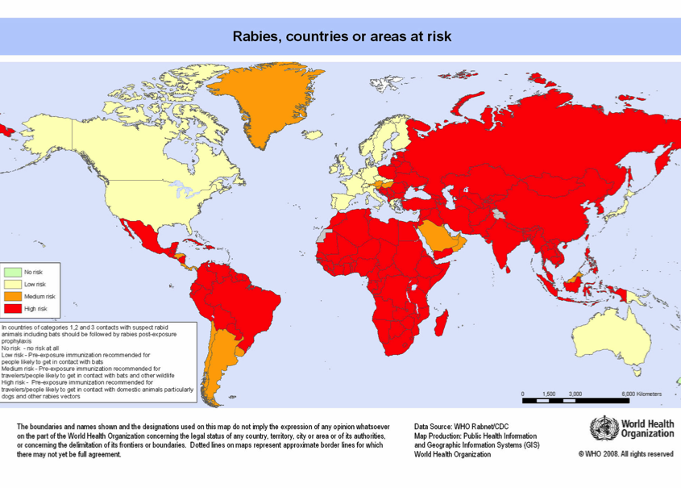
Diseases we don’t think about: Rabies
Post Exposure Care
Wash with soap+ water, then alcohol or iodine
IF NOT immunized: give immunoglobulin @ bite + immunization (4 doses) + stop chloroquine or Mefloquine as they can interfere
As you travel: pre-exposure prophylaxis
Recommended for: long term travelers or if traveling to area where Immunoglobulin not widely available

Slide 14
Malaria and other Insect vector illnesses
Permethrin:
Soak clothes + bed nets
Bed Nets:
They are hot, only useful if … used!
DEET:
Topical application with 35% will be enough
DEET + plastics = Melting…

Slide 15
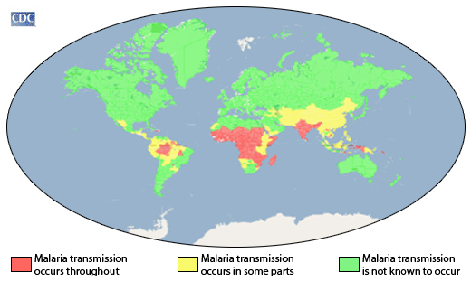
Malaria Prophylaxis
Atovaquone/Proguanil (Malarone)
Not used in patients: renal impairment, kids <5 or pregnant women,
Take with food; start 1-2 days prior, then daily, and 1 week after
Chloroquine – only useful if malaria is sensitive
Doxycycline
Not used in: kids <8 or pregnant women, Caution: Photosensetivity!! And pill esophagitis
1-2 days before travel, daily, 4 weeks after return
Mefloquine—Not for those with history of seizures, depression or psych illnesses

Slide 16
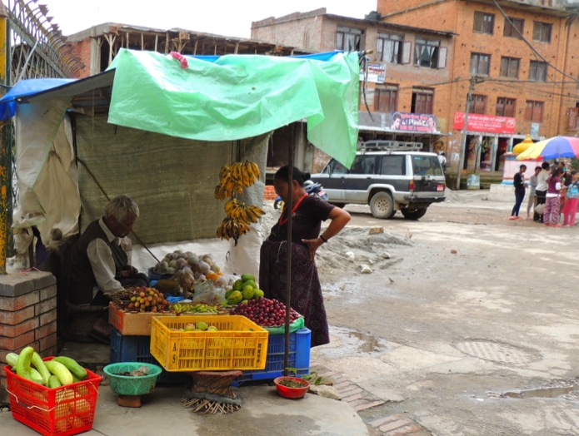
Travelers Diarrhea
What puts you at risk?
“lack of dietary discretion”
Low Gastric acidity: taking antacids, PPIs?
Age 15-29
What does it mean?
3+ unformed stools with at least 1: Nausea, Vomiting, Cramps, fever or blood in stool
Blood or mucus is unusual (5-15%)
Usually self limited = 3-5 days

Slide 17
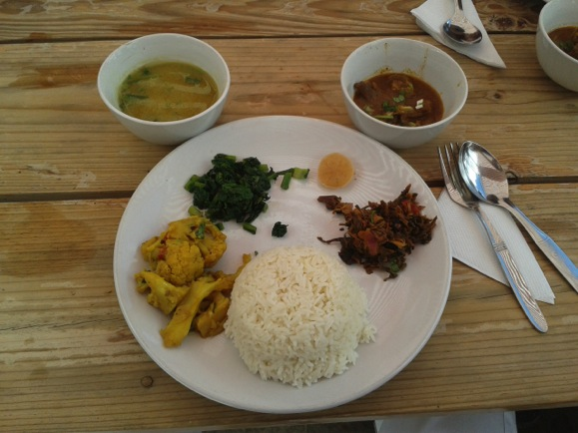
Travelers Diarrhea
“but I eat this all the time”
Ice?
Washed vegetables?
Sitting out?
Packaged - Boiled – Cooked – YOU peeled it!
Drinks ok if: Boiled, Canned or Pasteurized, coconut water, Beer or Wine
Wash your hands … with the right H₂O
Try a probiotic prophylaxis

Slide 18
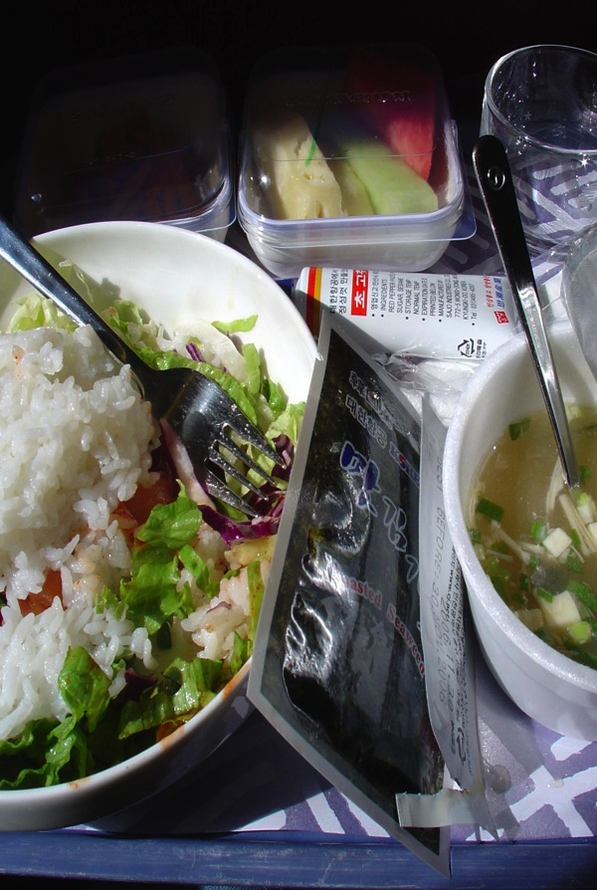
Travelers Diarrhea
In Country:
People make food for you?
Offer you drinks?
Risk is dose dependent
On the plane
All food is prepared and loaded into the plane from your departure city…

Slide 19
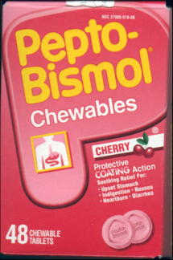
If you get it:
Early Treatment - Controls symptoms and shortens duration by 1-2 days.
Oral rehydration!!
Bismuth subsalicylate (Pepto-bismol) –
2 tablets an hour (or one ounce) - per hour up to 8 hours
Antimotility agents
Loperamide is only one safe; decreases stools by 60%
Antibiotics -
Ciprofloxacin
500mg twice a day for 1 day; if not improved, complete 3 day course
Azithromycin
1 gram (may cause nausea) once or 500mg q day X 3 days
Resistance is growing to cipro - 70% campylobacter resistance in Asia (Thailand) and subcontinent

Slide 20
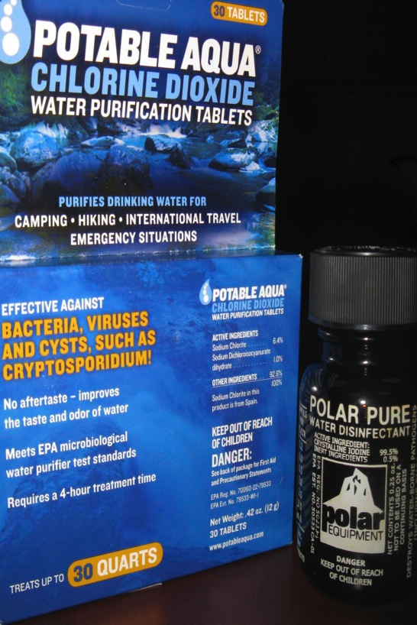
Clean Water?
Bottled Water
Heat – rolling boil x 10 min
Filtration
Halogenation: iodine or chlorine tabs

Slide 21
Smart Decisions
Scope of Practice:
Disclose
Best Rules:
IF YOU AREN’T ALLOWED TO DO IT INDEPENDENTLY IN A U.S. HOSPITAL, YOU PROBABLY SHOULDN’T DO IT INDEPENDANTLY SOMEWHERE ELSE.
The health and well being of the international patient is just as important as an American patient.

Slide 22
Smart Decisions
Taking pictures of Patients:
Get consent
Be especially conscious of taking pictures of other people’s children
DO NOT post pictures of wounds/disease or people’s faces to Facebook or other social media.
Going to use it for a presentation or publications?
Special U of L form for clinical photography

Slide 23
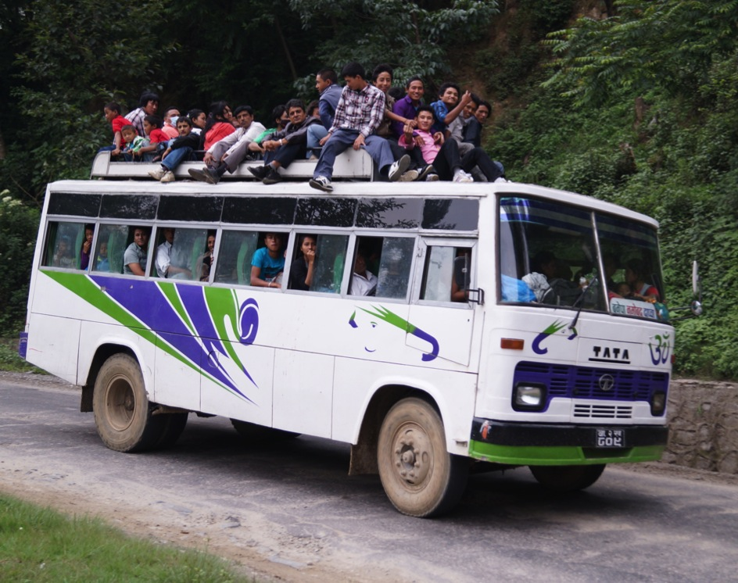
Smart Decisions
Traveling in country:
Public Transportation?
Motor bikes? Helmets?
Road accidents are the #1 source of mortality for international volunteers

Slide 24
Safe Decisions
Sex
Drugs
Rock and Roll (aka “The Club”)
Tattoos
Traveling with strangers

Slide 25
Other Important Links
UofL travel forms:
http://louisville.edu/studyabroad/resources/school-of-medicine
Student Health for travel prep:
http://louisville.edu/campushealth/services
UofL Travel Clinic (another option)
http://www.uoflvaccinesandtravel.com/
Supplies Over Seas: can buy items – good for group travel
http://www.suppliesoverseas.org/

