Slide 1
4th Year Medical Student Emergency Medicine Rotation
WELCOME TO LOUISVILLE!

Slide 3
Table of Contents
Welcome
Introduction to EM
Orientation
Scheduling and Attendance
Student Roles and Responsibility
Typical Student Shift
Didactics
Resources and Reading
Evaluation
Study Guide
Hospital Policies
The Department
Triage
Room 9
Main Department
X-Ray
EPS
First Care
Important Names and Numbers
Louisville Info

Slide 4
Welcome
Welcome to the University of Louisville Department of Emergency Medicine! Founded in 1971, we are one of the oldest programs in the country. Here you will find an atmosphere that promotes clinical excellence and education through collegiality among the residents, attending physicians and staff. Our stability is rooted in dedicated faculty, institutional support, and the recruitment of fun, energetic, and hardworking residents that thrive in the setting of autonomous yet supervised practice. It is the approach that hones our residents’ clinical and decision making skills well prior to their graduation.
Again, welcome. Prepare to work hard, study, and learn skills that you can use throughout your career.

Slide 5
Introduction to EM
Emergency Medicine is a fun, fast-paced, fluid, and exciting specialty. We treat whatever may show up at the door. You will have the opportunity to provide critical, surgical, medical, gynecological, obstetrical, psychiatric, and even palliative care to a wide range of patients.
Procedures abound in the emergency department and you are invited to participate. Frequently, we perform trauma and medical resuscitations, FAST scan ultrasounds, central venous line placements, tube thoracostomy, fracture & dislocation reduction and splinting, intubation, incision & drainage, and laceration repair.
We have a lot for you to do and learn. Come to the shift excited and be prepared to get you hands dirty.

Slide 6
Introduction to EM
Student Goals and Objectives
Develop good clinical judgement and learn to apply it to patient care
Deliver appropriate and compassionate emergency care
Broaden and apply you medical knowledge to patient care
Work to communicate effectively with both patients and colleagues
Always remain ethical, responsible, and reliable
Learn what resources are available to the ED and how to utilize them
Learn to recognize and treat a patient in distress

Slide 7
Introduction to EM
Student Core Competencies
Patient Care
Medical Knowledge
Problem-based Learning
Interpersonal Communication Skills
Professionalism
Systems-based Practice

Slide 8
Introduction to EM
What we expect of you:
Strong work ethic with a desire to learn and then teach what you learn.
Punctuality
Follow-through with what you are asked/volunteer to do
If a patient appears to be in distress, you need to IMMEDIATELY get help from an upper level resident or attending. DO NOT try to handle it yourself!
Professionalism is a must! All staff – from environmental services to patients and consultants – are to be addressed in a professional and respectful manner. Remember, this is a team sport

Slide 9
Orientation
On your first day, arrive in the ED academic office at 9:00 AM. It is located adjacent to the emergency department. Just ask anyone at the ED secretary’s desk and they will show you back.
Dress code is business casual
You will be making your own schedule this day, so bring your phone, planner, lunch napkin, or whatever else you use for organization.
You will tour the department, be given your badge, and all other formalities this day.
This will also be your opportunity to meet with the student coordinator, review the syllabus, ask questions, and get to know the other students on the rotation
Plan for this orientation to last ~3 hours

Slide 10
Scheduling and Attendance
Scheduling coverage is part of the EM career. Therefore, we leave it to YOU to create your own schedules. Here are the rules:
Students are required to work 15 shifts in the ED, 4 of which must be on a weekend.
Your 15 shifts must be evenly divided between the three shift times each day
08:00 AM – 04:00 PM
04:00 PM – 11:00 PM
11:00 PM – 08:00 AM
You will need to be available the entire four weeks of your rotation. You cannot frontload or backload your schedule to complete it in a shorter time.
You may not work more than 5 consecutive days, and must have at least 8 hours between shifts.
No more than 2 students may work the same shift
Switching is allowed, but you are responsible for finding a student to switch. All switches need to be approved by Alescia McKeel 24 hours before the scheduled shift.

Slide 11
Scheduling and Attendance
Other Responsibilities:
Student Didactic Lectures: These are mandatory lectures/hands-on teaching sessions presented by the residents. The schedule will be provided to you by Alescia McKeel. Every student must attend each of these unless you worked the 11PM – 8AM shift just prior.
Resident Lectures: The department has lectures scheduled for the residents each Wednesday morning, typically 9AM -12PM. They are held in the ED conference room and cover a wide array of useful topics. It is highly recommended that you attend these conferences during your rotation. Topics and exact times can be found on the conference schedule posted on the conference room door.
16th Shift: In addition to the 15 shifts you must complete in the ED, you must also do one extra shift during your rotation with one of the following:
Procedural shift in the ED
Poison Control shadow
Air Methods helicopter ride-along
Louisville Metro EMS ambulance ride-along

Slide 12
Late/Missed Shift
In the event that you are unable to attend a shift or will be late due to an emergency or illness, you are responsible for:
Calling the main department at (502) 562-3015 and alerting the third year resident currently working.
Calling your student coordinator (Alescia McKeel) at (502) 852-1035 to alert her and reschedule your shift. You will be responsible for making up any missed shifts.
If you find out that you will not be able to work a shift 24+ hours in advance, you must contact Alescia ASAP to reschedule the shift. Again, you are able to switch shifts with other students, but it is your responsibility to arrange this.

Slide 13
Interview Season
Interviews are important!
Your schedule should accommodate most of your interviews as your schedule is self-made and flexible.
You are required to complete 15 shifts, regardless if you have 0 interviews or 12.
If you have an interview scheduled on a day you are supposed to work, it is your responsibility to switch shifts and make it up.
If you are applying to UofL for a residency, there is a chance that you will interview during the month of your rotation.
The interview day will be announced in time for you to change your schedule (if necessary)

Slide 14
Student Roles and Responsibility
All students are responsible for the following:
Completing histories and physicals
Formulating clinical decisions
Ordering treatment and additional tests with supervision
Learning and performing procedures
Determining patient disposition
Learning how to obtain and completing consultation as directed by your resident
Assisting in treatment of critically ill patients in the trauma room (Room 9)
Check your email daily for updates

Slide 15
Typical Student Shift
Arrive 15 minutes early to your shift
At the beginning of each shift, all residents and attending(s) will round on all patients in the department. At this time, the leaving residents will turn over their remaining patients to the oncoming team.
Make sure that each patient you go to see appears stable. If the patient appears to be unstable or have a true emergency, get a resident immediately. Caution will never be viewed as a weakness. If a resident is not immediately available, ask a secretary or nurse to page the resident to the room STAT.
Take the patient’s history, PMHx, etc. Perform a physical exam.
Formulate a DDx and plan of action.
Present a concise history, physical, diagnosis, and plan to an upper-level resident. Include interpretation of completed labs/imaging/EKG as well as what else you would like to order and likely disposition (See slide 17).
Continue to follow-up with your patient, his/her lab/imaging results, and disposition until discharged or admitted.

Slide 16
Typical Student Shift
Your resident will then see the patient, and they will assist you in ordering relevant studies.
Once the orders are placed, be sure to follow up and get the results of the labs and x-rays. However, you must be quick or the residents will beat you to it!
Once disposition is determined, the resident will guide you in obtaining consultation, admission, or discharge
If procedures are necessary, you will be expected to participate
Learn something from every patient you see. Try to pick up a wide range of chief complaints and patients.
Keep enough patients to stay active but not overwhelmed.
At the end of the shift, we will round again. DO NOT LEAVE UNTIL ROUNDS HAVE FINISHED!
You may be called to present on any of your patients that are being turned over. This will be like your initial presentation (slide 17 for example). Be prepared to be asked questions. You are not expected to know everything, but you will be responsible for the basics. Know why you ordered/performed what you did.

Slide 17
Example Presentation
Pt is a 67 y/o AA male. Presented to the ED today with worsening angina with exertion. Pain free on presentation. Came because his wife made him. Hx of CAD, CABG. Pt is a smoker for 40 years. PEx is unremarkable. Labs so far all negative, including cardiac enzymes. EKG unchanged from 6 months ago, with evidence of an old inferior infarct. Last cath 3 years ago. Pt has had ASA, O2, IV and lovenox. Suspect unstable angina. Will consult Cardiology. Plan for Cardiology admission for likely repeat cath.
If you use a term, know the definition. A likely question here is “What are the different types of angina and how do you treat them?”
Know why you did things. “Why did you give this patient lovenox?”
Questions are meant to teach, not punish

Slide 18
Resources and Reading
Books
Rosen’s and Tintinalli’s are the staples for Emergency Medicine
Read about the topics outlined in the study guide
All students are provided with a loaned copy of Step-Up to Emergency Medicine
Organizations
www.acep.org
www.emra.org
www.saem.org
www.aaem.org
www.abem.org

Slide 19
Evaluation
Student grades will be compiled from two components:
Shift evaluations will count for 70% of you final grade
An evaluation will be completed from your upper-level resident at the end of each shift
Each student should have a minimum of 10 evaluations
End-of-clerkship exam will account for 30% of you final grade
Online, NBME exam. The date and time will be provided during orientation
See study guide for list of topics covered
Final grade breakdown
90 or higher : Honors
89.4 - 60.0 : Pass
Below 60 : Fail

Slide 20
Evaluation
Shift Evaluations are based on core competencies
Patient Care
Medical Knowledge
Problem-based Learning
Interpersonal Communication Skills
Professionalism
Systems Based Practice

Slide 21
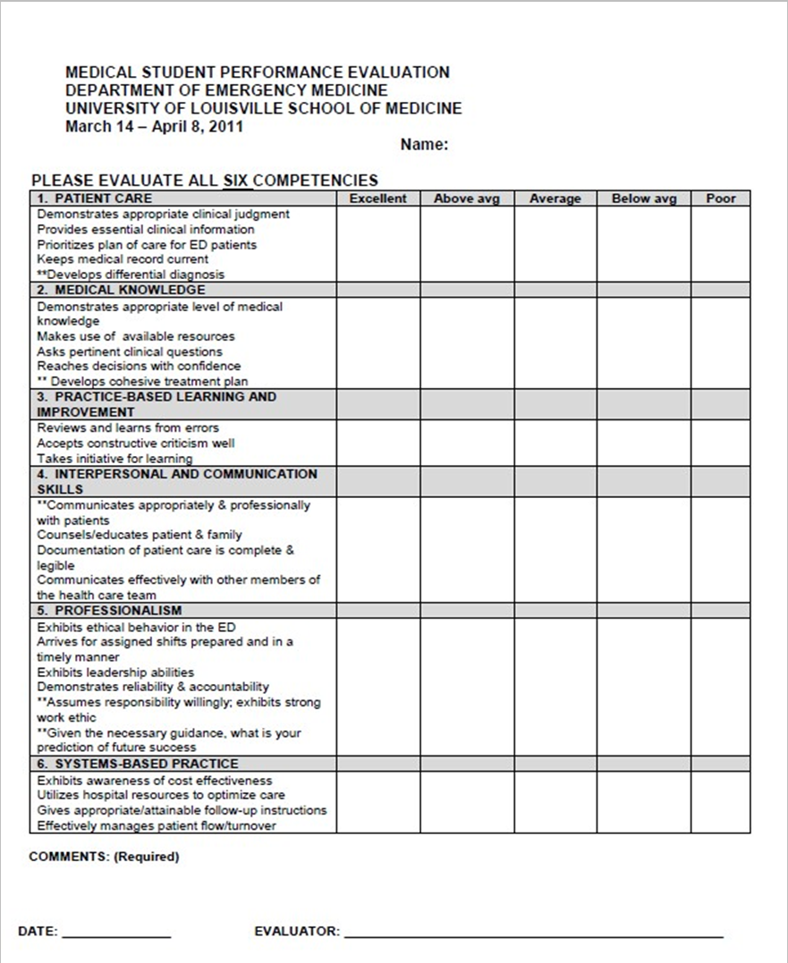
Evaluation

Slide 22
Evaluation Surveys
After your final shift and written exam, you will be asked to evaluate the residents
Please fill these out honestly. Your responses are anonymous. We value your feedback greatly, especially on the effectiveness of the rotation.
You will receive an email with the links to these surveys prior to your Shelf exam
These must be completed to receive your final grade

Slide 23
Important to Know
Your final grade will not be released until you have:
Completed the resident and course evaluation
Signed ALL of your patient charts
Returned your completed 16th Shift form to Alescia

Slide 24
Study Guide
The following information is meant as a broad guide for the questions you may encounter on the final exam. Any and everything about each topic is fair game!

Slide 25
Study Guide
HEENT
Otitis media
Bell’s Palsy
“The red eye”
Pharyngitis
Vertigo
Ocular foreign body
Glaucoma
Epistaxis
Globe rupture
Environmental
Lightning
Hypothermia
Hyperthermia
Diving
High altitude sickness
Drowning

Slide 26
Study Guide
Toxicology
Beta-blockers
Snake bite
Cyanide
Tylenol
ASA
TCA
EtOH
CO
Spider bite
Trauma
Resuscitation
Management of multiple trauma
Burns
Cervical X-rays
EMS Management
Shock

Slide 27
Study Guide
Respiratory
Dyspnea
Airway Management
ABG’s
PE
PNA
Asthma/COPD
Wounds
Suturing
Wound Care
Abdomen
Gallbladder
Pyelonephritis
Abdominal pain
Acute abdomen
SBO
Mesenteric ischemia
Pediatrics
Trauma
Infections

Slide 28
Study Guide
OB/GYN
Pregnancy
Eclampsia
Abortions
Vaginal bleeding
Ectopic Pregnancy
PID
Dermatology
Stevens Johnson Syndrome
RMSF
Lyme Disease
Neurology
Meningitis
CVA/Stroke
Mimicry of CVA
Seizures
Headaches
Psychiatric
Safety Measures
Suicidal/Homicidal Pt
Psychosis

Slide 29
Study Guide
Orthopedics
Sprains
Splints
Fractures
Hand Injuries
Arthritis
Cardiology
MI
Arrhythmias
CXR
ACLS
Endocrine
Adrenal
Thyroid
Anaphylaxis
Graves Disease
DKA

Slide 30
Hospital Policies
Fire Safety: we follow the RACE method
R – Rescue persons from fire, know exit locations and fire compartments, feel doors for heat, search while yelling “blue flash” or “fire”
A – Activate alarm pull station while yelling “blue flash” or “fire”. Dial 20 (code phone) to report fire location
C – Control/Contain the fire, Close all windows and doors
E – Extinguish or evacuate using portable fire extinguishers

Slide 31
Hospital Policies
Blood Exposure – If you experience a needle stick or other occupational blood exposure, please do the following:
Obtain consent for the patient involved for HIV testing and contact the nursing supervisor and attending
Complete an incident report
If you have a needle stick from a high-risk patient, call (502) 852-6446 immediately and ask to speak with MD on call. Start PEP within one hour.
Follow all exposure protocol and if you have any questions, call (502) 852-6446, which is answered 24/7

Slide 32
The Department
The following is a quick tour of our department of our department, with relevant information about each area.
This will give you an idea of the layout of the ED, where people can be found, and the ED flow

Slide 33
Triage
Patients sign in here and are sent to the proper location based on illness
Occasionally, residents are called to triage for evaluation of a pediatric patient, abnormal triage EKG, etc.

Slide 34
Room 9
Room 9 is our medical and trauma resuscitation room. There are four bays, one of which is seen here.
When you are in the ED and hear a buzzer sound followed by a “Room 9” page, please stop what you are doing and proceed to Room 9.

Slide 35
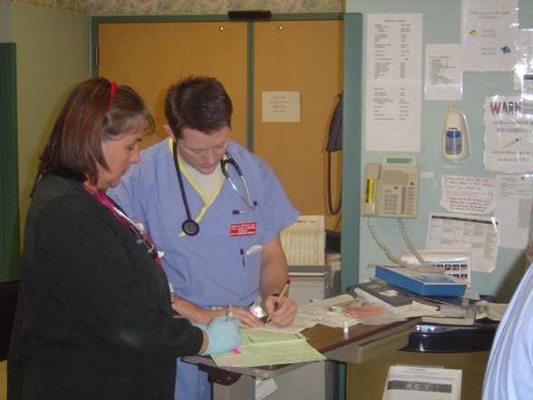
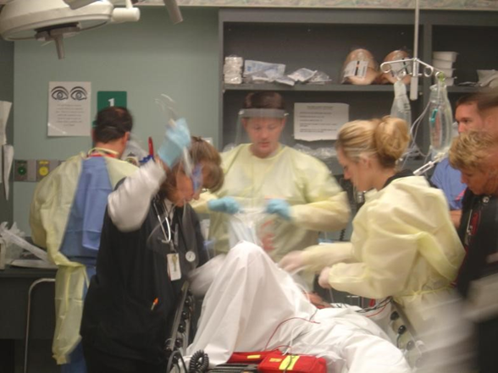
Room 9
Generally, only critically ill patients are seen in Room 9. Everything we need is right at hand and things move very quickly.
As your rotation progresses, you will be asked to participate with increasing frequency in Room 9, so pay close attention!

Slide 36
Room 9
As the residents become more comfortable with your skills, you may be asked to perform procedures in Room 9. So read up on nasal and oral intubation, chest tubes, central lines, and splints
If you do not know how to perform a procedure or are uncomfortable doing it, say so! Do not pretend to know how to do something you don’t know how to do. Your resident will teach you, and you can do the next one.

Slide 37
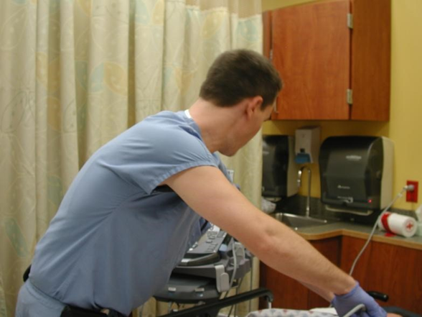
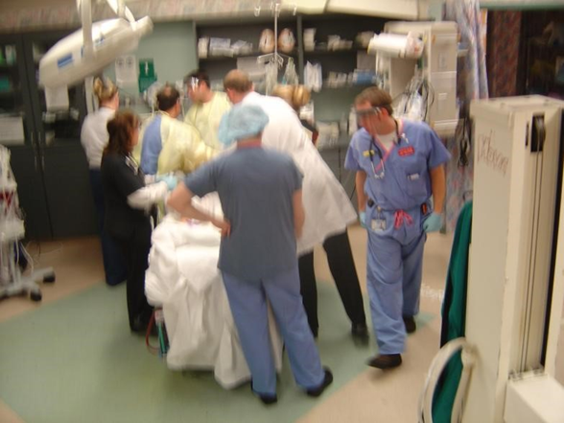
Room 9
Sometimes Room 9 patients are not serious and you may be dismissed to the department. When dismissed, please return to the department and continue seeing patients.
Sometimes the patient is too ill to be a teaching case. In this instance, you may be asked to stand aside and watch. This is only ever done when a patient’s life is on the line. Please do so quickly and do not take it personally.

Slide 38
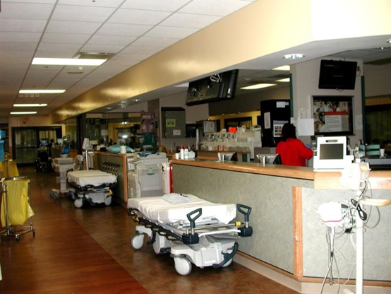
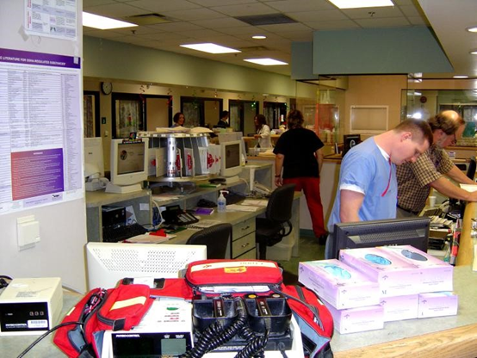
Main Department
This is a partial view of the main department. The design is an arena style with patient rooms on the periphery and staff seating located centrally
This is a view of where the residents and attendings sit and work. Please sit at the single monitor computers – upper levels will sit at the double-monitors.

Slide 39
Main Department
This is a picture of the glass room in the center of the dept. We call it the “fish bowl”. This is where our consulting services will do their work. That is Dr. Danzl, our chairman, on the phone. Of note, his name also appears on the cover of Rosen’s.
The phones and radios in this picture are located behind the resident’s seat. These are used to take transfer calls from EMS and AirMethods. Please do not use these phones at any time.

Slide 40
Main Department
Remember, EM is a team sport and collegiality is a hallmark of our program. Can you imagine what it would be like if no one took pride in keeping the ED clean?
An important thing to learn is that being nice to nurses and other staff will save you a lot of time and work. Plus, they deserve it. They work even harder than we do.

Slide 41
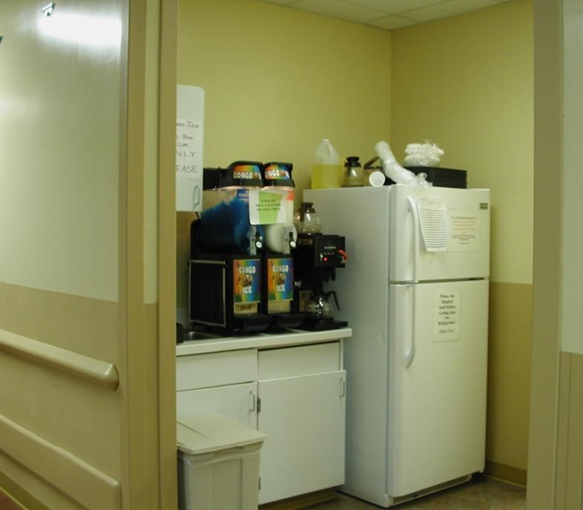
Main Department
Often, a patient or family will ask for food or drink. Other times it may be clinically important for the patient to eat/drink (diabetics, PO before d/c, etc.). Pictured here is the fridge and coffee maker where you can get drinks or crackers. Additional food is located at the secretary’s desk.

Slide 42
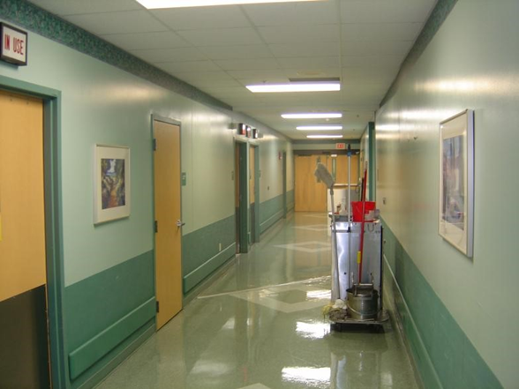
Radiology
We have our own dedicated radiology suites and CT scanner. They are located in the hall just behind the department. This is also where you can find our radiologists for direct consultation.

Slide 43
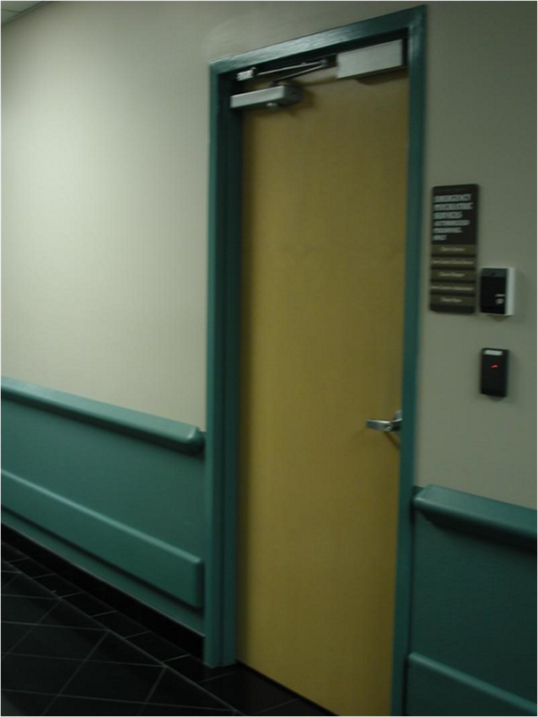
EPS
EPS (Emergency Psychiatric Services) is our department for EM patients that present with only psychiatric complaints. Psychiatrists staff this area 24/7. Patients with both psych and medical complaints will be seen in the main ED, and then transferred to EPS once medically cleared.

Slide 44
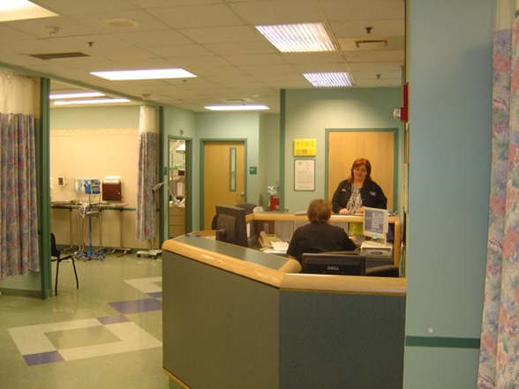
First Care
First Care is a fast track area. It is staffed by midlevel providers. Patients presenting to the ED with minor complaints are sent here.

Slide 45
Important Contacts
Course Director
Raymond Orthober, MD
raymondorthober@hotmail.com
Cell/text 502-759-0515
Student Coordinator
Alescia McKeel
akbjel01@louisville.edu
502-852-1035
Help Desk (IT)
502-562-3637 (3637 from ED phone)

