Slide 1
Writing in the workplace:
Resources and Strategies
Jessica Newman
Assistant Director for Graduate Student Writing
University Writing Center
University of Louisville
March 22, 2017 jessica.newman.1@louisville.edu

Slide 2
agenda
Writing Center Overview
Rhetorical Situation
Business Writing Principles and the Paramedic Method
Common Confusions
Other Strategies

Slide 3

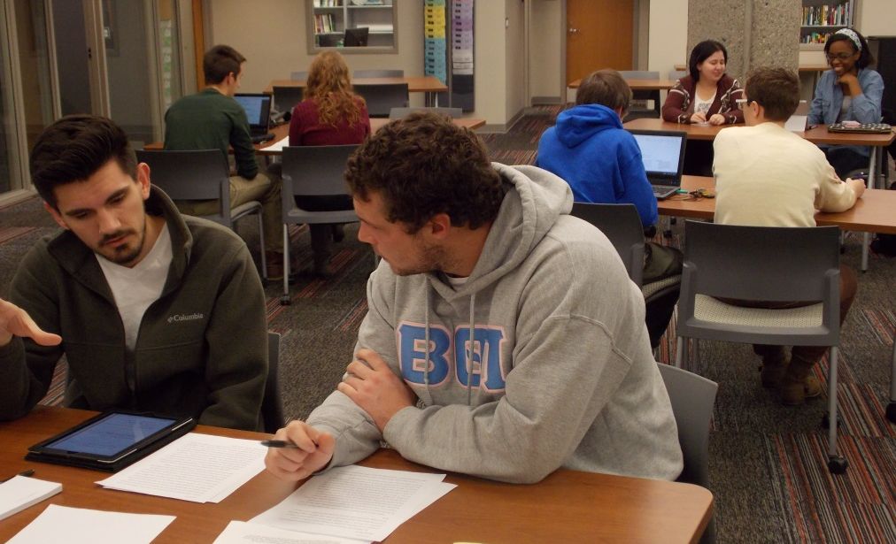
Ekstrom Library
Room 132
(502) 852-2173
louisville.edu/writingcenter
writing @ louisville.edu

Slide 4
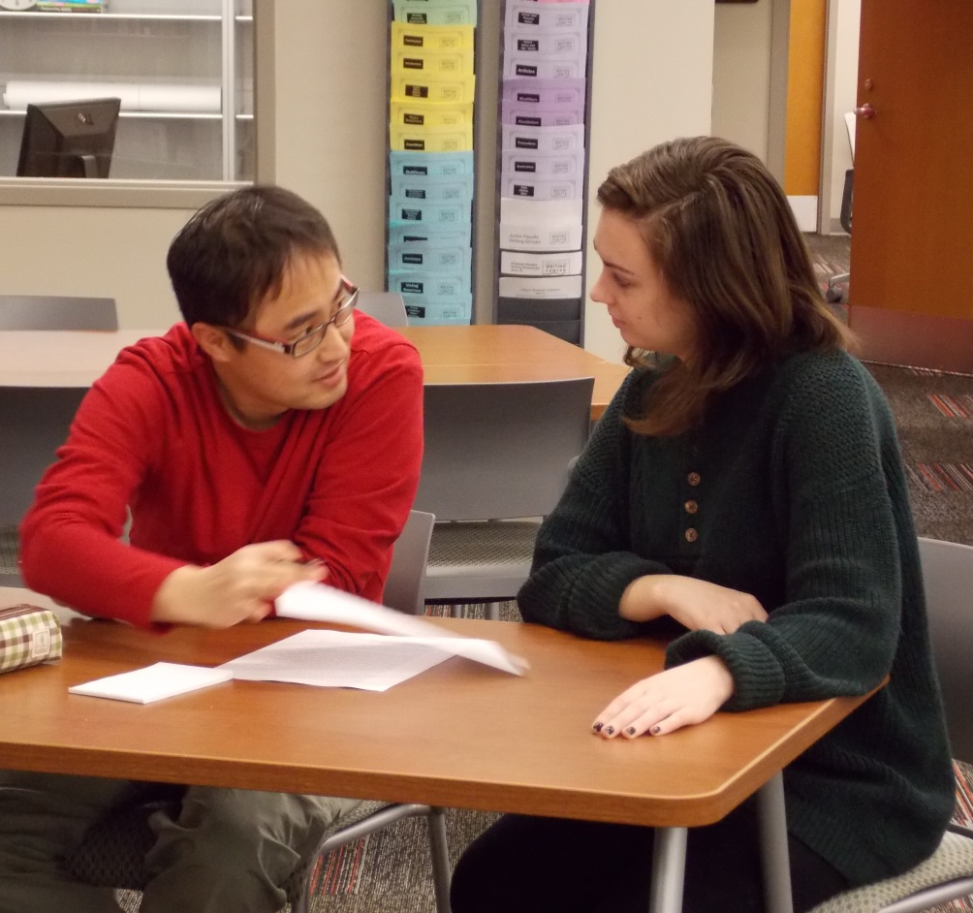
University Writing Center:
What We Do
We serve everyone in the UofL community, including undergraduates, graduate students, faculty, and staff.
We help at any point in the writing process:
Getting started on an idea
Working on a draft in progress
Revising a completed draft
Copyediting and polishing a final draft.

Slide 5
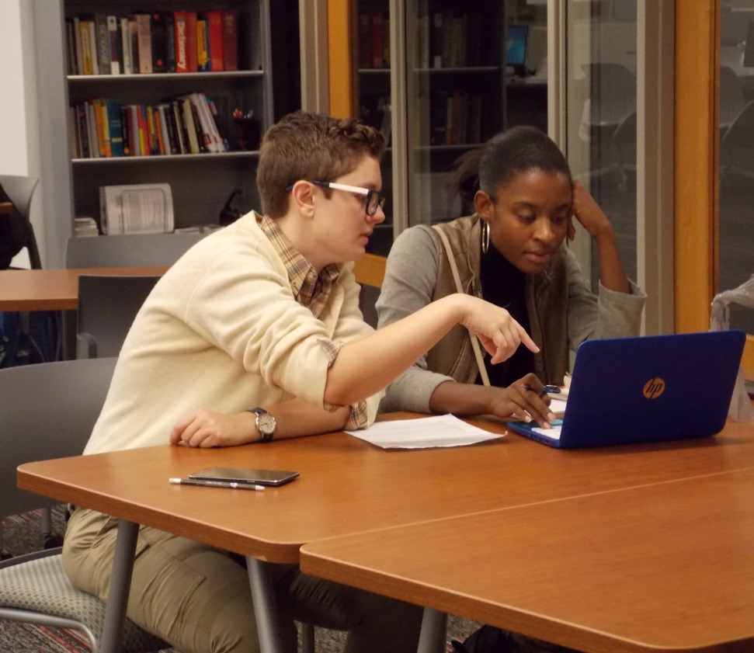
University Writing Center:
What We Do
We can help with:
  Seminar Papers
  Thesis or Dissertation
  Journal Articles
  Personal Statements
  CV/Resumes
  Job/Scholarship Applications
  Grant Applications
  Co-op or Internship Reports

Slide 6
University Writing Center:
How We Do It
Individual Appointments in the Writing Center:
Appointments are 50 minutes long and start at the top of the hour.
Writers bring any writing or notes relevant to the project.
Consultants ask about the writer’s concerns, read through the draft with the writer, and ask questions and offer suggestions about how to improve the draft. Our goal is both to help writers with their current projects, and offer strategies to help with future writing tasks. We are not an editing service, but work to help people become better writers.

Slide 7
University Writing Center:
Spring 2017 Locations and Hours
Belknap Campus – Ekstrom Library, Room 132
  Mon, Tues, & Fri: 9 am – 5 pm
  Wed & Thurs: 9 am – 8 pm
  Sat: 1 pm – 4 pm
Health Sciences Campus – Instructional Building, Room 120
  Wed: 10 am – 3 pm
  Fri: 1 pm – 6 pm

Slide 8
University Writing Center:
How to Make an Appointment
1. Use our online scheduling system. Go to louisville.edu/writingcenter and click on “Appointments.”
2. Call our main number: 502-852-2173
3. Stop by our offices.
Appointments last 50 minutes and start at the top of the hour.
Walk-ins are welcome, but making an appointment will insure people see a consultant.
People can schedule multiple appointments at one time. There is a limit of three appointments/week.
You can make appointments with the same consultant.
If the schedule is full, you can put your name on an electronic Waitlist to be notified of an opening.

Slide 9
Reflection (1)
What are some types of writing that you do in the workplace?
What are some things that you enjoy and some things that stress you out about written workplace communication?
What aspects of written workplace communication are you good at? Where could you improve?

Slide 10
Rhetorical situation
Purpose
Audience
Genre
Why are you communicating?
Who are you communicating with?
What type of writing are you using/creating?

Slide 11
Email etiquette: genre-appropriate moves
Subject line
Greeting and sign-off
Action items
Include all necessary details
Pay attention to To/CC and Reply/Reply All
Use PROFESSIONAL fonts and formatting

Slide 12
Strategies: ask yourself these questions
What is the rhetorical situation?
Are you following genre conventions?
Is your tone/level of professionalism appropriate?
Would the reader be able to understand what you are saying?
Is it obvious what you want the reader to do with this information?

Slide 13
business writing principles
Clarity
Concision
Active Voice
Active voice: She wrote the report.
Passive voice: The report was written by her.

Slide 14
Strategies: Paramedic method
Circle the prepositions
Draw a box around the "is" verb forms
Ask, "Where's the action?"
Change the "action" into a simple verb
Turn the doer into the subject
Eliminate unnecessary words
Some Common Preposition
of | in | to
for | with | on
at | as | by
about | like | between
adapted from
Purdue OWL/Lanham

Slide 15
Paramedic method
5
3
4
2
1
Circle the prepositions
Draw a box around the "is" verb forms
Ask, "Where's the action?"
Change the "action" into a simple verb
Turn the doer into the subject
I think that in this paragraph is a demonstration of the use of good style in the writing and creation of a report.
action
demonstrates
this paragraph
adapted from
Purdue OWL/Lanham

Slide 16
Paramedic method
6
Eliminate unnecessary words
This paragraph demonstrates
good style in
report writing.
I think that in this paragraph is a demonstration of the use of good style in the writing and creation of a report.
action
demonstrates
this paragraph
adapted from
Purdue OWL/Lanham

Slide 17
Paramedic method: Your turn
Circle the prepositions
Draw a box around the "is" verb forms
Ask, "Where's the action?"
Change the "action" into a simple verb
Turn the doer into the subject
Eliminate unnecessary words
I would argue that the email was written by her in a clear and concise manner.

Slide 18
Paramedic method
I would argue that the email was written by her in a clear and concise manner.
She wrote a clear and concise email.
action
wrote
she

Slide 19
Common confusions
Word choice/inflection
me/myself
i.e./e.g.
Grammar
sentence fragments or run-ons
misplaced/dangling modifiers
unclear pronoun references
inconsistent verb tense
Punctuation
commas
apostrophes
Spelling
than/then
its/it’s
their/there/they’re
affect/effect

Slide 20
Strategies: make your own list of things to check
Including:
Your own common confusions
Reminders of other things to look out for

Slide 21
Other Strategies
Read out loud
Print out to review
Don’t write on your phone
Use models
Use spell check
Get the details right
Listen!

Slide 22
Reflection (II)
What is the most useful concept that you will take away from this presentation?
Which of these strategies (if any) have you already been using?
How can you use these strategies to address the stressors that you wrote about earlier? To address areas where you could improve?

Slide 23
Questions?
? ? ?

