Slide 1
Ideas to Action (I2A)
Introduction to I2A
& Critical Thinking
A session for the Student Orientation Staff
Patricia R. Payette, Ph.D.
Hannah Anthony
May 23, 2008
Notes:
Dr. Mardis

Slide 2
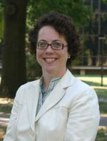

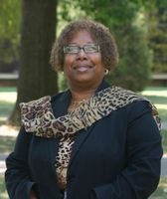
Introductions
I2A Team
  Dr. Patty Payette Dr. Cathy Bays Dr. Edna Ross
  Executive Director I2A Specialist I2A Specialist for Assessment for Critical Thinking
  Hannah Anthony, Program Assistant Senior

Slide 3

Ideas to Action:
Using Critical Thinking to Foster Student Learning and Community Engagement
Ideas to Action (I2A) is our Quality Enhancement Plan (QEP), and we need to show measurable progress to the Southern Association of Colleges and Schools (SACS) by April 2012.
Notes:
Dr. Mardis

Slide 4
From student focus groups:
“Reduce the amount of memorization required for tests, I feel I don’t learn as much by doing this.”
“Decrease the memorization required, can’t remember it all.”
“Too much memorization and no sufficient critical analysis.”
“The subject testing is not challenging due to memorization.”
“Regurgitated material (can just read chapters for tests).”
One student even suggested that student learning could be improved by offering a course that would aid in memorization.
Notes:
Patty

Slide 5
I2A and “Connecting the Dots”
“Our extensive consultation with all University constituencies yielded a surprisingly strong and clear call for education focused on the skills and knowledge needed to deal with real-world issues and problems, an education in which students can see the importance of the parts (the courses) to the whole (their education as citizens and workers).” [QEP Report, 2007]
skills and knowledge
real-world issues & problems
the parts to the whole
http://louisville.edu/ideastoaction/files/finalreport.pdf
Notes:
Patty

Slide 6
Employers Advise Colleges Where to Focus Resources to Assess Student Learning
One/Two Practices to Which Colleges Should Devote Resources | All Employers
Faculty-evaluated internships or community-based learning experiences | 50%
Essay tests that measure students' problem-solving, writing, and analytical-thinking skills | 35%
Electronic portfolios of students' work, including examples of accomplishments in key skill areas and faculty assessments of them | 32%
Faculty-evaluated comprehensive senior projects demonstrating students' depth of skill in major & advanced problem-solving, writing, and analytic-reasoning skills | 31%
Tests that show how a college compares to others in advancing students' critical-thinking skills | 8%
Multiple-choice tests of general content knowledge | 5%
From How Should Colleges Assess And Improve Student Learning
Peter D. Hart Research Associates, Inc., January 2008, Association of American Colleges and Universities
Notes:
Patty

Slide 7
I2A: What are the components?
Sharpen our existing focus on building critical thinking skills in the general education program…
…..continuing through undergraduate major courses with an emphasis on applying and refining those skills…
…resulting in a culminating experience, such as a thesis, service learning project, internship or capstone project that fosters engagement
Notes:
Patty

Slide 8

Define Critical Thinking
In groups of 3-4, use a short phrase to complete this sentence, draw a picture or give an example.
Critical thinking is ________________________.
Notes:
Hannah

Slide 9
Define Critical Thinking
In groups of 3-4, use a short phrase to complete this sentence, draw a picture or give an example.
Critical thinking is NOT ________________________.
Notes:
Hannah

Slide 10
Examples of when we use critical thinking…
Academic problems
  - What is the best interpretation of a piece of literature?
  - How can a leader most efficiently promote effective team work?
  Personal problems
  - What should I do to optimize my career options?
    Civic problems
      - How should I vote on a particular ballot initiative?
From Helping Your Students Develop Critical Thinking Skills
Cindy L. Lynch and Susan K. Wolcott, October 2001, The IDEA Center
Notes:
Patty

Slide 11
Critical Thinking definition adopted for I2A
(From: Scriven and Paul, 2003)
Critical thinking is
the intellectually disciplined process
a guide to belief and action.
that results in
Understanding
Concepts
Appreciation
Decisions
Synthesize
Application
Notes:
Patty

Slide 12
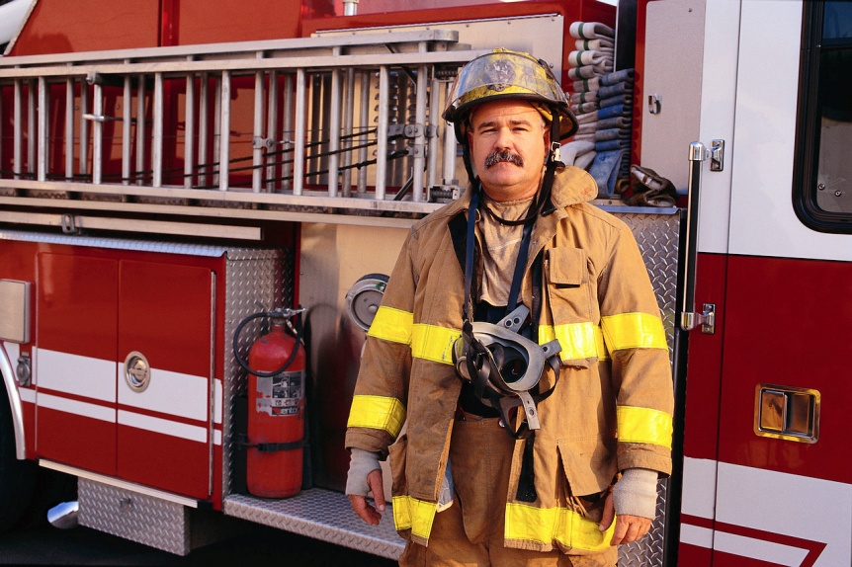
Critical thinking is
the intellectually disciplined process that
results in a guide to belief and action.
You’ve heard from DPS & had emergency training. Can you describe an intellectually disciplined process that will help guide your actions during an emergency?
Notes:
Patty

Slide 13
Model your thinking for new students!
What are some topics or situations that incoming students find complex or challenging?
Novice vs. expert thinking
How can you mentor them by modeling difficult decision making?
Notes:
Patty

Slide 14

Model your thinking for new students!
Are there ways you can help new students think critically about registering for classes?
What are some of the questions you ask yourself when you’re selecting classes?
Notes:
Patty

Slide 15
What Critical Thinking is NOT
Its true because I believe it
Its true because we believe it
Its true because I want to believe it
Its true because I have always believed it
Its true because its in my selfish interest to believe it
Notes:
Patty

Slide 16
…we want to foster an awareness that critical thinking is more than thinking, it’s:
Reflecting upon
Questioning
Monitoring
…my very reasoning itself in order to continuously improve my thinking.
Notes:
Patty

Slide 17
…we want to foster an awareness that critical thinking is more than thinking, it’s:
It’s being flexible in your thinking.
It’s “thinking things through.”
It’s making decisions (complex or not).
Notes:
Patty

Slide 18
Reflect, Question, Monitor
Example: Encourage students to get involved on campus! (Book in Common, RSOs, Greek Life, Freshman L.E.A.D, etc.)
Reflect on why getting involved is important
Question what organization/program would be best for you
Monitor your commitment and time
Notes:
Patty

Slide 19
A Well-Cultivated Critical Thinker:
(Richard Paul and Linda Elder, the Foundation for Critical Thinking:
http://www.criticalthinking.org/)
Raises vital questions and problems, formulating them clearly and precisely
Gathers and assesses relevant information, using abstract ideas to interpret it effectively
Comes to well-reasoned conclusions and solutions, testing them against relevant criteria and standards
Thinks open mindedly within alternative systems of thought, recognizing and assessing, as needs be, their assumptions, implications, and practical consequences
Communicates effectively with others in figuring out solutions to complex problems
Notes:
Patty

Slide 20
What you can do:
Become aware and discuss with your peers how and why critical thinking is important.
Model for other students—in a very explicit way—how you “think things through.” Give the gift of your time, your mentorship in issues large and small.
Tell students how Ideas to Action is focused on improving their experience at U of L!
Never forget that at the heart of critical thinking is learning to ask relevant, important questions. To re-evaluate, to reconsider and reflect on the answers –and then ask the next set of questions—are the intellectual habits of mind we wish to cultivate.
Notes:
Patty

Slide 21
How will Ideas to Action improve my experience at UofL?
Getting you connected with peers and faculty on and off campus
Supporting your engagement in real-world problem solving
Helping you explore new ways to think critically
Preparing you to find your passion and take action
Notes:
Patty

Slide 22
I2A…the next steps!
Help students think critically!
Increase awareness of Ideas to Action
Student Interest Group (Fall 2008)
Student representation on the I2A Task Group
Notes:
Patty

Slide 23
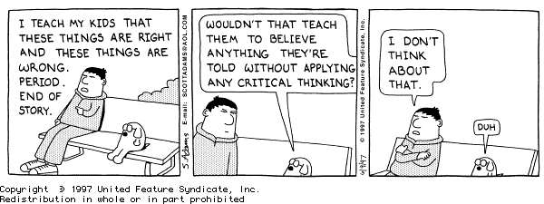

Slide 24

Questions
What is I2A?
What’s critical thinking?
What’s one thing you can do to help students think critically?
Notes:
Patty

