Slide 1
Be Searchable
Online Portfolios for the Job Search
Elizabeth Chamberlain efcham01@louisville.edu
Rachel Gramer rachel.gramer@louisville.edu
28 January 2015

Slide 2
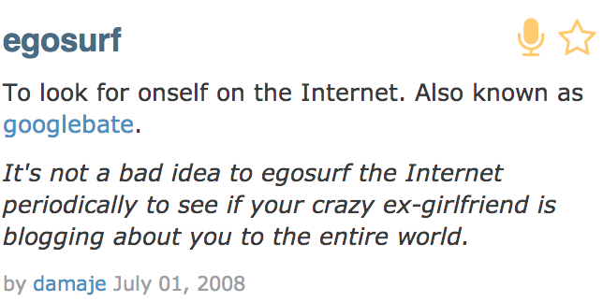

Slide 3
can’t be this bad

Slide 4
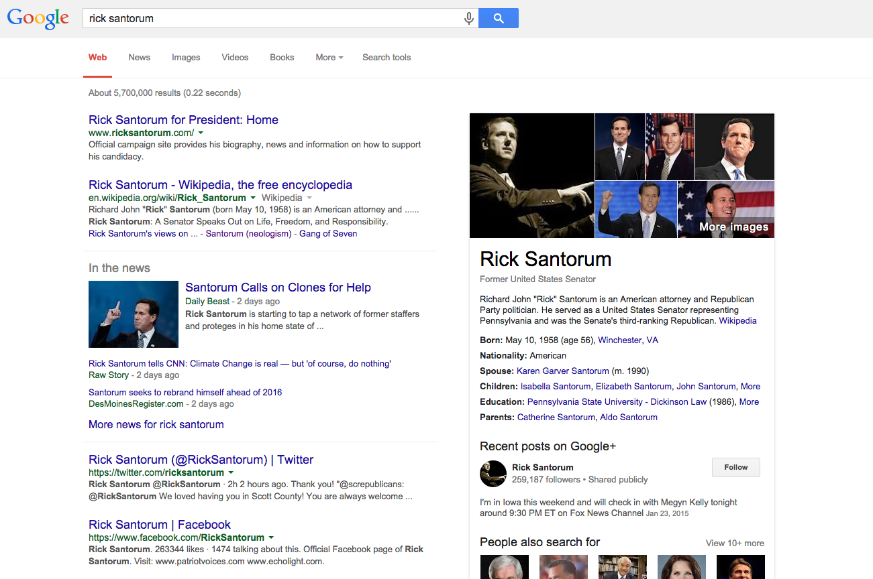

Slide 5
When people Google you now, what message do they get about you?
What message do you want them to get?
Notes:
these are going to be at the top usually. linking them together helps. Forecast structure of workshop, focusing on wordpress

Slide 6
Elizabeth's
Notes:
Elizabeth

Slide 7
Elizabeth's
Notes:
Elizabeth

Slide 8
Rachel’s
Notes:
Rachel

Slide 10
.com vs .org
Notes:
confusion of two sites, especially when looking @ support sites

Slide 11
own domain?
WordPress?
Notes:
price of WordPress hosting, buying own domain name

Slide 12
not obligatory
but can be an asset
Notes:
Elizabeth

Slide 13
“was mentioned
three times
in the search process”
—Shyam Sharma (Stony Brook)

Slide 14
“a couple of the programs told me during the campus interview
that they were impressed by it”
—Tika Lamsal (University of San Francisco)

Slide 15
“Armstrong's interviewers did indeed mention them [...] one of the two remembered my graphics”
—Rob Terry (Armstrong)

Slide 16
“hits to the site [...] were from the places I was visiting at the time.
—Shannon Howard (University of Alabama)

Slide 17
when?

Slide 18
“finish your dissertation”
—Bronwyn Williams

Slide 19
Trey: “incrementally… started before my first year”
Rob: “after I went over my resume and cover letter a few times for different jobs”
Shannon: “in my second year—it was really skeletal then”

Slide 20
Notes:
Rachel

Slide 21
“At some point, it
becomes a feedback loop.”
—Trey Conatser
Notes:
Elizabeth

Slide 22
Rachel Gramer: https://rgramer.wordpress.com/
Elizabeth Chamberlain: http://elizzybeth.com, http://elizabethfchamberlain.wordpress.com
Rob Terry: http://www.robertjterry.me/
Modeled his site on Andreas Viklund’s http://andreasviklund.com/
Shyam Sharma: http://shyamsharma.net/
Trey Conatser: http://novelideas19c.wordpress.com/
Shannon Howard: http://kshannonhoward.com/

Slide 23
WordPress Demo
Notes:
Rachel

Slide 24
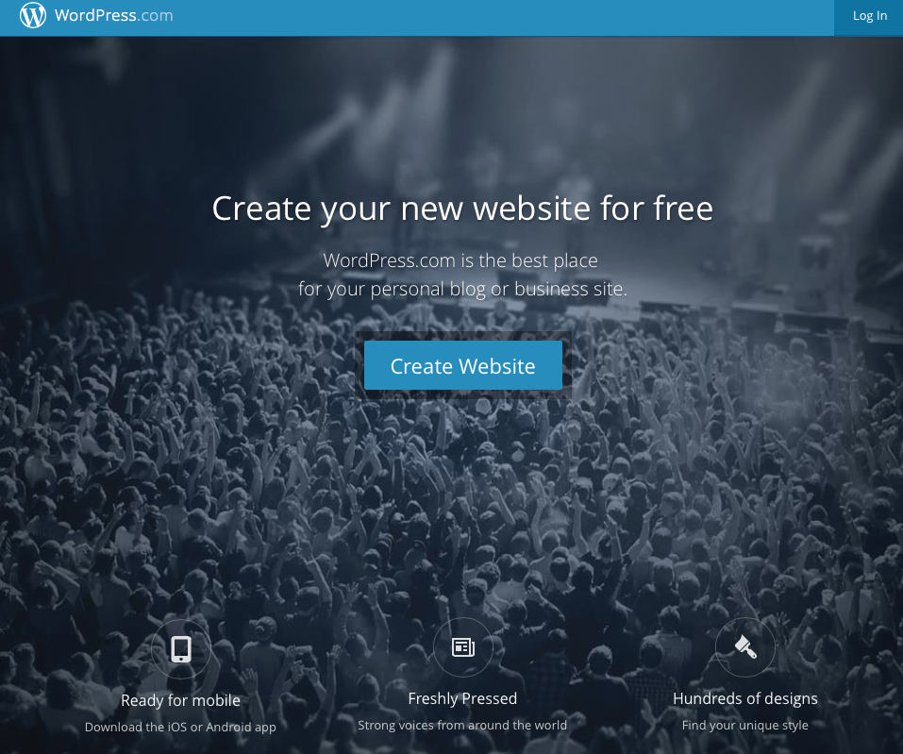

Slide 25
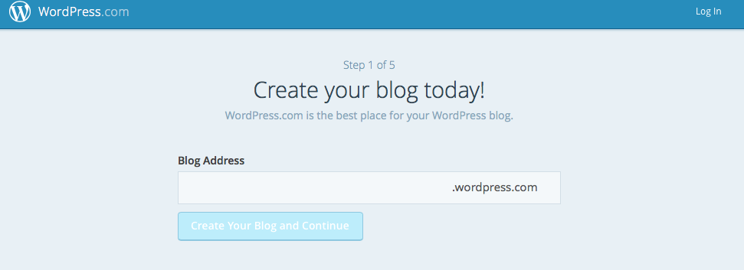

Slide 26
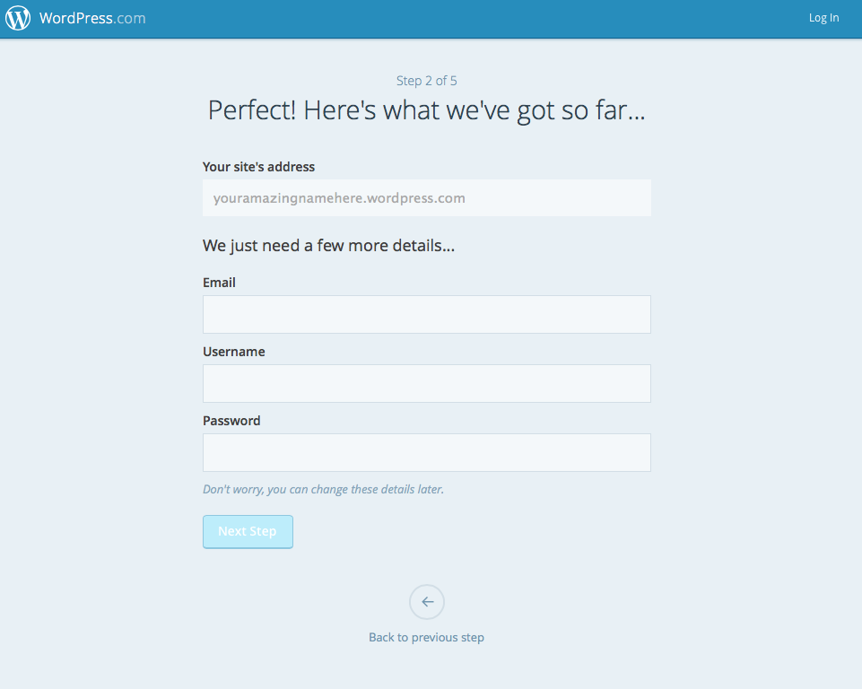

Slide 27
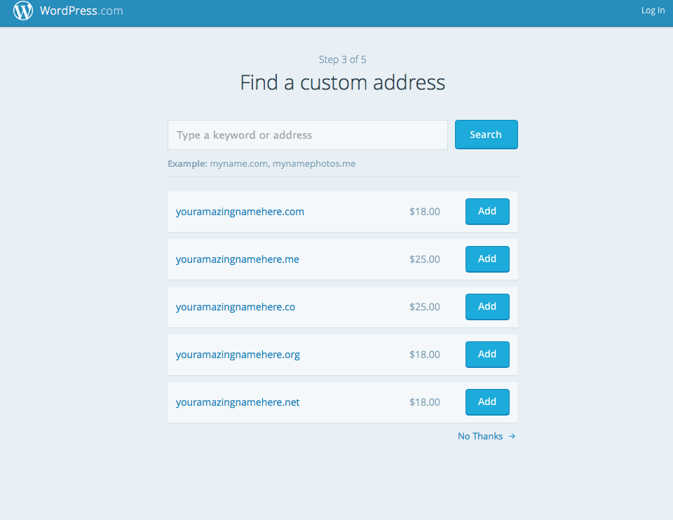

Slide 28
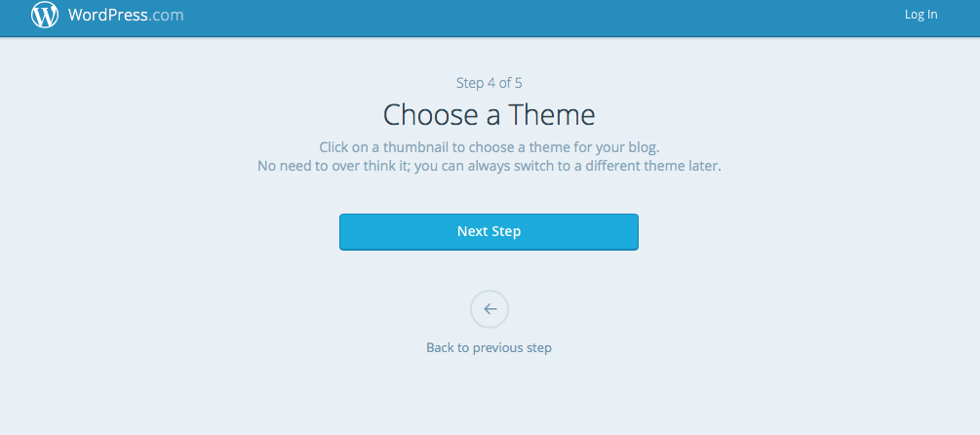

Slide 29
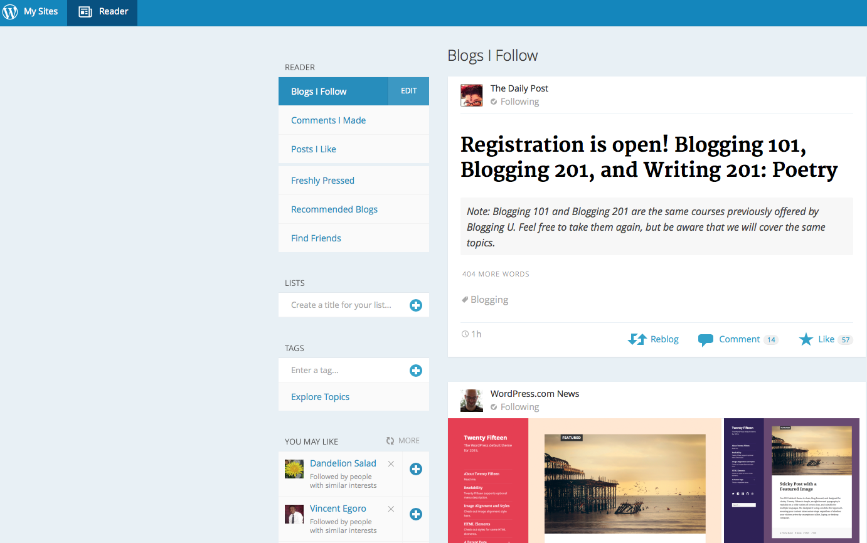

Slide 30
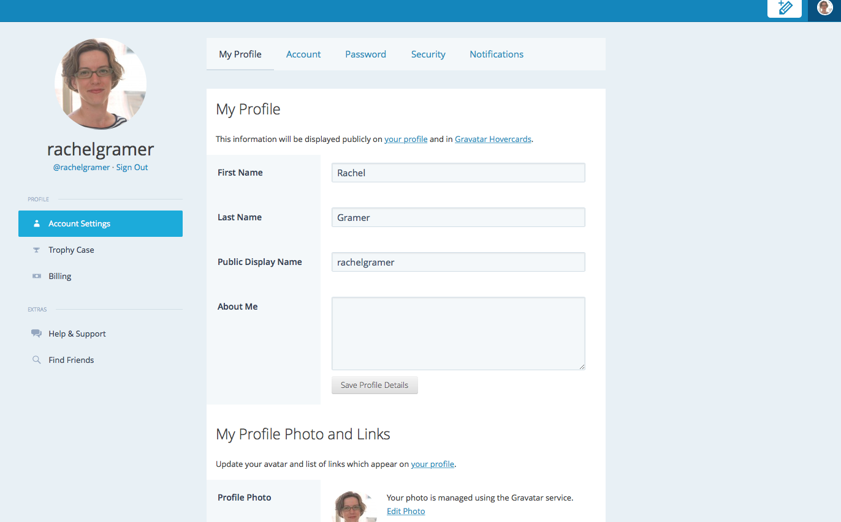

Slide 31
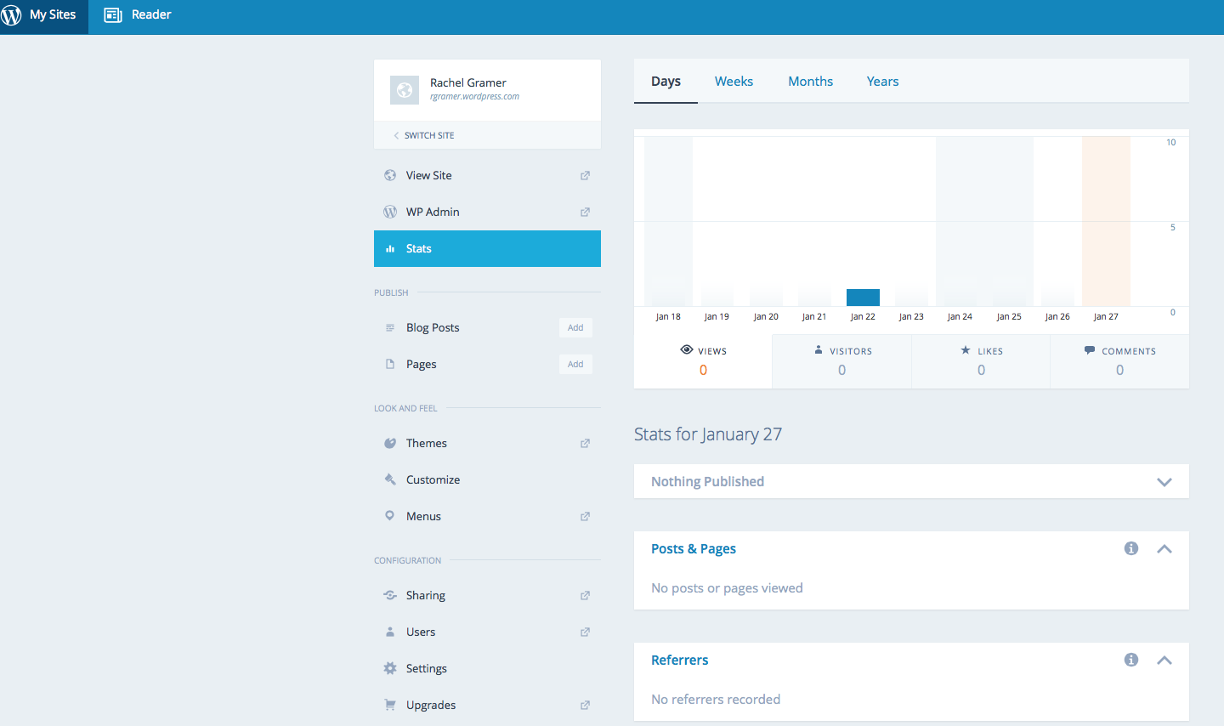

Slide 32
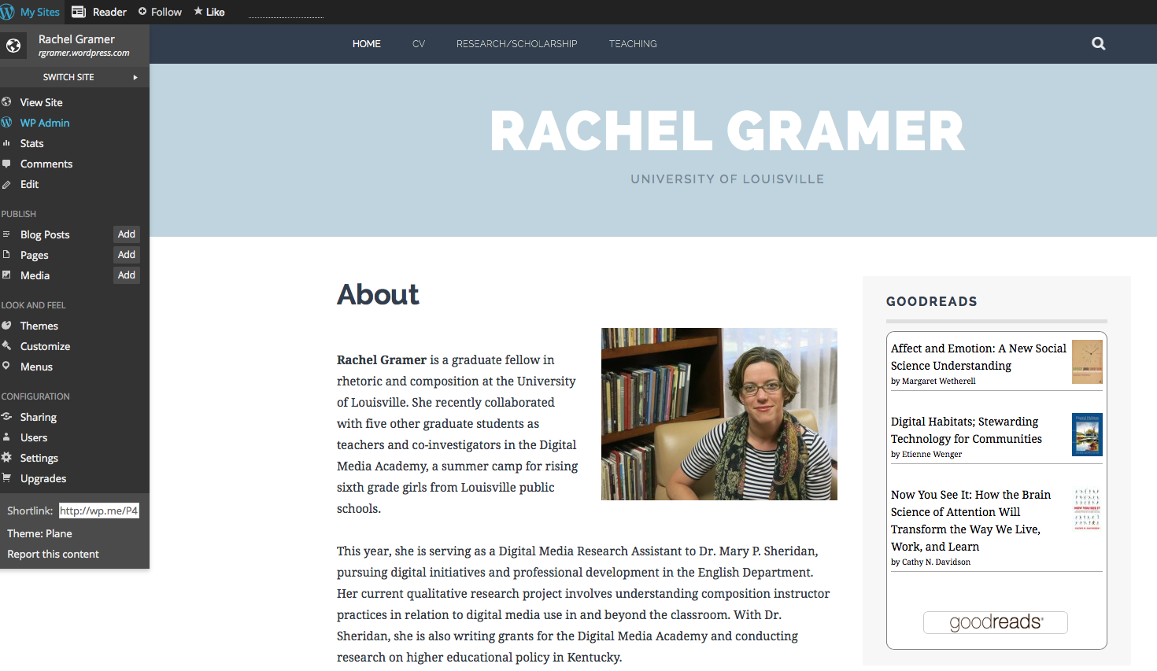

Slide 33
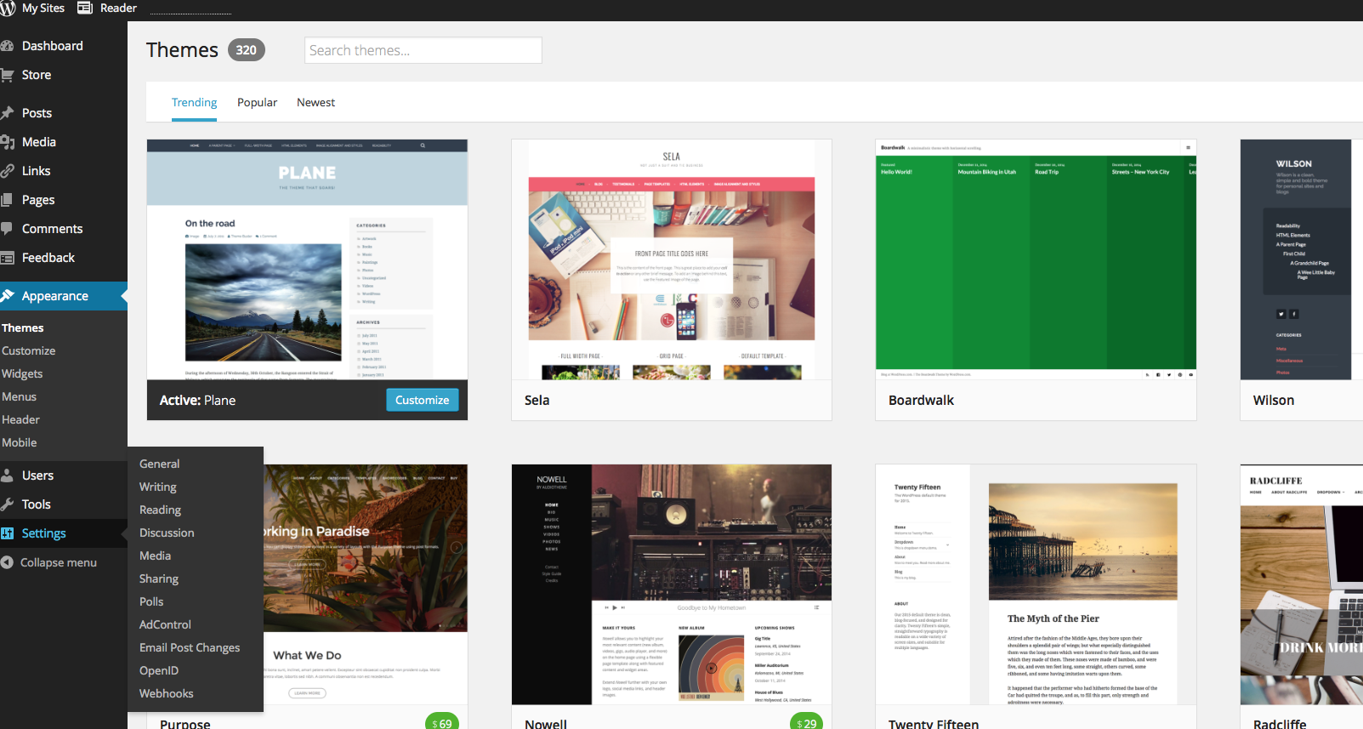

Slide 34
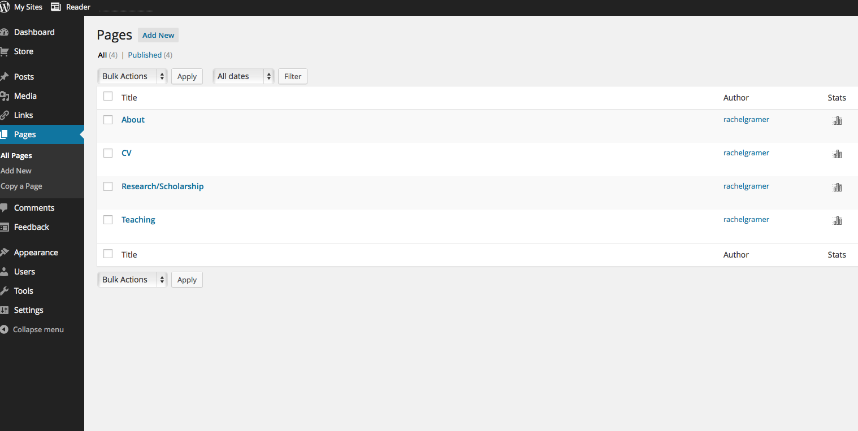

Slide 35
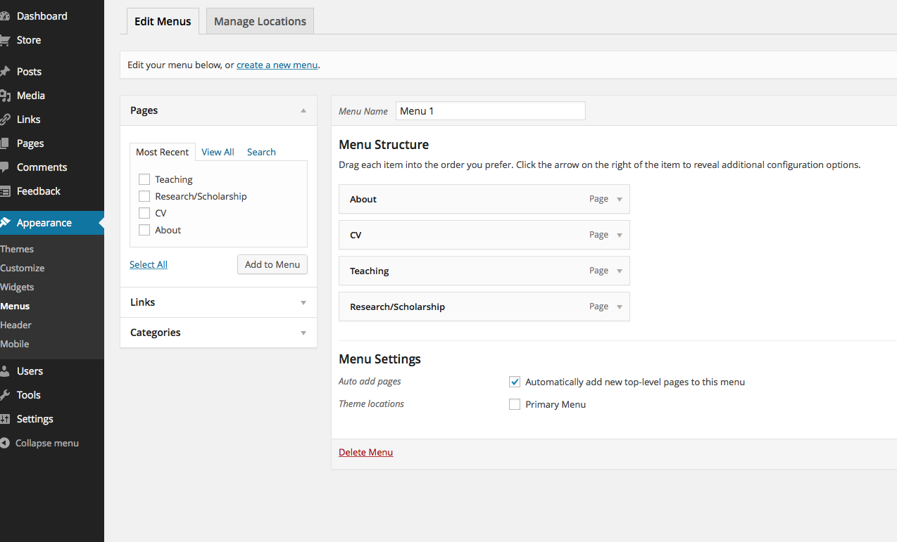

Slide 36
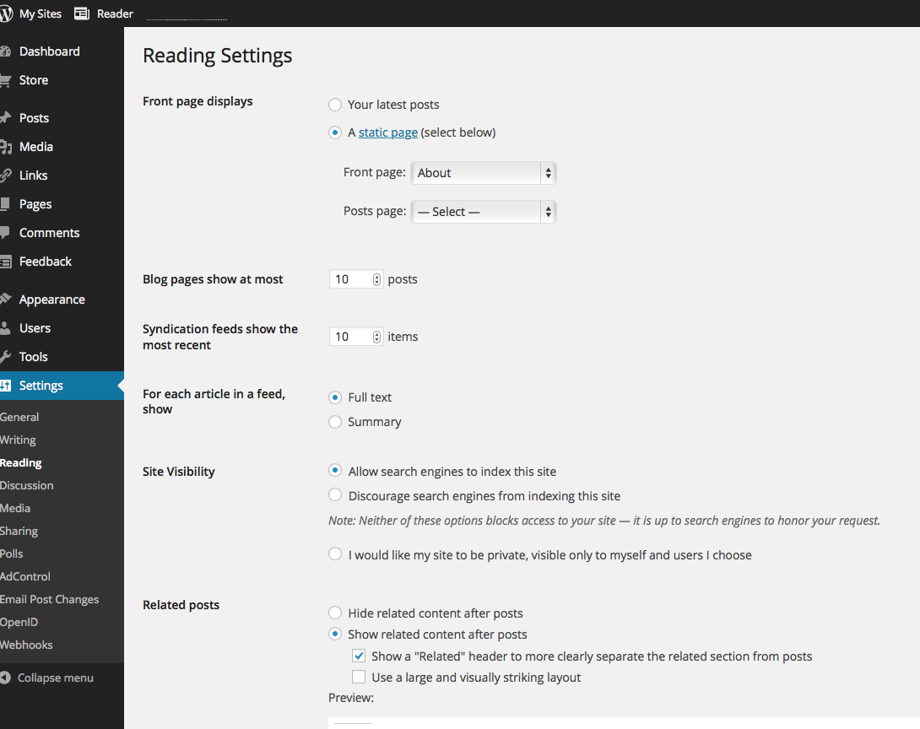

Slide 37
how else?

Slide 38
Do it yourself
Set-up or update Academia, LinkedIn, or Twitter accounts
Check Facebook privacy settings
Build a Wordpress profile
We’re here to help!

