Slide 1
Travel Award Tutorial
GSC Summit
September 8th 2016
Manooch Saeedi
Director of Graduate Travel

Slide 2
Going Somewhere??
Apply for Travel Funds!
GSC is able to offer funding for travel to conference or other academic/professionally related events
  $200 if not presenting
  $350 if presenting

Slide 3
Easy Steps to obtain travel funds
1- Apply for funding
2- Receive Award Letter
3- Travel/present/enjoy yourself!
4- Gather required documentation
5- Submit documentation
6- Sit back, relax, and let the funds roll in….

Slide 4
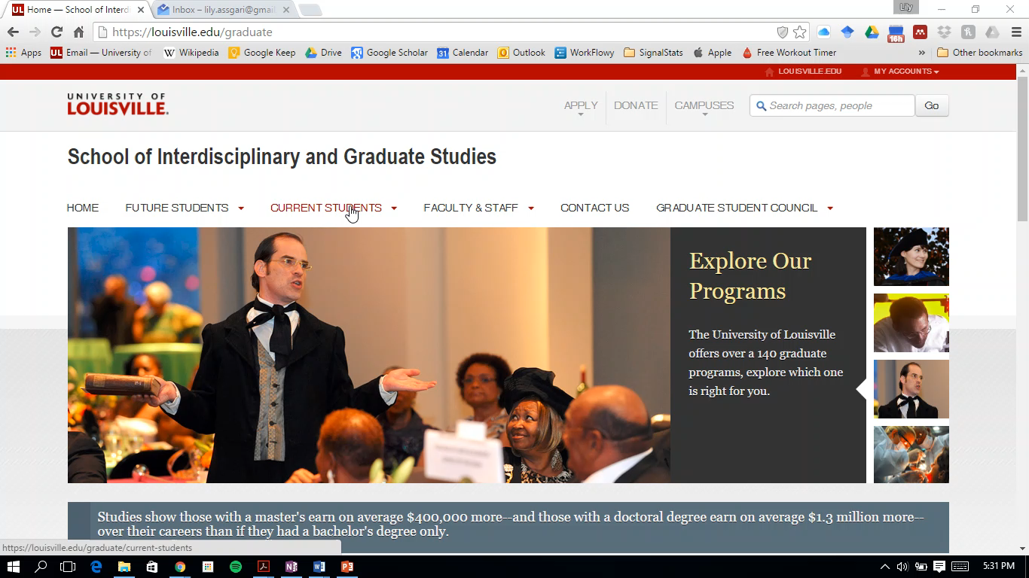
Step 1- Applying for funding

Slide 5
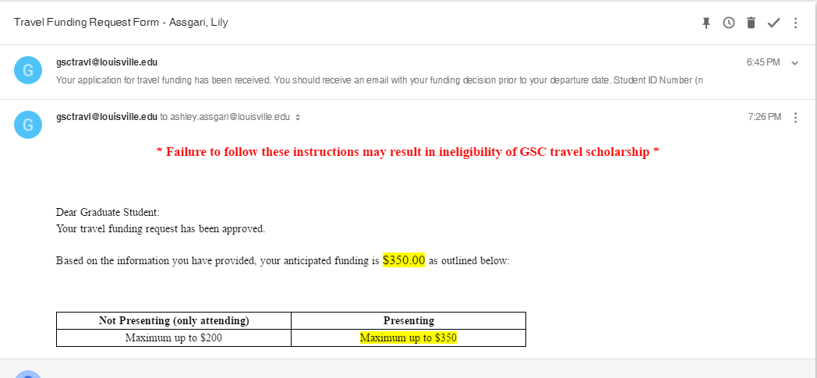
Step 2- Receive travel award letter

Slide 6
Step 3- Travel/Present/Enjoy Yourselves
BUT!!! Make sure you are gathering/keeping your receipts
  Hotels
  Rental car/ taxis/ Lyfts/Ubers
  Conference Registration
  Other travel related costs
  Sometimes.. Food*

Slide 7
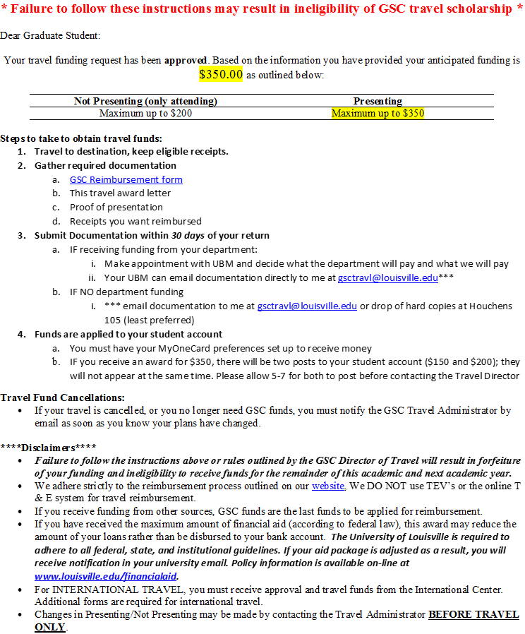
Step 4- Gather required documentation
GSC Reimbursement Form
Travel Award Letter
Proof of Presentation (if you presented)
  Abstract Acceptance email
  Screenshot of a conference program with your name
Receipt(s) that you want GSC to reimburse
  Scanned copies and PDFs work well!

Slide 8
Step 5- Submit documentation
Do you have departmental funding?
  YES!!
    Submit all documentation to your UBM
    They will determine what they will pay and what we will pay
      Our funds should be applied last!
    UBM should submit documentation on your behalf**
  No ☹
    **Scan and email required documentation directly to me (gsctravl@louisville.edu)

Slide 9
Step 6- Sit back, relax, and let the funds roll in….
Applied to your student account
  BankMobile- how financial aid disburses refunds
  What does this mean for financial aid?
    If you have the full amount of loans possible, your refund will be applied to those loans
  If you get $350, there will be two deposits!
    $200 and $150, will not hit at the same time
    Only one deposit for $200 or less.

Slide 10
Questions?

Slide 11
Potential reasons for Denial of Funds
Inactive department
Already funded this fiscal year
Failed to follow instruction when applying in the previous year

Slide 12
GSC Reimbursement Form

Slide 13
Travel Award Letter

Slide 14
Proof of Presentation
Abstract Acceptance email
Screenshot of a conference program with your name

Slide 15
Receipts that you want reimbursed
Scanned copies and PDFs work well!

Slide 17
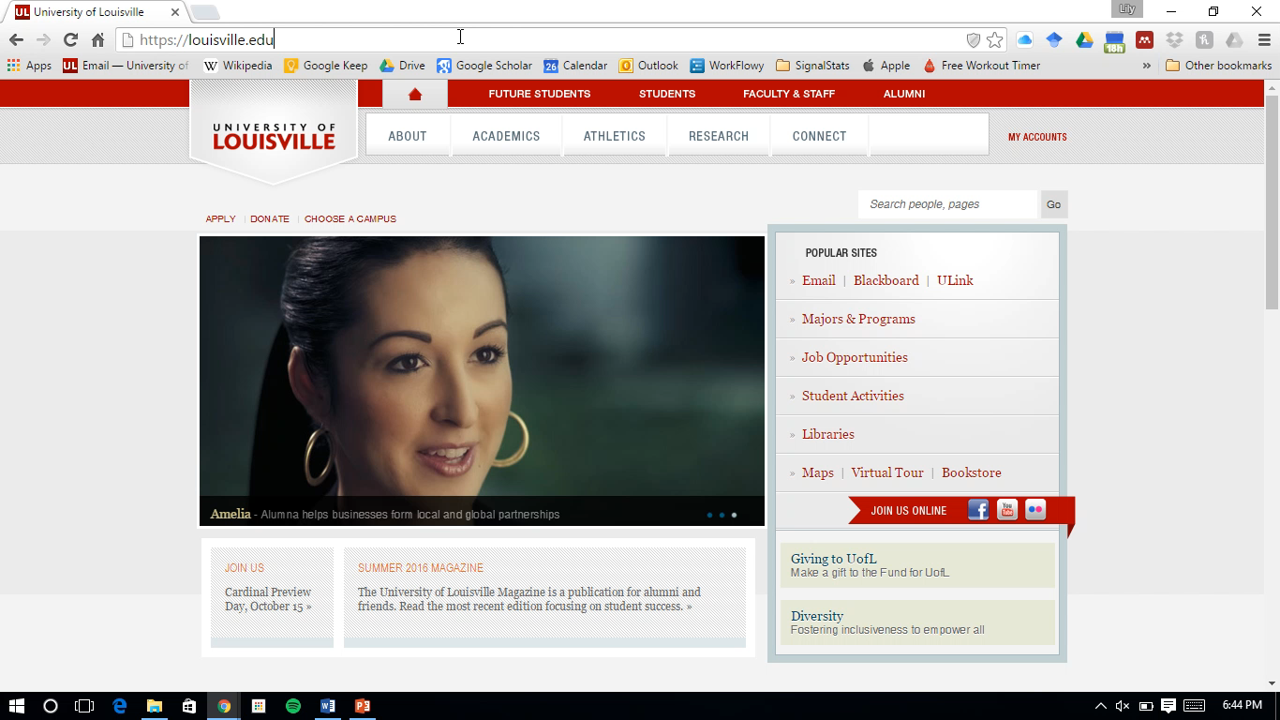
Step 1- Applying for funding

