Slide 1
SPLASH Meaningful Instruction for Students with the Most Complex Needs
Created by JCPS

Slide 2
Goals
Knowledge: What does independence mean for an individual?
Method: How can we instruct to the highest level of independence for our students?
Purpose: Why are increasing levels of independence important for our students’ quality of life?
Forms: How does independence impact quality of life?

Slide 3
Who are our targeted students?
“Students communicate primarily through cries, facial expressions, change in muscle tone but no clear use of objects/textures, regularized gestures, pictures, signs etc. to communicate. Student alerts to sensory input from another person (auditory, visual, touch, movement) but requires actual physical assistance to follow simple directions. Or the student’s response to sensory stimuli (e.g., sound/voice; sight/gesture; touch; movement; smell) is unclear.”
Alternate Assessment Dimension B, KDE
“In most instances, these students require extensive physical care-feeding, changing, and repositioning. This consumes a great deal of time from the educational staff that works with students with the most significant needs.”
-n2y Active Participation Guidelines

Slide 4
Other Possible Characteristics
Lack of meaningful communication (receptive and/ or expressive)
Lack of joint attention
Significant physical and medical needs
Poor stamina
Inconsistent participation (i.e. alertness, response)
Limited mobility
Cognitive abilities which cannot be measured

Slide 5
Purpose of this Module
SPLASH Training provides instruction across a broad range of classroom practices. This module is designed to extend on many of the topics previously introduced to address the needs of students with the most complex needs.

Slide 6
Expectations for ALL Students
Communication
Functional skills
Academic skills
Meaningful relationships with peers

Slide 7
The Power of Communication
Every person wants to make choices and have some form of control over their life.
Our students need to be taught skills to allow them to share in decision making.
These students will have care givers involved in every aspect of their lives. Without some communication skills they will have no self- determination.
Determining a consistent form of interpreting students’ wants is important for all people who will communicate with students throughout their life.
Notes:
It is important to always be thinking in terms of long range goals. A students future does not need to only be considered when they hit transition age. For instance if a student struggles with handwriting what other forms of expressing knowledge are available what other skills can be taught to make up for lack of handwriting skills. What is the ultimate outcome?

Slide 8
The Power of Communication
Individuals who cannot make or communicate choices will have all decisions made for them. These decisions may be made by people who do not know the student or their history.
People with disabilities have more opportunities to interact with their community than in the past and need the means to communicate.
It is important to offer opportunities to participate in making decisions about their living, recreational, and vocational options.

Slide 9
Communication for Students with Complex Needs
Independence for students with complex needs means being able to communicate: wants, needs, discomfort, happiness, likes, dislikes, choices, etc.

Slide 10
Communication for Students with Complex Needs
How to determine a response mode?
A functional communication system is necessary for educational participation.
A functional communication system is dependent on the abilities of the student. This could include:
Change of facial expression or body tension,
Cries or laughter,
Pointing or touching,
Eye gaze
Vocalizations,
Sign language or a picture communication system,
Verbal communication, etc.
A transdisciplinary approach should be taken when developing a communication system for each individual student, based on his/her abilities.

Slide 11
Communication for Students with Complex Needs
How to teach students and assess learning?
Challenging behavior should be perceived as communication.
Students with significant disabilities have a small repertoire of communicative responses that serve multiple functions.
For example, crying may be used to express: frustration, discomfort, need/ want, or exhaustion.
Replacement behaviors should be identified for problem behaviors and taught systematically.
Replacement behaviors should be functionally
equivalent to the problem behavior.

Slide 12
Examples of Communication
Use of pictures
Objects
High tech devices
Gestures
Facial expression
Change in posture/muscle tone
Vocalizations
Eye gaze

Slide 13
Sample Communication Instruction: Eye Gaze
Can the student track a highly preferred item?
Use a highly preferred item that can be immediately reinforced.
Using repeated trials to present the item, move the item in different areas within the student’s visual field
Cue: What do you want? (Note: Do not say “Look at___”)
Notes:
Other considerations: Some students will behaviorally resist. Consider 1) Is eye gaze the best communication option? [If not, what has the transdisciplinary team considered, such as a change in respiration, crying, a finger movement, etc.?] 2) Is the reinforcer sufficiently preferred? 3) Does the student have access to the reinforcer under other circumstances, impacting the student’s interest/satiation?

Slide 14
Sample Communication Instruction: Eye Gaze
Place item directly where the student is already looking.
Immediately reinforce with taste of/use of item.
Gradually move the item into positions where the child has to adjust eye gaze.
Immediately reinforce with taste of/use of item.
Introduce discrimination training.
Notes:
Instruction should begin with one preferred item. Item discrimination should be introduced after consistency of tracking one item has been established.

Slide 15
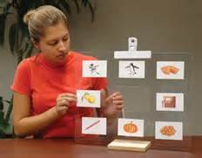
Considerations for Eye Gaze Instruction
Use Systematic Instruction procedures
(see: http://mast.ecu.edu/modules/ps/)
Practice designing lessons using Systematic Instruction (sample planning form follows)
Image: http://aalzamel.wikispaces.com/

Slide 16
Sample Planning Form for Systematic Instruction
Student: ___________________________________________________________
Activity: ___________________________________________________________
Objective: __________________________________________________________
FORMAT
Materials: ___________________________________________________________
Setting(s): ___________________________________________________________
Instructor(s): _________________________________________________________
Set Up/# of trials: _____________________________________________________
Instructional task: Discrete or Chained (Circle one)
INSTRUCTIONAL PROCEDURES
Instructional Method: (Check one)
_____ None (simultaneous prompting)
_____ Time delay (constant or progressive) (Circle one)
_____ Least intrusive prompts
_____ Most to least intrusive prompts
_____ Graduated guidance
_____ Stimulus fading or shaping
_____ Other (describe) ______________________________________________
Prompting: (What specific verbal/physical cues do you use? What do you say or do to introduce the activity?)
Exact prompts to be used: _________________________________________________
Schedule for fading prompts: _______________________________________________
________________________________________________________________________
Feedback/Reinforcement Procedures: (What do you do when the student does well? Makes an error?
How often do you reinforce?)
Correct: ______________________________________________________________
Error correction: _______________________________________________________
Fading schedule for praise: _______________________________________________
GENERALIZATION PROCEDURES
(What is done to help the student be successful in other environments and with other people?)
________________________________________________________________________
Comments/Notes:
________________________________________________________________________

Slide 17
Additional Considerations for Eye Gaze:
The discriminator can be a non-preferred item, or an item that is significantly different from the preferred item (size, color, dimensions [photo vs object], etc.)
Keep choice items within the parameters of the field of vision previously established
Background options: 1) clear 2) high-contrast color
Placement: vertical or horizontal (consider student’s ability to cross midline)
Size: should reflect student’s visual abilities
Objects: should have significantly different tactile qualities (if using objects due to low vision, or cortical vision blindness, allow for tactile cuing)
Wait time: consider student’s ability to visually focus

Slide 18
Error Correction for Eye Gaze
Ignore incorrect response
Remove the item from visual field
Count to 3
Repeat instruction while prompting the student to the correct response (i.e., controlling prompt; move item within the student’s field of gaze)
Reinforce correct response with use of/taste of item, paired with descriptive verbal praise (ex: “Great job! You chose ___).
Remove items from visual field and present again in a rearranged order.
Notes:
Considerations
do not deliver the attentional cue or verbal request more than once per item presentation
Limit visual and verbal distractions
Regarding step 6, some students may be prompted through a familiar established activity (e.g. clapping, raising hands, touching body parts, etc.). Be conscious to reinforce only the desired response

Slide 19
Communication for Students with Complex Needs
Identify a response mode
Determine student limitations and abilities through a transdisciplinary approach.
Physical Therapist
Occupational Therapist
Speech Therapist
Vision/Hearing Teachers
Special Education Teacher
Paraprofessionals
General Education Teachers

Slide 20
Communication for Students with Complex Needs
Identify a response mode
What are the physical capabilities of the student?
Pointing or touching
Eye gaze
Limb movement (head, foot, finger, etc.)
Changes in facial expressions
Changes in posture
Vocalizations/sounds
Crying and laughing
Placement of answer choices within a student’s visual field should be considered (top to bottom, left to right, crossing midline).

Slide 21
Communication for Students with Complex Needs
Interpreting responses
Once the response mode has been determined, practice and reinforce it in an adaptive setting.
Have the student’s needs been met?
When the student uses eye gaze, pointing, touching a switch, etc. to select a food item, does he/she consume it?
When the student indicates he/she wants a desired item, does he/she play with it?
Is the response consistent even when the answer choices are in a different order or location?
Data should be collected regularly on student choices to ensure responses are accurate and intentional.

Slide 22
Communication for Students with Complex Needs
How to interpret responses?
Were you able to interpret this student’s response?
Why or why not?
What prerequisite skills would you want to know about in regards to this student?

Slide 23
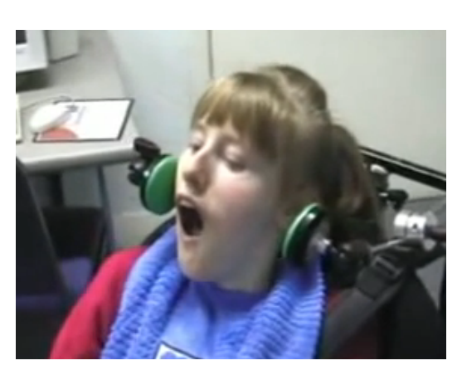
Communication for Students with Complex Needs
Providing access to communication:
http://www.youtube.com/watch?v=fAdEOXD9Tvk

Slide 24
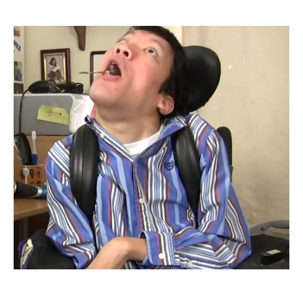
Communication for Students with Complex Needs
Assistive Technology in action: Meet Jared.
http://www.youtube.com/watch?v=bYKUxOdUAao

Slide 25
Instructional Strategies
Why teach standards-based instruction?
“Increased academic competence adds to the options students with severe disabilities will have as adults…”
http://factoregon.org/wp-content/uploads/2013/12/Courtade-Browder-Article1.pdf

Slide 26
Instructional Strategies
Why teach a functional curriculum?
“A functional curriculum is a curriculum in which the student learns functional skills in the most appropriate setting for specific skill acquisition and focuses on present and future needs.”
Areas applied to the functional curriculum are based upon the student’s level of competency and designed to increase the following areas of function: Math, Science, Reading/Comp., Writing, Consumer Skills, Social Studies, Social Skills, Music, Art., P.E. etc.
http://www.academyofstlouis.org/index.php?option=com_content&view=article&id=118:what-is-functionalsocial-curriculum&catid=37:aostl&Itemid=215

Slide 27
Instructional Strategies
How to teach students and assess learning?
Students with complex needs learn most effectively through systematic instruction.
Discrete trial
Repetitive practice/massed trials
Task analysis/chained tasks
Errorless learning
Simultaneous prompting procedure
Time delay strategies
Engineering environment for learning

Slide 28
Instructional Strategies
Critical skills to be taught…
Choice Making – Skills Involved
Ability to focus on multiple options (visual, tactile or auditory skills to recognize distinct characteristics).
Ability to discriminate between options.
Ability to recognize either/or (take one – leave one)
Ability to indicate option (physical or computer aided)
Motivation toward selection

Slide 29
Instructional Strategies
There is a chronology of independence.
Prompting hierarchies are designed to teach independence by gradually diminishing supports or providing supports as needed.
Below are several links with examples/ explanations of prompting hierarchies.
http://www.vcuautismcenter.org/resources/content.cfm/983
http://www.kansasasd.com/news.php?sid=299
http://www.theqmrp.com/qinfo/prompting.php

Slide 30
Instructional Strategies
Make instruction meaningful
Use multiple exemplars
Use massed trials
Embed core content into life skills instruction
Task analyze to teach grade-appropriate literature and content
Use Constant Time Delay (CTD) to teach content vocabulary
Scaffold lessons to include multiple levels of communication - abstract symbolic, concrete symbolic and pre-symbolic
Browder, D. M., Wakeman, S. Y., Flowers, C., Rickelman, R. J., Pugalee, D., & Karvonen, M. (2007). Creating access to the general curriculum with links to grade level content for students with significant cognitive disabilities: An explication of the concept. The Journal of Special Education, 41, 2-16.
http://files.eric.ed.gov/fulltext/EJ762919.pdf
Collins, B. C., Karl, J., Riggs, L., Galloway, C. G., & Hager, K. D. (2010). Teaching core content with real life applications to secondary students with moderate severe disabilities. TEACHING Exceptional Children, 43, 52-59.
https://gseuphsdlibrary.files.wordpress.com/2013/03/teaching-core-content-with-real-life-applications-to-secondary-students-with-moderate-and-severe-disabilities.pdf
Notes:
These are strategies that are discussed in other modules. We want the audience of this module to understand these strategies apply.

Slide 31
Instructional Strategies
The Principle of Partial Participation
All children can participate in activities to the extent permitted by their disability. Participation is supported by..
Modifying materials
Modifying or altering task requirements
Prompting strategies
Providing direct assistance (peer or adult)

Slide 32
Instructional Strategies
Strategies that can help promote understanding include:
Stimulus Pairing for Reinforcement - Strategically presenting a neutral stimulus with an established stimulus in order to transfer the reinforcing qualities to the neutral stimulus.
This is often required because our students have limited repertoire of learned behaviors and reinforcers. It allows us to expand or shape the behavioral response or reinforcement that our students prefer (for instance from primary to social).

Slide 33
Instructional Strategies
Shaping: Teaching new behaviors by systematically reinforcing successive approximations toward the behavioral objective.
Our students often need the small, interim steps provided by shaping in order to learn new skills.
http://www.scienceofbehavior.com/lms/mod/glossary/view.php?id=408&mode=letter&hook=S&sortkey=&sortorder=&fullsearch=0&page=9

Slide 34
Instructional Strategies
An example of shaping would be teaching a child to sign “eat”. At first the child would be reinforced by moving his hand near his face. Once that skill has been established, the instructor would require a more precise sign, perhaps touching his mouth. If the child is able to bring his fingertips together to touch his mouth, that would be required next. Once the skill level progresses to each next step, the child is no longer reinforced for approximations. Rather, the higher level of proficiency is required for reinforcement.

Slide 35
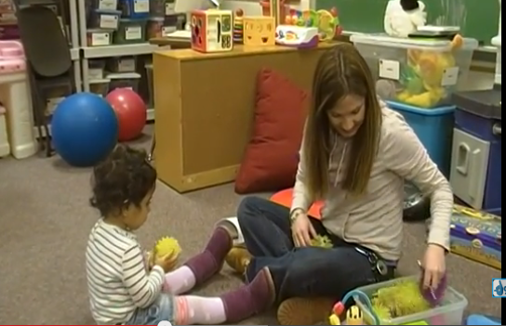
Instructing to the Highest Level of Independence
An example of pairing:
https://www.youtube.com/watch?v=FIJRw40mJ6c

Slide 36
Engagement
How to engage the student?
Use a multi-sensory approach to keep students engaged.
Work with PT to determine the best positioning options to encourage the student’s alertness.
Work with OT to determine if the student needs increased or decreased stimulation.
Consult SLP to determine communication needs (expressive, receptive, visual materials, assistive technology).
Determine the schedule of reinforcement.

Slide 37
Engagement
Work with OT to determine :
Strategies for alerting the student.
Calming strategies
Development of a sensory diet
Feeding strategies
Access to instructional materials
Notes:
Depending on the district, the SLP or OT may assist with feeding.

Slide 38
Engagement
Work with PT to determine :
Positioning needs for instructional, leisure, feeding activities, etc.
Consider bean bag, mat on floor, stander, chair, etc.
How long can the student be in this position?
Recommendations for structuring the physical environment.

Slide 39
Engagement
Work with the SLP to determine:
Appropriate assistive technology
Receptive and expressive needs of the student.
Effective feeding strategies
Functional communication systems to be used across settings
Effective materials to facilitate communication

Slide 40
Engagement
How to engage the student?
Does this student appear to be engaged?
Why or why not?
What would increase the student’s engagement?
Notes:
DISCUSSION

Slide 41
Engagement
How to engage the student?
Does this student appear to be engaged?
Why or why not?
What would increase the student’s engagement?

Slide 42
Motivation
Why is Motivation/reinforcement so important?
For a student who will likely not be gaining intrinsic reinforcement for
How do you motivate the student?
It can be difficult to determine motivators.
Identifying effective motivators is critical to the success of teaching students with complex needs.
Often times, identified effective motivators are not socially/age appropriate, however, they can be used and shaped over time.
Examples:
Hugs should be shaped to more socially acceptable/age appropriate behaviors (e.g., handshakes/high fives).
Barney videos can be shaped towards more socially/acceptable videos.
Notes:
Can we apply “shaping” to evolution of motivators? How do we connect a familiar reinforcer to a less familiar reinforcer and shape over a matter of time.

Slide 43
Motivation
A word about “satiation”
Limited experience and access to novel motivators and overexposure to familiar motivators can cause students to satiate on or become tired of even highly preferred items.
Condition responses to new reinforcement/motivators
Stimulus pairing, stimulus shaping
Rotate reinforcement/motivators.
Strategically offer motivators
Document use of motivators in order to analyze effectiveness
and track rotation

Slide 44
Motivation
How do you motivate the student? The reward must match the effort.
-Interview parents to identify interests, items, and activities that motivate their child.
-Conduct preference assessments.
-Keep a running record of items and activities that the student shows interest in.
-Have immediate access to preferred items and activities.

Slide 45
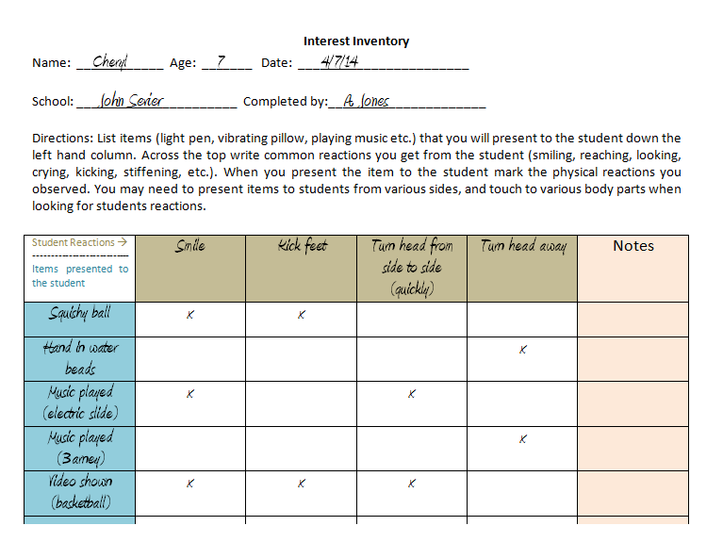
Motivation
Select the interest inventory appropriate for your student, based on abilities and needs.

Slide 46
Additional Information and Resources on Preference Assessments
http://www.interventioncentral.org/behavioral-interventions/special-needs/forced-choice-reinforcer-assessment-guidelines
Notes:
INTERVENTION CENTRAL.ORG

Slide 47
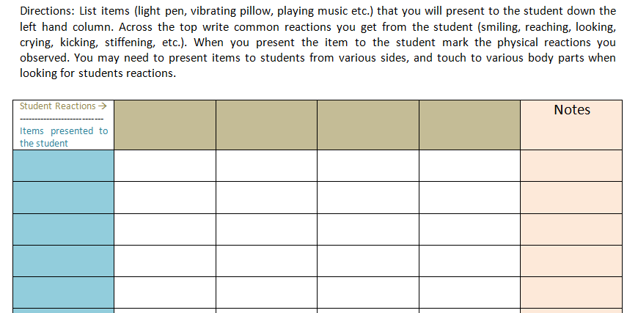
Motivation Activity
Complete the following inventory for a student you know.
Notes:
DELETE??

Slide 48
Motivation Activity
Activity Continued
After completing the interest inventory:
What did you determine to be the most motivating?
What did you determine to be the least motivating?
Did this help to expand choices to offer the student?

Slide 49
Reinforcement
Schedule of reinforcement defines how, when, and why it will be delivered.
Continuous reinforcement provides reinforcement for each and every instance of the target behavior.
Good for introducing new skills or for a student with poor engagement

Slide 50
Reinforcement
Intermittent reinforcement provides reinforcement for some but not all instances of target behavior (or responses)
Recommended for maintenance of skills
Can be used when thinning reinforcement
Increases engagement and motivation

Slide 51
Reinforcement

Slide 52
Reinforcement
Factors to consider:
How often should the student be offered the reinforcer? (e.g., continuous, variable ratio/interval)
How much time is needed with each reinforcer?
Does the student need to be reinforced in-between each expected response? (intertrial)
Can the student stay focused for multiple response opportunities?
How much time does a student need in order to produce a response (processing time/response interval).

Slide 53
Meaningful Relationships
Without deliberate interventions, our students with the most severe needs will not be likely to form meaningful relationships with peers.
One of the important ways we achieve “least restrictive environment” is through consideration of access to nondisabled peers.

Slide 54
Meaningful Relationships
KY Peer Support Network Project
http://www.kypeersupport.org/
KY Peer Buddies
http://www.kypeertutoring.org/
BestBuddies
http://bestbuddies.org/

Slide 55
Meaningful Relationships with Peers
“If you haven’t learned the meaning of friendship, you haven’t learned anything.”
Muhammad Ali

