Slide 1
Using Supports and Assistive Technology (AT) to Facilitate Learning
SPLASH Module 7
January 2015
Content written in cooperation with ILSSA/Anne Denham. the Kentucky Department of Education Toyah Robey, &
the Kentucky Low Incidence Consultants
Notes:
Welcome to Module 7 focused on assistive technology for students with moderate to severe disabilities. This training is designed as a self-study. It has notes on each page that are written as if the presenter were speaking directly to you. It also includes activities for you to complete along the way. Some of these will require you to complete outside of this presentation in preparation for the next school year. You will have a total of 3 homework assignments to prepare for next school year. For study ease, we suggest you print the presentation in “notes” format so that you can more clearly see the notes as you view the material in “presentation” mode on the computer. You are welcome to do the activities on your printed copy as you go for ease of sharing with your coach when they come for their observation or if you have a phone consultation prior to an on-site visit.
You are to complete this module as delineated on the SPLASH Schedule/Expectation sheet. Please contact your coach if you have any questions as you go through this presentation. Your coach will do a classroom observation with the expectation that you will have incorporated or expanded assistive technology into your instruction.

Slide 2


Targets
Goal Statement
Goal Question
To understand the definition & continuum of UDL & AT supports for students with MSD.
To remove barriers to learning for students with MSD using principles of UDL & AT supports.
To understand how to match supports in UDL & AT to the needs of students with MSD.
To understand the impact of principles of UDL & AT supports on learning for students with MSD to be CCR.
What are the principles of UDL and the continuum of AT supports?
How can you identify barriers to learning for students with MSD & match supports in UDL & AT to meet their needs?
How can we use the various options of UDL and AT supports to meet the needs of students with MSD?
Why is the use of UDL & AT important for students with MSD to be CCR?
Notes:
Abbreviations:
Assistive Technology (AT)
College & Career Ready (CCR)
Moderate/Severe Disabilities (MSD)
Universal Design for Learning (UDL)

Slide 3
Targets
To understand the definition & continuum of UDL & AT supports for students with MSD.
What are the principles of UDL and the continuum of AT supports?
Notes:
Abbreviations:
Assistive Technology (AT)
College & Career Ready (CCR)
Moderate/Severe Disabilities (MSD)
Universal Design for Learning (UDL)

Slide 4
UDL Introduction Video
https://www.youtube.com/watch?v=bDvKnY0g6e4

Slide 5
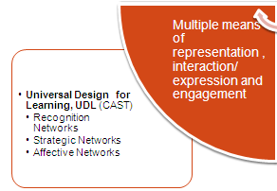
Universal Design for Learning (UDL)
Provide multiple means of representation
Provide multiple means of expression
Provide multiple means of engagement
(CAST)
  Can the student access instruction? Is targeted information provided in student’s mode of communication?
  Can the student interact with instruction and materials? Does the student have the means to demonstrate knowledge, skills, and concepts acquired?
  What will engage the student in the activity? How will the student remain motivated long enough to learn?
http://www.ric.edu/sherlockcenter/resourcelib.html
Notes:
Universal Design for Learning has a great deal of research behind how individuals learn. They identify many barriers that exist for the great variety of learners in our schools. If we think about the needs of the greatest number of students at the onset of instruction then we can minimize the barriers that exist through the way we approach it. They suggest options within the 3 main areas that when included in instruction will help the greatest number of learners achieve the outcomes of instruction. In the next few slides we address a selection of those options. This is only the essence of UDL. We are using UDL not just only as a framework of thinking, but we are using this as the areas that UDL can support representation, expression and engagement. The following slides will focus on these 3 areas

Slide 6
Activity
Explore the Paul V. Sherlock Center on Disabilities link cited on slide 5 and review some of the books.
Consider how this may be appropriate for your classroom.

Slide 7
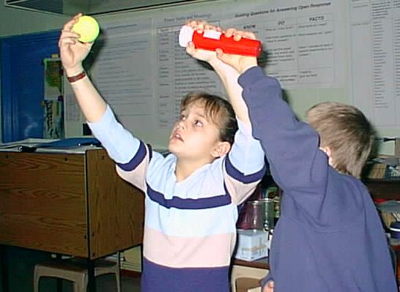
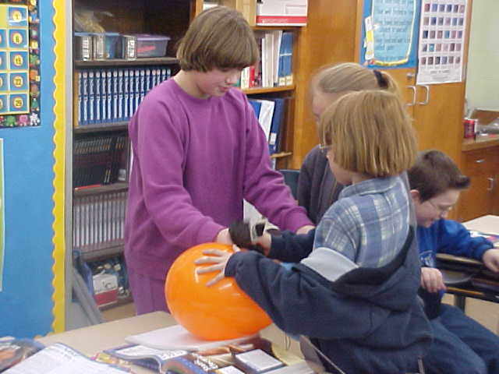
Principles of Universal Design for Learning
Phases of the moon
Multiple means of representation, to give learners various ways of acquiring information and knowledge
  Can the student access instruction?
  Is targeted information provided
  in student’s mode of
  communication?
Static electricity
Notes:
Think about the barriers that exist in this classroom as the teacher addresses topics and concepts in science. These students are non-readers. Text is a barrier, the abstract nature of the understanding the phases of the moon is a barrier, etc. The teacher is addressing these barriers by modeling the phases of the moon with simple materials. Accessibility is addressed through models. The text book exists but Marvin has a summary of information to look at using symbols. Paige is engaged by the balloon and can experience the effects of static electricity as she rubs the balloon on her sweater and it sticks to the wall.
These are questions that you can embed into your instructional planning as part of a process to ensure your students can access learning.
7

Slide 8




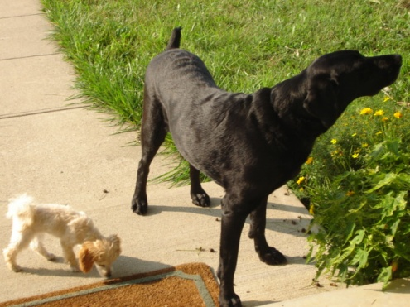

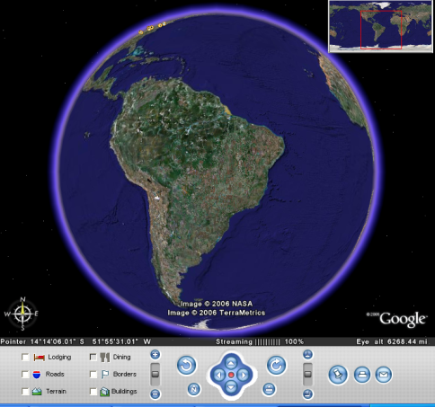

Multiple Means of Representation
Options in how students will access instruction
Make a connection to the student’s life that can be related to the new targeted knowledge.
Google Earth
Notes:
NOTE: Using the UDL Guidelines matrix, we will move through the following slides in groups categorized first by the curriculum element (instructional materials, teaching methods, assessment methods), and second by the principles of UDL (representation, expression, and engagement). The bullets provide the means to support each area, and the italicized text highlights the example illustrated on each slide.
INSTRUCTIONAL MATERIALS
Instructional Materials / Representation:
Provide options in the way information is presented.
Perceptual options
Linguistic options
Cognitive and background knowledge options (CAST, 2005)
Background knowledge is the frame of all new knowledge. Some students with significant cognitive disabilities may not have a sound base from which to conceptualize new information due to limited experiences. Providing background information increases the base from which a student can conceptualize new information. New learning is integrated into networks that have been shaped by previous learning (CAST). Linking new knowledge with something the learner already knows provides a structure from which to work. For example, using the home as a starting point may provide a link from which the student can begin to anchor new knowledge. This slide illustrates the introduction of a new topic. The student is asked to bring something from home which will provide an anchor for a discussion of a new environment or biome – the rainforest. The photographs provide discussion of where the student lives and what there is around them – grass, flowers, dog, and a sound clip is included. With this grounding of the home being a place to live, the rainforest is introduced as a place where other animals and people live. The digital format allows the manipulation of pictures, sound, and video which offer opportunities for recruiting interest in the topic and sustaining engagement, and the focus of sound and animation have the potential to highlight critical features and provide real life examples, which support the UDL framework.

Slide 9
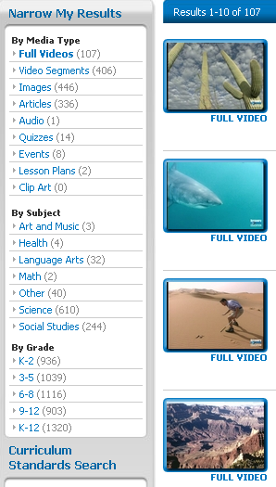
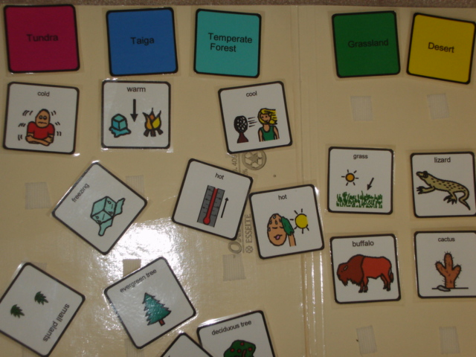

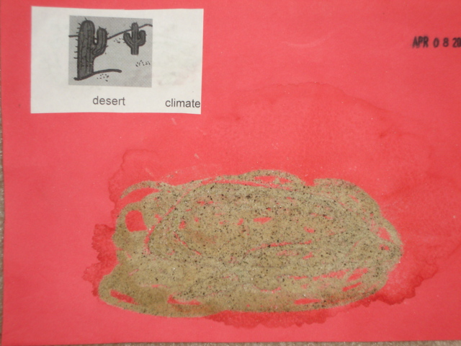

Multiple Means of Representation
Options in how students access instruction?
Environment, biomes, geography
Removable graphics
Sand
Notes:
Instructional Materials / Representation: Provide options in the way information is presented.
Perceptual options
Linguistic options
Cognitive and background knowledge options (CAST, 2005)
Multimedia tools are not new to teachers, but they may not be used consistently. It takes time to locate and prepare materials, and schools are not always equipped with the latest technology. However, for students with complex needs, these tools are essential to facilitate learning, and the likelihood of success for all students is increased.
Resources to Support Perceptual and Linguistic Options:
What is KET EncycloMedia?
KET EncycloMedia is a comprehensive online multimedia learning service offering downloadable/streamable video, a library of still photos and clip art, quizzes and lesson plans, a “this day in history” calendar, among other resources. It includes the popular Discovery Education unitedstreaming multimedia service, which has already been used successfully in several Kentucky school districts, as well as 50 hours of KET-produced video on Kentucky subjects. All of the materials—including the united library of more than 40,000 video clips—have been indexed to Kentucky academic standards. KET EncycloMedia is free to KY schools! (KET)
http://www.ket.org/education/encyclomedia.htm#faq
Boardmaker, Mayer Johnson
“Boardmaker is software that allows the user to design and create printed symbol-based communication and educational materials with Picture Communication Symbols and other pictures and graphics in 42 languages!” (Mayer Johnson) When combined with Speaking Dynamically Pro (Mayer Johnson), it creates augmentative and alternative communication (AAC) software for creating speaking communication boards.
http://www.mayer-johnson.com/MainBoardmaker.aspx?MainCategoryID=5419
SET BC “is a collection of downloadable visual supports that can be used by students for both receptive and expressive communication in the classroom, at home, and in the community. This searchable database allows you to find a wide range of useful visual supports for different curriculum areas, activities, and events. PictureSET resources are created and updated by dedicated professionals working with students in British Columbia.” (SET-BC)
http://www.setbc.org/setbc/communication/frame_pictureset.html

Slide 10
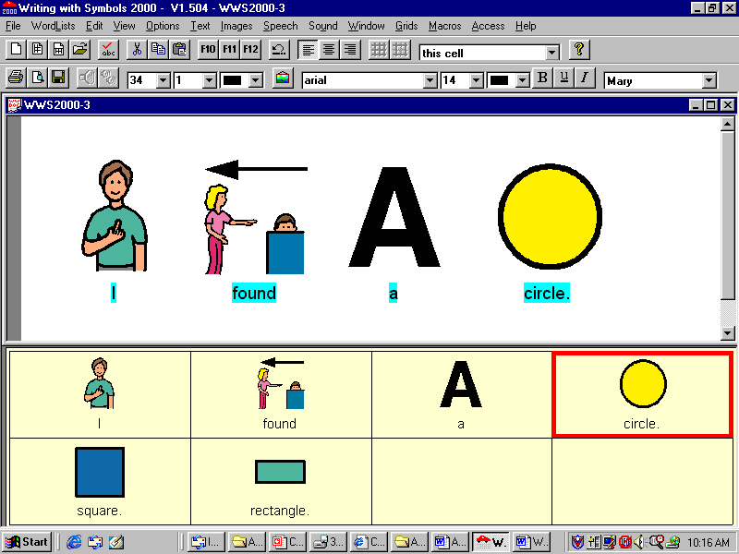
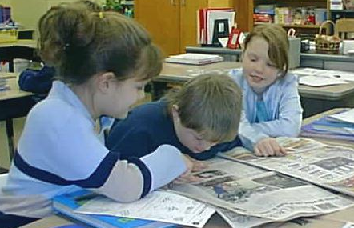
Principles of Universal Design for Learning
Multiple means of expression, to provide learners alternatives for demonstrating what they know
  Can the student interact with instruction and materials?
  Does the student have the means to demonstrate knowledge, skills, and concepts acquired?
Identifying shapes
Notes:
Look for barriers here. Again, the text book is a barrier but the teacher is using a newspaper with Marvin with pictures that are interesting to him and he is looking for shapes within the pictures. He is then able to show what he knows by using software that produces symbol based text and text-to-speech. He is writing but using a means that he can understand. He can create his sentence with a click of the mouse instead of laboring over letters that he doesn’t understand.
What are some ways you are ensuring your students can interact with instruction and materials and can demonstrate learning?

Slide 11

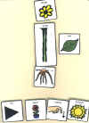
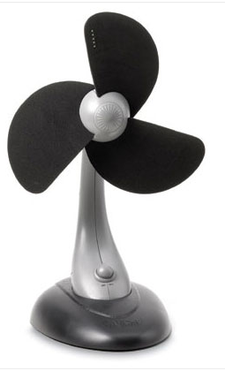

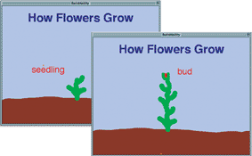

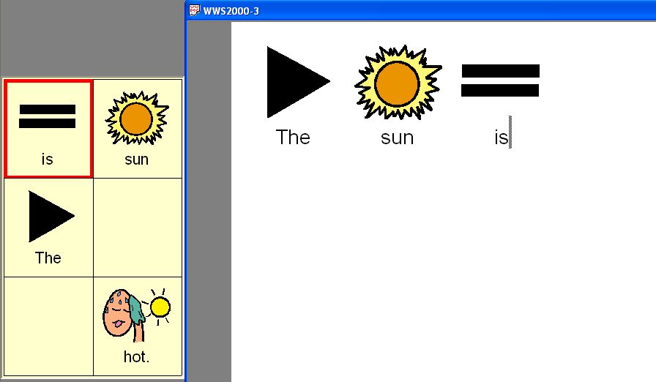
Multiple Means of Expression
Options in ways to interact with materials and demonstrate learning
Tango! Blink Twice
Graphic Organizer
Eye gaze, pointing, smiling, body tension
Drawing
A plant has
leaves
●
Sentence strips
Use a model
Writing with Symbols 2000, Widgit
Boardmaker, Mayer Johnson
Notes:
Instructional Materials/Expression: Provide options in the way students can express what they know
Motor skills required for action
Tools and media for expression
Levels of scaffolding for learning (CAST, 2005)
The graphics provide examples of assistive technology used to allow learners to share what they know. These examples are by no means exhaustive, in fact, barely scratch the surface, but they do range from low-tech to high-tech devices.
Consider drawing as a means for expression, sentence strips, a graphic organizer using software such as Inspiration, Read and Write Gold -version 8, etc. Include a graphic capturing device such as PC Notetaker which transfers a scribed image to digital form when it can be shared, enlarged, made audible, and animated. BuildAbility (Don Johnston) captures the drawing strokes or images that are created and replays them as an animation. It is captivating. One young man created his first drawing with this software. He used the mouse to create a Wooly Mammoth illustrating mammals from the Ice Age. He was motivated by the ability to re-play his drawing strokes. To the novice it may be confused for experimenting with the mouse, but the animation clearly shows how the student draws the long hair of the creature and the tusks. He took a printed copy home to his family where it has been framed along with the drawings of his siblings. His mother reported it was the first time he had recorded something like this.
The folder activity created with Boardmaker (Mayer-Johnson) provides cards that can be manipulated in a variety of ways. They can be used to support the recognition networks in terms of providing visual cues to the instructional content, and the same cards can provide ways a learner may demonstrate what they know.
TechTalk - This type of device has 8 pictures and up to 16 levels. A message can be recorded for each square. The user selects a cell and the recorded message is heard.
The Tango communication device (Blink Twice)
A text/symbol word processing software provides the means for a student to write using graphics. The flexibility of the software allows a wide variety of formats to support learners working on many different levels.

Slide 12
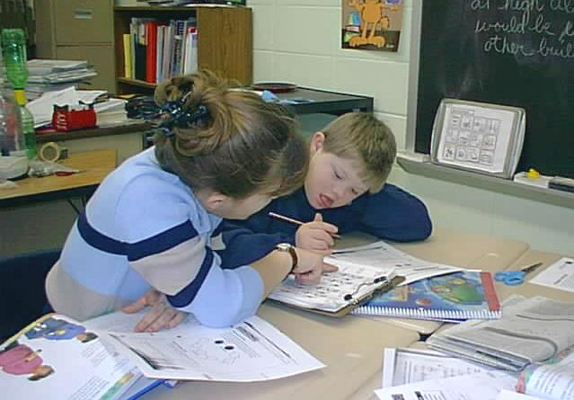
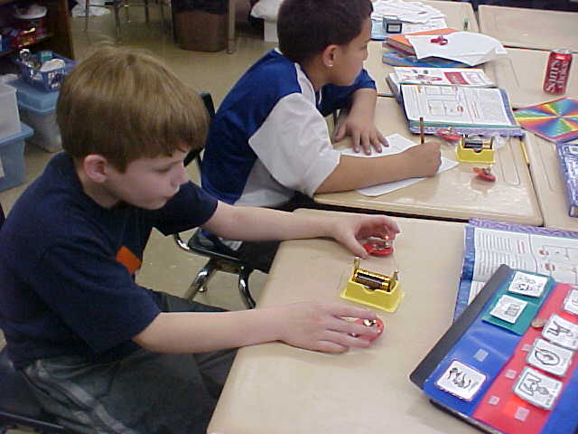
Principles of Universal Design for Learning
Multiple means of engagement, to tap into learners' interests, offer appropriate challenges, and increase motivation
Working with a friend
What will engage the student in the activity?
How will the student remain motivated long enough to learn?
Maintaining focus
Notes:
Engagement is addressed in many ways. Here, a topic that might not keep Marvin engaged for more than a minute is made more interesting through a partnership with a peer. In the bottom picture the student can engage in the material knowing expectations for the activity through the use of a mini-schedule. The length of time the experiment takes is a barrier for some students. Breaking it down removes that barrier of time.
Many teachers fall into the trap of using the same lesson plans from year to year without any regard to the individuality of their students. An even bigger misstep is disregard for student motivation. What is going to get this student excited and motivated to approach and stay engaged? Changing up and individualizing your lesson plans will keep both you and student engaged! I have observed many teachers doing to same standards and each one has used different methods-. Some were creative and engaging and others lacked effort on the teacher’s part. Remember to use items they are familiar with or think of unique ways to introduce new concepts through multisensory approaches. Use all the senses whenever possible. As a teacher, be excited and interested in what you are teaching! If you don’t look enthused with the content, neither will your students.

Slide 13
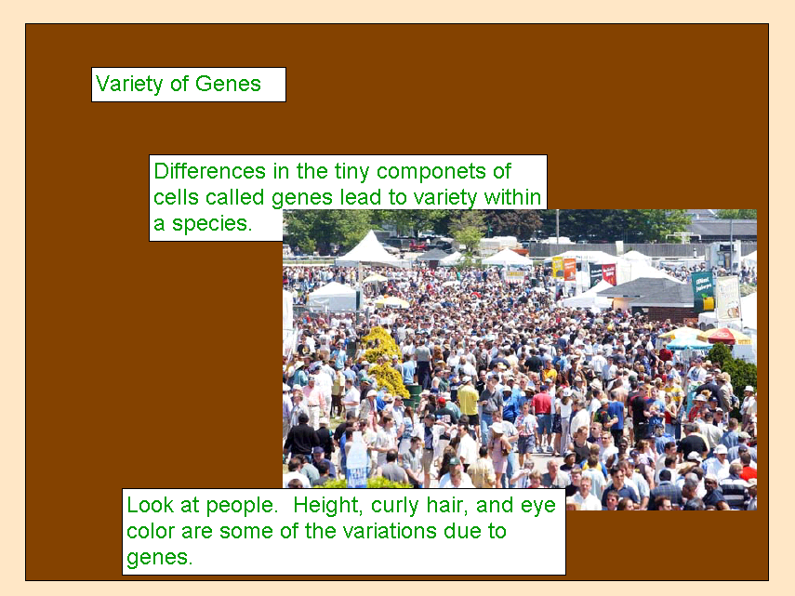
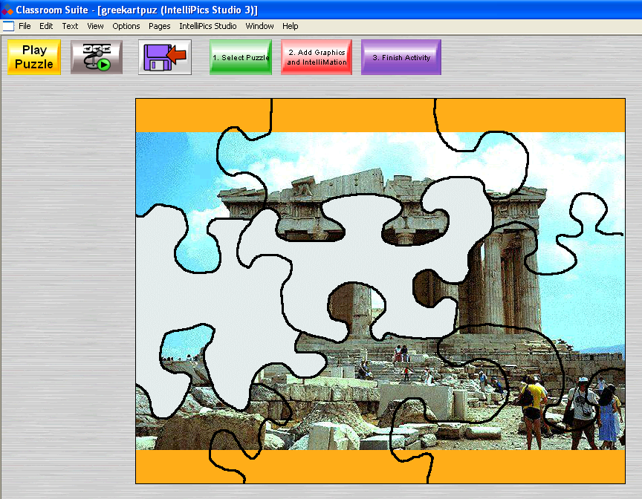
Multiple Means of Engagement
Provide Options for
recruiting interest, sustaining effort, and self regulation
Use a personal area of interest to recruit attention.
A clickable puzzle created using Classroom Suite (IntelliTools), maintains student interest through physical movement with auditory feedback, contrasting color, music, and animation at completion.
Notes:
Instructional Materials/Engagement: Provide options in the ways students are motivated or engaged.
Alternatives for recruiting interest
Alternatives for sustaining engagement
Alternatives for rewarding achievements (CAST, 2005)
To engage learners teachers must provide options in the ways that students are motivated or engaged.
A high school class is learning about biodiversity. To engage this student’s interest, the student is offered choices of pictures to illustrate a variety of genes, some of which pertain to a personal area of interest. In this case the student is interested in horses, and the picture is of a crowd at a horse race. Once offered this selection the student’s interest was captured and linked to the topic which may have originally lacked a motivator.
Once the student is interested in the learning topic, the student will need further alternatives for sustaining engagement. Continuing to ensure that materials available are of interest is most important. Consider color, texture, shape, size, multimedia, smell, movement, ease of use, level of challenge, etc.

Slide 14
IDEA (2004), Section 300.5
Assistive Technology Device
  Any item, piece of equipment or product system,
  Whether acquired commercially off the shelf, modified, or customized,
  That is used to increase, maintain, or improve the functional capabilities of children with disabilities.
Notes:
The term does not include a medical device that is surgically implanted, or the replacement of such device.

Slide 15
IDEA (2004), Section 300.6
Assistive Technology Service
Assistive technology service means any service that directly assists a child with a disability in the selection, acquisition, or use of an assistive technology device. The term includes—
(a) The evaluation of the needs of a child with a disability, including a functional evaluation of the child in the child’s customary environment;
(b) Purchasing, leasing, or otherwise providing for the acquisition of assistive technology devices by children with disabilities;
(c) Selecting, designing, fitting, customizing, adapting, applying, maintaining, repairing, or replacing assistive technology devices;
(d) Coordinating and using other therapies, interventions, or services with assistive technology devices, such as those associated with existing education and rehabilitation plans and programs;
(e) Training or technical assistance for a child with a disability or, if appropriate, that child’s family; and
(f) Training or technical assistance for professionals (including individuals providing education or rehabilitation services), employers, or other individuals who provide services to, employ, or are otherwise substantially involved in the major life functions of that child.

Slide 16
Assistive Technology
  Assistive technologies include
  Mechanical, electronic, and microprocessor-based equipment
  Non-mechanical and non-electronic aids
  Specialized instructional materials, services, and strategies that people with disabilities can use either to
    (a) assist them in learning,
    (b) make the environment more accessible,
    (c) enable them to compete in the workplace,
    (d) enhance their independence,
    (e) otherwise improve their quality of life.
  These may include commercially available or "home made" devices that are specially designed to meet the idiosyncratic needs of a particular individual.
  Blackhurst & Lahm, 2000, p. 7
Notes:
IDEA legislation requires that students with disabilities be provided the supports they need as a part of their Specially Designed Instruction (SDI). It is important that you understand the definitions of these supports as well as knowing where to reference the supports as the ARC develops a student’s IEP.
Assistive technology should be used as support for access, learning and performing daily tasks
Assistive technology needs must be considered along with a student's other educational needs.
Needs for technology must be identified on an individual basis.
Identification of technology needs must involve parents, the student when appropriate, and a multidisciplinary team.
Parents or other IEP Team members can ask for additional evaluation or an independent evaluation to determine assistive technology needs.
When an evaluation is being conducted, consider mobility, fine-motor skills, communication, and alternatives to traditional learning approaches.
Lack of availability of equipment or cost alone cannot be used as an excuse for denying assistive technology services.
If included in the IEP, assistive technology services and devices must be provided at no cost to the family.
Parents always have the right to appeal if assistive technology services are denied.
The last definition is taken from the Kentucky Administrative Regulation for Special Education Programs (KAR). The KAR discusses obligations on the part of the school to ensure the student’s needs are being addressed via his related services or supplemental aids and services. You will also locate assistive technology within the Definitions section (002) and the Individual education program section (320).
http://education.ky.gov/specialed/excep/Pages/Kentucky-Administrative-Regulations-and-Federal-IDEA-Regulations-for-Special-Education.aspx
On this website, you will find links to the IDEA 2008 and the KAR.
http://education.ky.gov/specialed/excep/Documents/Kentucky%20Administrative%20Regulations.pdf
This link will take you directly to the KAR.
http://education.ky.gov/specialed/excep/Pages/IEP-Guidance-and-Documents.aspx
This link will take you directly to the IEP Guidance Document which will discuss related services and supplemental aids and services.
(4) "Assistive technology service" means any service that directly assists a child with a disability in the selection, acquisition, or use of an assistive technology device. This term shall include: (a) The evaluation of the needs of a child with a disability, including a functional evaluation of the child in the child’s customary environment; (b) Purchasing, leasing, or otherwise providing for the acquisition of assistive technology devices by children with disabilities; (c) Selecting, designing, fitting, customizing, adapting, applying, maintaining, repairing, or replacing assistive technology devices; (d) Coordinating and using other therapies, interventions, or services with assistive technology devices, like those associated with existing education and rehabilitation plans and programs;(e) Training or technical assistance for a child with a disability or, if appropriate, that child's family; and (f) Training or technical assistance for professionals (including individuals providing education or rehabilitation services), employers, or other individuals who provide services to, employ, or are otherwise substantially involved in the major life functions of the child.

Slide 17
KAR Assistive Technology
  Section 7. Assistive Technology. (1) AN LEA shall ensure that assistive technology devices or assistive technology services, or both, as defined in 707 KAR 1:280(3) or (4) are made available to a child with a disability if required as part of the child’s special education, related services, or supplemental aids and services
  (2) On a case-by-case basis, the use of school-purchased assistive technology devices in a child’s home or in other settings is required if the ARC determines that the child needs access to those devices in order to receive FAPE.
  707 KAR 1:290 Free Appropriate Public Education, p. 12
Notes:
Services: Identifying items, adapting instructional materials, training & technical assistance, AT evaluation
LEA – Local Education Agency
KAR- Kentucky Administrative Regulations

Slide 18
Continuum of Assistive Technology
High Tech- devices that integrate sophisticated electronics or computers.
Medium Tech- devices that are relatively complicated mechanical devices, such as wheelchairs.
Low Tech- items that are less sophisticated and can include devices such as adapted spoon handles, non-tipping drinking cups, Velcro tabs to keep positioning pads in place, wrist splints, clipboards to hold papers steady, or pencil grips.
No Tech- solutions that are those that make use of procedures, services, and existing conditions that do not involve the use of devices or equipment. These might include services such as physical therapy, occupational therapy or the services of other specialists.
Notes:
As you see there is a continuum of assistive technology types ranging from low tech to high tech. There is such a wide range of assistive technology available today, there should be some type of assistive technology available to assist and support your students. The challenge is staying current with what is available. We will be sharing different examples of assistive technology ranging from no tech to high tech.
Another challenge is to not grow comfortable with the assistive technology you use in your classroom and not seek out new or different devices. As an advocate for your students, it is your obligation to make sure to keep abreast of what is going on in the field of assistive technology to ensure you are aware of new devices. Another reason to keep current is because as your students grow and advance, so will their need for different/updated devices.

Slide 19
Thoughts on How to Apply
Begin with no-tech and work up the continuum is essential
  Example: In teaching a student that has limited use with one arm to use a mixing bowl to prepare ingredients for cooking
  it might be better for a home economics teacher to teach that student how to wedge the bowl into a drawer and hold it with a hip while stirring, rather than request the purchase of an expensive medium-tech electric mixer that is equipped to stabilize the mixing bowl while it is being operated.
  Additional information about assistive technologies, including devices and services that they encompass, is provided by Blackhurst and Lahm (2000).

Slide 20
Activity
What are some examples of no-tech you currently use in your classroom with your students?

Slide 21
Common Assistive Technology Applications
Positioning
Access
Environmental Control
Augmentative Communication
Assistive Listening
Visual Aids
Mobility
Computer-Based Instruction
Social Interaction and Recreation
Self-Care
http://www.vats.org/aboutat.htm
Notes:
Please go to the website cited and read through pages 4- 6 (Start reading where you see the word “Positioning”). These pages will provide more detail about each of these common assistive technology applications.
After reading this section, reflect/respond to the questions on slide 22:
Link does not have much here as described.

Slide 22
http://www.vats.org/aboutat.htm pages 4- 6
After reading this section, reflect/respond to the following questions:
Were you aware that assistive technology had this many applications? Consider how many of these are currently used in your classroom. Please identify what you currently use in your classroom- list by individual application with the specific assistive technology used in each of the areas.
Will this list help you as a teacher when evaluating assistive technology needs in the future? How could you incorporate this list in your evaluation?
This link was developed by the parent group, Parents, Let’s Unite for Kids (PLUK). This is an excellent resource that you may want to share with parents. It is 70 pages to print, but well worth the information! This site is also available through the KDE Special Education Parent page. http://www.education.ky.gov/KDE/Instructional+Resources/Exceptional+Children/Parent+Involvement/
Notes:
Cannot find 70 page document referenced here. Link does not work

Slide 23
Activity
As you review each of the following 4 slides, use a highlighter to mark the assistive technology that you have used with students or have had experience.
Once you have finished reviewing and highlighting, evaluate if the assistive technology you use falls across the continuum of low tech to high tech. Record your findings.
Review each of the four pages and indicate an approximate percentage of the assistive technology you did not highlight. Identify at least 7 devices that could potentially be appropriate for your students.

Slide 24

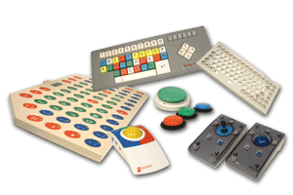
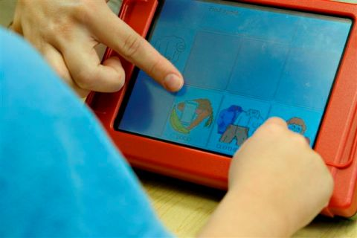
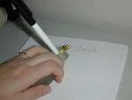
Assistive Technology for Access: Aids students who have difficulties in accessing communication, learning tools, or engaging in classroom or home activities.
Homework
Adapted common tools (e.g., big pencils)
A roller-ball (or tracker-ball) pointing device with a separate button for clicking
Adapted handles (e.g., pencil grips)
Scotch tape to hold paper in place, Velcro, slant borders
Adapted book-page turners or fluffers
Adapted paper (different sizes)
Built-up stylus
T-bar to assist with typing
Switches
Head pointers
Joysticks
Adapted mouse
Typewriter
A mouth stick to press keys on the keyboard
Foot pedals or hardware switches instead of a mouse to operate a technology device
Arm support
Slant board
Tilt board
Book holders
Key guards
Onscreen keyboards
Touch-sensitive colored lights
Voice input or output devices
Voice-recognition software (turns the spoken word into the typed word)
Eye-controlled computer-input devices
Computer-access modification software or hardware
Touch window
Portable word processor
Word-completion utilities
Adaptive switches (primary mouse)
Alternative keyboards (e.g., keyboards with easy access, touch keyboards)
Keyboards with accessibility options to input or encode text
Notes:
See slide 23 for directions.

Slide 25
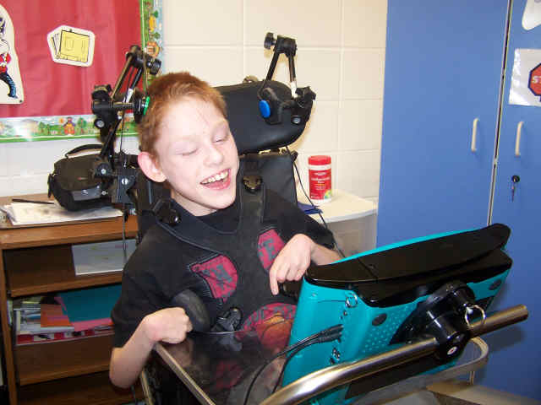
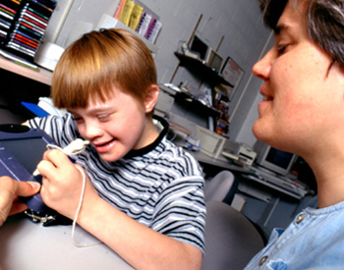

AT for Communication: Aids students who have difficulty in communicating effectively (i.e., they have unintelligible speech, have no or very little verbal skills, or have limited language proficiency).
Pictures, photographs, objects
Communication boards
Communication books
Eye-gaze or eye-pointing systems
Simple voice-output devices
Word cards or word manipulatives
Word window
Writing guides
Voice-output devices with levels
Voice output with icon sequencing
Communication software (allows for communication boards and visual displays)
Augmentative communication devices (visual display, printed or speech output)
Dedicated augmentative communication system
Text-to-voice and voice-to-text software
Talking word processing with writing support
Word prediction, abbreviation, or expansion options to reduce keystrokes
Software that allows communication via pictures and symbols
Head-pointing devices
Touch screens
Translating devices: voice language (e.g., English) to output different voice language (e.g., Spanish)
Electronic and software dictionaries
Notes:
See slide 23 for directions.

Slide 26


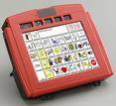
Assistive Technology for Hearing: Aids students who are deaf or hard-of-hearing
Hearing aids
Signaling devices
Vibrotactile switch
Pictures, photographs, objects
Communication boards
Assistive listening devices (e.g., amplified phone system)
Phonic ear
Headphones (to keep the listener focused, adjust sound, etc.)
FM amplification systems (e.g., auditory trainer)
TDD/TTY for phone service
Closed-captioning television
Real-time captioning
CD-based (text)books, electronic books
Audio-voice amplification device for teachers
Telecaption decoders
Vibrotactile systems
http://www.ncrel.org/sdrs/areas/issues/methods/technlgy/te7assist.htm
Notes:
See slide 23 for directions.

Slide 27
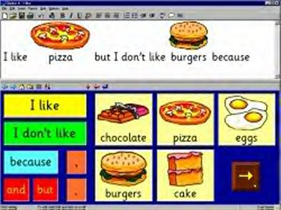
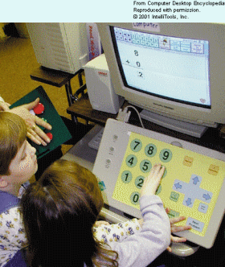
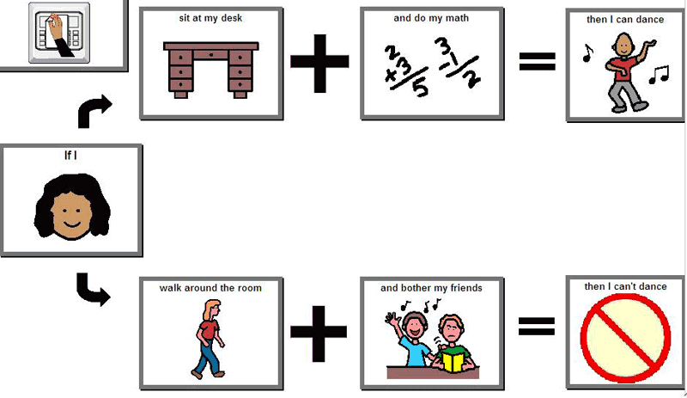
Assistive Technology for Learning and Studying: Aids students with disabilities to increase, maintain, or improve their functional capabilities.
Highlighting tape
Post-It notes
Picture schedule
Written schedule
Social stories
Written or picture-supported directions
Aids to help find materials (e.g., color tabs)
Editing devices: correction fluid (such as Liquid Paper or Wite Out) correction tape, correction pen, highlight tape
Sentence windows
Graphic organizers to visually help in developing and structuring ideas
Single-word scanners (reading pens) or hand held scanners
Portable word processors
Talking word processors
Hand held computers
Voice-recognition products
Software for organizing ideas and studying
Electronic organizers or reminders
Word-prediction software (assists in spelling and sentence construction)
Multimedia software for production of ideas (e.g., PowerPoint®)
Talking electronic device or software to pronounce challenging words
Graphic organizer software
Software for concept development, manipulation of objects, math computations
Portable word processor to keyboard instead of write
Closed-captioning television
Text-reading software
Tactile or voice-output measuring devices
Notes:
See slide 23 for directions.

Slide 28

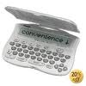
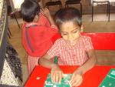
Assistive Technology for Vision: Aids students who are blind or visually impaired.
Eyeglasses
Large-print books
Books on tape
Magnifying glass
Slate and Braille stylus
Stencil
Tape recorder
Cassettes
Stereo headphones
Lighting contrasts
Adapted paper (e.g., raised surfaces, highlighted lines, various colors, sizes)
Pen lights
Calculator with large keys or large display
Talking calculators
Self-sticking notes (such as Post-It notes)
Highlighters
Color-blind aids
Braille writer (to take notes, store information, print in various formats)
Braille translation software (translates inputted text that can be Brailled)
Braille printer
Computer with speech output or feedback
Operating system special-accessibility options (screen enlargement, adjustment of keyboard, sound, display, mouse)
Closed-circuit television
Computer-screen magnifiers
Letter- or word-magnification software
Glare-reduction screens
Talking electronic dictionary, thesaurus, spell checker
Voice-output screen-reading software
Voice amplification or voice projector
Screen readers
Video magnifiers
Notes:
See slide 23 for directions.

Slide 29
Targets
To remove barriers to learning for students with MSD using principles of UDL & AT supports.
How can you identify barriers to learning for students with MSD & match supports in UDL & AT to meet their needs?
Notes:
Abbreviations:
Assistive Technology (AT)
College & Career Ready (CCR)
Moderate/Severe Disabilities (MSD)
Universal Design for Learning (UDL)

Slide 30
Using UDL Principles to Remove or
Reduce Barriers to Learning
  Is the student actively participating in each part of the instructional activity moving towards outcomes linked to the grade level content standard?
  Can the student access instruction? Is targeted information provided in student’s mode of communication?
  Can the student interact with instruction and materials? Does the student have the means to demonstrate knowledge, skills, and concepts acquired?
  What will engage the student in the activity? How will the student remain motivated long enough to learn?
Notes:
We can use UDL principles to guide instruction. Think about removing barriers via the 3 UDL principles: Multiple means of representation, expression and engagement. If we have removed barriers in these 3 areas then we have addressed accessibility. As a check we can ask these 3 questions.
Is the student actively participating in each part of the instructional activity? That may include reading, writing, speaking, listening, answering questions, doing research, taking tests, etc. These activities may be done in the context of different instructional formats such as group or individual work. The focus is not upon which instructional activities will the student participate in but how.
What is needed to engage the student in the instruction? This may not require anything additional to what all students are receiving, but using student interests can facilitate interest.
Does the student have a means to demonstrate the knowledge, skills, concepts acquired? Even though the student may be learning more complex and sophisticated ways to communicate knowledge, it may be preferable to rely on a more established means of communication so that the demonstration of new knowledge is not compounded by a “new” communication mode, as well.

Slide 31

Barriers to Learning
Physical- crowed classrooms and hallways
Attitudinal- low expectations for learners
Instructional- poor instruction or no access to
instruction
Notes:
We tend to think of barriers as being only physical, because they can be readily seen. Navigating a wheelchair though a classroom is often hazardous and many times the student has to sit to the side or at the back of the room. The desk does not allow the wheelchair to get close enough to use the surface. However barriers come in many forms.
Sometimes attitudes and low expectations are the biggest barrier. If we don’t expect a student to learn, we are less likely to make that effort to teach and provide learning opportunities. We prove ourselves correct – at least we think of it that way. I was right – that student can’t learn.
Instructional – Students have limited reading/writing abilities then they will have limited access to content. We need to make adaptations/modifications to bridge their access through other modes of responding (ex. Text reader, scribe, picture choices, etc.)

Slide 32
Activity
List some statements that teachers, classroom assistants, or administrators have made that are indicative of low expectations.
What are some other barriers that students with disabilities may encounter?

Slide 33
What are the instructional activities planned for all students in the general education setting? | Barriers to Learning
Research an excerpt from a newspaper report from 1853 in groups; “The wild woman who was found on the island of San Nicolas about 70 miles from the coast, west of Santa Barbara …..” Make notes and report out to class. | Reading text writing notes Speaking to ask Qs or to participate in group discussions.
Research the lives of the Nicoleno, a Native American tribe living on San Nicolas Island in California in groups. Create a poster to show who the people were, how they lived, island location, etc. Share poster with class. | Read text knowing where to find the information the amount of information-Need to know
Introduce the novel, Island of the Blue Dolphins. Predict what may happen in the story. Read the first few chapters in class, taking turns reading. | Read text ________? ________?
Read more chapters. Discuss events in the novel with a partner. Complete a graphic organizer recording main idea and supporting details. | ________? ________?
Notes:
To address the reading standard and the assessment target, in this general education classroom, instructional activities are set around the novel Island of the Blue Dolphin by Scott O’Dell. The left column shows what typical instructional activities might be in a 5th grade classroom as the novel is introduced. The column on the right looks at barriers to learning.
Instructional barriers:
Look at Instructional Activities carefully. All the barriers are to do with instructional methods, materials and mode of demonstration of knowledge. The student is NOT the barrier. We are all different and learn in different ways; diversity is natural. Instruction and materials must reflect that. We often unintentionally create the barriers in a classroom because we do not offer options in the way we teach and the way students demonstrate learning. These classroom activities really offer some variation in learning methods and materials but there are still hidden barriers. We need to look at how our students learn and then determine the barriers in the way we teach and the materials we use.
What are some barriers you have experienced in a collaborative setting? Be sure to include instructional methods and materials.

Slide 34
Activity
What are some barriers you have experienced in a collaborative setting?
Be sure to include instructional methods and materials.

Slide 35
Targets
To understand how to match supports in UDL & AT to the needs of students with MSD.
How can we use the various options of UDL and AT supports to meet the needs of students with MSD?
Notes:
Abbreviations:
Assistive Technology (AT)
College & Career Ready (CCR)
Moderate/Severe Disabilities (MSD)
Universal Design for Learning (UDL)

Slide 36
Directions
The following slides are going to walk you through an evaluation/analysis of a student.
This will help you to see how to analyze his needs based on curriculum and instruction, as well as the specific needs of the student.
You will be introduced to various concepts as we move through these slides.

Slide 37
Thinking about the needs of a student
Introduce David
Current expectations – academic content standards
Assessment target
Instructional activities
Identifying and analyzing barriers within the activities
Notes:
The following slides are going to walk you through an evaluation/analysis of a student. This will help you to see how to analyze his needs based on curriculum and instruction, as well as the specific needs of the student. You will be introduced to various concepts as we move through these slides.

Slide 38

Meet David
One to two word utterances. Intelligible to familiar listener only. Beginning Picture Exchange Communication (PECS) user
Knows 2 letters of the alphabet
Can distinguish between two pictures or symbols
Inconsistently identifies numbers to 3
Can follow a 1-step direction when he wants to
Learning to write first 3 letters of his name
Loves to be with peers
Has limited use of his right hand
Uses a wheelchair with a tray for mobility
Notes:
This is David and he is a 5th grade student at Anywhere Elementary. Take a moment to read through the information about David. David can be a challenge in the classroom as he is excitable and strong willed. Does he sound like a student that you have had in the past or currently have in your classroom? Let’s continue on through the slides to learn more on how to meet his needs as well as the needs of your students.
right arm.
Make sure student is seated correctly in his chair –desk or his tray.

Slide 39
Academic Standard
Alternate K-PREP Content Aligned Standards
5th Grade Reading
KCAS Standard
5th Grade Reading
R-5.4
Determine two or more main ideas of a text and how they are supported by key details.
READING STANDARDS
FOR INFORMATIONAL TEXT
RIT.2
Determine two or main ideas of a text and explain how they are supported by key details; summarize the text.
READING STANDARDS
FOR INFORMATIONAL TEXT
Notes:
Throughout the presentation we will use this example – a 5th grade reading assessment target linked closely to the reading content standards for all students. This is the standard that we are going to use for David.
Objective:
The student will identify two or more main ideas of a text and how they are supported by key details.
READING STANDARDS FOR INFORMATIONAL TEXT

Slide 40
Tools and Strategies for Removing Barriers
Assistive Technology supports and services; AT devices, training, instructional strategies
SETT Framework (Zabala)
Access to the general curriculum; high expectations
Least Dangerous Assumption
Further strategies based on research.
Other research
Multiple
means of representation, interaction/ expression, and engagement
Student
Environment
Task
Tools
Physical
Instructional
Affective Networks
Strategic Networks
Recognition Networks
Universal Design for Learning, UDL (CAST)
Anne Donellan
Notes:
Looking at this chart provides some research-based strategies that we can use to help support students. We talked about physical barriers, students who cannot manage steps often have to come into the school by a back way which is often dangerous in itself. We are more aware of physical barriers and there are more efforts made to make the environment accessible (e.g. sidewalk curb cuts, ramps that are engineered to be part of the architectural design, elevators, captioning on television). The others will be addressed in the next slides with more information in other modules or materials available ( e.g. Assistive Technology module with Dr. Joy Zabala).
We mentioned that lack of expectations can be a barrier. This is the Least Dangerous Assumption from Anne Donellan’s work. We have talked about this in terms of a barrier which is perhaps the greatest barrier of all – that of not presuming competence (kids with severe intellectual disabilities can’t learn beyond preconceived levels). If a teacher believes a student with a severe intellectual disability can’t learn certain concepts, the instruction will most likely be substandard because on some level (conscience or subconscious) the teacher has already set the student up to fail. Many students within this population are never exposed to many educational opportunities/experiences within the general setting because it’s either presumed not appropriate nor beneficial to that particular student. As a classroom teacher, it is your ethical responsibility to provide instruction that is rigorous and aligned with the standards, and designed to meet the needs of your students.
Anne Donnellan notes… “that educators lack data on outcomes of educational interventions with handicapped students, the criterion of the least dangerous assumption is presented as an interim standard. The criterion holds that without conclusive data educational decisions should be based on assumptions which, if incorrect, for potential will provide the least danger for independent functioning”. (CL)
There is a lot of information on this slide… we will break the components down and discuss on the next few slides.
Understand first and foremost as an educator, you are to presume competence (assume all students CAN learn) for each and every one of your students.
We have had so many teachers in the past couple of years comment to us, “Hey, I didn’t realize he could learn that and he did!” There is nothing more powerful and fulfilling as a teacher to see your students learn. Therefore, set the stage by employing the tools and strategies listed above and stepback and plan to be in awe!

Slide 41
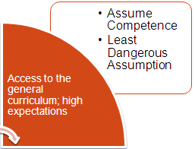
Least Dangerous Assumption
It is the least dangerous assumption to presume that with the right instruction and supports all students are competent to learn the general education curriculum
All students must have access to a communication system that allows them to communicate about age appropriate social and academic topics
Best place to learn is the general education classroom and other inclusive activities and environments in which there is a natural proportion of students with and without disabilities
McSheehan/Jorgensen
TASH 2007
Notes:
Lets talk about Least Dangerous Assumption in our own lives. I must believe that all of you are committed to helping your students learn and that you CAN do this. You must believe that I know how to do this and that the strategies I will show you, work. When we bring this to our own lives, it is not always easy to do.
We cannot talk about supports or assistive technology if we are not willing to commit ourselves to this assumption. We cannot talk about supports to learn if we don’t believe students can learn.

Slide 42
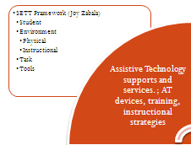
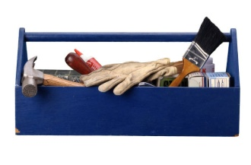
Tools – SETT Framework
S Student
E Environment
T Task
T Tools
Whatever is needed by the student and others for the student to do the tasks in the environments in order to meet expectations
ABILITIES
GOALS
TOOLS
http://www.joyzabala.com/
Notes:
This is just a brief into Joy Zabala has developed a simple decision making framework for supporting student’s in learning – The SETT Framework- Student, Environment, Task, Tool. As teachers we sometimes head straight for the TOOL before we have considered our student’s needs or the TASK they need to accomplish.
Student: As Special Education Teachers we are skilled at knowing our students well. With our students with the most significant disabilities this is no different. We know what our student’s physical needs and strengths are and what we can build on. We must use the student’s ABILITIES to access tools to reach the goal of learning. We must consider the student in all decisions and not base decisions on what is easiest.
Environment: We must look at both the physical and instructional environment.
Task: The activities that the student must engage in or accomplish.
Then the TOOL….

Slide 43

Tools for Students
The SETTS framework allows us to properly select the tools a student needs in an instructional context. Here are the tools that may be needed by the student to do the tasks in the environments in order to meet expectations
  Accommodations
  Modifications
  Technology, Assistive Technology
  Diversified Instructional Strategies
  Supports
  Services
  Training
  Documentation
  Etc.
http://www.joyzabala.com/
Notes:
This is not just a list of AT devices. Accommodations are tools. The modifications we make to instruction are tools – the student cannot participate in the general education activities if they are not modified. Students need services – the student cannot function to make the most of their abilities if they don’t get OT, PT, Speech services as appropriate. Training and clear documentation of their performance is the key to finding and funding communication systems and other AT.
NIMAS – National Instructional Materials Accessibility Standard.

Slide 44
Tools for Others
In addition, the SETTS Framework provides tools that may be needed by others for the student to do the tasks in the environments in order to meet expectations
Training & Support for Staff
  Decision-making
  Strategies
  Accommodations
  Modifications
  Device integration and operation
  Service delivery
  Curriculum, text books
  Planning time with general education staff
  Etc.
Notes:
We, as teachers, need tools (e.g. training in using AT, particularly communication devices, resources, funding). We need to ensure we are able to support the student and so we need the resources to do it. If our students are to access the full curriculum this will include general education curriculum maps, timely provision of lesson plans, text books so we can modify the instruction, and time to meet and have on-going plan with general education teachers who are the content experts. It is important to utilize these folks to help you understanding the content so that you can better adapt instruction to meet the student’s needs.

Slide 45

The SETT Framework
A Collaborative Planning and Decision Making Tool
Student __________________________________________Date ___________________ Perspective ________________
Homework
 | Student | Environment | Tasks | Tools
What We Know
What We Need to Know
by Joy Zabala, Educational Specialist, joy@joyzabala.com
Notes:
HOMEWORK for this Fall
Use the SETT Framework as a part of your instructional planning for this fall for at least 3 students for one lesson in one content area. Plan to share these with your coach– they may ask for these via email or request you share these when they do an on-site observation.
Multiple Perspectives: Everyone involved beings different knowledge, skills, experience, and ideas to the table. Although multiple perspectives can be challenging at times they are critical to the development of the accurate, complete development of shared knowledge. Not only are the multiple professional perspectives important to include, but also those of the student and the parents. This can make the difference between success and lack there-of.
The Environments
Arrangement (instructional, physical)
Support (available to both the student and the staff)
Materials and Equipment (commonly used by others in the environments)
Access Issues (technological, physical, instructional)
Attitudes and Expectations (staff, family, other)
The Tasks
INFORMATION SPECIFICALLY RELATED TO THE DETAILS OF THE TASKS THAT ARE CURRENTLY REQUIRED OF THE STUDENT OR WILL BE REQUIRED IN THE NEAR FUTURE.
What SPECIFIC tasks occur in the student’s natural environments that enable progress toward mastery of IEP goals and objectives?
What SPECIFIC tasks are required for active involvement in identified environments? (related to communication, instruction, participation, productivity, environmental control)
The Tools

Slide 46
Using the SETTS Framework:
The Next Few Slides
5rd grade assessment target
Examine the tasks within some general education activities designed to teach the content standard and look for patterns
Turn the pattern of tasks into a menu of supports
Design a menu of supports

Slide 47

David: Let’s review
One to two word utterances. Intelligible to familiar listener only. Beginning Picture Exchange Communication (PECS) user.
Knows 2 letters of the alphabet.
Can distinguish between two pictures or symbols.
Inconsistently identifies numbers to 3.
Can follow 1-step direction when he wants to.
Learning to write first 3 letters of his name.
Loves to be with peers.
Kentucky Common Assessment Standard (KCAS):
RIT.2 Determine two or main ideas of a text and explain how they are supported by key details; summarize the text.
READING STANDARDS FOR INFORMATIONAL TEXT
Alternate K-PREP Content Aligned Standards 5th grade reading:
R-5.4 Determine two main ideas of a text and how they are supported by key details.
READING STANDARDS FOR INFORMATIONAL TEXT
Notes:
We have talked about identifying barriers and have shown a some examples of how that can be addressed but the task can still be daunting.

Slide 48
What are the instructional activities planned for all students? | How can the student actively participate in the instructional activities?
Research an excerpt from a newspaper report from 1853 in groups; “The wild woman who was found on the island of San Nicolas about 70 miles from the coast, west of Santa Barbara …..” Make notes and report out to class. | Participate in group activity Make notes Speak, report out to class Research the newspaper report
Research the lives of the Nicoleno, a Native American tribe living on San Nicolas Island in California in groups. Create a poster to show who the people were, how they lived, island location, etc. Share poster with class. | Participate in group activity Follow directions Research the Nicoleno tribe Create a poster – draw, write, etc. Speak, report out to class
Introduce the novel, Island of the Blue Dolphins. Predict what may happen in the story. Read the first few chapters in class, taking turns reading. | Read the text in the book aloud Make predictions Take turns Sit in class Remain quiet
Read more chapters. Discuss events in the novel with a partner. Complete a graphic organizer recording main idea and supporting details. | Discuss events from the text Work with a partner Differentiate main idea and details Write to complete the organizer
Notes:
In this slide, we are looking at what goes on within the general education environment and what is expected of all students. Once the tasks are clear and we have addressed the skills and what is expected of the student, we can then see how to involve students with the most significant cognitive disabilities.

Slide 49
What are the instructional activities planned for all students? | How can the student actively participate in the instructional activities?
Research an excerpt from a newspaper report from 1853 in groups …. | Participate in group activity with others Make notes Record information Speak, report out to class Share information Research the newspaper report Read
Research the lives of the Nicoleno, a Native American tribe living on San Nicolas Island in California in groups….. | Participate in group activity with others Follow directions Research the Nicoleno tribe Create a poster – draw, write, etc. Record information Speak, report out to class Share information Read
Introduce the novel, Island of the Blue Dolphins….. | Read the text in the book aloud Make predictions Take turns Sit in class Remain quiet Engage in learning
Read more chapters. Discuss events in the novel with a partner …. | Discuss events from the text Share information Work with a partner Participate with others Differentiate main idea and details Make selections Write to complete the organizer Record information Read
Notes:
In this slide we are looking at the skills in a different way – looking for essence of what the skill is. You will begin to see that when re-worded to capture the essence of what the student really has to do, we begin to see some repetition.

Slide 50
What are the instructional activities planned for all students? | How can the student actively participate in the instructional activities?
Research an excerpt from a newspaper report from 1853 in groups …. | Participate with others Record information Share information Research Read
Research the lives of the Nicoleno, a Native American tribe living on San Nicolas Island in California in groups….. | Participate with others Follow directions Research Record information Share information Read
Introduce the novel, Island of the Blue Dolphins….. | Read Make predictions Take turns Sit Engage in learning
Read more chapters. Discuss events in the novel with a partner …. | Share information Participate with others Make selections Record information Read
Notes:
Remove extraneous information and concentrate on skills and the pattern becomes clear.

Slide 51
Repeated Tasks
Read
Read
Read
Read
Read
Sit
Share information
Share information
Share information
Make predictions
Follow Directions
Make a determination
Participate with others
Participate with others
Participate with others
Record Information
Record Information
Record Information
Notes:
Now we have pulled the tasks required for the activities in this unit and you can clearly see the repetitions. As more tasks are added from other content areas, more tasks will be included BUT many of them are repeated – e.g., reading – you will be reading in language arts but also in science and math.

Slide 52
Menu of Tasks
Read
Record information
Follow directions
Share information
Participate with others
Make predictions
Sit and listen
Make a determination
Notes:
These repeated tasks become a “menu” that can be addressed for the student.
How will the student read?
What is required for the student to read?
How do we know the student is reading?
This information can be supplied on the “Menu of Supports” and be provided to all those that are working with the student – general education teacher, para-professional, peer, etc.

Slide 53
Menu of Supports
Listen | Hint: What will student do to demonstrate listening during the time a teacher lectures? For example, provide graphics that represent elements of the lecture and have David select the representative graphic as the teacher discusses each point. This could also be provided digitally.
Record information | Hint: What will student do to take notes or record an observation during a science experiment for example? For example, the graphics provided above may serve as the David’s notes. Use software such as Writing with Symbols (WWS). If digital text is provided, a text reader may be used to read the notes. Take a digital picture.
Share information | Hint: What will student do to ask or respond to a question in class? For example, the same graphics provided may serve as possible answers to questions the teacher may pose to the class. The David could be asked to select from two answers, or be provided graphics where there is no wrong answer to encourage him to participate and receive recognition for his/contribution.
Participate in group | Hint: What will student do be able to participate in group work? For example, partner the David with a peer to share a role.
Notes:
This is a useful tool to record the ways in which a student will participate during a variety of tasks. Once this is established we can then worry about the content. This tool can be given to all those who work with the student – teachers, para-professionals, even student. Replace the text in the menu with a description of how the individual will participate:
E.g. Listen during lecture: Prepare David for some time seated – follow brief exercise routine designed for this purpose and stretch out right arm. Make sure student is seated correctly in his chair – buttocks towards back of seat, truck stable, harness fastened, materials placed on no-slip matting slightly to the right of midline on the desk or his tray. Limit the number of items on his tray to 3. Ensure his communication materials are accessible and ready to use. Using enlarged graphics from the focus of the text David will select the graphics as he hears them and place them on a Velcro strip at the top of his work folder. He may need a peer to make sure the folder remains flat on the table.
Think of a student in your classroom, how do you know they are really listening ?

Slide 54
Menu of Supports for David
Read – symbols supported with text, reduced amount of text, single symbols/text on 2 inch cards
Record information – manipulate 2 inch symbol based cards, arrange cards in sequence, use a symbol based writing grid on the computer, cut out pictures
Follow directions – simple 1 step verbal directions, 2 step directions written using symbols
Share information – one word utterances, present or point to pictures, present or point to symbol based text, graphic/visual representation (e.g. Mayer/Johnson symbols)
Participate in group – graphic/visual representation, clear directions, peer partner
Notes:
Lets make a rough menu of supports for David, with what we know.

Slide 55
Targets
To understand the impact of principles of UDL & AT supports on learning for students with MSD to be CCR.
Why is the use of UDL & AT important for students with MSD to be CCR?
Notes:
Abbreviations:
Assistive Technology (AT)
College & Career Ready (CCR)
Moderate/Severe Disabilities (MSD)
Universal Design for Learning (UDL)

Slide 56
The Next Few Slides (57-59)
5rd grade assessment target and activities designed to teach the content standard using Island of the Blue Dolphins
Look at access, interaction/demonstration of learning, and engagement with materials
Review some ideas for supports in our 3 areas
Use the materials to create supports
Notes:
KCAS
RIT.2 Determine two or main ideas of a text and explain how they are supported by key details; summarize the text.
READING STANDARDS FOR INFORMATIONAL TEXT
Alternate K-PREP Content Aligned Standards
R-5.4 Determine two or more main ideas of a text and how they are supported by key details.
READING STANDARDS FOR INFORMATIONAL TEXT

Slide 57
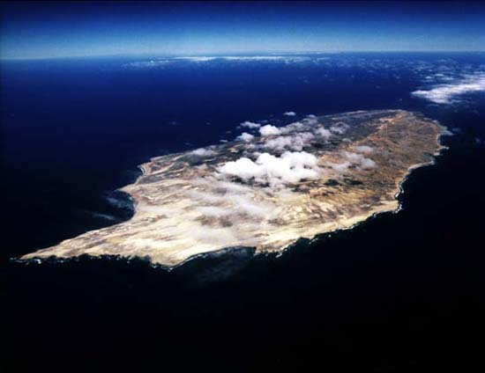
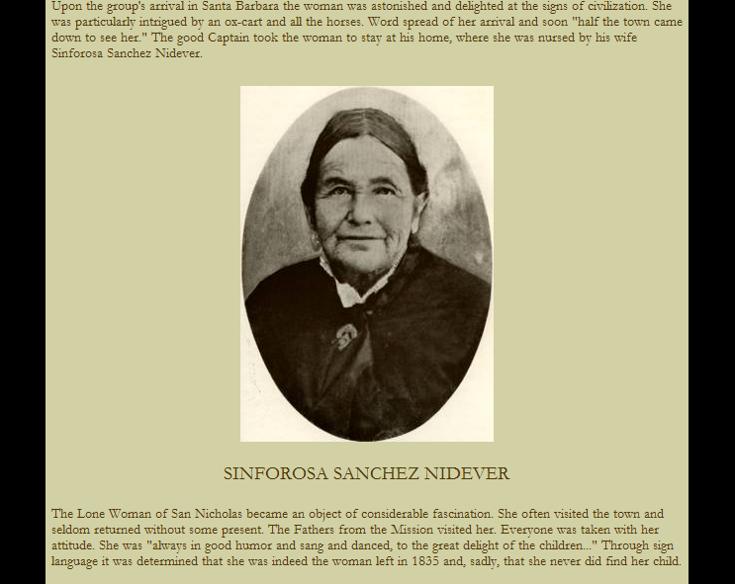
Activity from unit instruction:
Research an excerpt from a newspaper report from 1853 in groups; “The wild woman who was found on the island of San Nicolas about 70 miles from the coast, west of Santa Barbara …..” Make notes and report out to class.
Adapted activities for instruction:
Provide the web page, use a text reader
Create a PowerPoint from the materials to provide the research – record it and use symbol based text.
Have student add the graphics to a recorded slide for note taking.
Create a model of the island; diorama
?
Access
Interaction, demonstrate learning
Engagement
Notes:
R-5.4 READING STANDARDS FOR INFORMATIONAL TEXT
Determine two or more main ideas of a text and how they are supported by key details.
RIT.2 READING STANDARDS FOR INFORMATIONAL TEXT
Determine two or main ideas of a text and explain how they are supported by key details; summarize the text.
Looking ahead at the standard and how general education teachers will approach it, we find that it makes sense to let our students experience some of the elements that will be addressed within the lesson – for example, we cannot take for granted that everyone has had the chance to see the ocean, feel the water and smell the salt water. How can we bring this experience to our students? Access not limited to sitting in the classroom listening to a teacher.
Consider lack of background knowledge that our students have. Can you bring sand and water in, show pictures/video of the ocean to bring in background knowledge to help the student’s understand components of what is an island?
Emphasis that you must bring the activity to the student.
http://www.missionscalifornia.com/stories/lone-woman-san-nicolas-island.html
Link to story of Sinforsa Sanchez Nidever who inspired the story of the Island of the Blue Dolphin. Use this information to give students the background information on women who inspired the story.

Slide 58

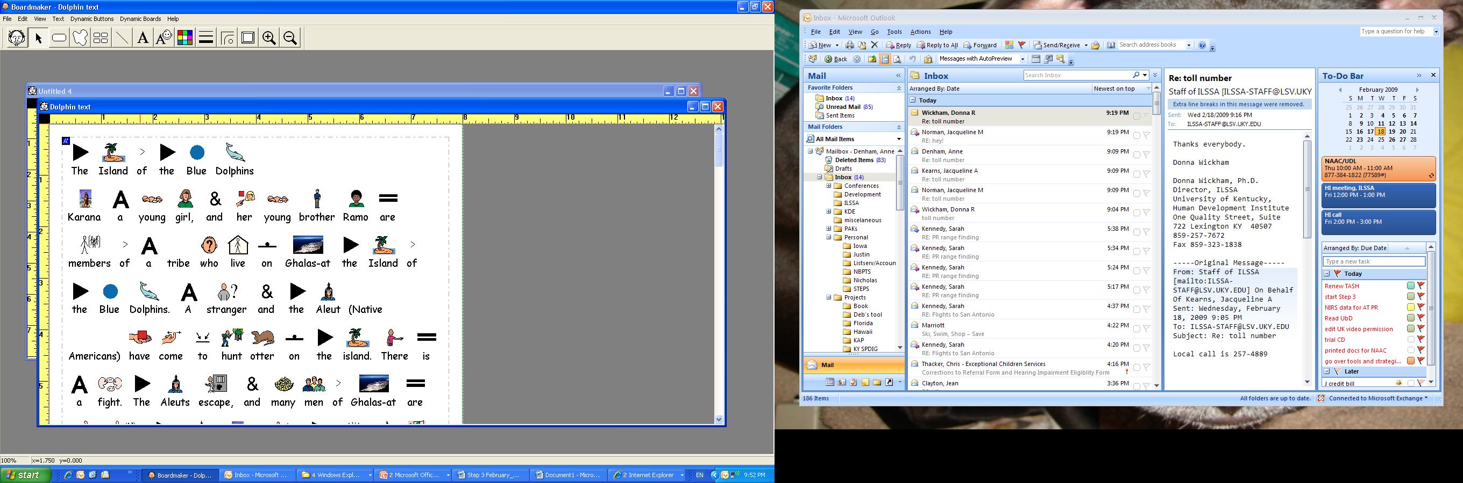

General education activity:
Introduce the novel, Island of the Blue Dolphins.
Predict what may happen in the story.
Read the first few chapters in class, taking turns reading.
-Access
-Interaction, demonstrate learning
-Engagement
Notes:
General education activity:
Introduce the novel, Island of the Blue Dolphins.
Predict what may happen in the story.
Read the first few chapters in class, taking turns reading.
Adaption: The Island of the Blue Dolphins has been adapted using WWS to provide visual supports for the text.
List other ways the text and activities could be adapted to meet the specific needs of your students.

Slide 59
Activity
List other ways the text and activities could be adapted to meet the specific needs of your students.

Slide 60
In Summary
  Can the student access instruction? Is targeted information provided in student’s mode of communication?
  Can the student interact with instruction and materials? Does the student have the means to demonstrate knowledge, skills, and concepts acquired?
  What will engage the student in the activity? How will the student remain motivated long enough to learn?
Notes:
Do your students really have ACCESS to the instruction???
HOMEWORK
Use the questions as a guide for you to respond on how your instructional planning and delivery ensure these are occurring OR on how you plan to address each of 3 questions to improve and ensure they will occur in the future. Share a copy of this plan with both your coach and building principal via email. In sharing with your principal, make sure you explain these are part of your instructional goals this year to improve planning for your students and you would like them to use this when observing you.
A few outcomes from this activity are:
You have also increased the understanding/built background knowledge for your principal in understanding your classroom and its unique needs, challenges, and opportunities!
You have also increased you own accountability and that will only make you strive to do that much better.
Ultimately, you have analyzed how you plan instruction and identified areas in which you are meeting student needs and areas for which you can improve, with a plan on how to improve in the specific areas.
We hope you found this format one with which you were able to learn. Again, do not hesitate to contact your coach if you have any questions while going through this self-guided study

Slide 61
Share
How will you use the materials as supports to address your student’s needs in 3 areas-
  access
  Interaction/demonstration of learning
  Interaction/demonstration engagement?
What have you created and how will it be used?
Use the materials in your classroom to help students access instruction and demonstrate what they know!

Slide 62

Homework
List examples of no-tech used in your classroom currently. (Slide 20)
Complete reflection questions after reading VATS website (Slide 22)
Complete list of AT used in classroom (Slide 23)
List low expectation statements from others and barriers (Slide 32 & 34)
Use the SETT Framework as a part of your instructional planning for this fall for at least 3 students for one lesson in one content area. Plan to share these with your coach– they may ask for these via email or request you share these when they do an on-site observation.

Slide 63
Resources
  Blackhurst, A. E. & Lahm, E. A. (2000). Foundations of technology and exceptionality. In J. Lindsey (Ed.) Technology and Exceptional Individuals (3rd ed, pp. 3 - 45). Austin, TX: Pro-Ed.
  http://bookbuilder.cast.org/
  Center for Applied Special Technology (CAST). http://cast.org/index.html
  Donnellan, Anne, (1984). The Criterion of the Least Dangerous Assumption. Behavioral Disorders, v9 n2 p141-50 Feb 1984 (print copy not available).
  http://www.joyzabala.com/
  KAR (2008). Kentucky Administrative Regulation for Special Education Programs. Kentucky Department of Education.
  http://natri.uky.edu/resources/fundamentals/defined.html#definition
  http://www.ric.edu/sherlockcenter/wwslist.html
  http://www.lrc.ky.gov/kar/707/001/290.htm
  http://www.lrc.ky.gov/kar/TITLE707.HTM
  http://www.missionscalifornia.com/stories/lone-woman-san-nicolas-island.html
  http://www.ncrel.org/sdrs/areas/issues/methods/technlgy/te7assist.htm
  http://www.setbc.org
  http://www.vats.org/aboutat.htm

