Slide 1
Maintaining Strong University and District Partnerships
KEEP Conference
May 2018
Christina Noel, Susan Keesey, Thomas Gross, and Ryan Farmer

Slide 2
Goals of partnerships
University
K-12 School

Slide 3
Goals of partnerships
University
K-12 School

Slide 4
Goals of partnerships
University
K-12 School

Slide 5
Goals of this presentation
Share WKU’s clinical model of education
Suggest ways short-term partnerships can be embedded into this sustained partnership

Slide 6
Hilltopper Preparatory Academy
Teacher candidates develop their practice by learning and working in a rich, authentic school environment with real children, teachers, administrators, and parents

Slide 7
Elements of “clinical”
WKU faculty teach in K-12 schools
Careful selection of partner schools
Daily face-to-face communication
WKU “Clinical Semester”

Slide 8
“Embedding teacher candidates in schools and authentic classrooms being led by experienced teachers who demonstrate the skills and dispositions needed to help children achieve academic success is a winning situation. We understand that working as a coaching and mentoring team – BGISD teachers and STE faculty – is the most effective way to prepare teachers.”
Gary Fields, Superintendent

Slide 9
Research Opportunities in Clinical

Slide 10
Research Opportunities from Clinical
Good Behavior Game
Working with partner teachers on EBP
Adding to the research base

Slide 11
Good Behavior Game
Existing Bullying Study
Lowest endorsement of persistence
Second lowest school climate
44% of 4th-5th graders report being victimized
Identification of classrooms
Principal nomination
Screening tool (SAEBERS)
82% match
Identification of Evidence-Based Practice
Identification of Problem Behaviors
Teacher interview
Direct observation
Good Behavior Game
Training and Implementation
Measured treatment fidelity
Direct observation of behavior
Notes:
By being selective with our schools and utilizing our screening data, but most importantly, by maintaining the ongoing relationship, everyone is comfortable enough to have real conversations about what is working and what is not working and led to our ability to establish nuanced procedures that are mutually beneficial for schools and research

Slide 12
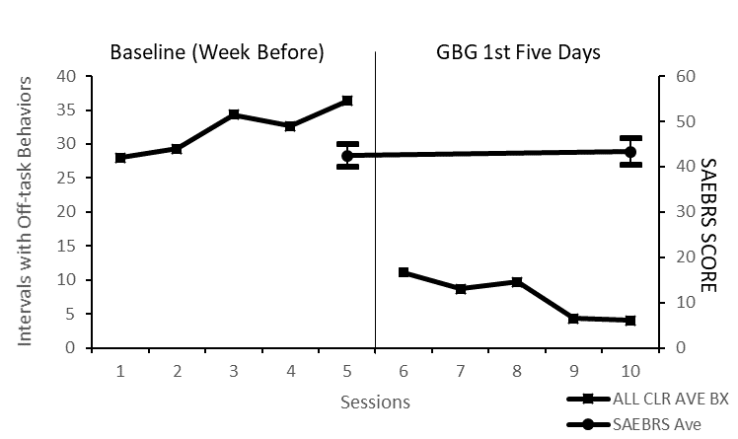
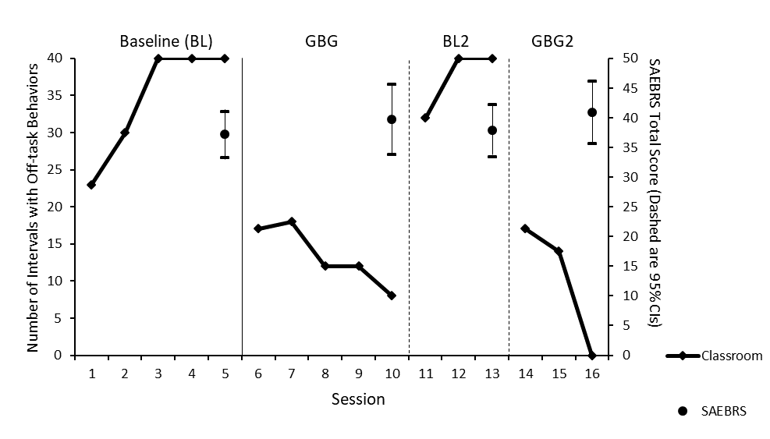

Slide 14
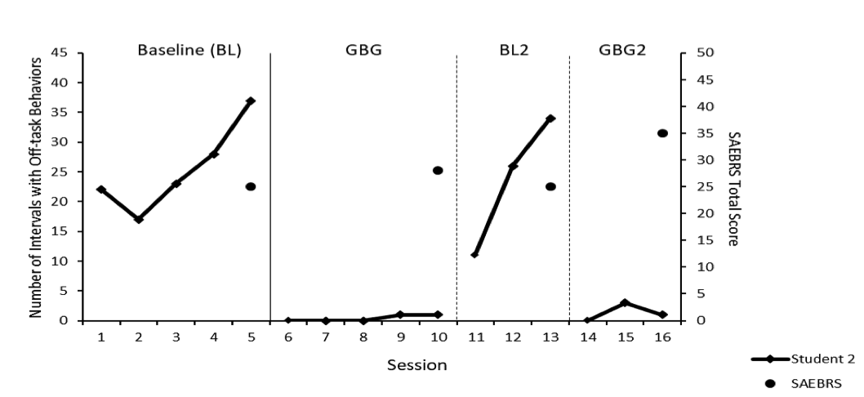
Notes:
By being selective with our schools and utilizing our screening data, but most importantly, by maintaining the ongoing relationship, everyone is comfortable enough to have real conversations about what is working and what is not working and led to our ability to establish nuanced procedures that are mutually beneficial for schools and research

Slide 15
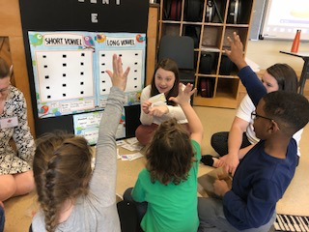
“Education is about making connections to real-life experiences. TopPrep has done that for me. This program has taken everything I’ve learned throughout my education courses and given it life. Combining typical instruction and hands-on practice in classrooms has impacted my journey in ways I do not even know yet.” - Lauren

Slide 16
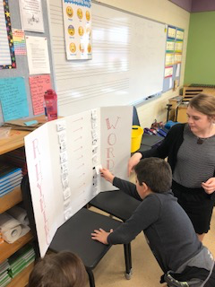
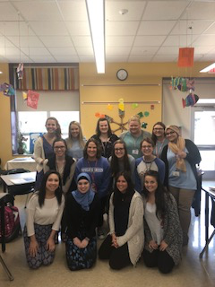

Slide 17
Questions/Information
Christina Noel- christina.noel@wku.edu

