Slide 1
Translating Flipped Classroom Design Principles: Learning Spaces and Active Learning in Action
Jeffrey L. Hieb
Associate Professor, Department of Engineering Fundamentals
TILL Faculty Fellow
Notes:
Introduce yourself
Started experimenting with flipped classroom in 2011
Just finished teaching Calc I, II and III, successfully ????, for the last two years.
Not an expert
Have made every mistake you can make, hope to help you avoid some mistakes.

Slide 2
Afternoon Concurrent Session
The Flipped Classroom Experience
Presenters: Jason Zahrndt, Digital Media Consultant, Delphi Center for Teaching and Learning and Digital Media Suite, Ekstrom Library, and Ray Chastain, Faculty Member, Physics and Astronomy
During this session, you will experience the technologies and activities of a flipped classroom. Learn how the flipped classroom structure can create opportunities for learning and engagement both inside and outside your classroom walls. Through activities and discussion, discover how you can incorporate flipped classroom techniques into your classroom.

Slide 3
Learning Objectives
Interpret flipped classroom design through the lens of the revised community of inquiry (RCOI) framework.
Summarize flipped classroom design principles
Apply design principles to the development of a flipped class
Notes:
Before I start.
Thanks for coming.
Poll for description of a flipped class.

Slide 4
Think Pair Share
Think-pair-share (TPS) is a collaborative learning strategy where students work together to solve a problem or answer a question about an assigned reading. This strategy requires students to (1) think individually about a topic or answer to a question; and (2) share ideas with classmates. Discussing with a partner maximizes participation, focuses attention and engages students in comprehending the reading material.
TPS Question: What is a flipped classroom?

Slide 5
A Model For Flipped Classroom Instruction
Traditional Class
Time
Homework from previous class
First exposure via lecture
Deeper
understanding via homework
Class
Flipped Class
Time
Some homework still and prep for the next class
First exposure via video (or readings)
Deeper learning via activities
Class
Notes:
What is often missed, is that the flipped classroom model is an instructional design model, not a technique like think-pair-share.
That is at least part of the reason.
The easiest way to understand the flipped classroom model of instruction is to compare it a more traditional model (animation 1) The model I am presenting here is taken from the Flipped classroom Field guide and credit Is given there to Derek Bruff. Though I have seen it used in other presentations.
In the traditional class student’s first exposure to course content and ideas is during a class lecture.
Usually they are left to pursue the deeper learning on their own in the assigned homework. Maybe this is group work, or other assignments, but usually the instructor is not there.
In the flipped classroom model the first exposure is moved outside of class, usually video, increasingly video+, and the lecture is replaced with activities (homework) that facilitate deeper learning.
Students in a flipped class might still have a few homework problems,
I think this graphic does a good job of explaining The flipped classroom model of instruction, and it was one of the reasons that compelled me to embrace the technique.
Advocates of the flipped or inverted classroom model argue that this design model:
Enables faculty to have more and better opportunities to detect and correct errors in thinking,
Have higher quality interactions with individual or small groups of students.
Puts greater responsibility on students for learning, but empowers them with greater control
Helps establish the community of learners, with learners connected to the community, something we now know is part of how people learn.
There are also Challenges, time being one of the most important challenges.
Designing the class activities is another. Students are mostly open to the flipped class, or at least that is what many studies report, thought there are always a few students who do not like this approach.
CASE STUDY: Talbert Papers.

Slide 6
Flipped Classroom Landscape
Lots of variation in how instructors implement flipped classes
Aspects of the flipped class are not well defined
Usually involves a technology component
There have been mixed results
Student surveys are often used in evaluation
Many studies identify benefits that can be expected
Fewer provide rigorous, methodologically sound, evidence
Little discussion of the evolution of a flipped teaching
Notes:
Two Chemistry Teachers in Colorado, Jonathan Bergmann and Aaron Sams are often referred to as the pioneers of Flipped Learning. They recorded videos, pod casts at the time, for students who missed their classes (for valid reasons) in 2007.
Posted to the Youtube (when it was just getting started). In 2012 they wrote a book called Flip your classroom: Reach Every Student in every class everyday.
At the same time they started the flipped learning network
But there were earlier proponents who used inverted classroom rather than flipped.
While the flipped class model is reasonably well defined, there is a lot of variation in the implementation details.
Common definition , Use videos to move lecture out of class, and replace it with homework during class.
BROADER: Facilitates interaction between students and teachers.
Most people use videos, though some don’t. Some definition require video lecture. Increasingly the first exposure is both leverage and driving cutting edge educational technology.
More research is needed both to provide rigorous evidence of its efficacy and to understand the mechanism.
Degree of detail in published works varies.
INTERESTINGLY, OFTEN EVALUATIONS ARE OF THE FIRST TIME A FLIPPED CLASS IS DELIVERED.
This last item is of particular interest to me
Maybe I am just not that good, but flipping my class was hard and learning to flip took time and experience.
When I went to teach my first class, traditional, I had a lot of experience as a student in traditionally taught courses. When I went to flip may first class, I had no experience to draw on.
There are best practices (which I was somewhat aware of) to follow, but there is no substitution for experience.
Your students, your class, your university, those things matter.
That studies comparing flipped (first time) to lecture (experience) show better performance on learning measures than do the lectures indicates that there might be much more to this flipped class model of instruction.

Slide 7
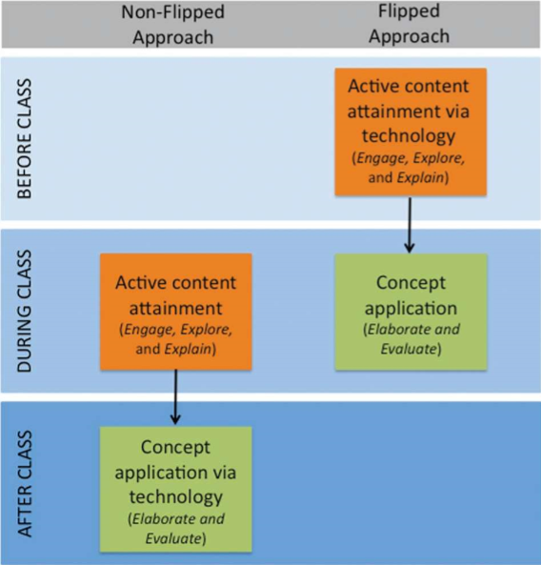
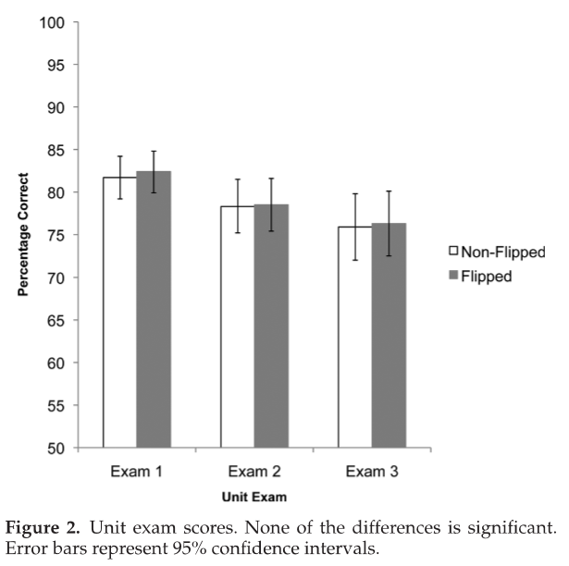
Jensen and Kummer (2015)
Jensen, J. L., Kummer, T. A., & Godoy, P. D. D. M. (2015). Improvements from a flipped classroom may simply be the fruits of active learning. CBE-Life Sciences Education, 14(1), ar5.
Notes:
No difference in Exam performance between flipped and non-flipped class when non-flipped class used active learning
Quasi-experimental design with two sections of the course being used as a control. Instructor facilitation was the main variable.
In the control, active learning was done during class during earlier part of the cycle. The same activities were used in the flipped but online and individual.
Only different was in attitudes. Flipped more negative attitude towards technology facilitated activities. But did feel activities had a more clear purpose for their learning.
In open-ended responses students in both section indicated that the active learning was what they most enjoyed about the class.

Slide 8
Design principles for flipped classrooms
Kim, M. K., Kim, S. M., Khera, O. & Getman, J. The experience of three flipped classrooms in an urban university: an exploration of design principles. Internet High. Educ. 22, 37–50 (2014).
Studied three flipped classes
Engineering
Sociology
Humanities
Used a mixed methods approach and factor analysis on RCOI
Developed 9 design principles for flipped classrooms
Notes:
Classes were all at USC.
Describe classes in a little more detail

Slide 9
Three flipped classes in the study.
 | Engineering | Social Studies | Humanities
Pedagogy | In-class problem solving | Project-Based Learning | Self-/co regulated discussion
Flipping approach | Flipping in-class lectures and quiz | Flipping in-class lectures and extended collaboration | Flipping the role of the instructor and students
In-Class Activities | Problem solving in small groups | Discussion of group projects for assigned time in classroom | The small group discussion without the presence of the instructor; recording a discussion.
Out-of-class Activities | Online video lecture; Quiz; comments on videos | Small group project via technologies | Instructor’s review of group discussion
Technology Used | YouTube, LMS (BB) | YouTube, LMS, Google Docs | Google Hangout, Video Cam, Dropbox
Notes:
Student Surveys: Uses scales for COI, adopted from others.
Student Interviews
Teacher reflections

Slide 10
RCOI: Revised Community of Inquiry
Shea, P. and T. Bidjerano (2010). "Learning presence: Towards a theory of self-efficacy, self-regulation, and the development of a communities of inquiry in online and blended learning environments." Computers & Education 55(4): 1721-1731.
Notes:
Factors that contribute to a successful learning environment.
Cognitive presence: Knowledge building involving critical and creative thinking
Social Presence: Encouraging collegial settings
Teaching Presence: Instructional orchestration appropriate to the learning environment
Learner Presence: Self- and co-regulation.
Added one other item.
Teaching Orientation is the classroom culture more teacher-oriented or student oriented
Survey students using established scales.

Slide 11
Relation Among Key Factors
Notes:
To examine the associations among the factors, correlation coefficient analyses were conducted on the factors from the survey.
Correlations greater than .5 are shown.
Teaching Orientation is the classroom culture more teacher-oriented or student oriented
Cognitive presence is at the center indicating that students are better engaged in higher-order thinking when the other domains are well developoed

Slide 12
Nine Design Principles and the RCOI Factors.
Notes:
This gives much more structure and guidance to the development of a flipped class.

Slide 13
ENTR 101: Foundations of Lemonade Stands in the U.S.
Course Description: Owner operator lemonade stands are the backbone of middle school aged student entrepreneurs. This course covers all aspects of starting and operating a lemonade stand in the US. International students are encouraged to take ENTR 102, Foundations of Lemonade Stands outside the US.
Topics
Stand Design and Construction
Advertising, Marketing and Customer Development
Quality assurance and Produce Innovation
Financing
Profit and loss statements
Human resources for successful Lemonade stand operators
Inventory Management
Notes:
Break up into groups, preferably 2 groups or 6 groups.
Take a few minutes and discuss teaching one or two class meetings of this course. Think only about learning objectives and content, not about how?
I have given you a starting place, but you can completely go nuts. Need to have some idea
Use

Slide 14
How to select the location for a profitable lemonade stands
Learning Objectives
Compare and contrast potential lemonade stand locations.
Rank a set of possible locations in terms of their potential as locations for a profitable lemonade stand.
List at least three critical factors in determining a profitable location for a lemonade stand.
For a given location, determine the relative weight of various factors in predicting the profitability of the location.
Describe potential trade-offs that may be required for a particular lemonade stand location.

Slide 15
Design a Lemonade Stand
Learning Objectives
Identify common lemonade stand construction materials and discuss their strengths and weaknesses.
Describe three or more frequently used lemonade stand designs
Identify and evaluate sources for construction materials in different situations
List three or more other factors that may influence lemonade stand design, explain how these factors impact on design.
For given construction materials and lemonade stand design, develop an estimate, with justification, of the cost and time to build the stand.

Slide 16
Set prices for a glass of lemonade
Learning Objectives
Given the price of bulk ingredients determine the direct costs for a single glass of lemonade
Given the price of bulk ingredients identify different price and sales figures required to achieve a desired net profit.
List and explain multiple factors that affect sales volume and discuss how relevant data can be collected and used to predict sales volume
For a given price of bulk ingredients and other situational information, select and justify a price per glass and total volume of lemonade to produce.

Slide 17
Activity: Design a flipped class or classes for ENTR-101 that engages Teaching Presence, Learner Presence, Social Presence and Cognitive Presence
Classroom for Group A
Classroom for Group B
Notes:
For a topic, a class meeting, you fit.

Slide 18
Learning Objectives
Interpret flipped classroom design through the lens of the revised community of inquiry (RCOI) framework.
Summarize flipped classroom design principles
Apply design principles to the development of a flipped class

Slide 19
Concluding Remarks
The flipped classroom is deceivingly easy to understand
The flipped classroom is an instructional design model
You can start by flipping a few classes but do more than one
You will want to create your own videos, but it may be that the best thing you can do is curate existing resources
Making sure your flipped class address Teaching Presence, Learner Presence, Cognitive Presence, and Social Presence can be a very useful both in designing the flipped class, and understanding when things don’t go well.

Slide 20
Thank You
Questions

