Slide 1
“5 HIGH IMPACT TEACHING PRACTICES”
Presentation by:
L. Dee Fink, Ph.D.
Educational Consultant in Higher Education
Author of: Creating Significant Learning Experiences
2018 Celebration of Teaching & Learning
University of Louisville
February 9, 2018

Slide 2
QUESTIONS I WILL TRY TO ANSWER:
What are “High Impact Teaching Practices”?
Why are they important?
Will they really make a difference?
What should I try to incorporate them into my teaching?

Slide 3
Origin of Idea of “High Impact Practices”
  2000: National Survey of Student Engagement (NSSE)
  “High Impact Educational Practices”
    First-Year Seminars
    Learning Communities
    Service Learning
    Undergraduate Research
    Capstone Courses and Projects

Slide 4
Two Basic Perspectives:
  Paradigm Shift: From “Teaching” to “Learning”
  Continuous Improvement

Slide 5
Basic Argument:
  If we want BIG IMPROVEMENTS
  in STUDENT LEARNING,
  We must make BIG IMPROVEMENTS in OUR TEACHING!

Slide 6
Getting Better Over Time
A
Quality of Teaching
B
When You
Began Teaching
NOW
Near Future

Slide 7
GOOD NEWS:
LOTS OF BOOKS WITH POWERFUL
IDEAS ON TEACHING & LEARNING

Slide 8
“New” Ideas on Teaching in Higher Education:
  How students learn
  Learning-centered teaching
  Designing learning experiences
  Identifying what students might learn
  Using active learning
  Using small groups
  Assessing student learning
  Motivating and enabling students to learn
  Using powerful teaching strategies
  Teaching large classes
  Using instructional technology
  Evaluating teaching
  Reflecting on your work as a student [teacher]

Slide 9
“5 HIGH IMPACT TEACHING PRACTICES”
  Change Students’ View of Learning
  Learning-Centered Course Design
  Team-Based Learning
  Engage Students in Service – With Reflection
  Be a Leader with Your Students

Slide 10
“5 HIGH IMPACT TEACHING PRACTICES”
  Change Students’ View of Learning

Slide 11
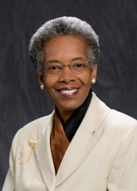
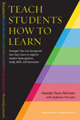
Saundra McGuire: Using ‘METACOGNITION’ to Help Students Learn How to Learn

Slide 12
Students’ Big Needs:
Change their views about “Intelligence”
Change the way they study, i.e., what they do when they try to learn something

Slide 13
Students’ Big Needs:
Change their views about “Intelligence”

Slide 14
Counting Vowels in 45 seconds
How accurate are you?
Count all of the vowels
in the words on the next slide.

Slide 15
Dollar Bill
Dice
Tricycle
Four-leaf Clover
Hand
Six-Pack
Seven-Up
Octopus
Cat Lives
Bowling Pins
Football Team
Dozen Eggs
Unlucky Friday
Valentine’s Day
Quarter Hour

Slide 16

How many items in the list do you remember?
2 or less
3 – 5
6 – 8
9 – 12
13 or more

Slide 17
Dollar Bill
Dice
Tricycle
Four-leaf Clover
Hand
Six-Pack
Seven-Up
Octopus
Cat Lives
Bowling Pins
Football Team
Dozen Eggs
Unlucky Friday
Valentine’s Day
Quarter Hour

Slide 18
NOW how many words or phrases do you remember?
2 or less
3 – 5
6 – 8
9 – 12
13 or more

Slide 19
What were two major differences between the 1st and 2nd attempts?

Slide 20
1. We knew what the task was
2. We knew how the information was organized

Slide 21

The Study Cycle
4
Reflect
3
Review
Preview
Preview before class – Skim the chapter, note headings and boldface words, review summaries and chapter objectives, and come up with questions you’d like the lecture to answer for you.
4
Reflect
Attend
Attend class – GO TO CLASS! Answer and ask questions and take meaningful notes.
Review after class – As soon after class as possible, read notes, fill in gaps and note any questions.
Review
Study – Repetition is the key. Ask questions such as ‘why’, ‘how’, and ‘what if’.
Intense Study Sessions* - 3-5 short study sessions per day
Weekend Review – Read notes and material from the week to make connections
Study
Assess your Learning – Periodically perform reality checks
Am I using study methods that are effective?
Do I understand the material enough to teach it to others?
Assess
*Intense Study Sessions
1 | Set a Goal | (1-2 min) | Decide what you want to accomplish in your study session
2 | Study with Focus | (30-50 min) | Interact with material- organize, concept map, summarize, process, re-read, fill-in notes, reflect, etc.
3 | Reward Yourself | (10-15 min) | Take a break– call a friend, play a short game, get a snack
4 | Review | (5 min) | Go over what you just studied
Center for Academic Success
B-31 Coates Hall ▪ 225.578.2872 ▪www.cas.lsu.edu

Slide 22
Average Exam Scores from 3 Courses
General Chemistry I - East Tennessee Tech
Class sizes: 70-90 students
Fall 2011:
  Teacher offered 50-minute intervention after 1st Exam
  After that, reminded students to use their new learning strategies
Question: How did exam scores compare to earlier years?

Slide 23
Average Exam Scores from 3 Courses
General Chemistry I - East Tennessee Tech
Class sizes: 70-90 students
Fall 2011:
  Teacher offered 50-minute intervention after 1st Exam
  After that, reminded students to use their new learning strategies
Question: How did exam scores compare to earlier years?

Slide 24
Average Exam Scores from 3 Courses
General Chemistry I - East Tennessee Tech
Class sizes: 70-90 students
Fall 2011:
  Teacher offered 50-minute intervention after 1st Exam
  After that, reminded students to use their new learning strategies
Question: How did exam scores compare to earlier years?

Slide 25
The Story of Three LSU Students
Travis, junior psychology student
47, 52, 82, 86 B in course
Joshua, first year chemistry student*
68, 50, 50, 87, 87, 97, 90 (final) A in course
Dana, first year physics student
80, 54, 91, 97, 90 (final) A in course
*2010 Summer Scholar

Slide 26
“5 HIGH IMPACT TEACHING PRACTICES”
  Change Students’ View of Learning
  Learning-Centered Course Design

Slide 27
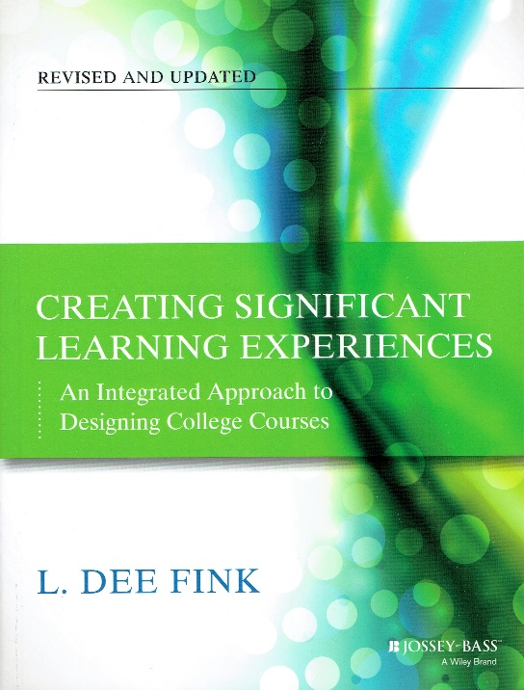
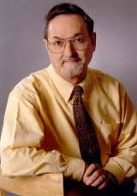
“Learning-Centered Course Design”

Slide 28
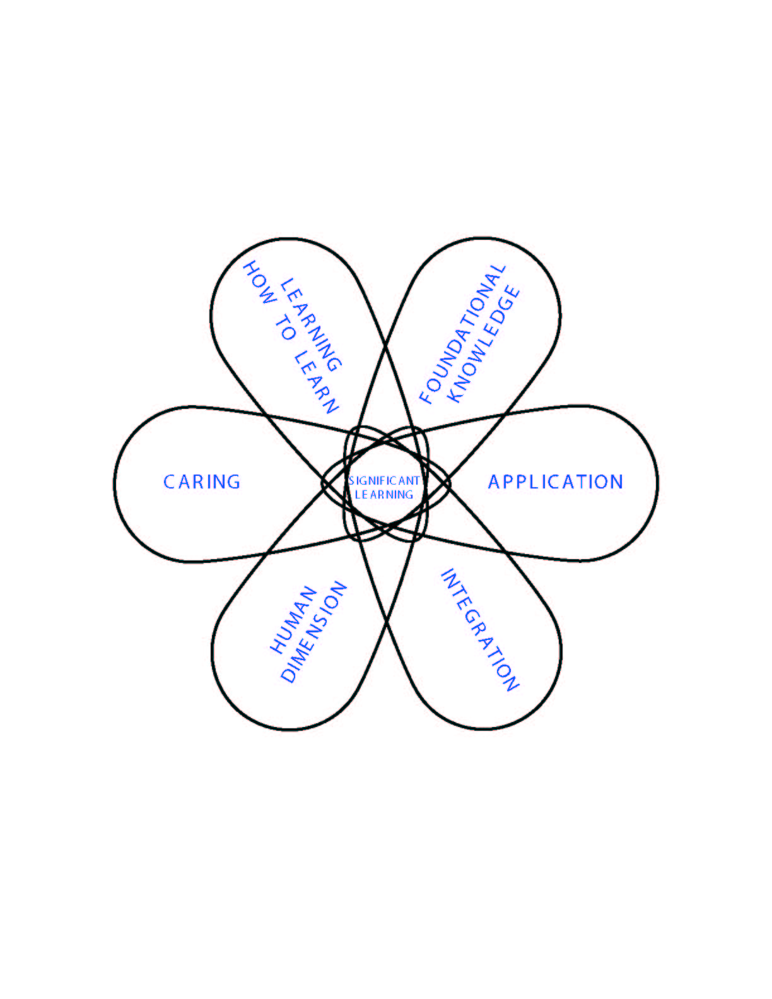
Taxonomy of Significant Learning

Slide 29
Taxonomy of Significant Learning
Learning HOW to Learn
Becoming a better student
Inquiring about a subject
Self-directing learners
Foundational Knowledge
Understanding and
remembering:
  Information
  Ideas
Application
Skills
Thinking: Critical, Creative, & Practical
Managing projects
Caring
Developing new…
  Feelings
  Interests
  Values
Integration
Connecting:
  Ideas
  Bodies of Knowledge
  Realms of life
Human Dimensions
Learning about:
  Oneself
  Others
Notes:
29

Slide 30
In a course with significant learning, students will:
Understand and remember the key concepts, terms, relationship, etc.
Know how to use the content.
Be able to relate this subject to other subjects.
Understand the personal and social implications of knowing about this subject.
Value this subject and further learning about it.
Know how to keep on learning about this subject, after the course is over.

Slide 31
INTEGRATED COURSE DESIGN:
Key Components
Learning Goals
Teaching &
Learning
Activities
Feedback & Assessment
S i t u a t i o n a l F a c t o r s

Slide 32
3-COLUMN TABLE:
Learning Outcomes: Assessment Activities: Learning Activities:
1. Found. Know.
2. Application
3. Integration
4. Human Dim.: Self, Others
5. Caring
6. Learning How to Learn

Slide 33
3-COLUMN TABLE:
Learning Outcomes: Assessment Activities: Learning Activities:
1. Found. Know.
2. Application
3. Integration
4. Human Dim. Self, Others
5. Caring
6. Learning How to Learn

Slide 34
3-COLUMN TABLE:
Learning Outcomes: Assessment Activities: Learning Activities:
1. Found. Know. | Multiple-choice tests
2. Application | Case studies
3. Integration | Essays, focused on Integration
4. Human Dim. Self, Others | Reflective essays
5. Caring | Statements of preferences
6. Learning How to Learn | Learning portfolios

Slide 35
3-COLUMN TABLE:
Learning Outcomes: Assessment Activities: Learning Activities:
1. Found. Know. | Multiple-choice tests
2. Application | Case studies
3. Integration | Essays, focused on Integration
4. Human Dim. Self, Others | Reflective essays
5. Caring | Statements of preferences
6. Learning How to Learn | Learning portfolios

Slide 36
3-COLUMN TABLE:
Learning Outcomes: Assessment Activities: Learning Activities:
1. Found. Know. | Multiple-choice tests | Reading
2. Application | Case studies | In-class problem solving, with fdbk.
3. Integration | Essays, focused on Integration | Discussion (small group?)
4. Human Dim.: Self, Others | Reflective essays | Reflections, essays
5. Caring | Statements of preferences | Community projects
6. Learning How to Learn | Learning portfolios | Project: learn something new

Slide 37
Criteria of “GOOD” Course Design
Significant
Learning
Learning Goals
Integrate
Teaching and
Learning
Activities
Feedback &
Assessment
Active
Learning
Educative
Assessment
S I T U A T I O N A L F A C T O R S
In-Depth Situational Analysis

Slide 38
Learning IMAGINED
- - - - -> - - - - -> - - -> Learning ACHIEVED
Learning Goals
Xxx
Xxx
Xxx
Xxx
Xxx
xxx
1
4
Week: | Mon | Wed | Fri
1
2
3
4
5
6
7
8
9
10
11
12
13
14
15
5
2
Learning Goals | Ass’m’t Activ. | LearningActiv.
Xxx
2. Xxx
3. Xxx
4. Xxx
5. Xxx
6. Xxx
3
3-Column Table
Weekly Schedule

Slide 39
2009: “New Directions for Teaching & Learning”
Issue #119: “Designing Courses for Significant Learning: Voices of Experience”
    Accounting
    Spanish
    Economics
    Music Analysis
    Multiple courses at one university
    Special Education (2)
    Philosophy and Art History
    Biology
    Engineering
    College Teaching

Slide 40
QUESTIONS or COMMENTS about…
  Helping students “Learn How to Learn”??
  Learning-centered course design??

Slide 41
“5 HIGH IMPACT TEACHING PRACTICES”
  Change Students’ View of Learning
  Learning-Centered Course Design
  Team-Based Learning

Slide 42
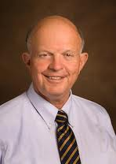

“Team-Based Learning:
A Special Way of Using Small Groups”
Larry Michaelsen

Slide 43
OBSERVATION:
Many teachers are using small groups these days.
QUESTIONS:
How many of you are using small groups in an intentional way?
What are your biggest concerns?

Slide 44
QUESTION:
Many teachers are using small groups these days. WHY?
ANSWER:
Social Constructivism
But: Not all ways of using small groups are equally good.

Slide 45
The Sequence of Learning Activities in Team-Based Learning
Covering a 2-3 week block of time
Dealing with one major topic within the course
Three Phases of Team Learning:
Preparation
Application (Practice with Feedback)
Assessment
Activities:
R.A.P.:
CULMINATING PROJECT
EXAM: Individual or Group
1. Individual test
(Continue
2. Team test
Group Work
Group Work
pattern as long
In-Class:
3. Appeals
(Simple)
(Complex)
as desired)
4. Corrective
Instruction
Out-of-Class:
Reading
Homework
Homework
Review
Approximate Level of Content Understanding at Each Phase:
40%
)
50%
)
60%
)
70%
)
80%
)
90-100%
)

Slide 46
TBL: What It IS and What it ISN’T
  ≠ Weekly RATs all semester long
  ≠ Just a Group RAT
  ≠ Graded group work without Peer Evaluation
  Permanent, intentionally-formed groups
  Individual & Group RAT’s
  = In-Class, SG Application Exercises
  Graded Group Assignments
  Peer Evaluation

Slide 47
KEY INSIGHTS:
  Difference between “groups” and “teams”
  Importance of right kind of…
    Assignments
    Feedback

Slide 48
Question:
What do professors and students think about TBL?
Video from Duke University:
http://www.youtube.com/watch?v=WFdVfycAWg4

Slide 49
“5 HIGH IMPACT TEACHING PRACTICES”
  Change Students’ View of Learning
  Learning-Centered Course Design
  Team-Based Learning
  Engage Students in Service – With Reflection

Slide 50
Engage Students in Service:
“Service Learning”, “Civic Engagement”:
What does that mean?
Courses or co-curricular actions are linked to SERVICE to a community group or organization.
> Service
= Service + Link to Course
+ Reflection

Slide 51
Service + REFLECTIONS:
Reflect on:
  what they experienced
  The possible impact of those experiences on “My understanding of…
The SUBJECT of this course; this discipline
ORGANIZATIONS – the impact of their: organizational structure, communication patterns, vision, implementation strategy, etc.
OTHER PEOPLE – their background, their situation, their feelings, their values, their behavior, how to best interact with them, etc.
MYSELF – my beliefs, values, life goals, career choices – How have these changed? How need to change?

Slide 52
Engage Students in Service:
Service + REFLECTIONS:
These Reflections can occur in the form of:
  One-minute papers
  Learning journals
  Learning portfolios

Slide 53
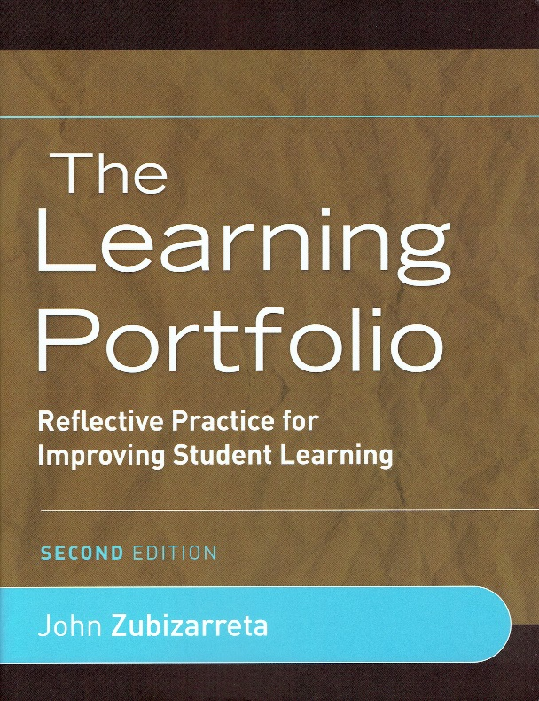
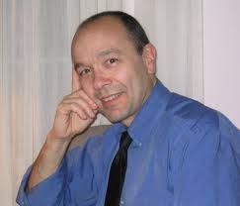
“Students Reflecting on Their Own Learning”
John Zubizarreta

Slide 54
“TAKING CHARGE OF ONE’S OWN LEARNING”
St1
St2
Teacher/Coach

Slide 55
?
Meta-Learner:
St1
St2
Teacher/Coach

Slide 56
?
Meta-Learner:
One Who Takes Charge of their…
Own Learning/
Development
St1
St2
Teacher/Coach
Own Knowing/Beliefs
Own Thinking
Own Performance
Own Caring/Values

Slide 57
Learning Portfolios: KEY QUESTIONS
WHAT did you learn?
HOW did you learn?
  What helped and didn’t help you learn?
  What does this tell you about: YOURSELF AS A LEARNER? About the NATURE OF LEARNING?
SIGNIFICANCE FOR YOU, of what you learned?
Plan for FUTURE LEARNING:
  WHAT ELSE do you want or plan to learn?
  HOW will you learn that?

Slide 58
The Sequence of…
Rich Learning Experiences + Reflection
= POWERFUL Learning Experience

Slide 59
“5 HIGH IMPACT TEACHING PRACTICES”
  Change Students’ View of Learning
  Learning-Centered Course Design
  Team-Based Learning
  Engage Students in Service – With Reflection
  Be a Leader with Your Students

Slide 60
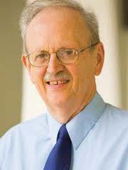

“Be a Leader With Your Students”
Ken Bain

Slide 61
FUNDAMENTAL TASKS OF TEACHING
Knowledge of the Subject Matter
Interact with Students
Designing Learning Experiences
Managing the Course
Beginning of the Course

Slide 62
FUNDAMENTAL TASKS OF TEACHING
Knowledge of the Subject Matter
Interact with Students
Designing Learning Experiences
Managing the Course
Beginning of the Course

Slide 63
LEADERSHIP:
“Motivating and enabling others to do something important well.”
Question:
What can teachers do, to LEAD students?
General Answer:
Create the right kind of RELATIONSHIP with students – one that is…
  caring
  respectful
  collaborative

Slide 64
Creating the Right RELATIONSHIP with Students: (Based on Bain)
Interact in a way that shows YOU CARE!
Interact in a way that MOTIVATES students.
Dynamic COMMUNICATION SKILLS
TRUSTWORTHY – in Power:Trust issues

Slide 65
Creating the Right RELATIONSHIP with Students:
Interact in a way that shows YOU CARE!
    about students,
    student learning,
    teaching-learning process,
    about the subject of the course

Slide 66
Creating the Right RELATIONSHIP with Students:
2. Interact in a way that MOTIVATES students.
  Give praise in a way that motivates
  Listen well to the learners
  Motivate by interacting differently with different students

Slide 67
Creating the Right RELATIONSHIP
with Students: (Based on Bain)
Dynamic COMMUNICATION SKILLS
    Sense of drama, rhythm
    Good use of language
      Use language of “promises” > “demands”
      Express belief in students’ ability to learn
      Celebrate achievements
      Use warm language

Slide 68
Creating the Right RELATIONSHIP
with Students:
4. TRUSTWORTHY – in Power:Trust issues
    Don’t use classroom to demonstrate power.
    Build trust relationships
    Give power to students to make decisions about their own learning
    Interact fairly (same policies for all)

Slide 69
Creating the Right RELATIONSHIP with Students:
Interact in a way that shows YOU CARE!
Interact in a way that MOTIVATES students.
Dynamic COMMUNICATION SKILLS
TRUSTWORTHY – in Power:Trust issues

Slide 70
“5 HIGH IMPACT TEACHING PRACTICES”
  Change Students’ View of Learning
  Learning-Centered Course Design
  Team-Based Learning
  Engage Students in Service – With Reflection
  Be a Leader with Your Students

Slide 71
QUESTIONS or COMMENTS about…
  Team-Based Learning??
  Service Learning + Reflection??
  Being a Leader with your students

Slide 72
SUMMARY

Slide 73
Outside individuals, groups
1. Learning –Centered Design of Learning Experiences
3. Focused small-group dialogue
4. Service Learning Opportunities
S
Learn How to Learn
S
S
L-PF:
S
S
Teacher
Re-Orienting Students’ Views of Learning:
Start
5. Leadership
- LEARNING PORTFOLIOS

Slide 74
BENEFITS TO…
  Your Students
  Society
  Your Institution
  Yourselves

Slide 75
Getting Better Over Time
WOW!!
Quality of Teaching
When You
Began Teaching
NOW
Near Future

Slide 76
THE END!
??
Higher Education:
Let’s make it all that it can be and needs to be!

Slide 77
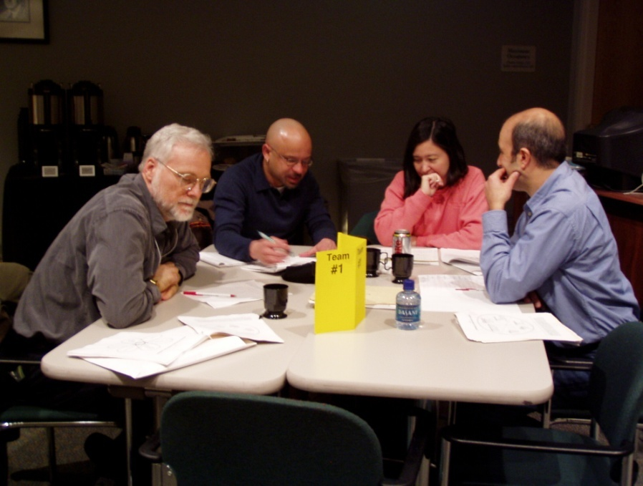
OR, A NEW START??
Teaching for the 21st Century . . .
        Let’s Get Started!!

