Slide 1
“5 HIGH IMPACT TEACHING PRACTICES”
Presentation by:
L. Dee Fink, Ph.D.
Educational Consultant in Higher Education
Author of: Creating Significant Learning Experiences
University of Louisville
Health Sciences Campus
February 8, 2018

Slide 2
Neither I nor members of my family have financial and/or commercial interest to disclose relating to the content of this presentation.

Slide 3
Your Situation at UofL HSC: 2 Questions
All of you want to be good medical educators.
Ultimate Goal: Help your students…
  Learn well
  Complete their health professions training
  Become competent health care providers and leaders within the profession
Your Professional Responsibility:
  “How can I support these goals, in my own courses?”
A Personal Question: “Your Life as a Teacher”
  What also makes [or would make] teaching your courses fulfilling – for you?

Slide 4
Your Situation
Questions now:
What can you do, in your own courses, to:
  Help your students learn well?
  Play your role in helping your health professions school fulfill its obligations?
  Teach in a way that will be fulfilling to you (as well as to your students)?

Slide 5
Two Basic Perspectives:
  Paradigm Shift: From “Teaching” to “Learning”
  Continuous Improvement

Slide 6
Basic Argument:
  If we want BIG IMPROVEMENTS
    in STUDENT LEARNING,…
  We must make BIG IMPROVEMENTS in OUR TEACHING!

Slide 7
Getting Better Over Time
A
Quality of Teaching
B
When You
Began Teaching
NOW
Near Future

Slide 8
GOOD NEWS:
LOTS OF BOOKS WITH POWERFUL
IDEAS ON TEACHING & LEARNING

Slide 9
“New” Ideas, Best Practices in Teaching (Hi. Educ.):
  How students learn
  Learning-centered teaching
  Designing learning experiences
  Identifying what students might learn
  Using active learning
  Using small groups
  Assessing student learning
  Motivating and enabling students to learn
  Using powerful teaching strategies
  Teaching large classes
  Using instructional technology
  Evaluating teaching
  Reflecting on your work as a student [teacher]

Slide 10
“5 HIGH IMPACT TEACHING PRACTICES”
  Learning-Centered Course Design
  Team-Based Learning
  Help Students Become Self-Directing Learners
  Engage Students in Service Learning
  Be a Leader with Your Students

Slide 11
“5 HIGH IMPACT TEACHING PRACTICES”
  Learning-Centered Course Design

Slide 12
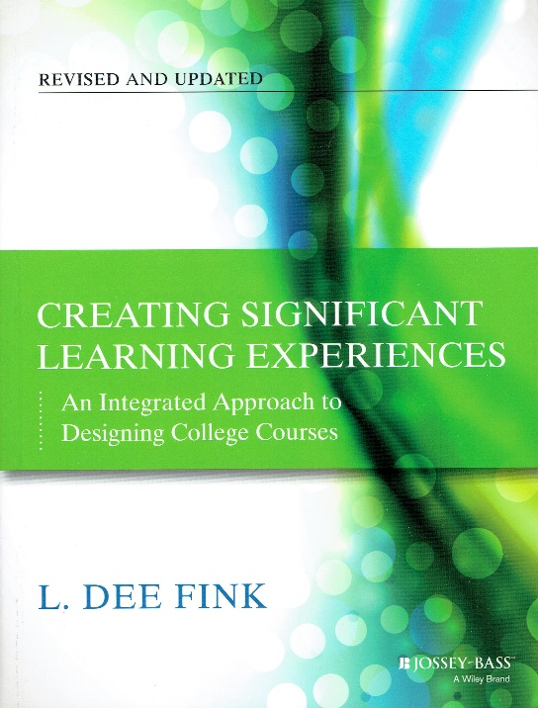
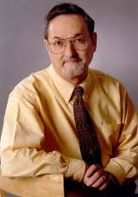
“Learning-Centered Course Design”

Slide 13
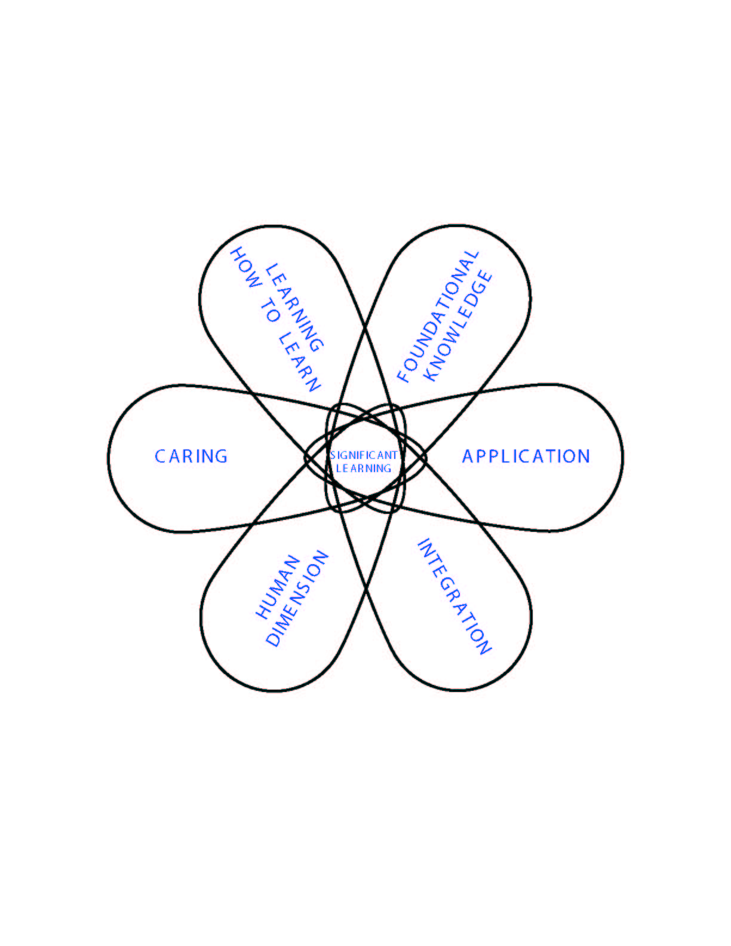
Taxonomy of Significant Learning

Slide 14
Taxonomy of Significant Learning
Learning HOW to Learn
Becoming a better student
Inquiring about a subject
Self-directing learners
Foundational Knowledge
Understanding and
remembering:
  Information
  Ideas
Application
Skills
Thinking: Critical, Creative, & Practical
Managing projects
Caring
Developing new…
  Feelings
  Interests
  Values
Integration
Connecting:
  Ideas
  Bodies of Knowledge
  Realms of life
Human Dimensions
Learning about:
  Oneself
  Others

Slide 15
In a course with significant learning, students will…:
Understand and remember the key concepts, terms, relationship, etc.
Know how to use the content.
Be able to relate this subject to other subjects.
Understand the personal and social implications of knowing about this subject.
Value this subject and further learning about it.
Know how to keep on learning about this subject, after the course is over.

Slide 16
Current LCME Curricular Content (Std. 7)
Fink’s Taxonomy: LCME Curric. Content:
Foundational Knowledge
Application
Integration
Human Dimension: A. Learning About One-Self
Human Dimension: B. Interacting with Others
Caring, Valuing
Learning How to Learn

Slide 17
Current LCME Curricular Content (Std. 7)
Fink’s Taxonomy: LCME Curric. Content:
Foundational Knowledge | Biomedical, Beh., & Soc. Sci.
Application | Diagnosis & Treatment Critical Judgment, Prob.-Solv. Skills Communication Skills
Integration | Soc. Problems with Medic. Conseq.
Human Dimension: A. Learning About ONE-SELF | Personal Biases
Human Dimension: B. Interacting with OTHERS | Cultural Competency Health Care Disparities Interpersonal Collaboration Skills
Caring, Valuing | Medical Ethics
Learning How to Learn | Scientific Methods, Research

Slide 18
Current ACGME Core Competencies
Fink’s Taxonomy: ACGME Competencies:
Foundational Knowledge
Application
Integration
Human Dimension: Interacting with Others
Human Dimension: Learning about One-Self Learning How to Learn
Caring, Values

Slide 19
Current ACGME Core Competencies
Fink’s Taxonomy: ACGME Competencies:
Foundational Knowledge | Medical Knowledge
Application | 2. Patient Care
Integration | 3. Systems Based Practice
Human Dimension: Interacting with OTHERS | 4. Interpersonal and Communication Skills
Human Dimension: Learning about ONE-SELF Learning How to Learn | Practice-Based Learning & Improvement Constant self-evaluation Life-long learning
Caring, Values | 6. Professionalism

Slide 20
Curricular Learning Objectives for Medical School:
Foundational Knowledge – Medical Knowledge
  Understand fundamental bio-medical concepts, terms, processes, and system interactions
  Understand determinants of health
  Understand the process of evidence-based medicine
Application – Patient Care, Clinical Skills
  Conduct patient interviews and physical examinations
  Diagnose patient health problems
Propose evidence-based therapeutic treatments
3. Integration – Systems-Based Practice
  Connect knowledge of patient populations and health delivery processes in making diagnoses and therapeutic recommendations
  Advocate for the humane, just, and prudent care of persons
Adapt to the complex economic and social structure of health care delivery

Slide 21
4. Human Dimension - Interpersonal Skills and Communication, Personal Growth and Professional Development, and Inter-professional Collaboration
  Learning about and developing: ONESELF
    Reflect upon one’s personal strengths & weaknesses to make changes in one’s behavior
    Find one’s own meaning in medicine
  Learning about and interacting with: OTHERS
  Deliver effective patient presentation and document in the medical record
  Communicate and work effectively with others, e.g., patients, families, health care team members, peers
Demonstrate appropriate leadership skills in a variety of settings

Slide 22
CARING/VALUING – Professionalism
  Care deeply about becoming an excellent physician
Value and behave in a manner consistent with the highest ethical standards of the profession
LEARNING HOW TO LEARN – Practice-Based Learning
  Develop a personal plan to become a better medical professional
  Nurture intellectual curiosity to question and advance knowledge through scholarship
            -Boonshoft School of Medicine
            Wright State University
            Dayton, Ohio, USA

Slide 23
INTEGRATED COURSE DESIGN:
Key Components
Learning Goals
Teaching &
Learning
Activities
Feedback & Assessment
S i t u a t i o n a l F a c t o r s

Slide 24
3-COLUMN TABLE:
Learning Outcomes: Assessment Activities: Learning Activities:
1. Found. Know.
2. Application
3. Integration
4. Human Dim.: Self, Others
5. Caring
6. Learning How to Learn

Slide 25
3-COLUMN TABLE:
Learning Outcomes: Assessment Activities: Learning Activities:
1. Found. Know.
2. Application
3. Integration
4. Human Dim. Self, Others
5. Caring
6. Learning How to Learn

Slide 26
3-COLUMN TABLE:
Learning Outcomes: Assessment Activities: Learning Activities:
1. Found. Know. | Multiple-choice tests
2. Application | Case studies
3. Integration | Essays, focused on Integration
4. Human Dim. Self, Others | Reflective essays
5. Caring | Statements of preferences
6. Learning How to Learn | Learning portfolios

Slide 27
3-COLUMN TABLE:
Learning Outcomes: Assessment Activities: Learning Activities:
1. Found. Know. | Multiple-choice tests
2. Application | Case studies
3. Integration | Essays, focused on Integration
4. Human Dim. Self, Others | Reflective essays
5. Caring | Statements of preferences
6. Learning How to Learn | Learning portfolios

Slide 28
3-COLUMN TABLE:
Learning Outcomes: Assessment Activities: Learning Activities:
1. Found. Know. | Multiple-choice tests | Reading
2. Application | Case studies | In-class problem solving, with fdbk.
3. Integration | Essays, focused on Integration | Discussion (small group?)
4. Human Dim.: Self, Others | Reflective essays | Reflections, essays
5. Caring | Statements of preferences | Community projects
6. Learning How to Learn | Learning portfolios | Project: learn something new

Slide 29
Criteria of “GOOD” Course Design
Significant
Learning
Learning Outcomes
Integration
Teaching and
Learning
Activities
Feedback &
Assessment
Active
Learning
Educative
Assessment
S I T U A T I O N A L F A C T O R S
In-Depth Situational Analysis

Slide 30
Learning IMAGINED
- - - - - -> - - - - - -> - - - - - -> Learning ACHIEVED
Big Dream → Culminating Project
1
5
Learning Outcomes
Xxx
Xxx
Xxx
Xxx
Xxx
xxx
Week: | Mon | Wed | Fri
1
2
3
4
5
6
7
8
9
10
11
12
13
14
15
2
6
3
Learning Outcomes | Ass’m’t Activ. | Learning Activ.
Xxx
2. Xxx
3. Xxx
4. Xxx
5. Xxx
6. Xxx
4
3-Column Table
Weekly Schedule

Slide 31
“5 HIGH IMPACT TEACHING PRACTICES”
  Learning-Centered Course Design
  Team-Based Learning

Slide 32
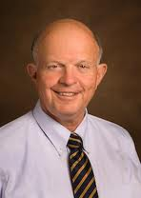
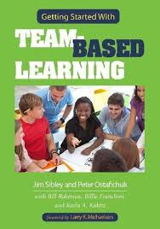
“Team-Based Learning:
A Special Way of Using Small Groups”
Larry Michaelsen

Slide 33
QUESTION:
Many teachers are using small groups these days. WHY?
ANSWER:
Social Constructivism
But: Not all ways of using small groups are equally good.

Slide 34
The Sequence of Learning Activities in Team-Based Learning
Covering a 2-3 week block of time
Dealing with one major topic within the course
Three Phases of Team Learning:
Preparation
Application (Practice with Feedback)
Assessment
Activities:
R.A.P.:
CULMINATING PROJECT
EXAM: Individual or Group
1. Individual test
(Continue
2. Team test
Group Work
Group Work
pattern as long
In-Class:
3. Appeals
(Simple)
(Complex)
as desired)
4. Corrective
Instruction
Out-of-Class:
Reading
Homework
Homework
Review
Approximate Level of Content Understanding at Each Phase:
40%
)
50%
)
60%
)
70%
)
80%
)
90-100%
)

Slide 35
TBL: What It IS and What it ISN’T
  ≠ Weekly RATs all semester long
  ≠ Just a Group RAT
  ≠ Graded group work without Peer Evaluation
  Permanent, intentionally-formed groups
  Individual & Group RAT’s
  = In-Class, SG Application Exercises
  Graded Group Assignments
  Peer Evaluation

Slide 36
KEY INSIGHTS:
  Difference between “groups” and “teams”
  Importance of right kind of…
    Assignments
    Feedback

Slide 37
Question:
What do professors and students think about TBL?
Video from Duke University:
http://www.youtube.com/watch?v=WFdVfycAWg4

Slide 38
Student Reaction
  Comments from a student in a course using TBL
  Course: “Preparing for College-Level Teaching” – for graduate students in Engineering and the Sciences

Slide 39
1. NEED
  “An engineering professional is almost always a part of a team. Engineering projects of any significant size are simply too much work or too much responsibility for one person to handle.”

Slide 40
1. NEED
2. RESULTS
  “[Students] learn the material better, which is the obvious reason for using TBL.
  “But there are so many other positives that emerge from the process, namely:
      social, writing, speaking, presenting and thinking skills all get improved during TBL.
      Students can learn more about scheduling, time management, working with difficult people, and organizing collective work through TBL.”

Slide 41
1. NEED
RESULTS
IMPLICATIONS
  “Without at least some TBL in their curriculum, they are significantly under-prepared for what is waiting for them in industry.”

Slide 42
“5 HIGH IMPACT TEACHING PRACTICES”
  Learning-Centered Course Design
  Team-Based Learning
  Help Students Become Self-Directing Learners

Slide 43
Engage Students in
REFLECTIVE Writing:
“We learn not from experience – but from reflecting on experience.”
      -Quote attributed to John Dewey

Slide 44
Engage Students in
REFLECTIVE Writing:
These Reflections can occur in the form of:
  One-minute papers
  Learning journals
  Learning portfolios

Slide 45
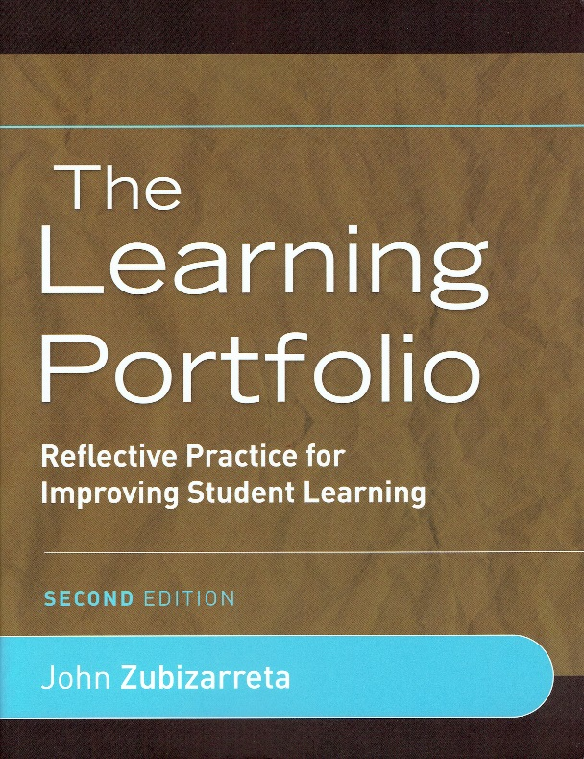
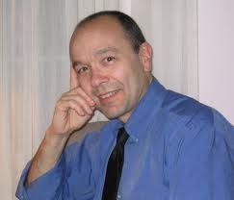
“Students Reflecting on Their Own Learning”
John Zubizarreta

Slide 46
St1
St2
Teacher/Coach

Slide 47
?
Meta-Learner:
St1
St2
Teacher/Coach

Slide 48
?
Meta-Learner:
One Who Takes Charge of their…
Own Learning/
Development
St1
St2
Teacher/Coach
Own Knowing/Beliefs
Own Thinking
Own Performance
Own Caring/Values

Slide 49
Learning Portfolios: KEY QUESTIONS
WHAT did you learn?
HOW did you learn?
  What helped and didn’t help you learn?
  What does this tell you about: YOURSELF AS A LEARNER? About the NATURE OF LEARNING?
SIGNIFICANCE FOR YOU, of what you learned?
Plan for FUTURE LEARNING:
  WHAT ELSE do you want or plan to learn?
  HOW will you learn that?

Slide 50
“5 HIGH IMPACT TEACHING PRACTICES”
  Learning-Centered Course Design
  Team-Based Learning
  Help Students Become Self-Directing Learners
  Engage Students in Service Learning

Slide 51
Engage Students in SERVICE:
“Service Learning”, “Civic Engagement”:
What does that mean?
Link courses [or curriculum] to activities in which students provide SERVICE to a community group or organization.
Possible Activities??

Slide 52
Service + REFLECTIONS:
Reflect on:
  What they experienced
  The possible impact of those experiences on “My understanding of…”
The SUBJECT of this course, discipline, and/or curriculum
OTHER PEOPLE – their background, their situation, their feelings, their behavior, etc.
ORGANIZATIONS – the impact of: organizational structure, communication patterns, vision, implementation strategy, etc.
Relationship of HEALTH PROFESSIONS to COMMUNITY WELFARE
MYSELF – my beliefs, values, actions, life goals, career choices – How these have changed or need to change?

Slide 53
Service Learning:
EXAMPLES at Louisville??
Review their CONTENT KNOWLEDGE?
Learn more about specific kinds of OTHER PEOPLE?
Learn how to assess and work within DIFFERENT ORGANIZATIONS?
Learn about the relationship of HEALTH CARE to COMMUNITY WELFARE?
Learn about THEMSELVES?

Slide 54
The Sequence of…
Rich Learning Experiences + Reflection
= POWERFUL Learning Experience

Slide 55
“5 HIGH IMPACT TEACHING PRACTICES”
  Learning-Centered Course Design
  Team-Based Learning
  Help Students Become Self-Directing Learners
  Engage Students in Service Learning
  Be a Leader with Your Students

Slide 56
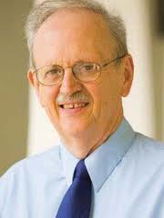

“Be a LEADER With Your Students”
Ken Bain

Slide 57
FUNDAMENTAL TASKS OF TEACHING
Knowledge of the Subject Matter
Interact with Students
Designing Learning Experiences
Managing the Course
Beginning of the Course

Slide 58
FUNDAMENTAL TASKS OF TEACHING
Knowledge of the Subject Matter
Interact with Students
Designing Learning Experiences
Managing the Course
Beginning of the Course

Slide 59
LEADERSHIP:
“Motivating and enabling others to do something important well.”
Question:
What can teachers do, to LEAD students?
General Answer:
Create the right kind of RELATIONSHIP with students – caring, respectful, collaborative

Slide 60
Creating the Right RELATIONSHIP with Students: (Based on Bain)
Interact in a way that shows YOU CARE!
Interact in a way that MOTIVATES students.
Dynamic COMMUNICATION SKILLS
TRUSTWORTHY – in Power:Trust issues

Slide 61
Creating the Right RELATIONSHIP with Students:
Interact in a way that shows YOU CARE!
    About…
      Students themselves,
      Their learning,
      The teaching-learning process,
      The subject of the course

Slide 62
Creating the Right RELATIONSHIP with Students:
2. Interact in a way that MOTIVATES students.
  Give praise in a way that motivates
  Listen well to the learners
  Motivate by interacting differently with different students

Slide 63
Creating the Right RELATIONSHIP
with Students: (Based on Bain)
Dynamic COMMUNICATION SKILLS
    Sense of drama, rhythm
    Good use of language
      Use language of “promises” > “demands”
      Express belief in students’ ability to learn
      Celebrate achievements
      Use warm language

Slide 64
Creating the Right RELATIONSHIP
with Students:
4. TRUSTWORTHY – in Power:Trust issues
    Don’t use classroom to demonstrate power.
    Build trust relationships
    Give power to students to make decisions about their own learning
    Interact fairly (same policies for all)

Slide 65
Creating the Right RELATIONSHIP with Students:
Interact in a way that shows YOU CARE!
Interact in a way that MOTIVATES students.
Dynamic COMMUNICATION SKILLS
TRUSTWORTHY – in Power:Trust issues

Slide 66
“5 HIGH IMPACT TEACHING PRACTICES”
  Change Students’ View of Learning
  Learning-Centered Course Design
  Team-Based Learning
  Engage Students in Service – With Reflection
  Be a Leader with Your Students

Slide 67
SUMMARY

Slide 68
Outside individuals, groups
1. Learning–Centered Design of Learning Experiences
2. Focused Small Group Dialogue
4. Service Learning Opportunities
S
S
S
L-PF:
S
S
Teacher
5. Help Students Become Self-Directing Learners – via Reflective Writing, espec. Learning Portfolios (L-PF)
3. Leadership

Slide 69
BENEFITS TO…
  Society
  This Institution
  Your Students
  Yourselves

Slide 70
Getting Better Over Time
WOW!!
Quality of Teaching & Student Learning
When You
Began Teaching
NOW
Near Future

Slide 71
THE END!
??
Higher Education:
Let’s make it all that it can be and needs to be!

Slide 72
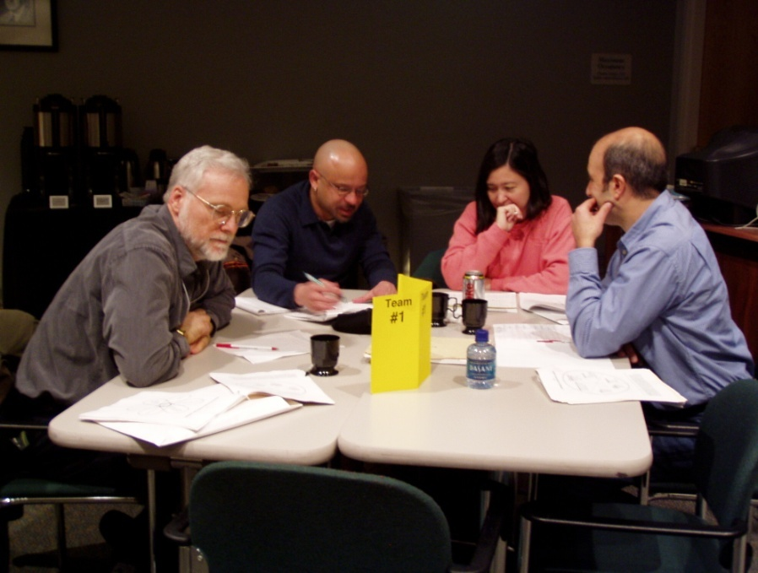
OR, A NEW START??
Teaching for the 21st Century . . .
        Let’s Get Started!!

