Slide 1
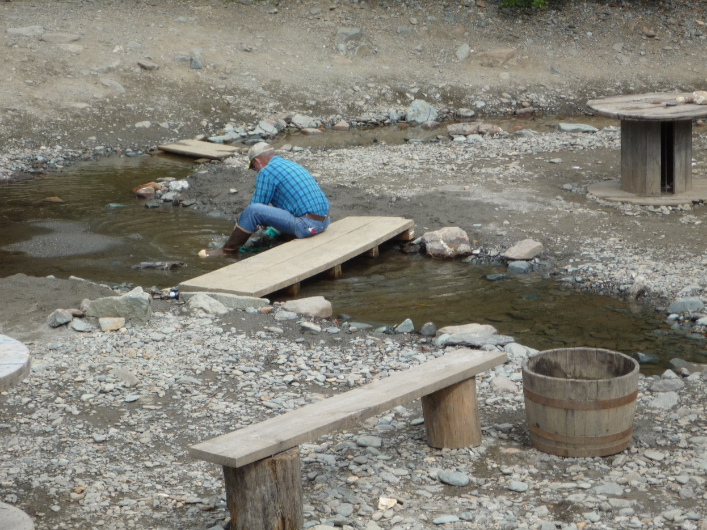
‘There’s gold in them thar hills’
Panning for successful teaching and learning with a flipped classroom sieve

Slide 2
Introduction
Jeffrey Hieb
  Ph.D. Computer Science Engineering, UofL,2008
  M.S. Computer Engineering and Computer Science, UofL, 2004
  B.S. Computer Science, Furman University , 1992
  B.A. Philosophy, Furman University, 1992
Joined Speed School Faculty in January of 2008
  Engineering Mathematics
    Department of Engineering Fundamentals
  Information Security
    Department of Computer Engineering and Computer Science

Slide 3
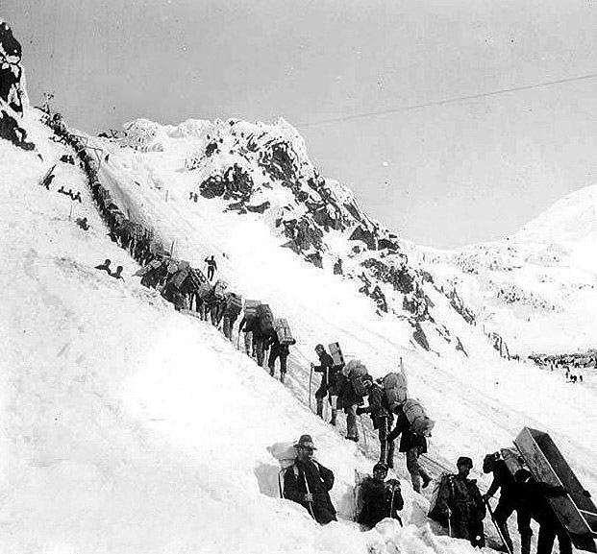
Klondike Gold Rush
Gold was discovered in August 16, 1896
Stampede of prospectors in 1897
Less than 40,000 made it to Klondike 2 years later
Around 4000 struck gold
Gold was discovered in 1899 in Nome, prompting an exodus from Klondike

Slide 4

Disclaimer
I think I have finally hit some pay dirt
  It took a long time so I am going to talk about what all I have done
I am not selling claims
  There is no one way to flip your classroom
I don’t have all the answers
  I will try to share with you the experiences and thoughts that have led me to become an educational prospector
Notes:
Your classes are different from mine, you are different from me

Slide 5
Outline
Deciding to make the journey
Staking a claim
Tools of the trade
Better tools
Finally, a nice size nugget
Conclusion and Final Thoughts

Slide 6
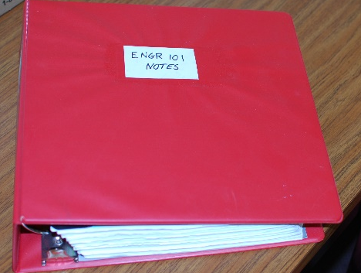
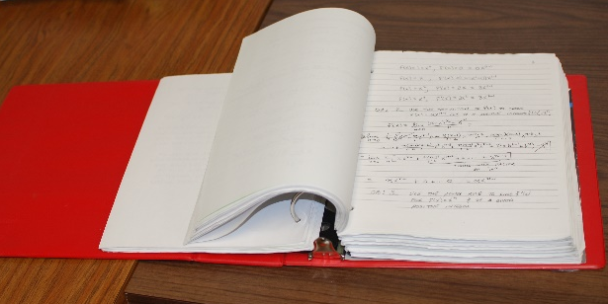
My First Class
Engineering Analysis I (five days a week)
Teaching
  Daily lecture
  Weekly homework assignments
  Weekly quizzes
  Weekly exams
Student Learning is not to my satisfaction
  C-35%; DFW-40%
Notes:
I learned calculus very well from teaching this course.
The Perspective is teaching.

Slide 7

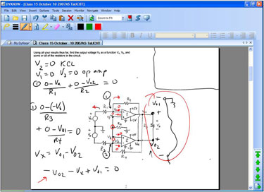
My Classroom Technology

Slide 8
2008 i2a FLC-CT
Critical Thinking
Metacognition
Active Learning
Reflective
Practice
Notes:
Spent time with senior University Faculty known to be excellent instructors (mini what the best college professors do)
Teaching critical thinking in engineering mathematics?
Not a methodology
Students Don’t learn critical thinking if we do all of thinking (Gerald Eldeman, neuro science)
Critical thinking was compelling as something to teach students
Also helped me clarify my own thinking, to be a better critical thinker and to exemplify good critical thinking

Slide 9
Teaching and Learning
From 2008 to 2011 I worked on improving my lectures
  Embedded Java Applet Animation
  Embedded Maple Worksheets
  Embedded Polls
  Answer Boxes
  Submit your work
  Moving around
  Slightly better hand-writing (slow down)
I am still dissatisfied with student learning
  Maybe my expectations are too high, but I am not willing to concede this yet.
However, I think my lecturing is pretty good
  And, interestingly, so do my students
Should I be doing something different to motivate student learning?
  Can I get students to take greater responsibility for their own learning?
Notes:
I am dissatisfied with student learning, but not my lecture, and neither are students dissatisfied with my lecture Also, all the responsibility is on me.

Slide 10
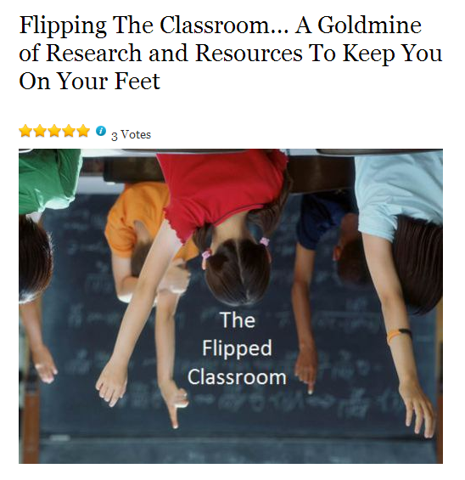

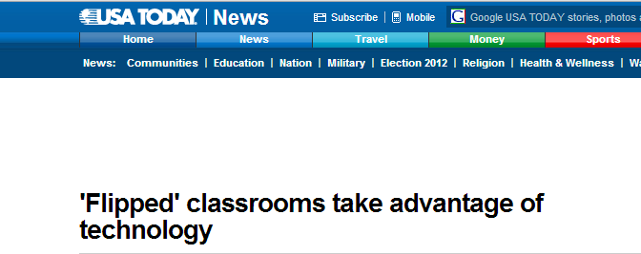


‘There’s gold in them thar hills’

Slide 11
The Flipped Classroom Model
Student use technology outside of class to watch online video lecture, demonstrations, and explanations of assignments
Class time is spent doing what is traditionally called “homework”, or what they used to do outside of class

Slide 12
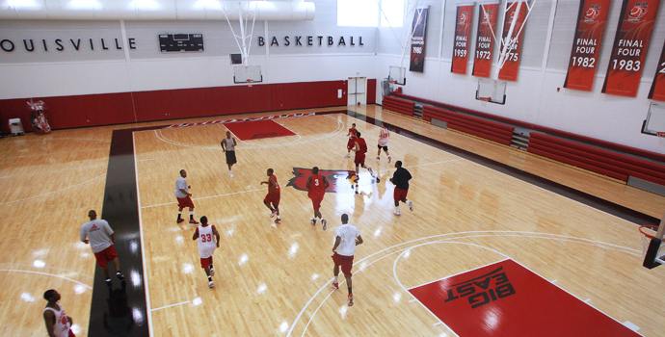
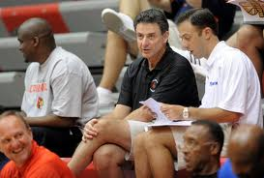
Rick Pitino is not running up and down the floor shooting lay-ups during practice while players watch, but he is there!

Slide 13
Flipping the Classroom to Motivate Student Learning
Places ownership of learning back on students
  Make students accept greater responsibility for their learning
  Need to come to class prepared
  Class time is active not passive
Students can struggle with difficult concepts in class instead of on their own
High impact interactions with individuals or small groups
Students can:
  skip parts of the lecture they are already familiar with
  re-watch parts they find challenging
Notes:
Coming to class prepared

Slide 14
Clintondale High School
Teachers create 3 videos a week
Students watch 5-7 minute videos at home
Class time spent doing labs or interactive class activity
Before the flip (n=736)
  50% of freshman failed English and 44% failed math
After the flip (n=249)
  19% of freshman failed English and 13% failed math

Slide 15
University of Michigan
Calculus Classes (since mid-1990s)
Students read and prepare for class
Instructor gives a brief lecture and works a single example
Students take turns going to the board to present their answers or work in groups
Instructor circulates while students are working, answer questions and correcting misunderstandings
Michigan students showed about twice the gain on concept inventory tests as students in other institutions who took the same concepts inventory test but had traditional lecture based calculus.

Slide 16
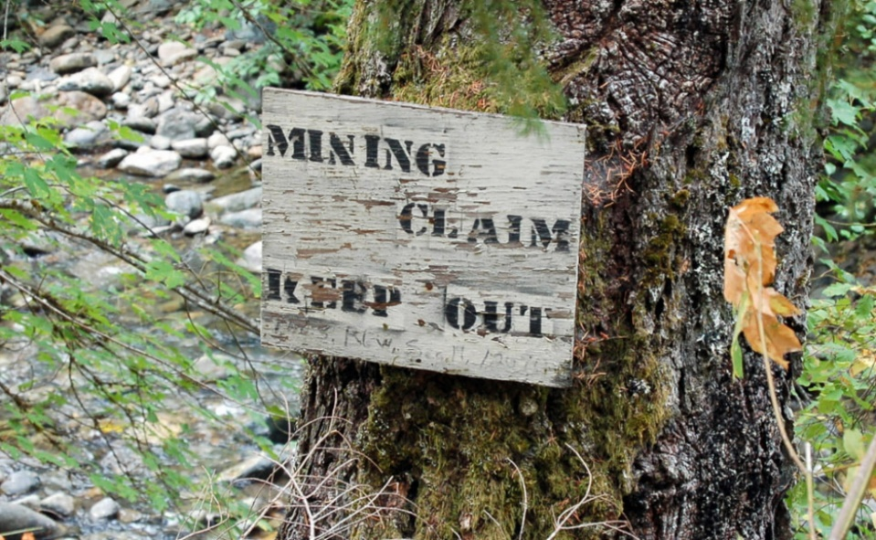
Staking A Claim:
Flipping Linear Algebra
2 Credit Hour Course
Sophomores and Juniors
Typically difficult
Summer 2011, 2012, 2013
Enrollment: ~75
Meet 2 hours per week, in lecture hall setting
Notes:
I did not read a great deal of literature

Slide 17
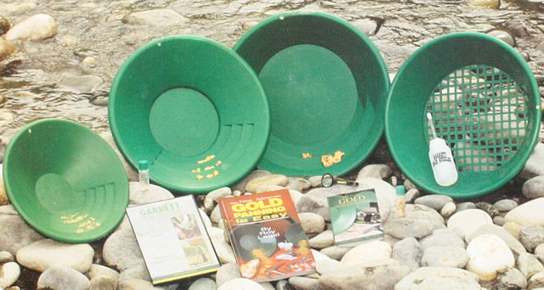
Tools for flipping
Tegrity
Tablet PC
OneNote
DyKnow
BlackBoard

Slide 18
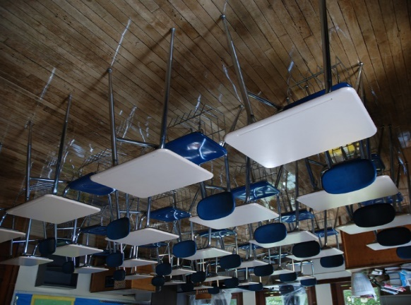
My First “Flipped Class”
Tegrity videos
  Supplement to class meetings
Quizzes in class over material in the “reading”
  Collected in DyKnow
More problem solving during class
  More advanced problems “together”
  Students submit their solutions
Students work problems and submit them during class for discussion (active learning)
Polling in DyKnow (active learning)

Slide 19
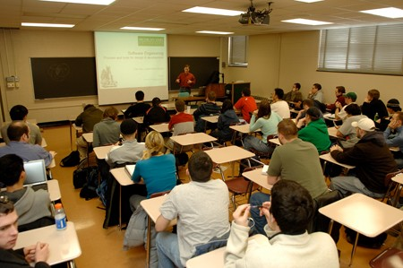
What happened
Students listened to my video recordings at 1.5X
Class time still felt mostly like lecture
  60 students in a “lecture hall setting” is a lot of inertia
I spent a lot of time making the videos
Suspected some students were not watching the videos
  Often felt like I had to cover what was in the videos b/c they were not prepared—Couldn’t discuss or work problems
Notes:
I spent a lot of time making the videos, and possibly not enough time developing what to do in class.

Slide 20
Please comment, in the space provided below, on the component(s) of this course, if any, you found helpful (e.g., instructor, textbook, homework, projects, labs, exams, web-based materials, etc.).
1. Videos while preparing for tests.
2. The tegrity videos were very much appreciated. They gave me a second chance to learn the material and was even more helpful as I have always been considered an audio learner.
3. The tegrity videos were a great help
4. Tegrity videos combo'd with examples and quizzes. Help ;me really learn the material
5. The tegerty videos that were provided by professor Heib makes all the difference. If it wasnt for the videos, i feel that my grades would have been lower.
6. Tegrity videos was all I used. Text book wasn't necessary. Homework wasn't necessary.
7. Tegrity videos were absolutely necessary. They helped tremendously.
8. Book was horrible. Did not give enough examples of problems. Again, the tegrity videos are great.
9. Homeworks definitely. Even though they were optional, doing them helped me and everyone else prepare for the test.
10. I really liked the videos that were put online. We could watch them before a test to study a little better.
11. tegrity videos
12. The tegrity videos were very helpful and a nice tool to have.
13. STOP RELYING ON TEGRITY!
14. Brought a bag of extension cords to class for plugs.
15. Tegrity was very helpful. It helped us all.
Notes:
There was one very positive take away, the students really like the videos
The problem seems to be that they still think class is for sleeping

Slide 21
One student’s response
I loved the Tegrity videos because any time day or night I could review them and see how the problem was worked. It was much better than just solutions to a homework problem.

Slide 22
Flipping again, Summer 2012
Embedded videos in to DyKnow Notebooks
Practice problems between videos
  Answers are “scratch off”
Submit some work through Blackboard
During class results about the same
  Students still seem unprepared for class
  Still feels like a lecture to me

Slide 23
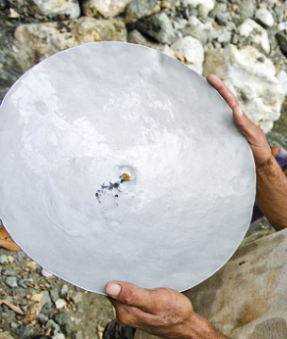
Reflecting on my first two flips
Notes:
Maybe the room is effecting students expectation.
50% successful
Very clear that many students like video lectures
Could be the book is that poor
Students don’t seem to be interested in taking responsibly for their learning
Still want lecture, maybe because it still looks like lecture
Auditorium seating
Screen up front
Replacing the lecture with active learning is the real challenge

Slide 24
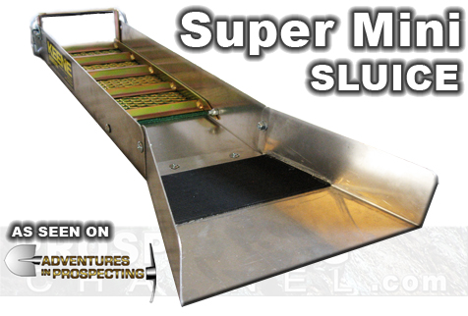
Better tools for half the flip
Camtasia
  Screen capture and
  video editing software
SoftChalk
  Web based Content authoring tool
But what to do about the other half?
Notes:
Open Camtasia
Open 330 Softchalk lesson

Slide 25
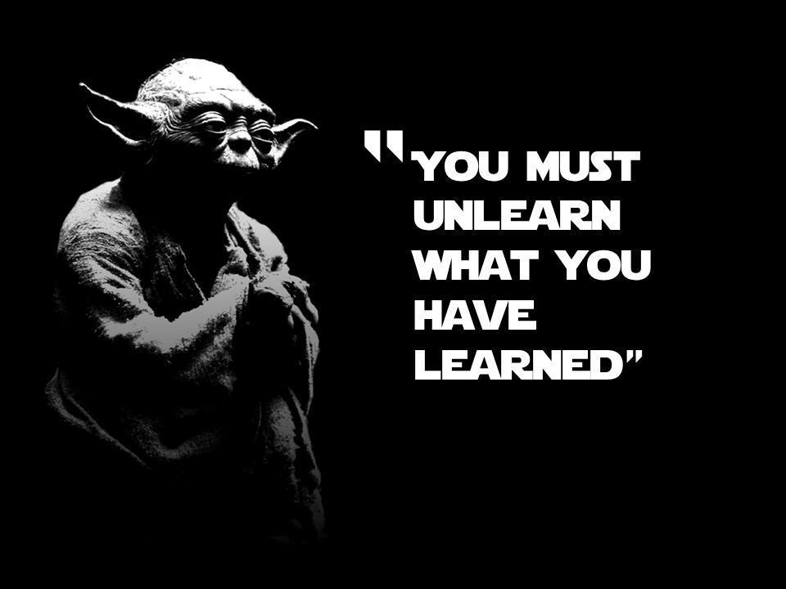

Slide 26
Flipping Linear Yet Again
Create Camtasia videos to replace Tegrity videos
Developed SoftChalk Modules for 60% of the content (ran out of time)
Student complete SoftChalk module (scored) before class
During class
  Student write on virtual whiteboard (DyKnow) terms from the “reading”
  Call on students, ask them explain concepts
  Conduct DyKnow Polls
    Call on students to explain your answer
  Work Problems

Slide 27

After Three Flipped Class Attempts
Notes:
So far I had not realized any great class benefits

Slide 28
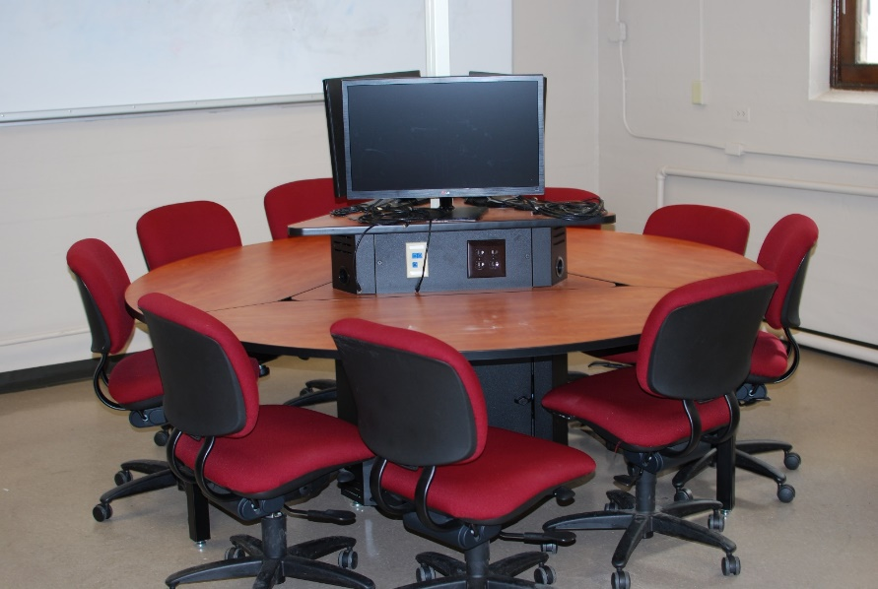

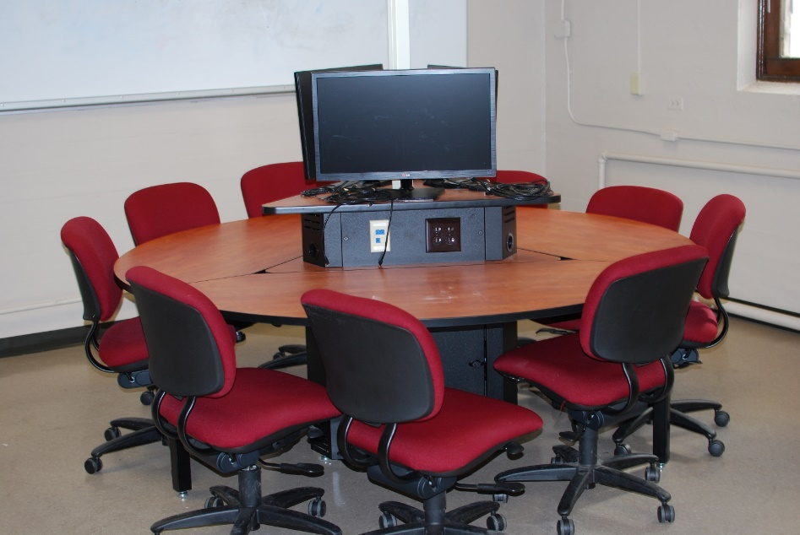
Speed School Center for Teaching and Learning Engineering:
Pilot Collaborative Learning Classroom
Notes:
Constructed Summer of 2013
Used for my emporium model Introductory Calculus class in the fall of 2013.
3 Round tables, 9 seats each
3 Monitors at each table
Motivation:
Difficult to do small group activities in a lecture hall
One problem maybe I still look like sage on the stage

Slide 29
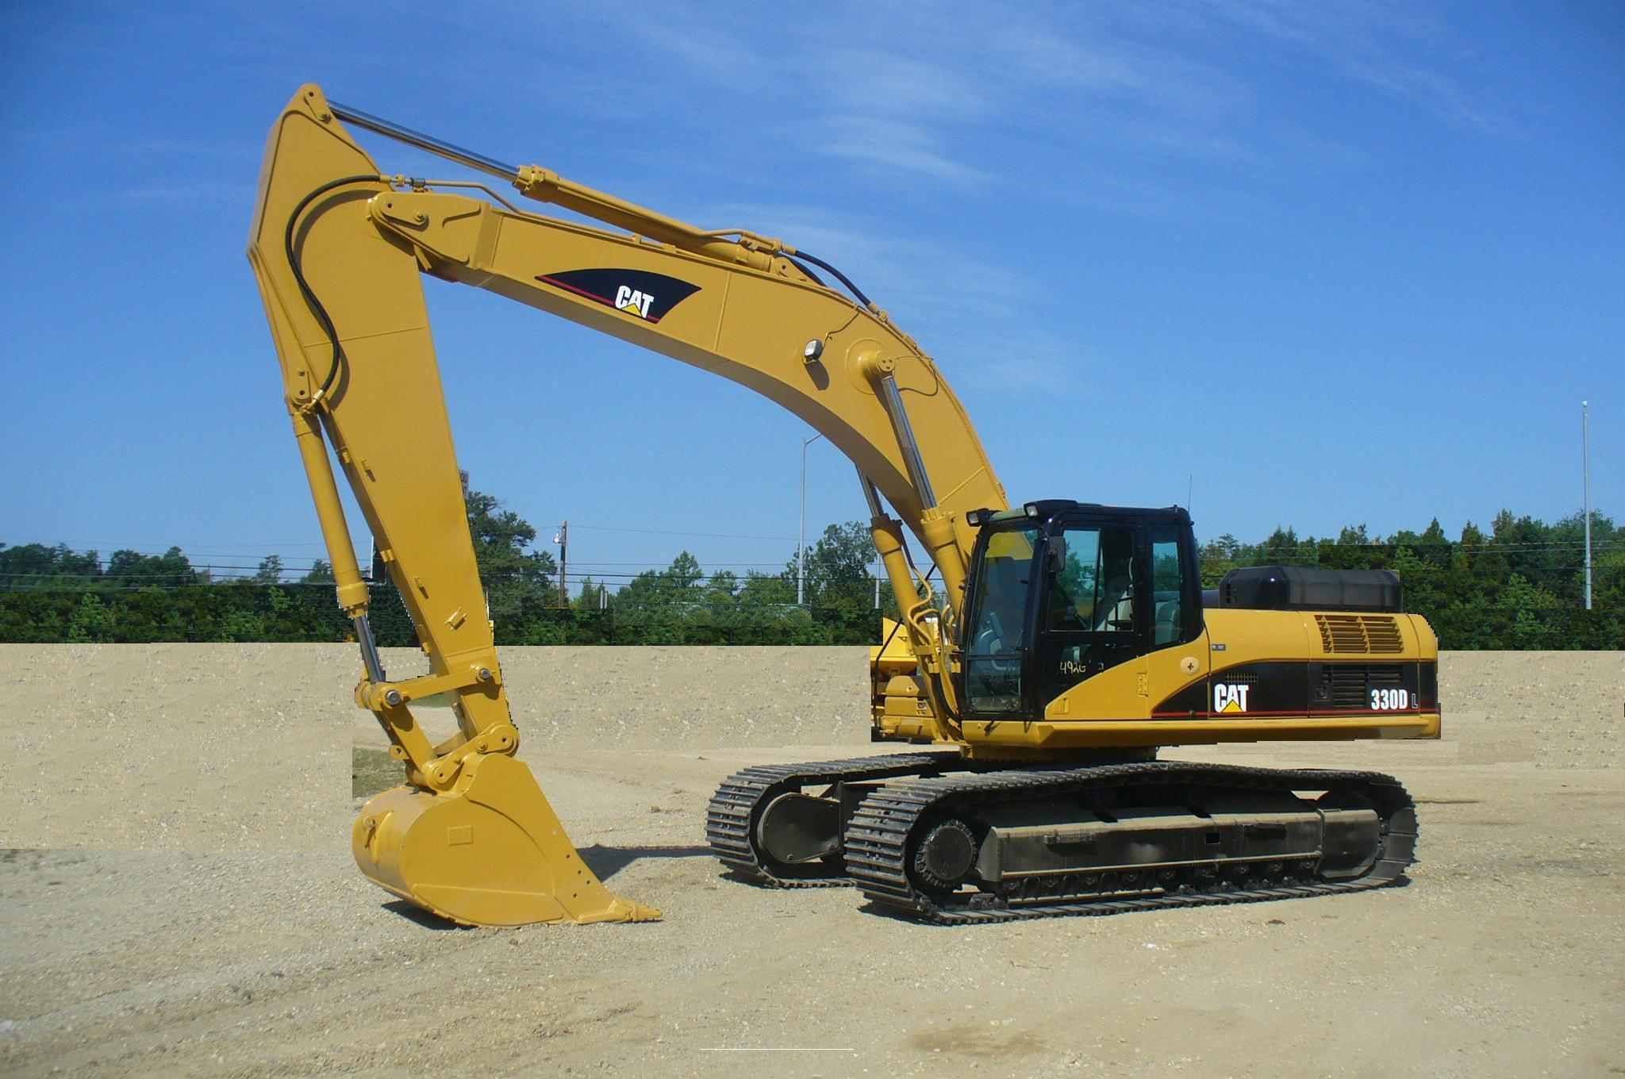
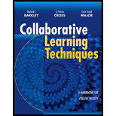
Collaborative Learning
Notes:
Collaborative versus Cooperative Learning
Collaborative learning is an educational approach to teaching and learning that involves groups of students working together to solve a problem, complete a task, or create a product. According to Gerlach, "Collaborative learning is based on the idea that learning is a naturally social act in which the participants talk among themselves (Gerlach, 1994). It is through the talk that learning occurs."

Slide 30
One more try (S2014):
Flipping Engineering Analysis I
Lecture 3 days a week (partial flip)
Videos provide remainder of the lecture material in each unit
2 days a week (the flip) collaborative learning lab
  Work in random teams of 2-3 on selected homework problems
  These homework problems are removed from assigned homework
  Quiz is collected and graded (check, check plus)
  Failure to attend is a 0, otherwise at least a 9.5/10
  Ask three then me
  Begin with 2-5 minute Ice-Breaker
Notes:
Note have to grade 1/3 the number of quizzes and am working to have students do their own grading

Slide 31
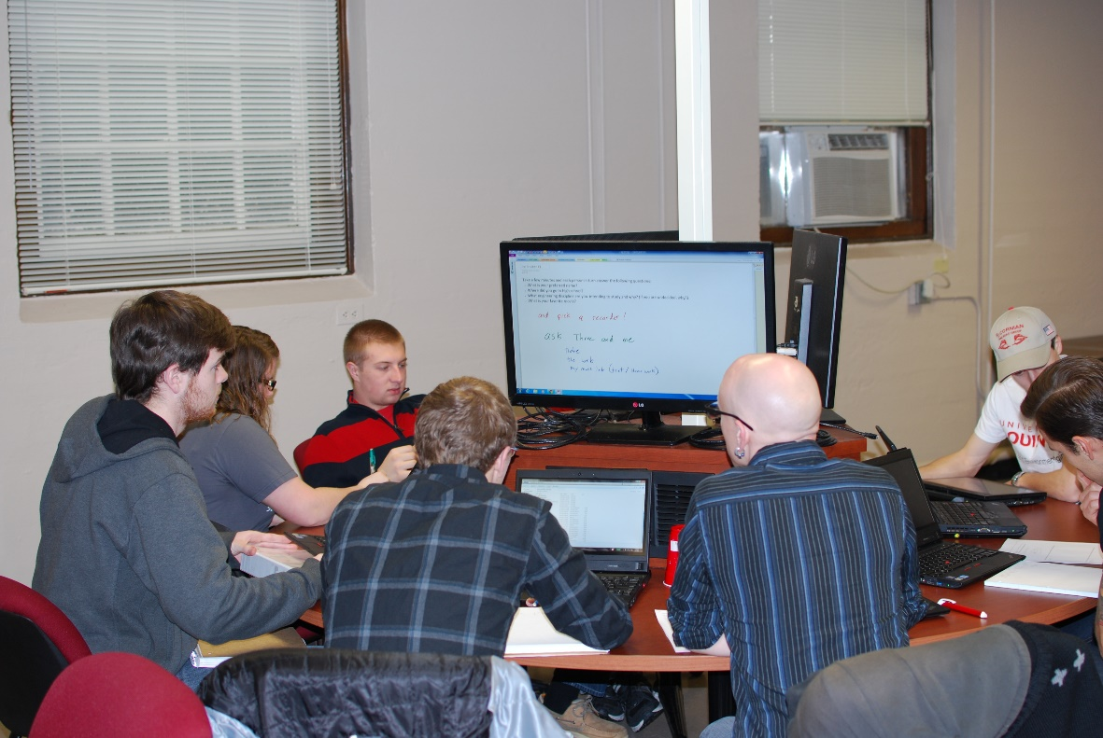
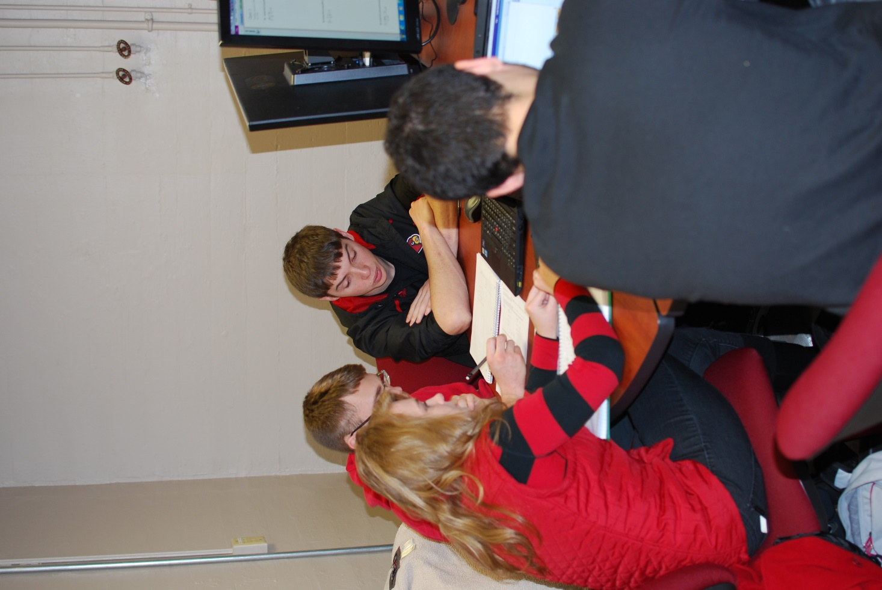
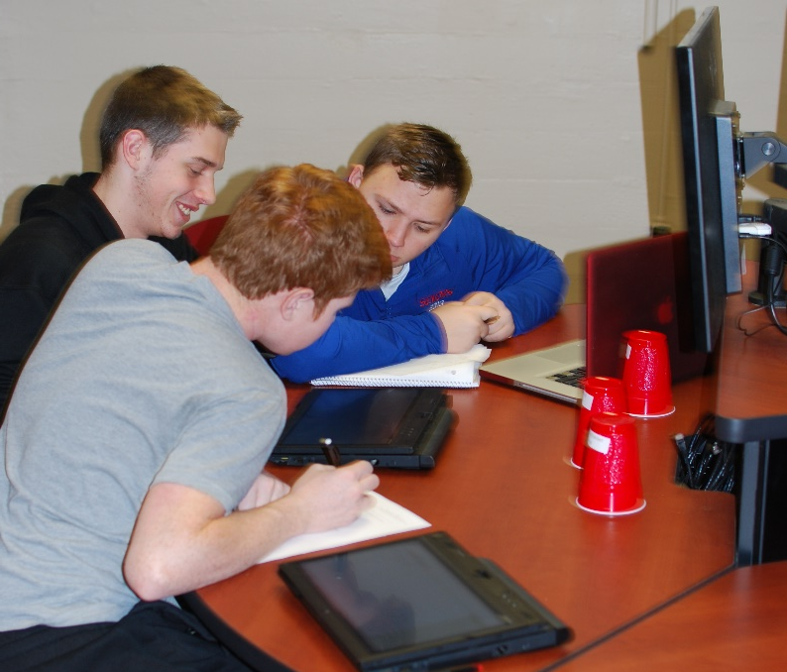
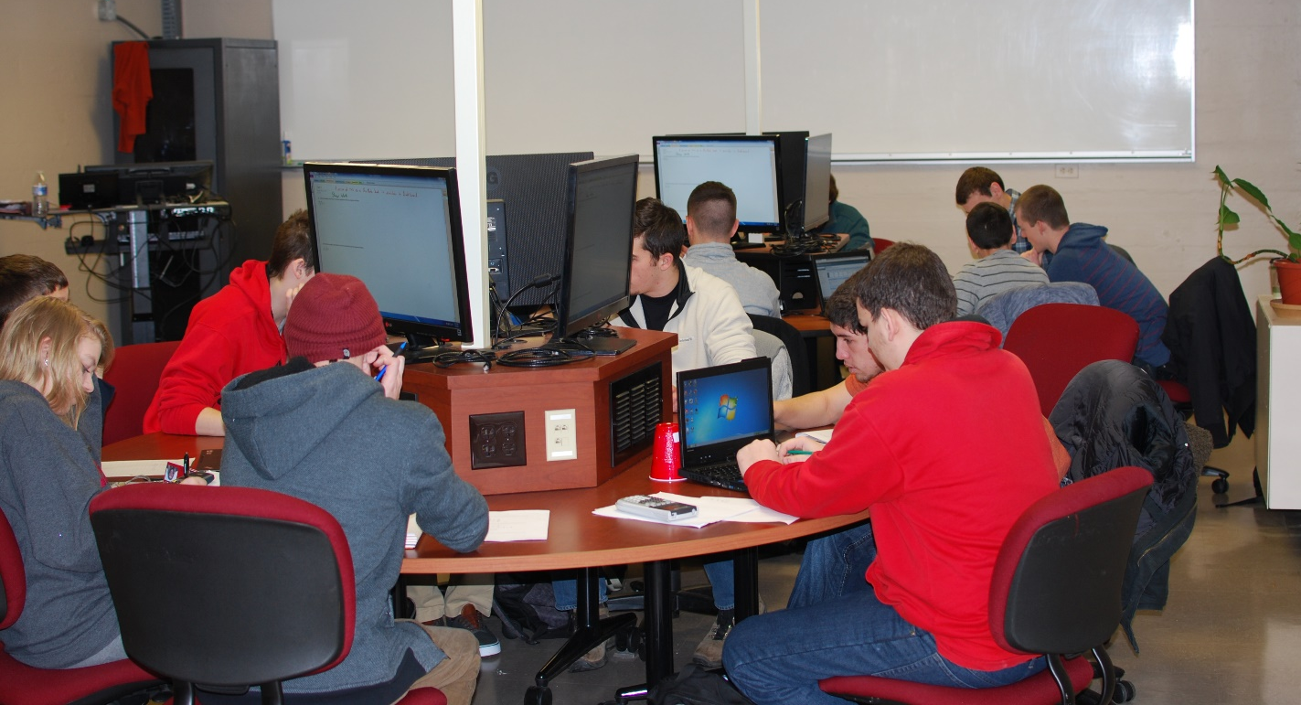
Gold! Gold! Gold!
Gold! Gold! Gold!
Gold! Gold! Gold!

Slide 32
Finally
‘There is gold in them thar hills’
I know more student’s names than ever before
I have to ask them to leave class
They are talking to each other about math
They are asking better and unexpected questions
I may have new learning outcomes for the course
Now can I weigh my gold?

Slide 33
Some Very Preliminary Results
Score (out of 100) for students in the flipped class versus students in the traditional class broken down by grade in the prerequisite course.
 |  | Grade in ENGR 190
 | All | A | B | C | D | F
Traditional | 59.53 | 84.27 | 67.16 | 60.23 | 50.96 | 38.20
Flipped | 57.68 | 80.00 | 71.90 | 71.43 | 35.00 | 31.50

Slide 34
Conclusions
Flipping a class isn’t easy
  Many students are very comfortable with passive lecture
Its not just about the videos
It takes a lot of time and effort
  ROI is not next time you teach the course
The classroom space can be really important
But when it works it is exhilarating

Slide 35
Flipping the classroom
Pros
Cons
Students no longer struggle with difficult concepts outside of class
Students can skip the parts of a lesson they already understand, and re-watch challenging parts
Applied learning in the classroom
Students come to class prepped and ready to learn
Videos can include links to supplemental material
Teacher can spend one-on-one time with individuals or small groups
Making sure every student has a computer and internet access
Students can’t ask questions to the video (yet, panopto)
Technology issues
Designing and grading frequent quizzes
Students have trouble buying in to this type of instruction
How to handle student who don’t watch the video
Creating or finding high quality videos
Notes:
94% of UofL students report owning a laptop, 40% a desktop

Slide 36
Some Final Thoughts
  Making online presentation of content good is just as hard as making lecture good, and it is different
Online videos were the starting point but today there are better tools and technologies
  SoftChalk
  Articulate Storyline
  Gradebook integration
What really makes flipping effective is when I it creates student centered learning
Collaborative learning does not feel like teaching
Consider low-tech in class, high-tech out class
  Don’t do for students what they can do for themselves
Notes:
Powering down for

Slide 37
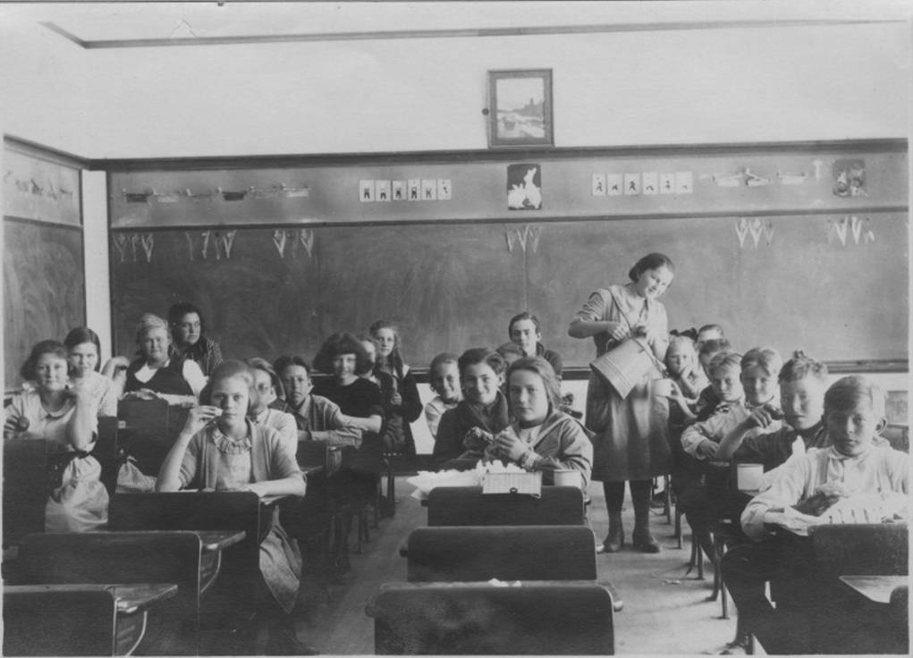
Grammar School Classroom, Circa late 1800’s

Slide 38
Thank You
Questions and Discussion

