Slide 1


Kent School of Social Work
Collaborative Teaching and Learning
as a Tool to Ignite the Spark in Students
Anna C. Faul, PhD
Thomas R. Lawson, PhD
Joseph G. D’Ambrosio, PhD
Daniel A. Boamah, PhD Student
Samatha Cotton, MSSW, PhD Student
Mohammed Alkohaiz, MASW, PhD Student
Lisa D. Smith, MSSW, PhD Student
Susan N. Lewis, MSSW, CSW, PhD Student
Lauren Brown, LCSW, PhD Student
Yongqiang, Zheng, PhD Student

Slide 2
Workshop Objectives
The dread of most doctoral students…
“SW 697: ADVANCED RESEARCH DESIGN and ANALYSIS!!!!”
Student motivation- Reality or Myth?
Collaborative teaching and Cooperative learning- Core tenets
Faculty/student reflection- True confessions

Slide 3
So what class do I have to take?
SW 7907: Advanced Research Design and Analysis
Students need to learn the conceptual, methodological, and statistical research methods in both quantitative and qualitative social science research
Found most difficult course in doctoral work

Slide 4
Student motivation?
Give me my “A” please
Teach me to be a scholar
Don’t demand too much
(I’m so busy)
I hate statistics
I love statistics
I want a tenured faculty position at a research University
Why does it matter, I want to teach
I really want to do research
I don’t get it
I know better
I am not a number person

Slide 5
What works in teaching research?
Focus on student learning style
  Who is in your class?
Group learner?
Individual learner?
Notes:
Graduate students who are group learners tend to score higher in research classes on cooperative-learning groups teaching vs. research methodology in which all assignments are undertaken and graded individually (Onwuegbuzie & Daley 1997)
Social orientation may influence how students perform in cooperative learning groups.
How can we make individual learners understand the value of collaborative learning – they need to see the benefit of the group

Slide 6


When you are not doing
collaborative teaching
Top down approach
Ask questions that the same few students always answer
Lecture
Give quizzes with no immediate feedback
Conduct discussions that engages only a small fraction of the class
Notes:
Student attention span is 15 minutes (Wankat, 2002)
Students remember 70% of information in the first 10 minutes of lecture and 20% of the information in the last 10 minutes of lecture

Slide 7
Collaborative Teaching and Learning
Collaborative Cooperative
Students
Joint Faculty
Based on Active Learning
-emphasis on student involvement-
other than simply watching, listening or taking notes

Slide 8
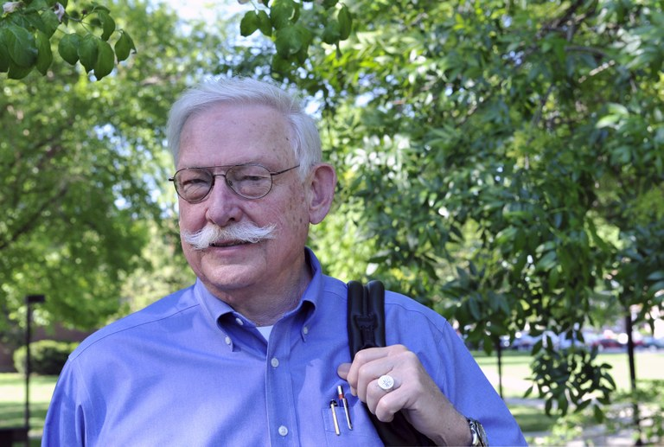

Collaborative Teaching
Tom Lawson, PhD
Annatjie Faul, PhD
“TEAM ARDA”
Notes:
Advantages- 1. includes a reflexive pedagogy
2. richer and less hierarchical relations between students and faculty
3. shared assessment
4. modeling collaboration
5. bring different skills to the class
Disadvantages- 1. challenges in negotiating shared classroom stage
2. challenges in planning, preparing for the semester
3. Keeping open lines of communication
4. When students are not comfortable with collaborative group, the discussions between co-teachers can be stressful

Slide 9

Collaborative learning
Students working together to maximize their own learning, as well as that of their group members
It includes cooperative learning where the basic premise is that cooperation is more effective than competition to produce positive learning outcomes
(Johnson, D.W., Johnson, R.T. & Smith, K.A.(1991)
Notes:
Another term is collaborative learning- 1. encompasses instructional methods in which students work together in small groups toward a common goal and includes cooperative learning
2. Emphasis on student interactions rather than on learning as a solitary activity
At its core…Cooperative learning is based on the premise that cooperation is more effective than competition among students for producing positive learning outcomes
There are numerous psychological theories, that predict students values, attitudes, and behavioral patterns are most effectively developed and changed in cooperative groups.

Slide 10
Cooperative learning tenets
Individual accountability
Face-to-face promotive interaction
Appropriate practice of interpersonal skills
Mutual interdependence
Regular self-assessment of team functioning

Slide 11
Cooperative learning tenets
Individual accountability
Small groups
Individual tests
Randomly call on students
Observe group interactions
Assign checkers
Require students teach
Develop a plan of accountability in advance of class starting
Notes:
Individual accountability- occurs when the student is evaluated, feedback is given both to the individual and to the group and the student is held responsible by other group members for not “coat-tailing.”
This makes each student learn together so that they can subsequently perform better as individuals.
Can be promoted by: 1. keeping the size of the group small
2. giving an individual test to each student
3. call on students randomly and asking them to present their group work to the entire class
4. observe how members of each group interact with other members and document the contributions of each student
5. assigning one member of each group (i.e. checker) to ask other group members to explain new material to the rest of the group
6. requires that each student teaches what he or she learned to a fellow group member or to someone from another group.
7. have students explain what they have learned
EXAMS
TEACHING SESSIONS

Slide 12
Cooperative learning tenets
Mutual Interdependence
Group share
Mutual support
Mutual encouragement
Acknowledgement of group success
Celebration of group success
Promote cohort development and positive interdependence
Notes:
Mutual interdependence- group members believe that they and all members are a team and essential for the success of the group. They believe that their work benefits the group and the groups work benefits them.
1. Students share resources
2. Give mutual support and encouragement
3. Acknowledgement and celebration of joint success
4. Add joint rewards- if all members score 90% correct or better on the test each receives 5 bonus points
5. Give students divided resources so that they will have to depend on each other to complete an assignment
6. use complementary roles- reader, checker, encourager, elaborator
Students need to sink or swim together
QUIZZES

Slide 13
Cooperative learning tenets
Face-to-face promotive interaction
Student feedback
regarding future performance
Student feedback
on other’s efforts to achieve group goals
Encourage opportunities for student feedback
Notes:
Face-to-Face promotive interaction- students encourage and facilitate each group member’s efforts to achieve group goals
1. Student’s provide feedback to each other with feedback to improve future performance
2. student’s influence each other to achieve group goals
3. students need to get to know one another on a personal and professional level (keep groups small 2-4)
ARTICLE CRITIQUES

Slide 14
Cooperative learning tenets
Appropriate practice of interpersonal skills
Mutual knowledge
Mutual trust
Communicate effectively with each other
Solve group conflicts
Don’t ever assume social skills- teach them and reward appropriate use of those skills
Notes:
Appropriate practice of interpersonal skills- involves appropriate use of small-group and interpersonal skills. TO facilitate social skills, students must have
1. mutual knowledge
2. Mutual trust
3. communicate effectively with one another
4. solve conflicts
Instructors- don’t assume social skills rather teach social skills and reward appropriate use of those skills

Slide 15
Cooperative learning tenets
Regular self-assessment of team functioning
What is effective?
What is ineffective?
What should we continue doing?
What should we discard?
Systematically monitor group processing
Notes:
Regular self-assessment of team functioning- Reflecting on a group session to describe what actions of the members were effective and ineffective and deciding which actions to continue, which to modify and which to discard.
1. actions that were effective
2. actions that were ineffective
3. actions to continue
4. actions to discard
Fine tune the effectiveness of what each student is doing to add to the group.

Slide 16
Structure of cooperative learning
Types of cooperative learning groups
Informal learning groups
Formal cooperative-learning groups
Cooperative base groups
Promotes higher achievement at many age levels and subject areas
Notes:
Informal learning groups- Less structured and short term, requiring students to undertake a task often associated with a lecture.
Formal cooperative-learning groups- longer in duration, comprise small (2-4 member) groups, and are established by the instructor to undertake an extensive project such as a term paper.
Cooperative base groups- are stable, long-term, peer support groups consisting of between 3 and 5 students. These are the most comprehensive and intense forms of cooperative learning which enhance student’s learning and increase attendance in large lecture classes

Slide 17
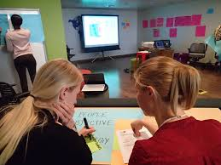
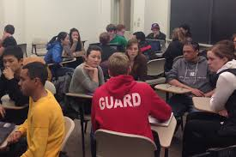
What does it look like?
Mentor approach
Problem-centered instruction
Team teaching
Reflexive pedagogy
Less hierarchy
Peer teaching

Slide 18
How we do it?
Co-teach
Utilize relative strengths and interests
Disagree with each other
Ask questions of each other
Have planning meetings
Share grading
Use problem-based learning
Collaborative Instructor Involvement

Slide 19
How to do it?
Student Involvement
Co-present
Self-grading
Lead class
Group discussion
Cohort building
Provide feedback
Collaborative quizzes
Create teaching examples

Slide 20
Faculty/Student Reflections
Let’s talk…….

Slide 21
Questions?
Anna C. Faul, PhD Professor Associate Dean Academic Affairs Kent School of Social Work Oppenheimer Room 104 Louisville, KY, 40292 502-852-1981 (O) | Thomas R. Lawson, PhD Professor Kent School of Social Work Patterson Hall, Room 105 Louisville, KY, 40292 502-852-6922 (O) | Joseph G. D’Ambrosio, PhD Part-time Assistant Professor, Program Manager Kent School of Social Work Oppenheimer Room 209 Louisville, KY, 40292 502-852-7374(O)
acfaul01@louisville.edu | thomas.lawson@louisville.edu | jgdamb01@louisville.edu
Thank you!

